Slide 1


Clinical and Biomedical Trials in Vilnius University Hospital Santaros klinikos
Prof. Augustina Jankauskiene
Faculty of Medicine, Vilnius University
Vilnius University Hospital Santaros Klinikos, Children Hospital

Slide 2
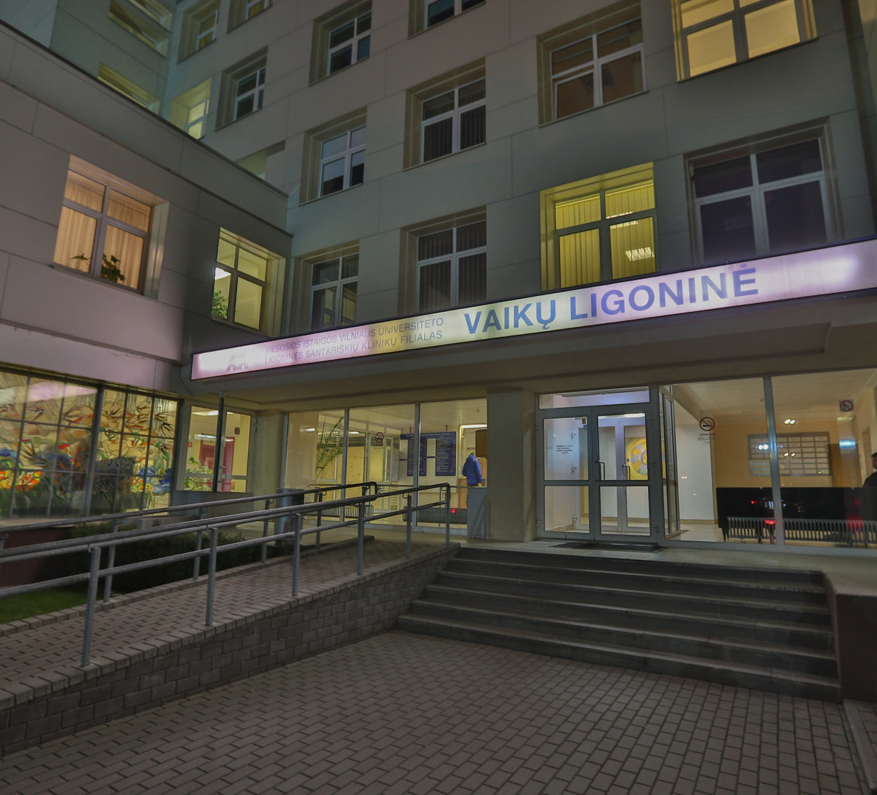
Outline
Our hospital
European Reference Networks
Law of Bioethics
Collaboration
Activities

Slide 3


VUHSK Children’s Hospital in numbers
Founded in 1945 (in its current location since 1978)
Covers all pediatric subspecialties
8 centers, ~500 beds
310 acute care (including 9 NICU, 12 PICU)
190 beds for child development and rehabilitation
Patient flow: 2018
24 300 hospital admissions
8 000 surgery cases
200 000 outpatient visits
12 000 pediatric day care services
52 000 ED visits
The largest pediatric healthcare provider for children in Lithuania

Slide 4
Centers and departments
Center for Pediatric Surgery, Orthopedics and Trauma
Center for Neonatology
Center for Pediatric Oncology and Hematology
Center of Pediatrics
Center for Pediatric Emergency, Intensive Care and Anesthesiology
Center for Physical Medicine and Rehabilitation
Center for Child Development
Coordinating Centre for Rare Pediatric Diseases
Outpatient Clinic
Radiology and Laboratory Services

Slide 5
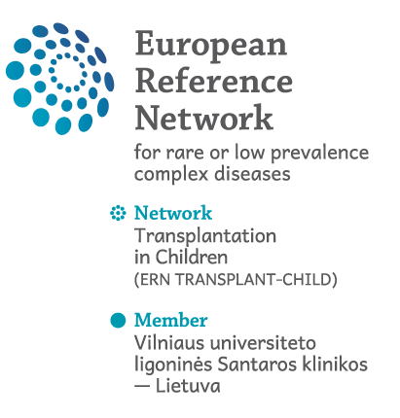
Reference center for pediatric hematopoietic stem cell transplantation in the Baltic region Number of children who were transplanted at the Childrens‘ Hospital in 2002-2018 Lithuanians (187), Latvians (16), Ukranians (2) = 208
HSCT services are provided for 3 pediatric oncology centers: in Vilnius, Kaunas and Riga
Notes:
As gal ERNus deciau cia? Toliau, kad ir sneketi apie musu pasiekimus? Cia pat butu galima ideti ir tuos onko isgyvenamumus ir kt?

Slide 6
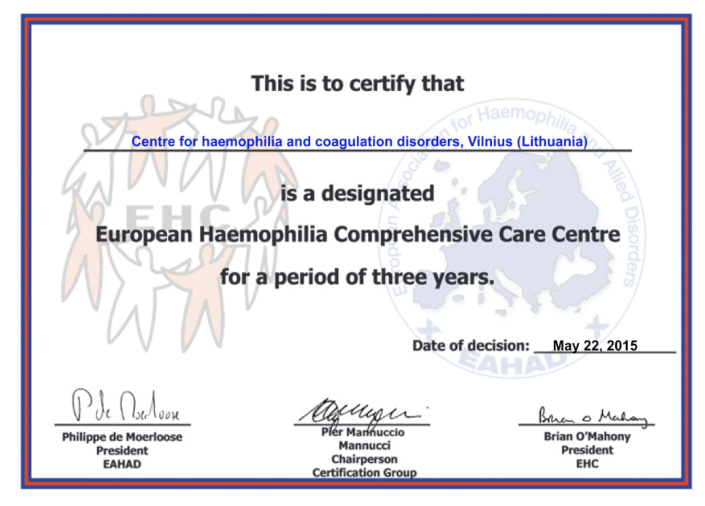
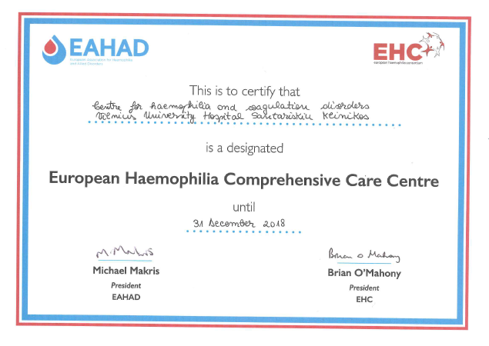
International recognition of the quality of services
In 2015 Coordinating center for Hemophilia and Coagulation disorders was certified as
European Haemophilia Comprehensive Care Centre
In 2018 - recertified

Slide 7
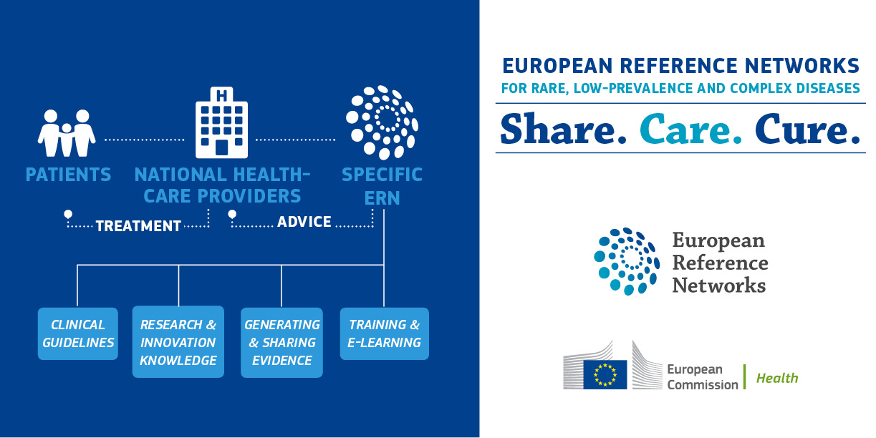

Slide 8

Participation in ERNs
Center for Pediatric Oncohematology and Surgical Oncology (PaedCan ERN)
Center for Haemophilia and Clotting Disorders Center (adult and children) (EuroBloodNet)
Center for Rare Kidney Diseases and Congenital Anomalies of Kidney and Urinary Tract (ERKNet)
Center for Rare and Complex Urogenital Disorders (eUROGEN)
Participation in TRANSPLANTCHILD (area – pediatric transplantology)

Slide 9
Competence Centers
Lipidology (adults and children)
Lysosomal storage diseases (adult and children)
Rare allergic, respiratory tract and skin diseases (children)
Pediatric onco-hematology and surgical oncology
Rare bone diseases (adult and children)
Primary and secondary immunodeficiencies (children)
Growth and sexual maturation disorders (children)
Congenital developmental disorders (children)
Pediatric epilepsies and sleep disorders
Pediatric neuromuscular diseases
Rare pediatric liver diseases and parenteral and enteral nutrition
Rare pediatric rheumatic and autoinflammatory diseases
Pediatric HIV and other rare infectious diseases
Cystic fibrosis

Slide 10

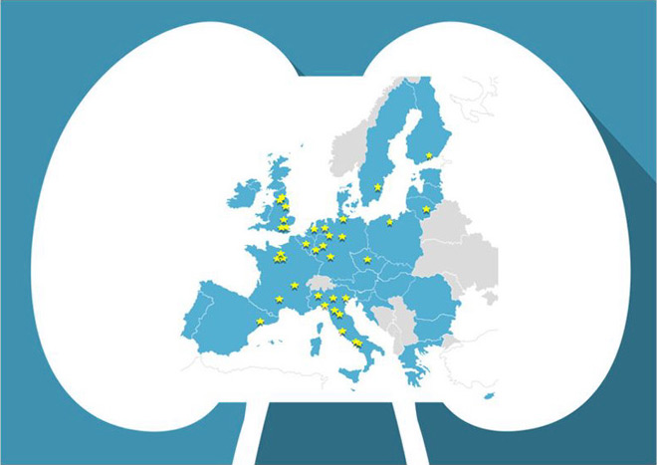
ERKNet European Rare Kidney Disease Reference Network
Germany:
Cologne
Essen
Hamburg
Hannover
Heidelberg
Münster
Sweden:
Stockholm
UK:
Birmingham
London GOSH
London RFH
Manchester
Newcastle
Finland:
Helsinki
Visit to the center in Nov, 2017
Lithuania:
Vilnius
NL:
Nijmegen
Utrecht
Amsterdam
Poland:
Warsaw
Belgium:
Brussels
Leuven
Czechia:
Prague
43,000 patients
Italy:
Siena
Torino
Milano
Padova
Naples I
Naples II
Florence
Bergamo
Rome Gemelli
Rome Bambino Gesu
France:
Paris Necker
Paris Mondor
Paris Tenon
Lyon
Toulouse
Spain:
Barcelona

Slide 11
Registry Concept
ERKNet
Local/ regional/ national patient registries
Centers
Direct data entry
Center administration
Disease demographics
Trial cohort information
Monitoring of guideline adherence, performance and outcome Indicators
ERKNet Registry
RaDiCo Cystinosis
RaDiCo Alport
EURenOmics Membranous Nephropathy
PodoNet SRNS
NeoCyst
Cilio-pathies
AReg PKD
IPDN Pediatric Dialysis
CERTAIN Pediatric Transplant
Genotype-phenotype information
Natural history information
Best medical practice information

Slide 12
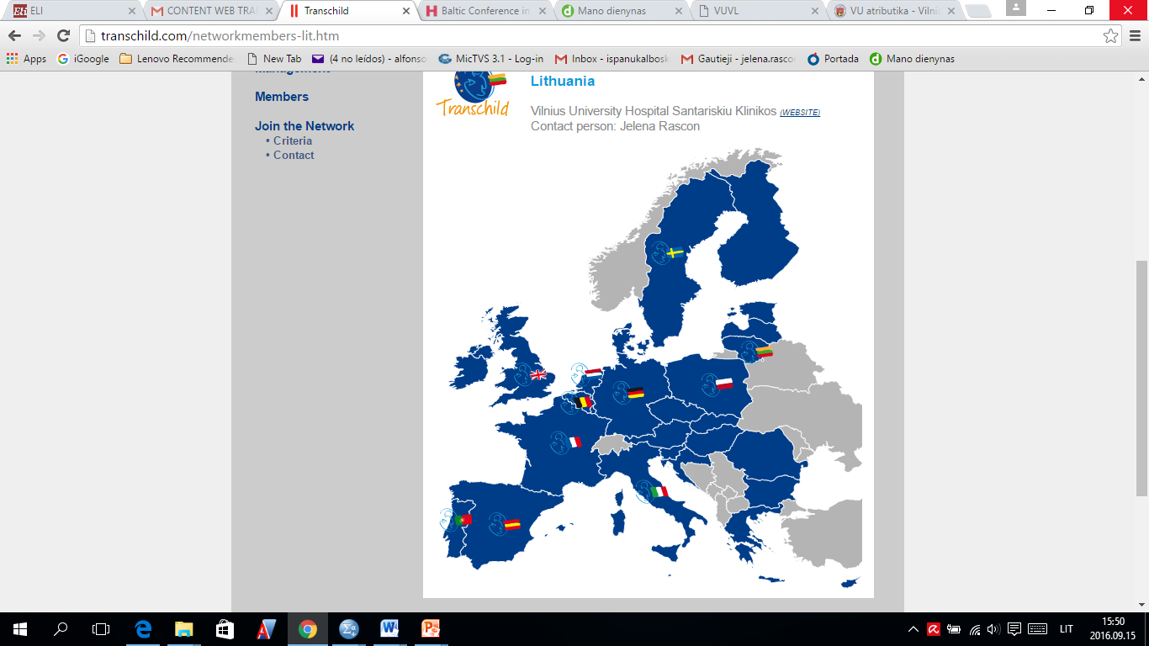

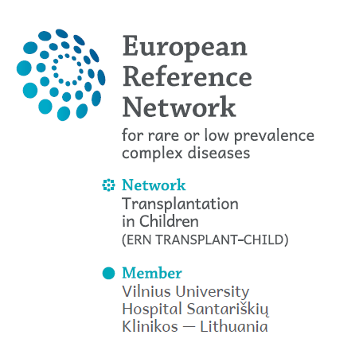
2017 Core Member of European Reference Network for Pediatric Transplantation TRANSPLANTCHILD
18 pediatric HSCT and solid organ transplant centers from 11 countries
Visit of the ERN coordinators on April 19th 2018
www.transplantchild.com

Slide 13
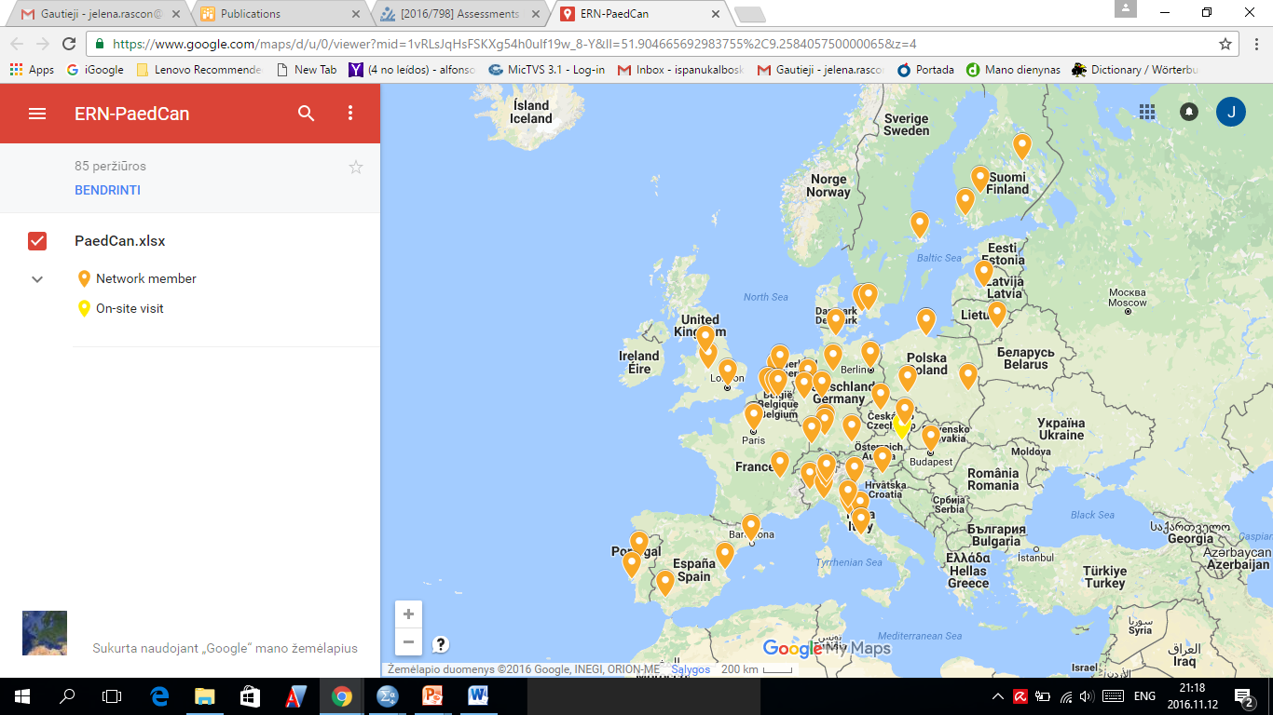
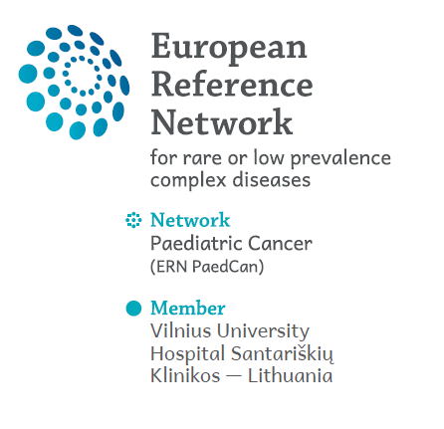
2017 Core Member of European Reference Network for Paediatric Oncology PaedCan ERN

Slide 14
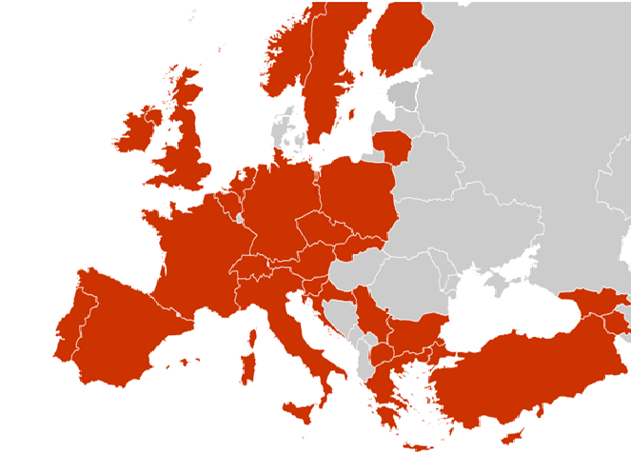
2017 Core Member of European Reference Network for Rare Blood Diseases EuroBloodNet
Adult malignant and benign hematology
Pediatric non-malignant blood diseases
www.enerca.org

Slide 15
IRB approval process in Lithuania
Biomedical trials
Clinical trials
The State Medicines Control Agency Under Ministry of Health
Lithuanian
Bioethics Commitee
Vilnius Regional Bioethics Commitee
Kaunas Regional Bioethics Commitee

Slide 16

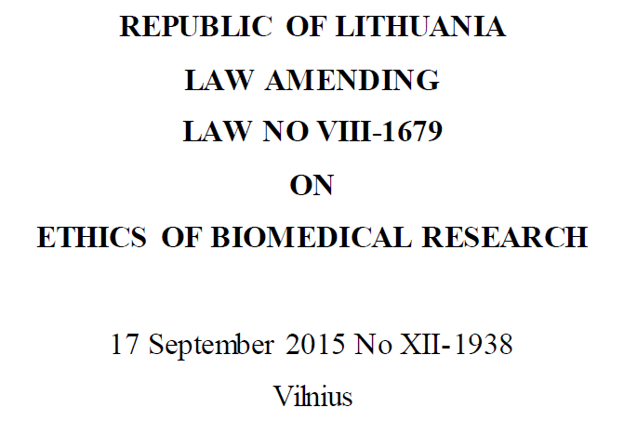

Slide 17
Article 6. Vulnerable subjects and protection of their interests
1. The following subjects shall be regarded as vulnerable subjects whose consent to participate in biomedical research may be influenced by external factors or who are wholly or in part incapable of defending their interests:
1) persons who for health reasons cannot be considered as being capable of rationally assessing their interests;
2) minors;
<…>
2. Other groups of persons may be recognised as vulnerable subjects by a reasoned decision of the Lithuanian Bioethics Committee or a regional biomedical research ethics committee when considering documents for the issue of an approval to conduct biomedical research or by a reasoned decision of the Lithuanian Bioethics Committee when considering documents for the issue of a favourable opinion to conduct a clinical trial on a medicinal product.

Slide 18
Clinical research may be undertaken on vulnerable subjects only in the following cases
1. When clinical research may be conducted exclusively on vulnerable subjects and there are scientific grounds for expecting that participation in the clinical research will produce direct benefit to the subject, which will outweigh the risks and inconveniences posed by the clinical research;
2. When clinical research may be conducted exclusively on vulnerable subjects and the clinical research relates directly to the medical condition from which the subject suffers and there are scientific grounds for expecting that participation in the clinical research will produce some benefit for the group of persons not participating in the research whereto the subject belongs, and the invasive research methods applicable to the subject for the purposes of the clinical research have slightly detrimental and temporary impact on the health of the subject;
3. When clinical research relates directly to the life-threatening or debilitating medical condition from which the subject suffers subject, in the case whereof there is no adequate personal health care, and there are scientific grounds for expecting that participation in the clinical trial will produce direct benefit to the subject, which will be outweigh the risks and inconveniences posed by the clinical research.

Slide 19
The rights of minors
A minor must, having regard to his age and capacity to understand, be provided with the information referred to in paragraph 8 of this Article. A person’s consent to participate in research in respect of a minor’s participation in biomedical research shall be given by the minor’s legal representatives, however if the minor who is capable of understanding the information provided to him expresses his wish not to participate in the biomedical research or, if the minor is already involved in such a biomedical research, to discontinue his participation therein, the minor’s participation in the research shall not commence or shall be terminated, unless this is contrary to the interests of the minor. The issue of whether the minor’s wish not to participate in the research is contrary to the minor’s interests shall be decided by the minor’s legal representatives having regard to the investigator’s opinion. When biomedical research involves minors, a decision to issue a favourable opinion to conduct a clinical trial on a medicinal product, shall be taken at the meeting of the Lithuanian Bioethics Committee attended by a representative of the State Child Rights Protection and Adoption Service under the Ministry of Social Security and Labour. The procedure for a minor’s participation in biomedical research shall be laid down by the Minister of Health and the Minister of Social Security and Labour of the Republic of Lithuania.

Slide 20
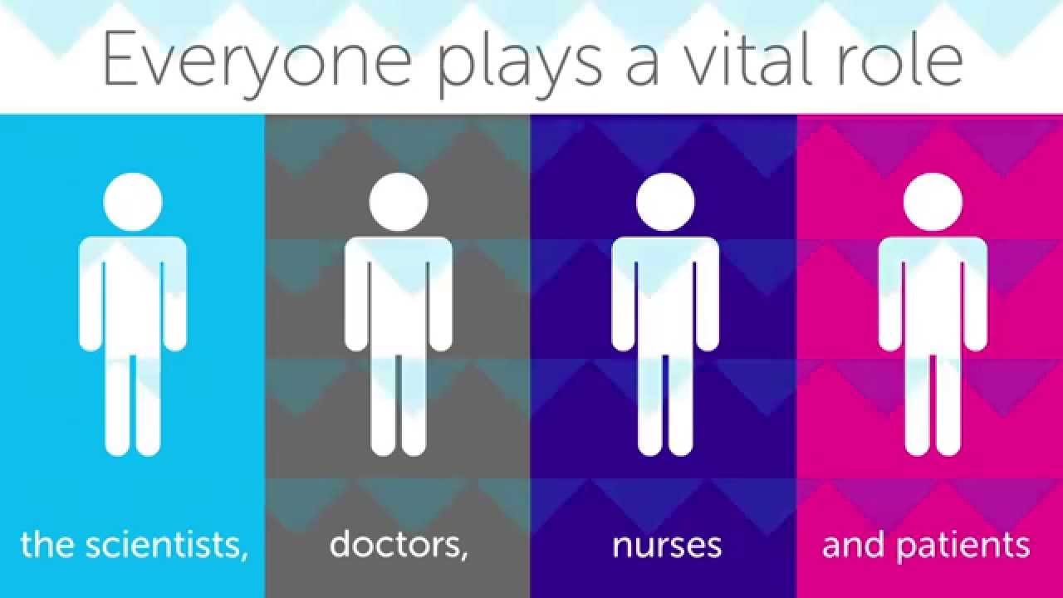
Research team

Slide 21
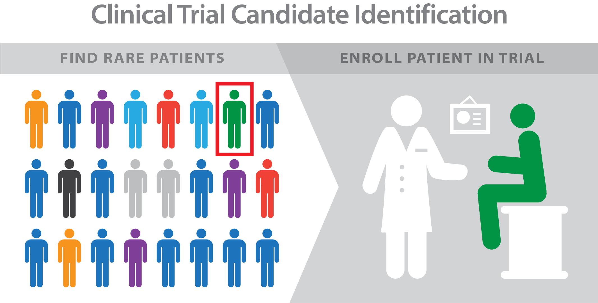

Slide 22
Clinical trials in VUH Santaros klinikos
Joint Centre for Competences and Biomedical Research controls scientific activities and conduction of clinical trials in Vilnius University Hospital Santaros klinikos
A contemporary database is used for over 20 years for the execution of clinical trials, medical devices and other fields of biomedical scientific researches.
JOINT CENTRE FOR COMPETENCES AND BIOMEDICAL RESEARCH
DEPARTMENT OF CLINICAL TRIALS AND PHARMACOLOGY
DEPARTMENT OF SCIENTIFIC RESEARCH

Slide 23
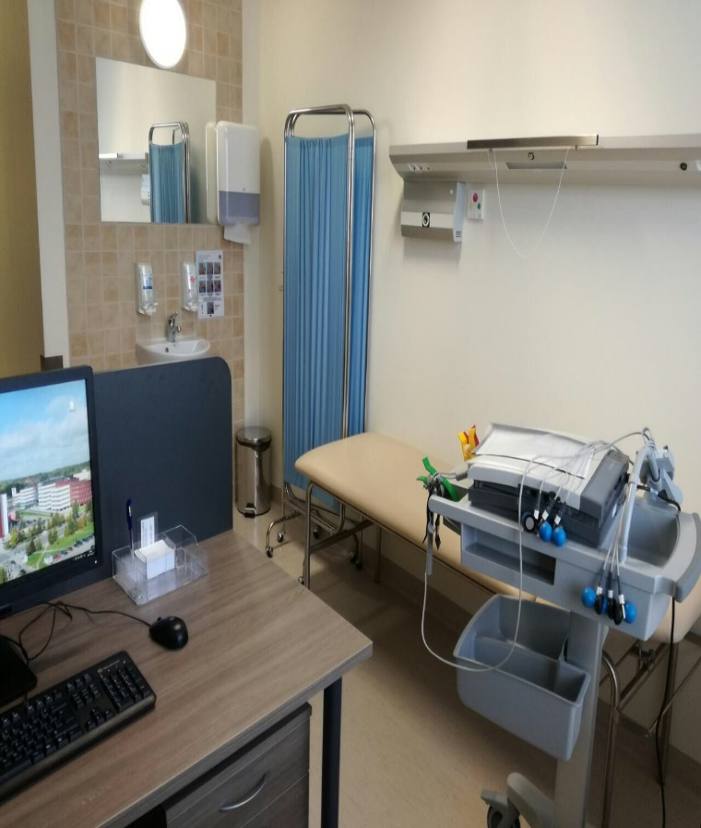
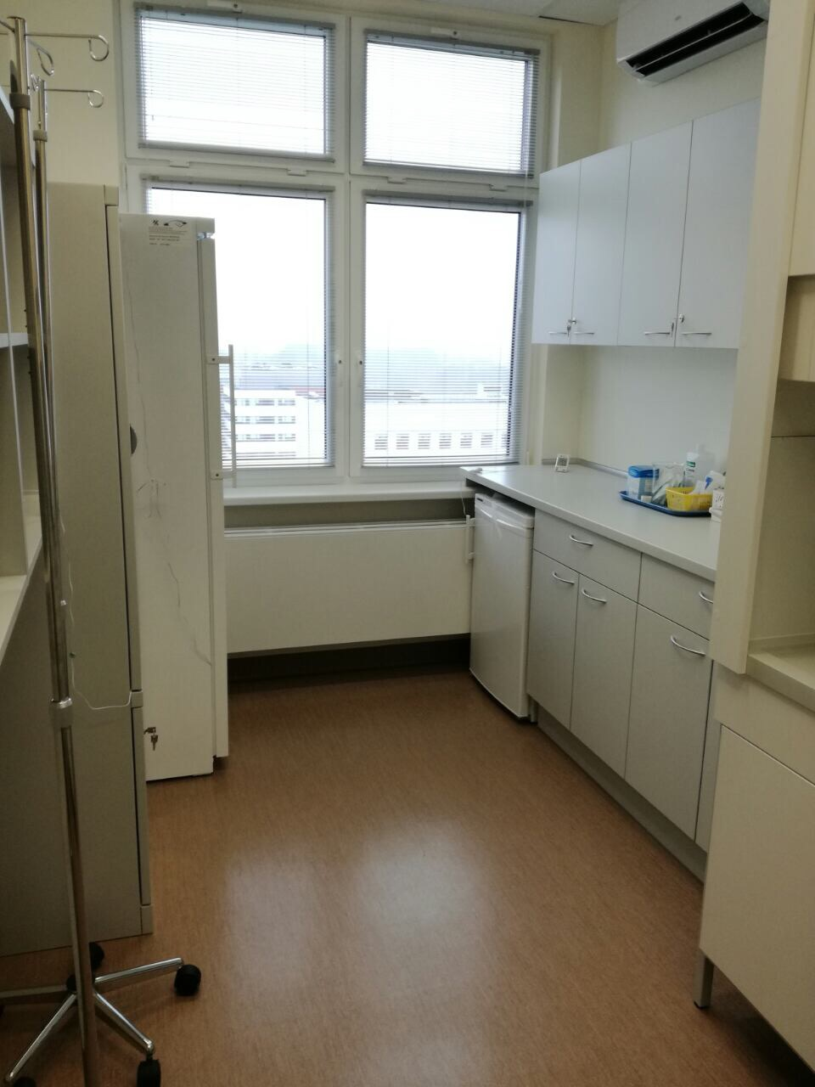
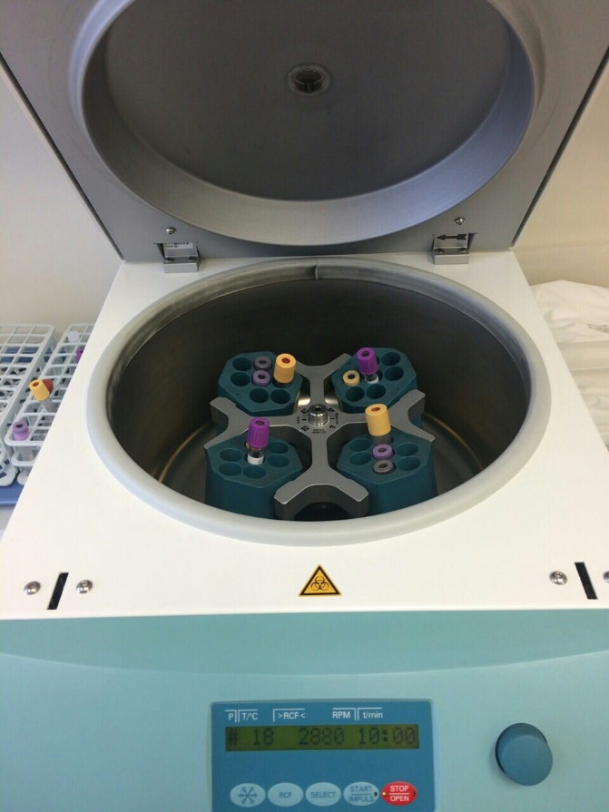
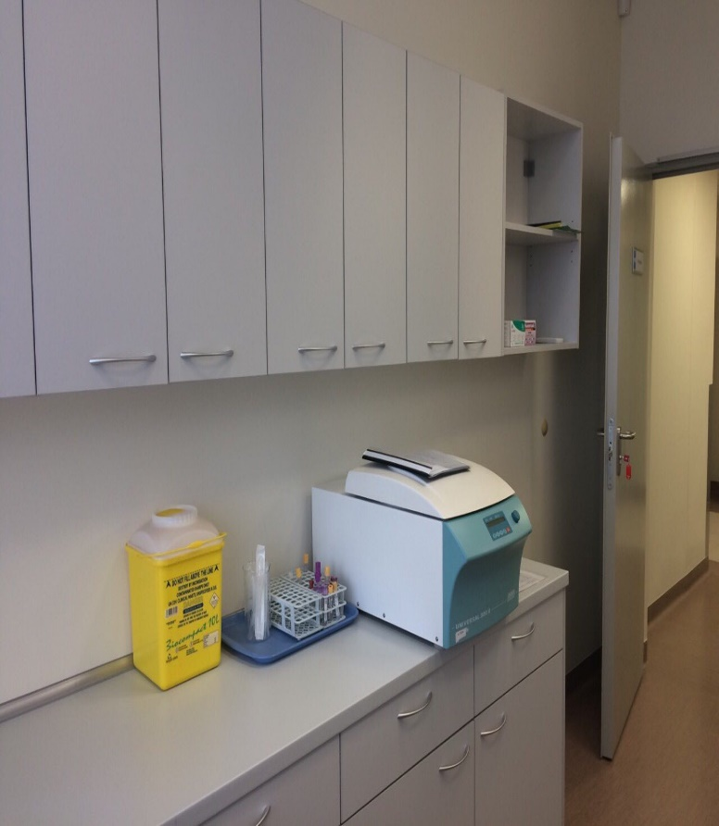
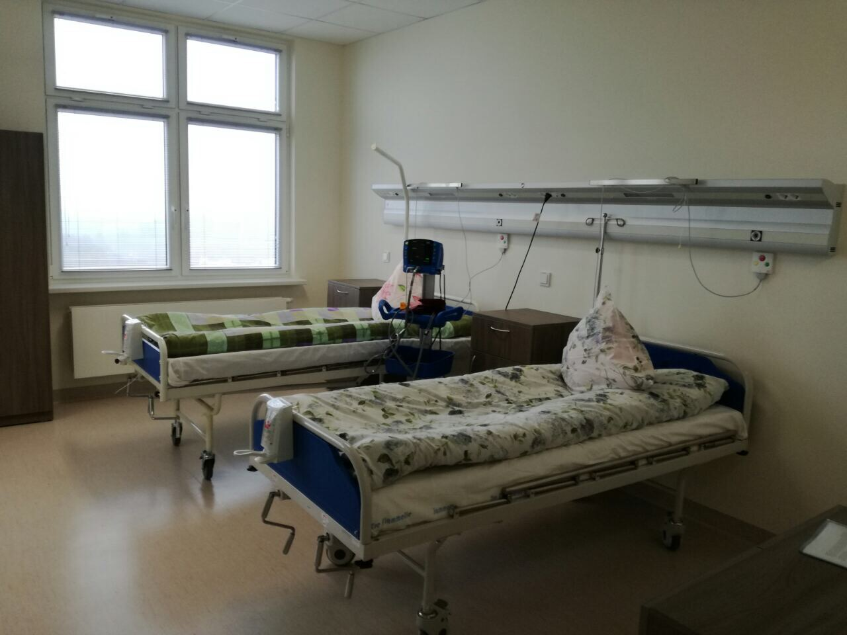
Clinical trials in VUH Santaros klinikos
The Departments of Clinical Trials and Pharmacology and Scientific Research are provided with high-quality equipment for the patients, investigators, study coordinators and sponsors
modern investigators‘ consulation rooms and equipment, wards, procedure rooms, premises for storage, preparation and delivery of investigational medicinal products, rooms for monitoring and other premises

Slide 24
Clinical trials in Pediatrics (2018)
69 clinical and biomedical trials ongoing, involving ~620 patients
22 new trials:
17 new clinical research studies
Therapy/Intervention/Prevention Study
Study of Etiology/Harm/Risk Factors/ Mechanism of Disease
Descriptive/Prevalence Study
5 drug development studies

Slide 25
Research areas
Pediatric diseases (PD)
Pediatric oncology and hematology (POH)
Pediatric emergency and intensive care (PEI)
Neonatology (N)
Pediatric surgery and traumathology (PST)
Rare diseases (RD)
Other (O)
Notes:
Cia vel nelabai aisku ar cia KT visi?

Slide 26
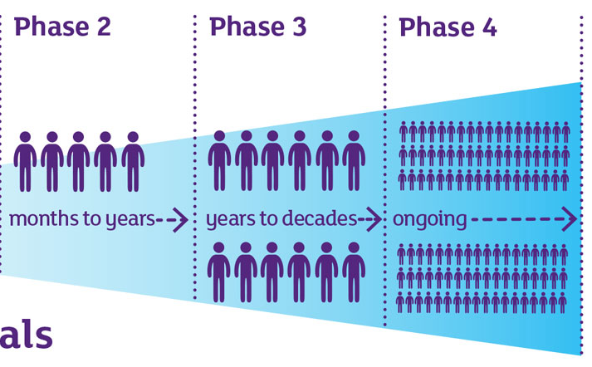
Clinical trials performed

Slide 27
Clinical trials in Lithuania

Slide 28









Collaboration
Partners list:
European Society for Paediatric Gastroenterology, Hepatology and Nutrition
European Society for Pediatric Nephrology
Bambino Gesu’ Children’s Research Hospital
Heidelberg University
Cologne University
Columbia University
Catholic University of Leuven
Great Ormond Street Hospital
Paediatric Rheumatology European Society
Istanbul University

Slide 29








Collaboration
Partners list:
Paediatric Tuberculosis Network European Trial Group
Rostock University
HZRM – Haemophilia Centre Rhine Main
Health Research Institute Hospital La Fe
University Hospital of Münster
Aarhus University Hospital
Fondazione Poliambulanza Hospital
Radboud University
St George's, University of London

Slide 30








Publications in Clarivate Analytics WoS 2016-18

Slide 31
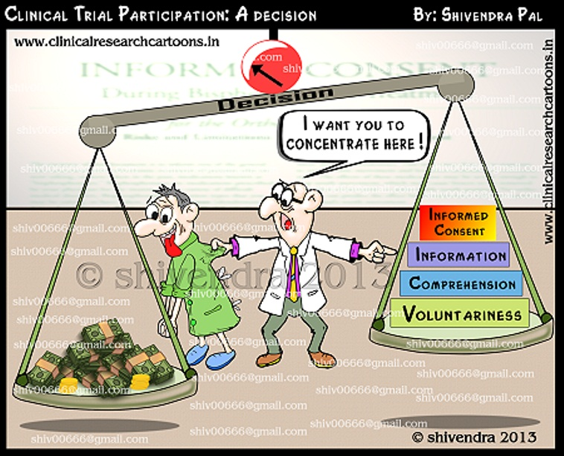
Difficulties

Slide 32
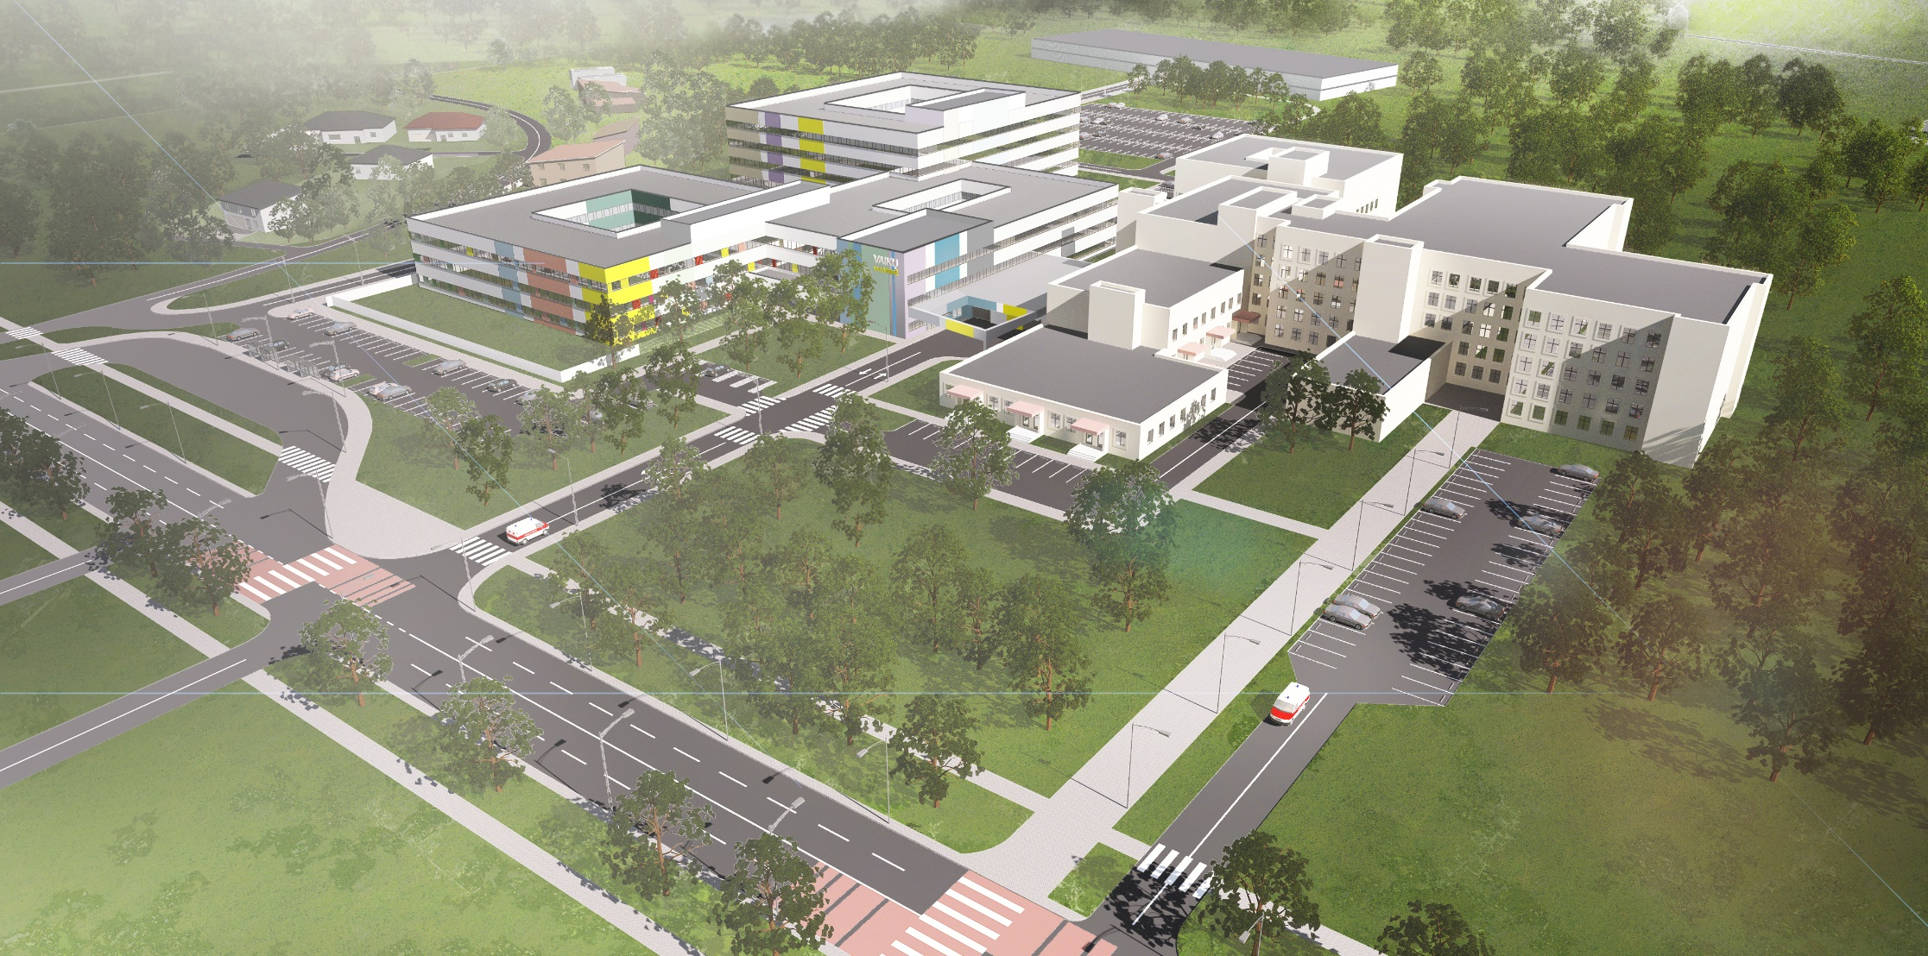
Better care for infants and children through pan-European clinical trial networks

