Slide 1

Paediatric Clinical Trials in Latvia
Dina Apele-Freimane, MD
Pauls Stradins Clinical University Hospital
Amanda Smildzere, MD
Children Clinical Unversity Hospital

Slide 2




University Hospitals in Latvia
Riga East University Hospital
Pauls Stradins Clinical University Hospital
Children Clinical University Hospital
Neonates/Infants
Adults
Only adults
Only Children

Slide 3
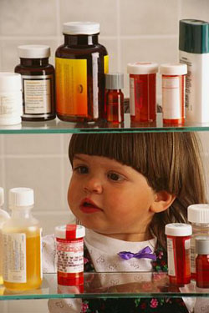
Paediatric Trials in Latvia
Clinical trial statistics are not encouraging
In 2018, only 5 paediatric studies (out of 68 in total) were approved in the State Agency of Medicines of Latvia:
- 3 RCT studies for treatment of atopic dermatitis in children > 12 years
- 1 RCT influenza treatment in children > 12 years
- 1 Phase II PK study in neonates and infants for antibacterial agent
Recently finished and ongoing paediatric trials:
- 2 subsequent RCTs for RSV prevention in preterm and term neonates
- 1 RCT for influenza vaccine in patients from 6 to 47 months of age
One trial not approved by the National authority
- reason for refusal – Paediatric Investigation Plan intended, but not yet submitted to the Paediatric Committee

Slide 4

What makes conduct of paediatric trials problematic?
Small population
- high competition for patients
- limited enrollment
Feasibility issues (opinion by pharmaceutical companies):
- low enrollment
- reluctance from healthcare professionals
- low parental trust, difficulties to obtain informed consent
- lack of general (national) strategy for conducting
clinical trials in children

Slide 5

What makes conduct of paediatric trials problematic?
Lack of research networks
- we are not “visible” on a global stage
- difficult to keep-up-to-date on the latest research projects
Ethic committees
- more than 5 Ethic Committees are functioning in Latvia
- the National competent authority does not monitor the activities of the Ethics Committees

Slide 6
Data sources
Hospital data bases
Patient registries – only for specific diagnoses
Follow-up program for preterm neonates:
- preterm neonates < 32 weeks of gestational age
- dynamic follow-up observation up to 2 years of age
Dynamic follow-up for post-asphyctic neonates with moderated and severe HIE (following to hypothermia treatment) up to 2 years of age
Shortcomings:
Lack of a common pediatric patient database – risk of missing data
Longer follow-up for preterm and post-aphyctic neonates would be more informative in terms of neurological and cognitive development

Slide 7
What can be done?
Awareness rising
Communication to clinical practitioners
- explanation of the importance of paediatric research
- training for researchers (practical, communication)
Communication to parents, patient organizations
- benefit of paediatric trials
- safety of paediatric trials
Joining to global networks, improved international collaboration
Introduction of harmonized diagnostic and endpoint evaluation
approaches (e.g. neurodevelopmental assessment for neonates)
Improved communication of clinical practitioners to parents →
improved obtaining of informed consent →
better patient enrollment

Slide 8

Thank you!

