Slide 1


Estonian Network of Paediatric studies
Irja Lutsar
Tallinn, 20. March 2019

Slide 2

c4c is looking for clinical experts
https://conect4children.org/2019/02/25/call-for-clinical-and-methodology-experts/
Gastroenterology & hepatology lead Nick Croft
Endocrinology & Diabetes lead Thomas Danne
Reumatology & Autoimmune diseases lead Nicola Ruperto
Infectious diseases & Vaccinology lead Theoklis Zaoutis
Cardiology lead Wim Helbing
Neuroscience & epilepsy lead Helen Cross
Neuromuscular diseases lead Volker Straub
Metabolic diseases lead Maurizio Scarpa
Oncology lead Gilles Vassal
Nephrology lead Franz Schaefer
RSV lead Louis Bont
Respiratory lead Jonathan Grigg
Intensive care lead to be nominated
Psychiatry lead Alessandero Zuddas
Neonatology lead Karel Allegaert
Adolescent Medicine lead Alessandero Zuddas

Slide 3
ELAV
Was established based on mutual agreement between University of Tartu, University Clinics of Tartu and Tallinn Children’s Hospital
ELAV is part of Clinical Trial Unit of University of Tartu
General aim to coordinate paediatric clinical trials in Estonia
ELAV is lead by the board of 5 people

Slide 4
Main tasks of ELAV
“One stop shop” for pharmaceutical industry and academic researchers
To support investigators in initiating clinical trials (ethics, regulatory submission)
  Together with clinical trials unit
To support study teams with training (GCP training)
To enable to share experiences in conducting clinical trials

Slide 5
Team members
Estonian Network of Paediatric studies (www.elav.ee)
Two level 3 paediatric hospitals involved
  Small and complex studies
Wide variety of expertise in the group
  Paediatrics, neonatology, pharmacology, clinical pharmacy, analytical science, study nurses
  Modelling (incl. PK modelling), clinical trials
Mostly academic trials but also experience with industry led trials
Recent international trials
  NeoMero, Mon4Strat, Closed, NeoVanc, Neurosis, Albino
Recent local trials
  DosOpt,
Supporting systems are in place
  Clear and transparent processes (regulatory, ethics, contracts)

Slide 6
What ELAV has done thus far?
Each year one meeting related to paedaitric reseach
Both paediatric hospitals have research nurses (funded by ELAV)
ELAV is member of c4c

Slide 7

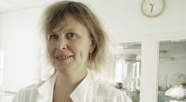
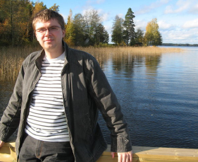
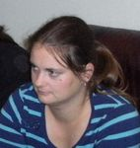

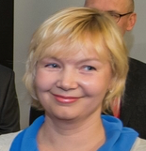
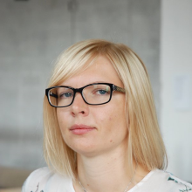



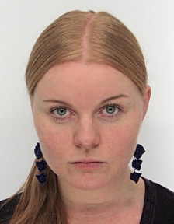
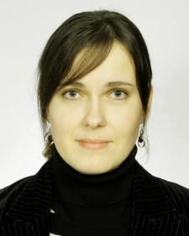

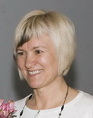
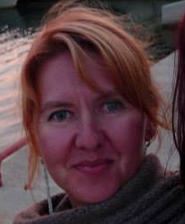
Estonian Network of paediatric studies

Slide 8
Our contribution
We have several years of experience in designing and conducting paediatric studies including PK studies and premature neonates among others
  Currently there 11 academic clinical trials ongoing
We would like to contribute in innovative study design and conduction, integrating electronic health system to clinical trials
  No data transcription
  Data collection directly from hospital records and monitoring devices
  Using electronic prescriptions to record medications (concomitant and study)
  Data transfer from computer to computer rather than data transcription from hospital records that requires quality control
  Establishing Baltic cooperation

Slide 9
Team members
Characterisation of beneficiary
Competence
expectations

