Slide 1

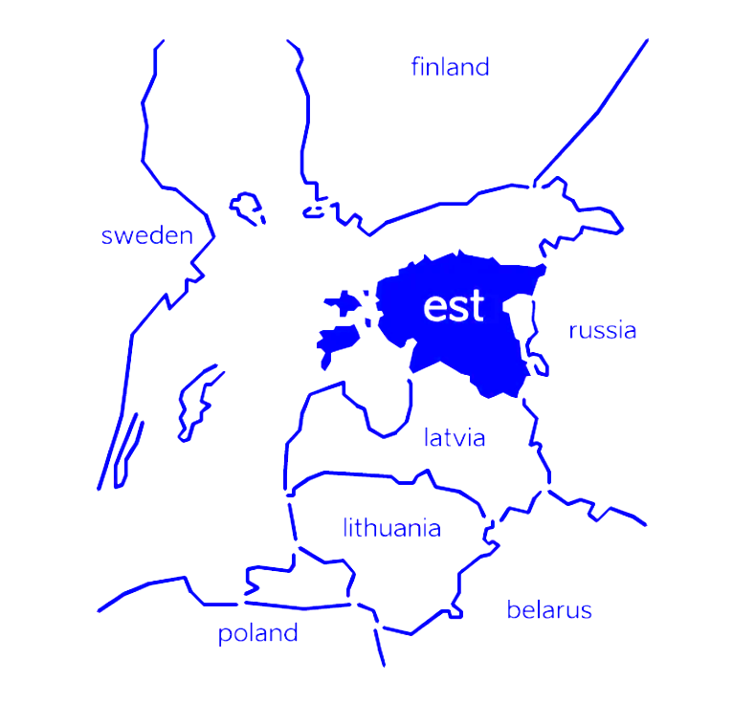
Welcome to Estonia
Sirli Sipp Kulli, Director
Social License to Operate
Responsible Mineral Exploration Conference
16th Sept 2025, Tallinn, Estonia

Slide 2
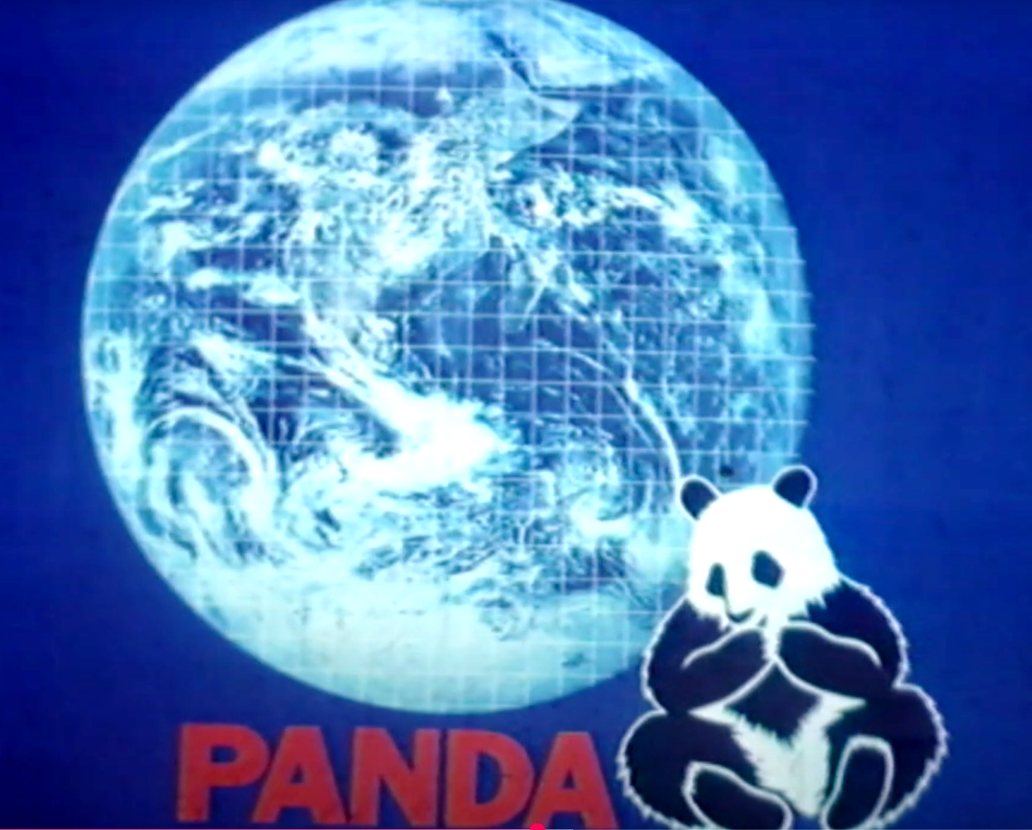

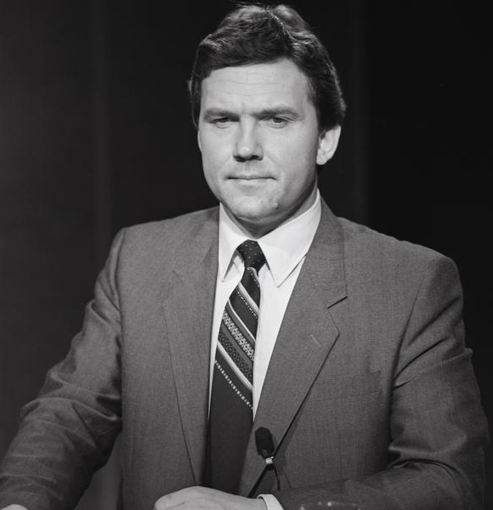
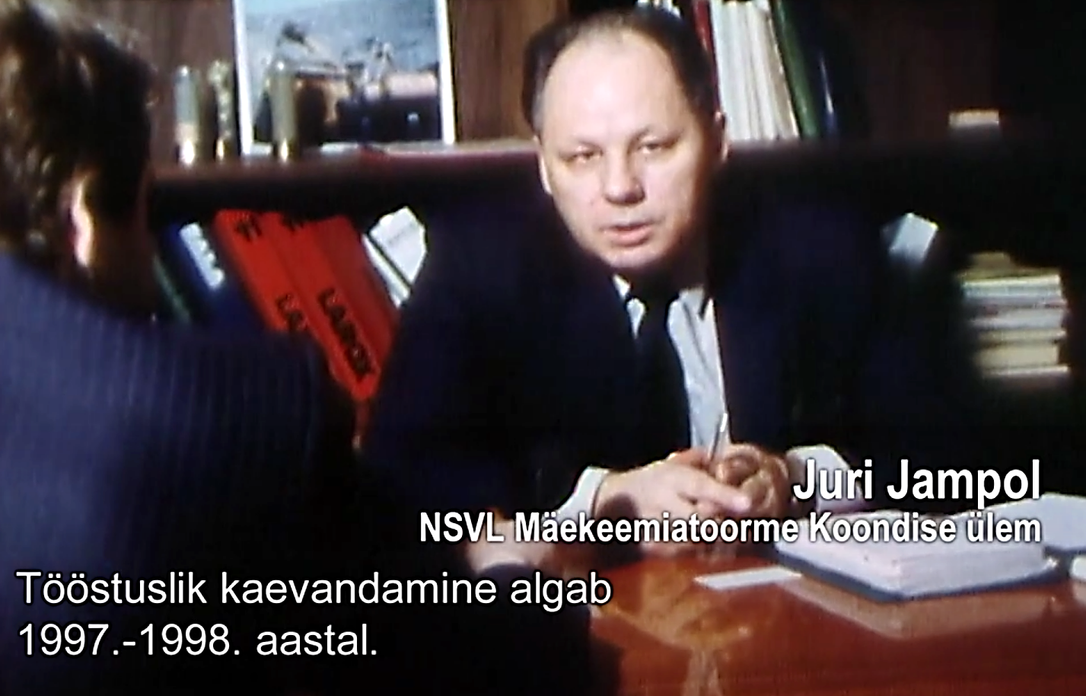
Juhan Aare
„Industrial scale mining starts in 1997-1998“

Slide 3
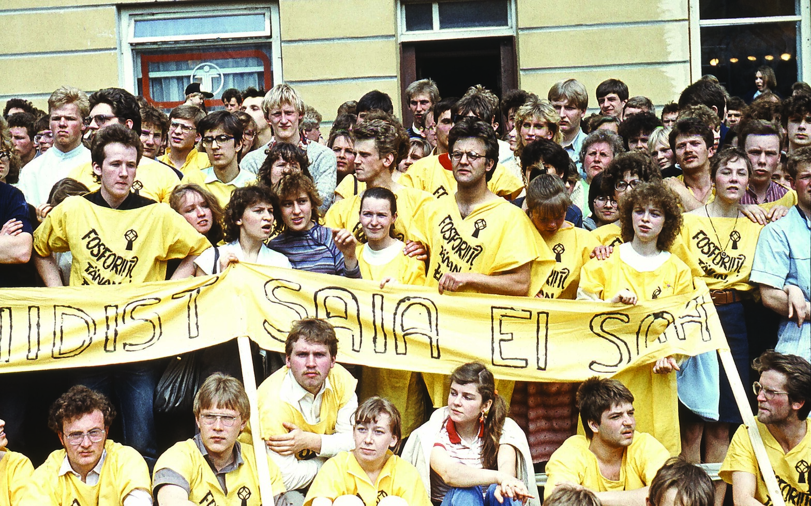
Let’s look back… 38,5 years
Successful Phosphorite War was the national protest movement in the late-1980’ies against the opening of large phosphorite mines in Estonia by the Soviet Union.
Country-wide campaign created opportunities for the public to pressure the political decisions, that led to the restoration of Estonian independence in 1991.
In the related turmoil the public image of geologists became negative, resulting a significant drop in the amount of geology students for the next 30 years.
For decades, geological services were provided by state-owned company, with main goal to create profit via providing services.
Protest meeting in 1987, Tartu

Slide 4
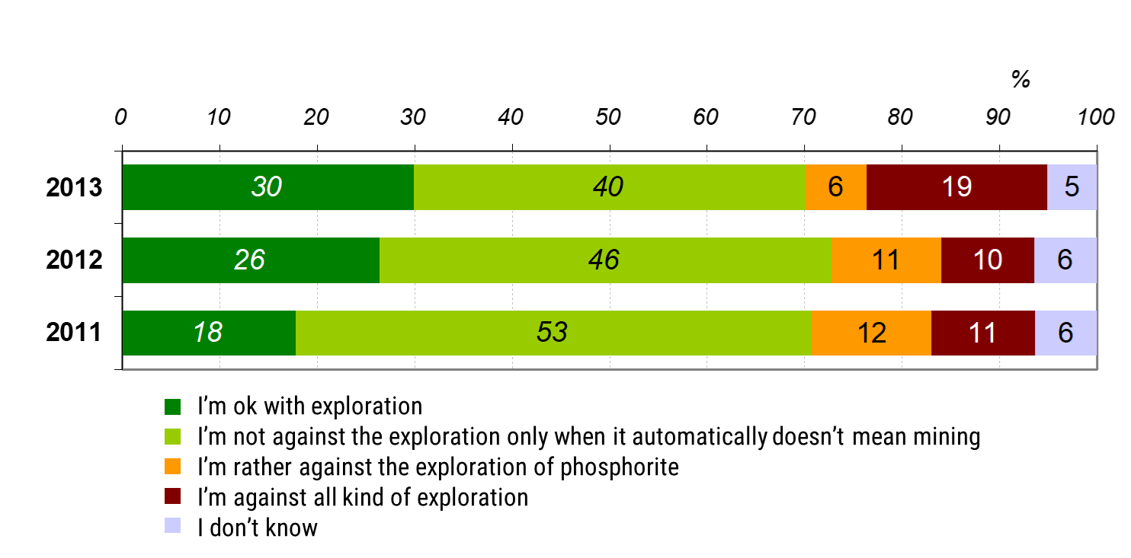
Public opinion about phosphorite exploration, 2011-2013

Slide 5
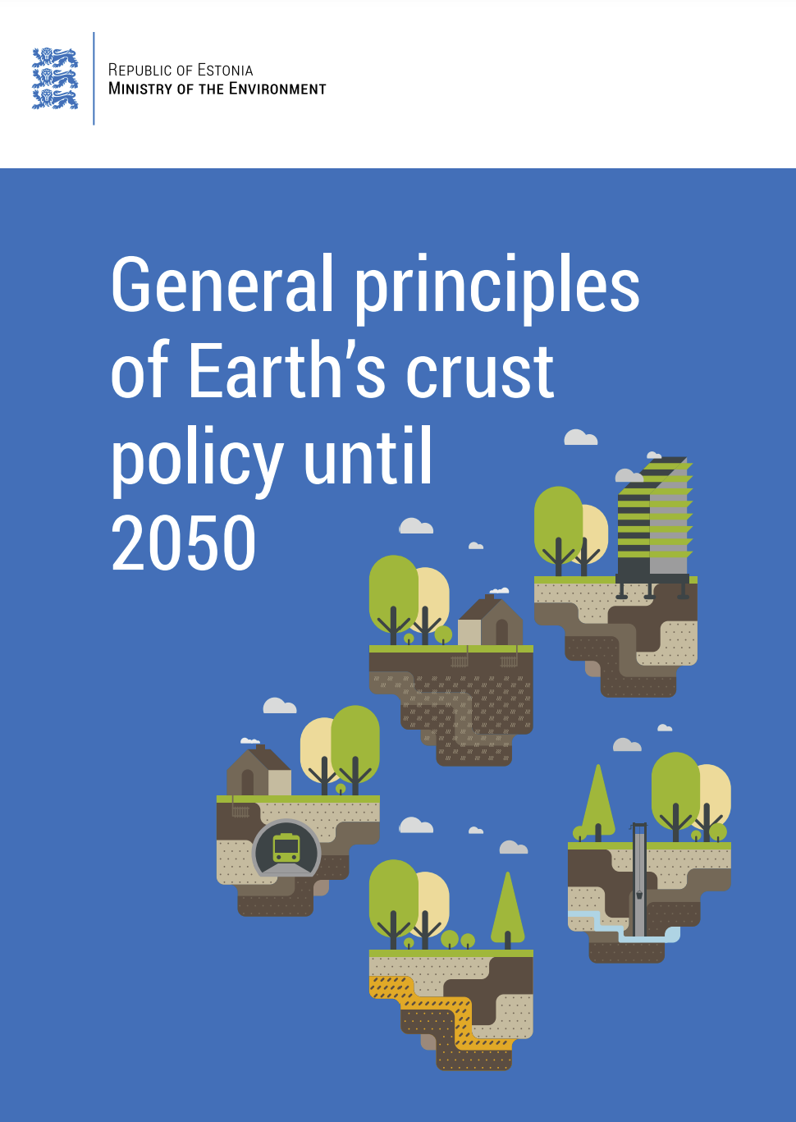
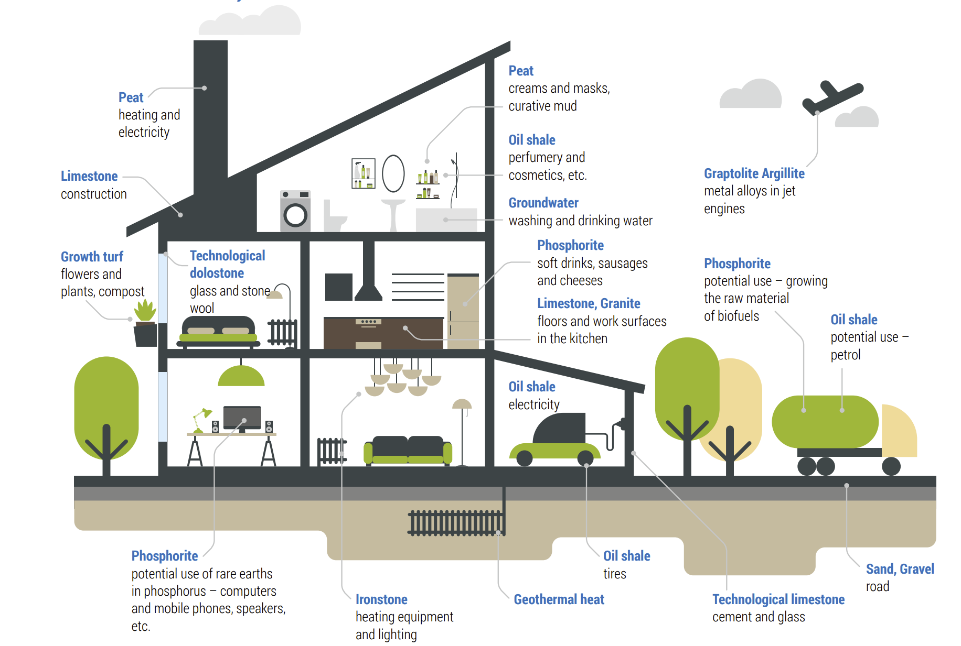
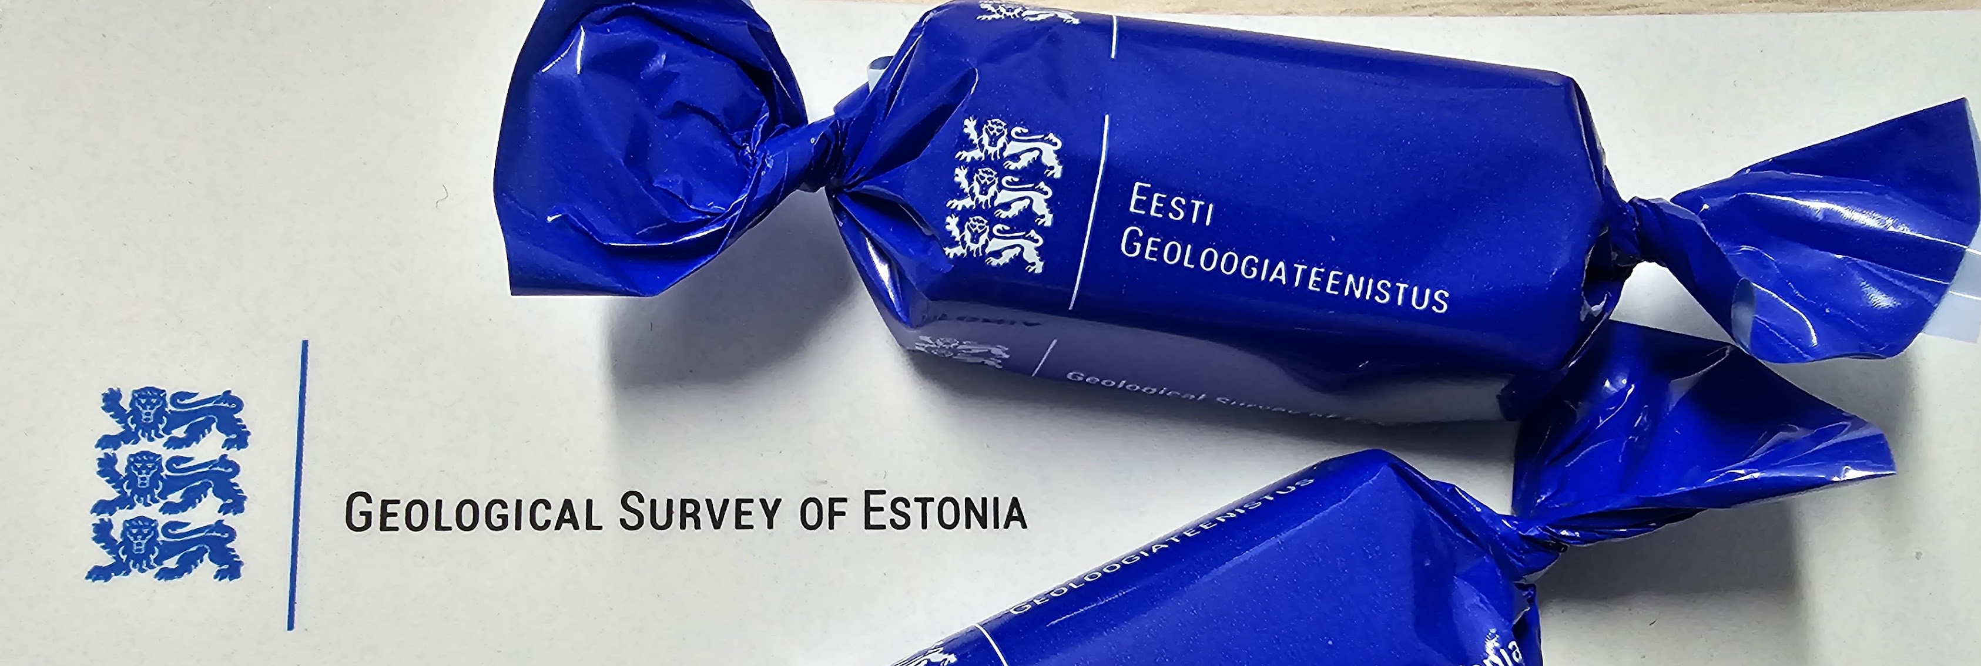
The New Start
Parliament of Estonia approved 2017 the framework strategy called “General principles of the Earth’s Crust policy until 2050” with the main goals of securing science-based management of geological resources and increase resource efficiency.
Geological Survey of Estonia as a national authority was re-established on 1st of Jan 2018 under the administration of the Ministry of Economic Affairs and Communications.

Slide 6
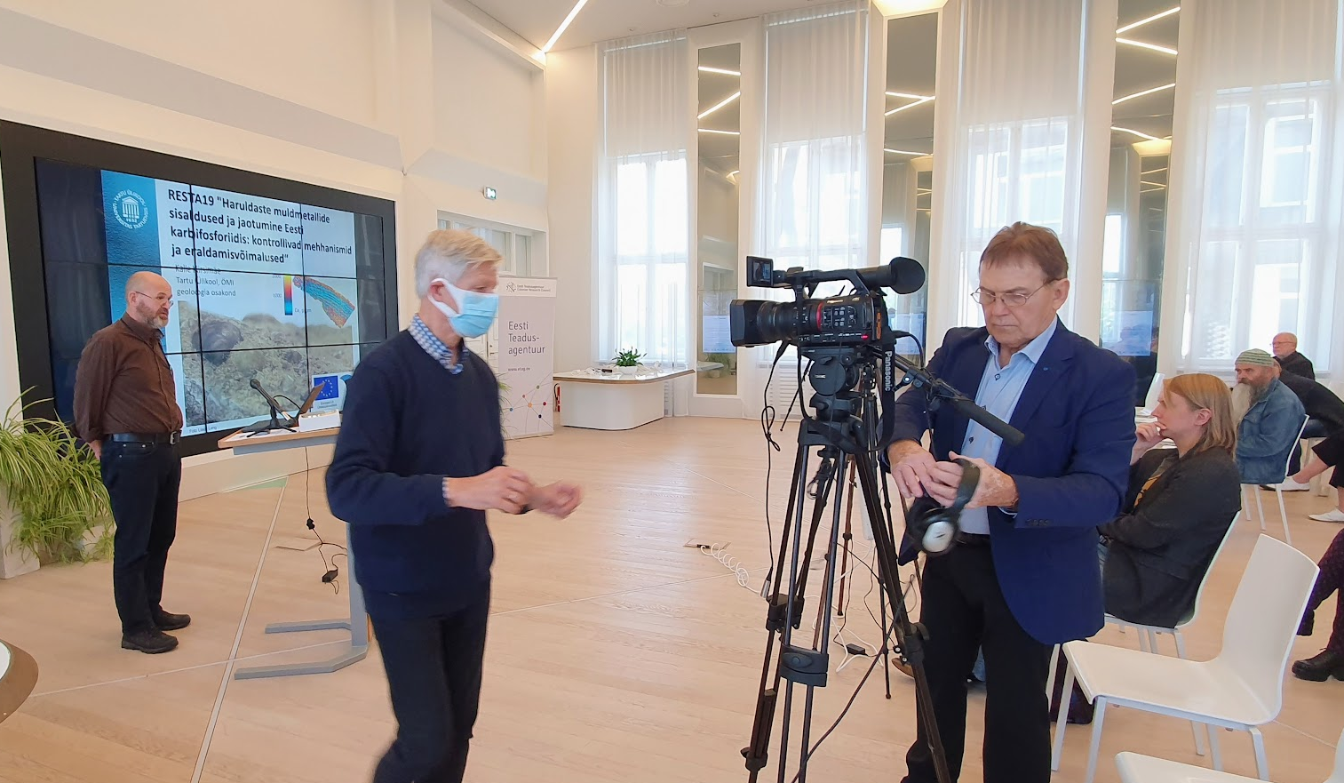
2020 EGT started to drill phosphorite

Slide 7
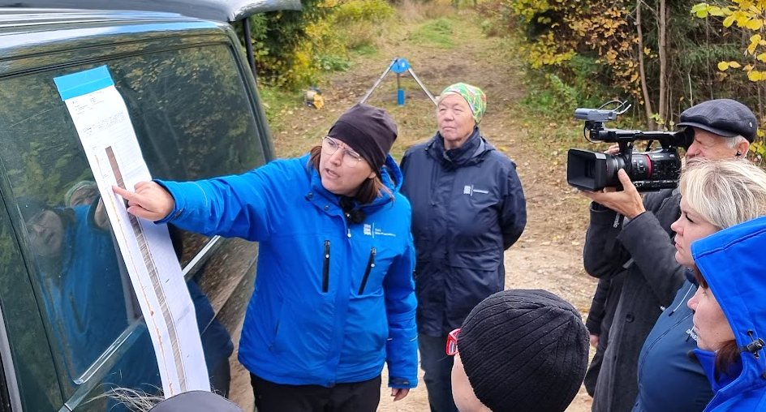
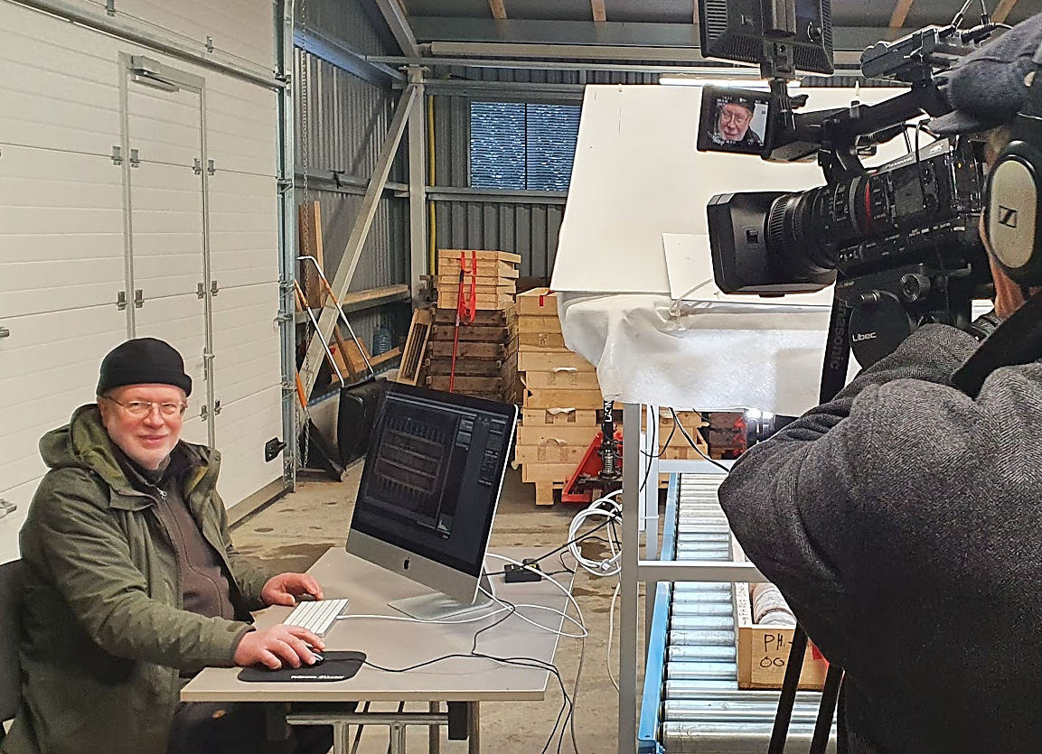
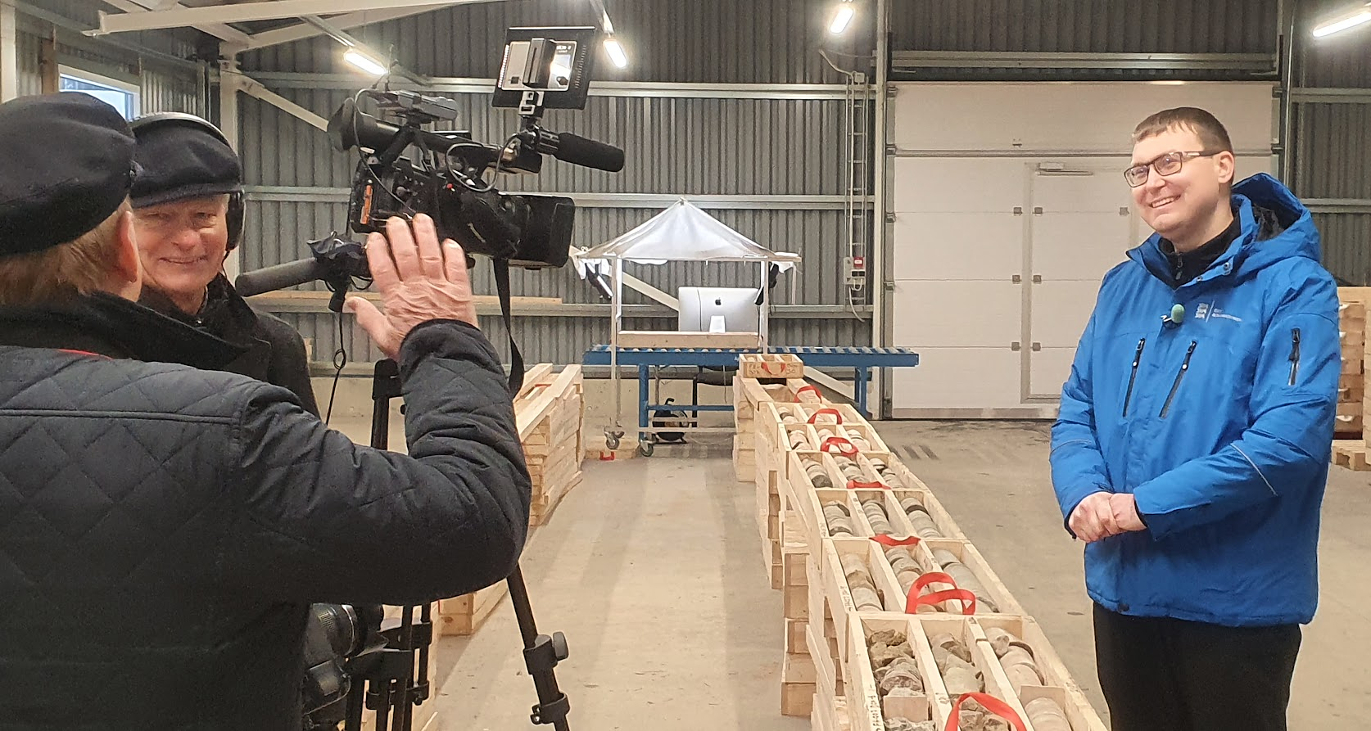
Communication was & is the key
Movie clips about explorations - made by Juhan Aare, a former leader of the Phosphorite war, public on EGT webpage

Slide 8
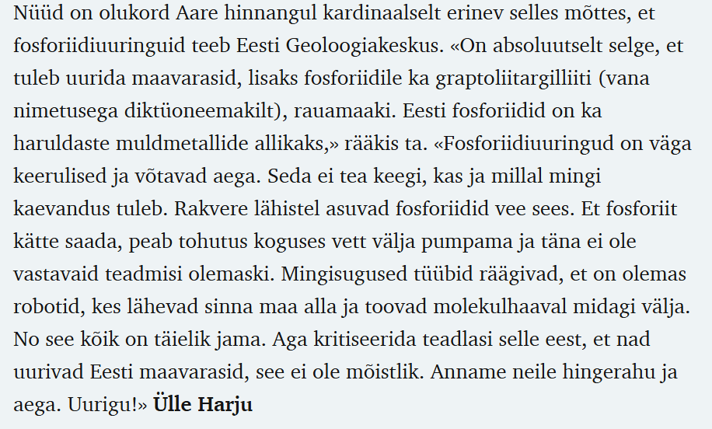


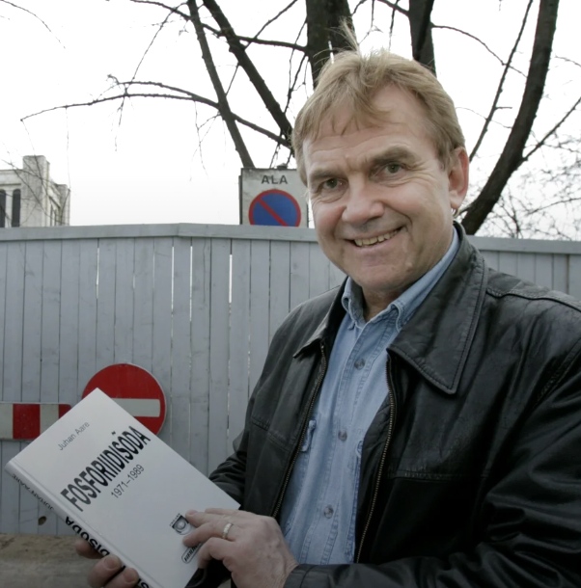
„It is unreasonable to criticize scientists for exploring Estonian mineral resources.
Let's give them peace and time.
Let them explore!“
Foto: Tiina Kõrtsini

Slide 9
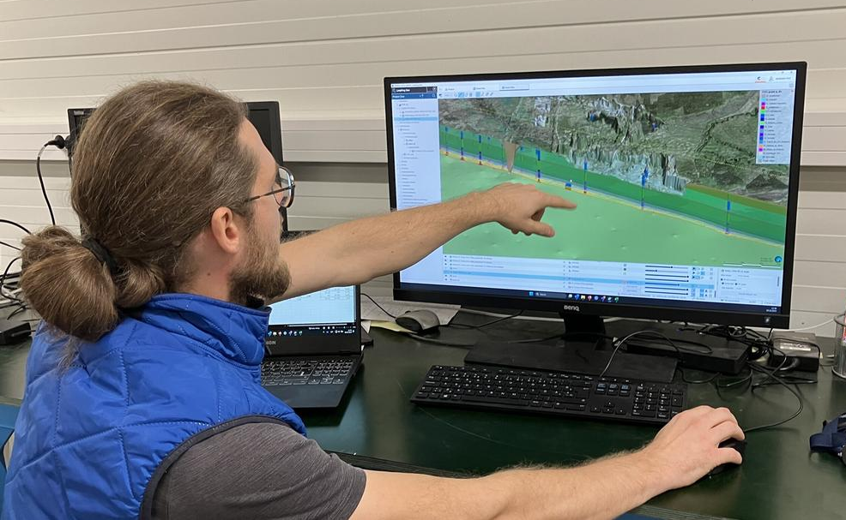
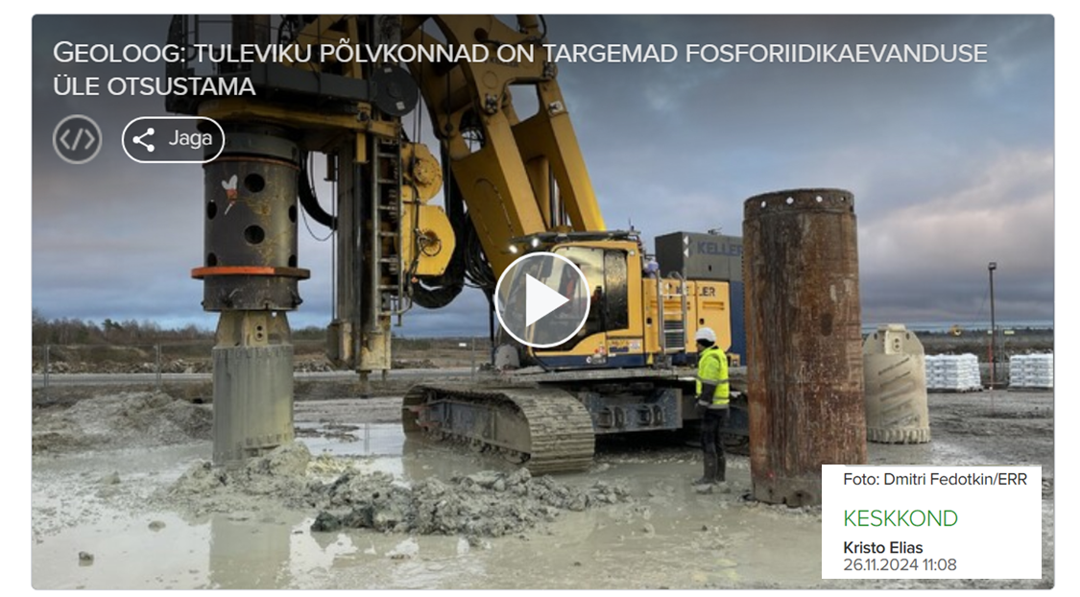
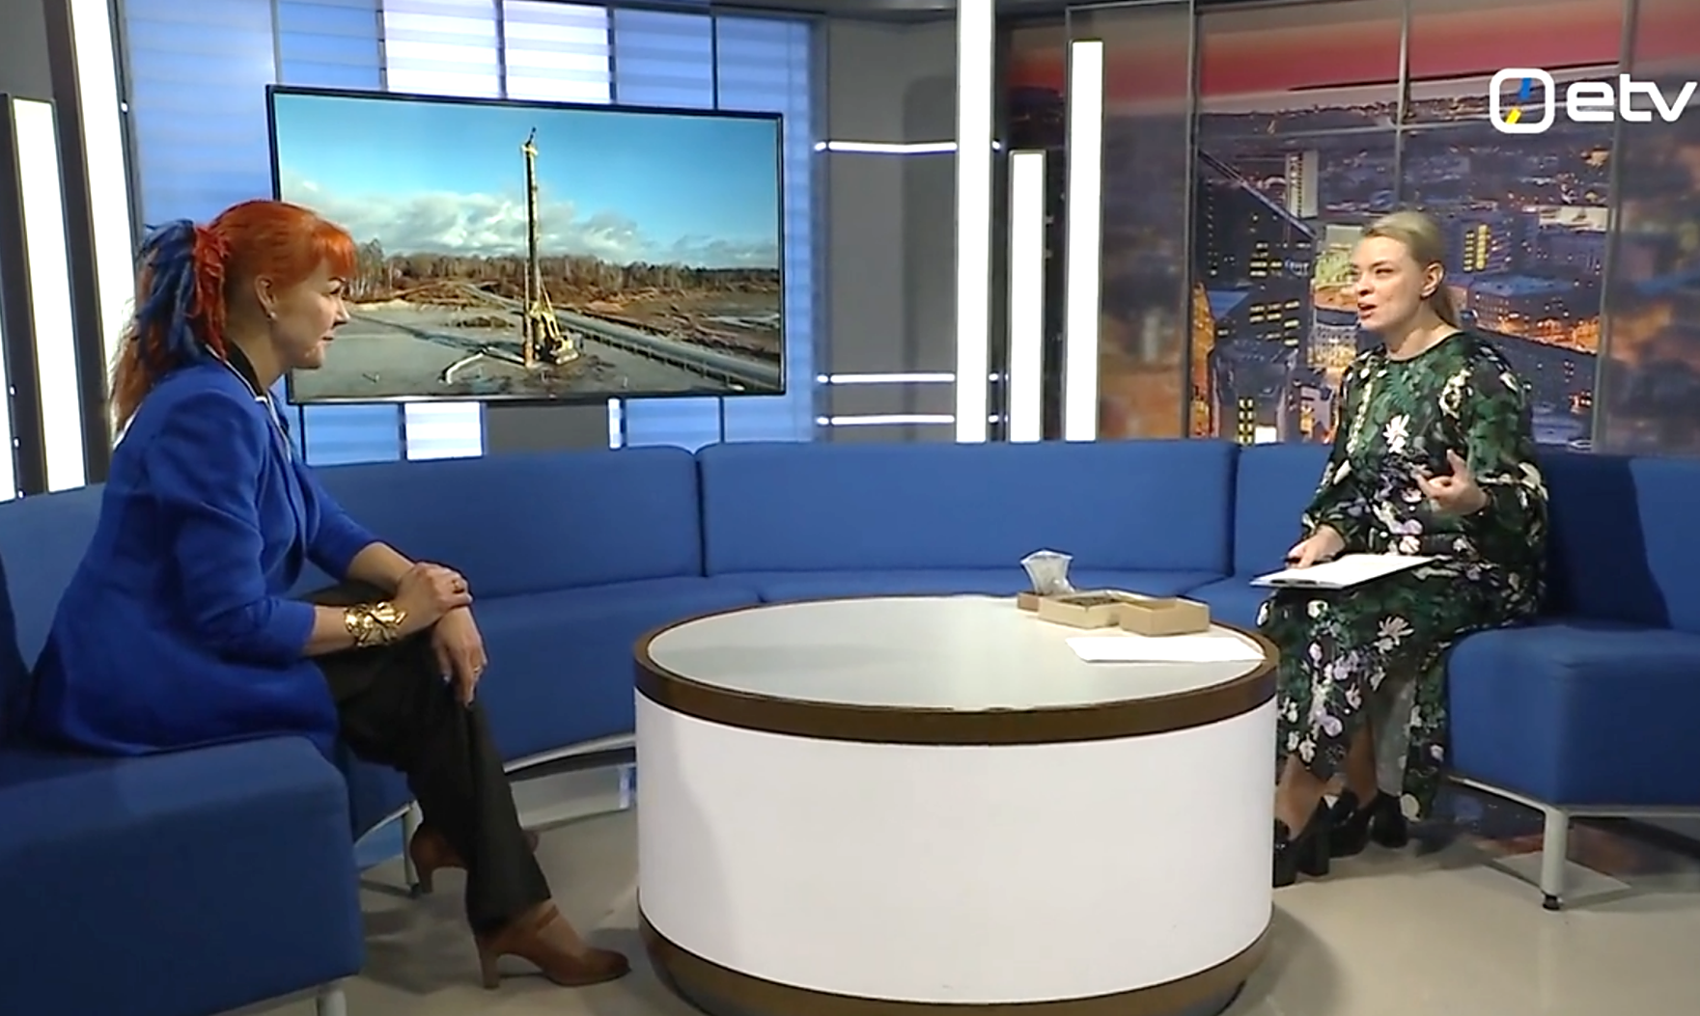
Communication was & is the key
Talks with media, locals, government, parliament, political parties.
Fall24, when sampling tons: geologists were stars of the media

Slide 10
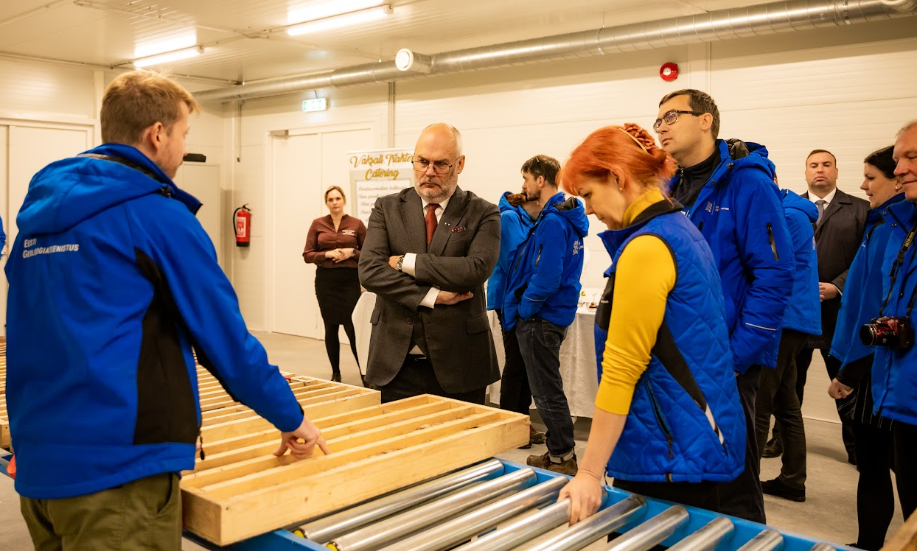
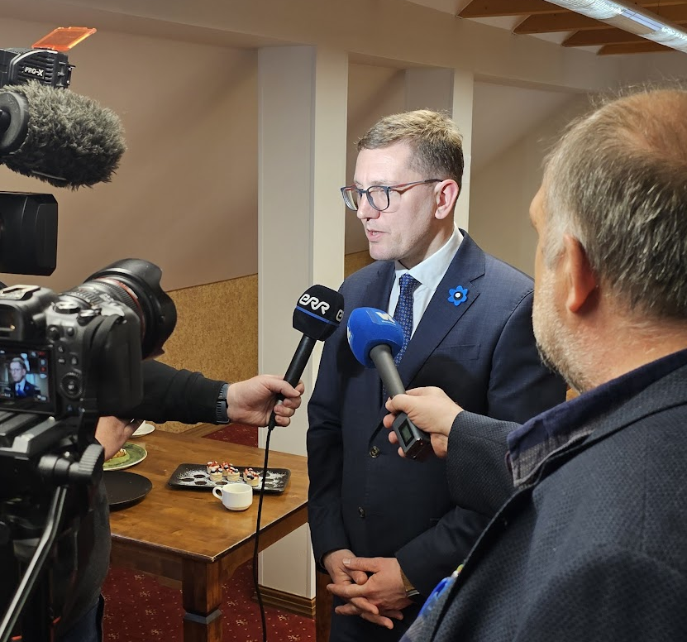
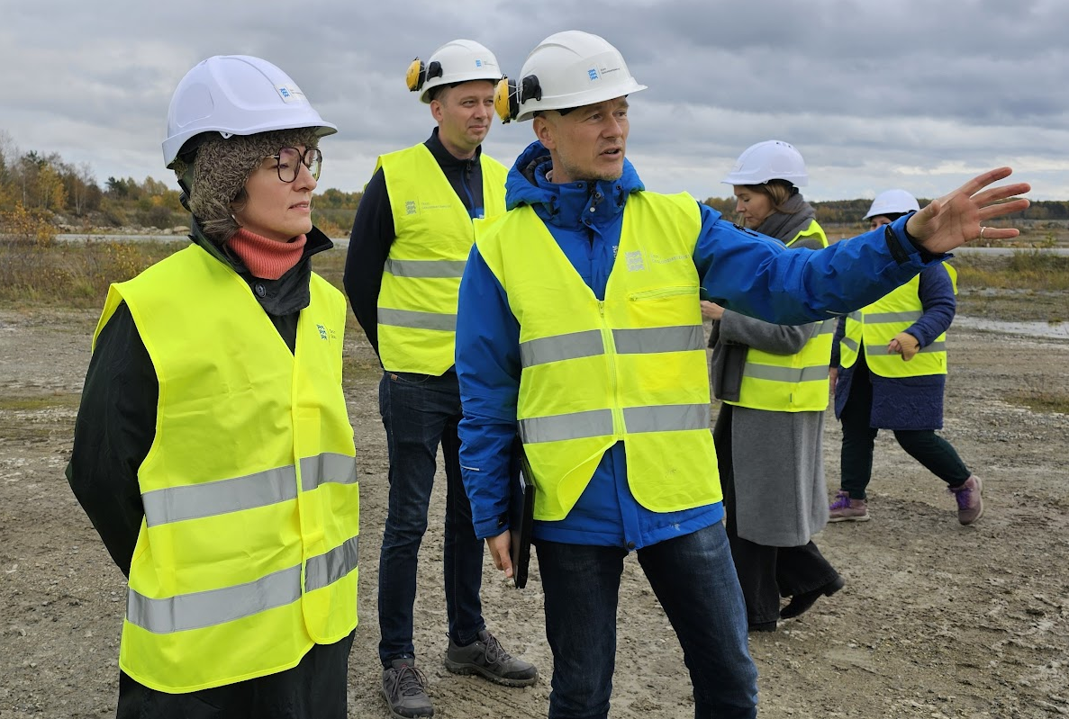
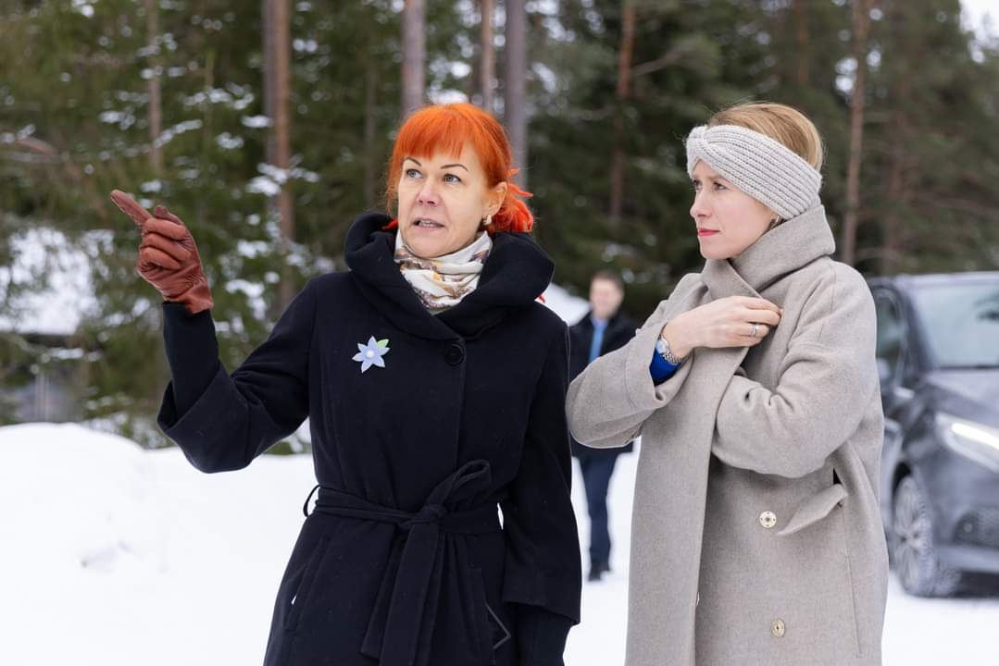
Raising awareness
among politicians

Slide 11

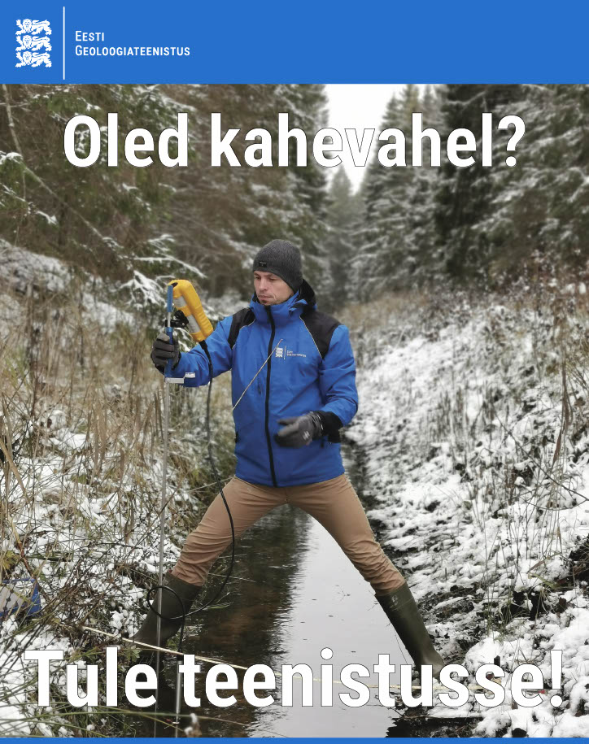


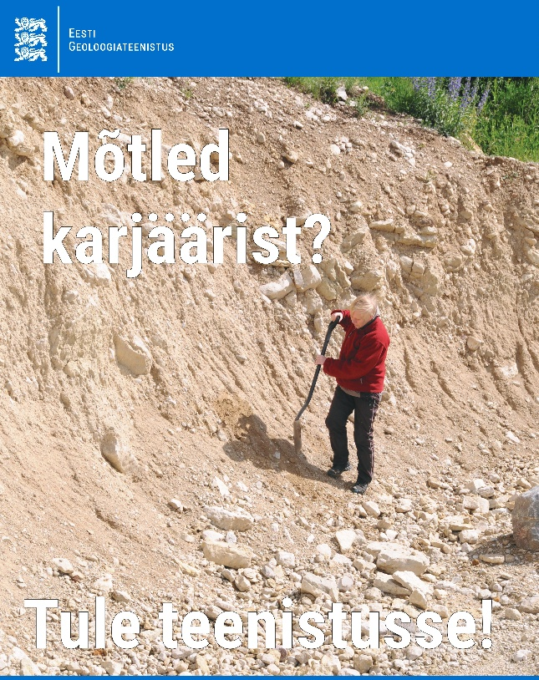
Raising knowledge and
new geologists

Slide 12
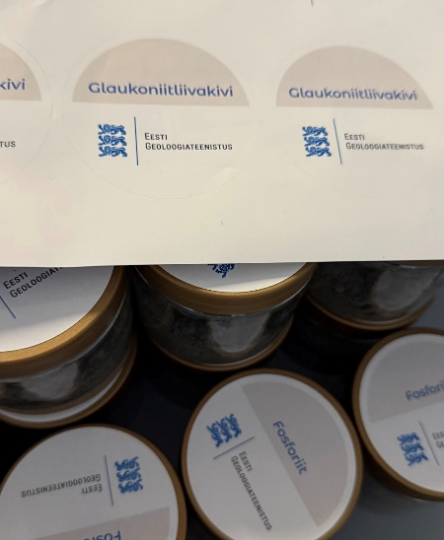
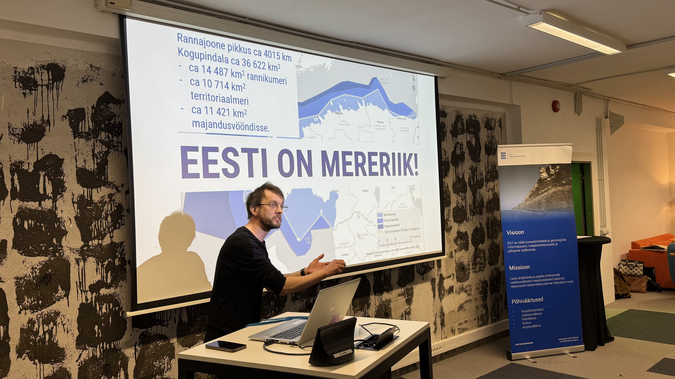
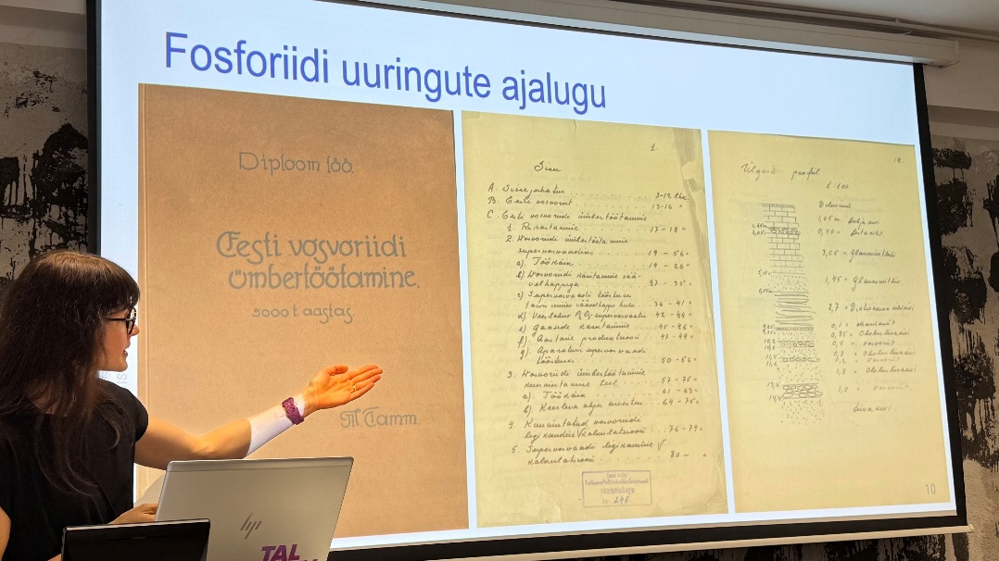
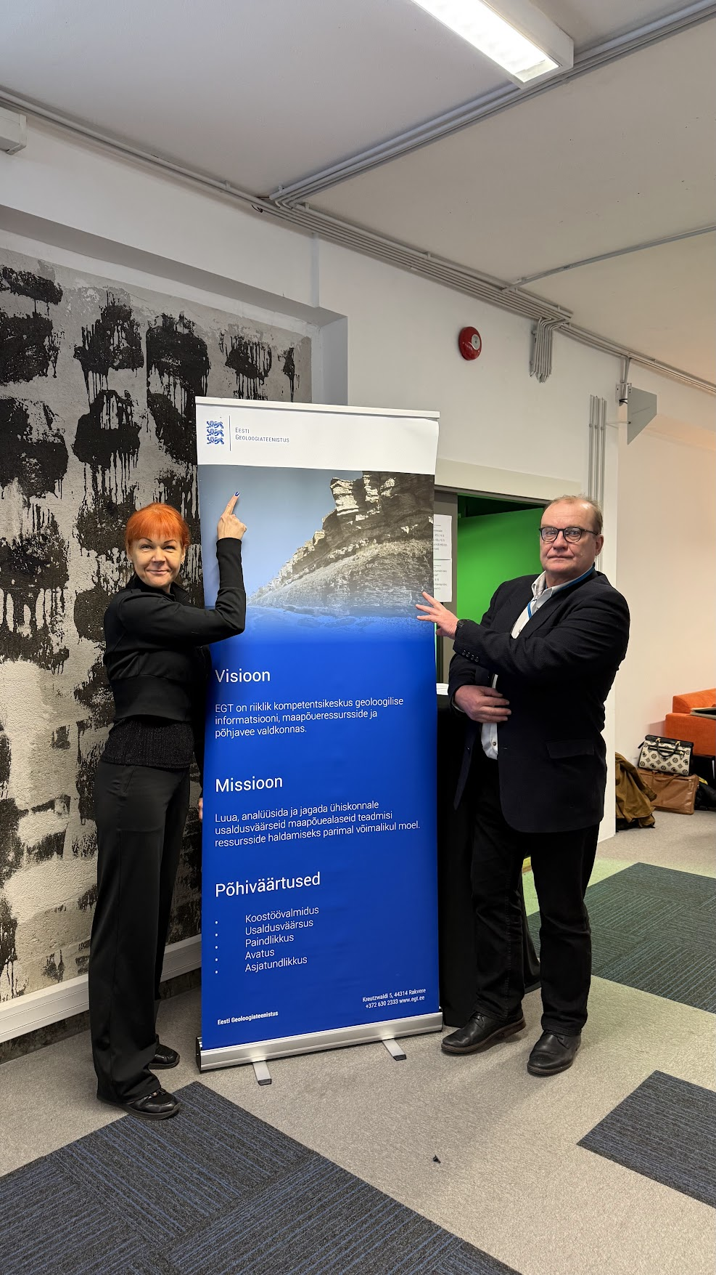
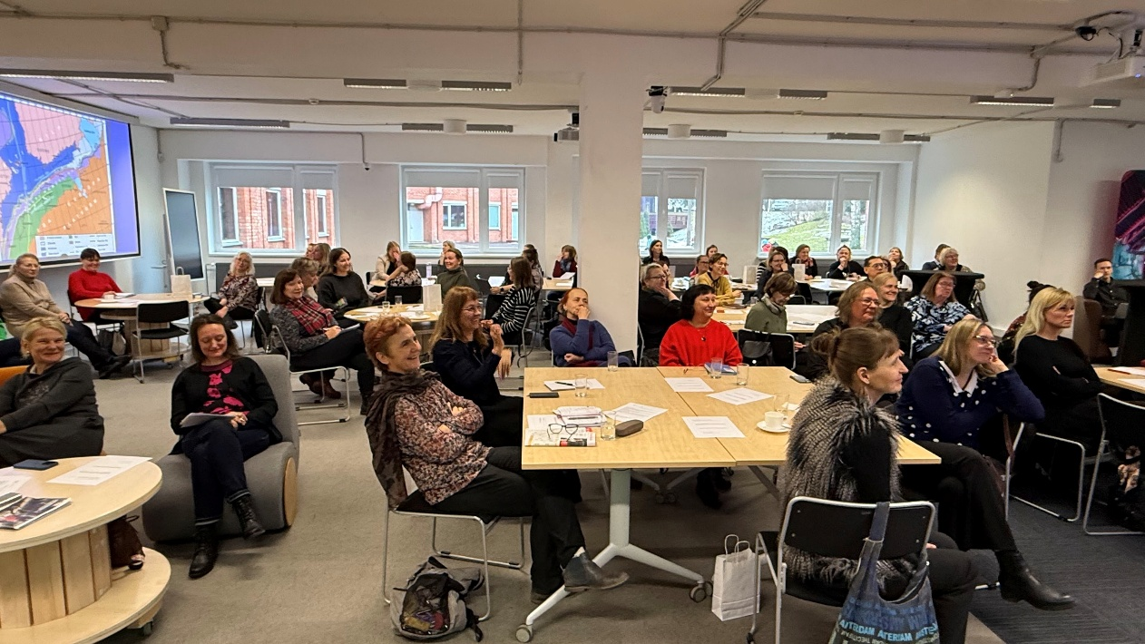
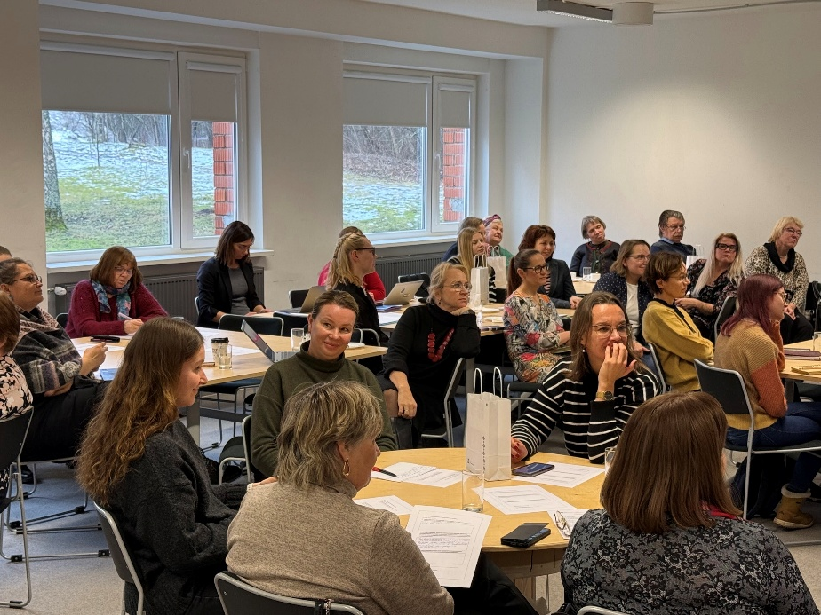
Trainings for teachers from Secondary Schools, samples, videos and posters

Slide 13
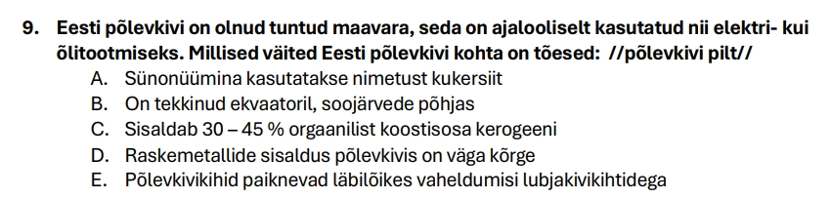

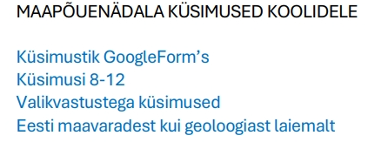
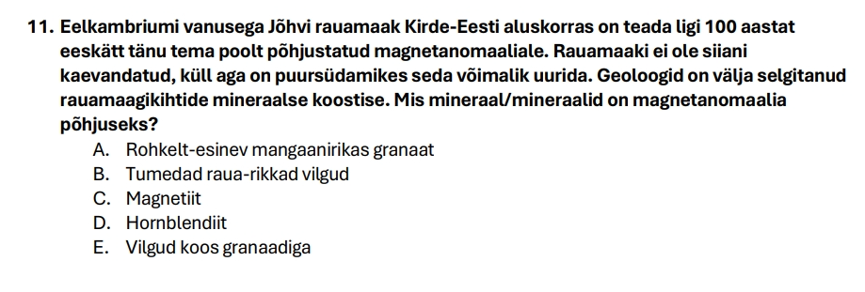
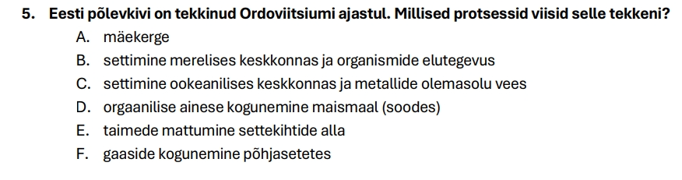
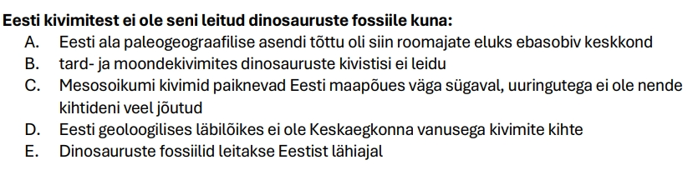

Slide 14
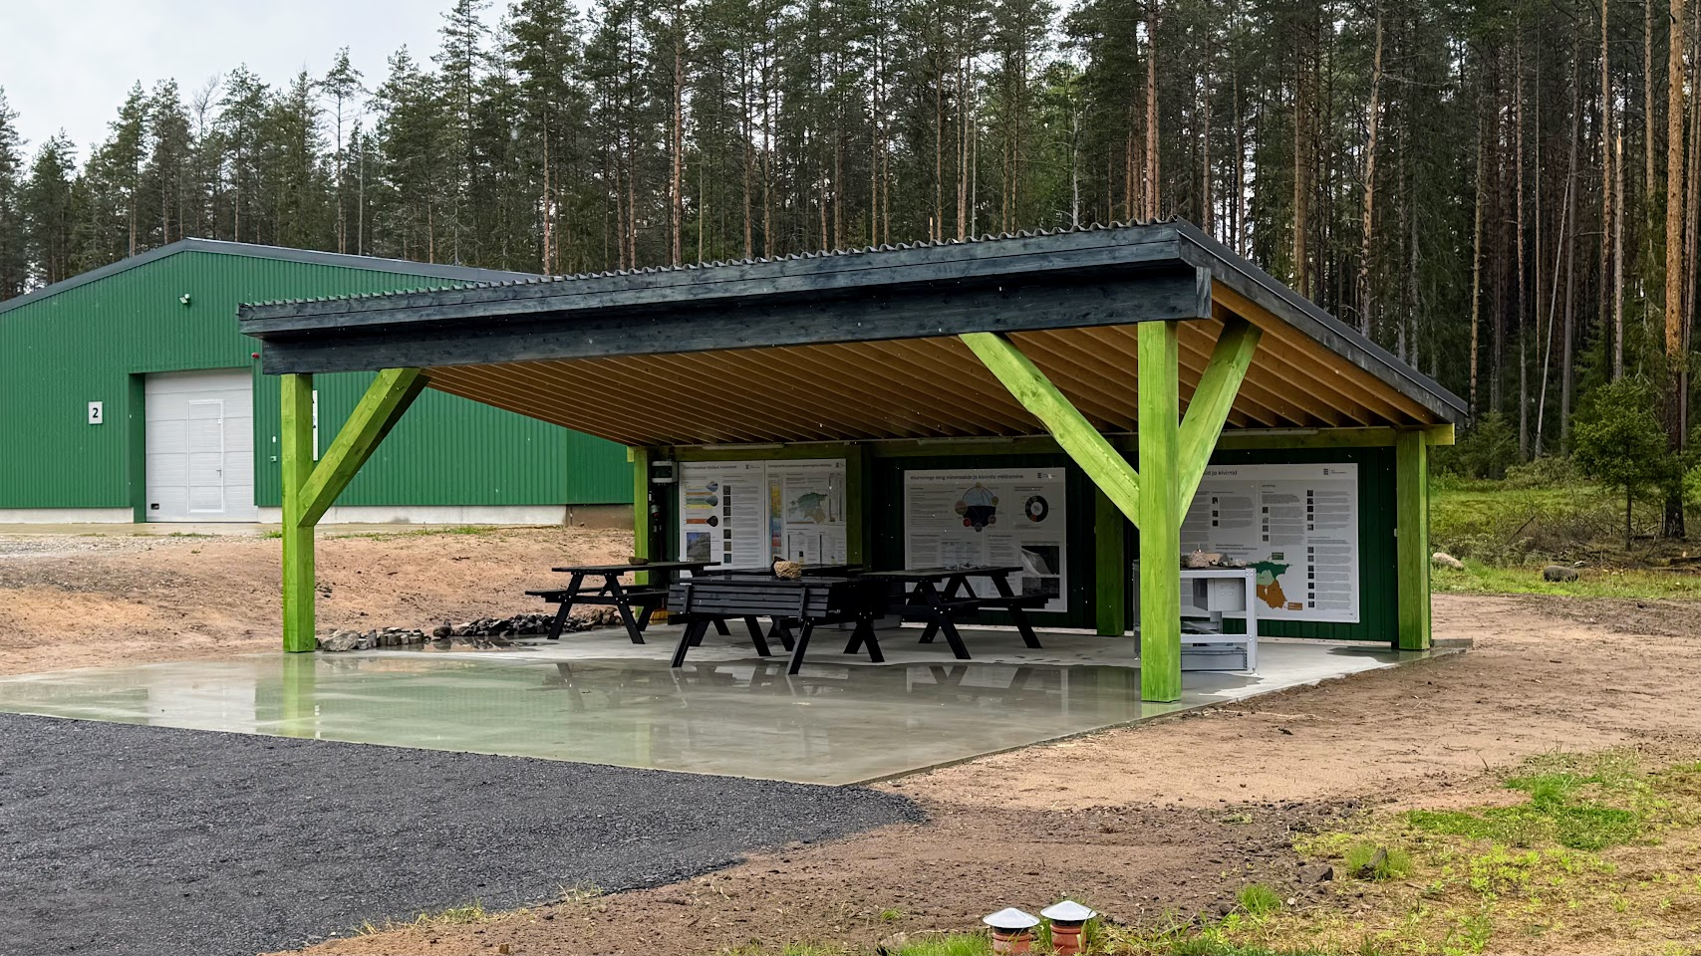
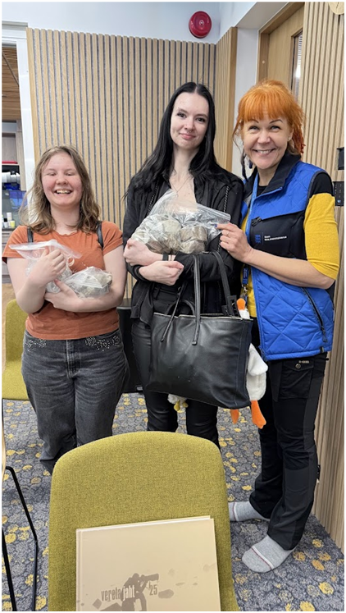
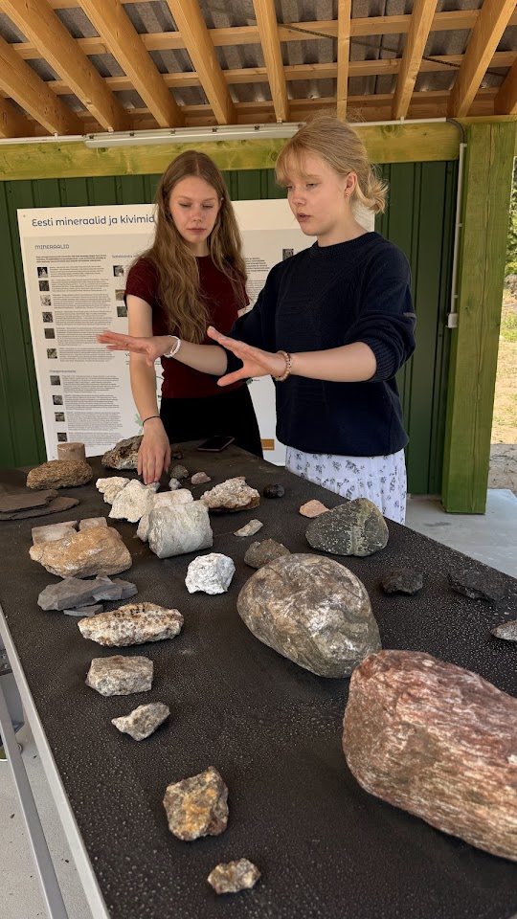
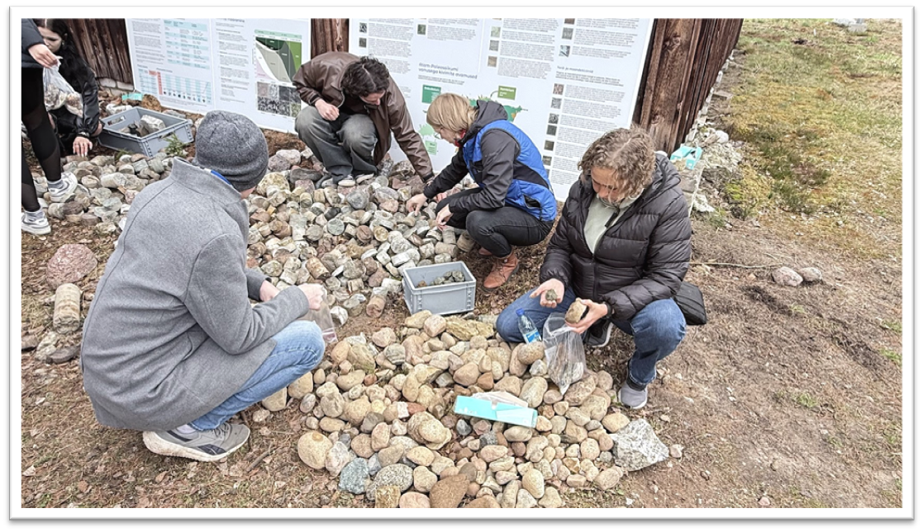
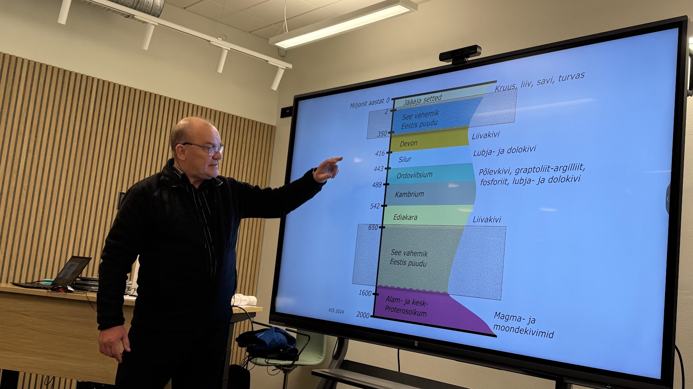
Rock lab
Rock pile

Slide 15
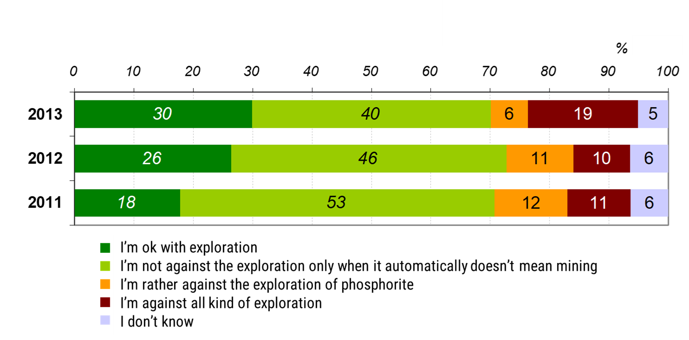
Effect …

Slide 16

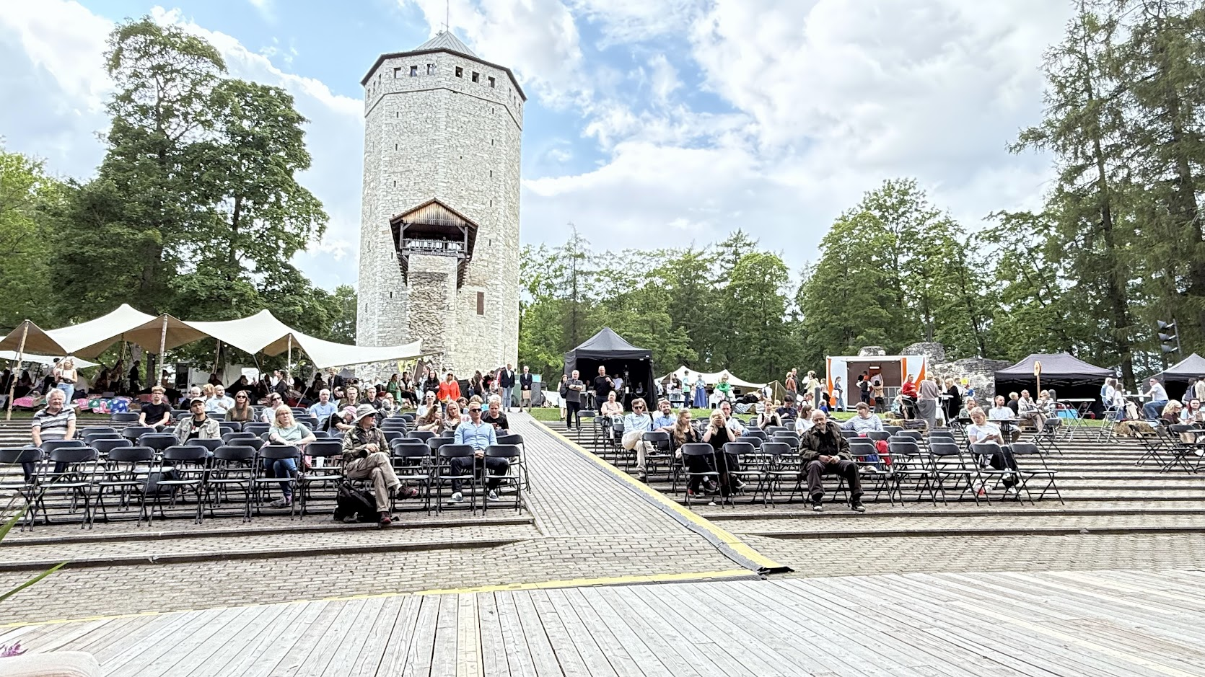
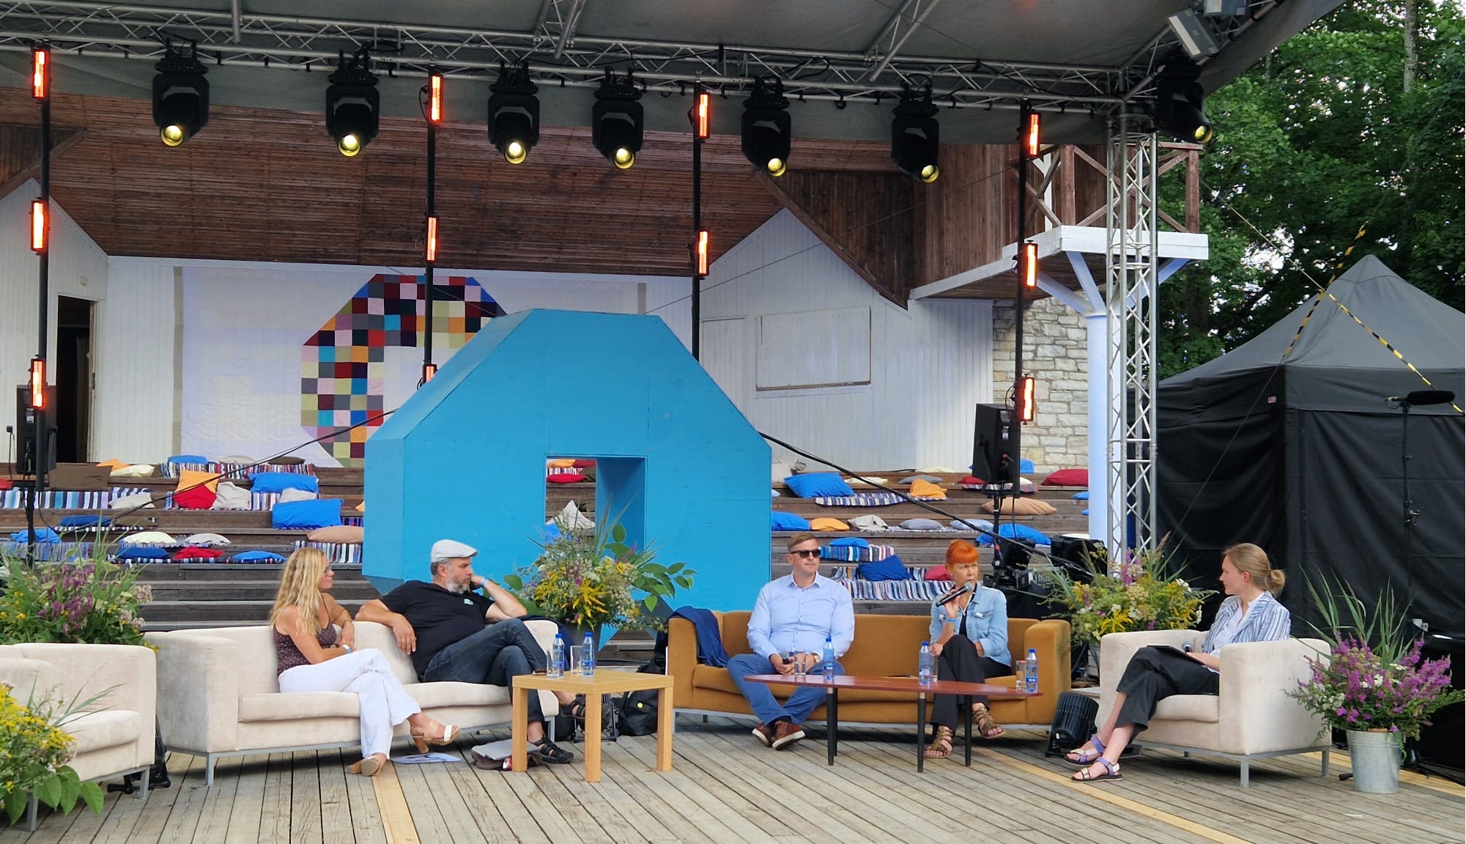
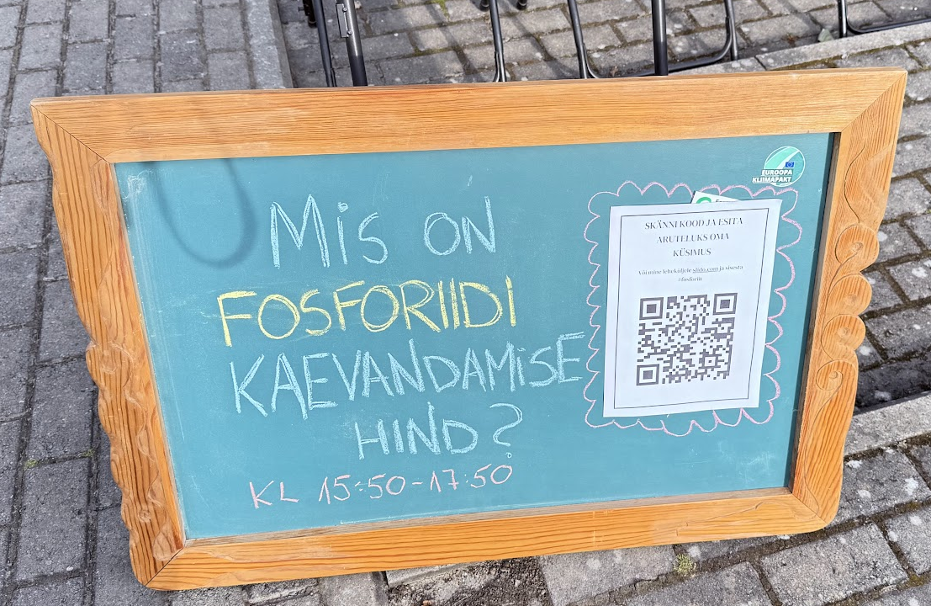

Slide 17

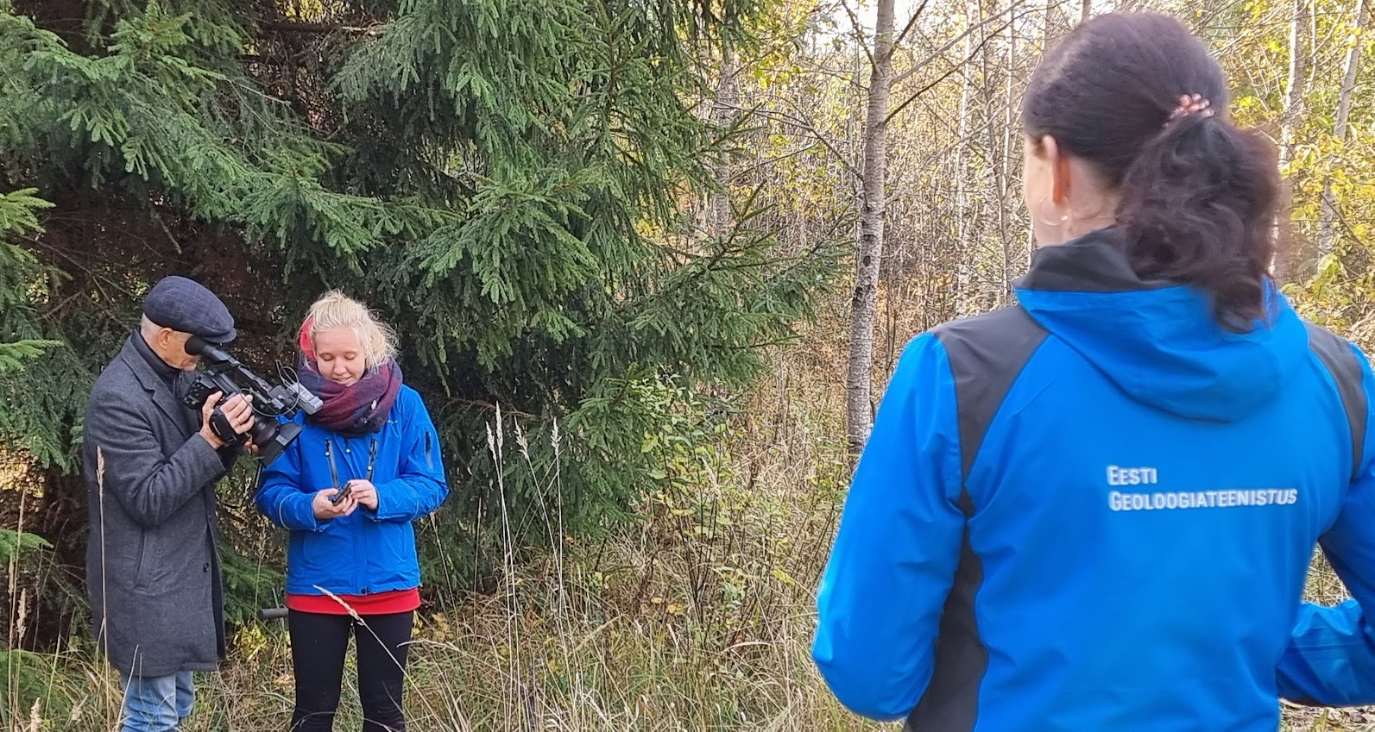
SLO based on raised knowledge
Sirli Sipp Kulli, director
sirli.sipp@egt.ee
+372 54 110 333

