Slide 1
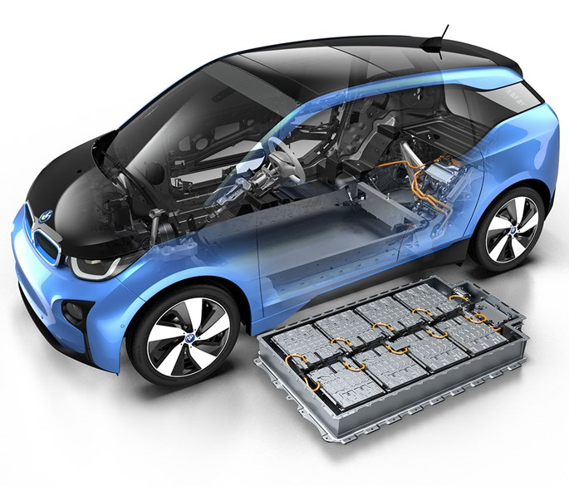
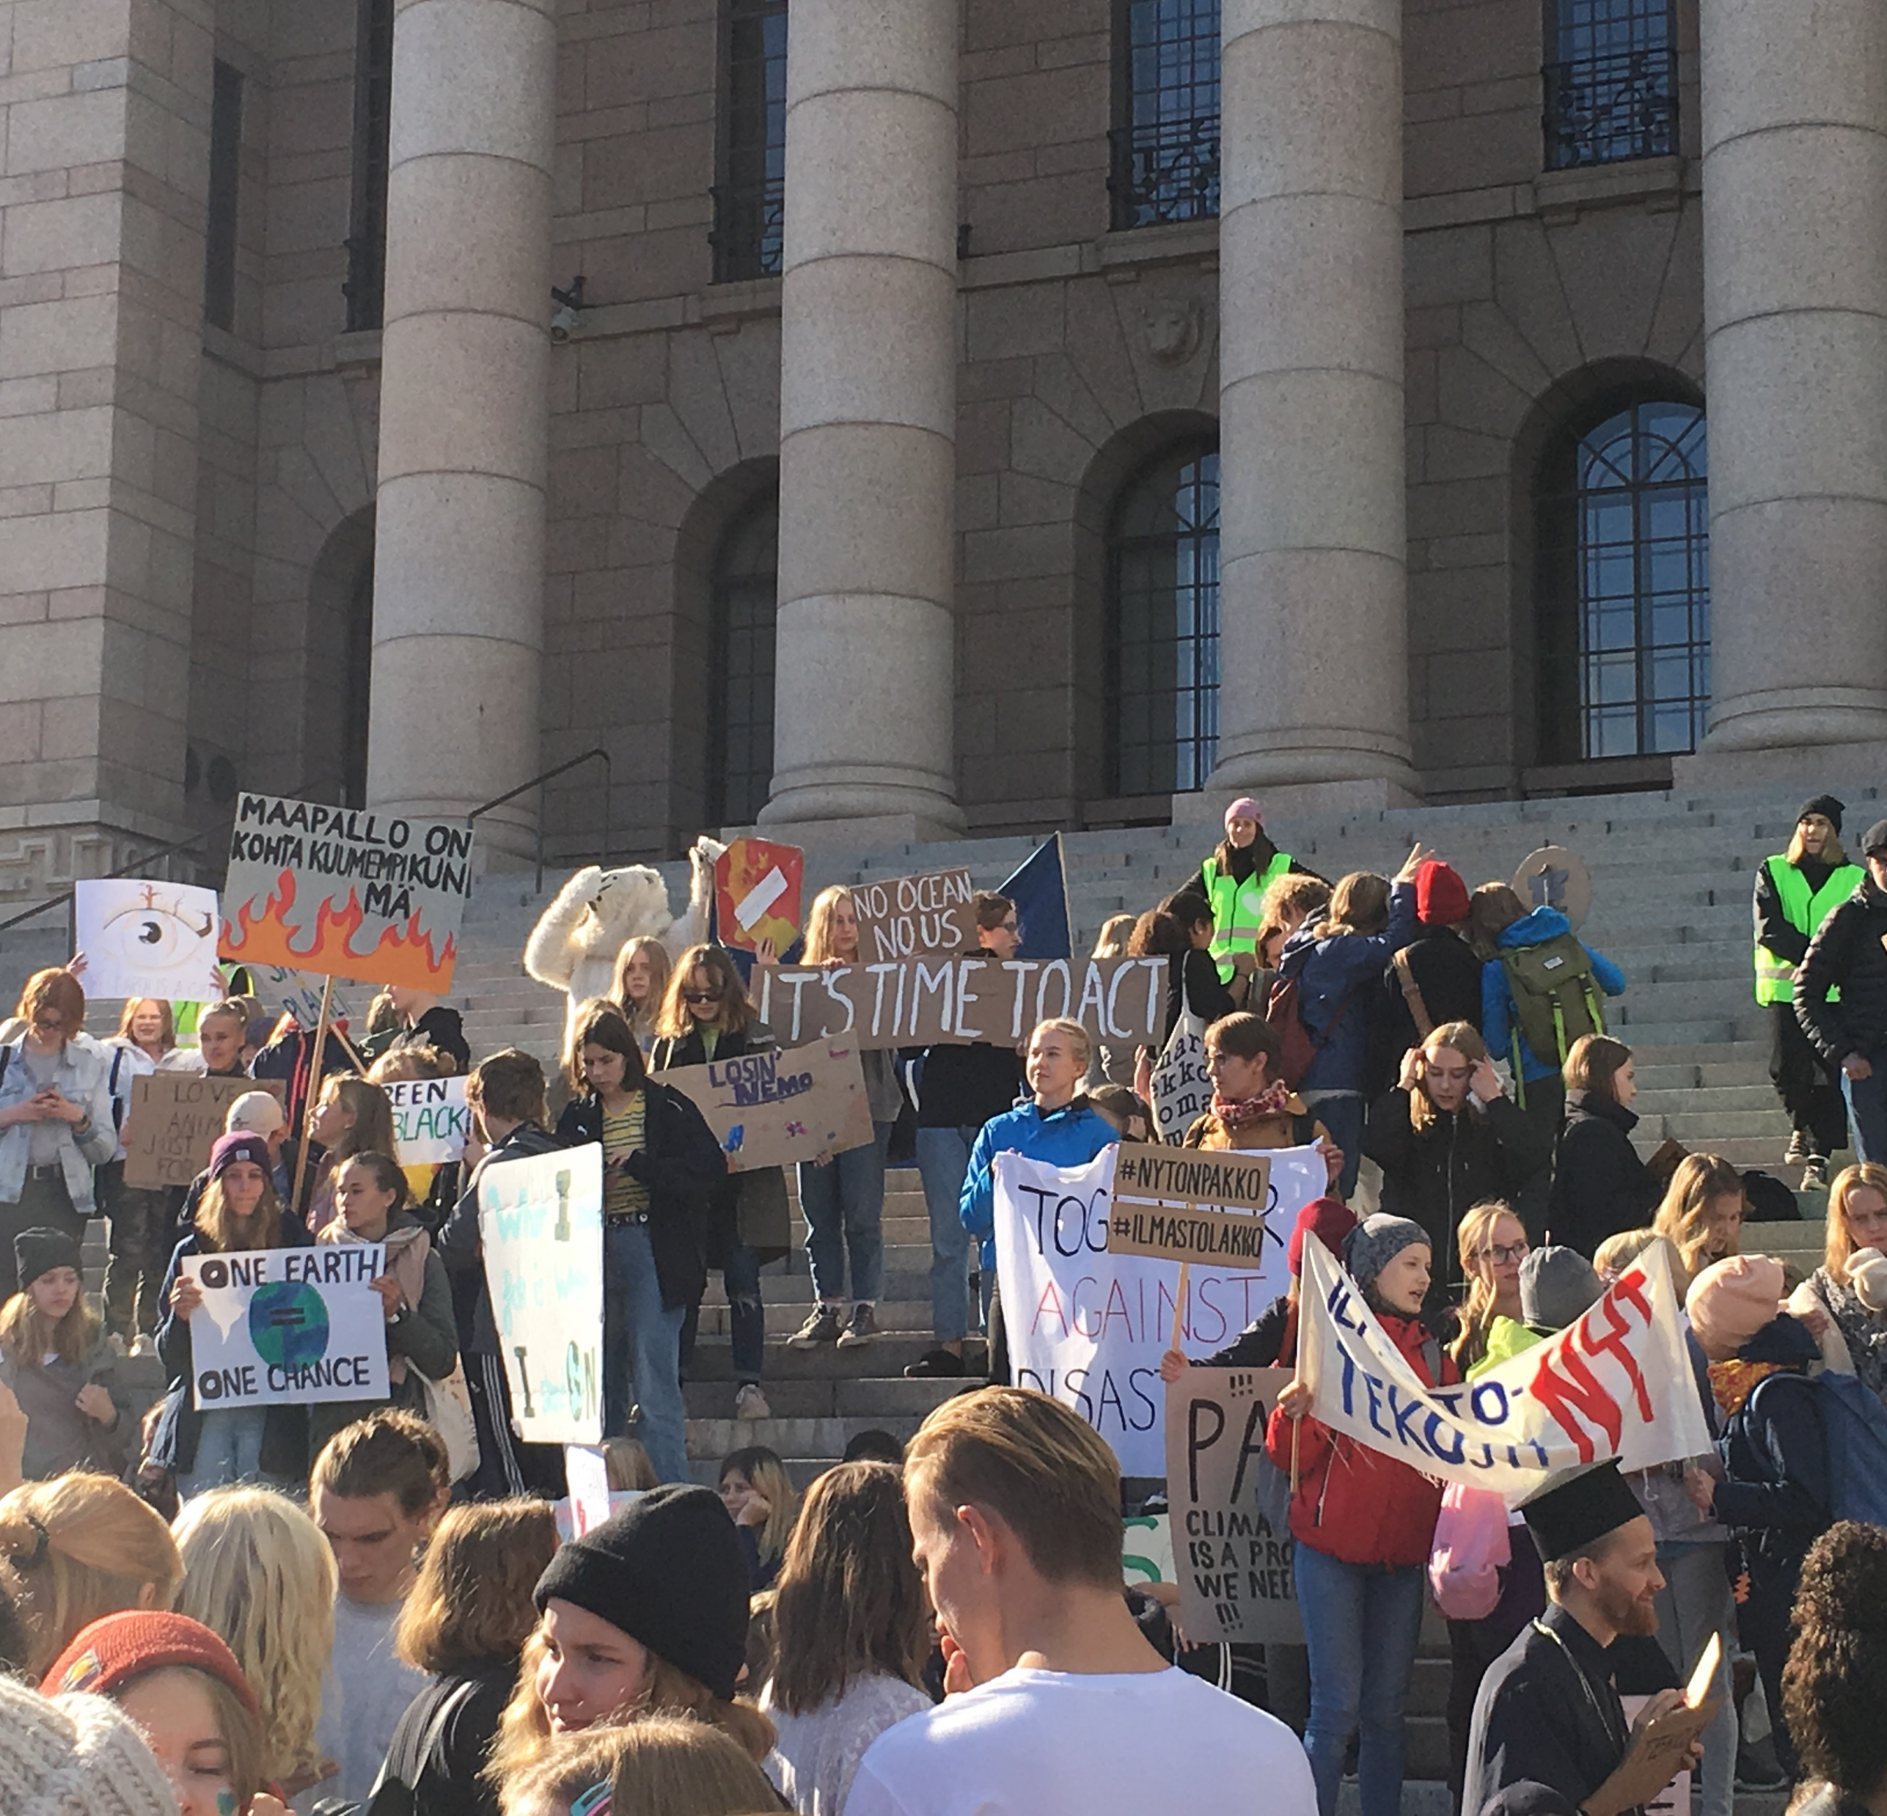
How the Urgency Can Influence the Acceptance of EV Battery Industry Projects: Learnings to Critical Minerals Mining?
Rauno Sairinen, Juha M. Kotilainen,
Hanna Lehtimäki & Nuppu Mielonen
University of Eastern Finland / GOVERMAT –Project funded by Academy of Finland
16th September 2025 SLO Conference in Tallinn, EGT-TWINN

Slide 2
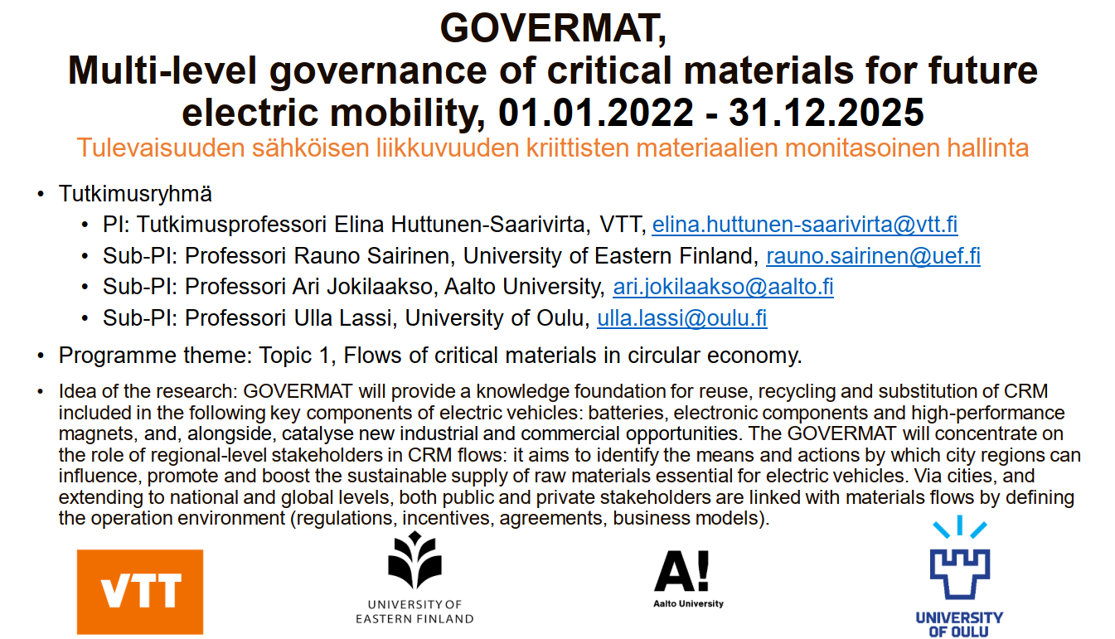

Slide 3
Focus
Urgency as a Driver for Action
Urgency is nowadays central to addressing global climate politics, green transition and green industrialization.
Urgency is also connected to recent geopolitical developments, security concerns as well as major economic opportunities for stagnating regions.
In Europe policy activities aim to accelerate green industries’ development to meet urgent resource needs, particularly for critical minerals and battery industries (e.g. CRMA Act / BATTERY Act) and to develop self-sufficiency and .
Focus of the GOVERMAT Study
Understanding how urgency influences multilevel governance (MLG) systems in the context of battery industry.

Slide 4
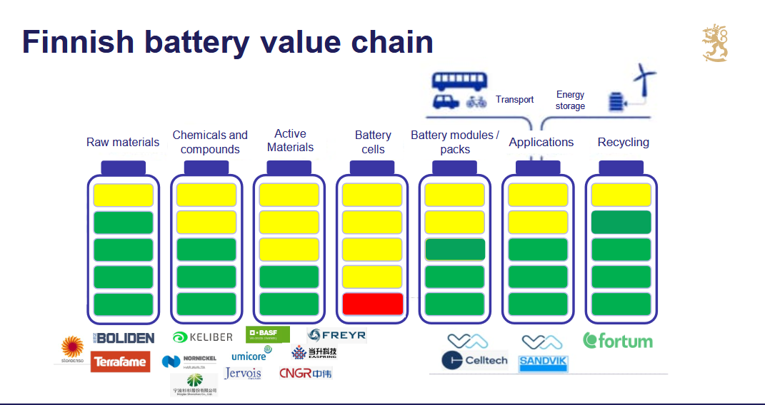


Slide 5
The Concept of Urgency in Governance
Urgency Defined
Urgency refers to an immediate need for action, often framed to trigger quick responses from policymakers (Cambridge Dictionary).
In the context of governance, urgency is not just an objective state but a narrative shaped by political actors and institutions (e.g., media, governments)
Implications of Urgency
Under “politics of urgency” it can be easier to push for certain decisions (necessary), as the sense of urgency leads to more readiness for change;
Can also bypass deliberation and formal processes, resulting in “fast policy” that may lack democratic input.
May amplify power imbalances and escalate societal tensions.

Slide 6
Multilevel Governance (MLG) of battery industry in the EU
A governance system where decision-making involves interaction between various levels: supranational (EU), national (government), regional (local governments, city regions).
Various policy levels should coordinate and support each others to achieve complex goals like green industrialization.

Slide 7
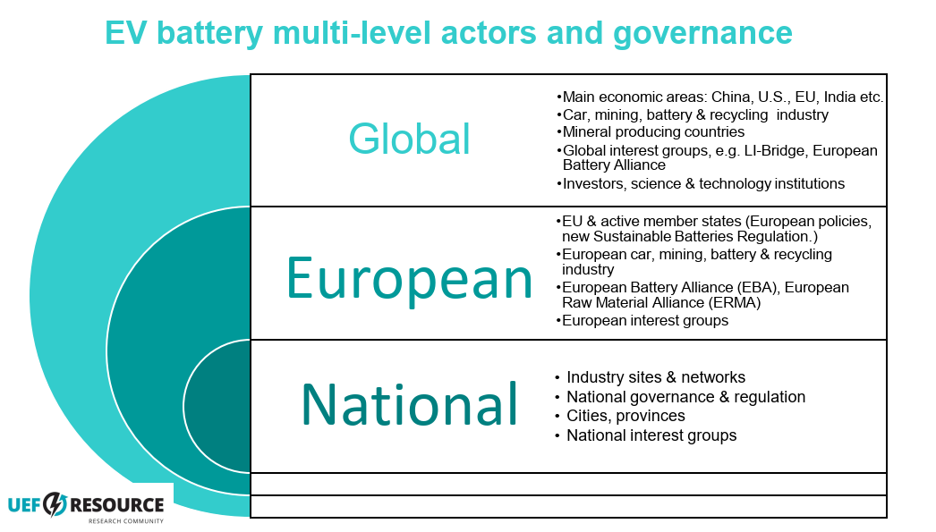
The role of GEOPOLITICS has been growing:
It is changing market conditions and actor relations!
And maybe the conditions for SLO?

Slide 8
Three-Dimensional Framework for Analyzing Urgency in MLG
1. Reinforcement of MLG under Urgency:
Key Question: How does urgency impact the alignment and interaction of governance tiers (supranational, national, regional)?
Impact: Urgency can either strengthen coordination or create fragmented, parallel efforts. It may lead to either intensified collaboration or uncoordinated decision-making

Slide 9
Three-Dimensional Framework for Analyzing Urgency in MLG
2. Power Dynamics in MLG under Urgency :
Key Question: How do power relations change when urgency drives governance action?
Impact: Urgency may empower central governments or large corporations (e.g., multinational mining companies), often sidelining local communities and smaller actors

Slide 10
Three-Dimensional Framework for Analyzing Urgency in MLG
3. Societal Tensions in MLG Related to Urgency:
Key Question: How does urgency intensify societal tensions?
Impact: Rapid, urgency-driven decisions often lead to trade-offs that generate conflicts or resistance from local communities, affecting social acceptance and legitimacy.

Slide 11
Urgency vs. SLO
It is important how urgency is being felt and experienced by the policymakers and the public in the local level, because its emotional weight – fear, anxiety and hope – can mobilize or paralyze collective action (Anderson 2010).
Rapid ’green’ industrialization driven by urgency can increase local opposition and tensions, particularly where communities feel their social license to operate (SLO) is being undermined or from fears over environmental damage, loss of livelihoods, and insufficient consultation with local populations.

Slide 12
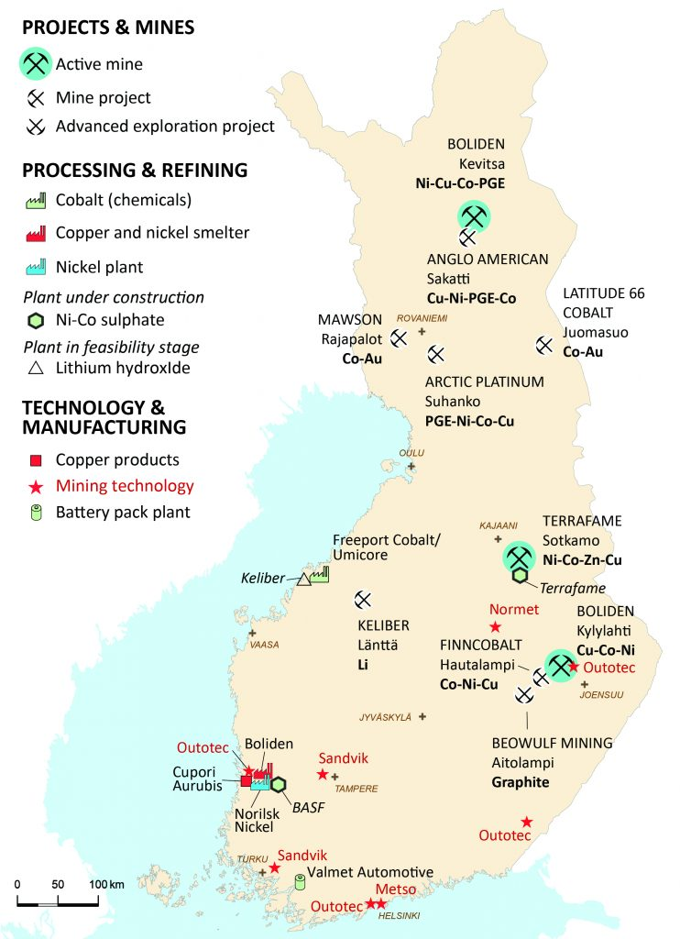
Overview of the Finnish battery ecosystem 2020:
Battery mineral deposits, projects and mines, processing plants, smelters and refineries, as well as mining technology centres (Dehaine et al 2020).
GOVERMAT case city regions:
Kokkola, Vaasa, Kotka-Hamina,
Pori-Harjavalta and Salo
https://eurogeologists.eu/dehaine-battery-minerals-from-finland-improving-the-supply-chain-for-the-eu-battery-industry-using-a-geometallurgical-approach/

Slide 13


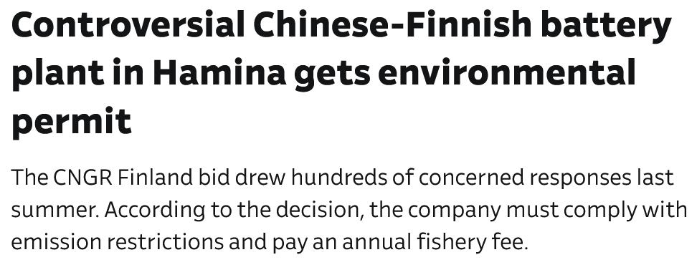
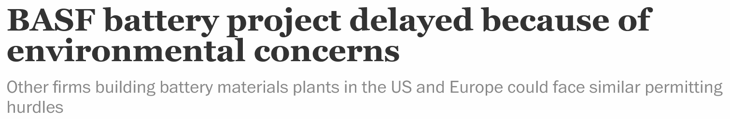


Regional eNGO: ”Voids all protection measures”

Slide 14
Results from Finland’s battery industry
Finland has tried to be fast and be among the first inventors and first movers in the battery industry in Europe: part of European urgencý
Some city regions in Finland have had a good opportunity for new industrial development: has required quick actions and national support.
The state has acted as an enabler of rapid development (strategies, organisatory solutions, regulatory development, R&D, streamlining environmental permits and planning systems). (BF & FMG)
Challenge: How well can a rapidly developing industry take care of environmental and social responsibilities and risks?
At the local level, concerns about water pollution / sulphite emissions from precursory production.
Industry complains the permit systems and court processes.
Last 2 years: Downturn in battery industry in Europe and Finland: reality check of the trend? Influence of Trump’s tariff and other politics will be seen…?

Slide 15
Conclusions
In the case of Finland’s battery industry, urgency has accelerated industrial development but also generated complex governance challenges and societal pushback.
We have not analysed mining in Finland from this perspective, but we would guess that the results are quite same kind.
Urgency has influenced need for streamlining the permit systems, fast-tracked development and shortening of assessment processes, which concerns many local people and NGOs and have most probably negative effect to SLO.
While urgency can open policy windows for fast-tracked industrial development, it can also risk undermining long-term sustainability goals and longer the project timescales through complaints.
The attitudes and practices between companies vary.
We need better understanding on how urgency shapes multilevel governance: helps policymakers, the industry and communities to navigate between speed, sustainability, local benefits, and public acceptance in green industrialization efforts.

Slide 16
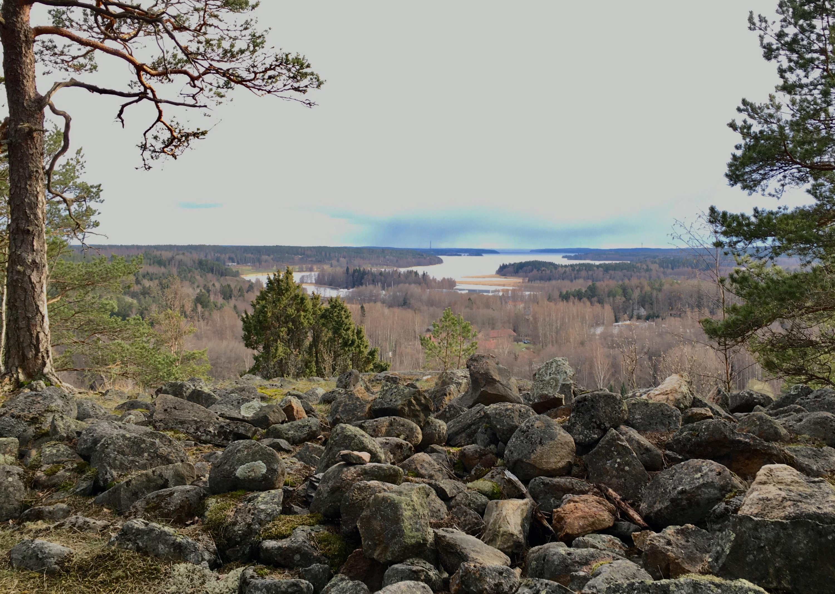
THANKS !

