Slide 1
Keeping the locals informed Practices, experiences and blunders from Geological Survey of Finland's bedrock projects
16.9.2025 Perttu Mikkola

Slide 2
Scope
Give brief into of guidelines Geological Survey of Finland follows in stakeholder engagements and share personal experiences in how things work or don’t work in Finland

Slide 3
GTK way
Each GTK project is nowadays more or less unique
=> guidelines are quite general and leave room for tailoring
Main points
recognize the appropriate stakeholders
be early (i.e. before you do anything in the field)
keep the message simple (use of layman terms)
repeat (each year or when phase changes)

Slide 4
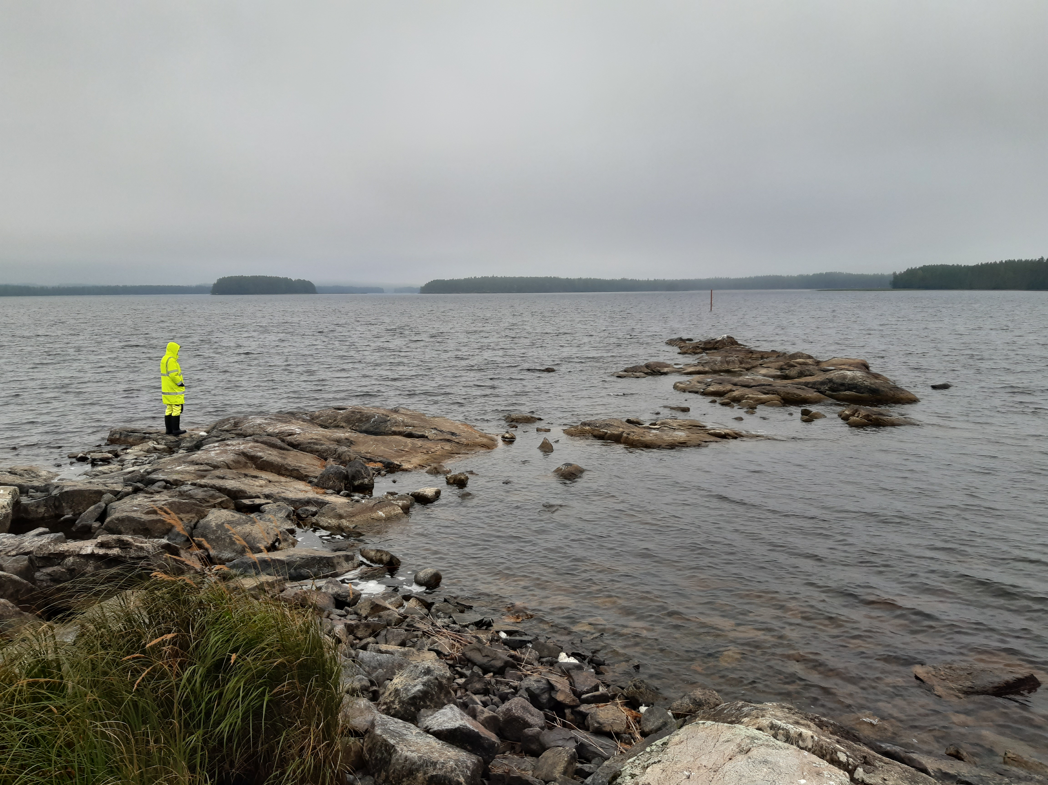
GTK level synchronisation
All notices about field activities systematically in one place
GTK level press release about target areas before start of field season
Public relations group provides help to individual projects

Slide 5
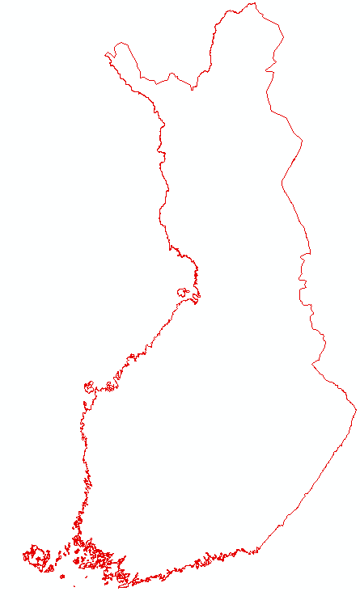
Possible stakeholder groups to take into account
Municipalities’ decision makers (policy makers and officials)
Some municipalities are pro-mining, some are antimining
Permanent residents (population in south and on west coast)
Summer residents (lake district in East Finland)
Reindeer herders (northern half)
National parks and nature reserves (northern half)
The Saami people (northernmost part)
Etc.
=> Each area has a unique combination of these
1200 km
500 km

Slide 6
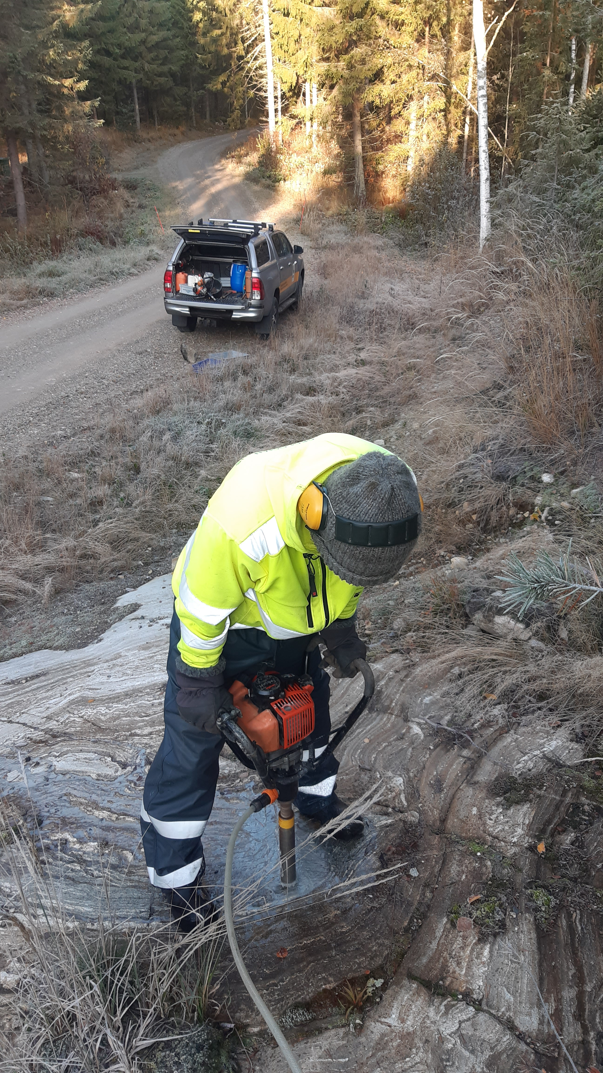
Permitting in Finland
Without expolaration license you can do ”minor” work
1 person can carry the instrument and the sample
But you have to inform the landowner before hand
In regional projects announcement in newspaper sufficient
Landowner can grant permission for ”anything”
Nowadays permits always asked in writing
BUT always worthwhile to call people and talk with them before postman arrives with the request letter

Slide 7
Open to all town hall meetings
Organised in any larger project
Repeated yearly in longer projects
In person, on-line or hybrid
Key points for presentation & discussion:
What is GTK, what & when will be done, where & why it is done, what is the environmental effect, what is the expected outcome, what are the possible outcomes, who can be contacted…..
AND DON’T FORGET TO TELL ABOUT THE GEOLOGY……..

Slide 8
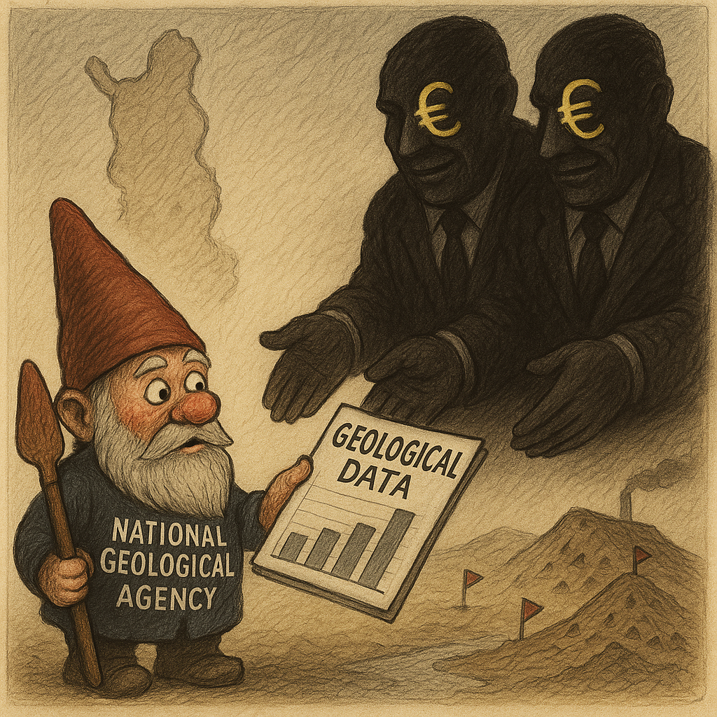
Challenges with GTK’s public image
GTK stopped all ore exploration 15 years ago, since then we’ve be doing ”ore potential evaluation”
Difference for ”normal” people vague
Many think that anything to do with bedrock is ore exploration and that bedrock data has no other use
Certain % of population see GTK simply as minion of the faceless international mining giants
Image by CoPilot

Slide 9
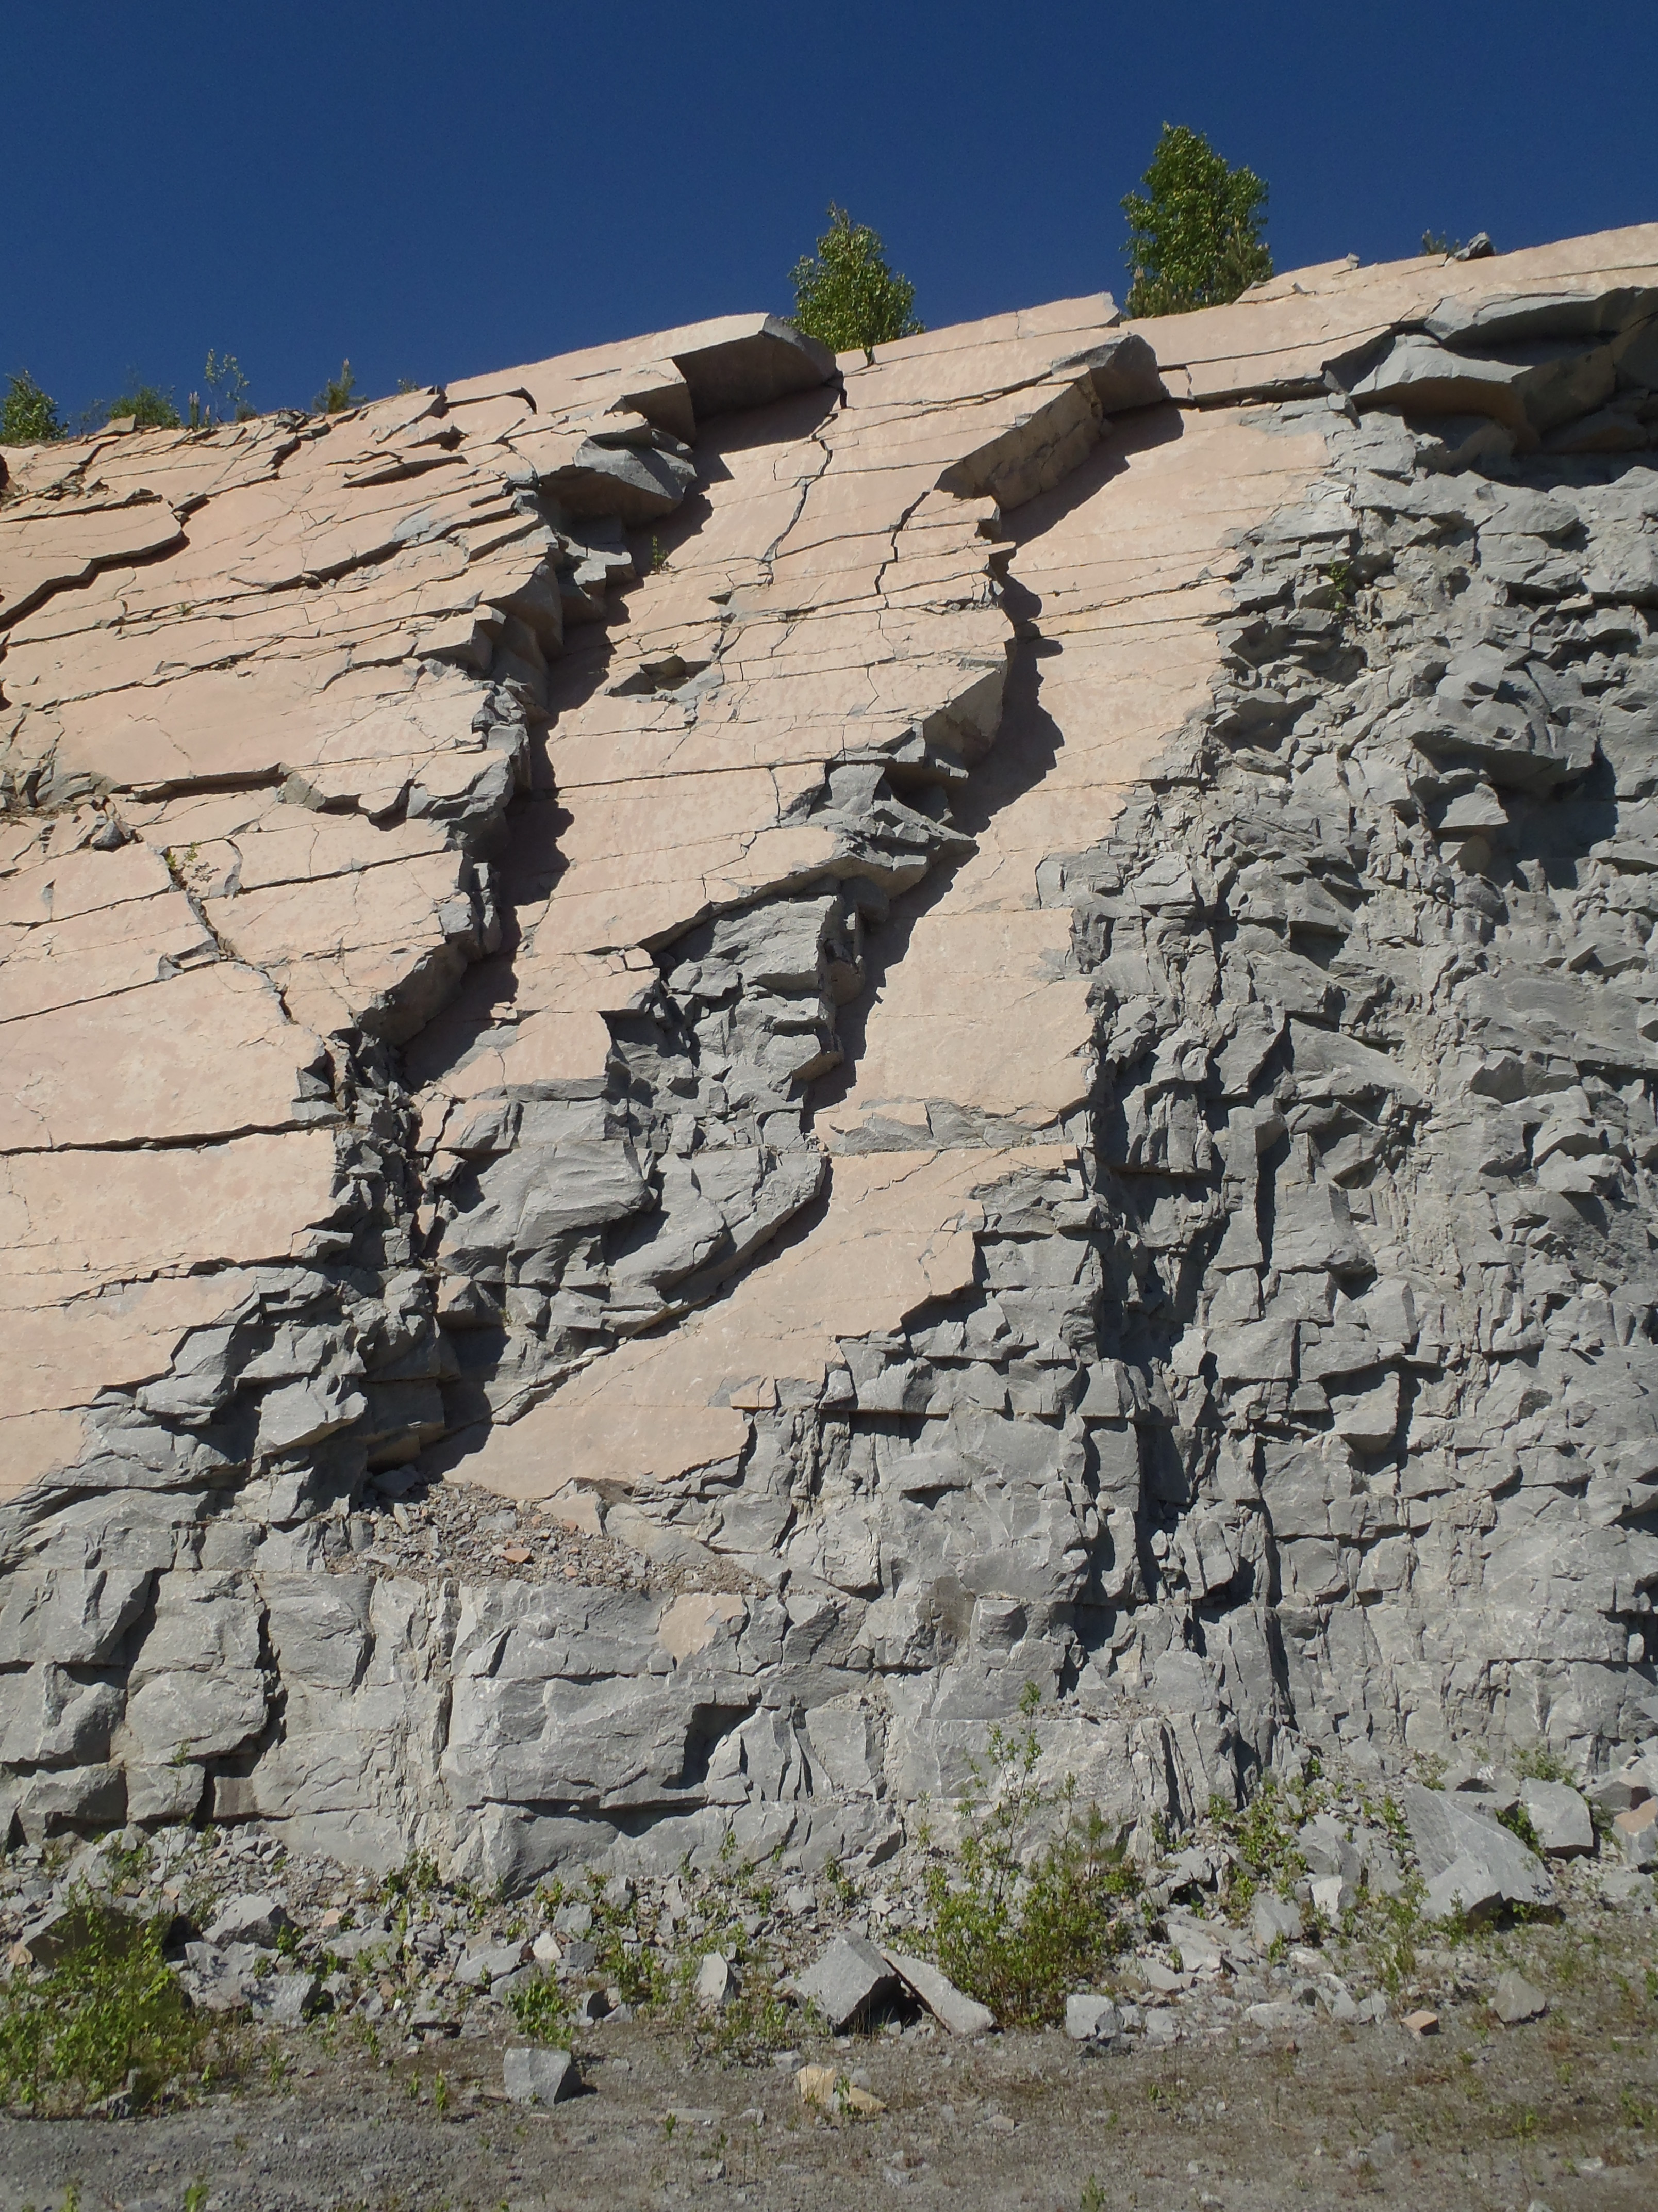
Trying to explain other uses of bedrock data
Active dissemination of information about other uses of geological data is one point we’ve trying to drive through…
Ground water quality
Correlates with bedrock, iron the most common problem, very local variation
Aggregate production
Good quality rocks locally scarce in Finland
Geothermal energy potential

Slide 10
People only read the headline
Town hall meeting in Central Finland for ore potential evaluation
No real ore indications in the region (very poorly studied)
Nice event, constructive discussion, good questions
One question: What do you regard as most likely ore type here?
=> Au (only one for which there were any indications)
Journalist made actually a very nice balanced article about the project
Editor-in-chief came up with headline:
GTK starts gold exploration in the area

Slide 11
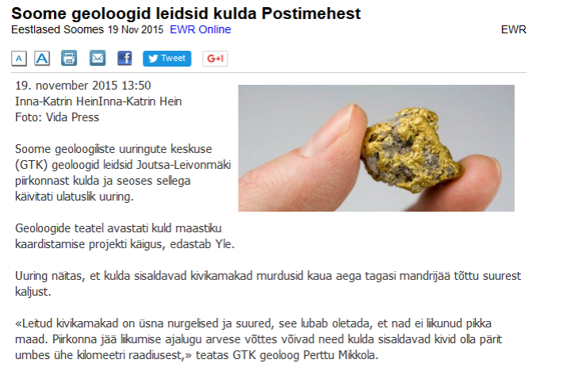
Only time my name made it to ”Postimees”
The whole 4 year project became in media labelled as gold exploration…..
(But in fact it was the only metal there really are indications in the area)

Slide 12
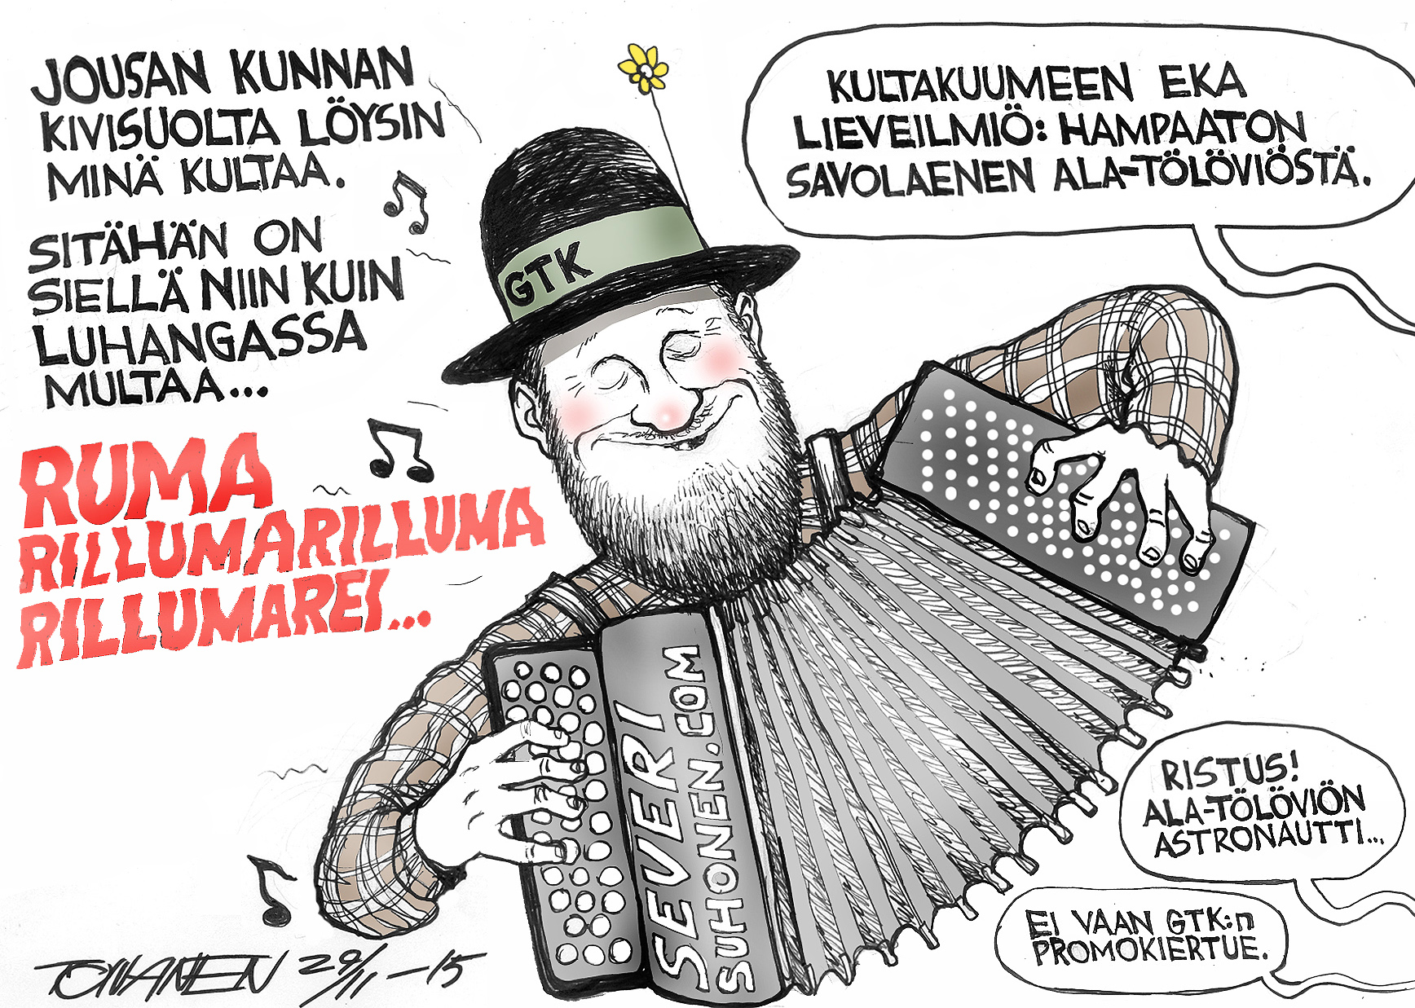

Slide 13
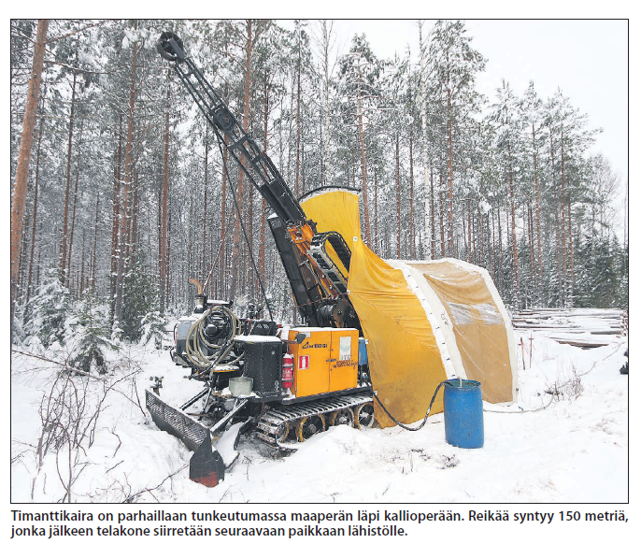
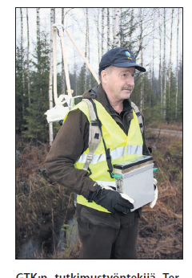
But still your best buddy is the journalist
Finland has plenitude of local small newspapers
Read in homes, at the service stations, cafe’s etc.
Coverage you just cant get in any other way
Good relationship benefits both
You get to spread the word he/she gets articles that interest the readers so:
Invite the journalist for a mapping day in the field
To have a look at the drilling, geophysical survey or what ever

Slide 14
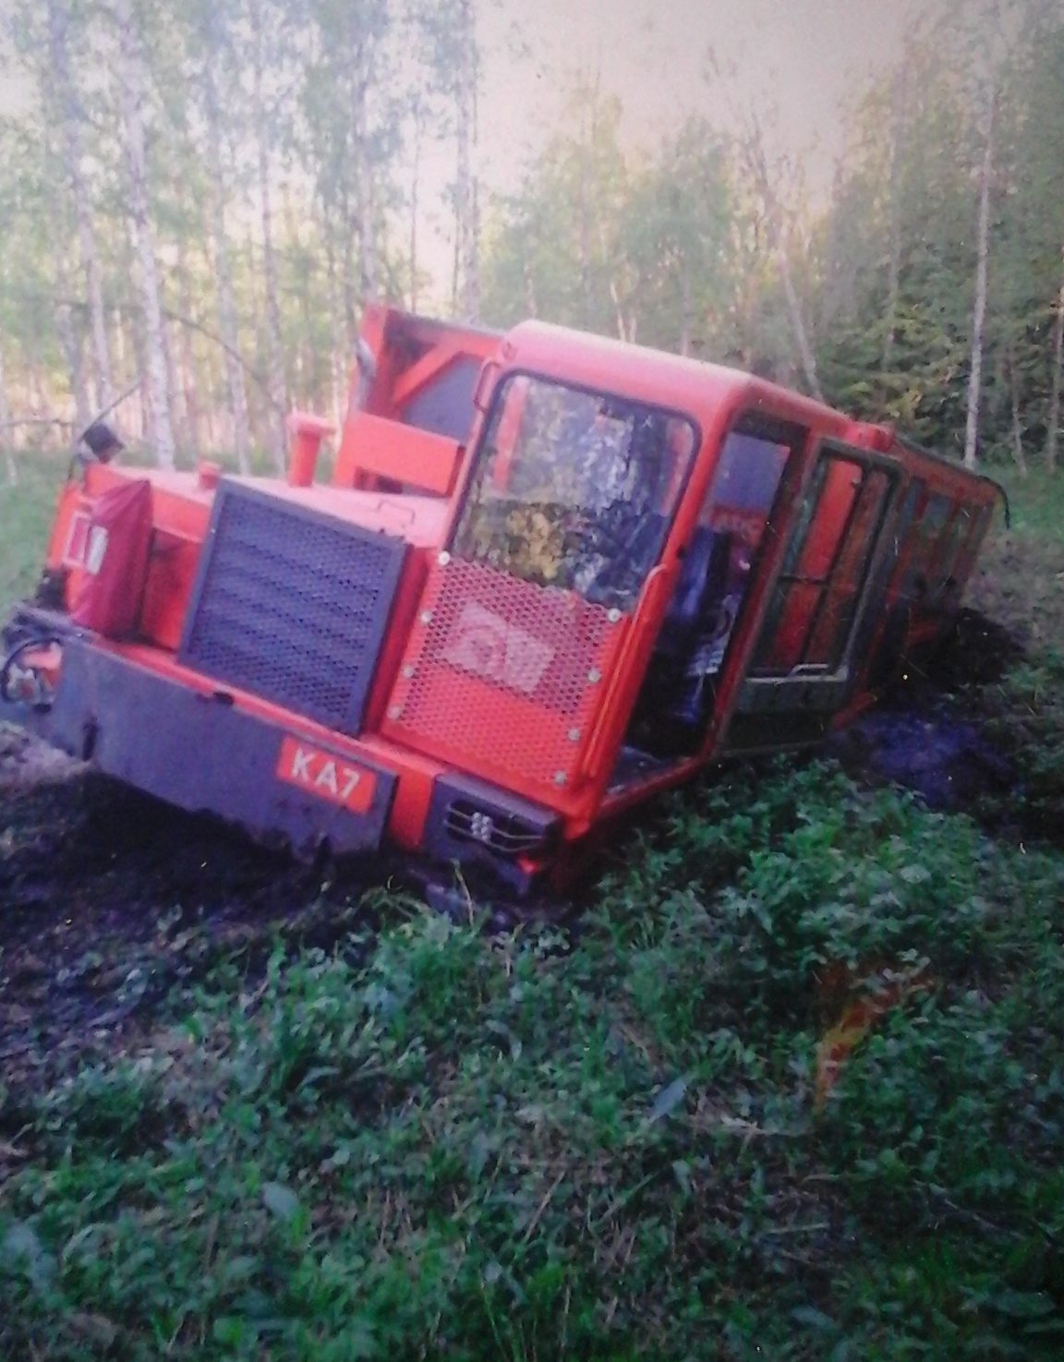
You can do everything right and still fail
Work: check few aeromagnetic anomalies to understand regional geology.
Ground geophysics => drilling => done
Email notice to stakeholders before surveys, before and after drilling
Delivery list included the local antimining NGO
Local newspaper made an article from each stage
NGO started in social media blaming GTK about secretiveness after the drilling was done and local newspaper had published the results

Slide 15
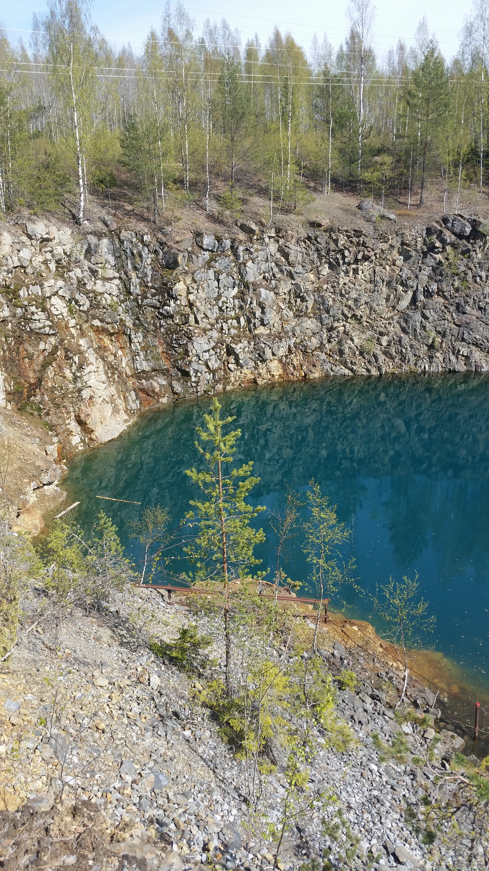
Summary
Stakeholder engagement is not rocket science, just use common sense
Act in time, before you do anything
Be understandable
Be respectful
Don’t deny the obvious, there ain’t such thing as ”green mining”

Slide 16
Perttu Mikkola
Geologist, Senior scientist
perttu.mikkola@gtk.fi
gtk.fi
THANK YOU!

