Slide 1


Community Development Agreements – a blueprint to reconcile minerals extraction and nature protection in Europe
Vitor Correia, W. Eberhard Falck / International Raw Materials Observatory
Nike Luodes, Hannu Panttila, Nikolas Ovaskainen, Toni Eerola / GTK
Jerry Barnes, Sybil Berne / MDB
Mauro Lucarini / ISPRA
Marzia Ceson / ALDA
Luis Rosendo / Generator
Ludwig Hermann / Proman Consulting
Julian Hilton , Malika Moussaid / Aleff Group
Sigurd Heiberg / Petronavitas
Ronald Arvidsson / SGU
Christian Marasmi/ Regione Emilia-Romagna

Slide 2
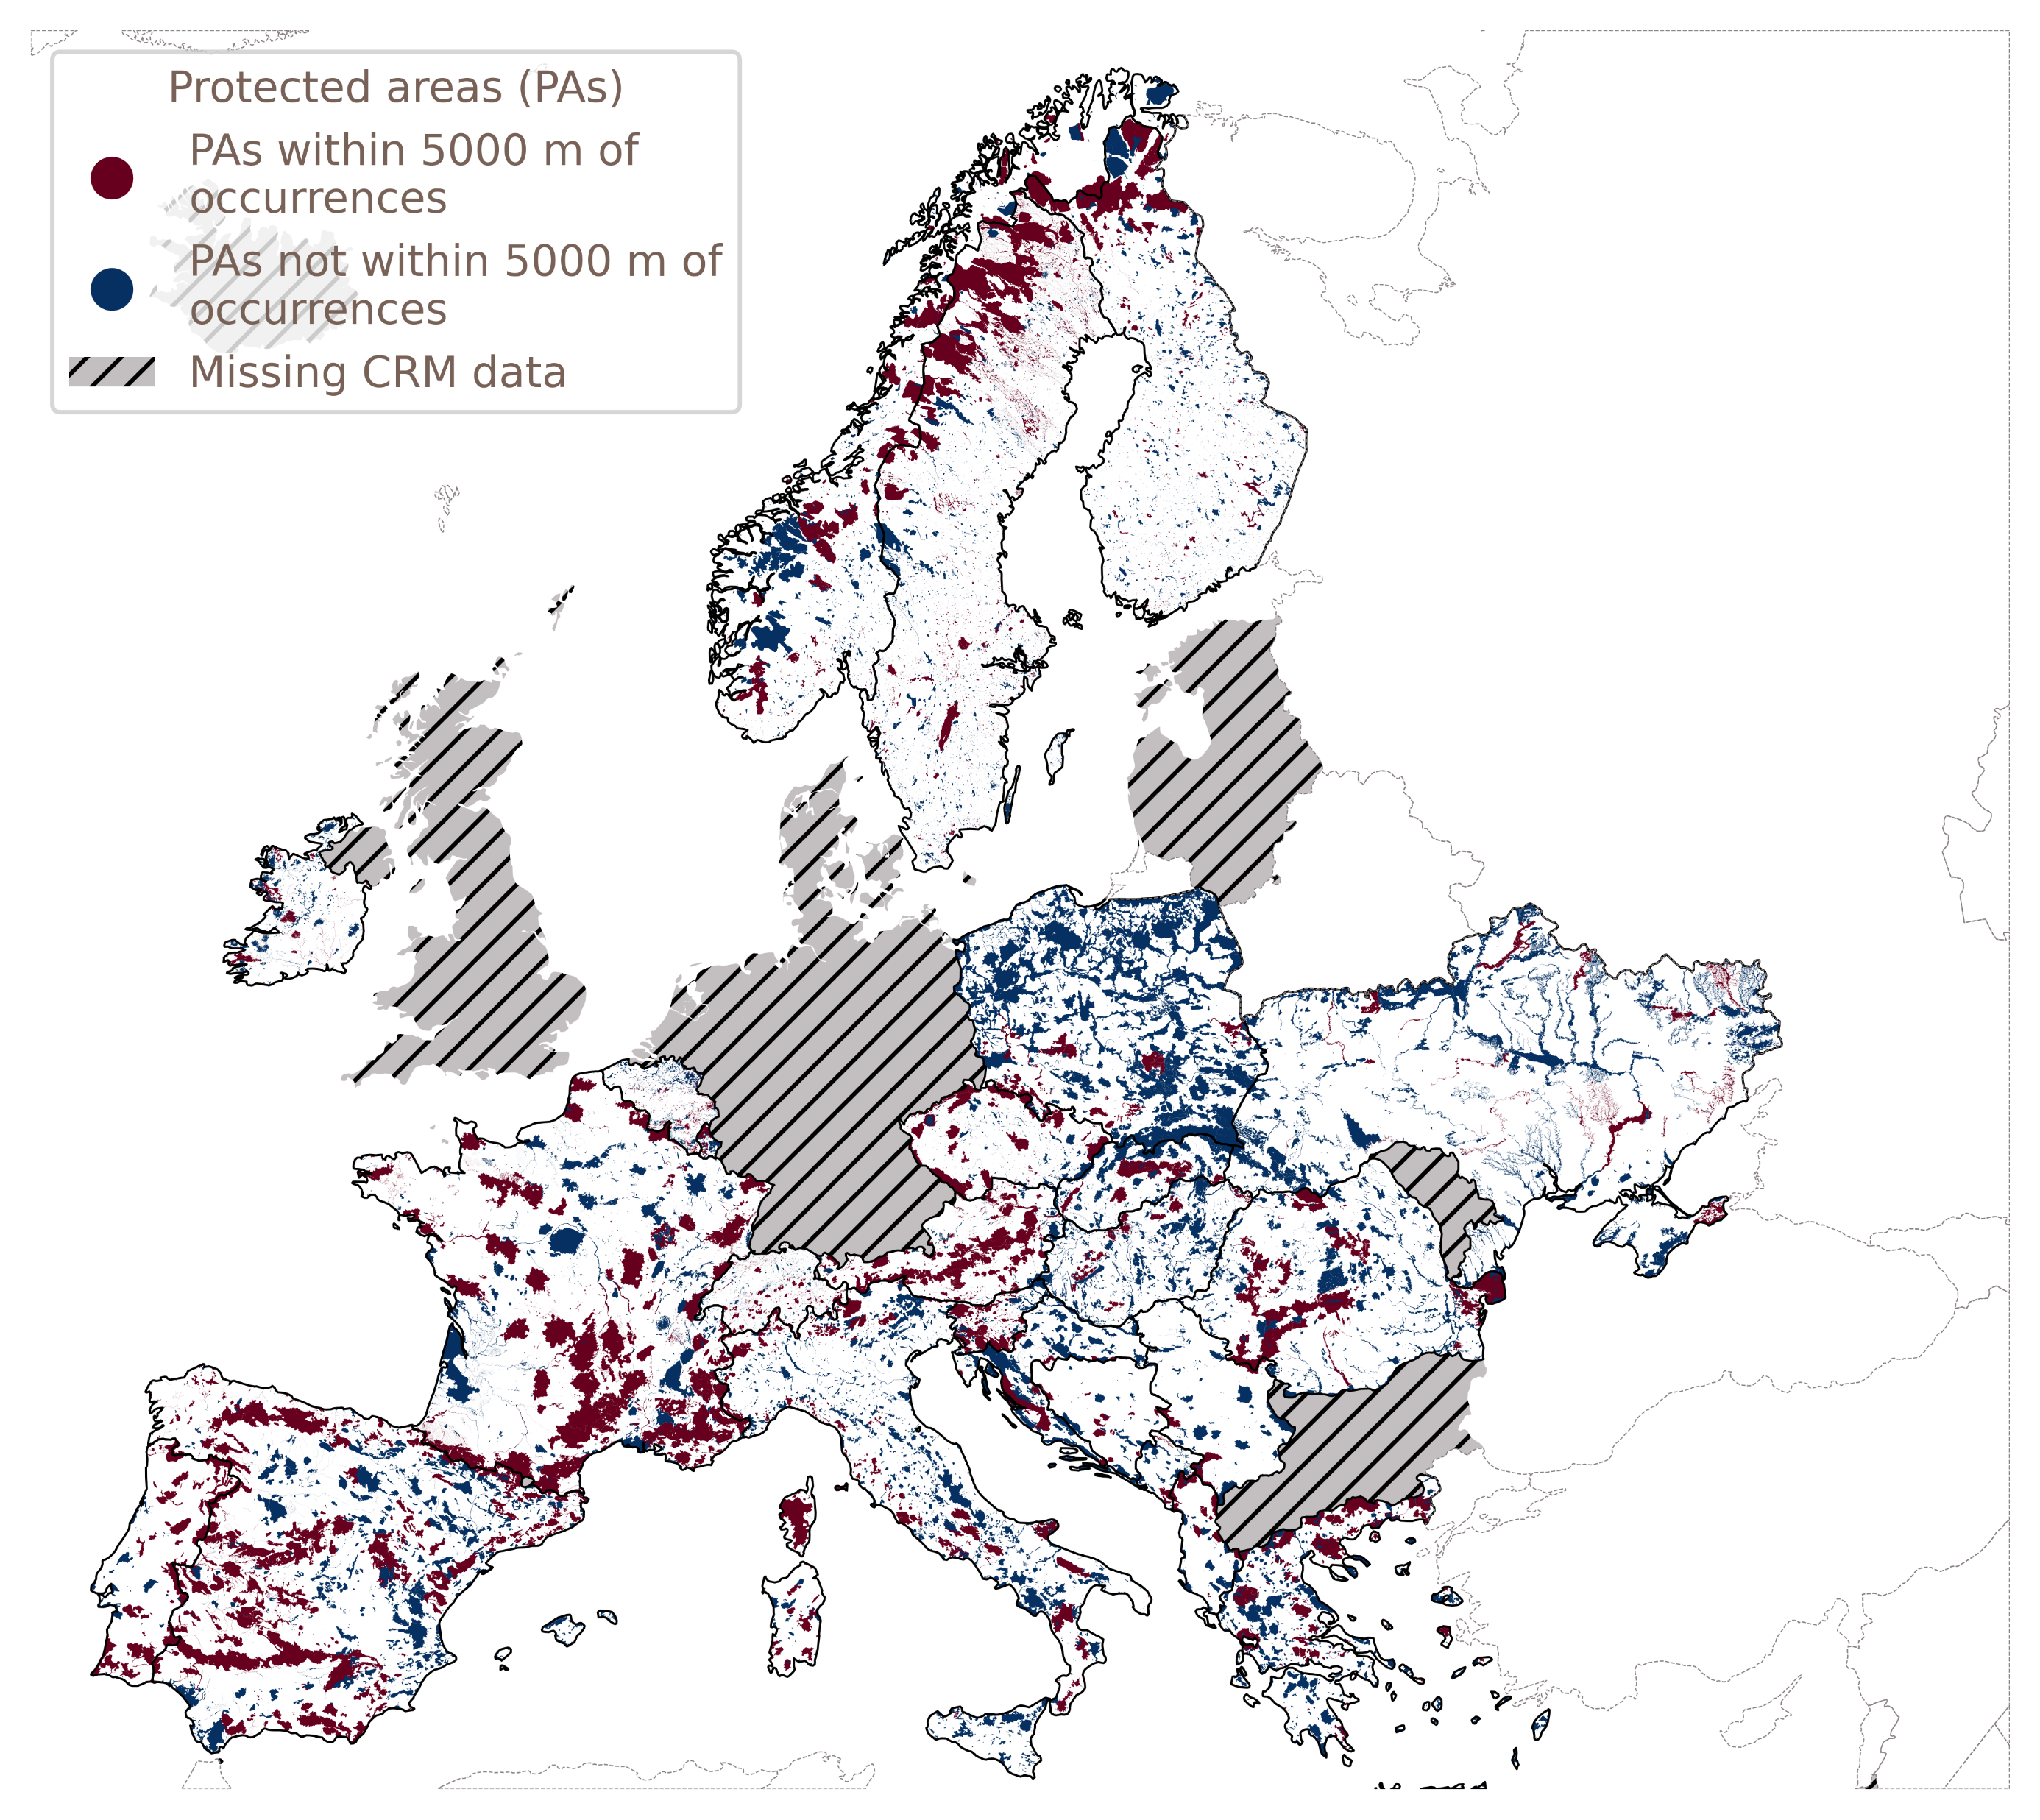
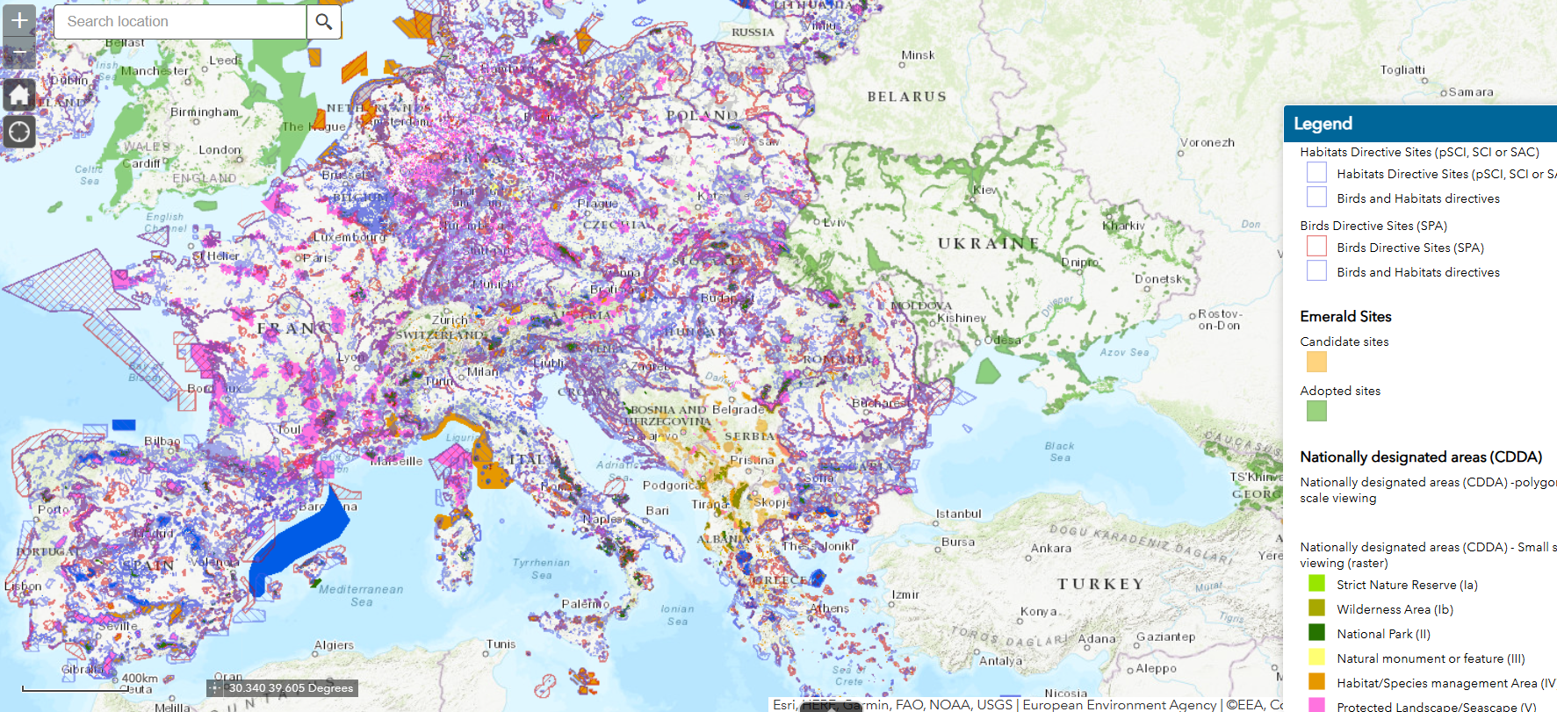

(2024 map provided by EEA).
Europe’s protected areas
85% of CRM deposits located within or less than 5km away from an environmental protected area
Notes:
85% of CRM deposits located within or less than 5km away from an environmental protected area (2024 map provided by EEA).
Add populated spaces and infrastructure, and we get an idea of the importance of this conflict.

Slide 3
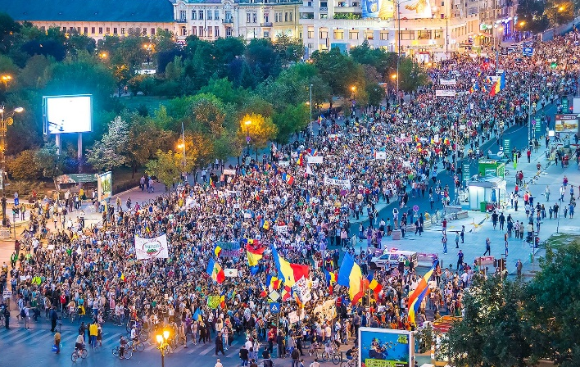
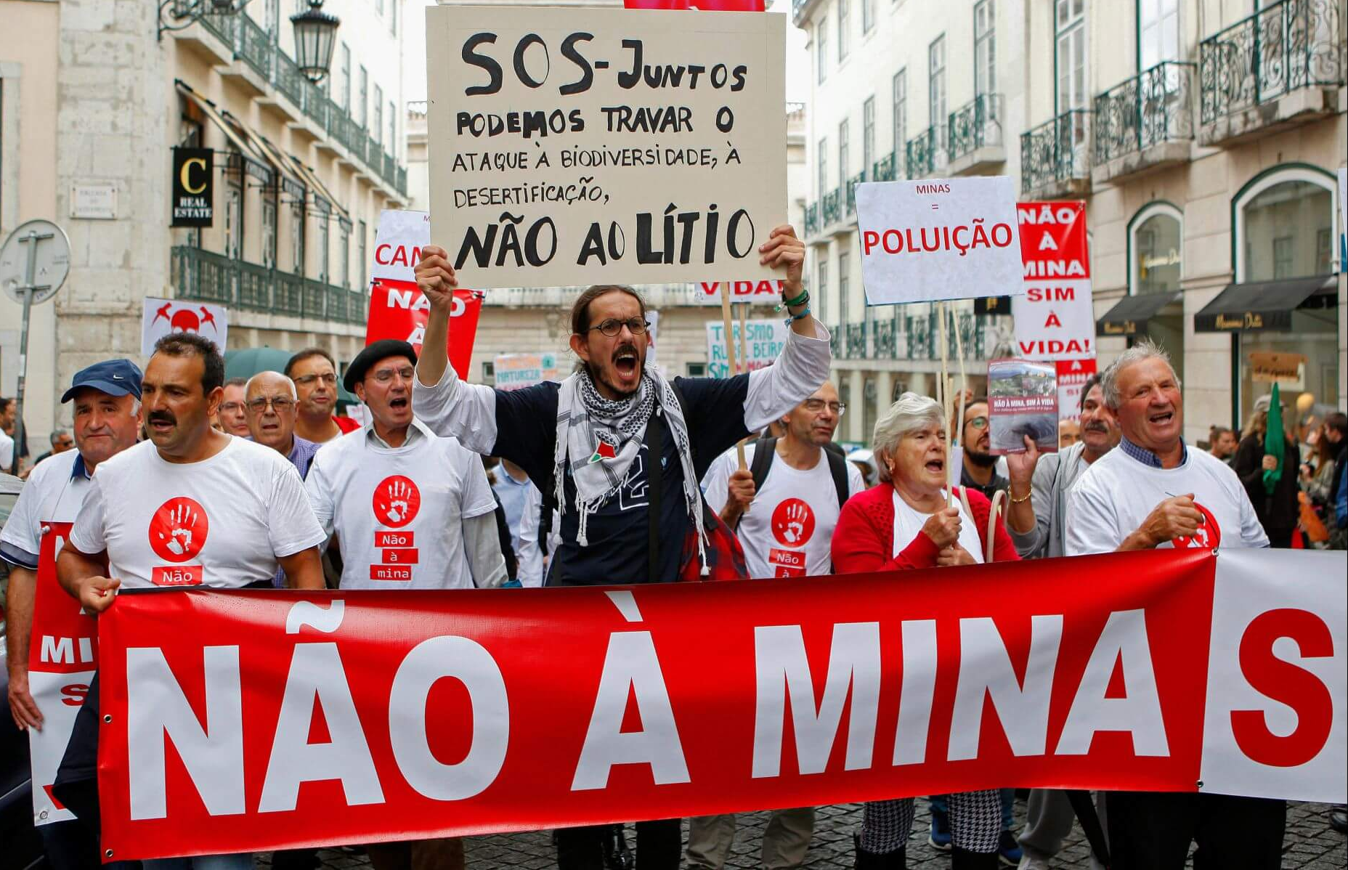
Strong public opposition to mining
Challenge the existing development model; against capitalism and extractivism
Disconnections between EU-level policies and local interests
The situation can easily escalate when trust in the government is low.
Notes:
Environmental groups often challenge the existing development model; they are against capitalism and extractivism, but not necessarily against mines (“if the mine belongs to the community, then it’s okay”) or defending the protection of natural ecosystems.
The situation can easily escalate when trust in the government is low.
The "green or greed" motto of environmental groups aims to highlight an ethical dilemma.

Slide 4
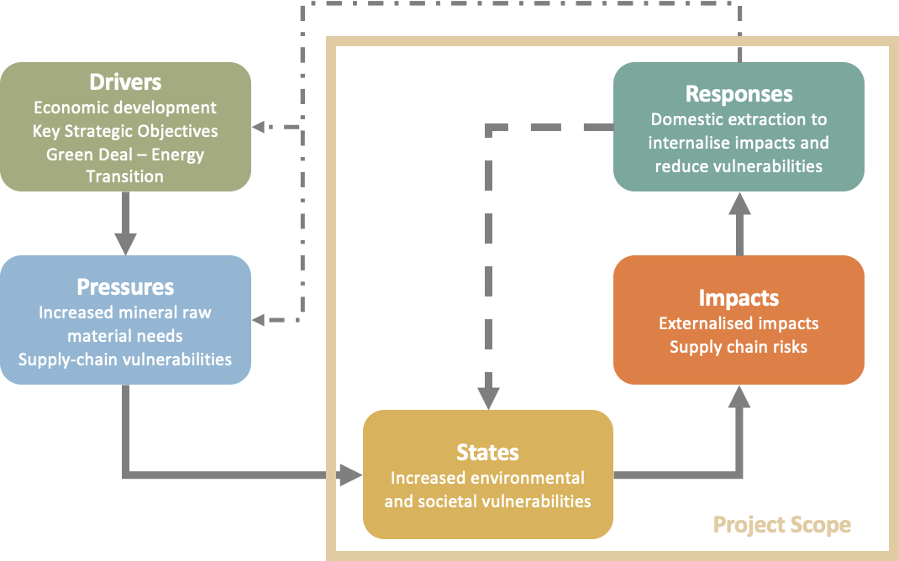
Consequences of decision-making
Systematic analyses of mining operations in proximity to protected areas across nine European countries, utilising the DPSIR
Notes:
When people understand the consequences of not having domestic mining, they show openness to mining projects.
Research conducted so far indicates that there are three main issues that must be addressed for a mine to be accepted in an environmentally protected area:
1) The mineral should be truly critical for society.
2) The negative environmental impact of the mine should be zero or minimal (BAT and advancements in robotics are enabling the underground exploitation of mineral deposits without any visible impacts on the surface)
3) The local community must receive a fair share of the benefits.

Slide 5
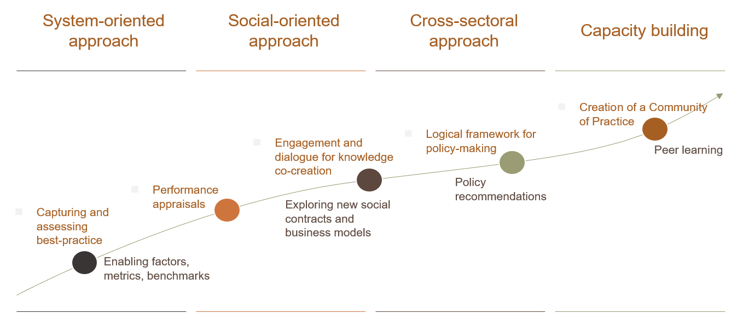
Methodology
Notes:
In case you have extra time and want to explain the overall approach.

Slide 6
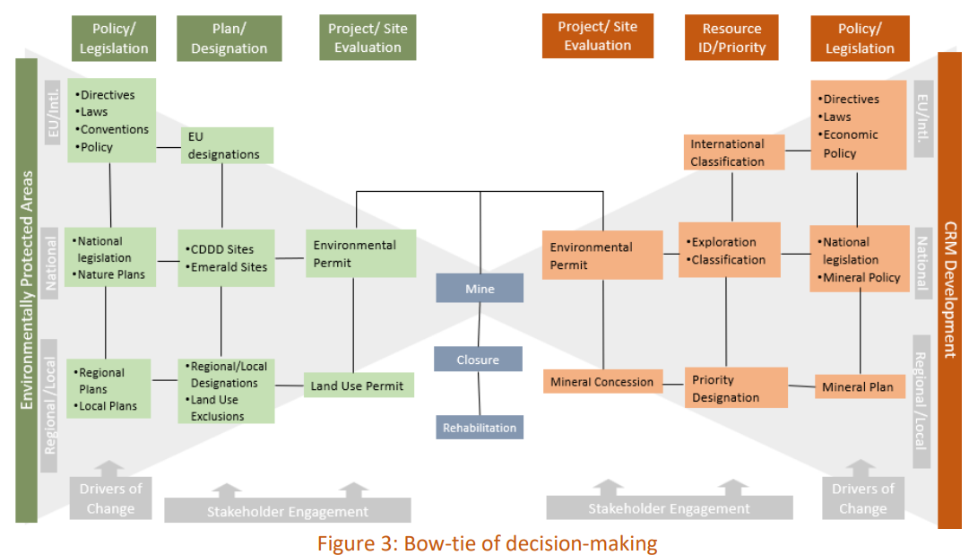
SUCCESSFUL CASES AND POLICY FRAMEWORK
Good practices from case studies
Mineral extraction feasible and socially acceptable across all studied cases
Comprehensive environmental impact assessments, effective stakeholder engagement, and robust post-mining planning.
Development of regulatory policies that strike a suitable balance between environmental protection and CRM extraction
Current regulatory frameworks do not categorically prohibit mining operations in protected zones, administrative impediments—notably understaffed agencies, politically motivated regulatory interpretations, and protracted permitting procedures—engender considerable delays.

Slide 7
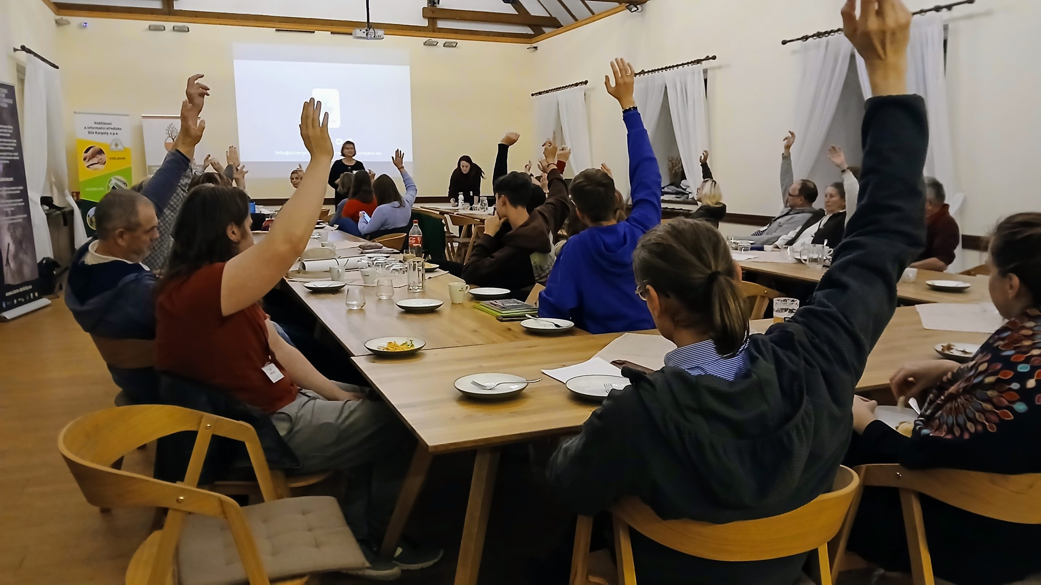
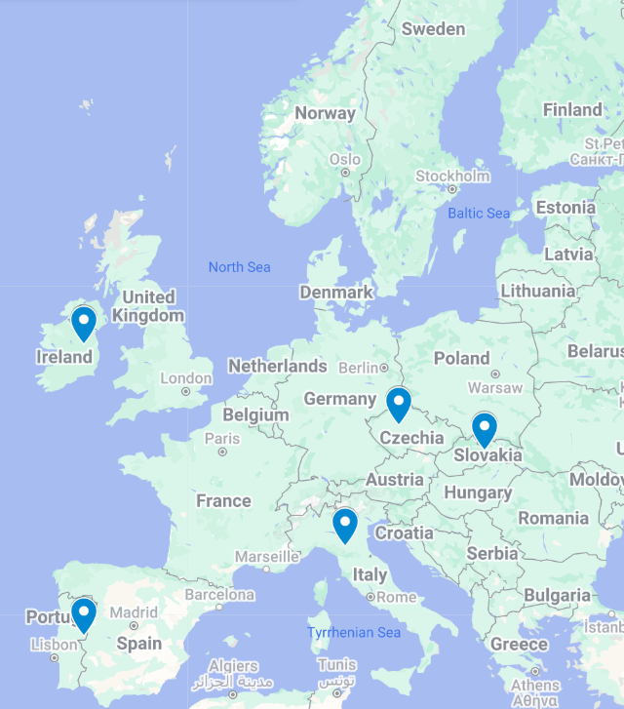
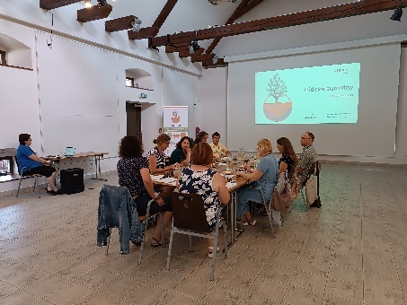
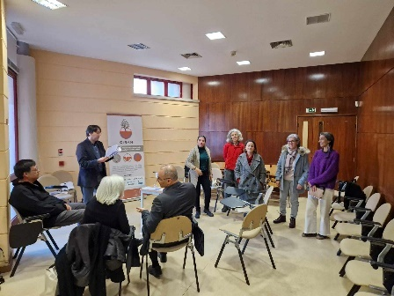
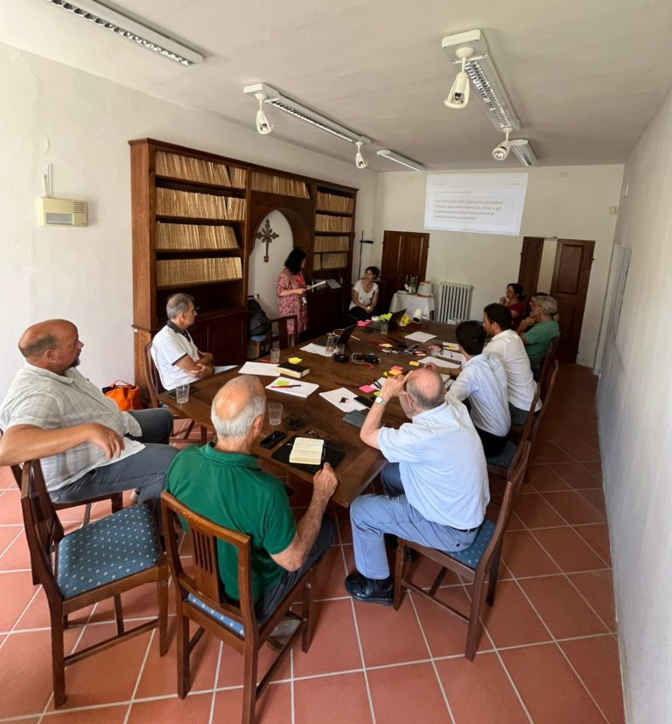
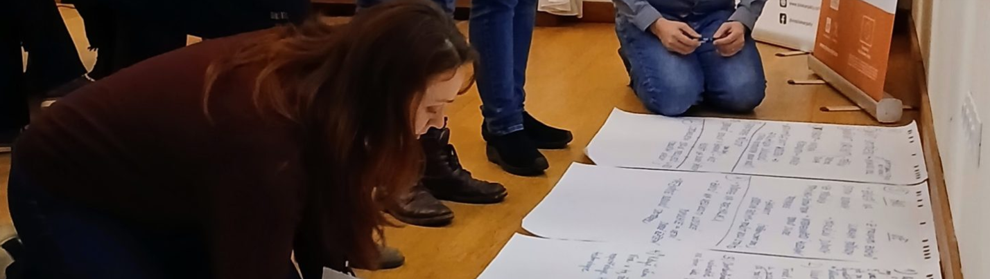
Understanding stakeholders
Notes:
Focus groups and public meetings in 5 different countries.
Communities living within or very close to environmentally protected areas.

Slide 8
Green or greed?
Politics
Local communities
Environmental groups
Mining companies
EU policies to defend EU vision, principles and governance model.
Enforce mining though new laws (CRMA) +
EU/EC/EP
Critical raw materials = sovereignty
Dealing with and neutralizing the actions of protest groups
Overriding public interest would solve a number of those issues.
Mining companies
National Governments
We have to support EU/EC/EP policies. This is a matter of sovereignty and security.
Extract raw materials as quickly and cheaply as possible
Following EU/EC/EP agenda
Get EU funds to support mining activities
Lobby to easing mining legislation
Tension zone
Legal opposition
Environmental groups
Local Governments
More legal, more aggressive.
Environmental impacts of mining are too great to justify the benefits
Defending local populations concerns & local economy
Electoral calculus drives support to local communities
Local communities
We have to support Environmental groups because they can help us to get our goals
Fear; health concerns; displacement / resettlement; disruption; local economy
More legal, more aggressive.In the capital and in Brussels they don’t understand our concerns.
Increase aggressiveness
Notes:
Lay people are often unaware of CRM; there is a complete disconnect between mining and the materials used daily.
Environmental groups find themselves trapped in contradictions: advocating for decarbonization while opposing mining, rejecting extractivism in the global south, and resisting domestic mining.
Politicians often exploit communities' fear of change for their own gain in the political arena.
Local governments generally lack support from central governments and often side with populations against mining projects.
Rural populations express disillusionment with the trajectory of Europe's development.
The distance of stakeholders from the planned mine site directly influences their degree of rejection or acceptance.

Slide 9
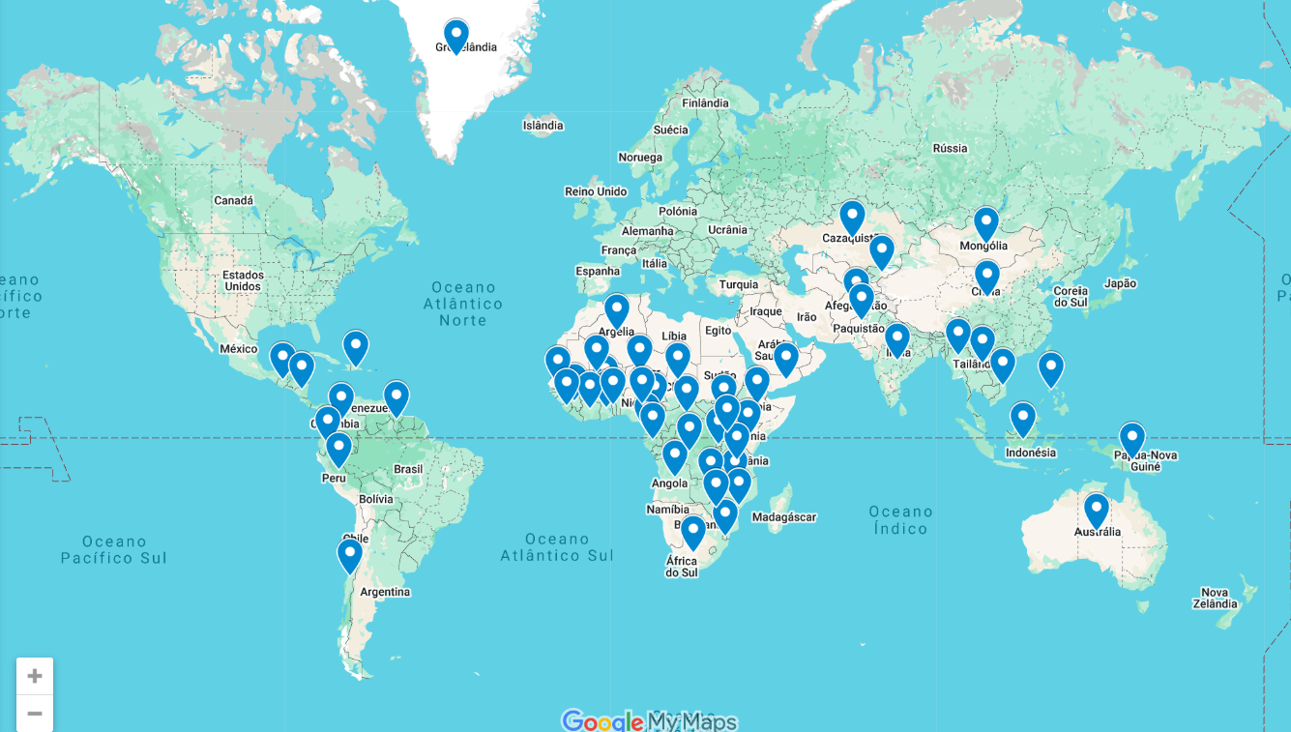
Community development agreements
Notes:
Community development agreements emerged as a tool to ensure that local communities benefit from mining activities and have a say in how these projects are managed.
The World Bank has been instrumental in developing and promoting CDAs. Their guidelines and frameworks help ensure that these agreements are comprehensive and effective.
CDAs are widely used in Africa, and help address social, economic, and environmental concerns, ensuring that communities receive tangible benefits from mining activities.

Slide 10
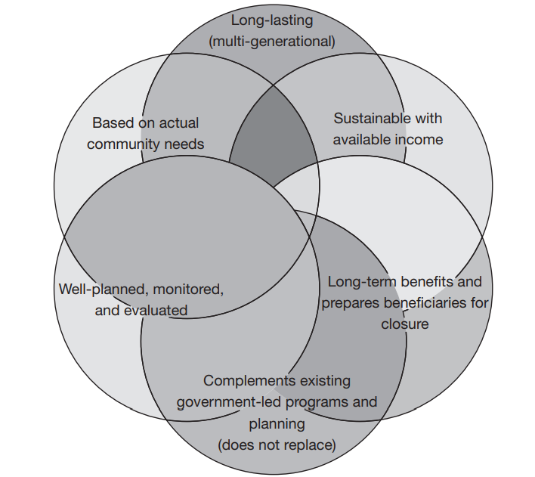
Core principles for CDA development
Tripartite arrangements between governments, mining companies and communities, focused on long-term regional development with equitable distribution of burdens and benefits.
The World Bank has been instrumental in developing and promoting CDAs. Their guidelines and frameworks help ensure that these agreements are comprehensive and effective.
Source: World Bank. 2012. Mining Community Development Agreements : Source Book. http://hdl.handle.net/10986/12641
Notes:
Community development agreements emerged as a tool to ensure that local communities benefit from mining activities and have a say in how these projects are managed.
The World Bank has been instrumental in developing and promoting CDAs. Their guidelines and frameworks help ensure that these agreements are comprehensive and effective.
CDAs are widely used in Africa, and help address social, economic, and environmental concerns, ensuring that communities receive tangible benefits from mining activities.

Slide 11
Key components of CDAs
Stakeholder Engagement
    Are all relevant stakeholders represented?
Capacity Building
Do local stakeholders need training (e.g., in negotiation or other areas)?
Benefit Sharing
Do the mine operator, government, and community agree on the benefits and their distribution?
Monitoring and Evaluation
Is monitoring transparent, and is there an independent commission in place?
Notes:
Key Components of CDAs:
Stakeholder Engagement: identifying and involving all relevant stakeholders, including local communities, government entities, and mining companies.
Capacity Building: enhancing the capabilities of local communities to participate effectively in the decision-making processes related to mining projects.
Benefit Sharing: ensuring that communities receive a fair share of the benefits from mining operations, such as infrastructure development, employment opportunities, and social programmes.
Monitoring and Evaluation: establishing dispute resolution mechanisms and monitor the implementation of CDAs.

Slide 12
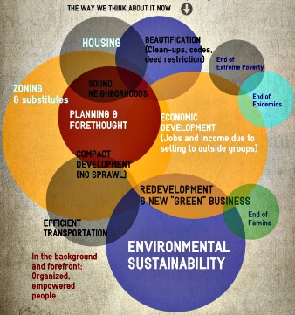
Relationships among elements of community development (example)
Source: A Good Community, 2024. Definition of Community Development Can Be Broad.
https://www.agoodcommunity.org/definition-of-community-development.html
Notes:
Key Success Factors for Community Development Agreements (CDAs):
Inclusive Dialogue: ensure that representatives from local communities, government (including local authorities), and the mining company sit together at the same table.
Legally Binding Contract: facilitate discussions leading to the signing of a legally binding contract.
Penalties for Non-Conformity: include in the contract specific penalties for non-compliance within the contract.
Dispute Resolution Mechanism: establish a clear dispute resolution pathway, such as using an arbitration court.

Slide 13


Follow us in www.ciranproject.eu
Thank you for your attention
Nike.luodes@gtk.fi
The views expressed are those of the authors and do not necessarily reflect the views of the European Union

