Slide 1
Factors leading to mining resistance
University Lecturer (University of Lapland), Adjunct Professor (Oulu University) Soc.Dr Leena Suopajärvi,
Social License to Operate Conference
16 September 2025, Hestia Hotel Europa, Tallinn, Estonia

Slide 2
Starting point
Companies want to make profit.
States want a strong national economy.
EU wants to be more self-sufficient in CRMs.
Only obstacle for mining developments is the local people.

Slide 3
Four factors behind mining resistance
Poor company performance and lack of company-community relationship.
Pro-mining national governance.
Positive and strong place attachment among people.
Environmentally friendly values.

Slide 4
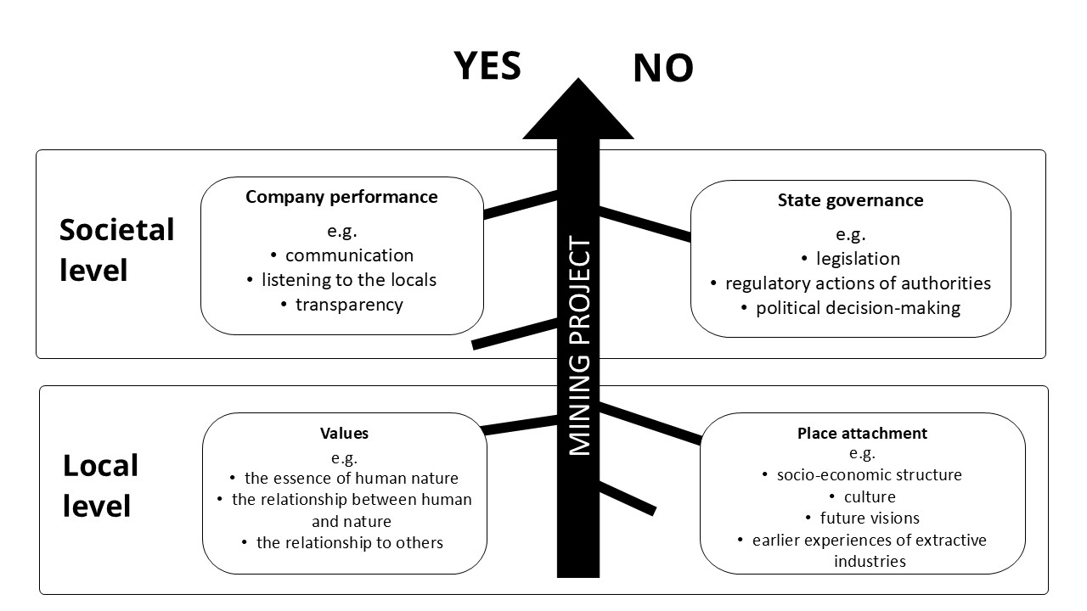
Four factors behind mining resistance

Slide 5
Thank you!
Please, feel free to contact me:
Leena.suopajarvi@ulapland.fi

