Slide 1
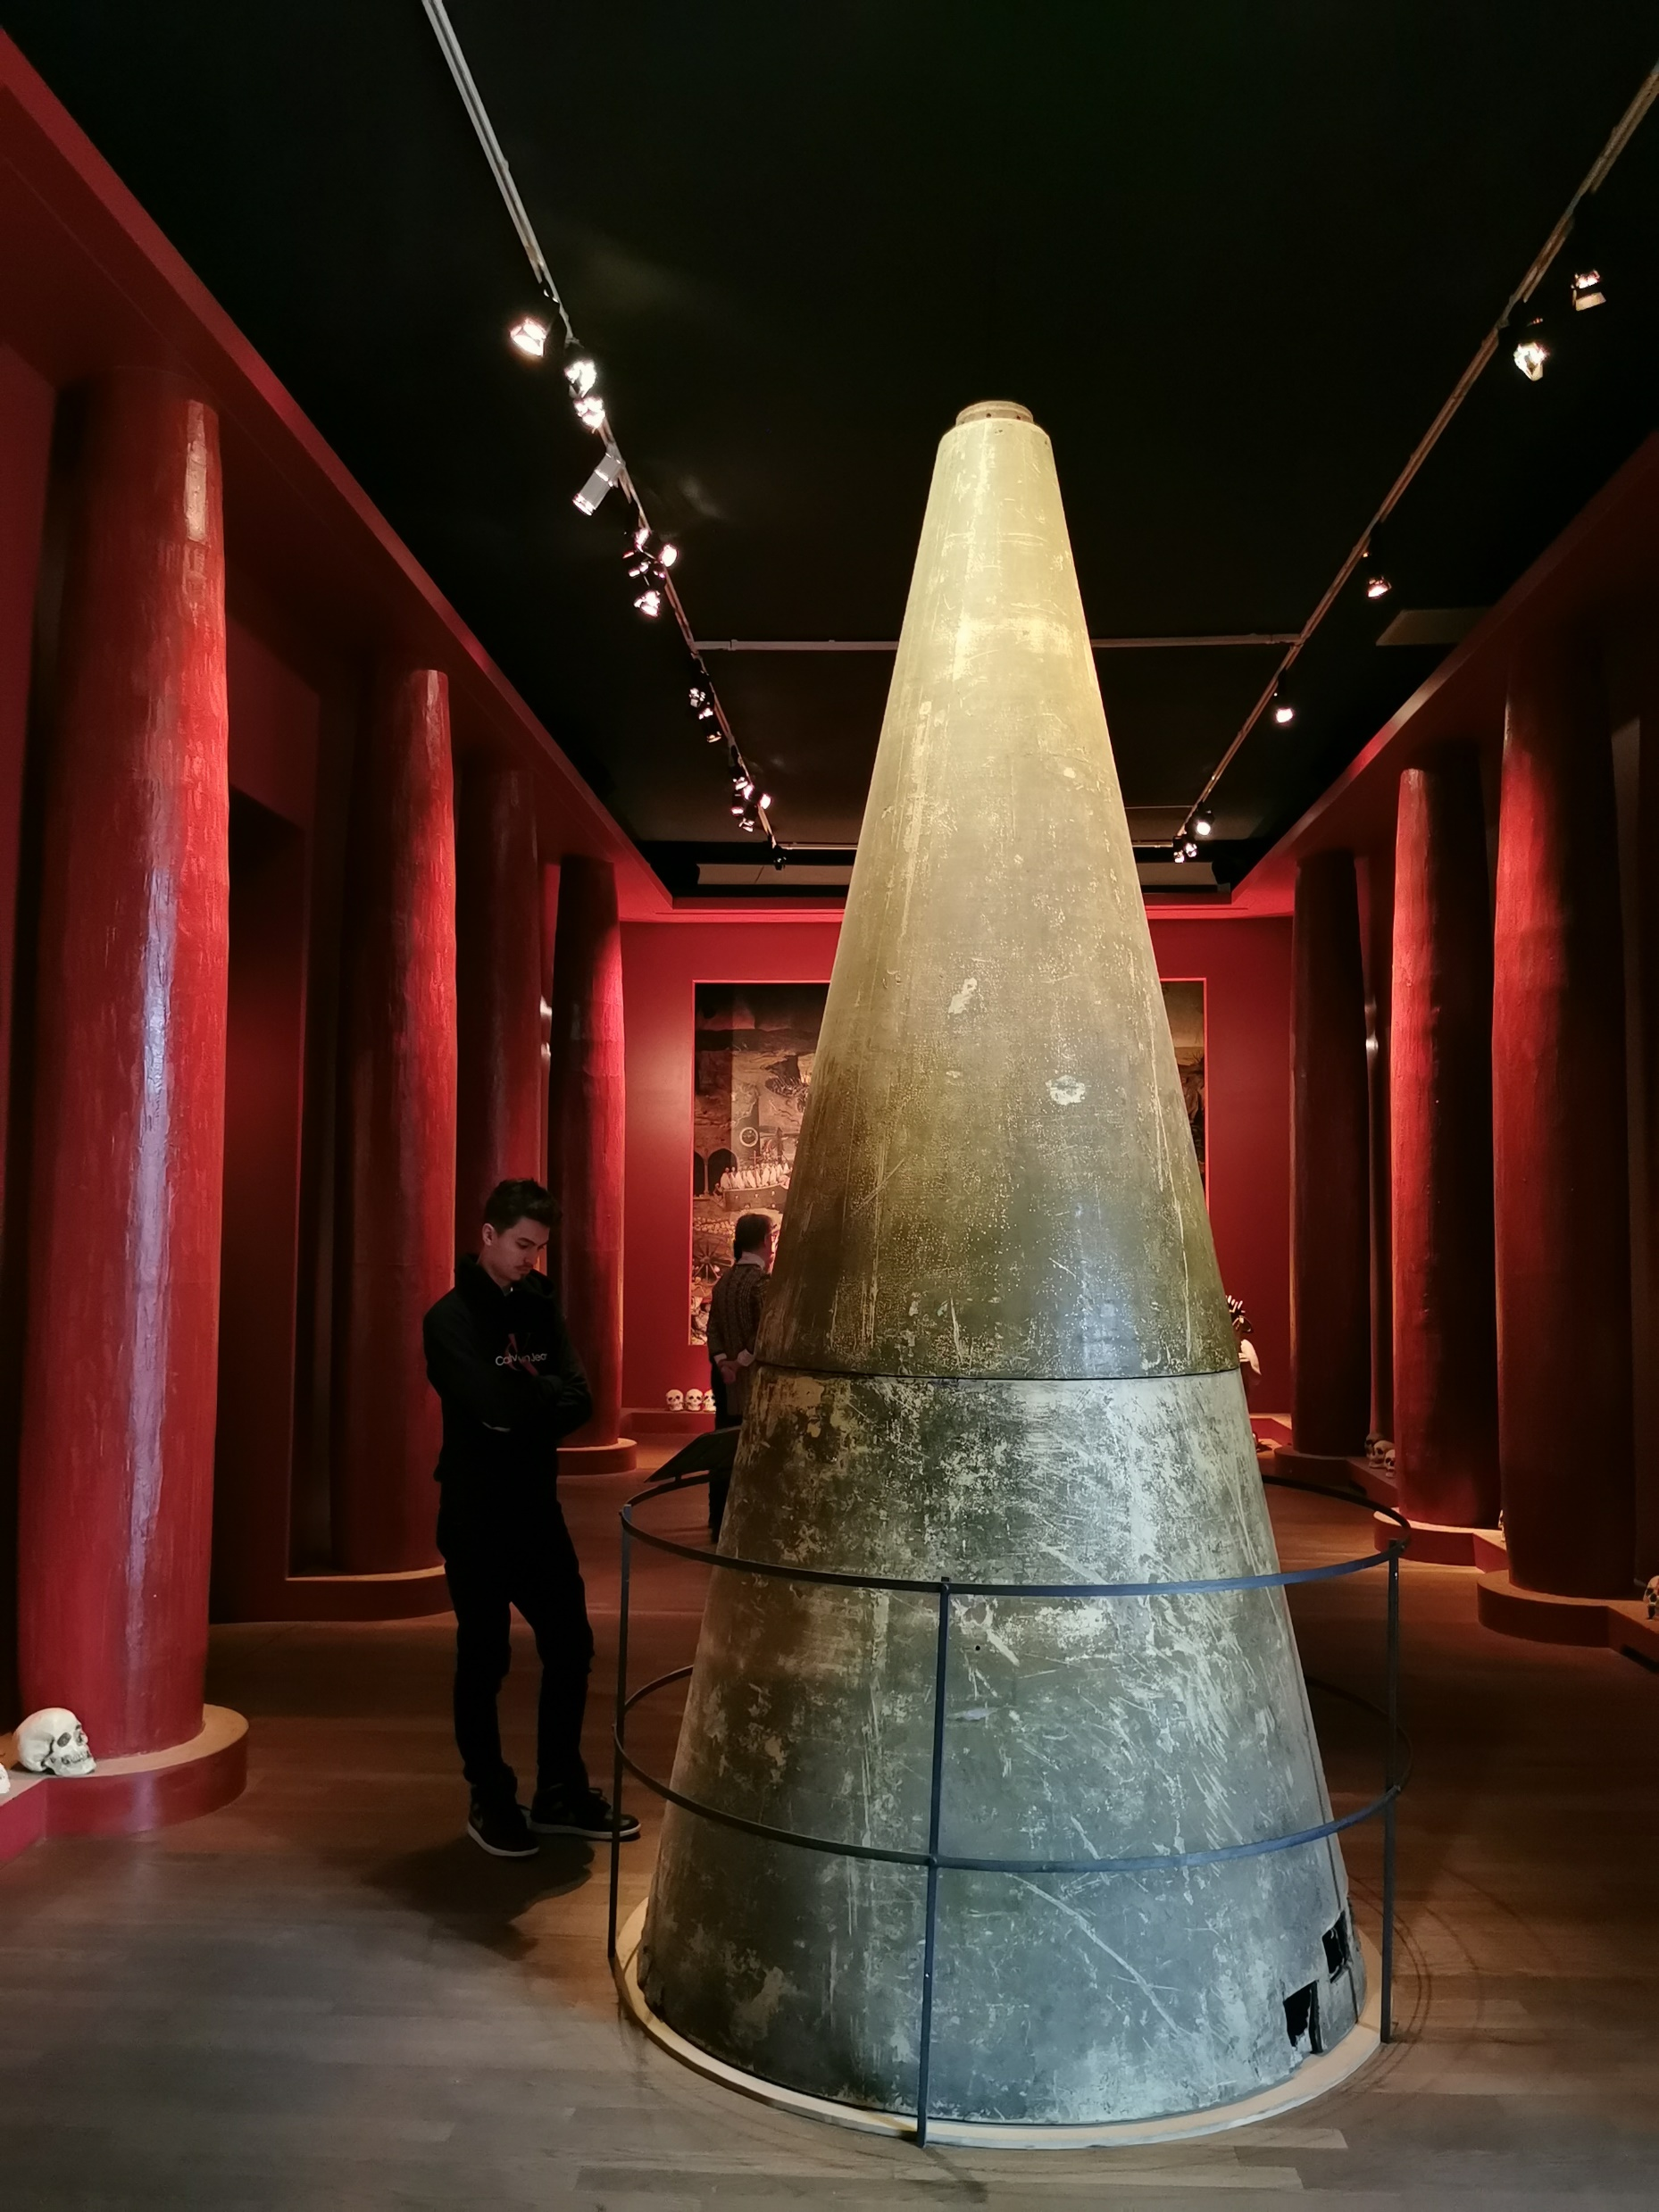
Social acceptance of Strategic and Critical minerals production in Europe
Social Lisence to Operate – Responsible Mineral Exploration Conference Tallinn Estonia 16.9.2025
Jussi Lähde responsibility and communication Latitude 66 Cobalt Oy +358 40 594 4444 jussi@lat66.com

Slide 2

Personal views based on experiences from Latitude 66 Cobalt since 2018
You can not postpone the moment of first impression
If you do not tell your story - the others will
Constant local presence is the only way
It is essential to invest on social surveys
Create spaces for the silent majority
In Finland the most important moment is the shared silence
Social acceptance is built on the understanding and trust of investors to the local operational team
Co-operation with GTK, universities and EU Horizon programs (AGEMERA, UNDERCOVER) are essential for company acceptance

Slide 3
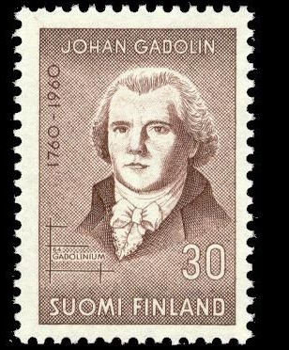
There is no social acceptance without historical understanding
Industrial history of Finland was based on Iron ore needs of Swedish Empire
Swedish scientific history is a Finnish success story, Rare Earth Elements defined by Professor Johan Gandolin in 1800.
Nickel production during Second World War shaped strongly the history of Finland
Country of innovations in mineral refining and mineral based production

Slide 4
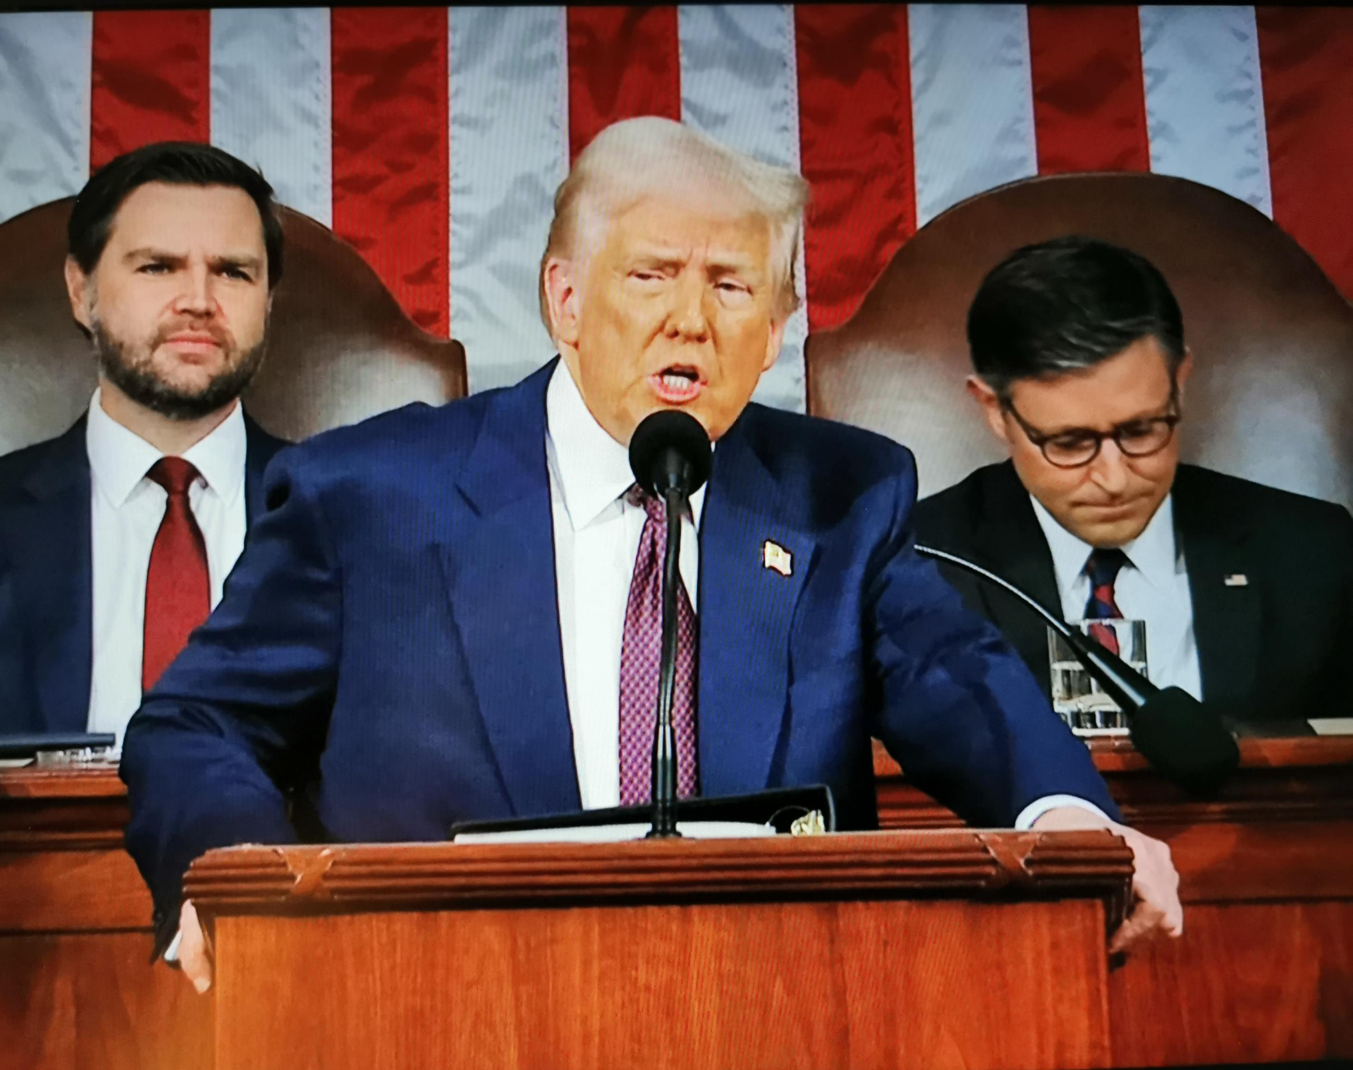
There is no social lisencing without understanding the future
Era on mineral deals is back
Mining and mineral refining have become critical infrastructure of security and industrial independence
National ownership and state involvement will be major factor for social acceptance but also investment approval
What does our security and industries need for next 30 years and how can we provide that?

Slide 5

Gelogical and industrial hertitage to next generations
Exploration and mining acceptance are dependent also on current social and political culture
We need to leave more geological data to next generations than what we inherited
Era of mineral colonialism to support welfare in Europe is over and the history needs to be recognized
Strategic and Critical minerals are question of existence and national responsibility

