Slide 1

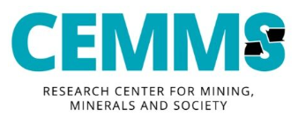
Community Benefit Agreements in the Nordic Mining Context
SLO Conference 2025 Tallinn, 16.9.2025
Juha M. Kotilainen, Postdoctoral researcher, University of Eastern Finland

Slide 2




Slide 3
Benefit agreements are a tool for local level mining governance
When a company proposes a mining project to an area, an agreement is negotiated between the company and the local community.
The aim is to increase the mutual and local benefits of mining and mitigate its negative impacts through collaboration.
Negotiated issues can vary vastly, from jointly agreed communication practices to community development programs – tailored to the context.
Beyond legislation: the issues/rules/content are negotiated locally, and through the agreement, have a binding element.

Slide 4
Europe is a new context for CBAs
Background in indigenous regions of Canada and Australia: regulation and voluntary measures were deemed insufficient
  Similar perceptions growing in Europe?
Nordic welfare states – different needs
Interest has emerged from local governments
  Special characteristics of mining (one-off use, place-bound, impacts)
  For example: municipalities would like mines to contribute more to financing the costs caused by mines

Slide 5
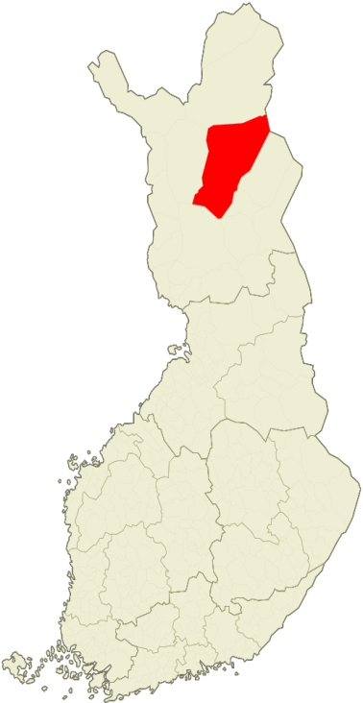
Case: Sodankylä municipality
Kevitsa copper-nickel mine since 2012 + advanced projects
Municipality interest in mid 2010s
Narrow focus on economic function and one mine
Political turmoil and legislation changes: hibernation
Idea revived in 2024 – now with AA Sakatti project
Memorandum of Undestanding between municipality
and Sakatti (June 2025)

Slide 6
Drivers / potential contents in Sodankylä
Foundation
Direct payments (pre mining tax)
Drivers for collaboration / CBA
Economic benefits
Coordinate resource use
Reduce overlapping activities
Improve communications
Local capacity building
Attract/retain high quality workers
Compensate harm
Improve long-term planning
Mitigate negative env. impacts
Contractor opportunities
Procurement/sponsorship principles
Coordinated stakeholder engagement activities
Education and training initiatives
Joint housing development
Co-develop local services
Compensation for noise & traffic
Road safety improvements
Participatory impact assessment(s)
Platform for collaboration

Slide 7
As a collaborative platform, CBAs fulfill three important needs:
They respond to the need to involve communities more deeply in local mineral governance by recognizing the existing interdependence between the actors
They go from mere stakeholder involvement (e.g., informing, consultation) towards more intensive collaboration (e.g., joint planning, shared decision-making)
They address the complexity and often contested nature of key questions by embracing collaborative processes, where shared understanding, trust and solutions develop over time

Slide 8

Interesting moment: first European CBA(s) soon?
  OECD (2025) recommendations for Europe
  Implementation
A tool for local mining governance: different functions for different actors
Focus on solving local issues; social acceptance as an indirect benefit
@JuhaKotilainen / juha.kotilainen1@uef.fi

Slide 9
References
Kotilainen, J.M. (2024). Emerging Forms of Collaborative Mineral Governance – Analyzing Preconditions for Community Benefit Agreements in Finland. Publications of the University of Eastern Finland, Dissertations in Social Sciences and Business Studies, 339. http://urn.fi/URN:ISBN:978-952-61-5354-4
Kotilainen, J.M., Peltonen, L., Reinikainen, K. (2022). Community Benefit Agreements in the Nordic mining context: Local opportunities for collaboration in Sodankylä, Finland. Resources Policy, 79. https://doi.org/10.1016/j.resourpol.2022.102973
Kotilainen, J.M., Pölönen, I., Peltonen, L., Metsä-Simola, K. (2019). Kaivossopimukset – Sisällöt, funktiot ja riskit [Community Development Agreements in Mining – Content, Functions and Risks]. Ympäristöpolitiikan ja -oikeuden vuosikirja XII 2019: 7–41.
Kotilainen, J.M. & Fraser, J. (In press). Collaborating beyond the concession: moving towards water stewardship in mining. In Mononen, T. & Peltonen, L. (Eds.). Future Transitions in the Mining Industry: Challenges for Sustainable Development. Routledge.

Slide 10
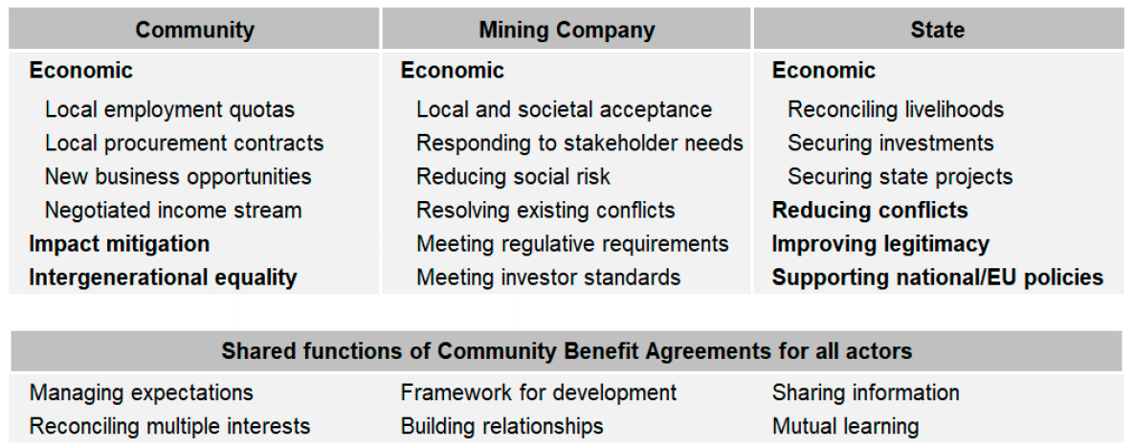
Actor-specific and shared functions of community benefit agreements

