Slide 1
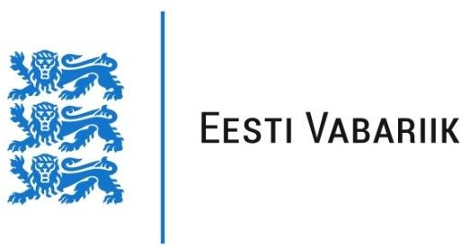
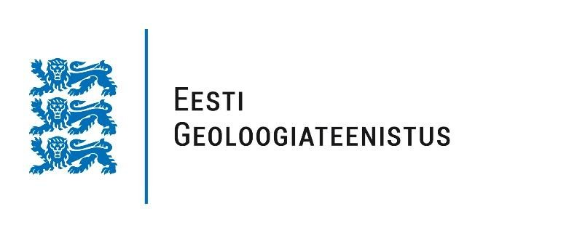

Public Attitudes Toward Phosphorite Exploration and Mining in Estonia Erki Peegel Geological Survey of Estonia 16th September 2025

Slide 2
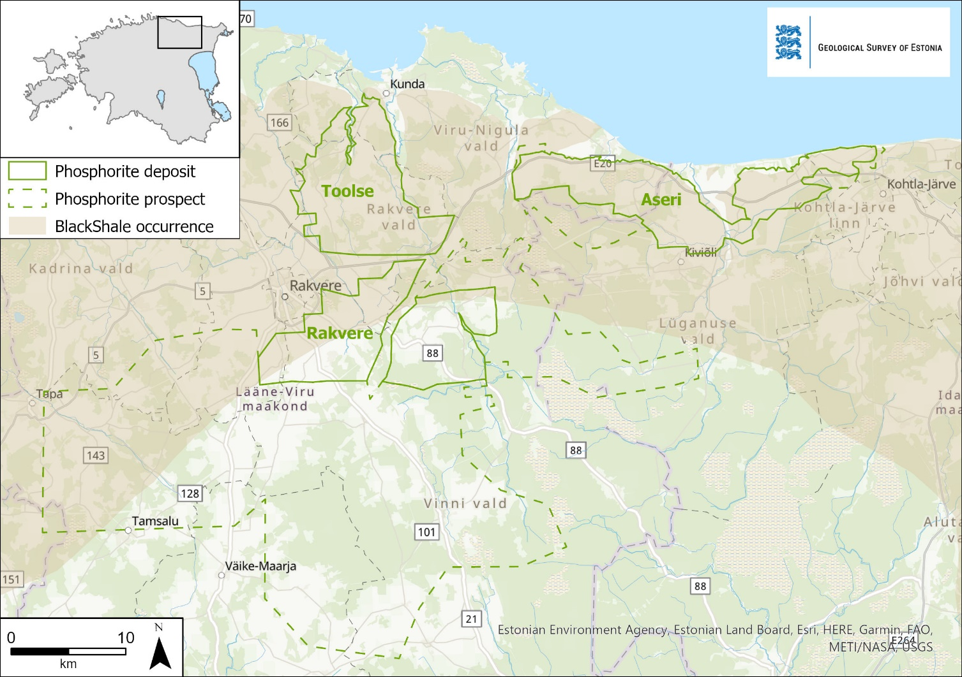
Estonia’s Phosphorite: The EU’s Largest Reserves
Estonia has significant phosphate resources, containing elevated concentrations of REEs
2.9 billion tons of P₂O₅ ore (10% P₂O₅ in average) in deposits and 8.4 billion tons as prospects.
Phosphorite and rare earth elements (REE) are listed as critical raw materials by the EU

Slide 3
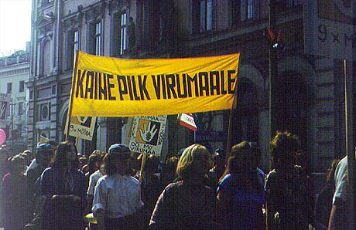
Phosphorite Exploration in Estonia
1924: Phosphorite exploration in Estonia started
1950–1980: Extensive exploration during the Soviet Union era
Thousands of drill cores collected, over 10,000 samples analyzed
1987: Major environmental & political protests - “Phosphorite War”
2014-15: Viru Keemia Grupp (VKG) conducted preliminary geological studies, triggerd strong public opposition.

Slide 4
Ongoing Phosphorite Exploration (2023-2026)
The Geological Survey of Estonia is conducting comprehensive research to:
- Assess economic viability of phosphorite extraction in extended Aru-Lõuna area;
- Develop environmentally sustainable processing methods;
- Evaluate rare earth elements (REE) co-extraction potential;
- Minimize environmental impact through advanced technologies.
Timeline: Results expected summer 2026 → Critical decision point for Estonia.

Slide 5
Research Problem & Knowledge Gap
The Challenge:
- Limited understanding of current public attitudes toward phosphorite exploration
- Unknown relationship between awareness and actual support levels
Why This Matters:
- Future decision requires social license for success
- Past conflicts highlight importance of public acceptance
- EU critical materials strategy depends on public support
Research Questions:
- What are Estonian attitudes toward phosphorite exploration and mining?
- How do awareness levels correlate with support/opposition?
- Can different public segments be identified for targeted engagement?

Slide 6
Methodology - Representative National Survey
Sample & Method: n = 1,020 Estonian residents (aged 15-74) Kantar Emor omnibus survey May 15-22, 2025 Random sampling, online interviews Demographics: 498 men, 520 women Age groups: 15-24 (128), 25-34 (167), 35-49 (304), 50-74 (421) Analysis: Descriptive statistics, correlation analysis, cluster analysis

Slide 7
Public Awareness Trends - Growing Familiarity Over Time
Familiar with Mineral Exploration: 2021: 31% familiar 2023: 39% familiar 2024: 47% familiar 2025: 45% familiar
Gender Gap Persists: Men: 56% familiar Women: 35% familiar
Key Insight:
Awareness levels stabilizing, but significant gender differences remain

Slide 8
Economic Benefits vs Environmental Risks
Public Recognizes Both Opportunities and Concerns
Economic Importance (2025):
Phosphorite exploration: 69% important
Metal ore exploration: 64% important
Environmental Risks (2025):
Phosphorite mining: 59% high risk
Metal ore mining: 44% high risk

Slide 9
Behavioral Intentions - Conditional Support
Majority Supports Responsible Development
Future Mining Support (10-20 years):
- Allow unconditionally: 17% - Allow under conditions: 52% - Should not allow: 12% - Don't know: 19% Top Conditions Required: - Independent environmental impact assessment (87%) - Best available technology (47%) - Municipal agreements (40%)

Slide 10
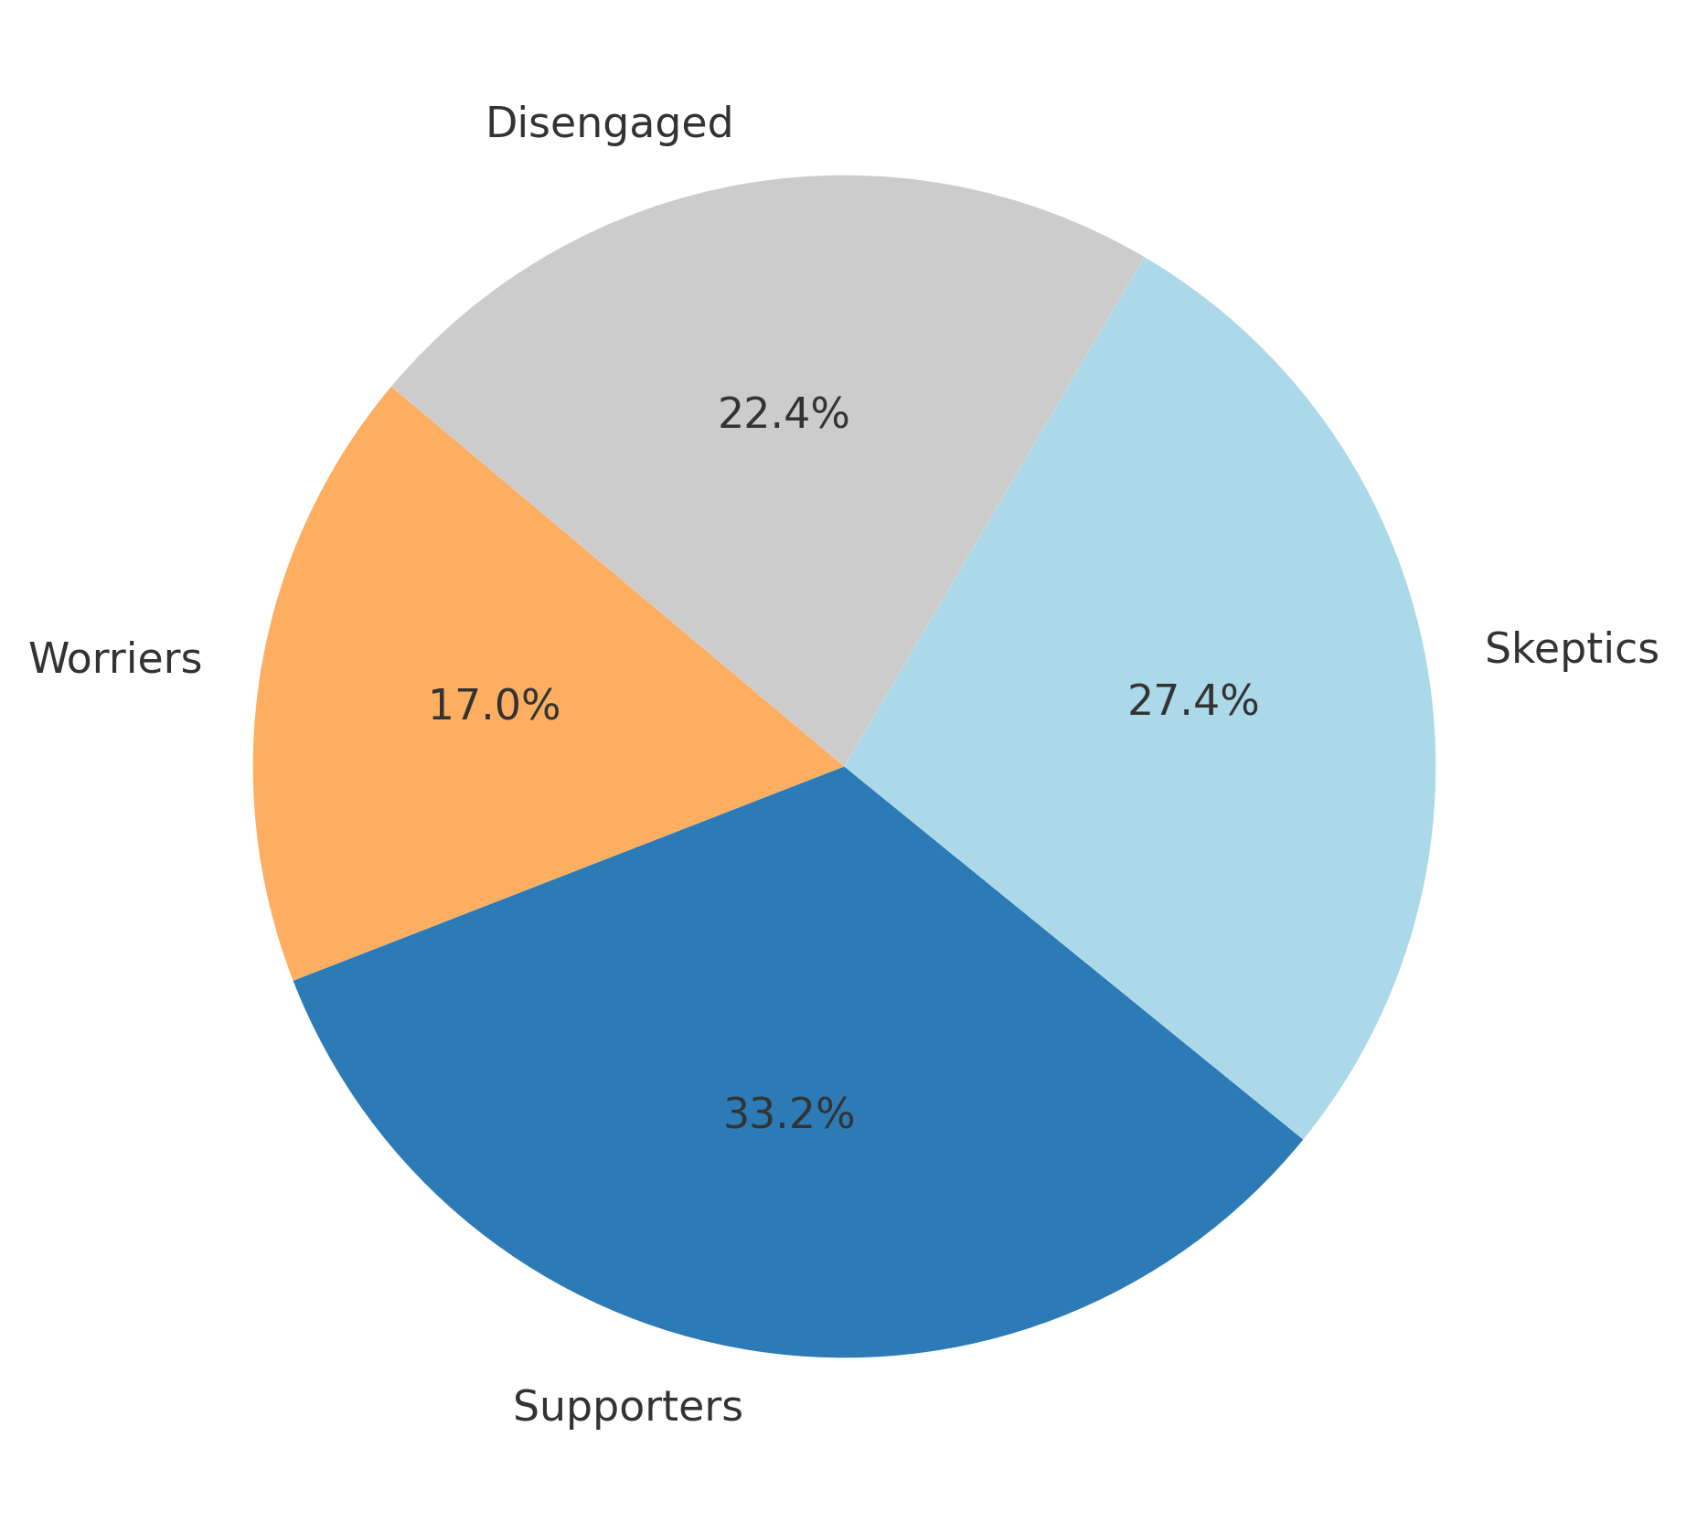
Four Distinct Public Segments
Supporters (33%)
support exploration and mining
more men, older
Tallinn & Northern/Western Estonia
Doubters (27%)
- want thorough, independentl study
- middle-aged/older, more women
Virumaa regioon
Worriers (17%)
environmental risks too high
younger/middle-aged women
Tallinn & Northern Estonia
Disengaged (22%)
no clear opinion
younger/middle-aged women
Tallinn & Northern Estonia

Slide 11
Social License Potential
Current Support Structure: Supporters: 33% Doubters: 27% Total Potential Support: 60% Key Correlations: Economic importance ↔ Exploration support: r = 0.621 (strong) Risk perception ↔ Mining support: r = 0.091 (very weak) Strategic Insight: Economic benefits drive support more than risk concerns limit it
Success Formula: Thorough environmental studies + transparent communication = social license

Slide 12
Key Conclusions
Current Status
Estonian public recognizes both economic potential and environmental risks
Majority support exists for exploration, conditional support for mining
Four distinct public segments with different engagement needs
Weak correlation between risk perception and behavioral intentions
Path Forward
Fresh knowledge and substantial, broad-based discussion needed before final decisions

Slide 13
Aitäh! Erki Peegel Geological Survey of Estonia

