Slide 1
Better Conditions for Youth Volunteering
Developed within Strategic National Agencies´ Cooperation on Volunteering

Slide 2
Volunteering Conference | Shaping volunteering in Europe and beyond
Volunteering Conference | Shaping volunteering in Europe and beyond
Proposals to advance volunteering
EU Volunteer status
Quality charter for volunteering
Capacity building
4 - 6 October 2023 | Podgorica, Montenegro

Slide 3
Volunteering Conference | Shaping volunteering in Europe and beyond
Volunteering Conference | Shaping volunteering in Europe and beyond
Continuing a solidarity-based program
Funding youth volunteering
Focus on solidarity
Strengthening civil society
New potentials
A value-based programme
A new perspective for partner countries
4 - 6 October 2023 | Podgorica, Montenegro

Slide 4
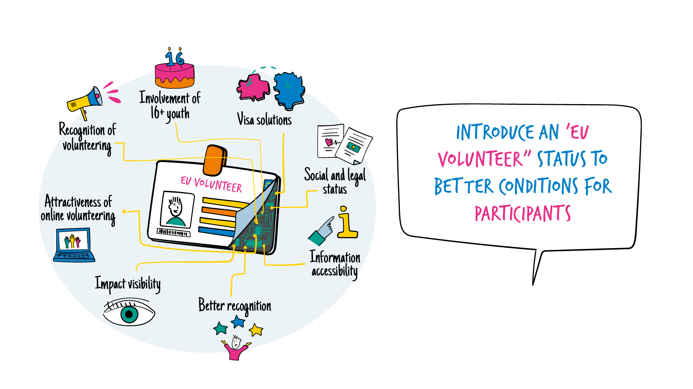
Volunteering Conference | Shaping volunteering in Europe and beyond
Volunteering Conference | Shaping volunteering in Europe and beyond
4 - 6 October 2023 | Podgorica, Montenegro
Notes:
Introduce a legal status for all full-time volunteers active in the European Solidarity Corps, to…
Facilitate visa solutions
Clarify social and legal status
Improve information availability and accessibility
Communicate benefits, recognition of skills and competences
Making impact more visible
Increase attractiveness of online volunteering
Increase and more coherent recognition of youth volunteering
Open volunteering possibilities for young people from 16 years onwards

Slide 5
Volunteering Conference | Shaping volunteering in Europe and beyond
Volunteering Conference | Shaping volunteering in Europe and beyond
4 - 6 October 2023 | Podgorica, Montenegro
Notes:
A “quality charter” for volunteering
Introduce minimum quality standards for volunteering, to ensure…
a focus on solidarity
health, safety and security of participants
support measures for mental health
inclusivity
inclusion of digital forms
inclusion of environmental aspects
recognition of skills
distinguishing between paid staff and volunteers

Slide 6
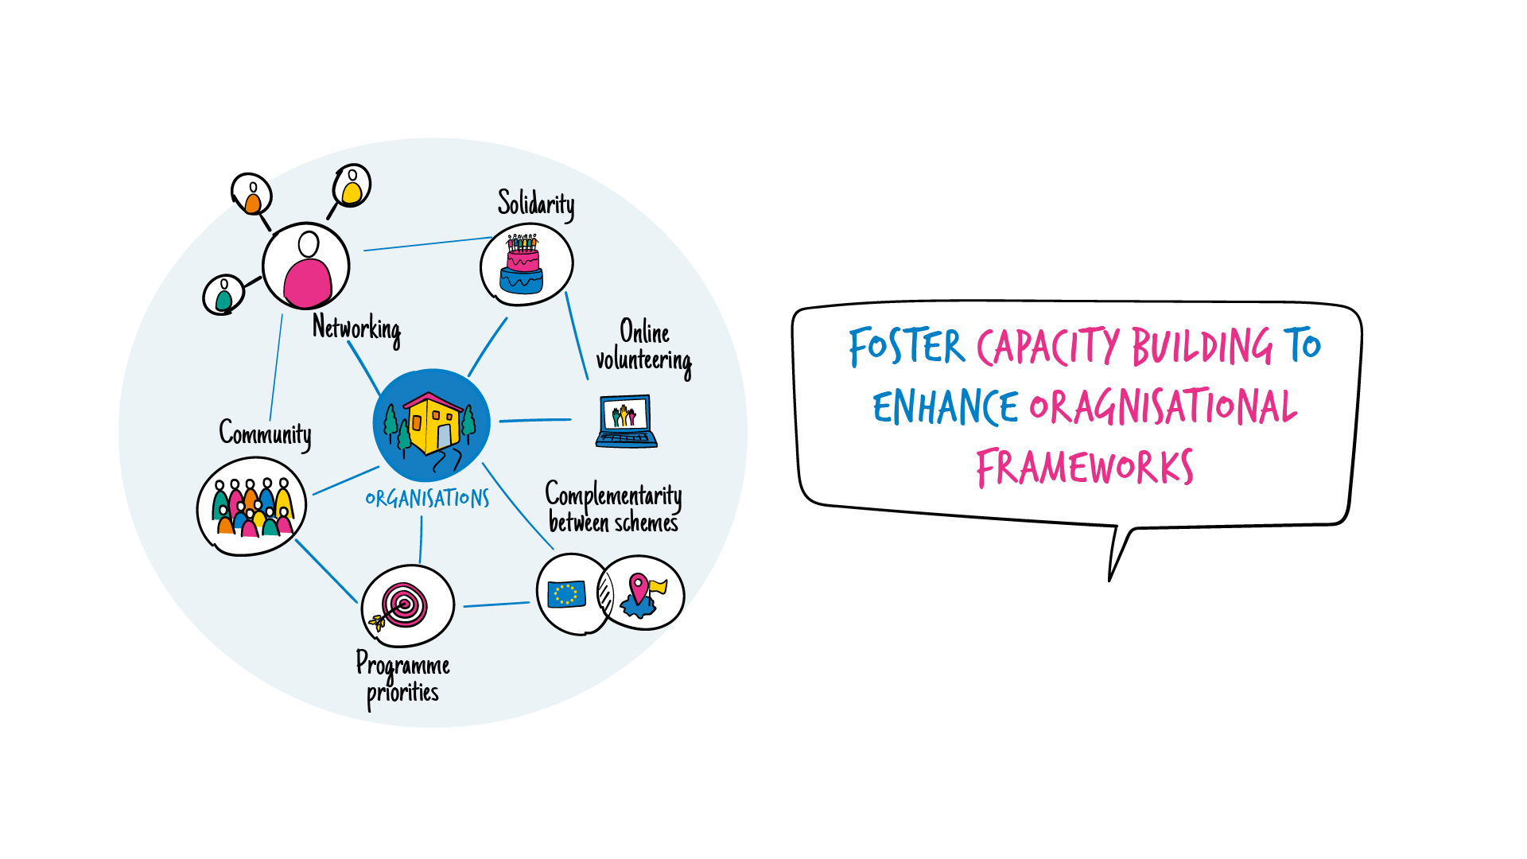
Volunteering Conference | Shaping volunteering in Europe and beyond
Volunteering Conference | Shaping volunteering in Europe and beyond
4 - 6 October 2023 | Podgorica, Montenegro
Notes:
3. Foster capacity building
Ensuring that instruments are available, being promoted and being used for capacity building in the field of solidarity and volunteering, to…
Focus on solidarity
foster networking and knowledge sharing
explore complementarity between different volunteering schemes
explore community involvement and impact
Increase thematic work on/with programme priorities
Explore online volunteering

Slide 7
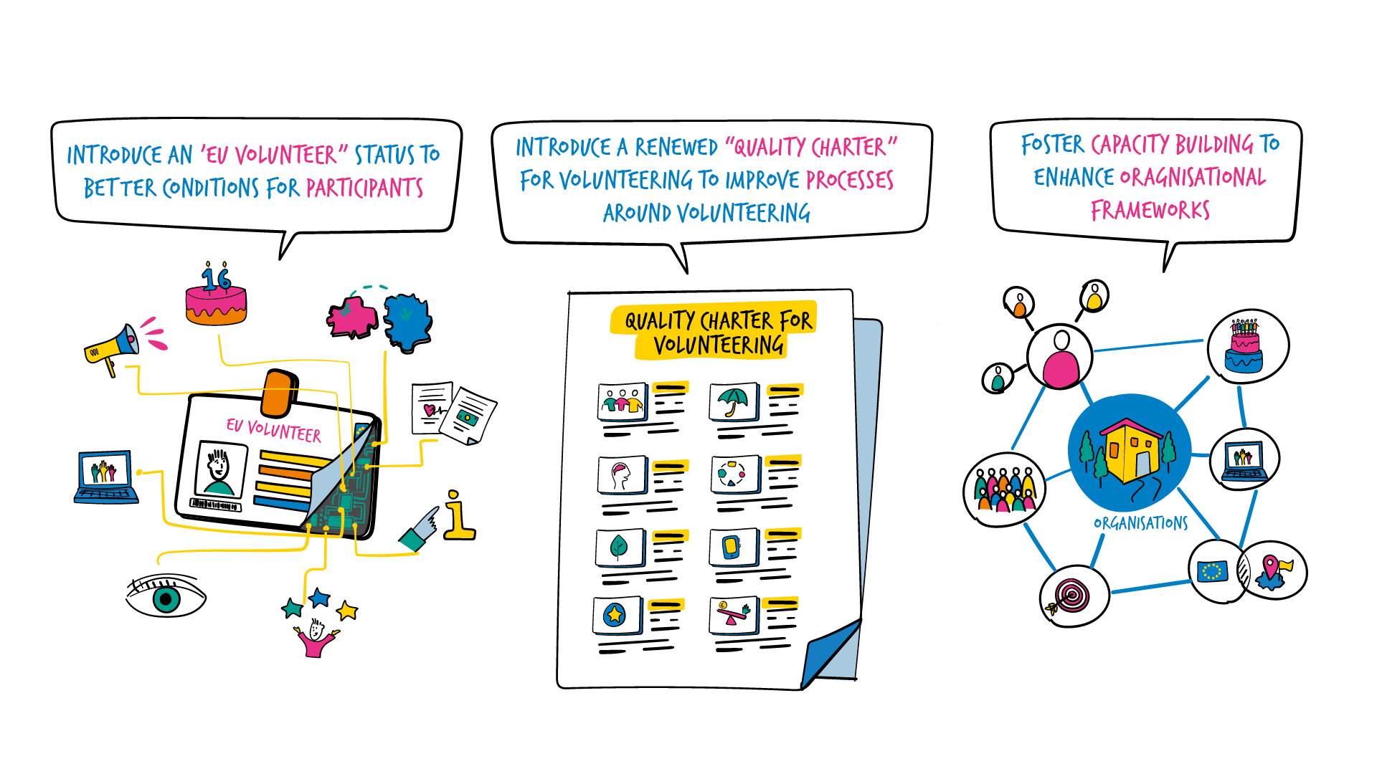
Volunteering Conference | Shaping volunteering in Europe and beyond
Volunteering Conference | Shaping volunteering in Europe and beyond
4 - 6 October 2023 | Podgorica, Montenegro
Notes:
3. Foster capacity building
Ensuring that instruments are available, being promoted and being used for capacity building in the field of solidarity and volunteering, to…
Focus on solidarity
foster networking and knowledge sharing
explore complementarity between different volunteering schemes
explore community involvement and impact
Increase thematic work on/with programme priorities
Explore online volunteering

Slide 8
Volunteering Conference | Shaping volunteering in Europe and beyond
Volunteering Conference | Shaping volunteering in Europe and beyond
Q & A
Your feedback is valuable!
4 - 6 October 2023 | Podgorica, Montenegro

