Slide 1
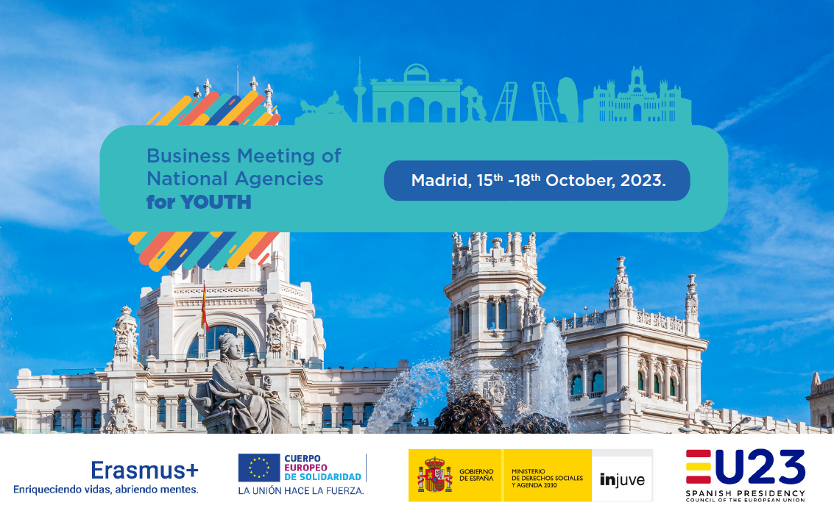
Welcome to the BM in Madrid!

Slide 2
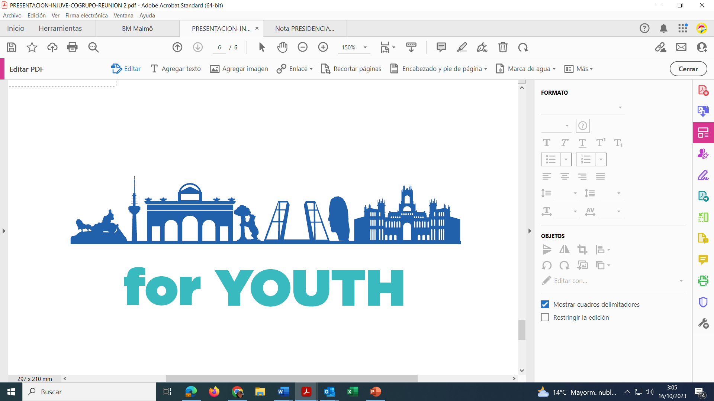
Thanks.
Gifts.
Topics.
Coffee & Lunch.
Cultural Agenda:
Wine & Canned Seafood (18:30 h).
Dinner and flamenco at Torres Bermejas (20 h).
City Tour Bus around Madrid (18:15 h).
Dinner at the Real Casino of Madrid.

Slide 3
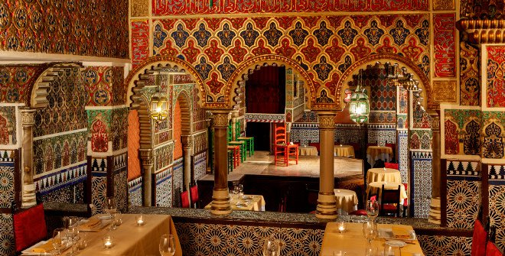
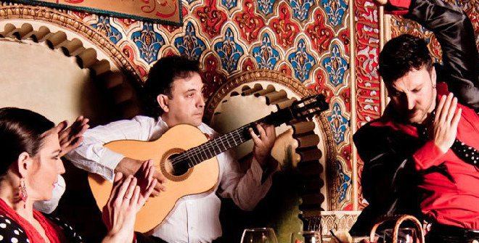

Slide 4
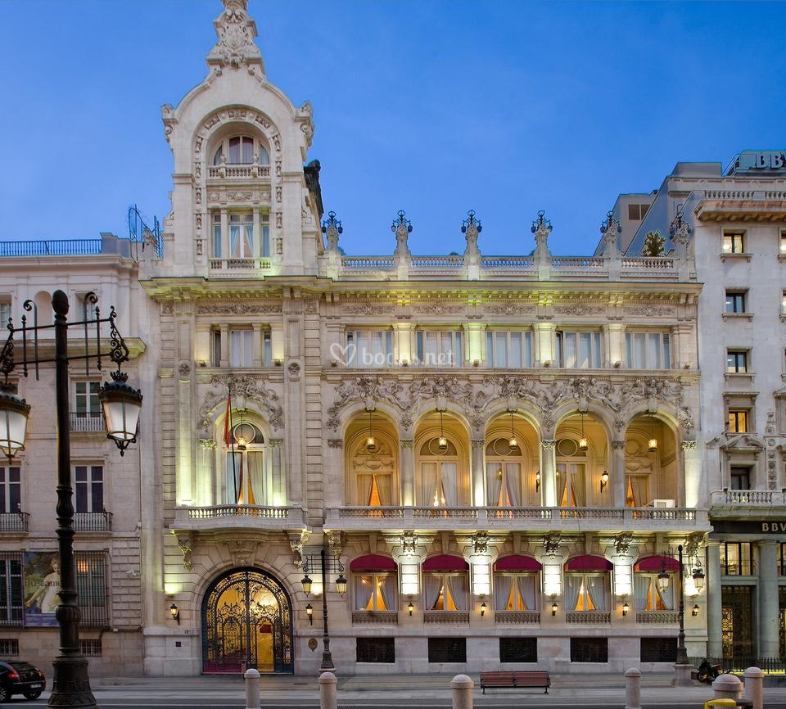
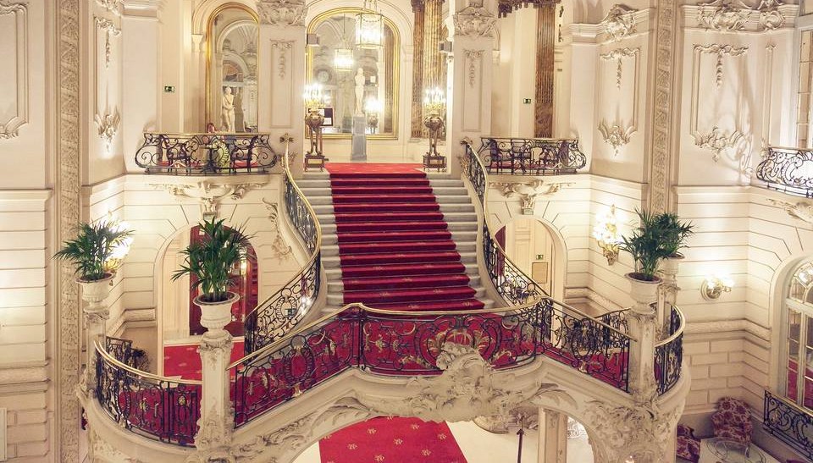
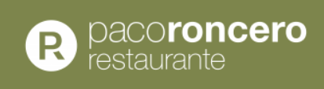

Slide 5

Updates from the Spanish EU Presidency

Slide 6
Updates from the Spanish EU Presidency
Co-Group Retreat. Madrid, 28-30 August.
Informal Meeting of Ministers (RIM) for Education and Youth. Saragossa, 18-19 September.
How to commit Europe to its youth? Education, rights and welfare of young people.
1.- How does the structured and accessible participation of European young people contribute to the greater legitimacy and credibility of EU decision-making processes?
2.- How can youth mainstreaming in public policies in the EU contribute to the well-being of young people and the fulfilment of young people's expectations for the future?
3.- How can the impulse of a closer cooperation and coordination between the European institutions, Member States and youth representatives improve mutual learning, analyses of young people's challenges and the implementation of initiatives with a significant impact on their lives?

Slide 7
Updates from the Spanish EU Presidency
EU Youth Conference. Alicante, 1-4 October.
10th Cycle of Dialogue (18th month). #3 Inclusive Societies.
250 participants (Youth Delegates, Ministerial Delegates, NGOs, researchers & facilitators).
1.- What are the current barriers to the full inclusion of all young people?
- Lack of connections: intergenerational, rural Vs urban environment, cognitive, education Vs work.
- Lack of resources: financial, dedicated to housing, health, skills, information, inclusive youth spaces.
- Lack of recognition: skills, youth professionals, diverse representatives.
2.- What actions must necessarily be taken to allow the inclusion of all young people?
- Mainstreaming of youth policies (attention to the needs of young people in other political areas).
- Include the youth perspective in the process of design, implementation and evaluation of youth policies.
- Evidence-based.
3.- How can youth work and the youth field better enable the full inclusion of all young people?
- Youth professionals must take an intersectional approach when addressing the issue of inclusion.
- Educate educators first.
- Provide an inclusive participation structure for the entire young population.

Slide 8
Updates from the Spanish EU Presidency
DG Youth Meeting. Alicante, 4-5 October.
Commission implication.
EU member states participation.
OECD, European Economic and Social Committee (EESC), YFJ, EU-CoE youth partnership.
Session 1: joint session with youth delegates (interactive session).
Session 2: Embedding the youth perspective in policymaking through mainstreaming, youth impact assessment, youth test, youth check or other: way forward.
Session 3: European Union Youth Strategy and EU Youth Programmes: fostering synergies to support common goals, in the context of interim evaluations.
Business Meeting of NA for Youth. Madrid, 15-18 October.

Slide 9
Updates from the Spanish EU Presidency
Council of the EU. Education, Youth, Culture and Sport Council. Brussels, 23 November.
1.- Conclusions on the impact of mental health problems on European youth people and on comprehensive public policies to address this issue.
2.- Conclusions on an inclusive and participatory response that safeguards the rights and well-being of all young people. (mainstreaming).

Slide 10
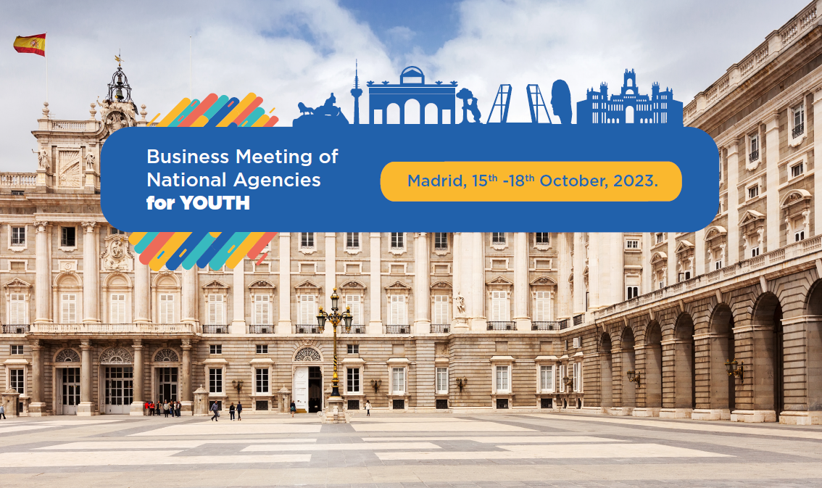
From Malmö to Madrid

Slide 11
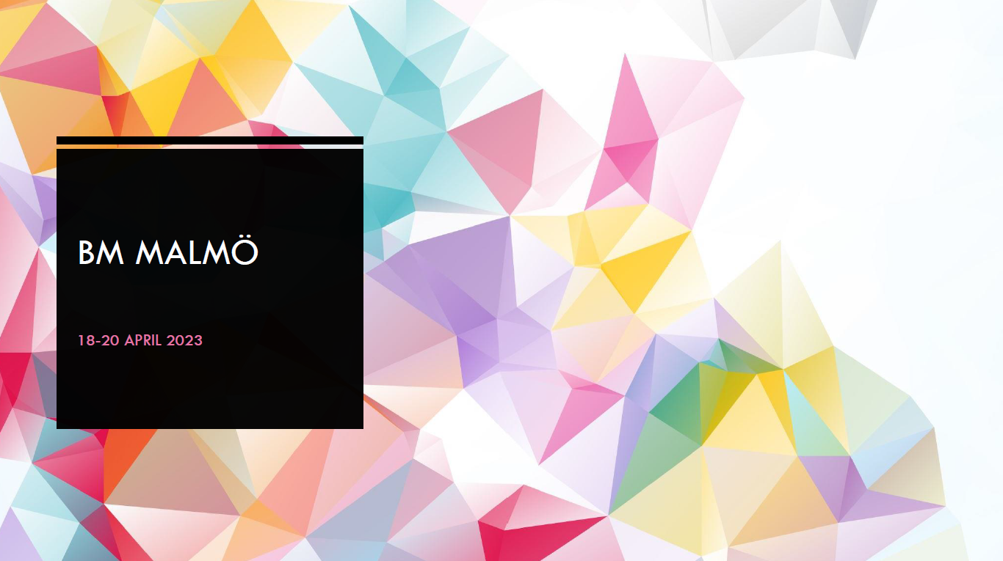

Slide 12
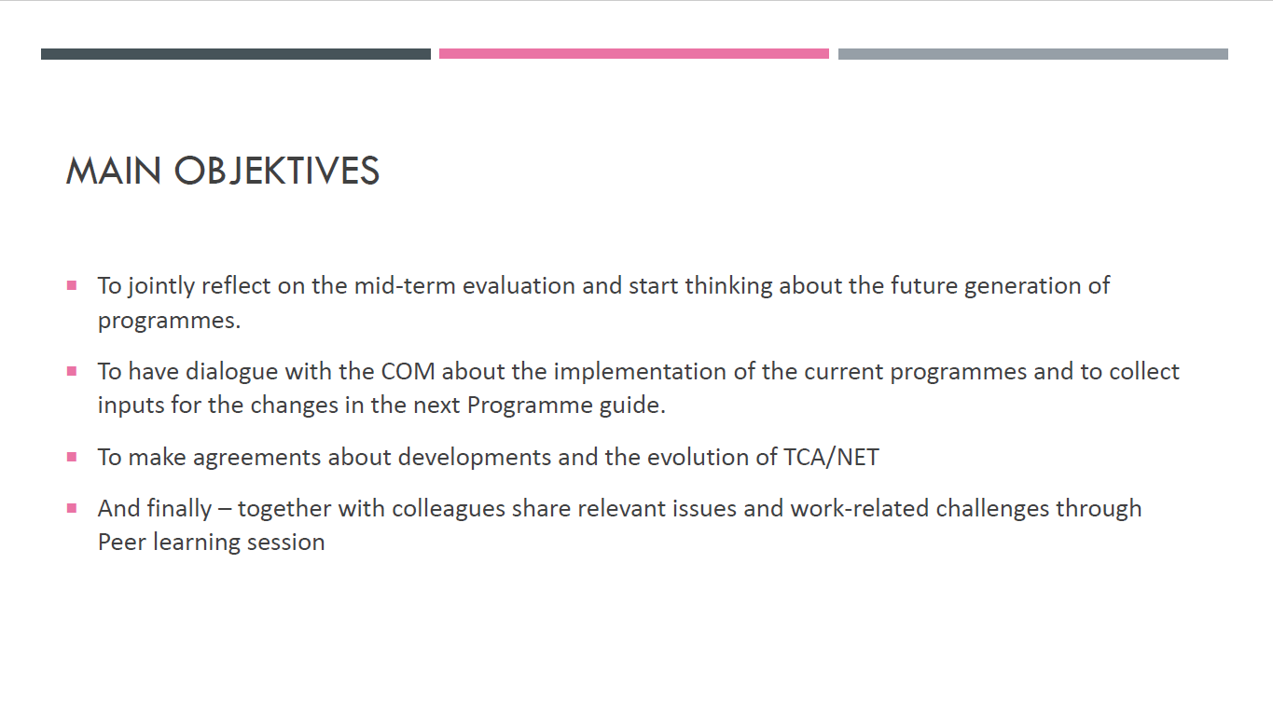

Slide 13
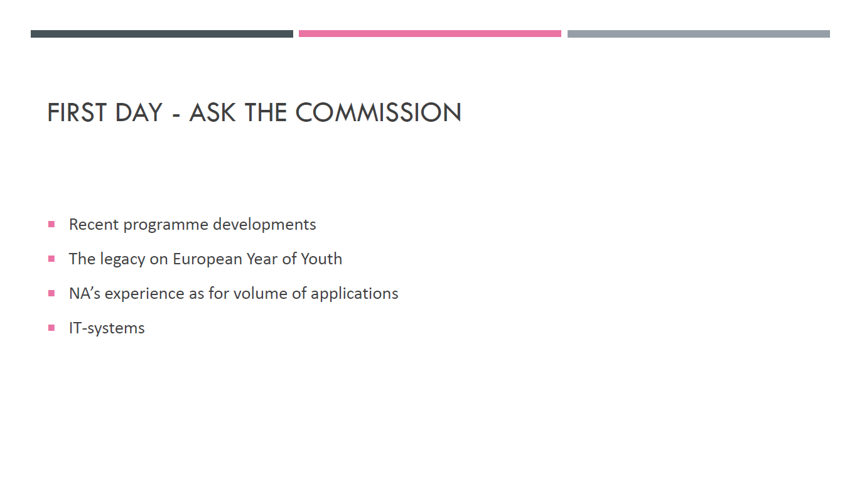

Slide 14
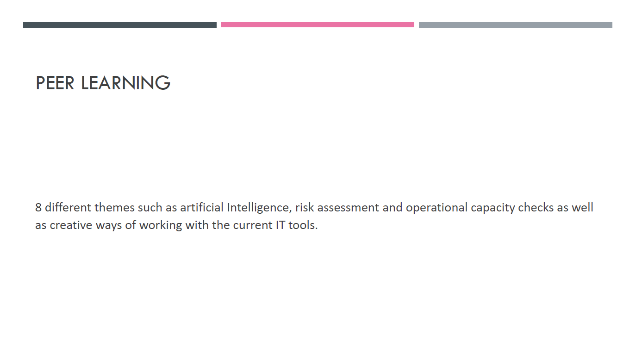

Slide 15
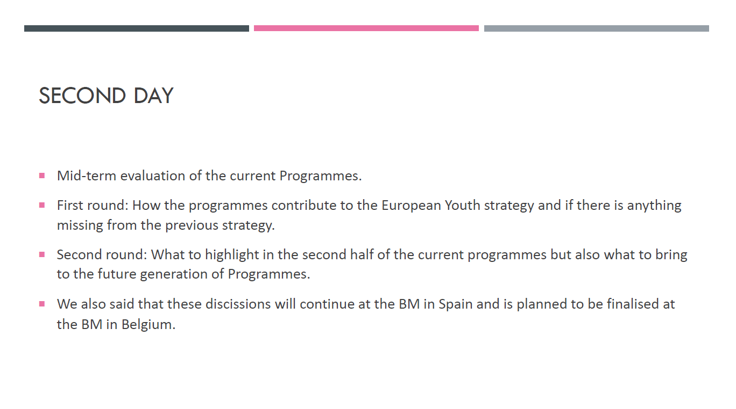

Slide 16
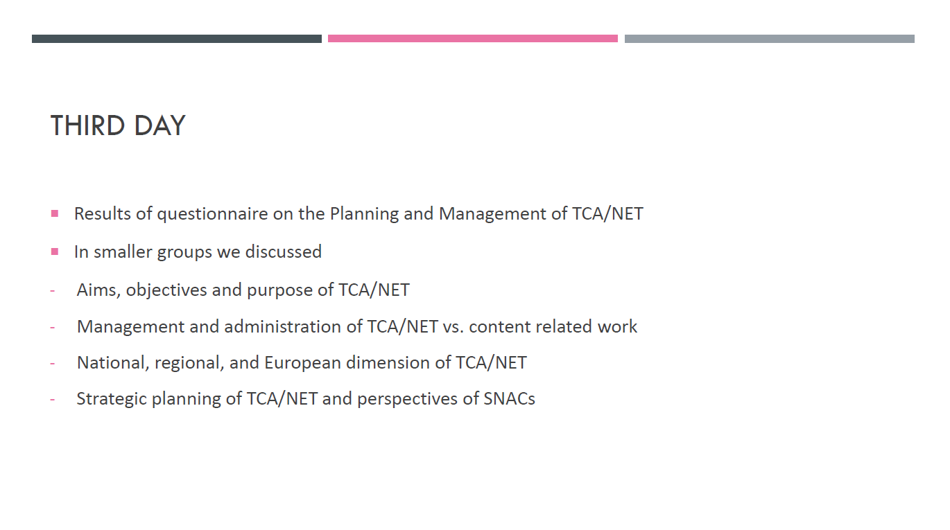

Slide 17
Co-group’s messages from the Retreat

Slide 18
Co-group’s messages from the Retreat
1.- Open Topics with the COM:
  Discussed how to address the issues with IT Tools and the TCA/NET Budget.
2.- Mid-term Evaluation:
  Emphasized the need to expedite certain steps.
  Noted that the Parliament is preparing their report, which needs to be adopted by the end of the year.
  There is a draft paper, the co-group prepared based on the executive summary of BM Malmö with recommendations linking the EU Youth Strategy and EU Youth programmes which could serve as a base for the report. The co-group continues working on this.
  Worked on an Advocacy Plan.
3.- Architecture of the Future Programmes:
  Explored preferred structures for future programmes.
  Discussed how to elaborate the network's position on future programmes.
4.- Planning of the BM Madrid:
  The group discussed the planning and organization of the upcoming Business Meeting.
  Discussed possible external input for the BM (future trends, RAY, youth perspective).

Slide 19
Co-group’s messages from the Retreat
5.- TCA / NET, including SNACs:
  Reviewed the current status of SNACs.
  Discussed the mission statements, engagement strategies with new initiatives and how to continue or conclude existing ones.
  An overview of SNACs and their links between each other as well as some conclusions the co-group worked on will be presented and discussed here at the BM Madrid.
6.- Work Plan of the Network:
  The group reviewed the current status of various actions and reviewed the network plan that the coordination group is following.
  Discussed long-term planning for the network.
  Identified responsibilities for various fields or actions.
7.- Organisation of the Coordination Group:
  Discussed profiling of support and tasks and responsibilities of the support persons (Sabrina & Andrei).
  Slightly restructured working groups focusing on long-term goals and limited resources.

Slide 20
The working groups

Slide 21
The working groups
Communication (internal + external) | Luis Alves David Lafuente Durán
Monitoring + evaluation of programmes (including RAY) | Reet Kost Koenraad Lambert Uros Skrinar
KMST + Competence Framework | Jojanneke de Waal Margret Zeiner
Linking Programmes to Policy, Priorities, Youth Strategy and EYWAgenda (including SALTOs, Strategies) | Manfred von Hebel Koenraad Lambert
Monitoring of TCA/NET (including SNACs) | Manfred von Hebel Laurence Hermand Reet Kost Uros Skrinar
Strengthening ESC Programme (if the focus is on "strengthening") | Gerhard Moßhammer Mathieu Roumegous

Slide 22
The support persons

Slide 23
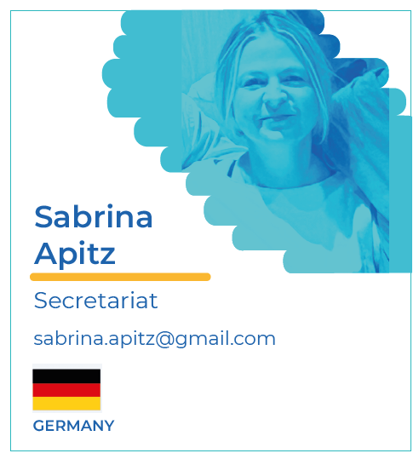
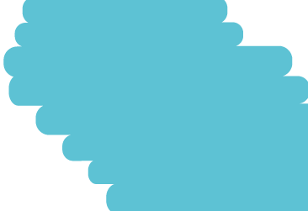
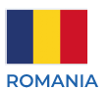
The support persons
Andrei
Popescu
Communications
andreipopesq@gmail.com

Slide 24


