Slide 1


Slide 2
Belgium

Slide 4
Norway

Slide 5
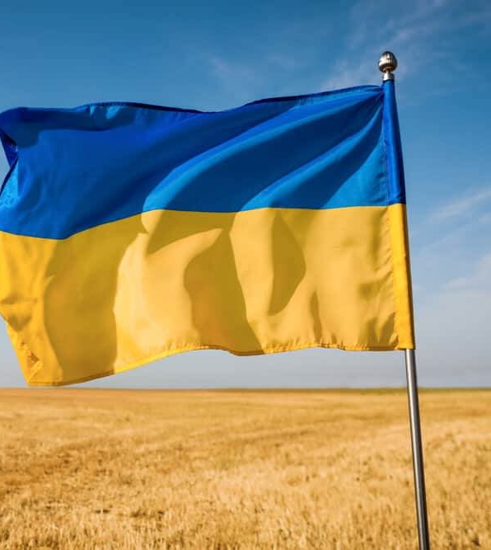
NORWEGIAN NA YOUTH & UKRAINE
64.301 refugees so far
2024: 10.000
12 applications → 9 sent to assessment
Please contact us to share experiences and ideas!
camillaringdal.Dukefos@bufdir.no
Notes:
Hvilke utfordringer står vi overfor i Norge mtp Ukrainske flyktninger, og hva er prognosene for ankomst?
The Directorate of Integration and Diversity (IMDi) requested all municipalities to collectively receive 38,000 refugees in 2023. IMDI provides online data on its website regarding the number of Ukrainian migrants, allocation places, settled individuals, and their distribution at the county and municipal levels, which is updated weekly. This helps us keep track of municipalities with the highest number of Ukrainian migrants. Additionally, statistics from the Directorate of Integration and Diversity show that registered applications for protection from Ukrainian citizens in 2022-2023 amount to 64,301, with the majority being children, youth, and women. For 2024, UDI refers to a planning forecast of 10,000 refugees from Ukraine, but the number is highly uncertain.
However, the challenge here is that we lack data on how many Ukrainian children and youth are involved in integration activities in various municipalities. Each of the municipalities we have established contact with demonstrates a sincere interest in opportunities for both local and international support for Ukraine.
We firmly believe that our Erasmus+ Youth program can play a central role in facilitating the local integration process and enhancing the capabilities of the youth participating in these initiatives.
Hva har vi gjort for å synliggjøre muligheten i Erasmus+ ungdom for de som ønsker å lage aktiviteter for ukrainske flyktninger og ukrainske organisasjoner?
We used various channels to disseminate information about opportunities for partnerships with and involvement of Ukrainian organizations and youth locally in Norway:
Updated our Erasmus+ website provides detailed information about the available opportunities, along with the exceptions made for implementing local youth exchanges. We have also included a link to the support program. Furthermore, contact details for the person responsible for addressing initial inquiries and guiding support organizations and municipalities through the application process are available.
We established contact with Frivillighet Norge, the advocacy and policy collaboration platform for the voluntary sector, comprising over 350 member organizations and more than 50,000 local chapters throughout Norway. Here, we identified organizations directly engaged in refugee work, particularly with Ukrainian refugees. Subsequently, we compiled a contact list and conveyed information about the opportunities for project support through Erasmus+.
We initiated direct communication with KS (the municipal sector's organization). All Norwegian municipalities and county municipalities are members of KS. They had already been in dialogue with over 40 municipalities expressing interest or already in contact with Ukrainian municipalities. These municipalities were directly engaging with youth councils and fostering ideas for cross-collaboration. We leveraged this opportunity to invite the municipalities to a webinar where we shared information about various support programs through Erasmus+ and encouraged all those interested to reach out for guidance.
Hvem har søkt, hvem har vi sendt videre og hvilke aktiviteter har vi søkt om?
4 organization – youth exchanges (1 Eligible)
4 municipalities – youth exchanges (4 Eligible)
1 municipality - youth participation activities (1 Eligible)
1 organization - youth participation activities (1 Eligible)
1 municipality – mobility of youth workers (1 Eligible)
+ 1 application on cooperation partnerships in youth (1 Eligible)
Total: 9 applications send to assessment
Hva gjør vi fremover?
Following up on our communication with KS, the municipal sector's organization, and are exploring the possibility of scheduling another webinar. This webinar will serve as a platform for sharing successful stories and project ideas from the municipalities that will be granted projects in the third round of Erasmus+ applications.
Targeting major organizations actively involved in refugee work or having international Ukraine partnerships, like the Red Cross, YMCA-YWCA Norway, Save the Children, and Ungdom og Fritid.
Identifying contact persons in other national agencies working on Ukrainian projects to establish a collaborative working group for sharing information and best practices.
In the process of obtaining an OID number, allowing national-level organizations to implement local youth exchanges for Ukrainian and Norwegian youths without the need for Ukrainian partnerships.
Sharing information about the possibilities within Ukrainian projects at various upcoming events, including regular seminars and webinars, such as the "Frokost seminar," organized by Erasmus+ Ungdom.

Slide 6
Malta

Slide 7
4th European Youth Work Convention
MALTA 5 - 8 May 2025
Professionals and multipliers in the youth field
To share the latest developments in youth work practice and further elaborate the Youth Work Agenda
A steering group will be set soon to start preparations
NAs organising previous editions shall be invited to participate
Other interested NAs may be considered - depending on size of group
Needed: eventual support by sending delegations and financial support

Slide 8
Ireland

Slide 9

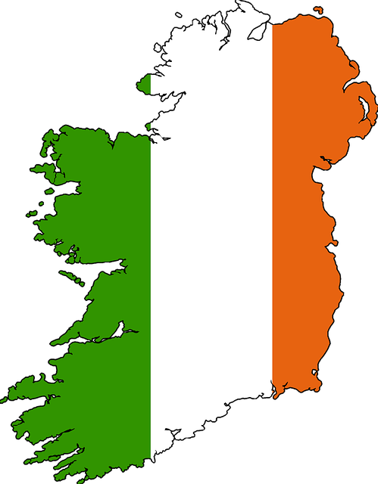
Youthlab 2024
25TH- 27TH SEPTEMBER
Ireland

Slide 10


We are seeking….
Dynamic and enthusiastic NA reps (max 4) to participate in the prep team.
What will be involved ?
Residential preparatory meeting: 2 full days on 24th -25th January 2024, in Ireland.
Online meetings with the coordinator and when needed, the organising team, during the preparation phase.
Youth LAB: 25th -27th September 2024 in Ireland.
The team is expected to arrive one day earlier.

Slide 11


How to apply…
Deadline 3rd November 2023
Email to youthlab24@leargas.ie
We look forward to hearing from you!

Slide 12
Czech Republic

Slide 13
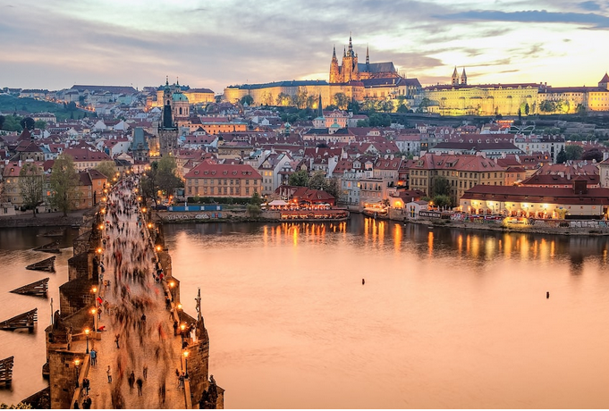
Staff meeting in Prague
December 2022 was great
Together with E&T
March – May 2024 (tbd)
Interested?

