Slide 1
KMST Working Group Members
Anna Pavlovych (PL)
Simona Musteata (RO)
Tinkara Bizjak (SI)
Jojanneke de Waal (NL)
BE FL -> new colleague (BE FL)
Gisèle Evrard Markovic (SALTO T&C)
Małgorzata Kozłowska (European Commission)
Emma Hansson (SE) -> Job-shadowing
Leaving us (new jobs)
Stephanie Nowakowski (BE FR)
Nathalie van den Meersschaut (BE FL)
New members are welcome & needed!!

Slide 2
Agenda
Job-shadowing
KMST Survey
Update KMST Welcoming Document New Head of NAs
Update KMST Staff Training Canvas
KMST Calendar 2022
Competence Framework

Slide 9
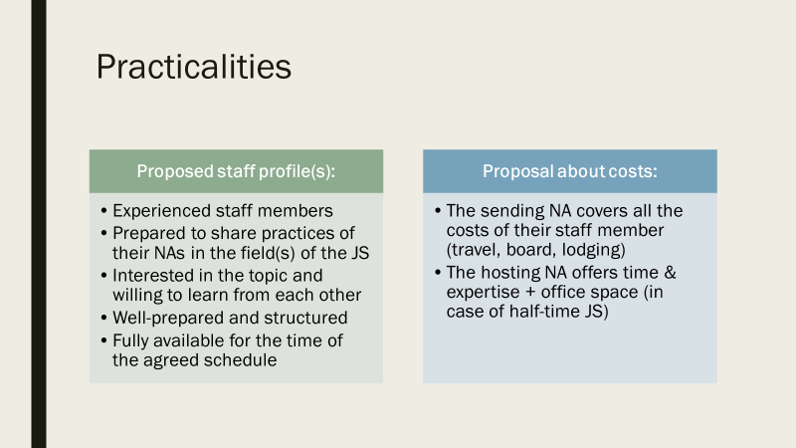

Slide 12
KMST Survey

Slide 13
KMST Staff Training Survey
Included in Training Strategy: each KA/ESC & Priority: every 18 months
Padlet & other feedback BM: too many trainings in calendar
Very difficult to find sufficient hosts
Request from BM to re-evaluate the offer
Outcome survey 2019: all training should be offered yearly
22 answers

Slide 14
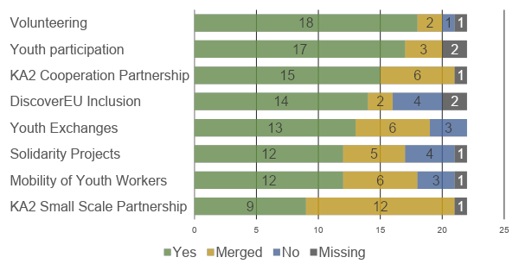
KA/ESC Staff Training
A) Youth Part.; B) Volunteering
A) Youth Work (KA2); B) YE
KA2 Cooperation Partnership
Proposal:
Merge KA210 and KA220
Solidarity Projects (pilot separate training May 2022 based on request from SP officers) & Mobility of Youth Workers: include question in evaluation of upcoming Staff Training
Specific Staff Training for all (other) KAs/ESCs

Slide 15
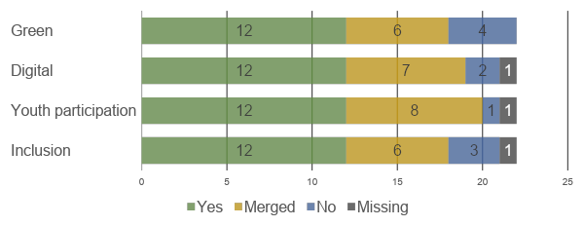
Priorities
A) All Kas/ESCs; B) All priorities together
A) All KAs/ESCs; B) SNAC
A) All KAs/ESCs; B) YE/YP/SP; C) Inclusion
A) All KAs/ESCs
Debate:
Separate staff training 18 months: 12 <-> Merged or no staff training: 9 or 10
Proposal: A) Transversal offer (include in CANVAS with help of SALTO’s), B) Youth Lab and C) Specific staff training every 2 or 3 years

Slide 16
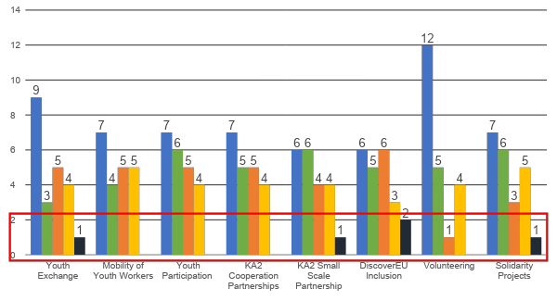
Frequency staff training KA/ESC
Ca. 50%
Tendency towards once a year
Proposal to stay with current offer (18 months)
No capacities in the field to offer all staff training once a year residential (not sufficient hosts/too much for staff)
Every KA/ESC every 18 months, with online follow-up in between if decided during Staff Training (to be hosted by prep-team of Staff Training)

Slide 17
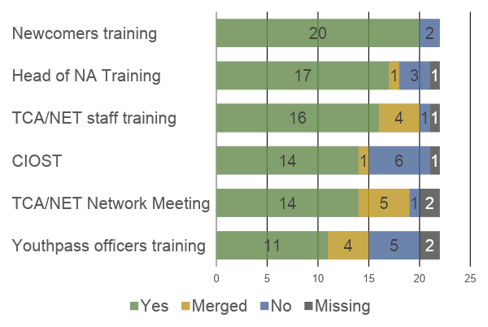
Special target groups
Proposal
No changes: all target groups (yearly as they also include other aspects; excep. Head of NA: 18 months)
All clearly needed (maybe only exception: Youthpass: include in evaluation of next meeting)
No new other target groups mentioned

Slide 18
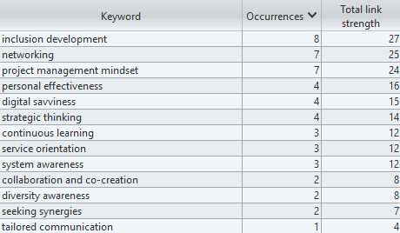
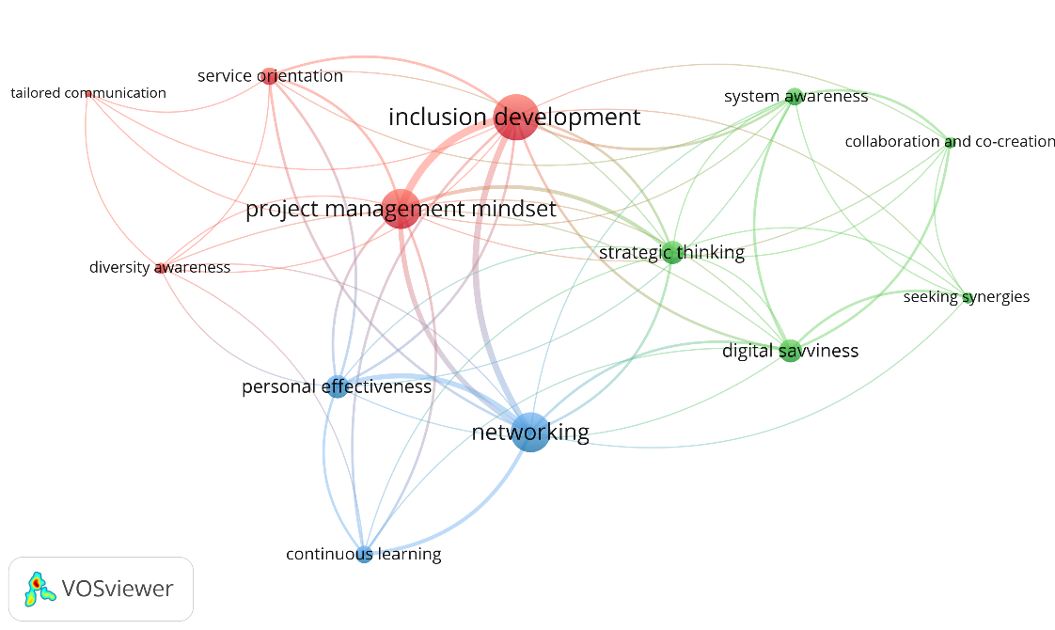
Overview of competences per training: YE
Used for staff training (e.g. 1st 3 competences)

Slide 19
Update Welcoming package new Head of NAs

Slide 20
Objectives
Welcome to the network
Knowing of existence of a strong network
Knowing where to find which information
Link to buddy within the co-group
Mainly links to information!

Slide 21
Proposal Content
Welcoming letter
Network & Co-group
KMST
Relevant Strategies & SALTO’s
SNACs & TCA/NET
RAY
List of tools
NAConnect
Offer of Buddy from Co-group
Any other suggestions?

Slide 22
Next steps
See proposal for content on BM website
Include new suggestions
Develop offer during summer
Ready before next BM

Slide 23
Update CANVAS Staff Training

Slide 24
Objectives (Training Strategy)
Quality offer
Develop a canvas for repeated staff training, including necessary elements of a training
Develop quality guidelines for implementation of NA staff trainings / events.
Support host NAs in preparing and implementing those offers.
Based on existing guidelines
Two parts: A) Practical arrangements and B) Content of training offer

Slide 25
Content CANVAS
Based on existing guidelines
Two parts: 1) Practical arrangements (to support especially new hosts) and 2) Content of training offer
Proposal for content elements of training
Strategy development (incl. proposal of possible topics)
Competence Development (competence framework)
Quality development (discussion, link to TCA, etc.)
Operational topics
Knowledge management/support throughout the year (how to find each other)
Evaluation

Slide 26
Next steps
See proposal for content on BM website
Include new suggestions
Develop offer during summer
Ready before next BM

Slide 27
KMST Calendar 2022

Slide 28
Calendar 2022
Offer 2022 complete; all trainings have hosts! Thank you!!
Finally Youth Lab has taken place!
Nice to mention for Calendar 2022:
Several new comer staff trainings
Separate Solidarity Projects staff training (based on request SP officers and confirm KMST Strategy)
First DiscoverEU staff training
KA210 & KA220 combined
First Digital staff training
Meeting on Partner Countries (no staff training)
Current calendar always accessible through SALTO website (now 2022/2023)
https://docs.google.com/spreadsheets/d/1Br3LNEsfQ0HmzNfvmAu0V9KlKHt7w6z04xpR-RuzRII/edit#gid=2089043716

Slide 29
Other topics Calendar
Calendar 2023 to be developed based on outcomes of BM today
As soon as we have a start, we will send an update per email
Youth Lab 2024: Ireland!

Slide 30
Short reflection
https://padlet.com/domagoj_moric/kmst_padlet
Please share your thoughts and remarks on the following, if something is unclear or needs more elaboration, please explain below.
Jobshadowings
Programme priorities: KMST proposal A) Transversal offer (include in CANVAS with help of SALTO’s), B) Youth Lab and C) Specific staff training every 2 or 3 years
Update Welcoming package new Head of NAs – anything missing?
Staff trainings 2023 – anything missing in the calendar? Anything missing in training CANVAS?
General impressions
Competence Framework – next steps. Which option are you for the budget split? Is everything clear?

Slide 31
Competence Framework

Slide 33
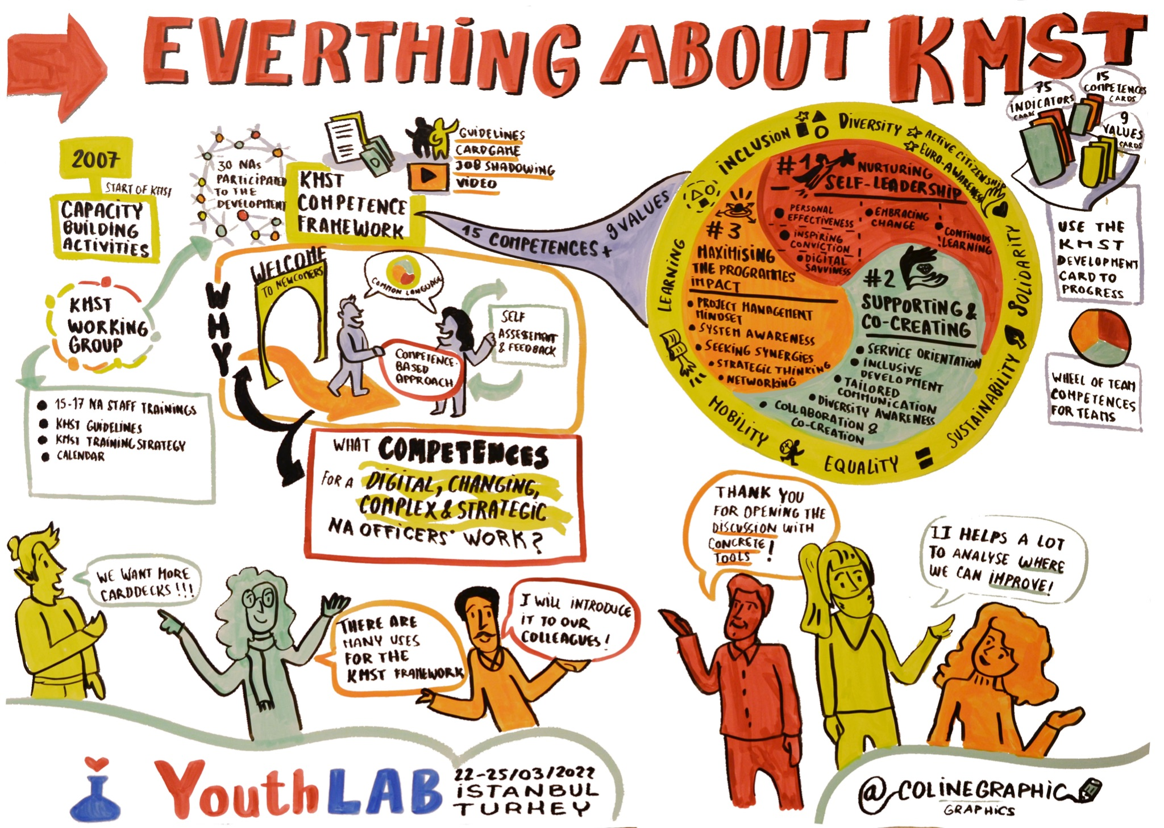

Slide 34
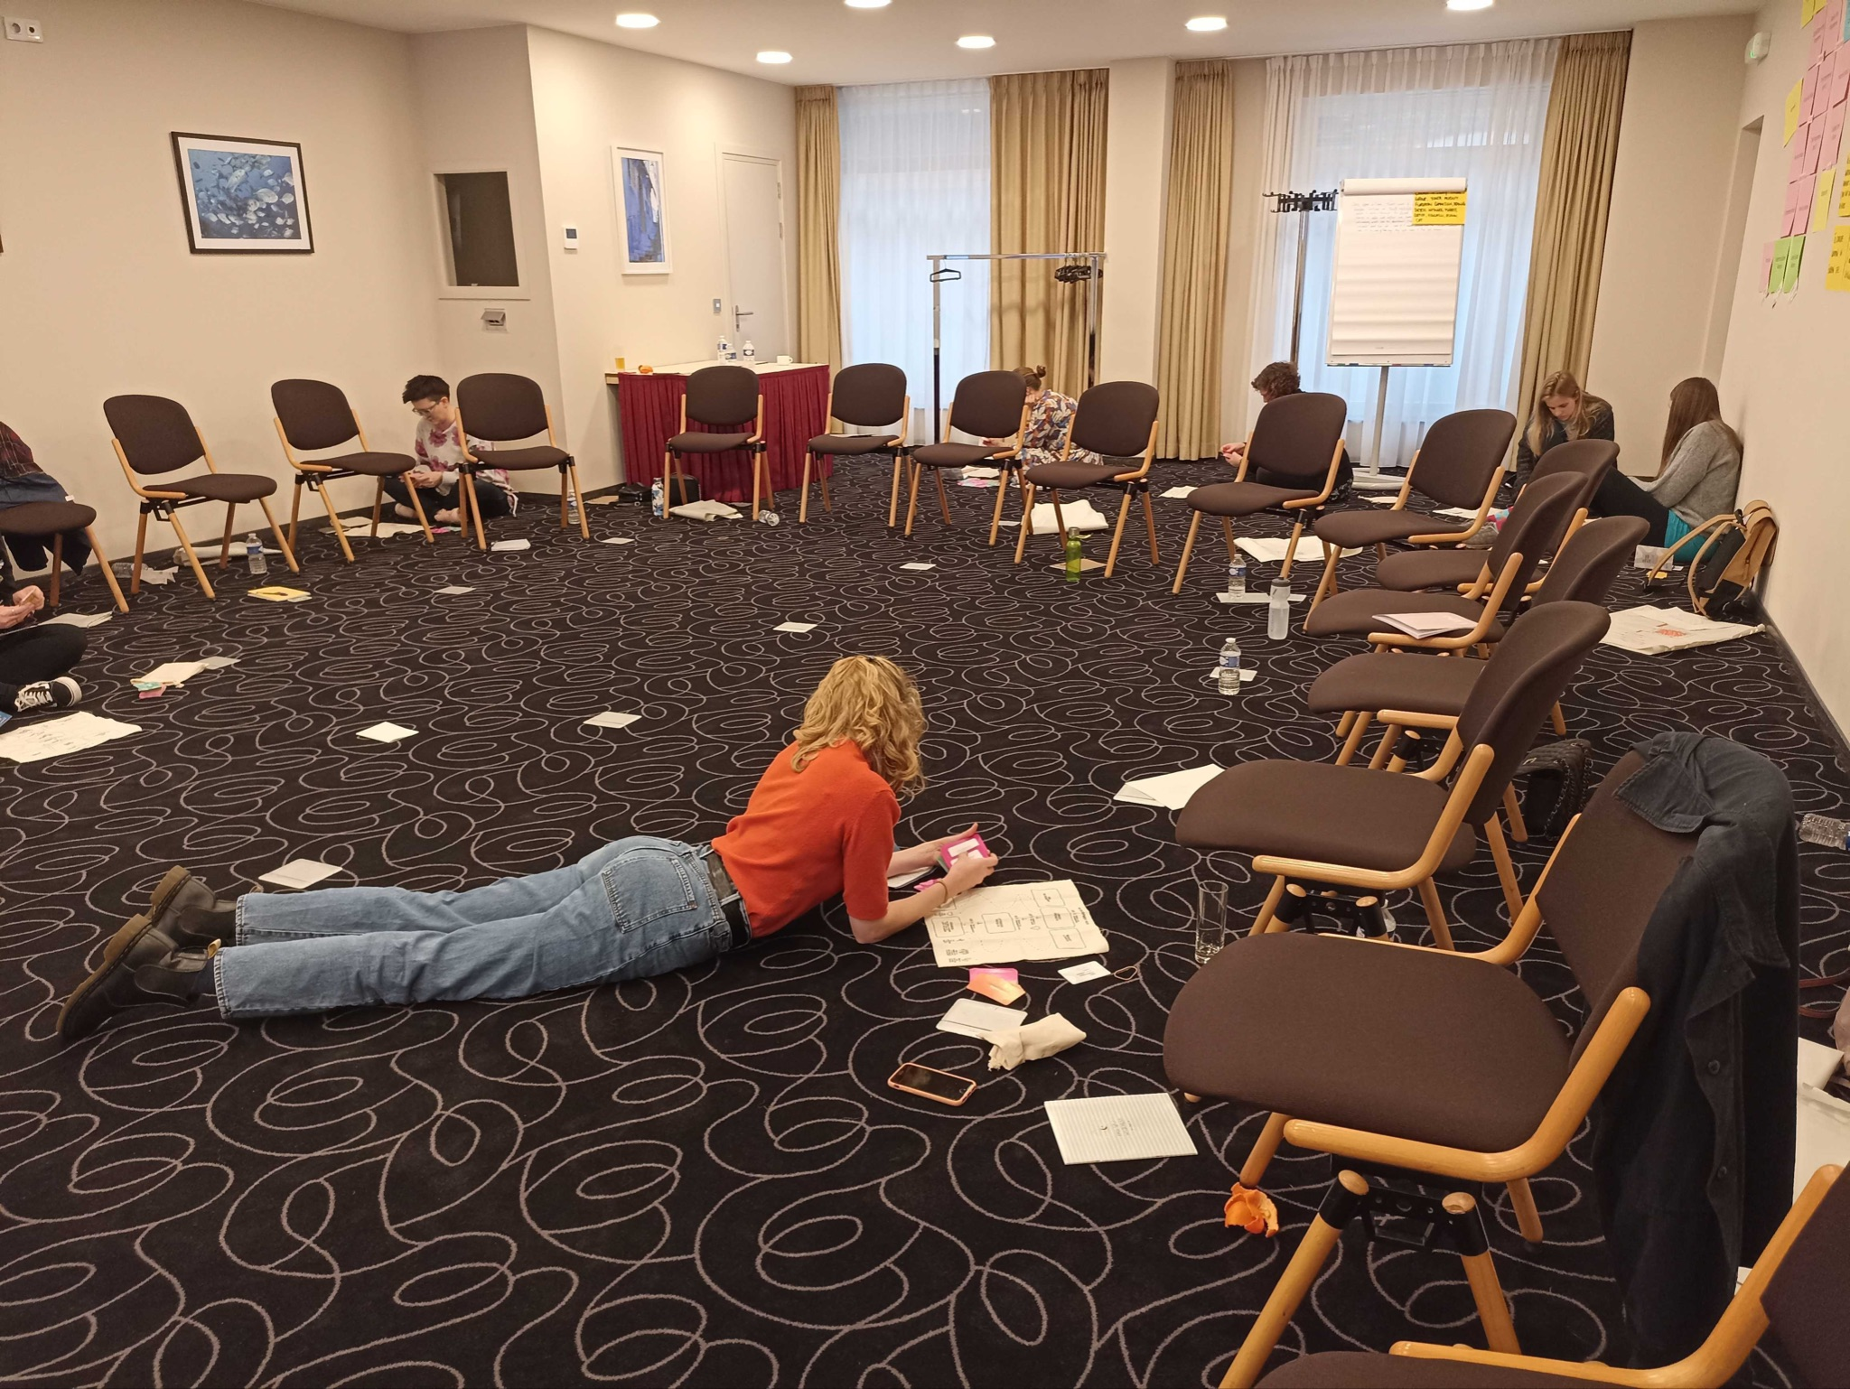
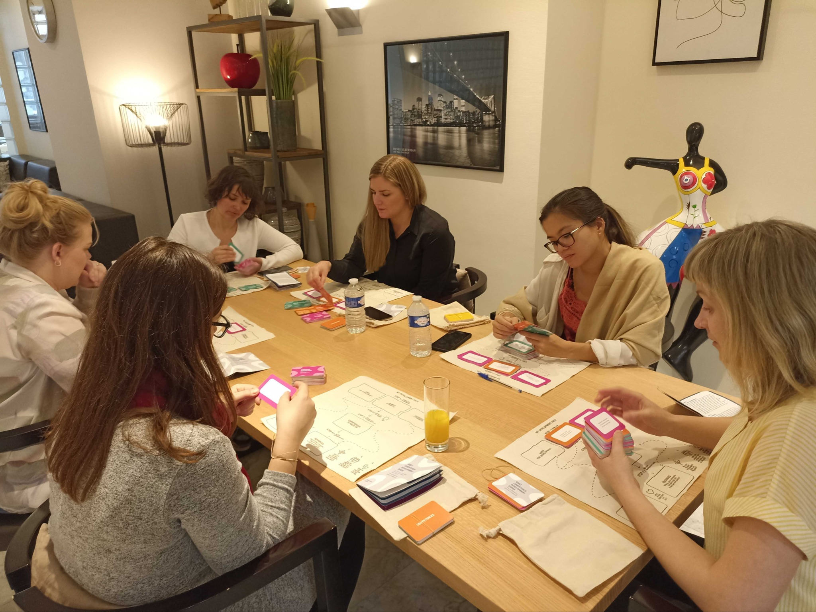
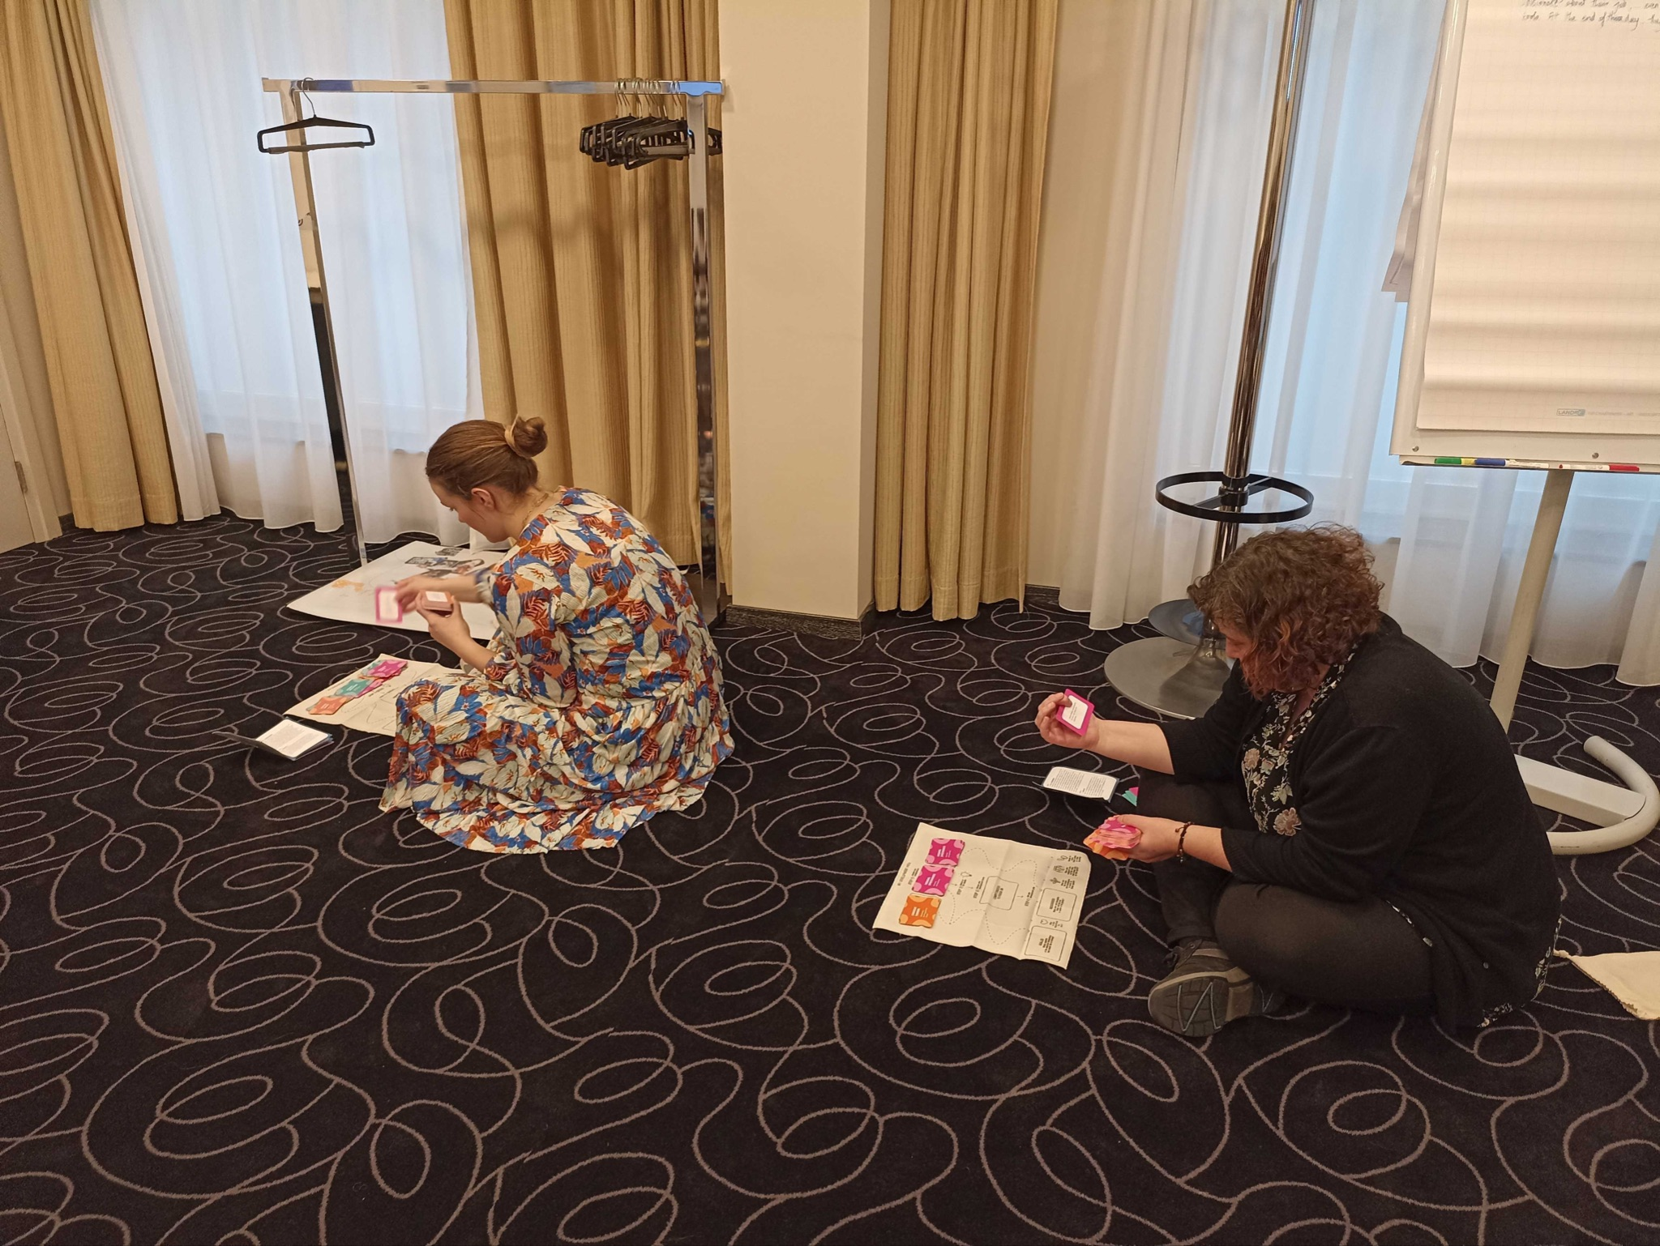

Slide 35
Reminder: How it was developed
From November 2020 till October 2021
‘From scratch’, using the bottom-up approach.
Based on the actual experiences of the NA officers on how they recognise the quality performance
Mapping key functions of NA officers
Desk research
Two extensive surveys with National Agency officers
Interviews with the Heads of National Agencies.
30 National Agencies were involved in the development of the Competence Framework

Slide 37
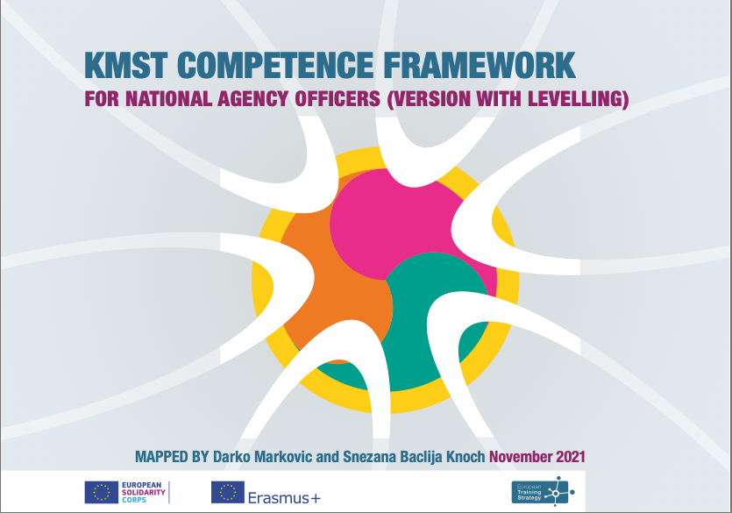
Two versions: without levelling and with levelling

Slide 38
KMST Competence Framework - structure
A. Essential Knowledge
B. Core Values
C. 15 competences with indicators, grouped in 3 clusters

Slide 39
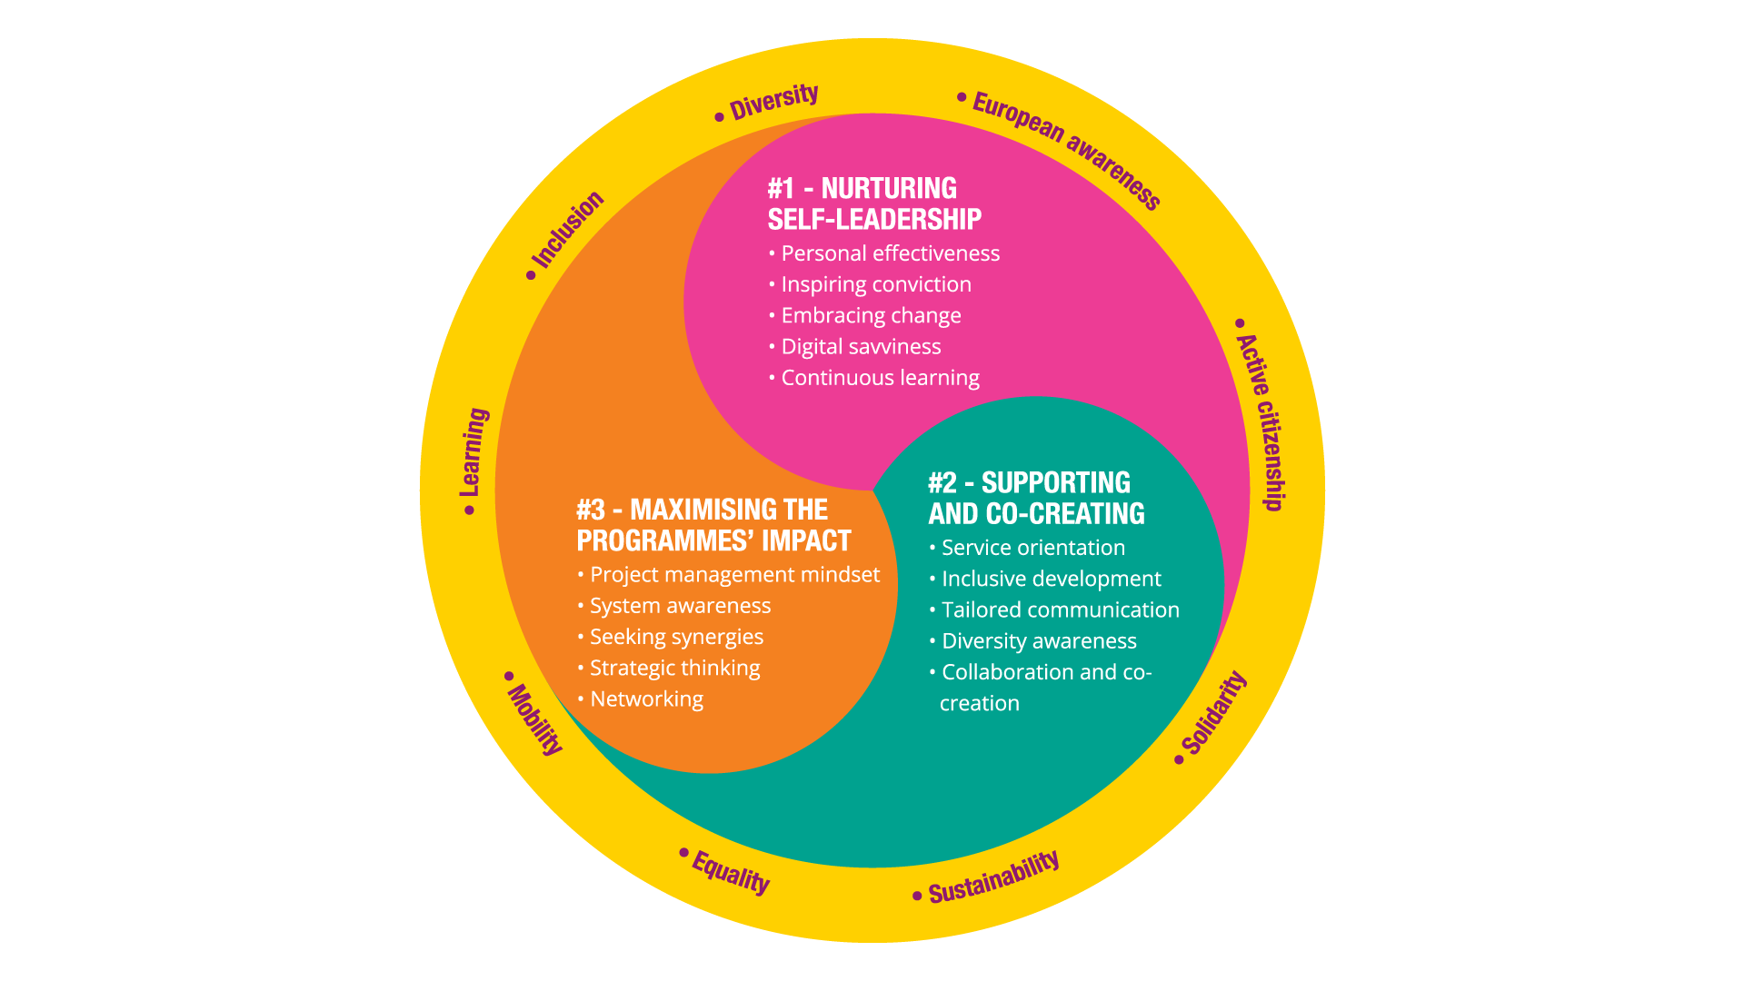

Slide 40
Cluster #1: Nurturing Self-Leadership
Focus: Self
Competences:
1. Personal effectiveness
2. Inspiring conviction
3. Embracing change
4. Digital savviness
5. Continuous learning

Slide 41
Cluster #2: Supporting and Co-creating
Focus: Other
Competences:
1. Service orientation
2. Inclusive development
3. Tailored communication
4. Diversity awareness
5. Collaboration and co-creation

Slide 42
Cluster #3: Maximising the Programmes’ Impact
Focus: Outter
Competences:
1. Project management mindset
2. System awareness
3. Seeking synergies
4. Strategic thinking
5. Networking

Slide 43
KMST CF with developmental levelling

Slide 44
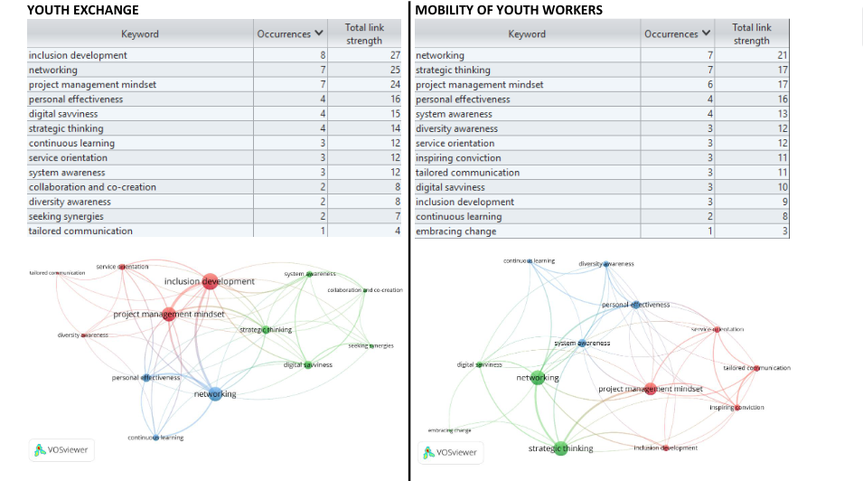

Slide 45
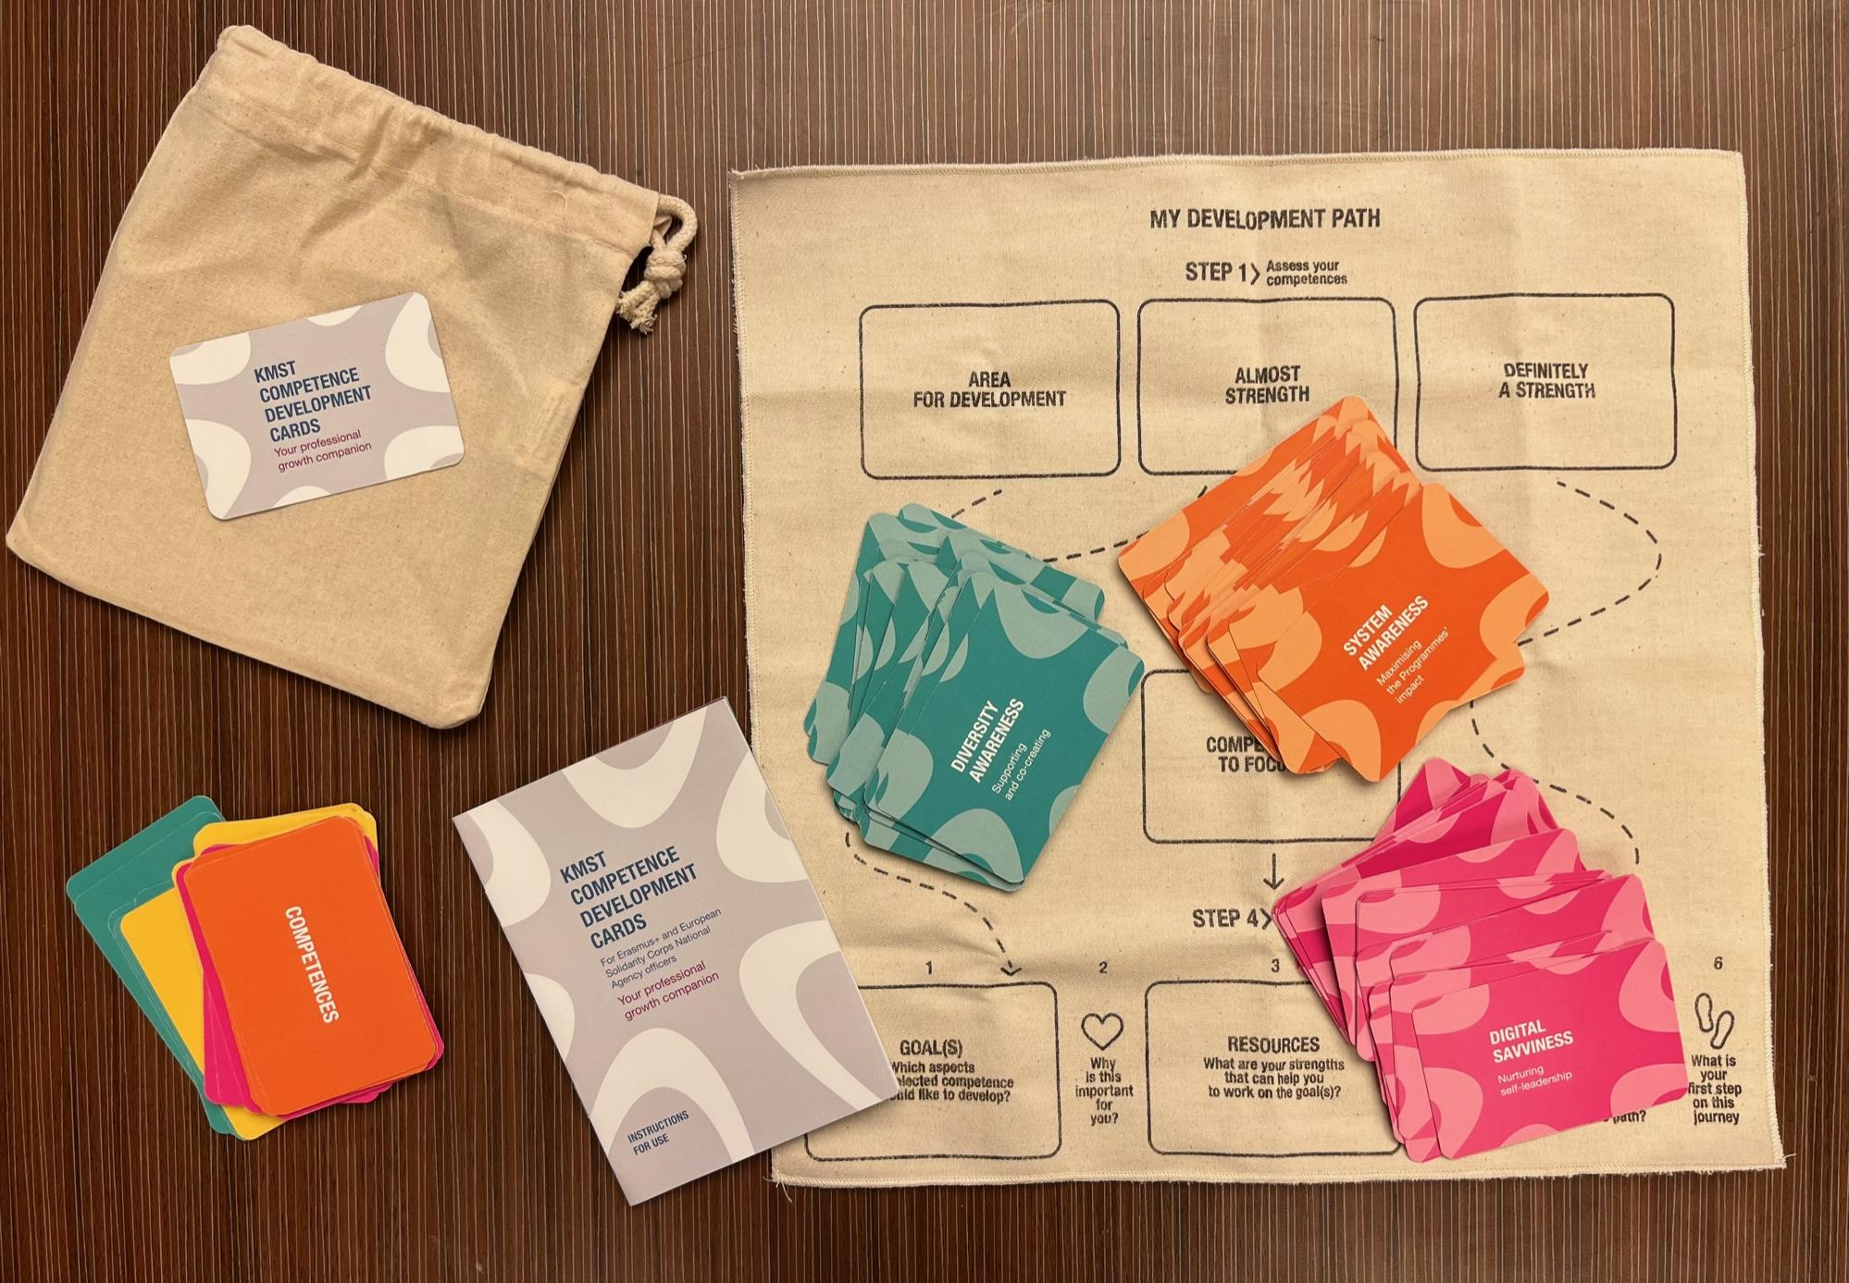
Self-assessment and development cards

Slide 46
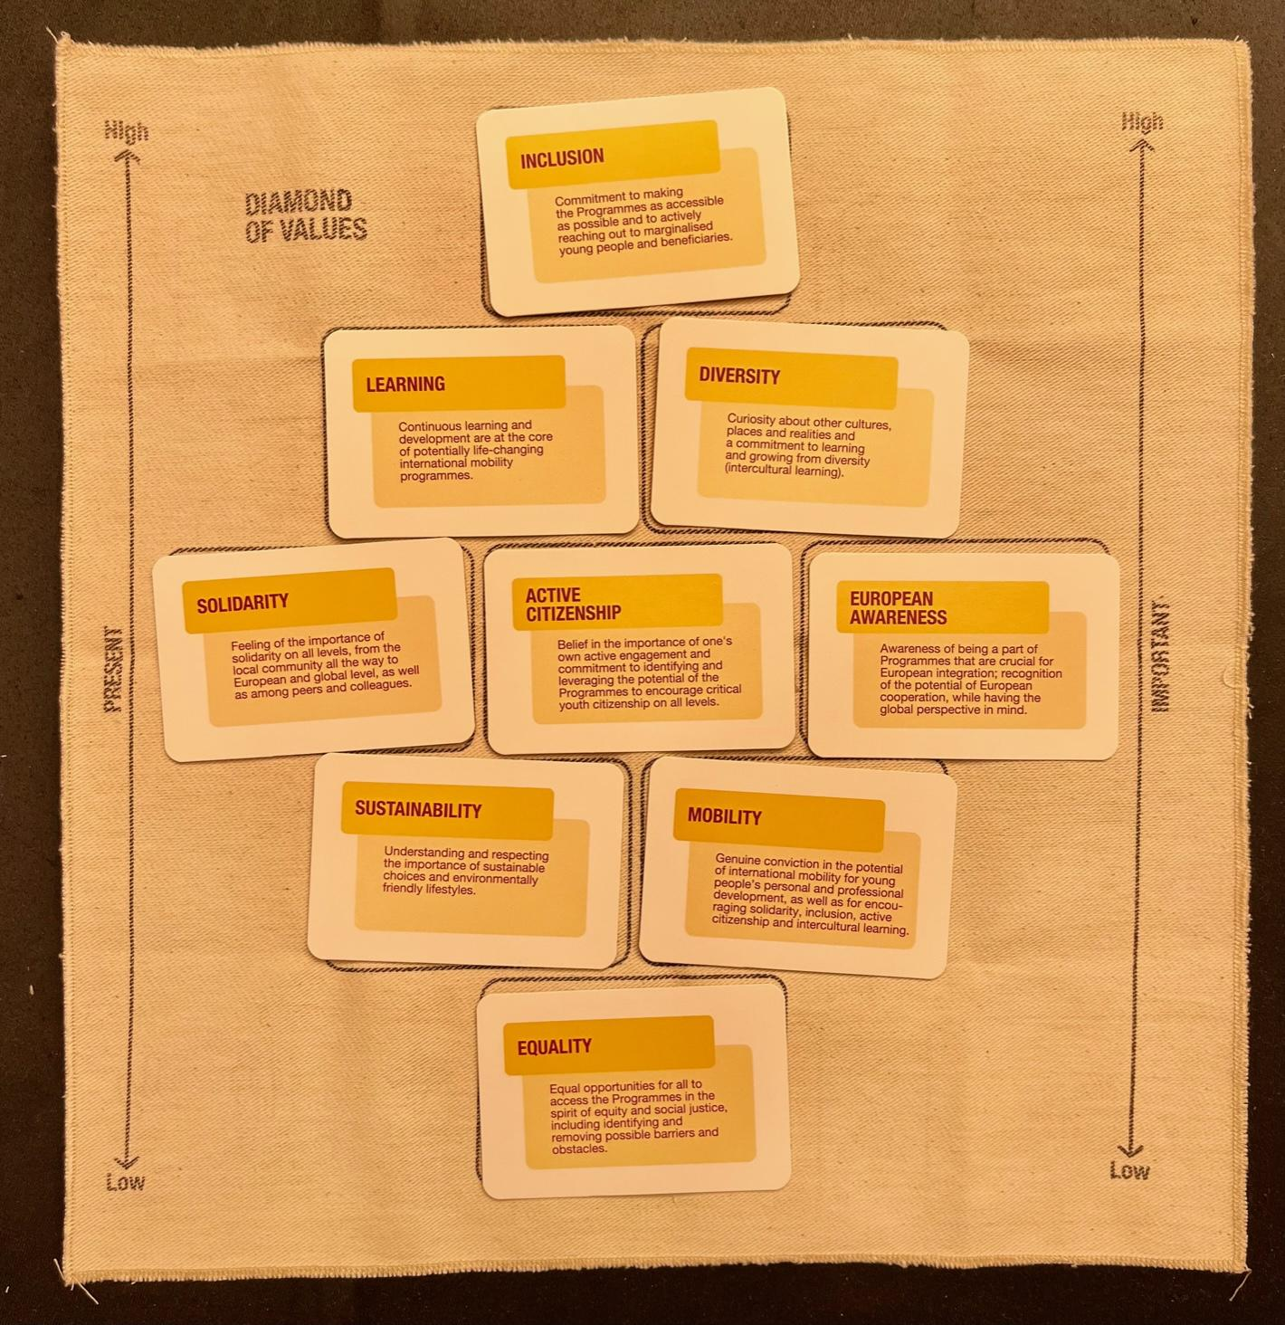
Diamond of Values: reflection on values that are guiding our work

Slide 47
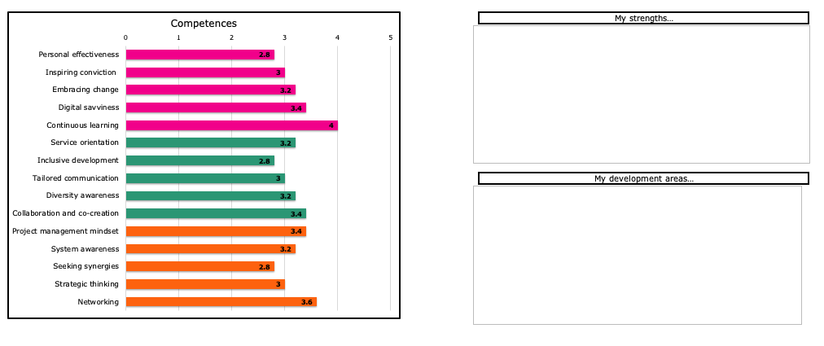
Digital Self-assessment Tool

Slide 48
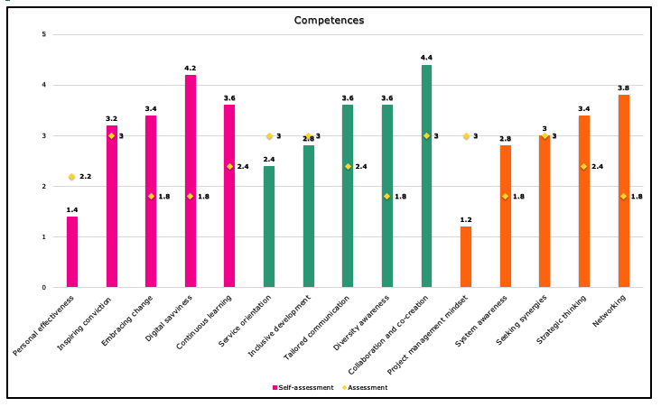
Digital Feedback Tool (without levelling)

Slide 49
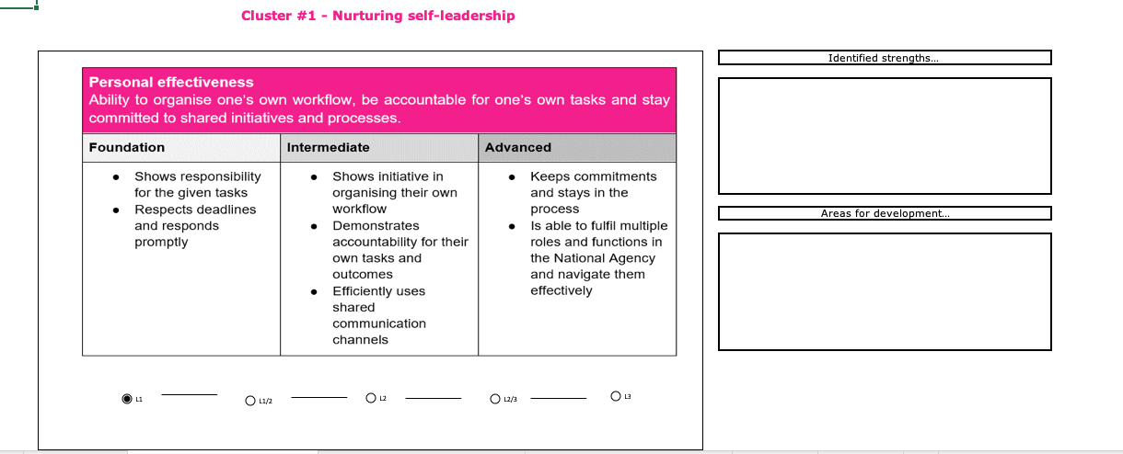
Digital Feedback Tool (with levelling)

Slide 50
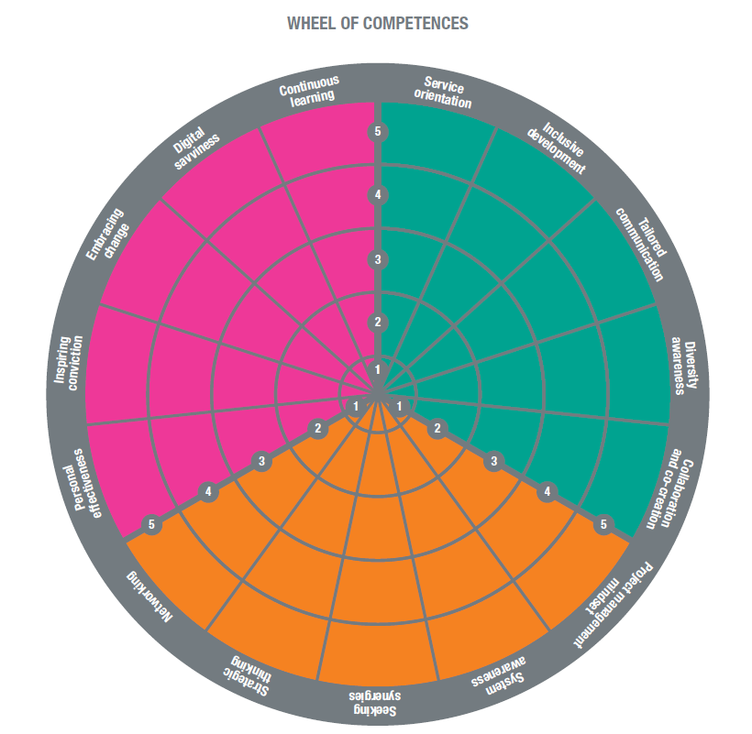
The Wheel of
Team Competences

Slide 51
Exercise: experiencing the KMST feedback tools
Choose which tool to use: with leveling or without levelling
Self-assessment part is already pre-filled
Your task is to do the assessment part
Having in mind one officer from your NA
In the version without levelling start with the sheet ”Instructions A” and then click on “Assessment”, it will take you to the inventory. You respond on the scale from ”Never” to “Consistently”
In the version with levelling, read the sheet ”Instructions A” and then click to the following sheets for each competence cluster. You respond by identifying the developmental level: L1 - L1/L2 - L2 – L2/L3 – L3

Slide 52
Main areas of the KMST CF application
Strategic management of the competence development (KMST WG)
Competence-based training design in KMST staff trainings (Trainers)
Self-assessment (NA officers)
Feedback and development talks (NA officers and Heads of NAs)
Coaching and development (NA officers and Heads of NAs)
Team reflection and team assessment (Teams in the NAs)

Slide 53
Steps in the implementation during 2022
Including the CF in the annual survey of training needs
Webinar for Heads of NAs (5. May 2022, 10:30-13:00)
Webinars for NA officers (in May and June, TBC)
Introduction video for the Competence Framework
Training and guidelines for KMST trainers
Supporting trainers in using it during the pilot phase in 2022
Instruction package for use of the tools for Heads of NAs (Coming soon!)
Collecting experiences about its use by the National Agencies
Evaluation of the pilot use and implementation (end of 2022)
Revision of the tools and methodology (end of 2022)
Writing the manual for the overall methodology (end of 2022)

Slide 54
Next steps
Testing of Framework & tools
The Competence Framework will be piloted in three courses before summer 2022
Evaluation of testing before summer
Final approach on how to use the Competence Framework in Staff Training (end of 2022)
Start up Webinars
May: ½ day webinar for Heads of NAs: how to use it in NA professional development practices
May: webinar for trainers of staff training pilot phase: how to use it during staff training
May and June: webinar for interested NA staff
Use
Link will be shared with all Heads of NAs
Introduction video will be developed before summer 2022
Instruction document for Heads of NA and staff
Guidelines for KMST trainers
Use will be included into KMST staff training Canvas
Integrated in the ETS monitoring and evaluation process

Slide 55
Budget Competence Framework
Webinars and support videos
€ 10.240 + 19% VAT (2 persons 16 days at € 320 a day. So 2 x 2 x 8 x € 320 = € 10.240 ex vat = € 12.185,6 incl. VAT)
This covers all activities until the end of 2022 + additionally € 5.000 should be added for video costs
Shared: then half of last invoice (but lots of work) so if some agencies could volunteer to split the costs (e.g. €15 000 split 5-6 times = € 2.500-3.000 per 1 NA), that would help a lot.
Printing of tools
Cards: cards for test events are included in the costs
After testing the final versions will be shared with all NAs to be printed locally for staff. We will come back to that
Proposal
To be checked.
Use usual split? Or divide among 5 or 6 NAs?

Slide 56
KMST PADLET - please share your thoughts
https://padlet.com/domagoj_moric/kmst_padlet

Slide 57
KMST Working Group Members:
Anna Pavlovych (PL)
Simona Musteata (RO)
Tinkara Bizjak (SLO)
Małgorzata Kozłowska (COM)
Jojanneke de Waal (NL)
Gisèle Evrard Markovic (SALTO)
Emma Hansson (SE) -> Job-shadowing
New members are welcome & needed!!

