Slide 1
From Ljubljana to Paris

Slide 2
BM Ljubljana, 5th to 8th of October 2021 Connecting the Dots and Coming Together

Slide 3
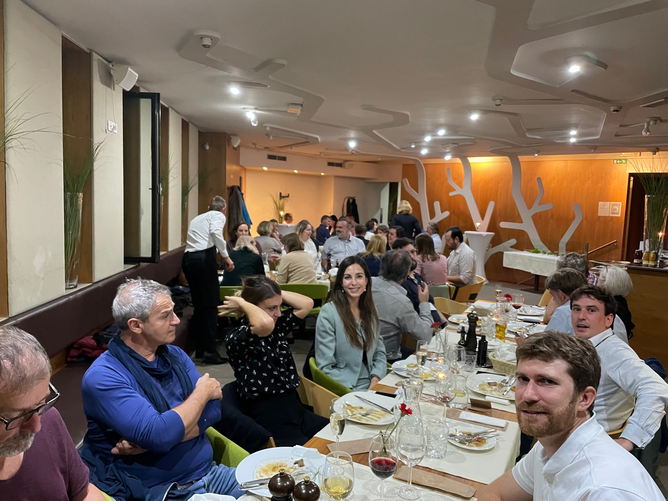
To reconnect with colleagues and meet physically in a larger group since the beginning of the pandemics

Slide 4
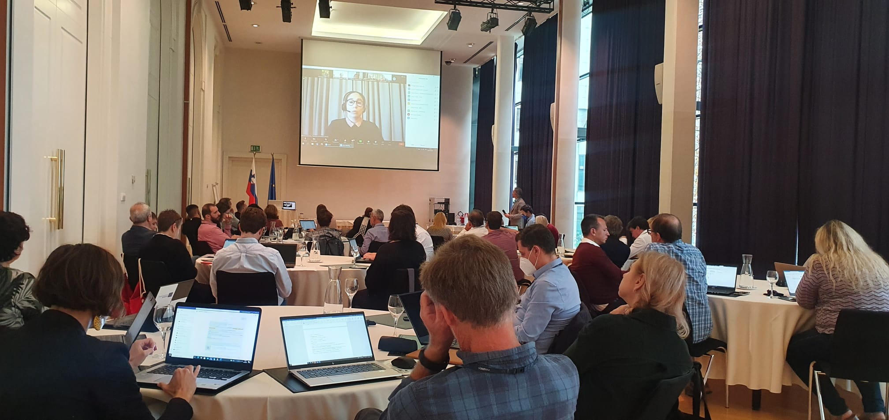
To share and get support for the implementation of the new Programmes and development of multiannual work plans

Slide 5
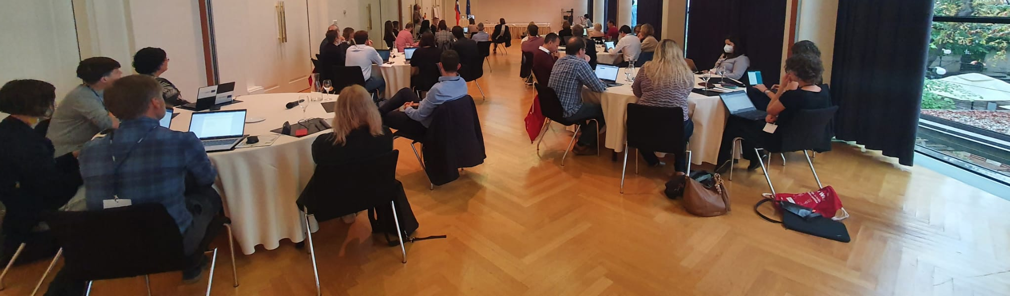
To work together on the inputs for the NA Network Work Plan for the forthcoming period

Slide 6
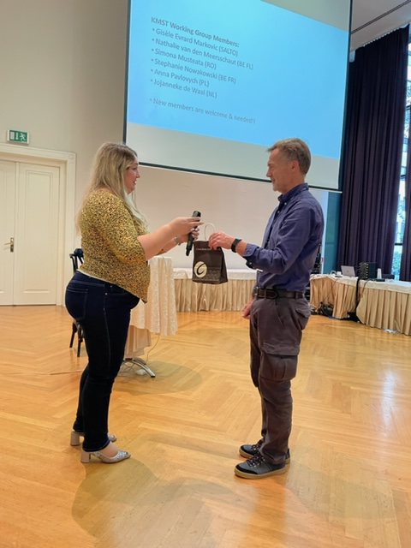
To update and consult with the colleagues about the KMST activities

Slide 7
Probably much more, but especially…

Slide 8
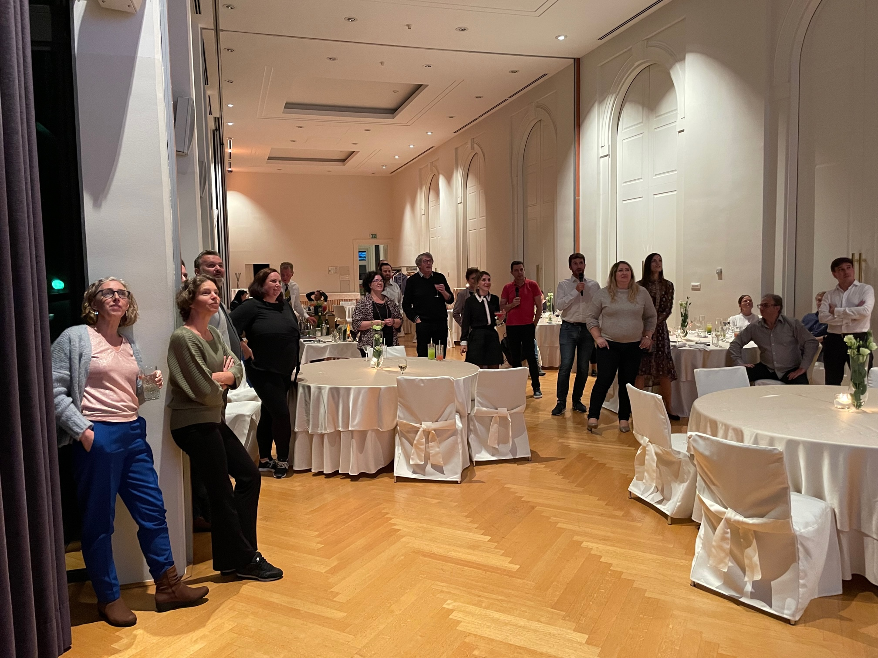
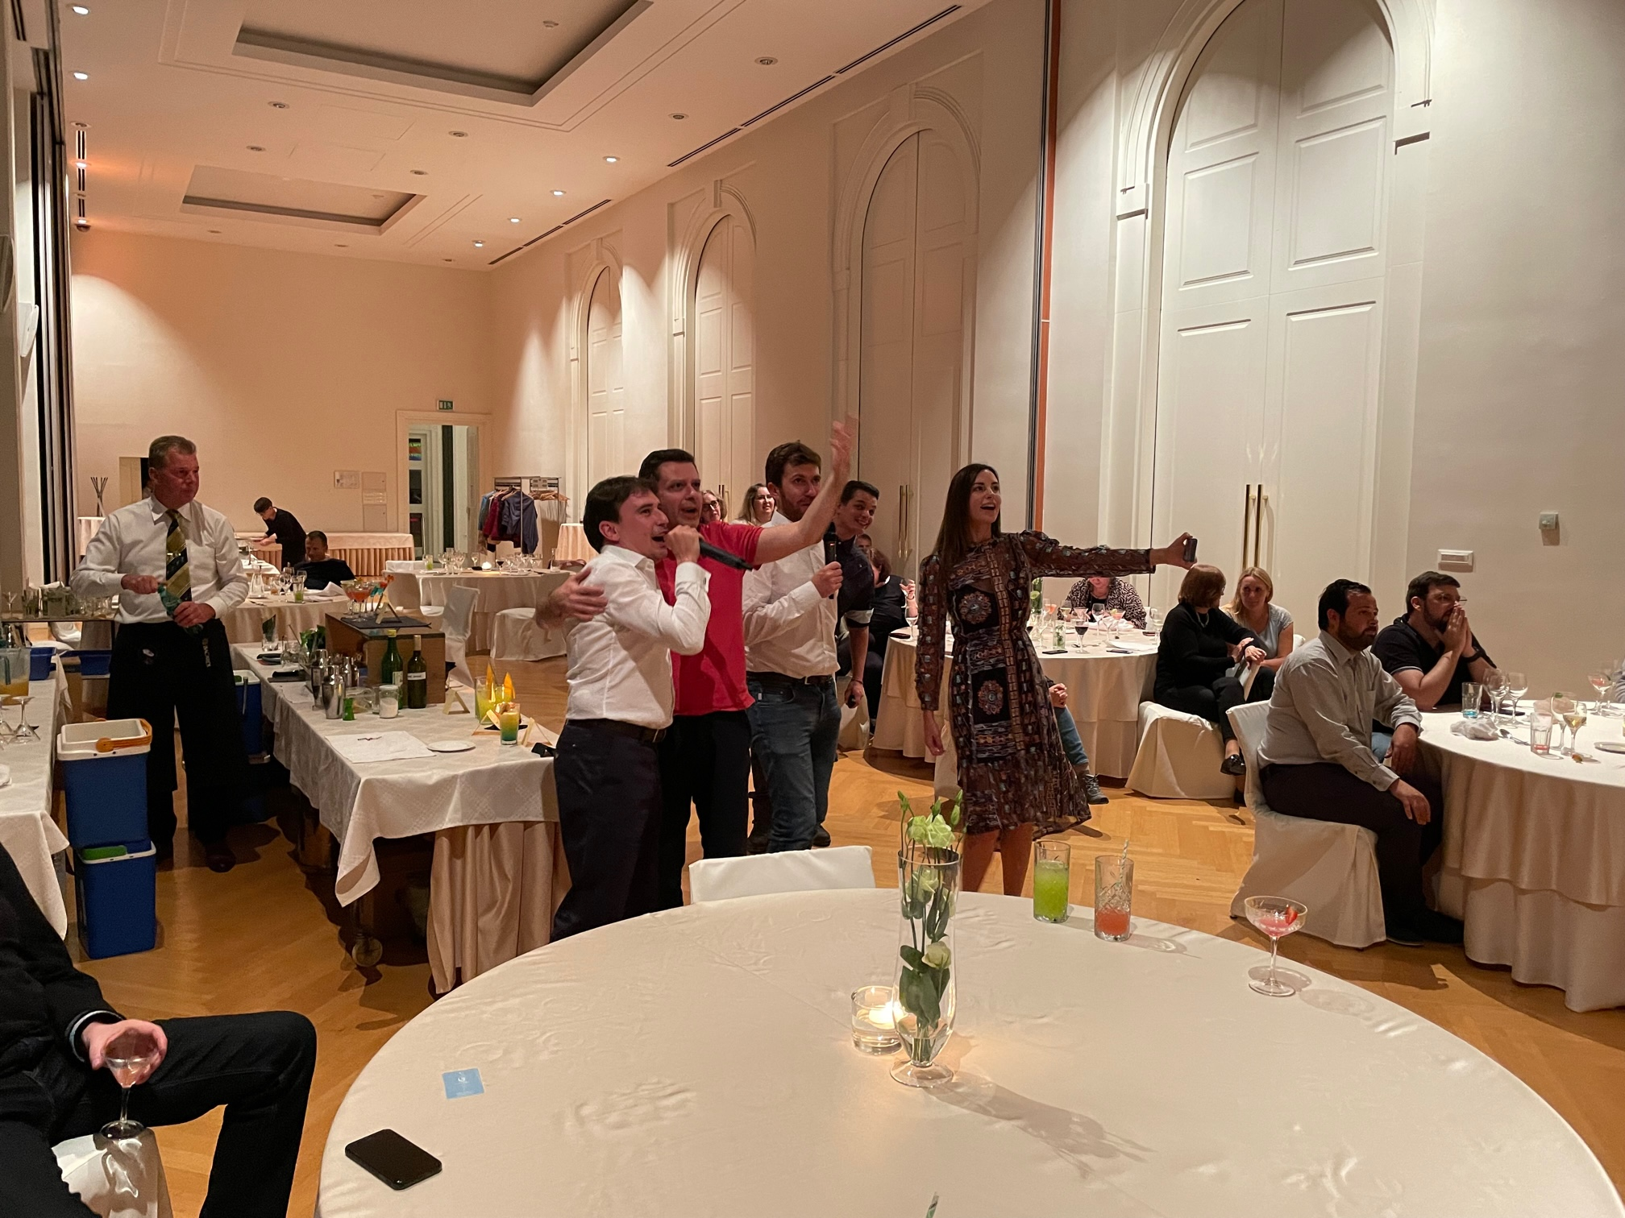
To sing karaoke. ☺

Slide 9
And after BM in Ljubljana?
Executive summary prepared and sent to COM
Letter sent to COM to extend eligibility period for TCA/NE/STEC/DEU
Ask your colleagues sessions for Heads

Slide 10
And after BM in Ljubljana?
Reinforcing the network
Working on network strategy
Working on action plan
Proposal for funding
Welcoming new members in the co-group
Keeping up dialogue with EC

Slide 11
And after BM in Ljubljana?
Implementing the programmes in the context of war in Ukraine
Ask your colleagues session
Proposals sent to EC
Brainstorming with EC
Preparation of BM in Paris
To reconnect with colleagues and meet physically in a larger group since the beginning of the pandemics
To share and get support for the implementation of the new Programmes and development of multiannual work plans
To work together on the inputs for the NA Network Work Plan for the forthcoming period
To update and consult with the colleagues about the KMST activities
To get updated about relevant developments and initiatives in the Network (e.g. Cooperation platform, Recovery conference, etc.)

