Slide 1
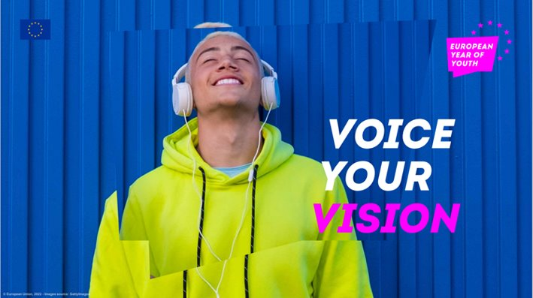
Ioannis Malekos Head of Unit DG EAC.B3
European Year of Youth 2022 - update
EYY2022@ec.europa.eu

Slide 2
The Year’s Main Objectives
1. Renewing the positive perspectives for young people, and drawing inspiration from young people
2. Supporting young people, especially those with fewer opportunities to become active and engaged citizens and actors of change
3. Promoting opportunities for young people in a green, digital and inclusive world
4. Mainstreaming youth policy across all relevant policy fields to encourage that a youth perspective is brought into policy-making at all levels.

Slide 3
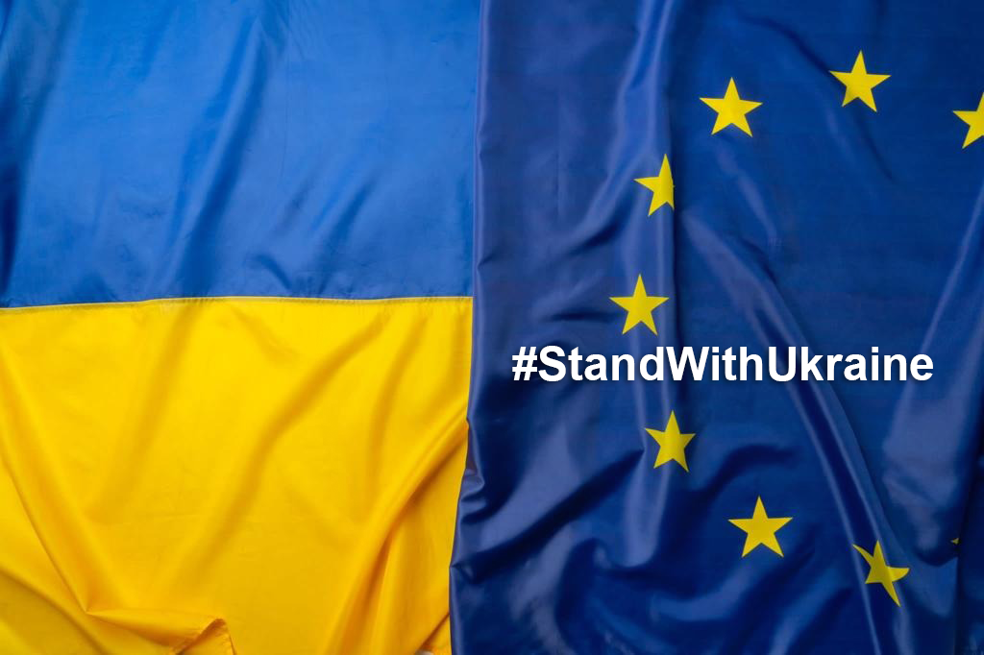
EYY solidarity with Ukraine
Narrative adjusted to fit the current situation:
"It is important to mobilise Europe’s young people around the values of solidarity, peace, unity, democracy, justice, dignity, security, safety, rule of law, freedom and fighting disinformation and to show our support towards Ukraine and its young people".

Slide 4
Across 8 policy areas
•European Learning Mobility
•Employment and Inclusion
•Policy Dialogues and Participation
•Green
•Digital
•Culture
•Health, Well-being and Sport
•Youth and the World

Slide 5
Flagship initiatives in the 8 policy areas
35th anniversary campaign of Erasmus+ (EAC)
Launch of ALMA (EMPL)
Review of the CR on Quality Framework for traineeships (EMPL)
Policy Dialogues between Commissioners and Young People (SG/EAC)
Green Track campaign in the run up to the COP15 (ENV)
Updated Better Internet for Children Strategy (CNECT)
Youth angle in the new mobility scheme for artists in the EU (EAC)
HealthyLifeStyle4Youth Ideas Labs (EAC)
Youth Guarantee for the Western Balkans (NEAR/EMPL)

Slide 6
Policy Dialogues as a flagship initiative
Giving young people the space to directly engage with high-level decision-makers, notably with European Commissioners.​
In the context of meaningful conversations about the topics of their interest and concern. ​
Each Commissioner would devote at least two hours to the Policy Dialogue to engage with young people. ​
The young participants will be able to raise questions, share ideas and suggestions face-to-face (or on-line) with the Commissioner responsible for the area they are interested in.

Slide 7
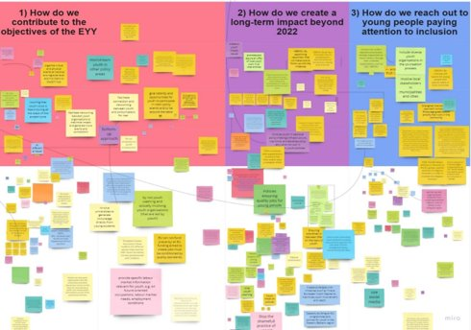
Co-creation
EU institutions
Youth stakeholders
29 National coordinators
National Contact Points
National Agencies
Creative Europe Desks
Young people

Slide 8
Examples of relevant activities for 2022
conferences, events, and policy initiatives to promote an inclusive and accessible debate
promoting youth participation: new tools, channels, programmes
gathering ideas using participatory methods to co-create and co-implement the Year​
information, education and awareness-raising campaigns to convey values such as respect, equality, justice, solidarity, volunteering​
creating spaces and tools for exchanges on turning ideas into actions in entrepreneurial spirit
studies and research on the situation of youth
promoting programmes, opportunities, projects, actions & networks

Slide 9
Budget increases within Erasmus+
Increase in management fees
Youth Participation Actions by EUR 13 million (↑76%)
Training & Cooperation Activities by EUR 2 million (↑10%)
Top-up to Eurodesk network by EUR 240,000 (↑10%)
Eurodesk Brussels link by EUR 70,000 (↑10%)
National Working Groups EUYouth dialogue by 100,000 EUR (↑10%)
National Coordination EYY by EUR 4,5 million (new)
European Youth Forum by 500,000 (↑19%)

Slide 10
Budget increases within the European Solidarity Corps
Increase in management fees
Solidarity projects by EUR 2,500,000 million (↑22%)
Networking activities (decentralised) by EUR 700,000 (↑10%)
European Solidarity Corps Portal by EUR 200,000 (↑28%)
Support IT developments by EUR 100,000 (↑5%)

Slide 11
Visual identity
THE LOGO​: The speech bubble becomes the central layout element
Available in 7 colours and all languages: https://europa.eu/youth/year-of-youth/communication-material_en
THE HASHTAG: use #EYY2022 and #EuropeanYearofYouth

Slide 12
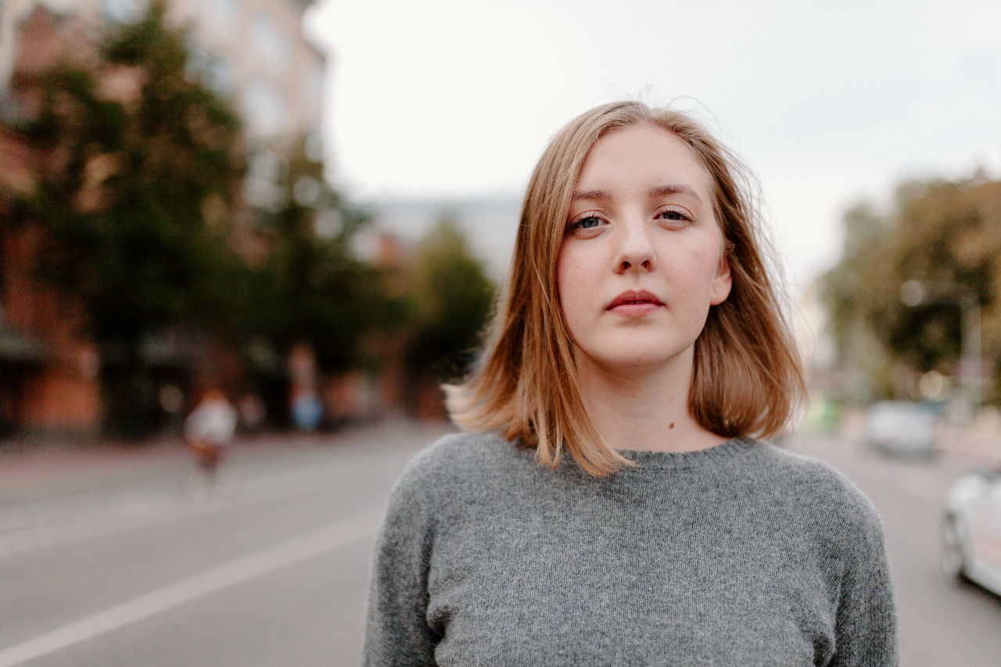
New visuals

Slide 13
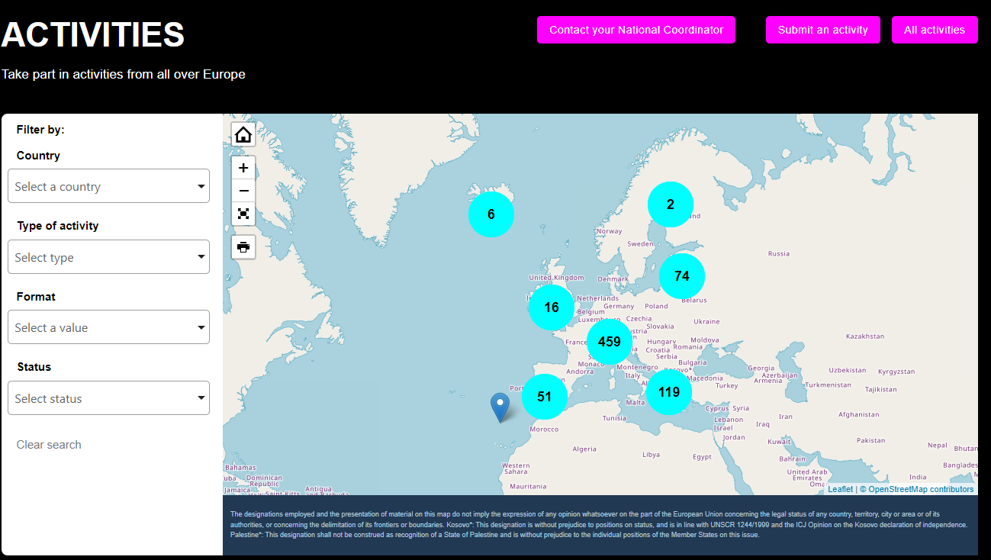
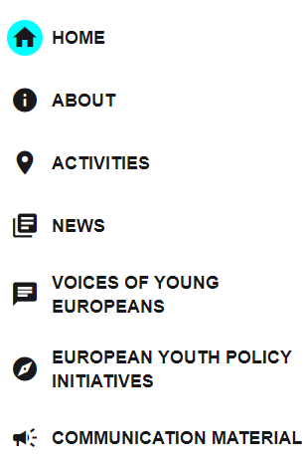
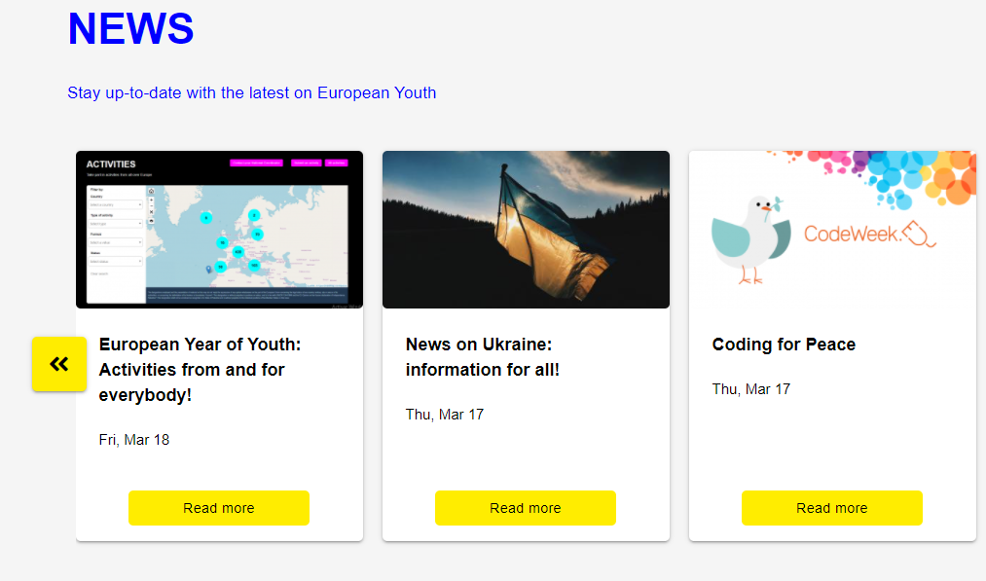
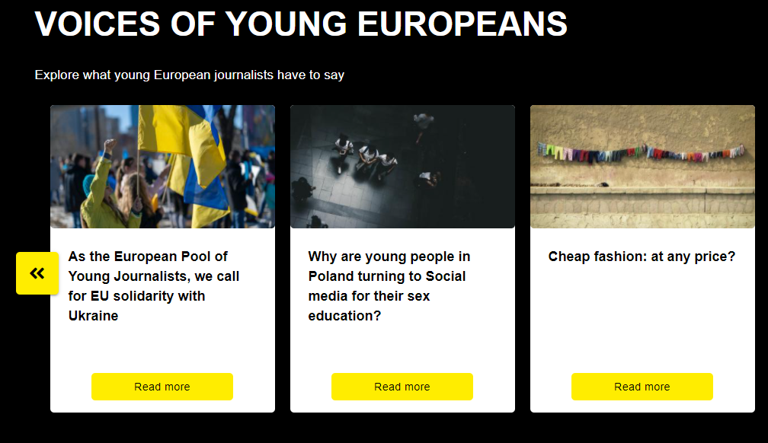
EYY pages on the European Youth Portal
- 750 activities on the map
- articles from young journalists
- European youth policy initiatives

Slide 14
EYY solidarity with Ukraine
European Youth Portal will have a strong focus on the Ukraine situation:
Relevant links and information
Display Ukranian flag and hashtag #StandWithUkraine
Addition of "solidarity with Ukraine" as topic for the Activity map and Policy section
Opinion-based articles by the pool of European young journalist published (some of them reporting from the Ukranian borders).

Slide 15
EYY2022 - Role of the National Agencies
Advising beneficiaries / participants
Spreading the word and helping us reach out every corner of the EU, raising awareness within your communities
Organising communication & dissemination activities
Using the EYY logo, visual identity and hashtag #EYY2022 and #EuropeanYearOfYouth

Slide 16
EYY2022 - Role of the National Agencies
Uploading activities in the European Youth Portal & validating them
Encouraging beneficiaries to organise their own activities
Validating activities of own country in the European Youth Portal
Staying in contact and cooperating with the appointed National Coordinator, responsible for the coordination of relevant activities on the European Year of Youth at national level
Supporting reporting on the Year

Slide 17
EYY solidarity with Ukraine
National Coordinators are encouraged to reshape some of their activities for the Year (as part of the grants) to mobilise young people to show support and solidarity to Ukraine.
National Agencies are encouraged to promote relevant Erasmus+ and ESC projects (such as providing relief and assistance to refugees, values, disinformation)
Notes:
For example, Agencies may help identify projects in line with the European Year of Youth objectives and, linked to the situation in Ukraine, are spreading messages of solidarity, peace, unity, democracy, fighting disinformation and raising awareness of EU values and fundamental rights, and which can also serve as inspiration for others.

Slide 18
Voice platform
EYY is designed to make young people’s voice heard
Focus on participation, physical or digital
‘voice recording platform’ – voice your vision
an online 3D platform where young people can record their voices
Youth expressing their views and opinions on the EYY policy areas
a digital journey through the future visions of the young generation by ”voice recordings”
Intended to be launched on the first week of April

Slide 19
Upcoming events
9th May events
a series of local and regional events will take place in the Member States under the theme of Europe Day, organised by the Member States and the European Commission Representations
For example: Fête de l'Europe #PFUE2022, European Youth Festival
Democracy Festival (28-29 October)
Youth Talks on Democracy and EU core values will be organised
A possible talk on active citizenship is also in the pipeline
CZ Presidency
Youth Conference in July
Closing Conference in December

Slide 20
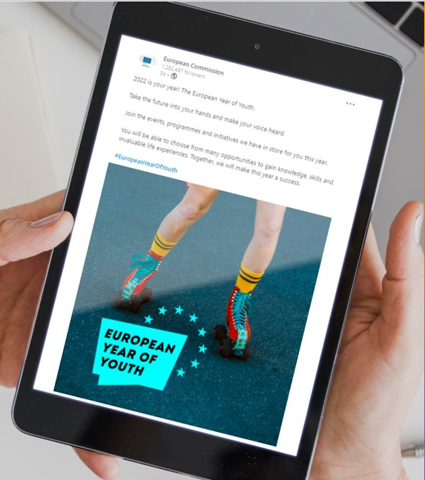
Getting involved
Contacting National Coordinators
Joining events European Year of Youth page
Organising activities and making them visible on the Activity map
Supporting EU policy initiatives of the EYY
Spreading the word (EYY logo, #EYY2022 #EuropeanYearOfYouth)
Follow developments @EuropeanYouthEU on Instagram, Twitter and Facebook

Slide 21
Questions & Answers ?

