Slide 1
From Prague
to Malmo

Slide 2
10 a.m. start
Feedback taken
You can use the morning to get the work done and come focused ;)

Slide 3
TCA letter
- Joint letter by Youth and E&T addressed to COM

Slide 4
Guide 2023
Increase in rates
Anti-plagiarism addition
Thanks for that to COM!

Slide 5
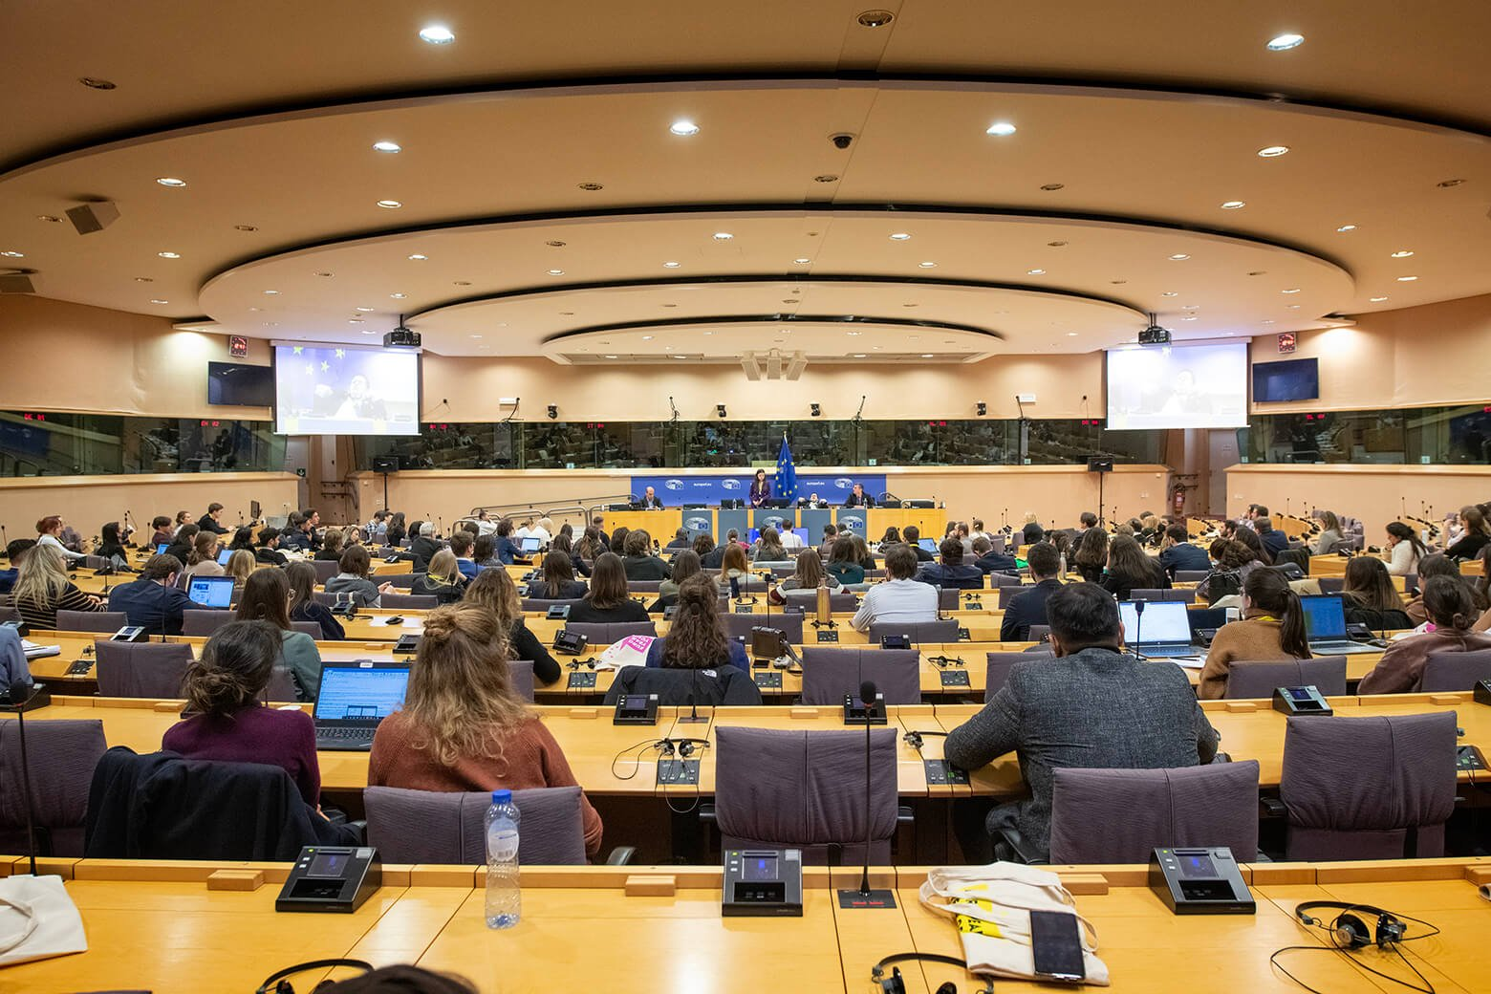
Year of youth
Final conference under Czech presidency
750 young people + streaming
Participative approach

Slide 6
Co-group team
Welcome Margret, Federica, Giuseppe and Manfred ☺

Slide 7
Co-group org. support
Huge thanks to Luis and Portugese NA!

Slide 8
AI
How many of you have tried it?
Vast impact

Slide 9
IT tools
Sorry but we need to say it
Still the biggest problem

Slide 10
Youth consultative group meeting
DiscoverEU (IA & Learning cycle)
YPA and microgrants
TCA
Validation
Absorption of funds

Slide 11
Documents for BM
On the BM website
bmsweden2023.voog.com
Read it please
Hopefully not lullabies…

Slide 12
Welcome Sabrina!

