Slide 1
EASA ATM/ADR rulemaking
– safety related personnel
Tartu Seminar
15 November 2012

Slide 2
ATM/ADR rulemaking – safety related personnel
OUTLINE:
1) EASA – what & why?
2) Rulemaking
3) ATCO licencing
4) ATSEPs
5) Airport personnel
6) Q&A

Slide 3


EASA - What is it?
“We have established a European Aviation Safety Agency which is independent in relation to technical matters and has legal, administrative and financial autonomy.”
S. Kallas
European Commission Vice President
EASA is located in Cologne, Germany
It employs around 600 professionals from all EASA Member States

Slide 4
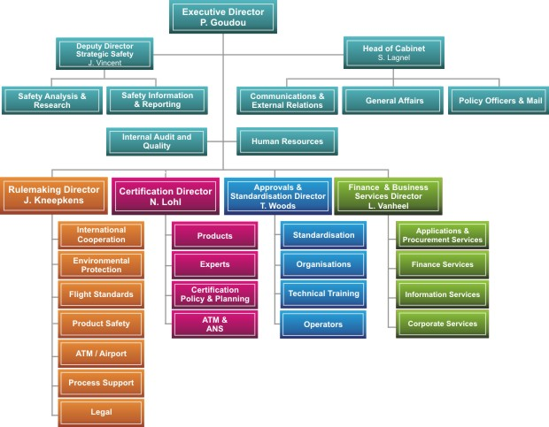
EASA - Organisation

Slide 5
EASA - Why?
High & uniform level of aviation safety ensured by:
European aviation safety regulatory system
  establishing common safety rules
  ensuring that products, services, persons and organisations comply with rules
  establishing independent safety regulator = EASA
EASA system = shared roles between Member States, Commission, EASA & stakeholders
Aviation system behaves as a network
  progressive harmonisation of safety requirements
  Safe -> aircraft - operations - air traffic - landing/take-off

Slide 6
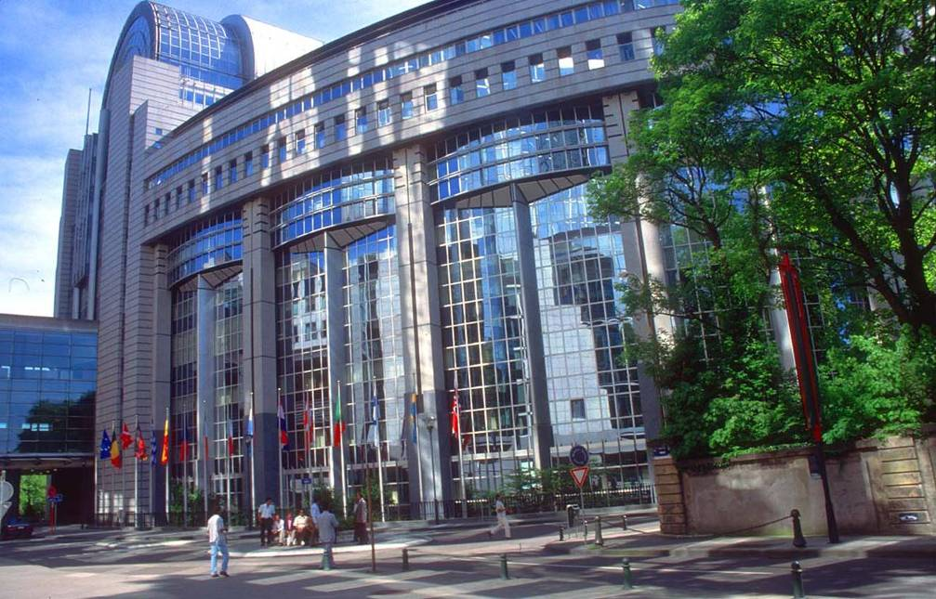
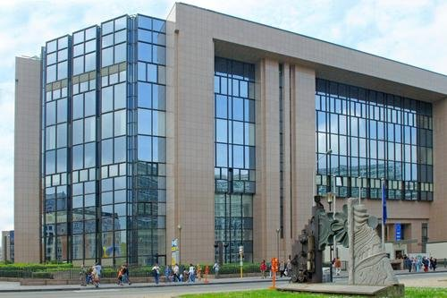

The EU system
EU Parliament and Council
Decide on powers transferred from Member States to EU
Adopt Essential Requirements as the safety objectives ‘by law’
EU Commission
Adopts standards for implementing Essential Requirements
The Agency (EASA)
Develops proposals (“Opinions”) for Essential Requirements and implementing rules
Adopts non-binding standards for implementation and guidance
Notes:
6

Slide 7
Who decides what?
Legislator Commission EASA
Transfer of
powers from
MSs to EC (in BR)
Essential
Requirements
(ER’s)
specifying the
safety objectives
Implementing
rules
(IRs)
=
binding
standards
to implement
BR & ERs
CS, AMC, GM
=
non-binding
standards to
implement
ERs and IRs

Slide 8
EASA - Legal framework
 | Regulation
Initial | 1592/2002/EC
1st ext. | 216/2008/EC
2nd ext. | 1108/2009/EC*
Competence
Airworthiness Environmental Compatibility
Flight Crew Licensing Operation of Aircraft Safety of 3rd country aircraft
Safety of Aerodromes and ATM/ANS
*Entered into force on 14 December 2009

Slide 9
EASA system – ‘Key players’
EU COMMISSION
Adopts implementing rules &
enforcement measures
Opinions
Reports
Comitology
STAKEHOLDERS
via SSCC
EASA
Proposes IRs (Opinions)
Adopts - AMC, CS & GM
Standardisation inspection
Issues (rarely) certificates
Assists States & stake- holders to apply the rules
STATES
Implement rules
Issue (most) certificates
and licences
Oversee organisations
and personnel
Advise EASA (e.g. rulemaking groups)
MB/RAG/TAG
Standardisation

Slide 10
Total System Approach
Economic regulation
3rd Country
Operations
ATM/ANS
Airworthiness
Operations & FCL
Aerodromes
Performance regulation
Safety regulation
TOTAL AVIATION SYSTEM APPROACH

Slide 11
EASA - tasks in ATM
RULEMAKING
Rules & AMC/CS/GM on;
ATM/ANS service provision
Safety oversight
ATCO licensing
Rules of the Air (SERA)
ATM/ANS systems & constituents
Requirements on airspace users
STANDARDISATION
Inspections of national
competent authorities in
ATM/ANS
‘SAFETY ADVISER’
in SES implementation
OVERSIGHT
pan-European service providers
non-EU ANSPs
non-EU ATCO & ATM training org.
Network manager
SAFETY ANALYSIS
- covering ATM/ANS

Slide 12
ATM/ADR Rulemaking – risk-based approach
ATM/ADR rulemaking
EASA RMP 2013-16 adopted
Standardisation visits
&
EASA oversight
safety actions
European
Aviation
Safety
Programme
safety
recommendations
AIBs
feedback loops

Slide 13
ATCO licencing

Slide 14

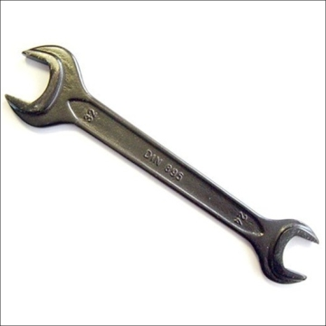
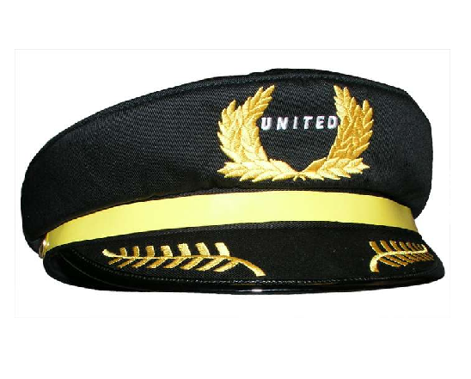

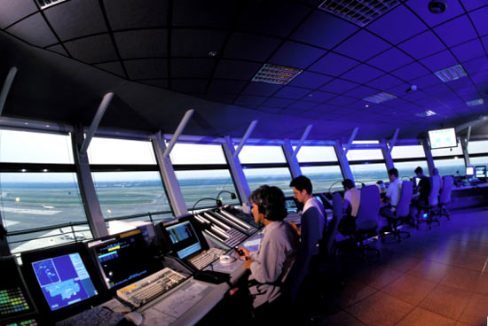

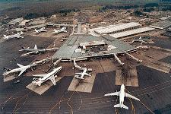


Current rules (EASA) – ATCO licencing
Basic Regulation (EC) No 216/2008
Airworthiness
Flight Standards
ATM/ANS
Initial Airworthiness
Continuing Airworthiness
Air Crew
OPS
Air Traffic Controllers Licences
ATM/ANS Oversight
ANS Providers
AUR and ACAS II
SERA

Slide 15
ATCO licencing – by the law (BR)
Art. 8c Air Traffic Controllers
Art. 8c.1 “ATCOs as well as persons/organisations training, testing or medical assessment shall comply to ERs in Annex Vb”
Art. 8c.2 …8c.11.
“Commission shall adopt measures in Art. 8c by 31.12. 2012.”
Theoretical knowledge
Practical skill
Annex Vb (ERs)
Art. 3 (Reg 1108/2009)
Language proficiency
Synthetic training
Training course
Instructors & Assessors
Medical criteria

Slide 16

ATCO licencing – objectives …
  High & uniform level of safety, but also …
Common training standards, including AMC/GM;
    EU level recognition of licences (incl. training schools)
    Promote/enable ATCO mobility, FAB integration, etc.
Clear framework for ATCO training organisations + recognition of their certificates;
Synergies of aeromedical examiners & centres on medical certification;
Implementation feedback
    Member States’ written proposals (excluded in ‘fast-track’)
    ATM Standardisation visits

Slide 17
ATCO licensing rule - process
BR extended to ATM
‘Fast-track’ rule
Rule – full BR compliance
ATCO rule (with full BR compliance):
NPA - Nov 2012
Opinion – Q3/Q4 2013
EASA Committee – 2014 (?)
Entry into force - TBD
now

Slide 18
ATCO licencing - major novelties
Gaps not taken into account for the 1st phase:
  instructor and assessor certification and qualifications
  harmonising ATCO training by introducing “basic” requirements into IRs + complementing them with AMC/GM
  incorporating the EUROCONTROL Class 3 medical requirements
  harmonising TO (Training Organisation) requirements with ICAO SARPs

Slide 19
ATCO licencing - structure of proposed rule
COVER REGULATION – 9 ARTICLES
4 ANNEXES
  Annex I: PART-ATCO - Requirements for the licensing of air traffic controllers
  Annex II: PART-ATCO.AR – Requirements for competent authorities
  Annex III: PART-ATCO.OR – Requirements for air traffic controller training organizations and aero-medical centres
  Annex IV: PART ATCO-MED – Medical requirements for air traffic controllers
12 APPENDICES TO THE REGULATION

Slide 20
ATCO licencing - next steps
  PUBLIC CONSULTATION until 1/04/2013, please consult http://hub.easa.europa.eu/crt/ for placing comments
  WORKSHOP
    Where: EASA, Cologne
    When: 16/01/2013
    Registration via the EASA web:
    http://www.easa.europa.eu/events/events.php

Slide 21
Approved ATCO Training Organisation (ATO)

Slide 22

ATO requirements - by law (BR)
Concept in Basic Regulation (BR):
ATO for ATCO shall be certified and comply with the rule implementing BR Essential Requirements (Annex Vb, Chapter 5c):
  … have all the means necessary for the scope of responsibilities associated with its activity;
    = facilities, personnel, equipment, methodology, documentation of tasks, responsibilities and procedures, access to relevant data and record-keeping, etc.
  … implement and maintain a management system related to safety and the standard of training, and aim for continuous improvement of this system; and
  … establish arrangements with other relevant organisations, as necessary, to ensure continuing compliance with these essential requirements.
Notes:
22
22
22
22

Slide 23
ATO requirements - currently
Regulation (EU) No 805/2011:
Very limited while only minor amendments were made to the ATCO Directive provisions:
  Some general requirements for certification
  Very general requirements for the management system (same level as the BR Essential Requirements)
  Requirements for the establishment and for the approval of training courses, initial and unit training plans and unit competence schemes and
  Requirement (general) for ATO to define the way examinations or assessments are organised
Notes:
23
23
23
23

Slide 24
ATO requirements – basis to amend
Basis to amend ATO requirements:
  … to facilitate mutual recognition
  … to expand the conditions for the certification
  … to complete the requirements for management system with more details on the objectives to be met
  … to alignment with ICAO Annex 1 and draft Annex 19 (where possible) and
  … to make distinction between two types of training organisations:
    Training organisations providing Basic training and
    Training organisations providing Unit and continuation training
Notes:
24
24
24
24

Slide 25
ATO requirements – examples (proposed)
Typical requirements (1):
  Determination of competent authority to which they have to submit their application for certificate;
  Application for certificate;
  Terms of approval and privileges of a training organisation certificate;
  Changes to the training organisation;
  Continued validity (keeping the validity of certificate);
  Access to training organisations facilities and data (by the competent authority);
  Findings (how to deal with findings by CA);
  Immediate reaction to a safety problem (safety measures by CA in case of safety problems)
Notes:
25
25
25
25

Slide 26
ATO requirements – examples (proposed)
Typical requirements (2):
  Occurrence reporting (as required it applies to ATO providing unit and continuation training having impact on the safety of the services);
  Management system of training organisations (general management system requirements oriented to manage safety for training organisation providing unit training and that is quality oriented for training organisations providing basic training);
  Contracted activities (how to manage the activities contracted to other organisations);
  Personnel requirements (identification of the key relevant personnel/functions and the relevant requirements: accountable manager responsible for training, theoretical instructors, STDI);
  Facilities (general requirements including criteria for instruction OJT and STD)
Notes:
26
26
26
26

Slide 27
ATO requirements – examples (proposed)
Typical requirements (3):
  Record-keeping (relevant records and period (min. 5 years));
  Requirements for training courses, training plans and unit competence schemes (general requirements to establish the training courses, training plans and competence schemes in accordance with the detailed requirements for training. Needed for the certification!!!).
Notes:
27
27
27
27

Slide 28
ATSEPs

Slide 29
ATSEPs – situation today
Today – general requirement on State/ANSP level, but no common rules
By law - EASA BR (Annex Vb(5)(a)(iv));
  “service provider shall use only suitably qualified and trained personnel and implement and maintain training and checking programmes for the personnel”
  No licence required but responsibility by service provider
Method; EASA rulemaking group (with external experts) -> consultation -> EASA Opinion
  amend Regulation 1035/2011 (new Annex on ATSEPs) + AMC/GM

Slide 30
ATSEPs – requirements
Scope - Training & Competence assessment
  Initial, systems/equipment and continuation training
  Initial - Eurocontrol ATSEP CCC transposition (no changes)
  Continuation – 3 types: refresher, emergency and upgrades
  Proportionality to be ensured
Other safety related professions - ?
  Study being conveyed by EASA
  When – NPA (to amend Regulations 1034 & 1035/2011) for consultation by Q1/2013

Slide 31
Airport personnel

Slide 32
Aerodrome personnel – by law (BR)
By law – BR Art. 8a & Annex Va (ADR Essential requirements) define the European safety requirements;
  Including (e.g.) personnel in safety related duties
  Implementing rules & AMC/CS/GM to be adopted by 2013
Rulemaking tasks
Aerodrome operator & oversight requirements
Aerodrome operations
Aerodrome design

Slide 33
Aerodrome personnel – requirements
Aerodrome operator to ensure;
  Scope – 1) personnel in aerodrome operation, RFFS, maintenance and management; 2) unescorted persons operating on the movement area
  Training programme
  Qualified and experienced instructors and assessors
  Proficiency checks (and records)
  Prior approval (training programme) by competent authority
  Implementing rules + AMC/GM

Slide 34
Aerodrome rules - process
BR extended to ADR
Preparation by EASA
Adoption process (comitology)
NPA – Dec 2011
Opinion – Q1 2013
EASA Committee – during 2013
Entry into force - TBD
CRD – Nov 2012
now

Slide 35

Thank you for your attention

