Slide 1
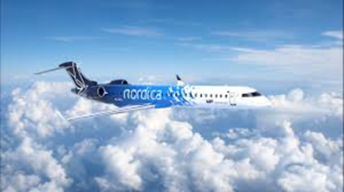
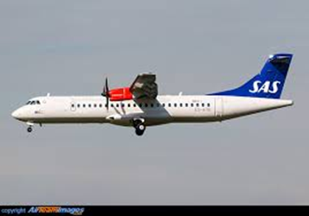
REGIONAL JET OÜ FUTURE BUSINESS CONCEPT A CAPACITY PROVIDER AND LONG-TERM STRATEGIC PARTNER TO MAJOR AIRLINES WHAT KIND OF BUSINESS IS THAT ?

Slide 2
TRENDS IN THE AVIATION INDUSTRY
Globalization means continues growth + 6% per Year = 250 million pax
Network carriers and LCC’s will become just airlines
Environment of course more and more important
Global alliances – Ownership rules will change ....
Consolidation will continue (Bankruptcies, Aquisitions or Mergers)
Smaller independant airlines will have a hard time to survive
Production will be more and more separated from ticket sales
Who will sell tickets in the future – Airlines, Google, ....

Slide 3
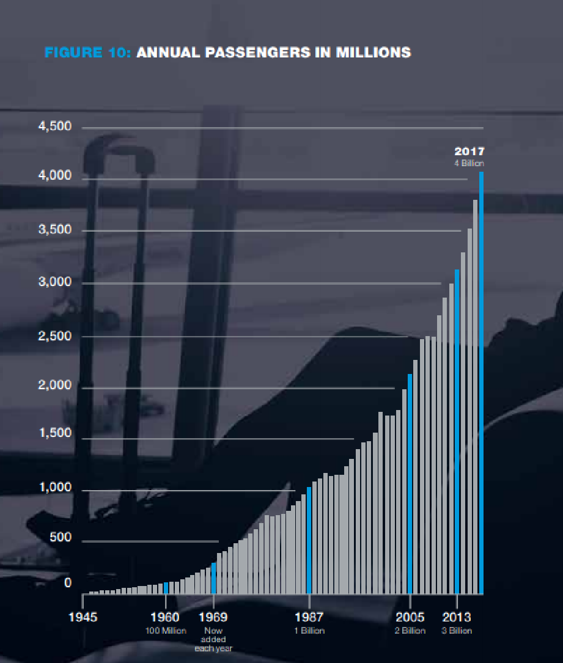
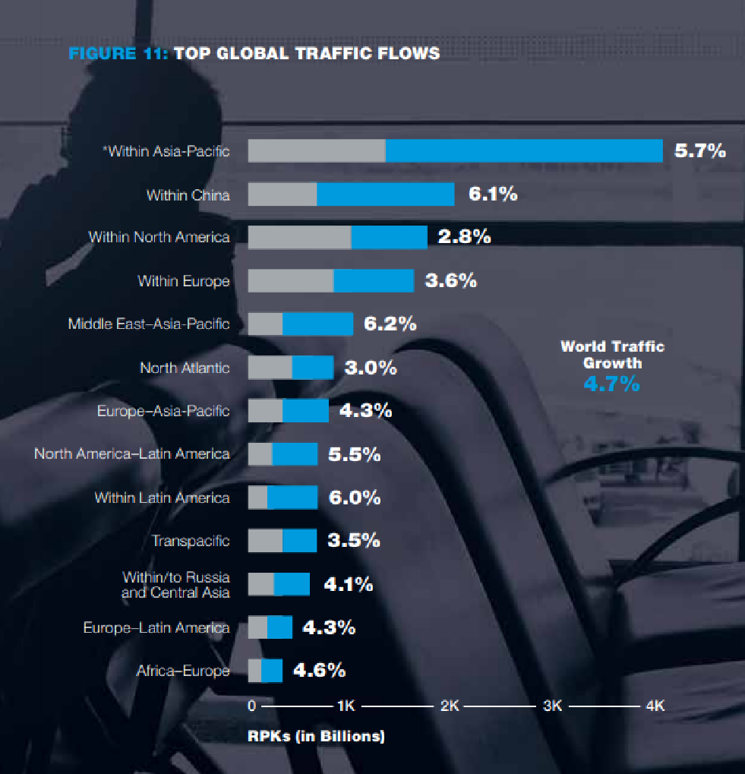
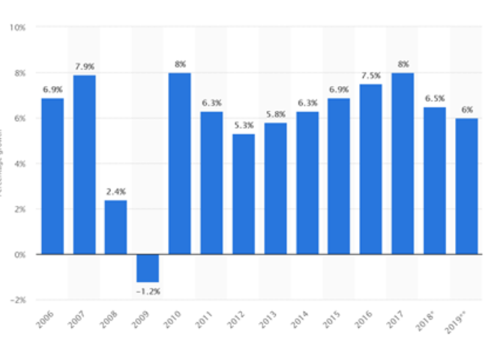

Slide 5
Regional Jet OÜ – Structure designed for CP
Commercial Agreement
Nordica
LOT Polish Airlines
100%
6xCRJ900
4xCRJ900
Majority ownership
Republic of Estonia
7xCRJ900
Republic of Poland
51%
49%
TVH
„ACMI“
ACMI
100%
Local Crewing Agencies
Lessors
Regional Jet
(AOC)
Local Crewing Agencies
Local Crewing Agencies
Aircraft
Crew
SAS ATR/CRJ CP/ACMI
Air Serbia ACMI
Adria, Logan ACMI
Gällivare Arvidsjaur PSO
Services-based relationships
Ownership-based relationships

Slide 6
TRENDS RELATED TO REGIONAL JET
Pax Growth will continue on high level as we saw
Pilots, engineers and technicians will continue to be a bottle neck
Regional feed is important to support growing hubs
Legacy carriers will not operate aircraft below 130-140 seats
Focus on competition in the 200+ seat market segment
LCC’s have started to create transfer time tables – Hub’s
Legacy carriers want it to look like their own products and brands
Wetleasing are normally too short to become cost effective and sustainable
Europe will develop similar to US.
Not exactly the same, but sub-contracting for longterm strategic Capacity Provider Operations.

Slide 7
CAPACITY PROVIDER = WETLEASING (ACMI) ?
YES in principle, but actually NO – Far from it !!
Simple definition of ACMI’s (Wetleases)
ACMI = Aircraft & Insurance cost + Crew Cost + Maintenance Cost + Profit
Period, Traffic Program, Time Table, Base, Flight hours defined will be the base for calculating the ACMI rate.
Normally in the range of 1.500 € - 2.500 € per BLH.
Production typically 200 – 350 BLH’s per month
Performance requirements, Minimum Blockhours, Drop-down rate, Deposits, Payment terms, Extension options, DOC cost, Overnight Cost, Per diems, etc..

Slide 8
TYPICAL WETLEASE PROJECTS IN EUROPE
Normal terms 1-24 months
Reasons are normally the following:
Summer season requirements
Cover for Heavy maintenance or AOG’s
Start-up of new routes
No special requirements for branding, livery, interior, service concepts or products, but of course audits from a safety point of view
IOSA basic requirement and also CARA for LH Group
Pilot Unions have a lot of influence on restricting wetleases

Slide 9
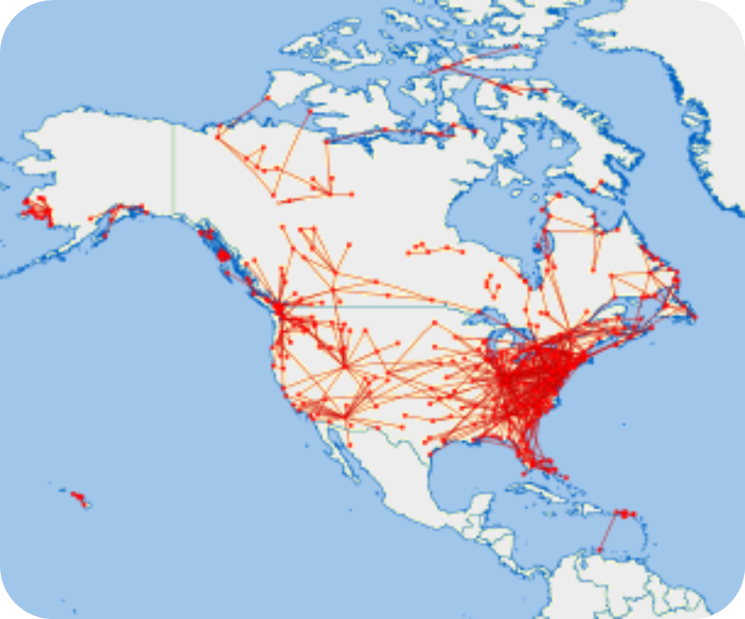
HOW IS IT DONE IN USA ?
DELTA uses several Regional Capacity Providers
2000
2015

Slide 10
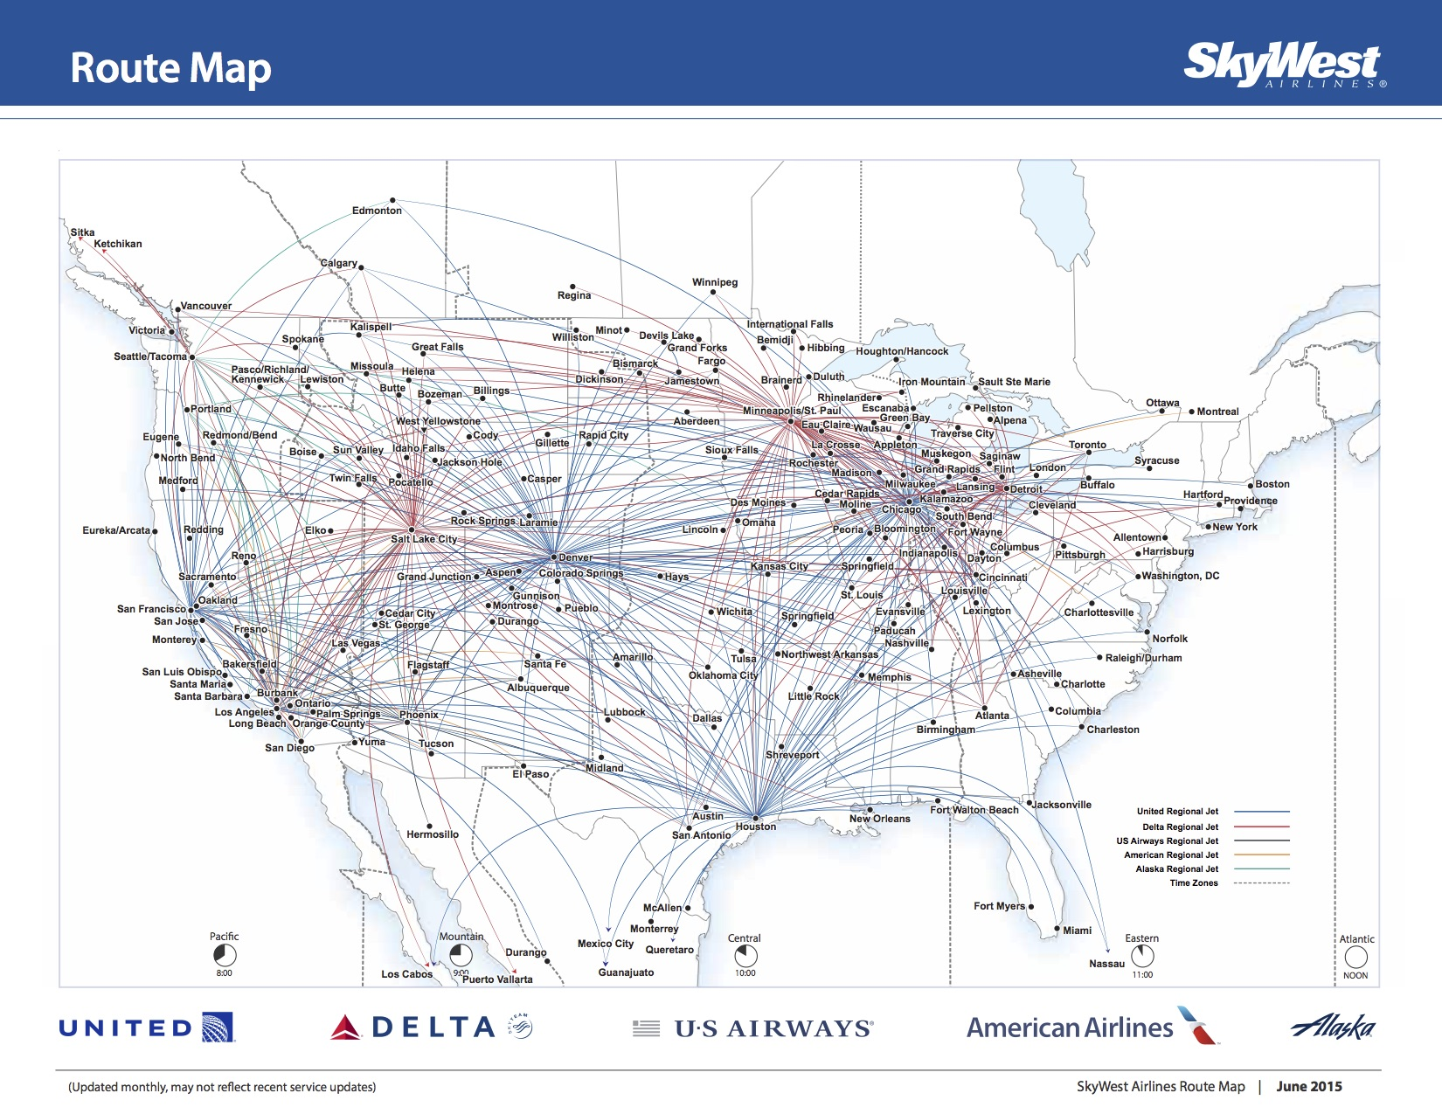
HOW IS IT DONE IN USA ?
SkyWest is the largest independant Regional Capacity Provider Airline in the world
Abt 500 aircraft
Mix of Embraer & Bombardier
50 to 76 seats
Operating for all of the Major’s
Longterm contracts – Normally described as Cost+
Limits due to the Scope Clauses
Chapter 11
There are a number of other Capacity Providers, but a bit smaller:
MESA
Republic
Etc

Slide 11
Current US Regional Airline Market
Annual Departures 3.68 Million
Daily Departures 10,081
Average Number of Seats 64
Total Passengers 153.25 Million
Average Stage Length 487 miles
Number of Airports with Regional Service 619
Number of Airports served ONLY with Regional Jets 409 (63%)
Percentage of US Departures that Regional Jets 41%
*Source 2018 RAA Annual Report
41% of all US departures are made by aircraft < 76 seats !

Slide 12
HOW DOES IT LOOK LIKE IN EUROPE ?
Still mostly inhouse Regionals
SAS the most advanced CP buyer
Brussels has had a lot of ACMI’s and starting to plan more
Lufthansa slowly moving against CP solutions. Cityline next ?
Austrian on the way to outsource Q400 operation and becoming more CP buyer.
LH sold out LGW and wetlease back = CP solution
KLM, AF, BA still very much union controlled

Slide 13
WHAT IS A CAPACITY PROVIDER ?
Strategic longterm partnership
Contracts 6+ years (US 16 years = life of a new aircraft)
BRAND
Integrated planning processes
Products and Services as mainline
Livery, interior, uniforms, etc as mainline
Safety, security, training not exactly as mainline but audited and agreed
Collective agreements or similar working conditions required
Pilot career opportunities can be beneficial for both parties
Open book cost optimization for sustainable operation

Slide 14
WHY IS CAPACITY PROVIDER THE FUTURE ?
Basically the same reasons as in the USA
Cost advantage compared to inhouse solutions
Productivity – Not so many FTL restrictions
Flexibility, change of aircraft size, traffic programs, destinations, etc
Crew recruitment and training outsourced
Mainline can focus on where their real competition is - 200+ seat market
Critical mass and risk balance
If the Major airline outsource only a few aircraft (< 15) to a CP they will not utilize full scale effect on the cost side.
On the other hand if they outsource all aircraft operations to only one CP the risk exposure will increase
That is why we see Regionals working for all Majors in US
SAS has already 3 CP’s and they will most likely balance the number of aircraft between the providers.

Slide 15
HOW DOES IT WORK?
Our SAS contract in Denmark is an example on how it can look like:
SAS came out with a RFP for 4 ATR72-600 operating as feeder to CPH hub
6 year contract with abt 2.500 BLHs per aircraft annualy
CLA requirement
Crew bases CPH, BLL & AAR
CLA with FPU, isolated for work in Denmark and SAS (New 2 year agreement)
Crews employed by local Danish Crewing Company PAS
Crews contracted by Regional Jet from PAS
Aircraft painted in SAS livery and interior as of SAS specification
Local Danish MRO contracted for Line Maintenance
Performance bonus/penalty for Lessor controllable reasons
Service concept and different SAS products to be developed
Close co-operation between RJ OPC and SAS OPC for IRR situations
Weekly operational meetings and close relation with SAS Management
Long-term planning for future capacity

Slide 16
RJ TODAY

Slide 17
RJ REFERENCES

Slide 18
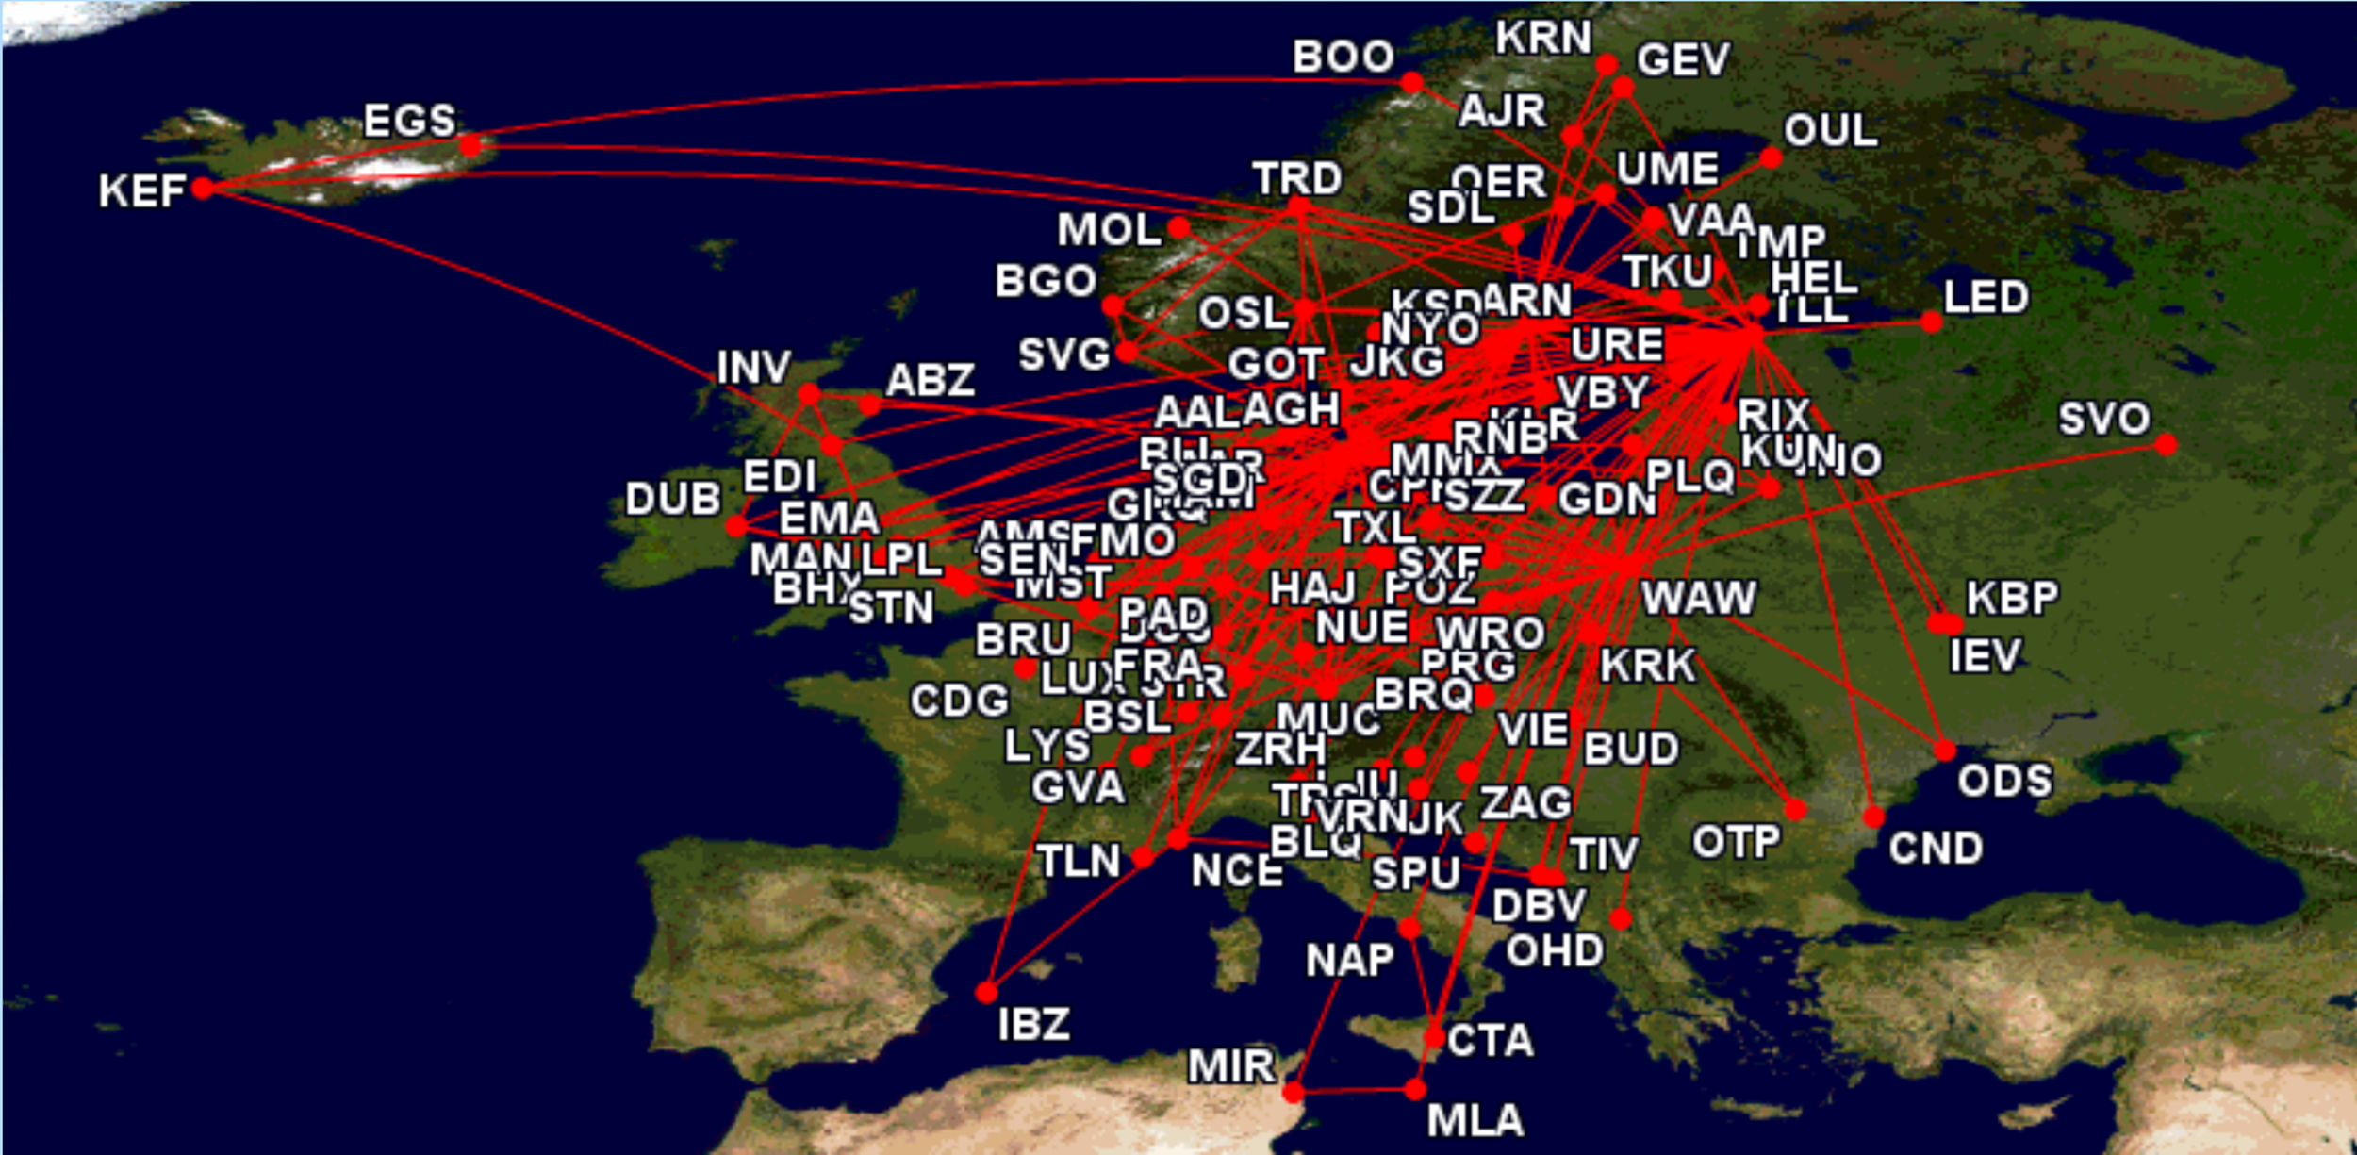

Slide 19
RJ POTENTIAL
We are already chosen as Strategic Capacity Provider Partner to SAS
Operating 4 ATRs and 2 CRJs at the moment
Before the end of 2019 another 4 ATRs
Before the Summer 2020 another 3 CRJs
Before the Summer 2021 another 3 CRJs
Looking forward to potentially operate either 10-15 Embraer E2’s or A220’s from 2022 – SAS is looking for replacement of older B737-600/700.
Above is enough for some time but we would like:
LH Group with Brussels, Austrian and LH Cityline. CARA required.
LOT will go through an extensive transition in the near future.
There is also a number of PSO’s and Regional Connectivity Projects

Slide 20
RJ MARKET POSITION
The potential CP market in Europe is 3+ billion EUR per Year.
About 300 MEUR (10%) is already contracted
RJ Market Share 10% of market and 3% of the potential
Huge potential for growth!!!
Our Position for growth ?
Yes we are an independant CP/ACMI provider with no direct links to the commercial business of selling tickets
Yes we have a business structure which makes it easy to adapt to any specific requirement from any major airline
Yes we have already SAS as a super reference
Yes we have a very good track record among many of the potential CP customers
Very few competitors, at least at the moment.
No major airline will put all eggs in one basket, so just to be an alternative is good.

Slide 21
NEEDED FOR GROWTH & SUSTAINABILITY
A very important and growing activity - HR & Legal
Recruitment of Competent and Experienced aviation people, both Crews and Office people.
We need to become more European - Different labor laws and tax rules in every country as well as Culture, Contact's, Behavior, etc
CLA negotiation competence and experience, especially related to SAS at the moment
We need to be able to meet the highest professional expectations from our customers, like SAS, NAG, LOT, LH Group, etc concerning Flight Safety!!!!
Performance !!!
To be able to stay cost-effective and profitable over time we need to have deep understanding of the aviation industry in general, especially the leasing of aircraft market and the reqruitment and training of crews, since there are not so many major cost items we can control and do something about.

Slide 22
IMPORTANT WHEN BEING A CP
To become The leading CP in Europe = Our Target ?
Aircraft We need to get the AC cost on par at all time
Crew We need to be able to attract and produce crews
Maintenance We need to be the best since this is a „black hole“
Insurance We are ok
Operations Planning, OPC and Crew Control = Heart of business
Performance We need to meet Industry expectations
Cost-effectivness For sure
Productivity Customer demands will be higher than we can deliver
Relations Trust, open book, fair treatment, experience, etc
Marketing Owners support and track record

Slide 23
The Academy is an important and amazing source for our development
We already have a lot of people in Regional Jet from the Academy
I am 100% sure we will be able to offer some interesting possibilities for some of your students.
We certainly appreciate a close cooperation with the Academy

Slide 24
Thank you

