Slide 1
NATO Integrated Air and Missile Defence System
(NATINAMDS)
AIR POLICING AS PART OF IT
Notes:
Recent developments in regional security environment has made society worried. Foreign military aircraft flying in the vicinity of our borders more than usually and disobeying
simple flight rules, causing several flight safety issues.
There has been doubts about whether NATO will be able to keep the situation under control.
Therefor I would like to introduce the System called NATINAMDS.

Slide 2
AGENDA
NATINAMDS
NATO AIR POLICING
CASE STUDY

Slide 3
NATO Integrated Air and Missile Defence System (NATINAMDS)
It is the integration of capabilities and overlapping operations of all services to deter and defend all Alliance territory, populations and forces to ensure freedom of action by negating an adversary’s ability to achieve adverse effects from its air and missile capabilities.
It includes a network of interconnected systems to detect, track, classify, identify and monitor airborne objects, and – if necessary – to intercept them using surface-based or airborne weapons systems, as well as the procedures necessary to employ these systems.
Notes:
NATO Integrated Air and Missile Defence is the integration of capabilities and overlapping operations of all services (air, land and maritime forces) to deter and defend all Alliance territory, populations and forces to ensure freedom of action by negating an adversary’s ability to achieve adverse effects from its air and missile capabilities. It includes a network of interconnected systems to detect, track, classify, identify and monitor airborne objects, and – if necessary – to intercept them using surface-based or airborne weapons systems, as well as the procedures necessary to employ these systems.

Slide 4
NATO Integrated Air and Missile Defence System (NATINAMDS)
Started in the 1970s.
NATINAMDS is a cornerstone of NATO air and missile defence policy.
Notes:
NATO member countries started working together in the 1970s to establish an integrated air defence structure and system, combining national assets supplemented as needed by NATO elements. Operating together is both more effective and more efficient in protecting against air attacks than national air defence systems operating independently. With the advent of an Alliance ballistic missile defence capability, this structure is now known as the NATO Integrated Air and Missile Defence System (NATINAMDS). It comes under the command and control of NATO’s Supreme Allied Commander Europe (SACEUR).
The NATINAMDS is a cornerstone of NATO air and missile defence policy, and a visible indication of cohesion, shared responsibility and solidarity across the Alliance.

Slide 5
NATINAMDS
Components:
Command, Control, Communications and INTEL
Surveillance
Active Air Defence
Passive Air Defence
Notes:
.

Slide 6
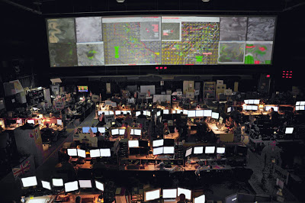
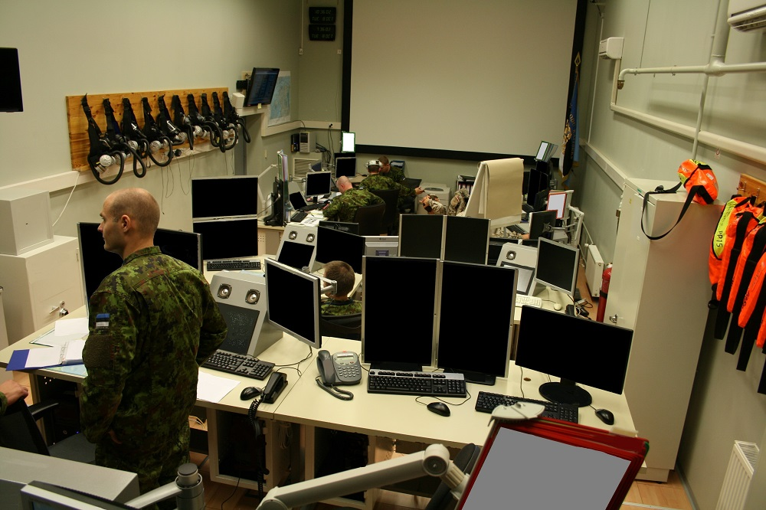
NATINAMDS Components
Command, Controll, Communications and INTEL:
Notes:
Command and control is about decision making, the exercise of direction by a properly designated commander over assigned and attached forces in the accomplishment of a mission, and is supported by information technology.
Command and Control (C2) is essential to the success of any operation. It provides commanders situational awareness.
In recognition of the increasingly joint nature of military operations, NATO has developed a new and more robust capability that will be a C2 system for all air operations, which will facilitate the planning, tasking, execution and coordination of all integrated air and missile defence missions in peacetime, crisis and conflict.

Slide 7
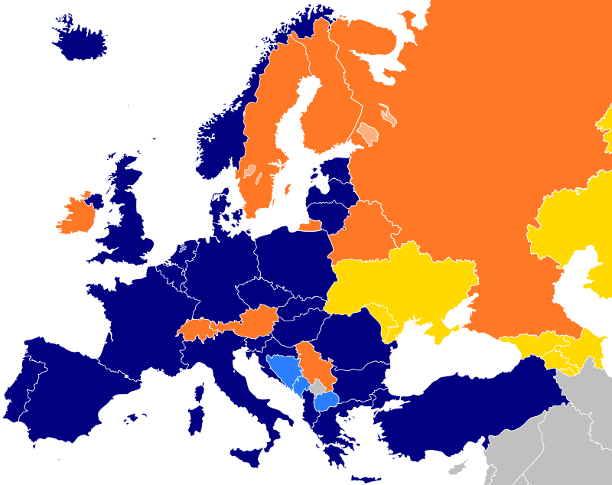
NATINAMDS
HQ AC Ramstein
Notes:
NATINAMDS is orchestrated by HQ AC Ramstein.
The planning and execution of all NATO Integrated Air and Missile Defence Operations within SACEUR’s Area of Responsibility.
The planning, integration, and Command and Control of Air operations within and beyond SACEUR’s Area of Responsibility during crises and conflict.
The provision of advice on Air and Space competency, force proposals, military requirements, exercises, as well as standardization and evaluation priorities.

Slide 8
NATINAMDS
CAOC UEDEM
Notes:
To carry out its missions and tasks, HQ AC Ramstein has two Combined Air Operations Centres (CAOC), one in Torrejon, Spain, and one in Uedem, Germany.
The CAOCs focus on Air Policing (AP) and Ballistic Missile Defence (BMD) related duties, and constitute the backbone of Collective Defence Operations within the NATO Area of Responsibility.
Based on RAP and other information sent by subordinated units, CAOC makes the tactical decision whether to scramble QRA aircraft or not.

Slide 9
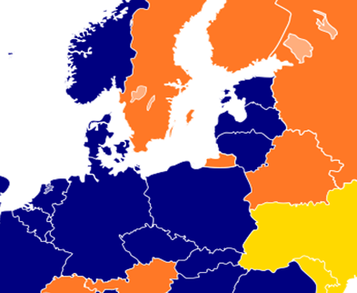
NATINAMDS
CRP ÄMARI
CRP LIELVARDE
CRC KARMELAVA
BALTNET
CAOC UEDEM
Notes:
In Baltic region those subordinated units to CAOC are CRC Karmelava, CRP Karmelava, CRP Lielvarde and CRP Ämari. All together they form protject named BALTNET (Baltic Air Surveillance and Control Network System). These C2 units are responsible for RAP production and distribution and reporting to CAOC. Only CRC Karmelava and CRP Ämari are currently able to execute tactical control over NATO Air Policing Assets.

Slide 10
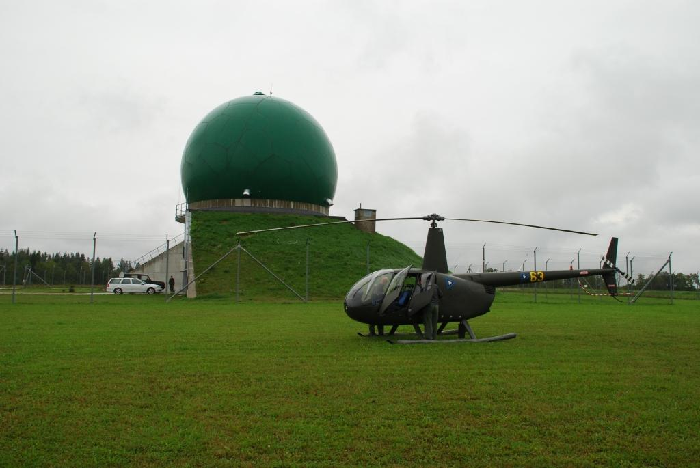
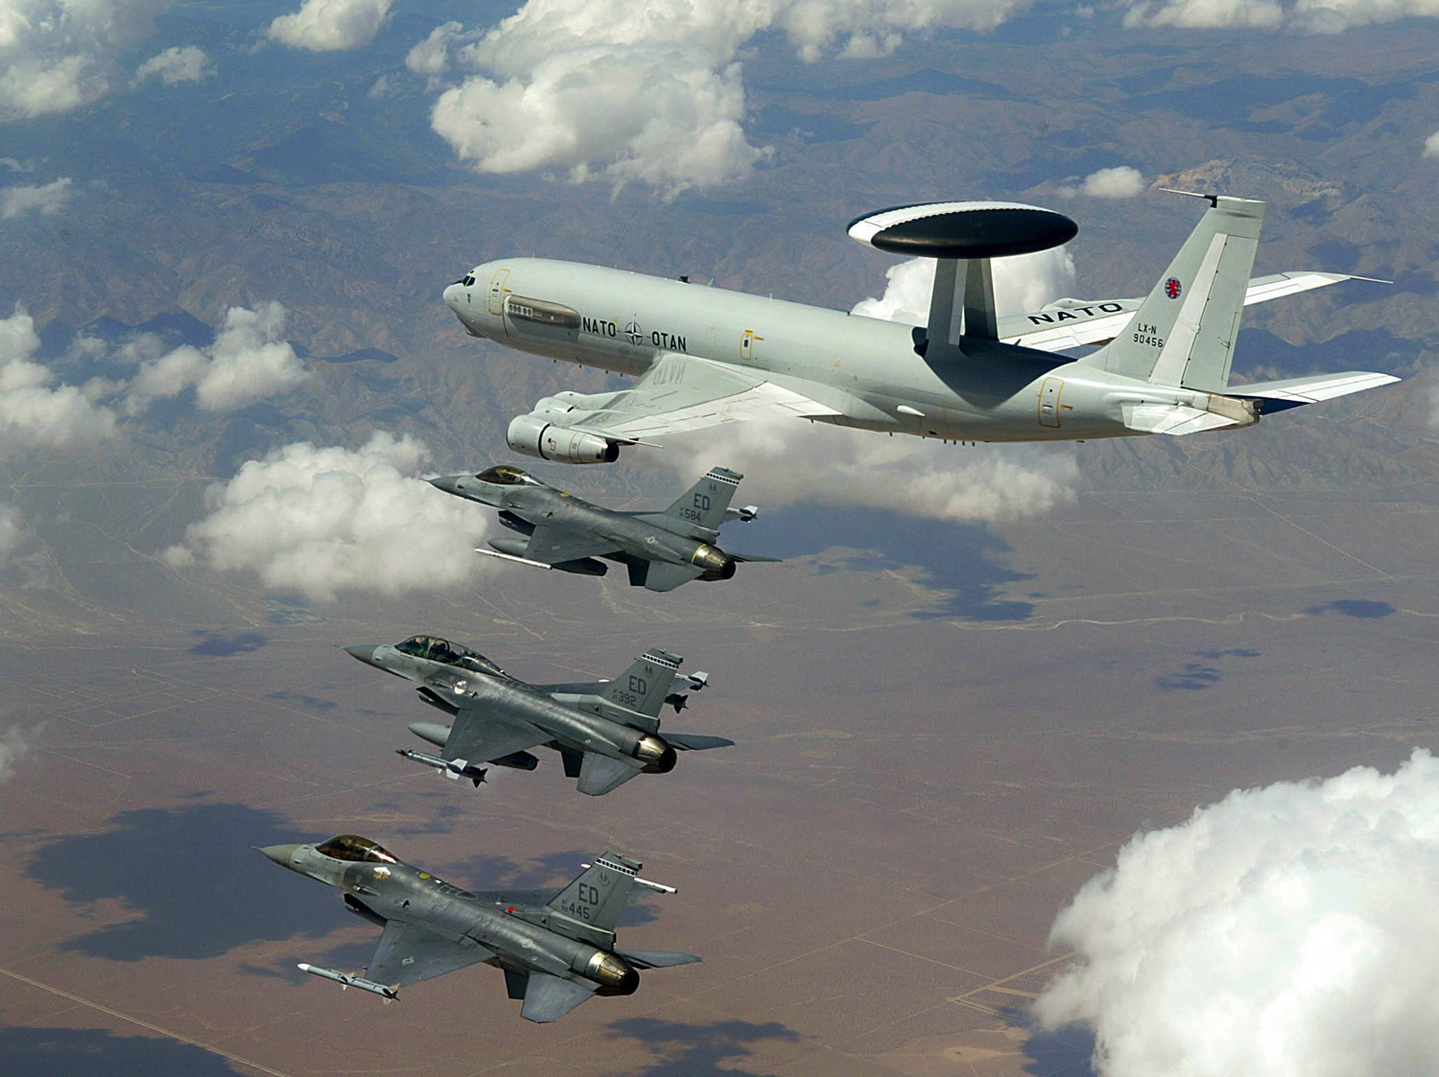
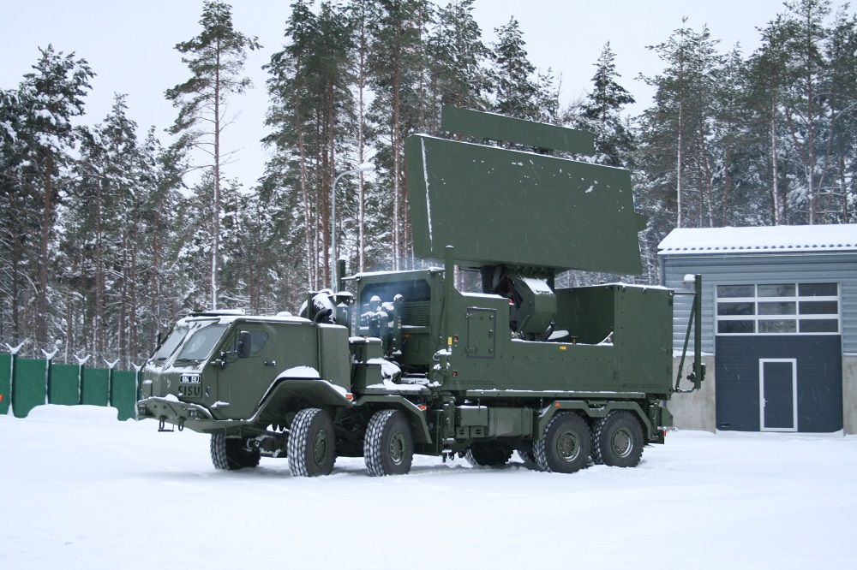
NATINAMDS Components
Surveillance:
Notes:
The surveillance and identification Assets are responsible for providing continuous Surveillance over the assigned airspace, identifying all airborne objects, and providing RAP information to the relevant control centers (like CAOC) and AD units.

Slide 11
NATINAMDS Components
Passive Air Defence:
Dispersal
Hardening
Shelters
Camouflage
Decoys
Electronic Protection Measures (EPM)
Notes:
Passive AD consists of all other measures taken to minimize the effects of hostile air action.

Slide 12
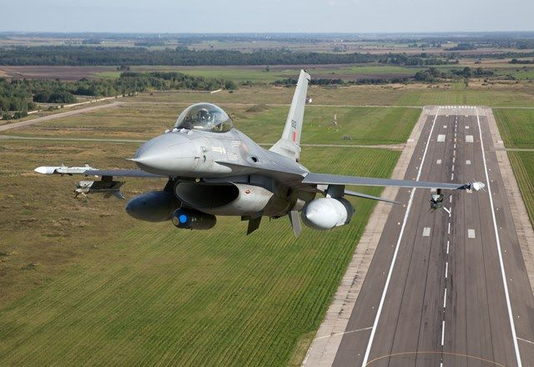
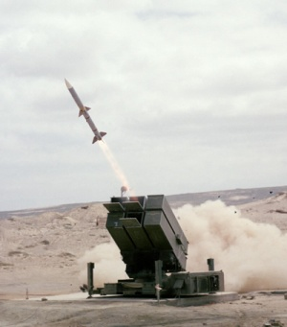
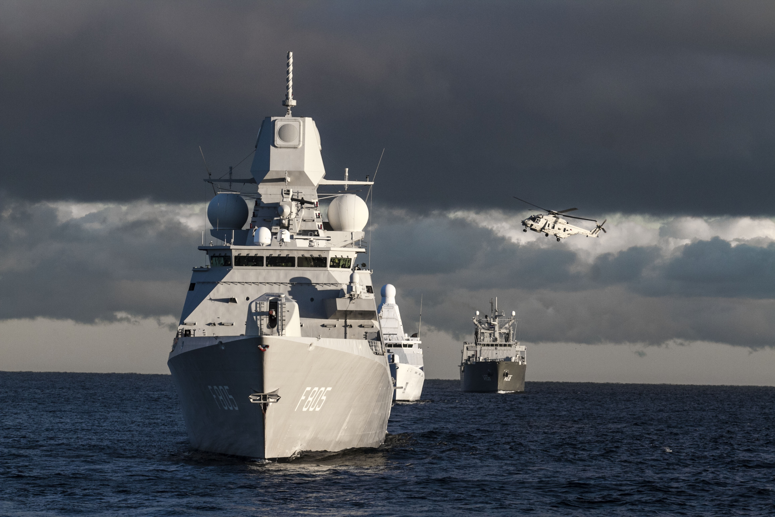
NATINAMDS Components
Active Air Defence:
Notes:
- It is a combination of AD asstets to nullify or reduce the air threat.
- Air Battle Management allows interception (meaning Air Policing) , marking, covering and engagement of potential air and space targets.
- Positive and/or procedural Airspace Control
- Compilation and dissemination of a RAP which allows detection, tracking and identification of potential air and space targets.
- Assigning weapons and/or aircraft and placing them under appropriate tactical control.

Slide 13
Active Air Defence
NATO Air Policing:
It is a peacetime mission which requires an Air Surveillance and Control System (ASACS), an Air Command and Control (Air C2) structure and Quick Reaction Alert (Interceptor) (QRA(I)) aircraft to be available on a 24/7 basis.
This enables the Alliance to detect, track and identify to the greatest extent possible all aerial objects approaching or operating within NATO airspace so that violations can be recognized, and the appropriate action taken.
Notes:
NATO Air Policing
NATO air policing is a peacetime mission which requires an Air Surveillance and Control System (ASACS), an Air Command and Control (Air C2) structure and Quick Reaction Alert (Interceptor) (QRA(I)) aircraft to be available on a 24/7 basis.. This enables the Alliance to detect, track and identify to the greatest extent possible all aerial objects approaching or operating within NATO airspace so that violations and infringements can be recognized, and the appropriate action taken.
Although not all Allies possess the necessary means to provide air policing of their airspace, other countries provide assistance when needed to ensure that no country is left at a disadvantage and equality of security is provided for all.
SACEUR is responsible for the conduct of the NATO air policing mission..

Slide 14
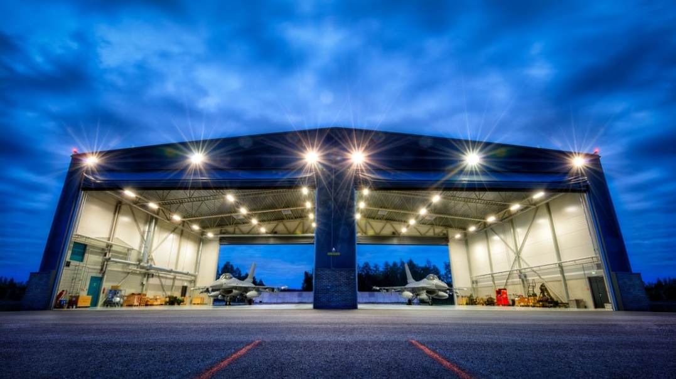
Air Policing Aircraft in Ämari
Armed Air Policing Aircraft are parked in the QRA hangars.
Office space, small kitchen, leisure space and sleeping rooms between
Alarm is given by CRP Ämari for scramble.
Startup takes place in the hangar.
Aircraft are given combat orders by CRP and then clearance from Ämari Radio.
Reaction time is classified but it all takes only minutes.

Slide 15
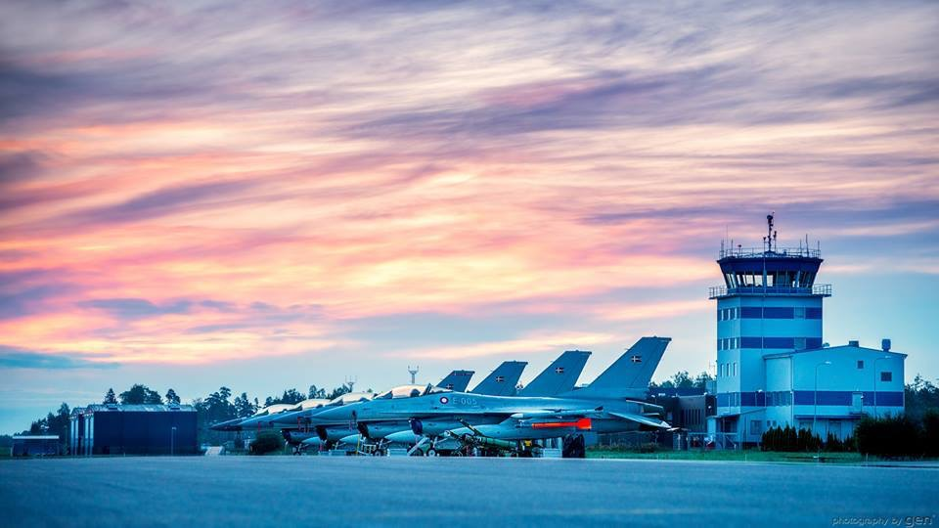
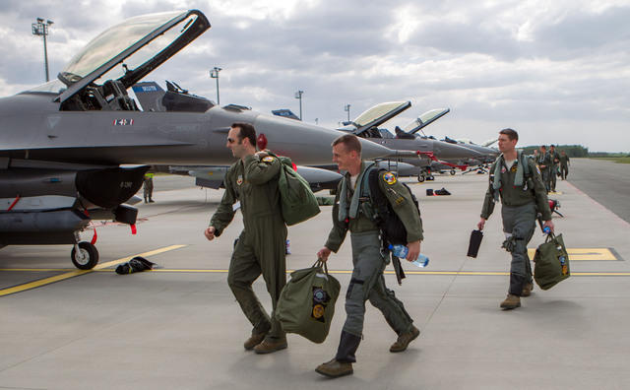
AB Essential Services
RWY maintenance
Arresting cables
Wildlife containment
Crash, Fire, Rescue: category5
Air Traffic Control
Meteo service
Fuel service: F34 and F35
Medical service
Weapons and missile handling
Cross Servicing
Navigation and landing aids
Secure communication

Slide 16
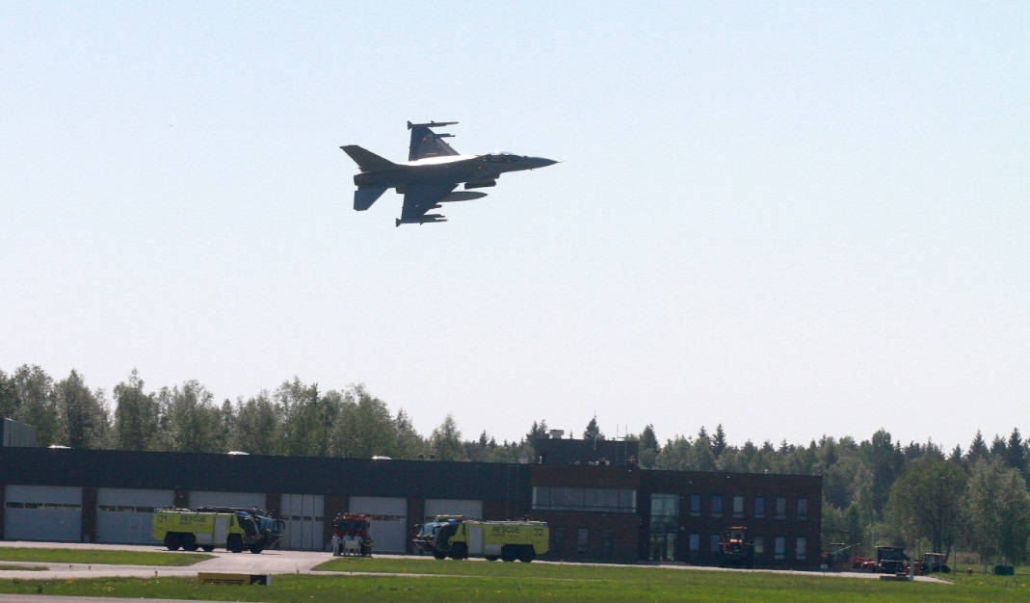
24/7 shift
One shift has approx 55 people
C2 unit
Airfield
Force Protection
Dining Facility

Slide 17
CASE STUDY
During the afternoon of 28 October, NATO radars detected and tracked seven Russian combat aircraft flying in international airspace over the Baltic Sea. The aircraft were detected at approximately 3:30 p.m. (Local). CAOC decided to scramble the NATO Air Policing QRA (I) aircraft from Ämari.

Slide 18
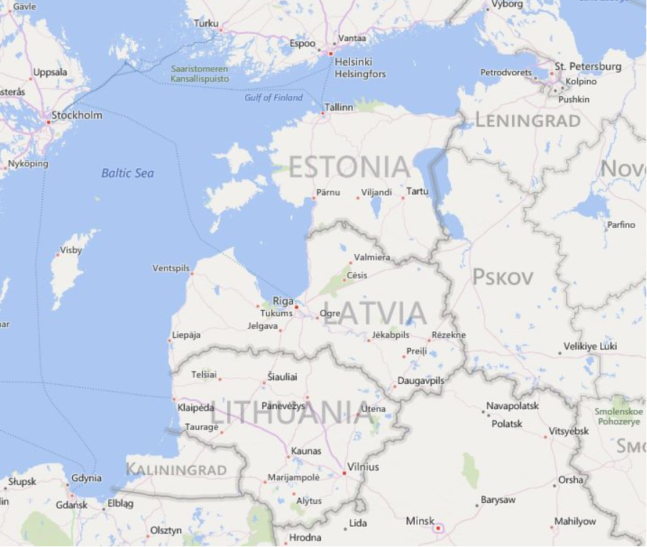
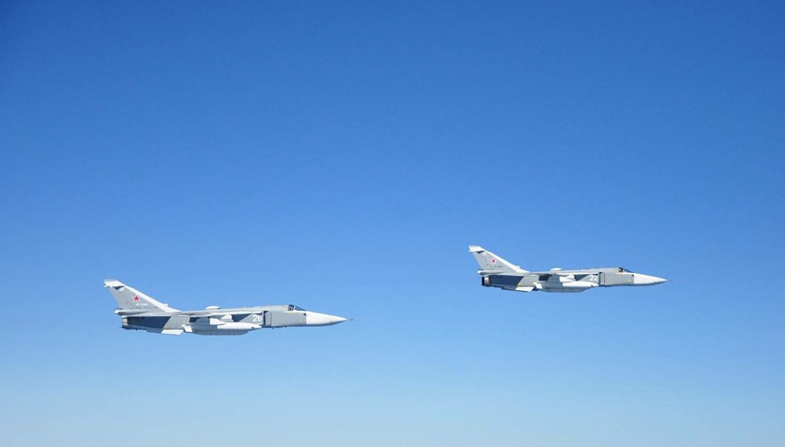
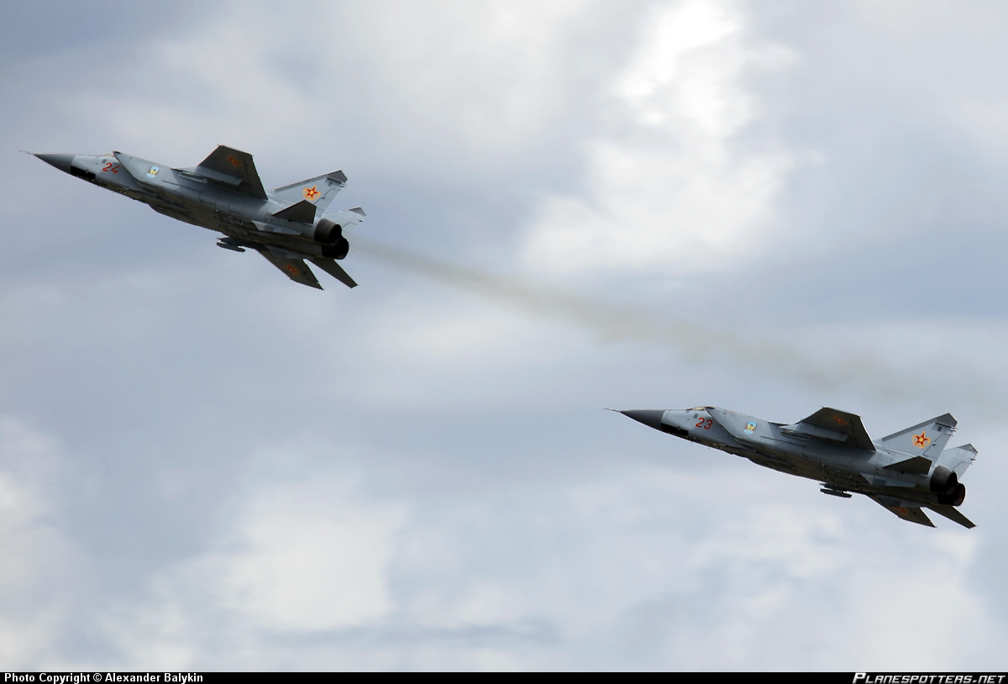
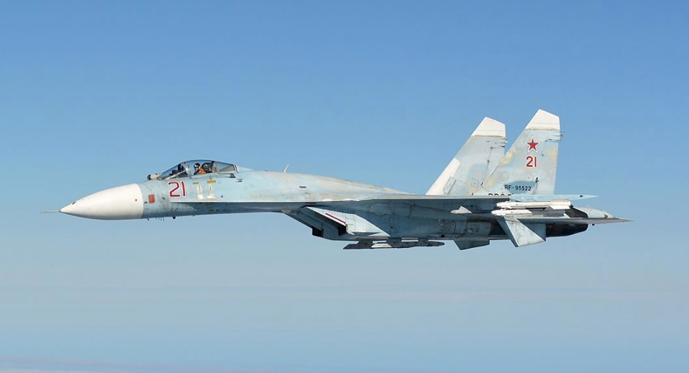
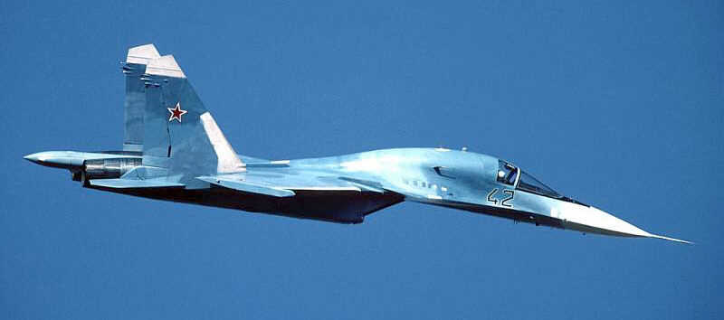
CASE STUDY 28.10.2014
2x MIG31
2x SU34
2x SU24
1x SU27
Notes:
The Russian aircraft were flying in the Gulf of Finland and were intercepted by German Typhoon fighter jets from NATO’s Baltic Air Policing Mission in order to identify the aircraft and protect Allied air space. The Russian aircraft formation included 2x MiG-31 Foxhound, 2x Su-34 Fullback, 1x Su-27 Flanker and 2x Su-24 Fencer jets. They continued into the Baltic Sea and were also intercepted by fighters from Finland and Sweden, which are not members of NATO. The Russian fighters continued to the Kaliningrad Oblast. These combat aircraft had filed a flight plan with Air Traffic Control authorities, they were using transponders, but did not maintain radio contact with civilian air traffic control.
NATO jets were on standby throughout the duration of Russian flights and Russian aircraft were continually tracked using Allied assets on the ground and in the air.
Scrambles and intercepts are standard procedure when an unknown aircraft approaches NATO airspace.
However, such flights pose a potential risk to civil aviation given that the Russian military often do not file flight plans, or use their on-board transponders. This means civilian Air Traffic Control cannot detect these aircraft nor ensure there is no interference with civilian air traffic.
NATO Allies protect their airspace on a 24/7 basis. Allied air defence efforts are focused on stopping unauthorised incursions into NATO airspace and on preventing acts of airborne terrorism.
http://www.aco.nato.int/nato-tracks-largescale-russian-air-activity-in-europe.aspx

Slide 19
Questions

