Slide 1
Magnetic MRO
omanikuvahetuse järgsed plaanid
Jan Kotka
COO

Slide 2
16.40-17.00
15min - Magnetic MRO omanikuvahetuse järgsed plaanid
Hangxin’i strateegilised suunad
MMRO strateegilised suunad
Peamised kasvuvõimalused
Sünergia MMRO edasiliikumiseks HX’ga
5min Q&A

Slide 3
Aviation technology oriented company delivering effective technical solutions in the field of aircraft engineering and safety.
Total technical care and asset management organisation with more than two decades of sectoral expertise.

Slide 4
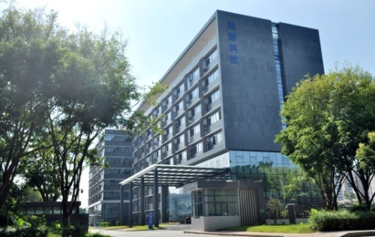
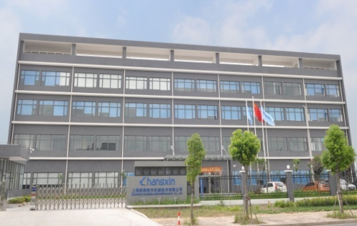
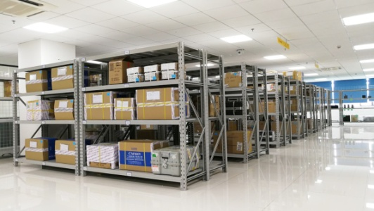
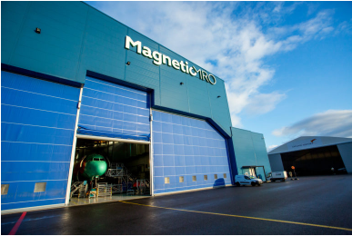
Structure
Hangxin
Guangzhou Hangxin Avionics
Shanghai Hangxin Mechanics
Hangxin Aviation Services(HongKong)
Magnetic MRO
Qingdao Xinlong Aviation Engineering (JV)
SkyHo Aviation Technology (JV)
CAAC/FAA/EASA 145 Repair Station
CAAC 147 Training Organization
CAAC Aviation Parts Distributor
OEM Service Center
CAAC/FAA/EASA 145 Repair Station
CAAC 147 Training Organization
OEM Service Center
Repair Management
Aviation Parts Trading
Consignment & Logistics Services
Total technical care
Civil Aircraft Leasi ng
Civil Aircraft/Engine Teardown
Asset Management
Aircraft Base Maintenance
HangXin GuangZhou
HangXin ShangHai
HangXin Hongkong
MMRO

Slide 5
100%
Direct Maintenance
SUBSIDIARY
Recent acquisition by MMRO. Netherlands based Line Maintenance services providing company. A well known strong brand offering services in Europe and in Africa for wide selection of wide and narrow body aircrafts

Slide 6
Magnetic MRO – Full Scope of Services
For Airlines
For Asset Owners
Heavy Maintenance
Line Maintenance
Engine Fleet Management
Spare Parts & Components
Integrated Engineering Services
Design & Production
Interior Workshop
Full Aircraft Painting
Technical Training Courses
Asset Acquisitions & Management
Technical Support During Leases
End of Life Asset Management
Transitions Between Lessees
Risks/Rewards Sharing Projects
Main growing business areas
“Unicorns”
Engine Stands 24

