Slide 1
Implementation of North European Free Routing Airspace
Estonian Aviation Seminar
Jaan Tamm
November 12, 2015

Slide 2
Content
FRA concept and its origin
Basics
NEFRA / NEFAB FRA history
Project execution
Enablers
Benefits
Lessons learned, way forward

Slide 3
Free Route (Free Routing) airspace is..
.. a specified airspace within which
(1) users may freely plan a route between a defined entry
point and a defined exit point,
(2) with the possibility to route via intermediate (published
or unpublished) way points,
(3) without reference to the ATS route network,
(4) subject to airspace availability.
Within this airspace flights remain subject to air traffic control.
Notes:
Within the Free Route Airspace (FRA) area, airspace users will be able to flightplan user preferred trajectories (subject to any overriding airspace restrictions), through lateral and vertical interfaces to the fixed route network via defined waypoints, as published in the NEFAB national AIPs.
Within FRA the airspace user may file intermediate waypoints as required to optimise the trajectory with regard to weather systems and wind patterns or other requirements that are suitable for airspace users.
The FRA deployment is supported by new procedures (ATS, ASM, ATFCM and AO flight planning), appropriate system support for conflict detection and management, as well as trajectory and queue management and also adapted airspace structures to ensure the safety of operations.
Within FRA, flights remain subject to air traffic control service. Separation and traffic synchronization tasks will be performed by the air traffic controller. The lateral and vertical boundaries of FRA shall be published in national AIPs in a coordinated manner.

Slide 4
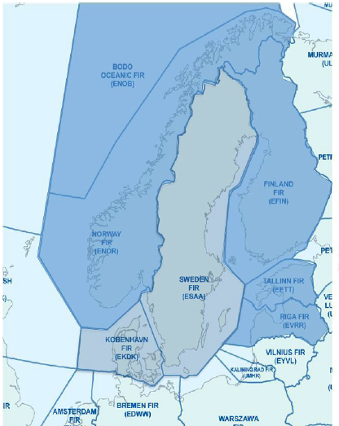
FRA Concept of Operations (1)
... users may freely plan a route between a defined entry point FRA (E) and a defined exit point FRA (X) ...
FRA (X)
FRA (E)
Notes:
Free Route (Free Routing) airspace is a specified airspace within which
(1) users may freely plan a route between a defined entry
point and a defined exit point,
(2) with the possibility to route via intermediate (published
or unpublished) way points,
(3) without reference to the ATS route network,
(4) subject to airspace availability.
Within this airspace flights remain subject to air traffic control.

Slide 5
FRA Concept of Operations (2)
... with the possibility to route via intermediate (I) (published or unpublished) way points ...
FRA (X)
(I)
FRA (E)
Notes:
Free Route (Free Routing) airspace is a specified airspace within which
(1) users may freely plan a route between a defined entry
point and a defined exit point,
(2) with the possibility to route via intermediate (published
or unpublished) way points,
(3) without reference to the ATS route network,
(4) subject to airspace availability.
Within this airspace flights remain subject to air traffic control.

Slide 6
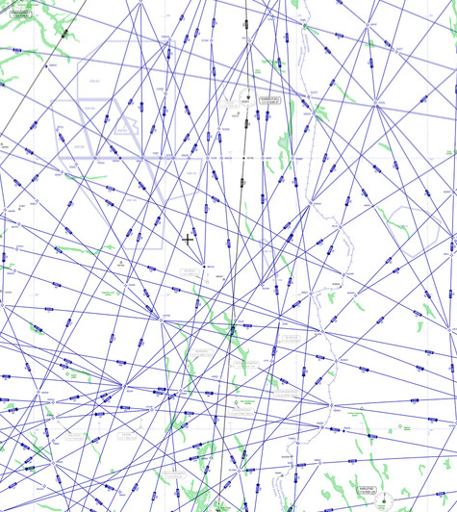
FRA Concept of Operations (3)
... without reference to the ATS route network ...
FRA (X)
(I)
FRA (E)
Notes:
Free Route (Free Routing) airspace is a specified airspace within which
(1) users may freely plan a route between a defined entry
point and a defined exit point,
(2) with the possibility to route via intermediate (published
or unpublished) way points,
(3) without reference to the ATS route network,
(4) subject to airspace availability.
Within this airspace flights remain subject to air traffic control.

Slide 7
FRA Concept of Operations (4)
... subject to airspace availability.
  In the case of cross-border FRA major change in ATCO mind setting needed
  – clearing aircraft DCT into the downstream ACC without prior coordination
FRA (X)
(I)
TSA
(I)
FRA (E)
Notes:
Free Route (Free Routing) airspace is a specified airspace within which
(1) users may freely plan a route between a defined entry
point and a defined exit point,
(2) with the possibility to route via intermediate (published
or unpublished) way points,
(3) without reference to the ATS route network,
(4) subject to airspace availability.
Within this airspace flights remain subject to air traffic control.
(FRA is part of or coincides with the controlled airspace)

Slide 8
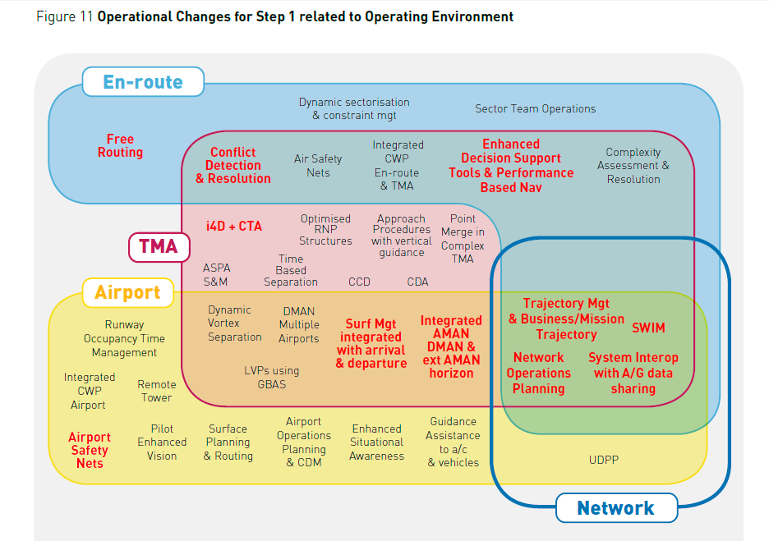
The origin of FRA Concept
The European ATM Master Plan –
Chapter 3.5.3 –
Free Routing
is describing
Deployment
Baseline
Step 1: Time
based Ops
Step 2: Trajectory
based Ops
not yet describing
Step3: Performance
based Ops
Notes:
The FRA concept originates from the European ATM Master Plan, where operational changes related to en-route operational environment to implement Free Routing operations (deployment baseline and step 1 – time based ops) are described.
The questions often asked..
- Whether it pays off?
- How does it influence the ATCO workload?

Slide 9
FRA enforcement in the Pilot Common Project
Commission Implementing Regulation (EU) No 716/2014,
of 27 June 2014 on the establishment of the Pilot Common Project supporting the implementation of the European Air Traffic Management Master Plan
Extended Arrival Management and Performance Based Navigation in high density TMAs
Airport Integration and Throughput
Flexible Airspace Management and Free Route
Network Collaborative Management
Initial System Wide Information Management - iSWIM
Initial Trajectory Information Sharing
More detailed approach for introduction of these ATM functionalities is presented in the SESAR DM Deployment Programme 2015
Notes:
The PCP IR requires the deployment of Free Route Airspace (FRA) within Member States’ airspace of the ICAO EUR region at and above FL 310. The implementation is coordinated through the NM European Route Network Improvement Plan (ERNIP) and the Network Operations Plan following the Strategic Objectives and Targets set in the Network Strategic Plan and in the Network Manager Performance Plan. All European ANSPs have included in the ERNIP Part 2 - ARN Version 2014-2019 projects for full or partial implementation of Free Route Airspace selecting their implementation step.
Olukord marsruudivaba opereerimisega Euroopas 2015 suveks:
- 34 ACC 64-st mingil moel juurutatud, sealhulgas
- 6 ACC – täielikult 24/7
- 12 ACC – öine FRA
Euroopa-ülesed peamised väljakutsed lähitulevikuks:
Riikide FRA-de vahelised piiriülesed marsruudivabad piirkonnad
FRA-sid puudutava aeronavigatsioonilise info harmoniseerimine
Efektiivsem FUA tänu paremale koostööle NM, õhuruumi kasutajate /lendude planeerijate ja ANSP-de vahel
Selleks tegeldakse ERNIP (European Route Network Improvement Plan) dokumendi edasiarendamisega
Piiriüleste FRA-de juurutamisel tuleks rohkem tähelepanu pöörata piirnevate vastutusalade ANSP-de informeerimisele

Slide 10
Goals of FRA Concept
Those along to SES key performance areas (KPAs) –
maintaining or improving (1) safety objectives and offering (2) environmental, (3) flight efficiency and (4) cost-efficiency gains
Operational –
as a step to full trajectory based operations the FRA concept brings increased flight predictability, reduced uncertainty for the Network; which in turn can lead to potential capacity increases for ATM
Notes:
The FRA concept brings significant flight efficiency benefits and a choice of user preferred routes to airspace users. As a step to full trajectory based operations the FRA concept brings increased flight predictability, reduced uncertainty for the Network which in turn can lead to potential capacity increases for ATM which will also benefit the user.

Slide 11
Pan European challenges
  Implementing of cross-border, multi-State FRAs
  Harmonising FRA related aeronautical information and publication procedures
  More efficient Flexible Use of Airspace thanks to better co-operation between ANSPs, Network Manager and Airline Operators
Notes:
The FRA concept brings significant flight efficiency benefits and a choice of user preferred routes to airspace users. As a step to full trajectory based operations the FRA concept brings increased flight predictability, reduced uncertainty for the Network which in turn can lead to potential capacity increases for ATM which will also benefit the user.

Slide 12
FRA history in Europe
May 2009 – Portugal (Lisboa FIR) above FL245 H24
July 2009 – Ireland above FL245 H24
2011 – Maastricht UAC, Germany (Karlsruhe UAC),
Denmark/Sweden above FL285 H24
Dec.2012 – Finland above FL095 Night Time (21:00-03:30)
2013-2015 – several Night Time FRAs (Romania, Bulgaria, Moldova,
Ukraine, Serbia + Croatia)
May 2014 – Spain DRA above FL245 in Santiago-Asturias sectors H24
Feb.2015 – Hungary all levels H24, route structure deleted
......
Nov 12, 2015 – NEFAB FRA start-up
Summer, 2016 – planned NEFRA start-up
2016-2021 – planned Borealis FRA stepwise implementation
01.01.2022 – common requirement of PCP implementing regulation
Notes:
Another radical ATM development programme after implementing RVSM in 41 European States’ airpaces on January 24, 2002
Rather versatile history:
April 2009 – Sweden (Sweden UIR) – no co-operation with NM
May 2009 – Portugal (Lisboa FIR) above FL245 H24
July 2009 – Ireland above FL245 H24
Dec.2009 – UK/Ireland FAB (Shannon UTA)
Feb.2011 – Maastricht
June 2011 – Germany (Karlsruhe UAC)
Nov.2011 – Denmark/Sweden above FL285 H24
Dec.2012 – Finland above FL095 Night Time (21:00-03:30)
May 2013 – Czech Republic, Croatia, Poland and Serbia
Nov.2013 – Romania above FL105 Night Time
Nov.2013 – Bulgaria above FL245 Night Time
May 2014 – Moldova above FL095 Night Time
May 2014 – Spain DRA above FL245 in Santiago-Asturias sectors H24 (route structure deleted)
Feb.2015 – Hungary all levels H24, route structure deleted
March 2015 – Ukraine above FL275 Night Time
April 2015 – Serbia + Croatia above FL325 Night Time (no route structure that time)
......
12.11.2015 – NEFAB FRA rakendumine
23.06.2016 – tõenäoline NEFRA (nn 8.stsenaariumi) rakendumine
01.01.2022 – PCP rakendusmääruse järgne kohustus Euroopas (DCT 01.01.2018)

Slide 13
NEFRA / NEFAB FRA timetable
2012-2013 - Preparatory phase (consolidating the FRA baseline in 6 North European States)
  March 11, 2013 - 6 States declaration initiating NEFRA
  March 24, 2014 - NEFRA CEO signed ToRs
2013-2014 - Design phase (Project plan, ConOps, ATM System Spec, ATCO procedures, harmonized AIP proposal)
2014-2015 - Implementation phase (Back-up plan, NSA
approvals, publication, co-ordinated implementation)
  April 2015 - Change of scenario – to implement NEFAB FRA
  May 2015 - NSA application and relevant documentation
  May 2015 - AIC regarding the start-up of NEFAB FRA
  June 2015 - Split of NEFAB FRA into two volumes (WEST and EAST)
  Sept 2015 - AIP FRA amendment
Nov 12, 2015 - Start-up of NEFAB FRA (NEFRA phase 1)
Summer, 2016 - Planned „full“ NEFRA start-up
Notes:
Sept 2012 - ettevalmistustööd DK/SE FAB FRA ja NEFAB FRA võimaliku ühendamise osas
8.mai 2013 - 6 ANSP CEO kokkulepe DK/SE FAB ja NEFAB ühise NEFRA programmi kohta (Oslo)
24.märts 2014 - NEFRA CEO allkirjastatud ToRs
1.mai 2015 - taotlus ja dokumentatsioon NSA-le
20.mai - ringkiri (AIC) NEFAB FRA kohta
16.juuni - NEFAB FRA 2-osaline (WEST ja EAST)
28.juuli - lõplik AIP pakett NSA-le
15.aug - õhuruumi muudatuste kinnitus NSA-lt
1.okt - LoAd Soome ja Lätiga allakirjutamiseks
31.okt - ATM süsteemide valmisolek
2014 - Fast-time simulation/CAPAN analysis performed in each ACC- results showed that no blocking issues were found
2014-2015 - Real-time simulations were performed as needed to verify the concept (System support requirements were verified, ATCO procedures are important)
Safety Case - DK/SE no needed, based on existin approval, NEFAB FRA SC together with ECTL (valuable for local safety assessments)

Slide 14
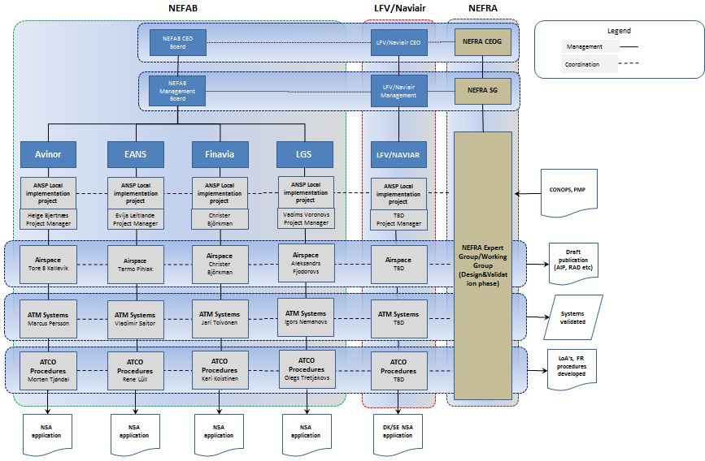
Organisation – Design Phase
Notes:
Further about project execution..
1. NEFRA is a comprehensive cross-border undertaking, which requires capable project organisation and governance.
2. CEO Board – Steering Group – Expert group – supporting (temporary nature) sub-groups (Airspace, ATM Systems, ATCO Procedures, AIS-TF)
3. ANSP Local implementation project – ANSP specific
4. This is very much an airspace project - continuous State and NSA involvement is essential

Slide 15
Organisation – Implementation
Notes:
European Route Network Improvement Plan (ERNIP),
Part 1: European Airspace Design Methodology – Guidelines
6.5 – FRA; 6.5.1 – FRA Concept
NEFAB CONOPS
NEFAB Network Plan
NEFAB Target Concept
NEFRA CONOPS
ATM System support for NEFRA
Project Management Plan for NEFRA
Back-up Plan for NEFRA Implementation
EstFRO ConOps
EstFRO Project Management Plan (FRA, LARA, OLDI)
Some lessons learned from organising such large scale international cooperation:
Capable project organisation and governance is required
In design phase – most workload on the expert group, additionally some specific ad hoc sub-groups may be needed from time to time, required contribution from partner ANSPs’ staff remains low
In implementation phase - workload within the ANSPs begins increasing, staff of ops units must start contributing, to prepare their job front under new circumstances; their efforts are co-ordinated by implementation group. Occasionally expert group input may be needed.

Slide 16
FRA enablers
Adaptations to airspace structures
Adaptations to airspace management procedures
ATC procedures – enhancements where necessary for operations within FRA and at its interfaces
Setting the flight planning rules
Appropriate system support - enhancements
  for the purposes of flight planning and ATFCM
  OLDI between cross-border FRA partners
Harmonised preparation and dissemination of the aeronautical information
Notes:
The enablers are presented in accordance with the European Route Network Improvement Plan (ERNIP), supplemented with specific elements for cross-border FRA
Expressing that all in a nutshell - the FRA deployment is enabled/supported
- by new procedures (ATS, ASM, ATFCM and AO flight planning),
- appropriate system support for conflict detection and management, as well as trajectory and queue management and
- also adapted airspace structures
- and appropriate aeronautical information reflecting the FRA-realted changes
to ensure the safety of operations.

Slide 17
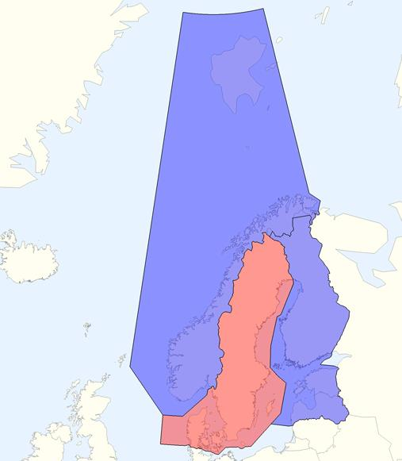
1.1 NEFRA lateral dimensions
On November 12th 2015..
NEFAB FRA starts in two volumes:
  FRA Area 1 – Norway FIR and Bodø Oceanic FIR –
  NEFAB WEST FRA
  FRA Area 2 – Finland FIR,
  Tallinn FIR and Riga FIR –
  NEFAB EAST FRA
DK/ SE FRA will continue without change
Summer 2016..
NEFRA = NEFAB FRA + DK/SE FRA
Notes:
For the NEFRA implementation date of Nov 12, 2015 the NEFRA 6 states airspace has “simplified” to NEFAB FRA, in two separate volumes, and DK/SE FRA not yet interfaced to NEFAB FRA. This interface will be arranged for June 23, 2016.
The lateral and vertical boundaries of FRA shall be published in national AIPs in a coordinated manner.

Slide 18
1.2 NEFRA vertical limits
Notes:
Norway FIR above FL135, FL195 over certain parts of the North Sea
Bodø OFIR above FL 195
In 2004 Norway proposed to consolidate its FIRs and change the name of the FIR to „Norway FIR“
ICAO: A control zone, control area or flight information region should be identified by the name of the unit having jurisdiction over such airspace

Slide 19
2.1 Adaptations to ASM procedures and FUA
ASM as a customary planning function
with the primary objective of maximising the utilisation of available airspace by dynamic time-sharing
at times, the segregation of airspace among various categories of airspace users on the basis of short-term needs;
Applying flexible use of airspace (FUA) procedures in accordance with the EC Regulation No 2150/2005
Cooperation between the ATM stakeholders and the implementation of the LARA tool
LARA - Local and Sub-Regional Airspace Management
Support System, a EUROCONTROL software package
to use the LARA as information system of FRA partners functioning according to uniform principles
Notes:
LARA kasutamise tulemusena tekkivad väljundid on:
1) AUP/UUP (NM süsteemidesse) Õhuruumi kasutusplaan (AUP) ja sellesse avaldamise järgselt tehtavad muudatused (UUP) genereeritakse LARA-s tuginedes vastava ajaperioodi (24h) kohta koordineeritud reserveerimisinformatsioonile. LARA võimaldab AMC-l kui AUP-d/UUP-d väljastaval kasutajal määratleda seda, milliseid andmeid ning sektsioone AUP/UUP sisaldab. LARA poolt genereeritud AUP/UUP eksporditakse ACA formaati, seejärel edastatakse see üle B2B ühenduse NM andmebaasi.
2) AUP/UUP (internetti) Lisaks NM-i süsteemi saatmisele teeb AMC nii AUP kui ka UUP kasutajatele avalikuks ka selleks loodud spetsiaalse veebikülje vahendusel HTML formaadis Lennuliiklusteeninduse AS-i Lennuinfo osakonna veebilehel (aim.eans.ee). AUP/UUP informatsiooni reaalaegne kajastamine internetis võimaldab tagada õhuruumi kasutajate teavitamise kõikide AMA alade staatusest ning marsruudisegmentide saadavusest lendude planeerimisel.
3) NOTAM-teadete tekstid Kui ala reserveerimise puhul on nõutud NOTAM-teate väljastamine, on LARAsse seadistatud vastavale operaatorile meeldetuletuse kuvamine. LARA võimaldab NOTAM-teate teksti automatiseeritud koostamist ning NOTAM-büroole edastamiseks eksportimist (NOTAM-teadete automaatset edastamist AFTN-i kaudu LARA ei võimalda).
4) Õhuruumi kasutamise statistika Eesti õhuruumi paindliku kasutamise järel-hindamiseks on LARA andmebaasi kogutud andmete alusel võimalik teostada Tallinna FIRi õhuruumi paindliku kasutamise (FUA) peamiste tulemuslikkuse indikaatorite (KPIde) analüüsi. Militaarse õhuruumikasutuse statistilise analüüsi teenuse PRISMIL kasutuselevõtu korral on võimalik vastavate andmete automaatne edastus LARA-st.

Slide 20
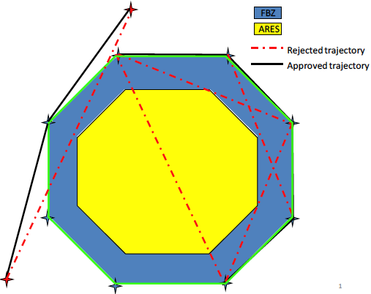
2.2 FUA structures and Airspace restrictions
Flight plan buffer zones (FBZ) have been established for pre-tactically bookable TSAs for flight planning purposes only
FBZs are published in AIP ENR 5.2,
FBZ width is planned 6 nm
For circumnavigating the
TSAs/FBZs the existing
waypoints or specially
introduced intermediate (I)
points shall be used, e.g.
OMAXA, PIPAV (ENR 4.4)
TSAs/FBZs shall be
administered using LARA
information system
Notes:
Õhuruumi korraldamise tehniline tugi
Vajadused on määratletud NEFAB Network Plan, Annex 6-s
Võimekus esitada jooksvaid ja eelseisvaid õhuruumi piiranguid lennujuhi positsioonile nii ACC-s kui teistes üksustes
Võimekus vajalikus ulatuses õhuruumi konfiguratsiooni kohta info vahetamiseks NEFAB naabritega (Soome ja Läti)
Võimekus käsitleda piirangualade reserveerimise protsessi telefoni kasutamata

Slide 21
3.1 Enhancements of ATC procedures for FR Ops
Coordination of FPL trajectory in close proximity to a 3rd party airspace (closer than 2,5 nm)
Tactical re-routing:
Re-joining FPL trajectory within own AoR (preferred)
Re-joining close to the downstream AoR may be cleared DCT to next significant point in current FPL
If this takes the flight into 3rd party airspace, coordination to „new“ downstream unit is required
Tactical re-routing causing need for circumnavigating the ARES
Within downstream AoR
In the 3rd party airspace
Coordination with NM (AFP, ACH, APL)
and with NEFRA partners (OLDI ABI, ACT, MAC)
Notes:
AFP (ATC Flight Plan Proposal) – mean for ATC to update flight plan data using IFPS. Reasons for an AFP:
Missing FPL
Diversion
Change of RFL
Change of aircraft type
Change of flight rules IFR/VFR
Change of flight type GAT/OAT
Change of equipment
Change of route/trajectory

Slide 22
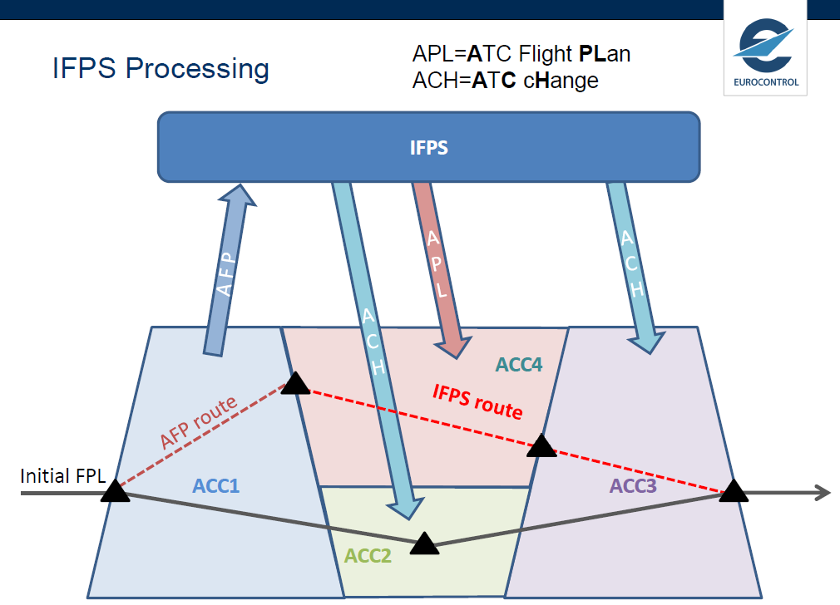
3.2 Updating FPL at Change of route/trajectory
Notes:
IFPS – Integrated Initial Flight Plan Processing System
AFP – ATC Flight Plan Proposal
APL – ATC Flight Plan
ACH – ATC Change

Slide 23
4.1 Flight Planning Rules
From | To | Remark
FRA Entry Point | FRA Exit Point | Flight plan DCT or via one or several additional points. Additional point can either be a Navaid (as published in ENR 4.1) or a significant point (as published in ENR 4.4) in the national AIP of Estonia, Finland, Latvia or Norway. Additional point can also be entered as coordinates.
 | FRA Arrival Transition Point
FRA Departure Transition Point | FRA Exit Point
 | FRA Arrival Transition Point
Notes:
Setting the flight planning rules - Operators may need certain adaptations and modifications in their flight planning systems to be able to use offered FRA advantages
FRA-spetsiifilised definitsioonid
Üldised põhimõtted ja definitsioonid on esitatud ERNIP 6.5.4 ja 6.5.6
Definitsioonid NEFAB FRA juurutamisel vt ENR 1.3
FRA sisenemispunkt FRA Entry Point (E)
FRA väljumispunkt FRA Exit Point (X)
FRA üleminekupunkt FRA Transition Point
FRA saabumise üleminekupunkt FRA Arrival Transition Point (A)
FRA lähte üleminekupunkt FRA Departure Transition Point (D)
FRA FRA üleminekumarsruut FRA Transition Route (ENR 3.5)
FRA vahepunkt FRA Intermediate Point (I)
RAD (Route Availability Document) esitab ühtse integreeritud ja koordineeritud piirangute loetelu ja nõuded kõigis valdkondades, kus NM osutab ATFCM teenuseid
Nende piirangutega esitatakse lisatingimused IFPS-i laekuvate lennuplaanide töötlemiseks
Näiteks: 0NM DCT will be changed to 999NM (? vastupidiselt ERNIP-ile)
Reference for ADEX points (ENR 4.4)
Eligible cross-border DCTs, DCT rejections
EFHK restrictions to/from EETT

Slide 24
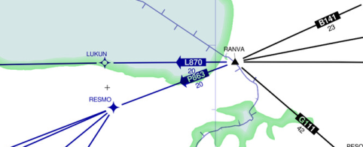
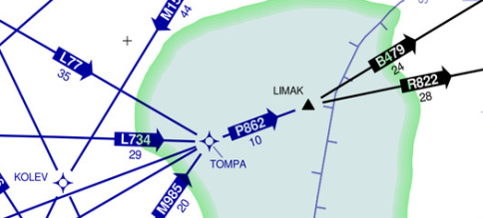
4.2 FRA interface with non-FRA airspace
Entry into FRA from RANVA – FRA FPL are allowed to start from LUKUN or RESMO
Exit from FRA via LIMAK – FRA FPL should end at TOMPA (X)
(ENR 4.4)

Slide 25
5.1 Technical functionalities
In the cross-boarder FRA environment the next ATM system basic functionalities are required:
The ATM systems shall be able accept and process the NEFRA flight plans – all ATM systems of NEFRA partners shall include the complete database of NEFRA system area (all significant points (ENR 4.1 and 4.4) and all routes/ route segments)
NEFRA ACCs shall be able to process and coordinate flights via OLDI. This coordination shall be based on the point where the planned DCT crosses the AoR boundary
Enhancements include:
Automated trajectory update via OLDI: sending, receiving and processing of route changes (updated field 15 information) in ABI and REV messages
NM integration: automatically sending AFP message to the NM upon route/level change and processing of received ACH/APL messages
Notes:
Basic requirements
The following systems support is deemed as basic requirements to accommodate NEFRA operations:
a) The ATM systems have to be able accept and process the NEFRA flight plans
b) NEFRA ACCs shall be able to process and coordinate flights via OLDI. This coordination shall be based on the point where the planned DCT crosses the ACC boundary.
Enhancements include:
a) Automated trajectory update via OLDI: sending, receiving and processing of route changes (updated field 15 information) in ABI and REV messages.
b) NM integration: automatically sending AFP message to the NM upon route/level change and processing of received ACH/APL messages.

Slide 26
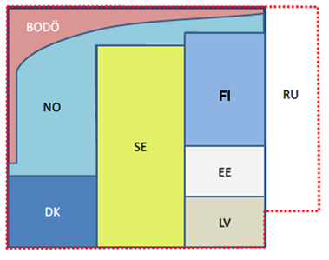
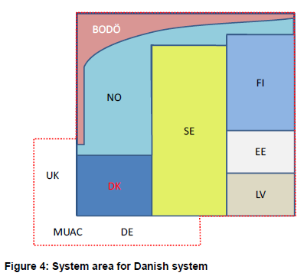
5.2 NEFRA system area
  NEFRA geographical area the ATM systems are „aware of“ –
  includes all significant points (en-route points/fixes/nav-aids)
  and routes and route segments of that area
  at least all NEFRA information
  plus (selectively) information
  from adjacent ACCs
Fig. System area for Finnish
and Estonian systems
Notes:
FRA relevant uppdates of Estonian ATM System (TopSky from Thales)
B6 (17 August, 23 October 2015)
ECP‐136 ‐ Addition of local buffer around TSA for APW
ECP‐149 ‐ FSA with range/bearing from COPN
ECP-153 ‐ Global/local buffer implementation around TSA for SAP
ECP‐155 ‐ SEP tool enhancement
ECP‐161 ‐ Read‐only Manual Transfer Window on non‐eligible PPOS
B7 (spring 2016)
ECP‐144 ‐ Field 15 route amendment
ECP‐154 ‐ Unconcerned sector proximity warning
ECP‐158 ‐ Handling of re‐entry flight
ECP‐162 ‐ LARA interface
ECP-168 ‐ Re-evaluation of controlling state upon FRUL change

Slide 27
6. AIP FRA-changes
ENR 1.3 Instrument Flight Rules
- Estonia follows Commission IR No 923/2012 (SERA)
- Adding FRA general procedures:
  Relevant FRA definitions
  Eligible flights
  Flight planning rules, incl. FRA requirements for departing and arriving traffic
ENR 1.10 Flight Planning – changes caused by FRA implementation
ENR 2.2 Other Regulated Airspace – NEFAB, and NEFAB EAST FRA lateral and vertical limits
ENR 3.5 Other Routes – traffic departing from /arriving to Helsinki
ENR 4.4 Name-code Designators for Significant Points – supplemented with FRA relevant points (E, X, A, D, I)
ENR 6 En-route Charts – Free route airspace
Also FRA relevant FBZ supplements in ENR 5.2 Military Exercise and Training Areas and Air Defence Identification Zone
Notes:
AIC – May 20, 2015
AIP changes – September 2015
RAD restrictions
Lisaks on üleminekut marsruudivabale opereerimisele kommunikeeritud huvigruppidele mitmesuguste ürituste ja infomaterjalide kaudu.

Slide 28
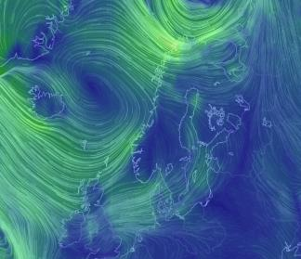
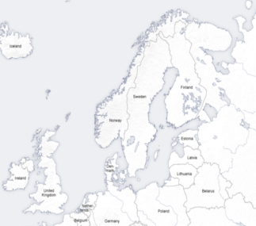
Possible benefits from Free Routing operations
Operators will have wider opportunities to optimize their flight plans / flight profiles to improve cost-effectiveness, taking into account the following variables:
Distance flown and flight time
Fuel consumption and fuel cost
Navigation charges
Weather conditions
Airspace restrictions
The larger the FRA area, the more spacious optimization opportunities and the higher the probability that the operator will take the opportunity of free planning
Wind structures
En route unit rates*
*Per May 2015
Source: EUROCONTROL and EANS
56,34€
50,22€
65,33€
31,10€
27,69€
29,71€
63,21€
46,93€
101,25€
35,91€
90,26€
Notes:
Concluding from Free Routing Operations
Within the Free Route Airspace (FRA) area, airspace users will be able to flightplan user preferred trajectories (subject to any overriding airspace restrictions), through lateral and vertical interfaces to the fixed route network via defined waypoints, as published in the NEFAB national AIPs. Within FRA the airspace user may file intermediate waypoints as required to optimise the trajectory with regard to weather systems and wind patterns or other requirements that are suitable for airspace users.
But they must take into account a number of factors:
Lateral and horizontal limits of such airspace
Airspace restrictions (e.g. temporarily closed military training areas) and the circumnavigation procedures
Established waypoints and flight planning rules
Fixed ATS-route network will be maintained
Free Route and ATS-route network together will enable mixed mode operations.

Slide 29
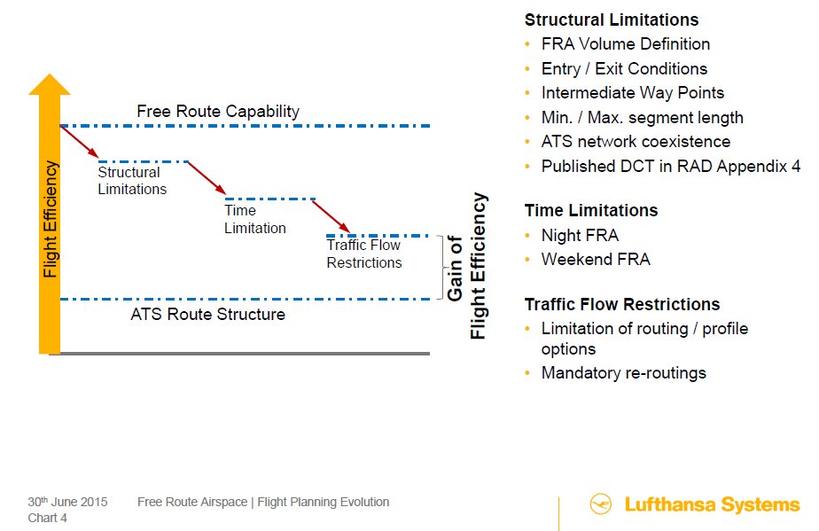
Correlation btw FRA design and gain of flight efficiency

Slide 30
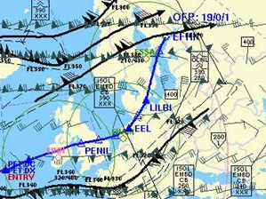
Example of unconventional flight planning
Notes:
Flight FIN5 EFHK-KJFK on Sept 30, 2015 – because of strong headwind on conventional route was carried out significantly southern

Slide 31
Lessons learned, way forward
The importance of a clear back up plan to make the complicated decisions easy (vital to face the risks ahead in a realistic way)
The value of simulations in close-to-real environment
User friendly interfacing of cross-border FRA areas
NEFRA scenario 8 („full“ NEFRA) – summer, 2016
  „Overdue“ phase 1, containing elements from phase 2
  Enhanced OLDI (REV/MAC, Field 15,...)
  Improved NM integration (automatic processing AFP, ACH/APL...)
Further expansion – Borealis FRA
  Drafting of ConOps, PMP and Back-up plan..
  Co-operation with SJU

Slide 32
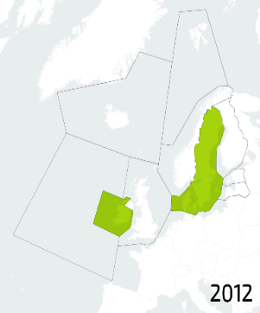
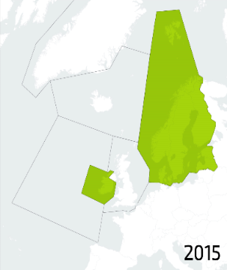
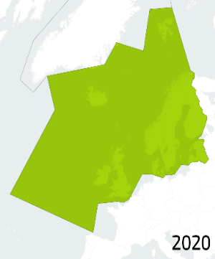
Expansion of NEFRA – Borealis FRA
Borealis FRA will cover 3 FABs (NEFAB, DK/SWE, UK/Ireland) and large area of the North Atlantic controlled by Isavia - Icelandic ANSP
Lately Baltic FAB (Lithuania and Poland) has
expressed their ambition to join Borealis FRA

Slide 33
Thank you for your attention!
Tänan tähelepanu eest!
Any questions?

