Slide 1
Introduction of Estonian Aviation Academy's helicopter FNPT II MCC
20-th Estonian Aviation Seminar 13.11.2015
Jaan Annus
ATO CGI
Helicopter pilot (police-border guard)

Slide 2
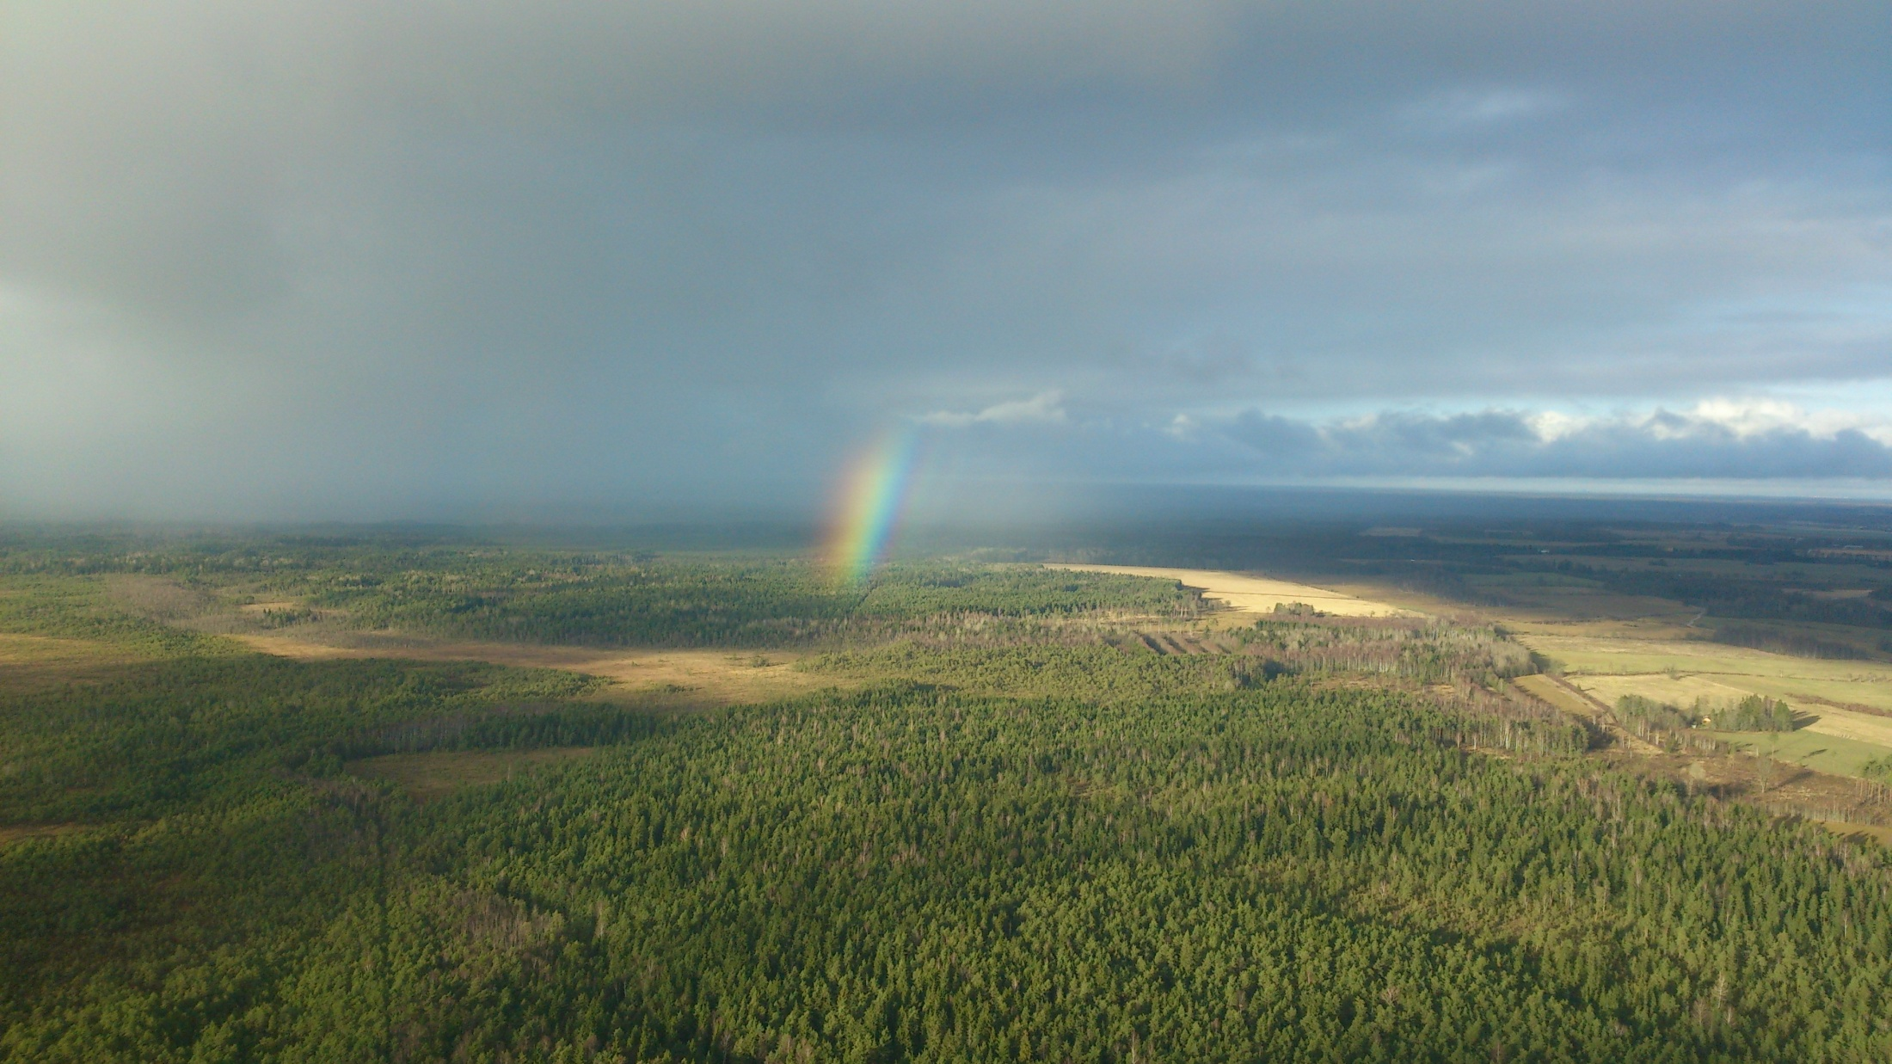
Helicopter FNPT II MCC –
Flight and Navigation Procedures Trainer, level II, Multi Crew Cooperation training

Slide 3
CS FSTD(H).200 Terminology
‘Flight and navigation procedures trainer (FNPT)’ means a training device which represents:
- the flight deck/cockpit,
- equipment,
- computer programmes.
FNPT mimics an aircraft or class/type of aircraft in flight operations to the extent that the systems appear to function as in an aircraft.

Slide 4
Motivating the FNPT H MCC Procurement:
- Call for improvement
- Employers/customer expectations for training
- Commission Regulation (EU) No 1178/2011
- European Union Structural Support Fund to Estonia - Modernisation of higher education and R&D institutions

Slide 5
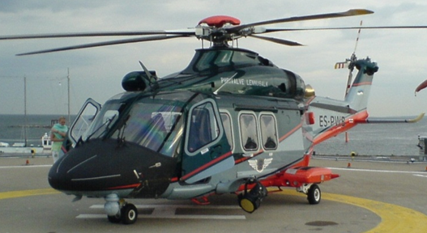
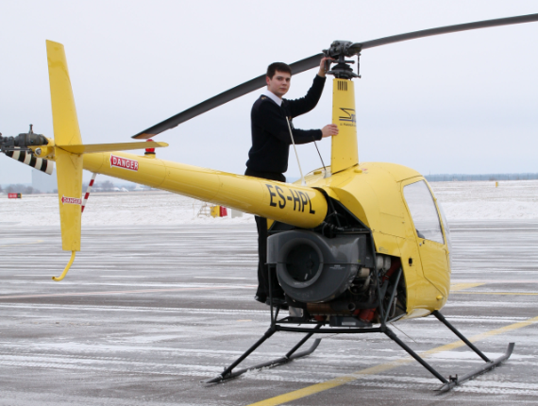
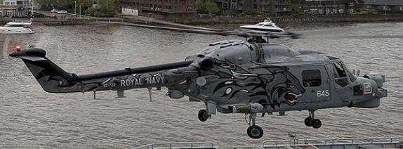
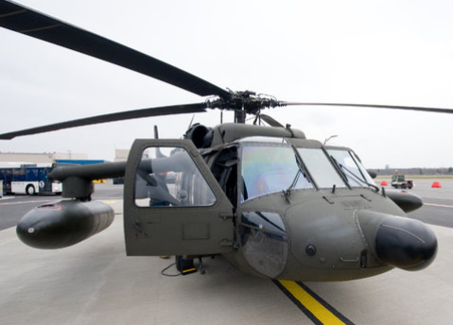
The Missing Link

Slide 6
From Words to Deeds
Spring 2014 – Start of the project
20.11.2014 – Launch of public procurement
31.12.2014 – Opening tenders
09.01.2015 – Signing the contract with Entrol
8.-11.06.2015 – Factory acceptance tests
22.-25.06.2015 – Transport
06.-10.07.2015 – Installation
31.07.2015 – Function and subjective tests
26.09.2015 – Initial evaluation by the ECAA
02.10.2015 – Certified by the ECAA

Slide 7
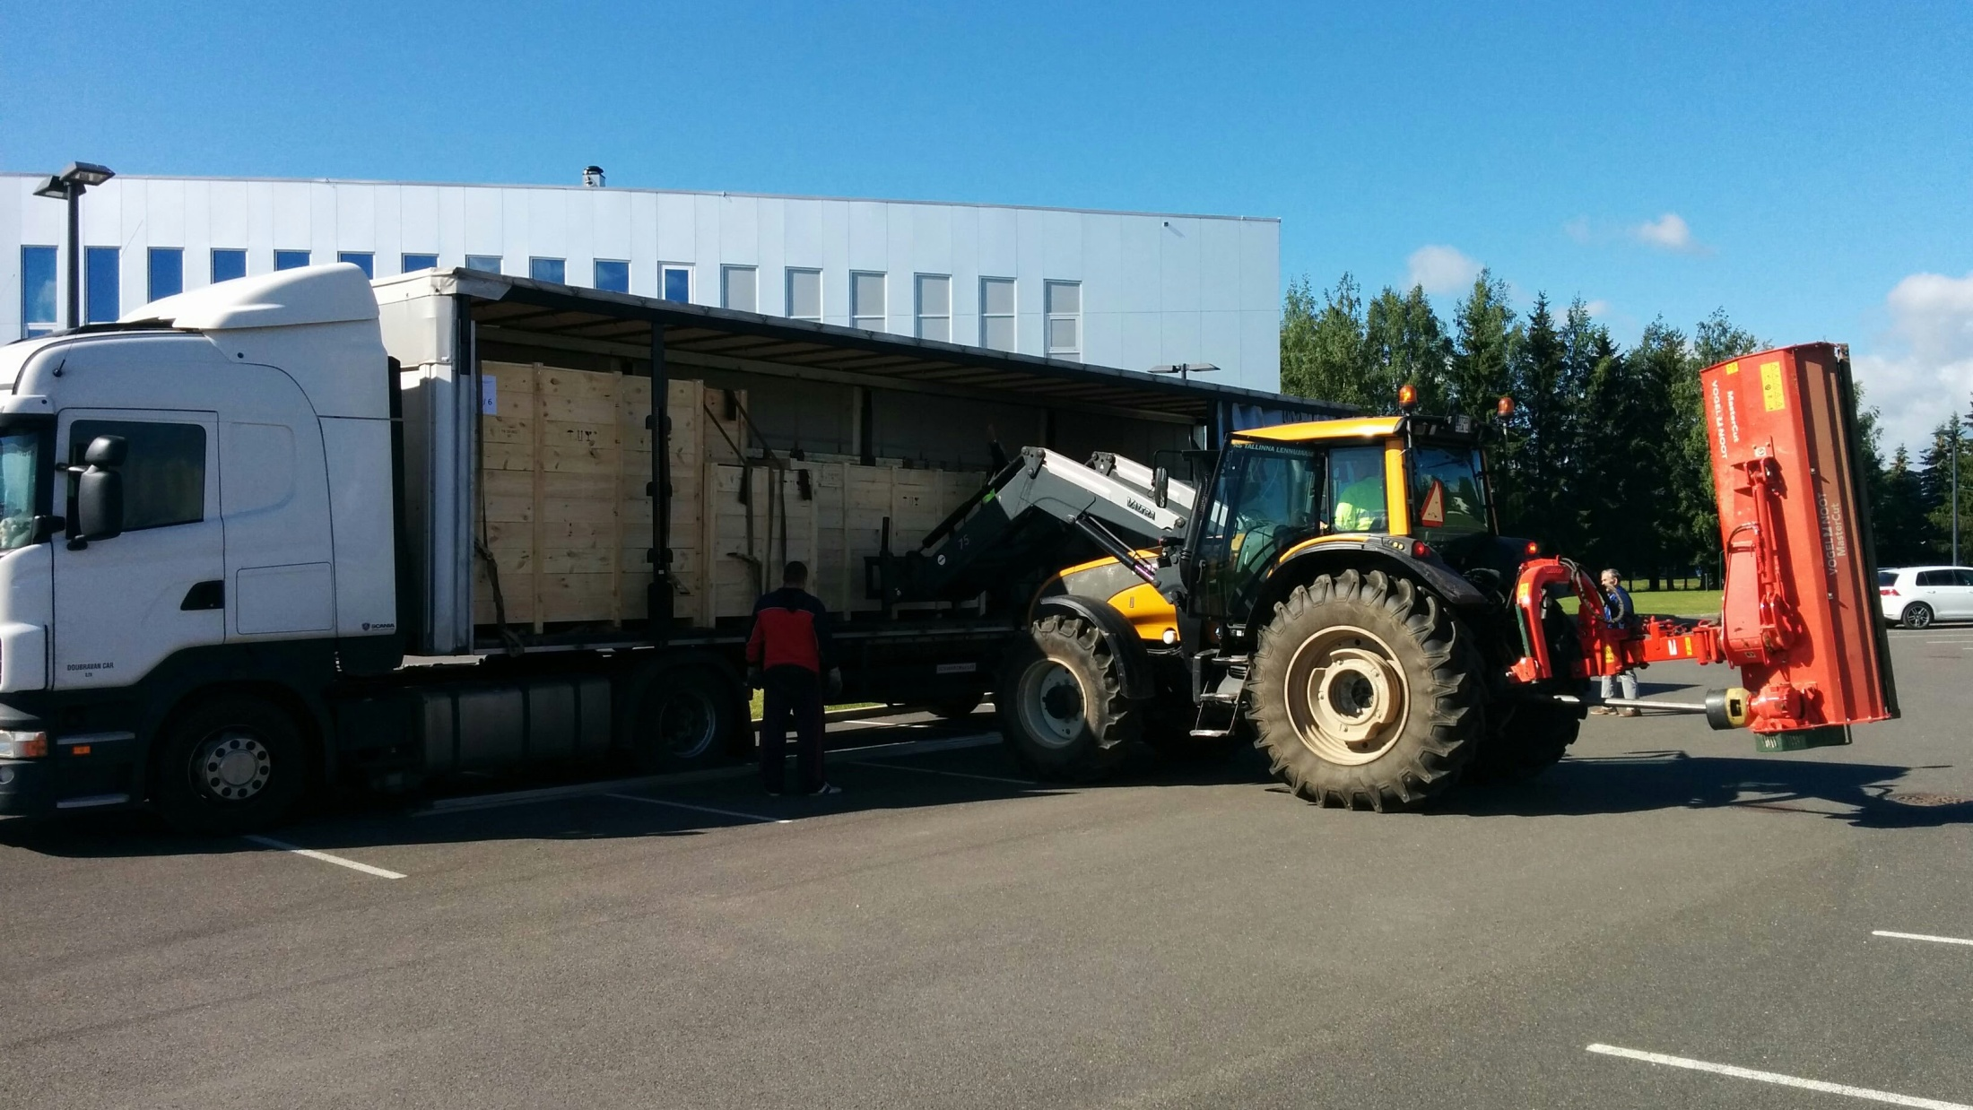
Installation in July 2014

Slide 8
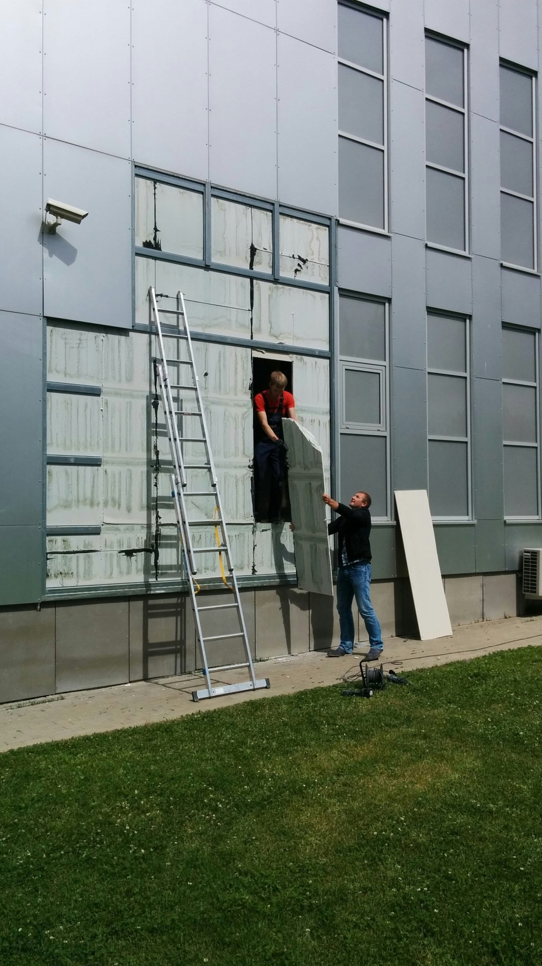
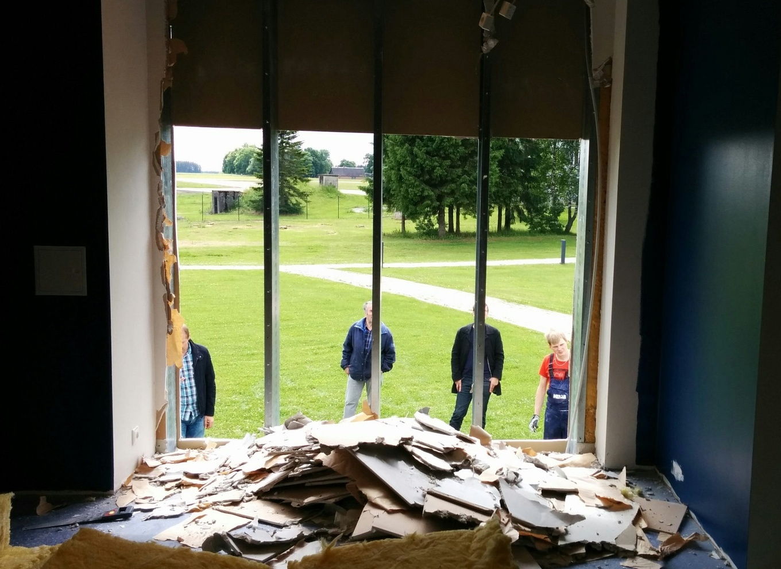
Installation in July 2014

Slide 9
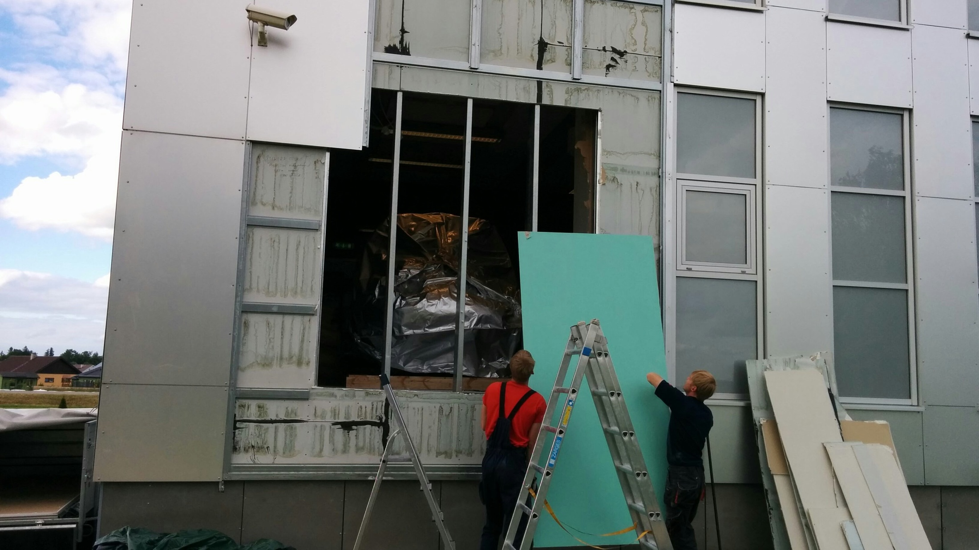
Installation in July 2014

Slide 10
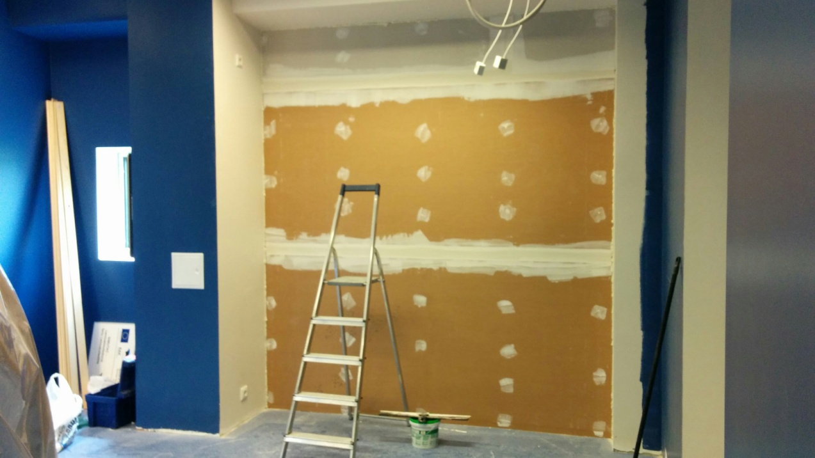
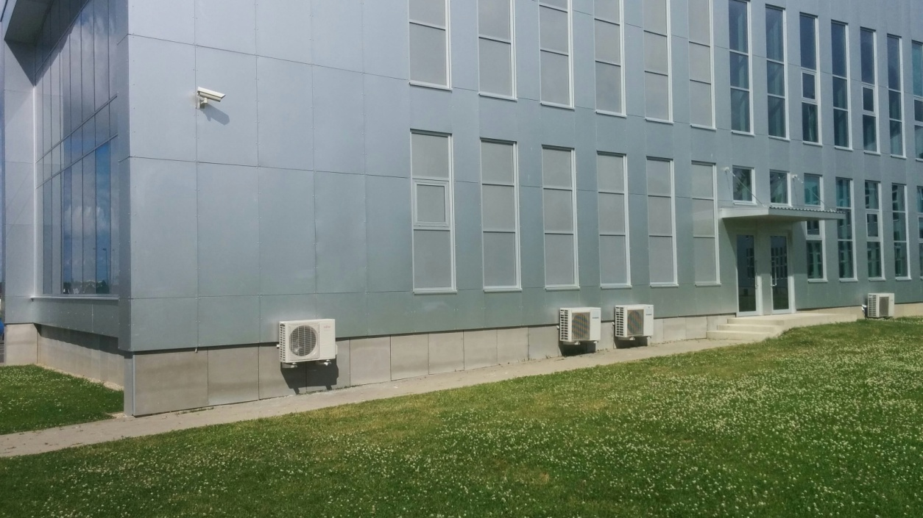
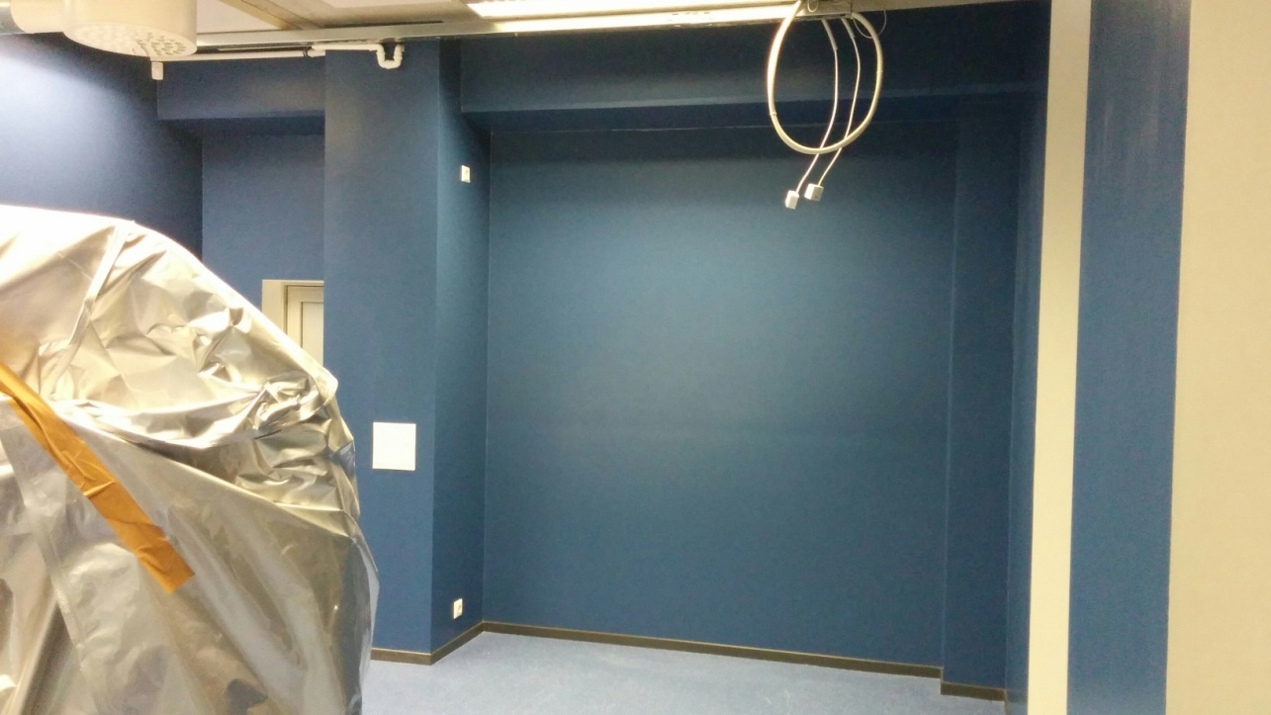

Slide 11
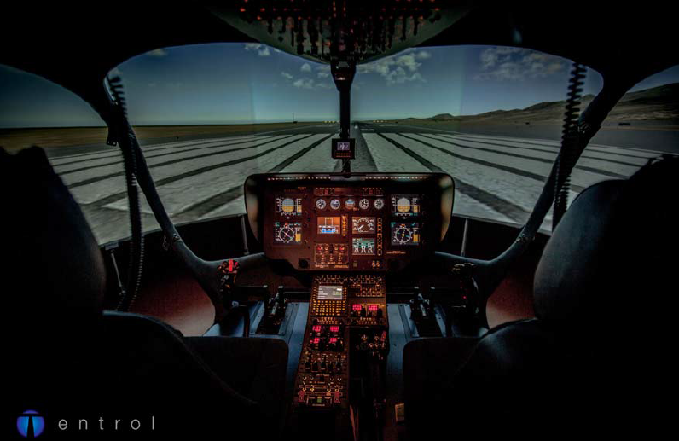
FSTD Identification And Detailed Specification
- Type: FNPT II MCC H11
- Manufacturer: Entrenadores Olarte S.L (Entrol)
- Registration number: S/N031
- Date of entry into service: 05.10.2015

Slide 12
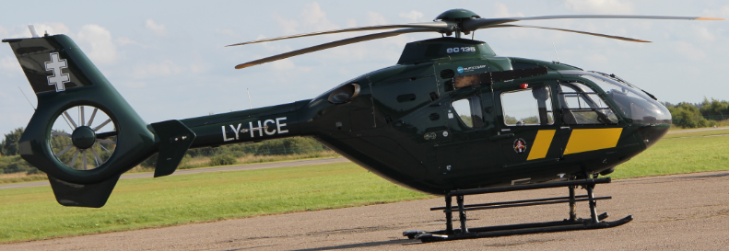
FNPT Identification and Detailed Specification
- Host computer: MS Windows 7 OS generic PC
- Visual system: 150˚x40˚, VIVITEK D5190HD
- Motion system: N/A
- Type of IOS: 2x24” touch screen, Entrol IOS
- Simulated helicopter: EC 135 P2

Slide 13
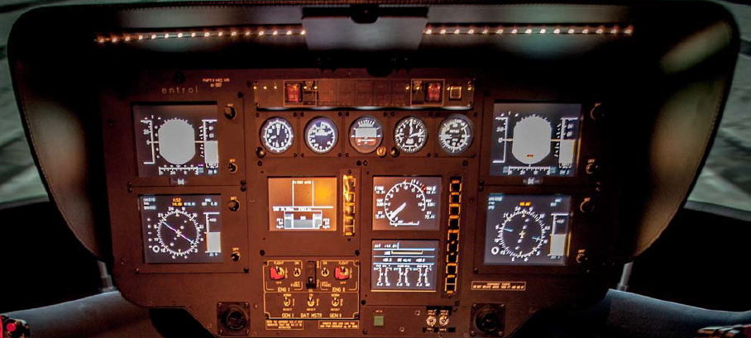
Relevant Features I
- Multi-engine and multi-pilot helicopter
- Dual pilot IFR configuration
- Category A criteria performance reserves
- Glass cockpit
- Digital engine control

Slide 14
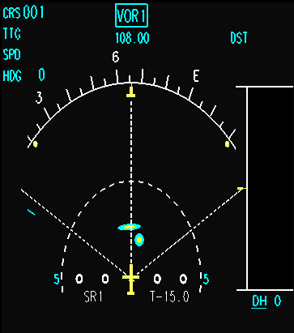
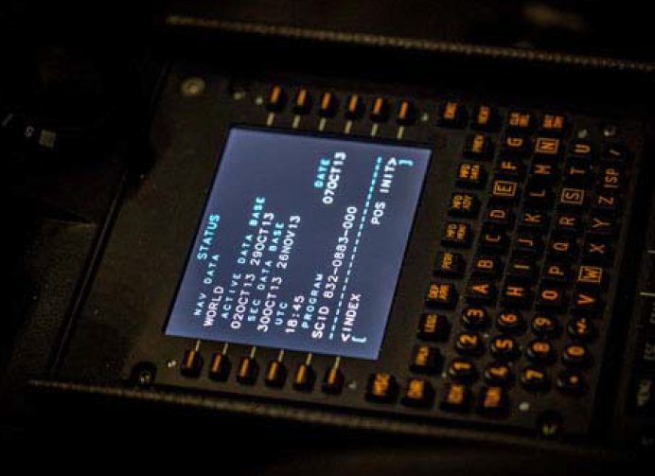
Relevant Features II
- 4 axis autopilot with upper modes
- Anti-icing or de-icing systems
- Fire detection and suppression system
- Weather radar with map mode for ARA
- Electrical control loading
- FMS (NMS)
- TCAS

Slide 15
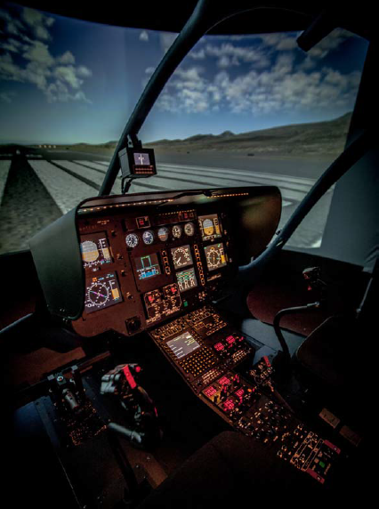
Relevant Features III
List of failures:
- Engines
- Transmission & Hydraulics
- Flight Controls
- Electrical
- Fuel System
- Navigation
- Displays & Indication
- Misc (baggage fire, heating, etc)

Slide 16
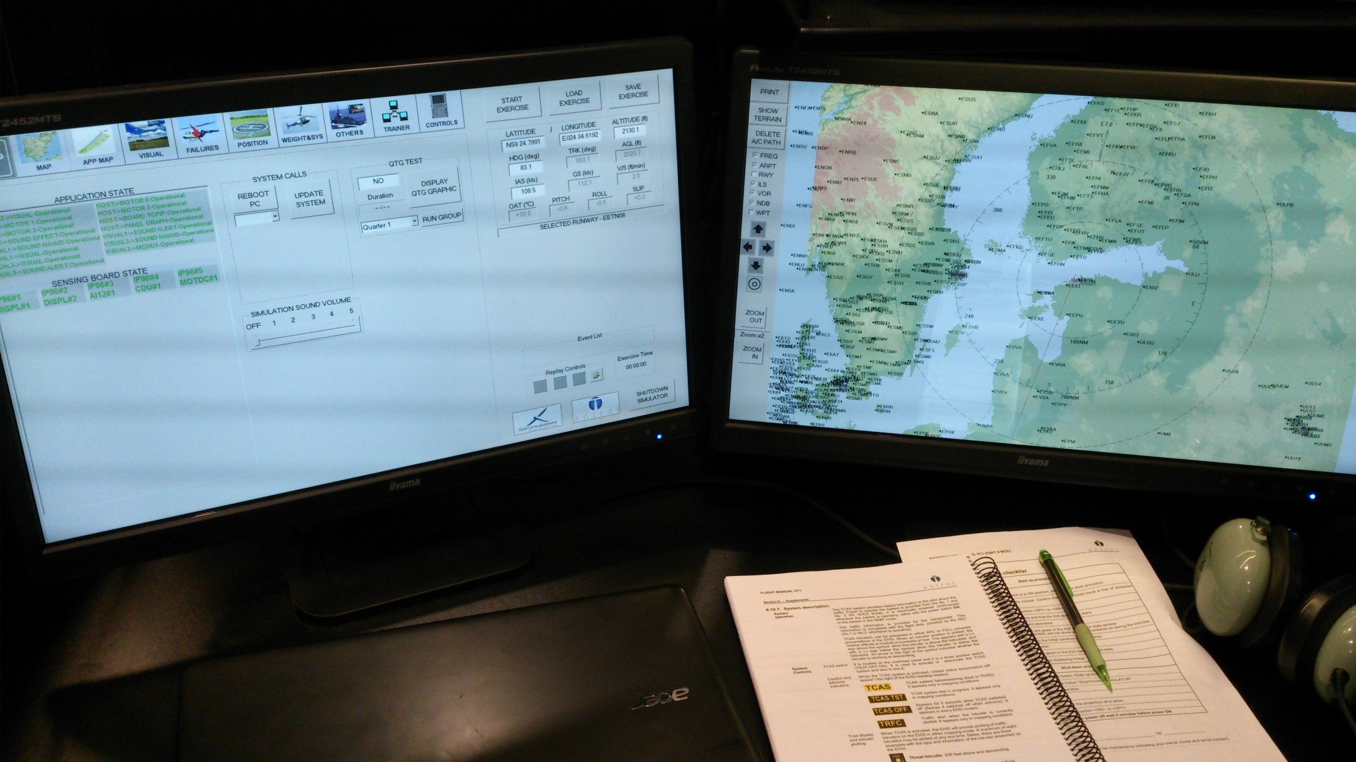
IOS Station

Slide 17
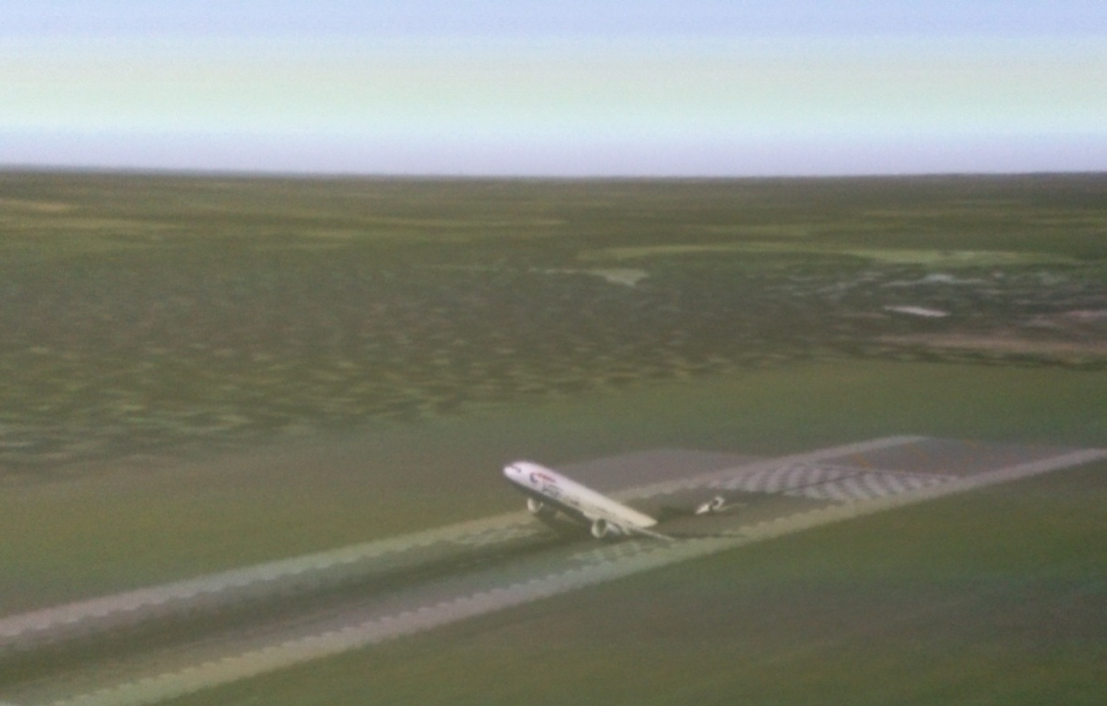
Aerodrome/Operating Sites Visual Databases
- Tallinn (EETN/TLL)
- Kuressaare (EEKE/URE)
- Ämari (EEEI)
- Tartu (EETU/TAY)
- Helsinki (EFHK/HEL)

Slide 18
Helipads
- Linnahall (EECL)
- Kärdla hospital
- Kuressaare Borderstation
- Narva Borderstation
- Värska Borderstation
- Unprepared sites for confined area takeoffs
and landings
- Oil rigs with helipad
- Ship with helipad

Slide 19
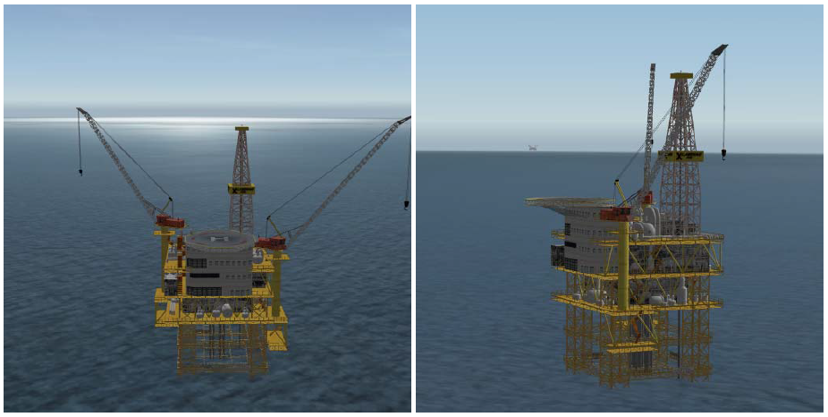
Oil Rigs

Slide 20
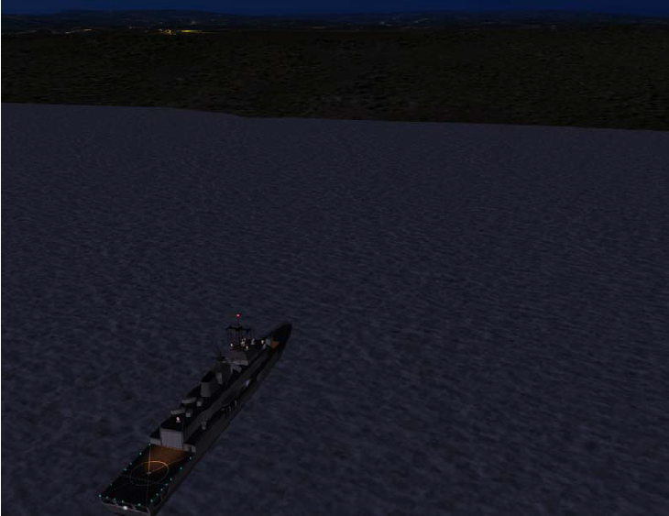
Ship with Helipad

Slide 21
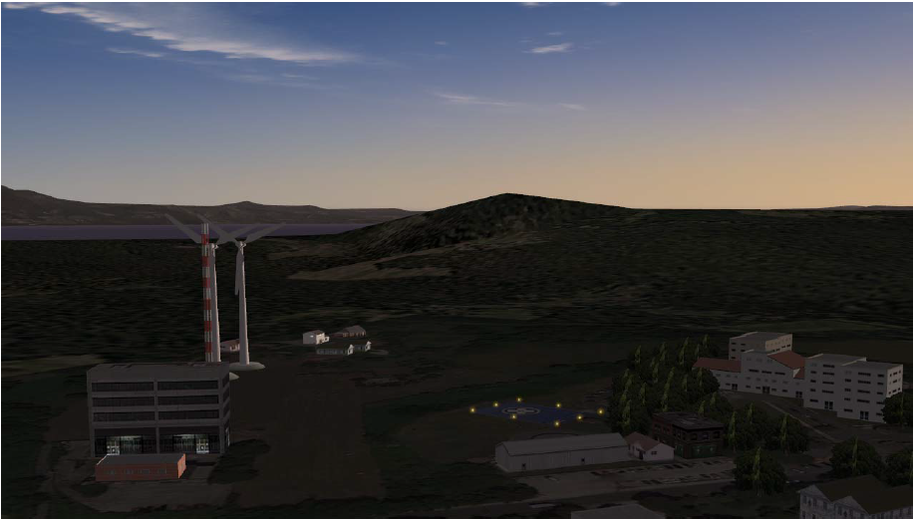
Confined Area

Slide 22
Licence/rating | Training Item | FCL Requirements | FNPT II MCC
PPL | TRAINING | 45 hrs | 5 hrs
ATPL/IR INTEGRATED | VISUAL | 130 hrs | 20 hrs
 | BASIC INSTR. | 10 hrs | 20 hrs
 | INSTR. RATING | 40 hrs | 20 hrs
 | MCC | 15 hrs | 15 hrs
ATPL/VFR INT. | VISUAL | 130 hrs | 20 hrs
 | BASIC INSTR. | 10 hrs | 5 hrs
 | MCC/VFR | 10 hrs | 10 hrs
CPL/IR INT. | VISUAL | 130 hrs | 20 hrs
 | BASIC INSTR. | 10 hrs | 5 hrs
 | INSTR. RATING | 40 hrs | 20 hrs
CPL INT. | VISUAL | 125 hrs | 20 hrs
 | BASIC INSTR. | 10 hrs | 5 hrs
CPL MODULAR | VISUAL | 20 hrs | 5 hrs
 | BASIC INSTR. | 10 hrs | 5 hrs
IR MOD. | SINGLE ENGINE (SE) | 50 hrs | 35 hrs
 | MULTI ENGINE (ME) | 55 hrs | 40 hrs
MCC | MCC/IR | 20 hrs | 20 hrs
 | MCC/VFR | 15 hrs | 15 hrs
 | MCC/IR FOR MCC/VFR HOLDERS | 5 hrs | 5 hrs
CPL SKILL TEST |  |  | YES
IR REVALIDATION |  |  | YES
IR SE TO IR ME | EXTENSION OF PRIVILEGES | 5 hrs | 3 hrs
ATPL | EXPERIENCE | 1000 hrs | 25 hrs
FI | TRAINING | 30 hrs | 5 hrs
IRI | TRAINING | 10 hrs | 10 hrs
Crediting Training

Slide 23
FNPT Annual Qualification Procedures
QTG tests
Function and subjective tests
Software Updates
Problem reporting and solving
Day to day operation procedures
Configuration management (Entrol)
IOS and navigation database update in every 3 months

Slide 24
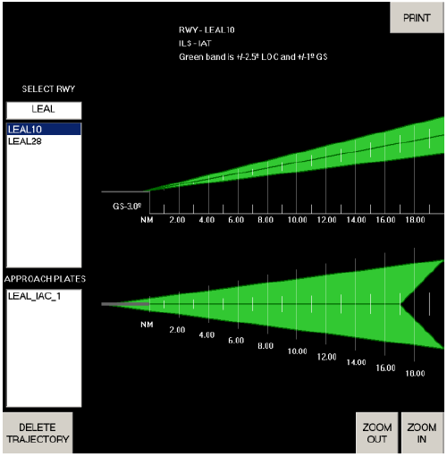
FNPT Management System
Management evaluation meeting (1 x year)
Compliance measures
Compliance monitoring
Feedback system
Record keeping ( 5 years)
Training
FNPT usage procedure

Slide 25
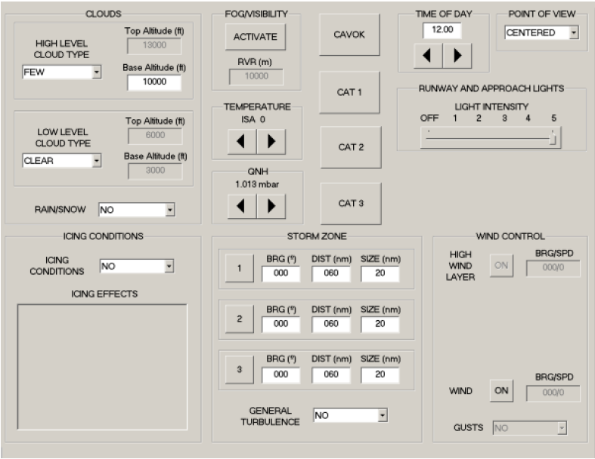
Quantitative Measurements
Total flight hours
Total sessions
Quality rating average
Availability rate
Lost training time hours
Number of complaints

Slide 26
FNPT Usage Procedure
Relevant training programme approved by ECAA
ATO head of training is responsible and coordinates training
Written agreement with external users
Training for all instructors and students
Report deviations
Fulfil Training log
Report about discrepancies

Slide 27
Thank You!

