Slide 1
Estonian Aviation Cluster
Kristo Reinsalu, Cluster Manager
@Aviation Seminar, 11.04

Slide 2
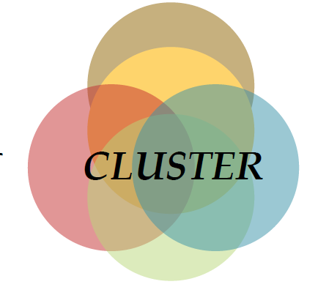
Where it all started?
Acknowledging importance of the sector (3% of GDP!)
Creating more high-paying jobs
Cooperation in value chain (ICT, tourism, logistics)
Attracting foreign direct investments
Having platform working with others – becoming member of EACP
Investigating new business opportunites

Slide 3
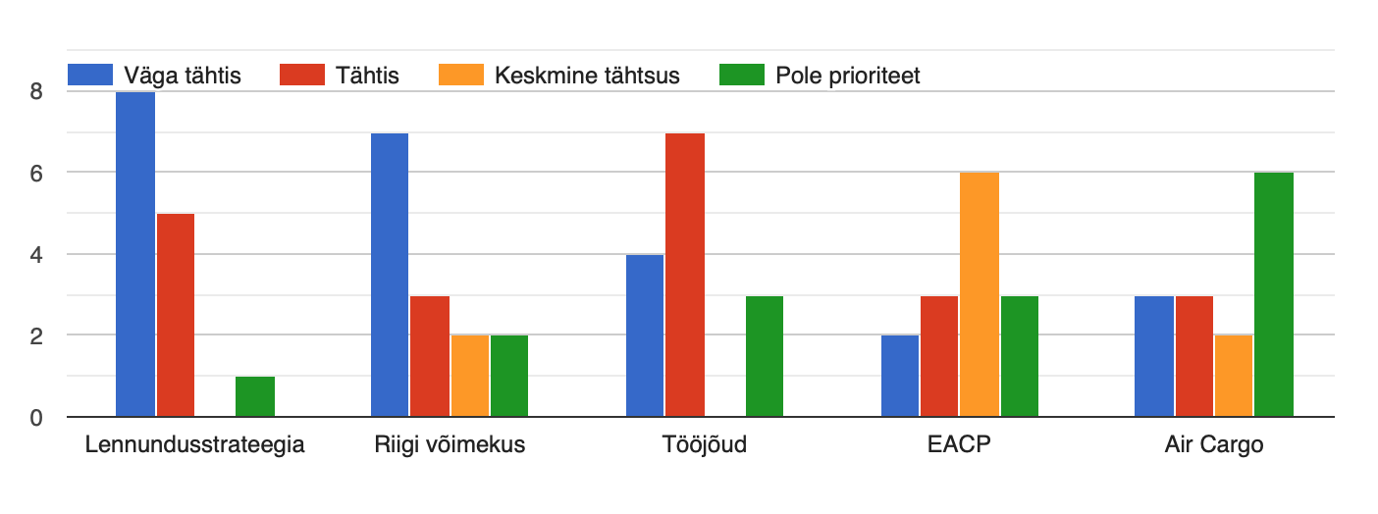
Competitiveness – survey results

Slide 4
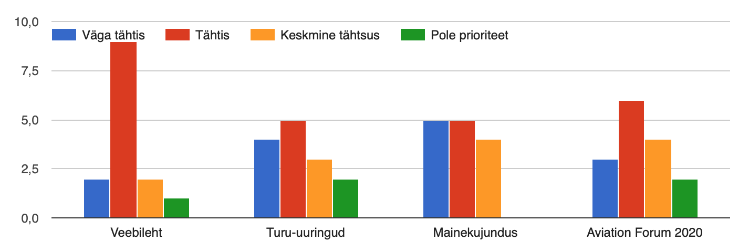
Marketing – survey results

Slide 5
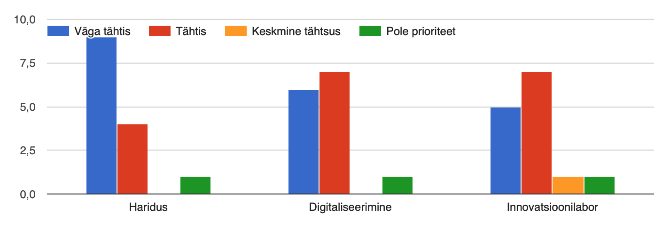
Education, technology, innovation – survey results

Slide 6
Cluster Strategy
COMPETITIVENESS
INNOVATION
MARKETING
Aerospace gives 5% of Estonian GDP
in 2023 (2018 it stood at 3%)
Goals & Targets
Added value per employee
will increase 30% by 2023
Total turnover of partners
will increase 50% by 2023
Number of cluster
partners will double
by 2023
Development of new
services/products
Creation of new jobs
Attracting foreign direct investments (FDI)
Joint development projects (keywords: ICT, digitalization)
Estonian Aviation Forum 2020
Development of aerospace value chains
Creating favorable investment climate (regulations etc)
Raising popularity of aviation curricula
Stimulating cross-border cluster cooperation (EACP)
Developing Estonian Aviation Cluster as a brand (through marketing events)
Activities
National Aviation Strategy (being a partner to government)
Mapping competences and capabilities of cluster partners
Raising visibility of aviation theme throughout society

Slide 7
Cluster Management
NPO Estonian Aviation Cluster
General Meeting (3-4 times a year)
NPO Estonian Aviation Cluster
Executive Board (operational managenent)
STRAND I
Appointed leader
STRAND I
Appointed leader
STRAND I
Appointed leader
COMPETITIVENESS
National Aviation Strategy
Regulations and infrastructure
Labour Force
Priority fields (e.g. MRO, Air Cargo)
MARKETING
Website as a communication tool
Creation of public identity and brand
Market research
Estonian Aviation Forum 2020
INNOVATION
Education (to address labour gap)
Digitalization across value chain
Innovation lab (platform for new breakthroughs)

