Slide 1
EST AF helicopter pilots multinational COOPERATION
MAJ Ivar „Chief“ Värk
LT Armin „Chairman“ Mau
LT Martin „Boss“ Noorsalu

Slide 2
SCOPE
Background
Intent
Initial training in GER
Training in UK
Service in 9 Regt AAC.
Training in USA.
Service in Maryland ARNG
Summary.
Questions.

Slide 3
Background
Started 2007 as EDA project.
Multinational project (Estonia, UK, Finland, Germany and others)
Initial agreement: Royal AF EH-101 Merlin 4 pilots
Training in Germany
Last minute change: Army Air Corps Lynx 2 pilots
Loan service in AAC started 14th Feb 2011
Estonia was looking alternative solution for two pilots.
USA stepped on board in May 2011 and offered UH-60 and loan service in Maryland ARNG.
Loan service in Maryland ANG 27th July 2011.
Notes:
3

Slide 4
Intent
Main intent: Increase helicopter availability for ISAF forces in AFG
To fulfill operational requirements while providing work experience and multinational interoperability proficiency to the Estonian Defense Personnel assigned.
Assigned Estonian Defense Personnel shall gain operational expertise and technical knowledge while providing operational support to the UK and U.S. Army.
Medium category multifunctional helicopter procurement – Cancelled late 2012

Slide 5
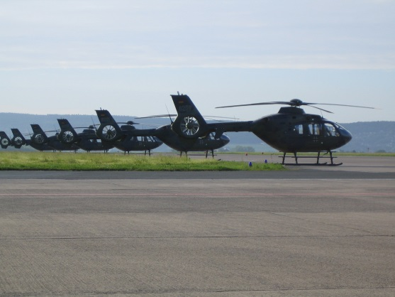
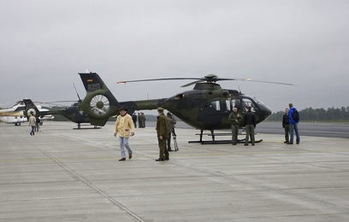
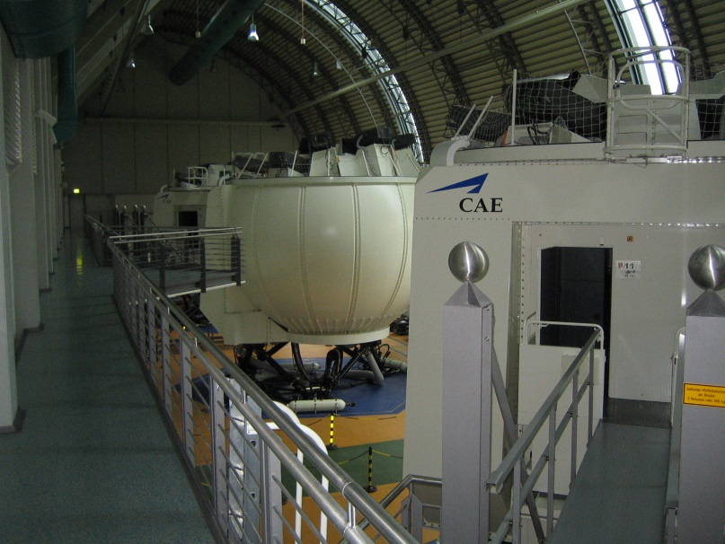
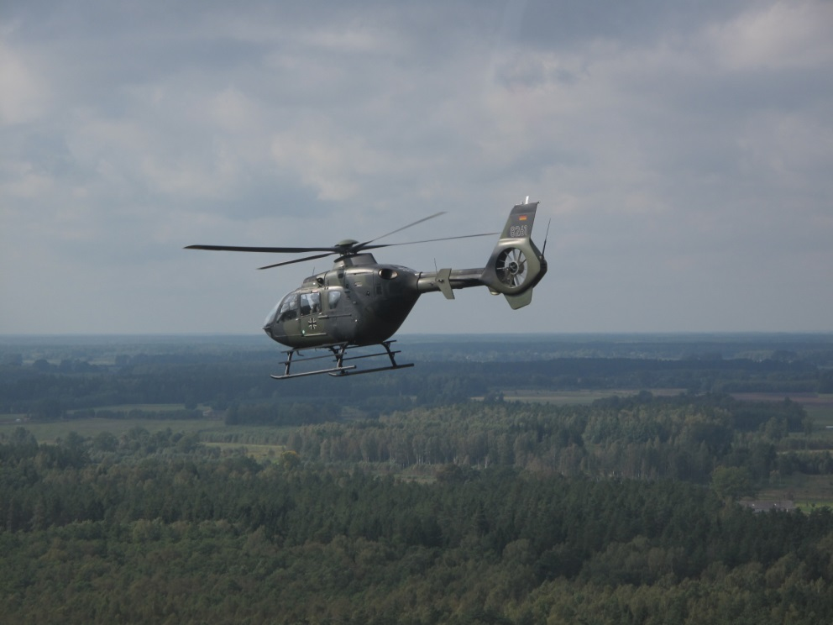
Initial Training
EC- 135 type
MCC training
IFR training
NVG training

Slide 6
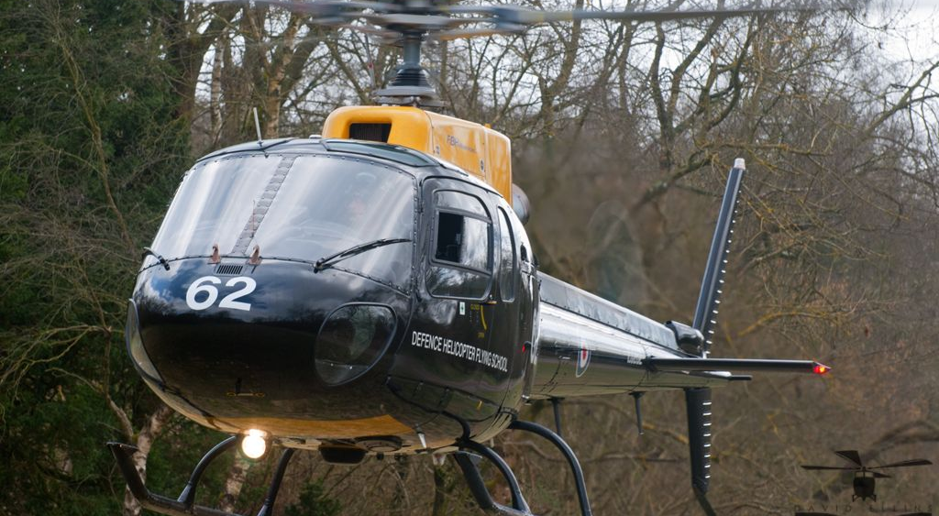
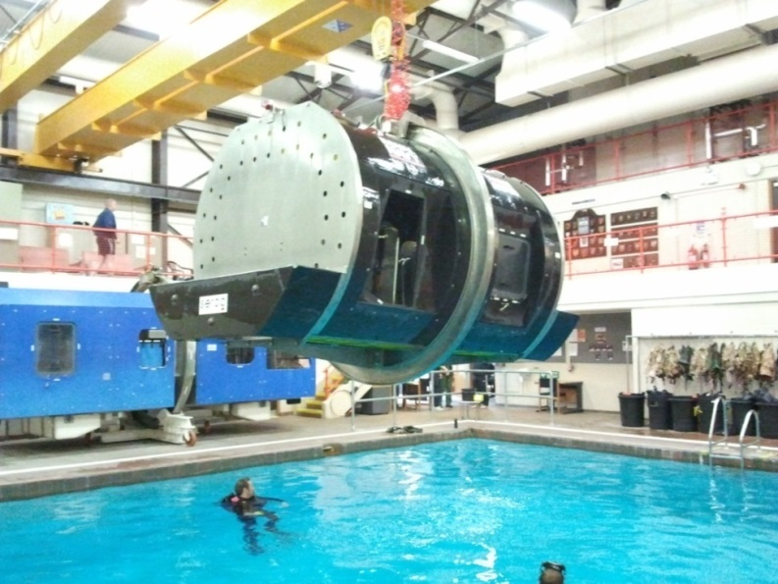
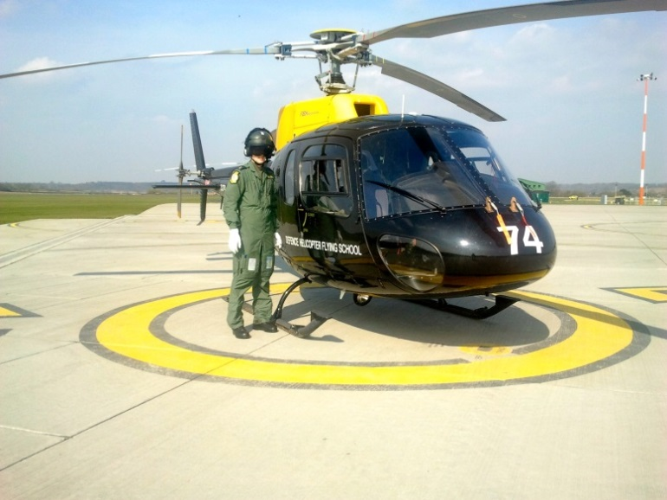
Training in RAF Shawbury
AS-350 Type
UKOC
Sea survival
Aero Medical Training

Slide 7
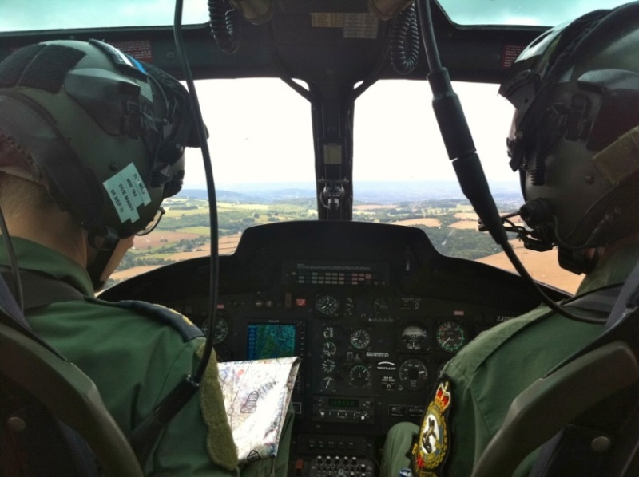
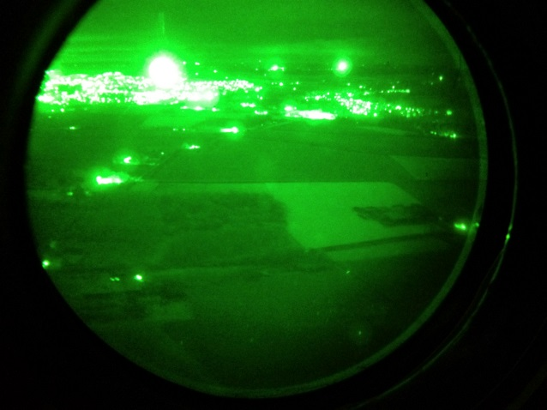
Training in the AAC, Operational Training Phase
Phase I
General flying skills
Basic Mountan flying
Low level flying
NVG

Slide 8
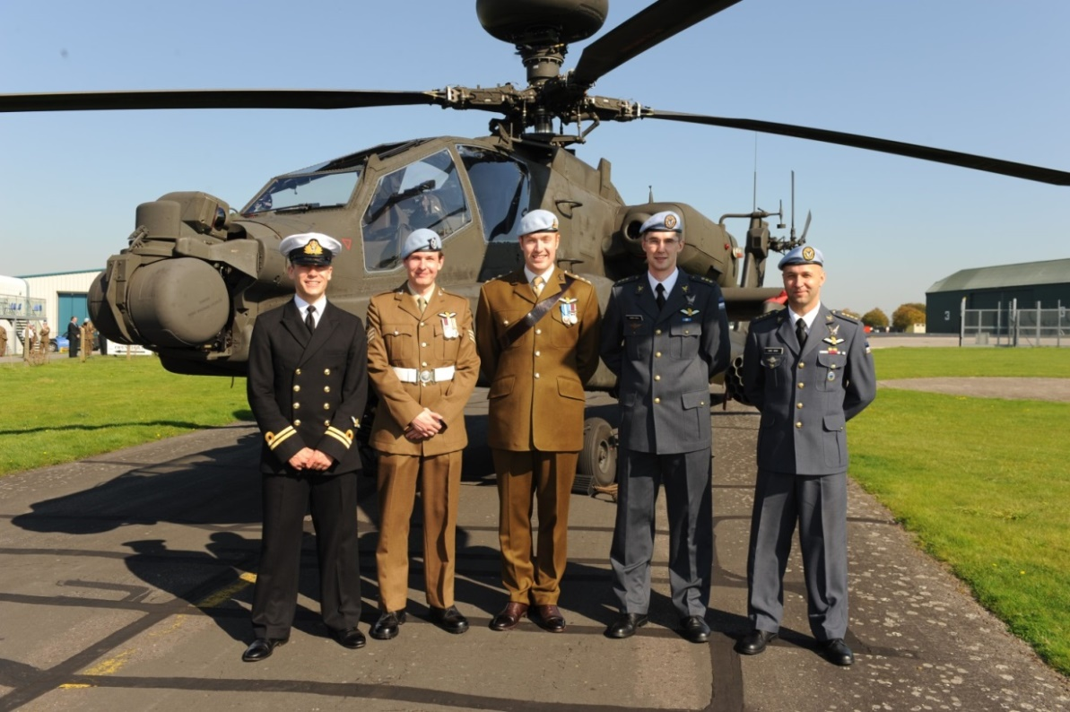
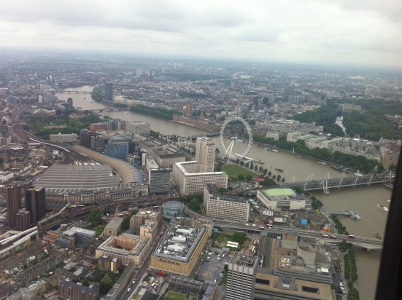
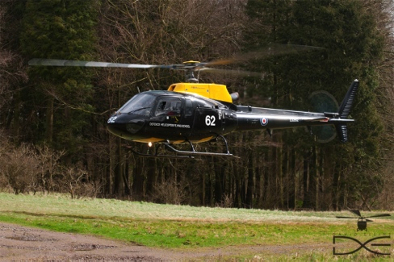
Training in the AAC, Operational Training Phase
Phase II
Tasking
Qualifications
AC NCR
NVG A(F)
Gun controller

Slide 9
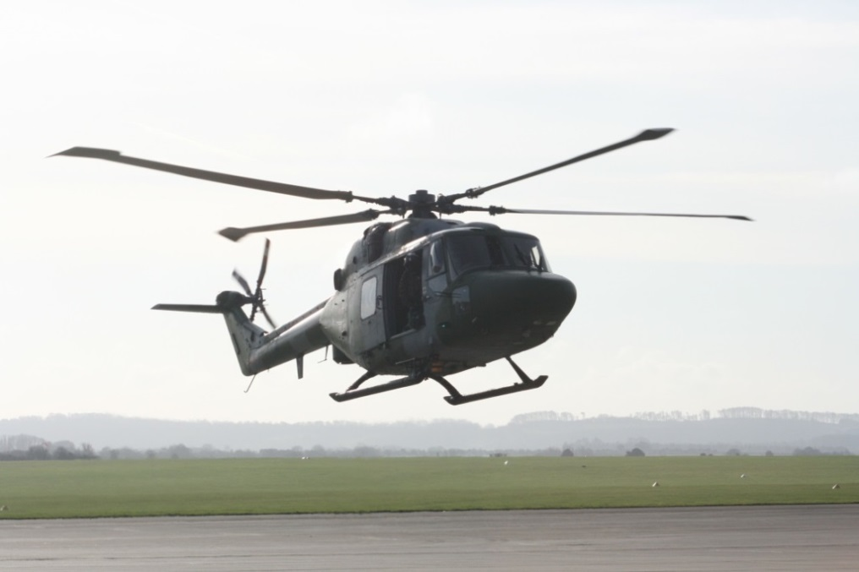
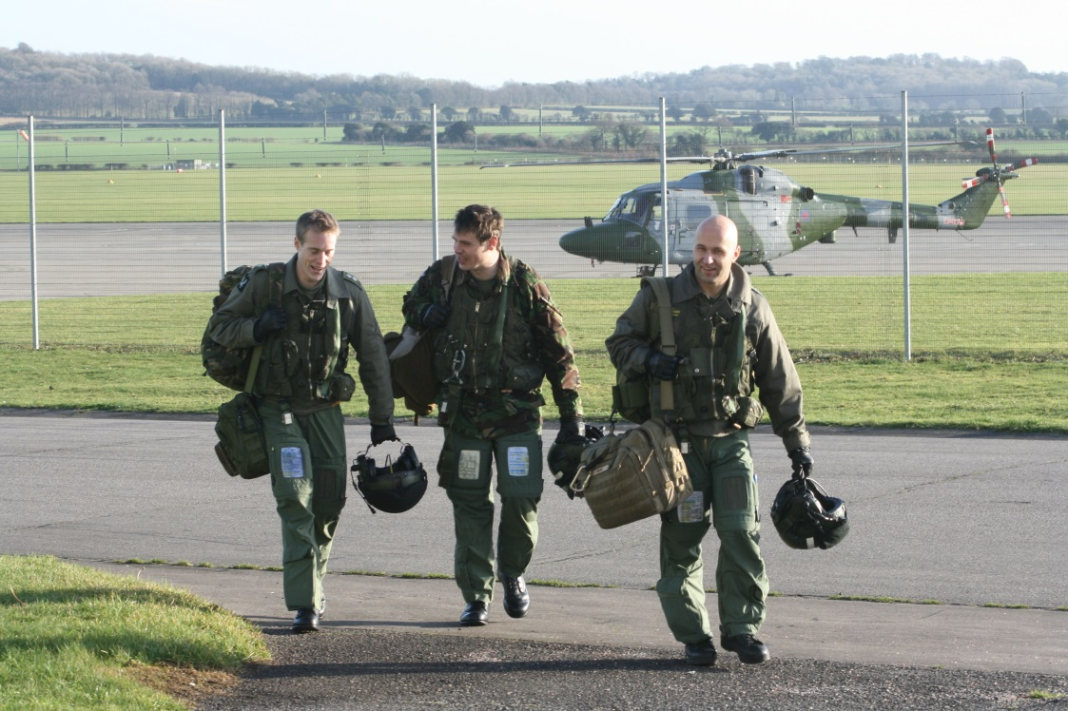
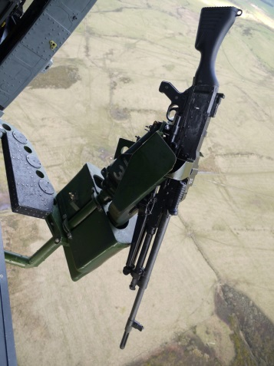
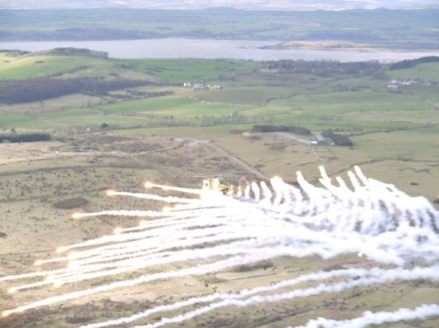
Training in the AAC, Lynx CTT and CTR.
Qualifications
AC LCR
NVG A(F)
Gun controller

Slide 10
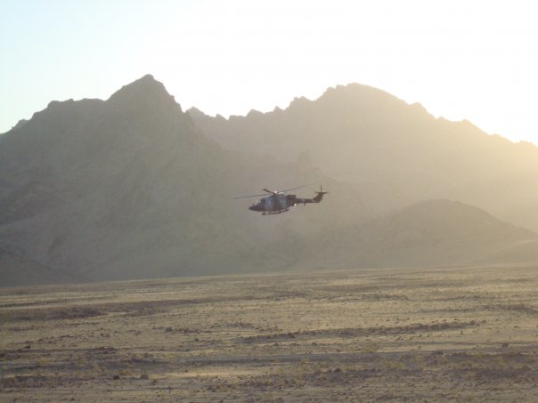
Service in 9 Regt AAC.
Maj Värk
672 Sq
PlansO and SQN 2IC (Second in Command)
Lt Mau
669 SQN ACM flight commander
659 SQN aircrew
Flying duties
Flying as pilot and a/c commander,
Army regular tasks,
Taining flights
Maintenance test flights.
Additional tasks
Base duty officer
Base senior duty officer

Slide 11
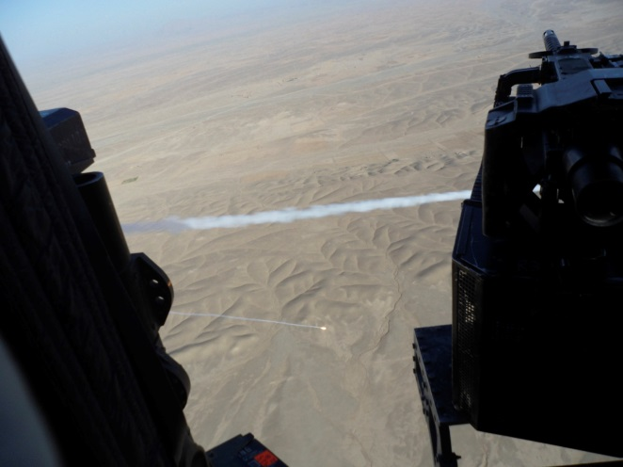
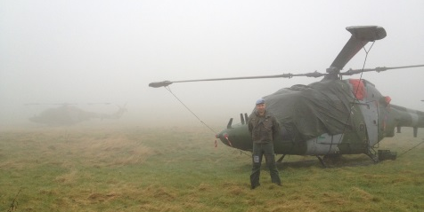
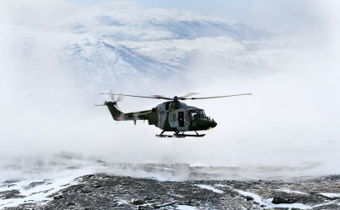
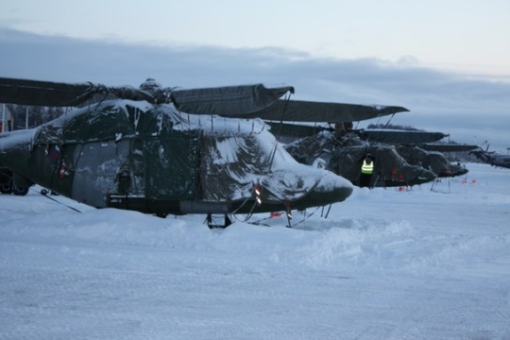
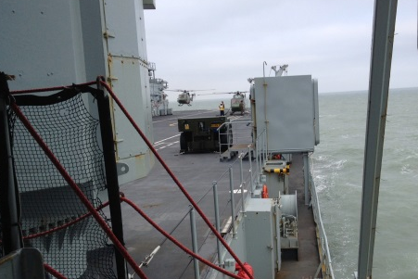
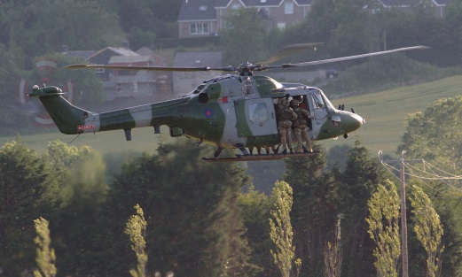
Service in 9 Regt AAC.
Op Olympic, an call service
SERE B, UK
MATTS, UK
Lt Mau:
Ex Clockwork, NOR
Ex Joint Warrior, UK
AAC Adv EW training, UK
RAF Dangeros Goods Cse, UK
MAA Flying Authoriser Cse, UK
Post Crash Management Officers Cse, UK
Cold Weather Survival Cse, NOR
EDA Europian Helicopter Tactics Instructors Cse, UK
Traing for Ship borne operations/Deck Landing Qualification, UK
Maj Värk:
AAC MC cse, UK
AAC EW Cse, UK
Ex Urban Warrior, FRA
Ex Lynx Vortex, USA
Ex Pashtun Sabre, UK
Ex Mercurys Peak , UK
Ex Eagles Nest , UK
Op HERRICK 19/20 , AFG

Slide 12
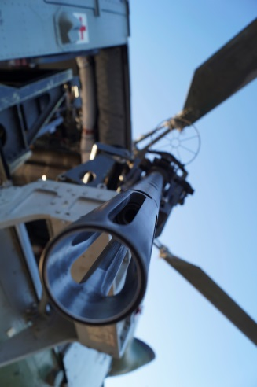
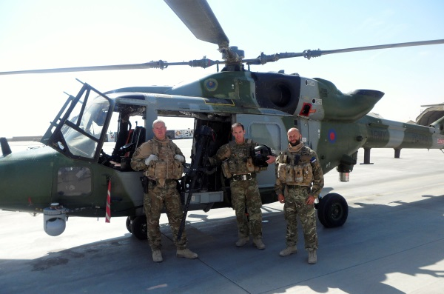
OP Herrick 19/20, Afghanistan
3 Month tour, SW Afghanistan, Camp Bastion
With UK Army Air Corps 672 Squadron
4 x Lynx Mk9a
86 member's in SQN
As Squadron 2IC and P1/ Aircraft commander
103 Missions + 15 Airtests
143 Combat flight hours
Work cycle: 1st crew
2 nd crew
Airtest crew
Duty Aviator
Admin day
Crew rest day

Slide 13
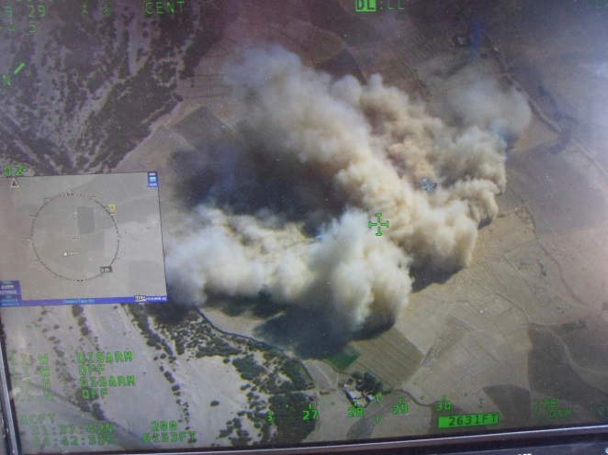
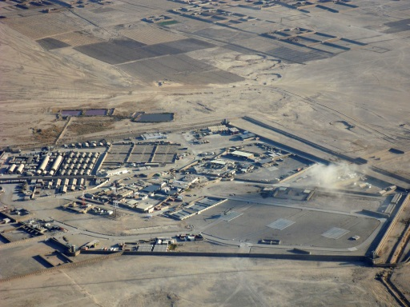
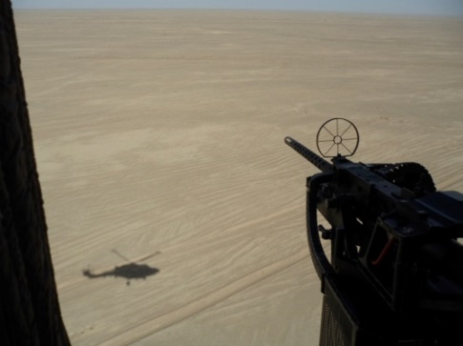
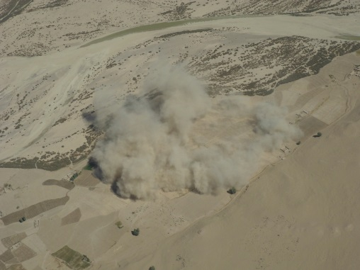
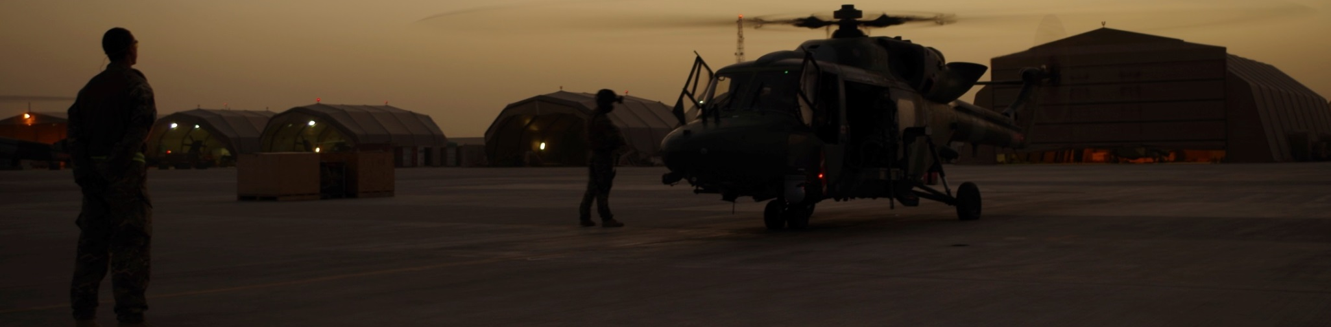
OP Herrick 19/20, Afghanistan
Flying duties:
Mutual support for MEDEVAC
Convoy escort
Troop transport between FOB-s
CAS for ISAF troops
Recce and ISTAR flights

Slide 14
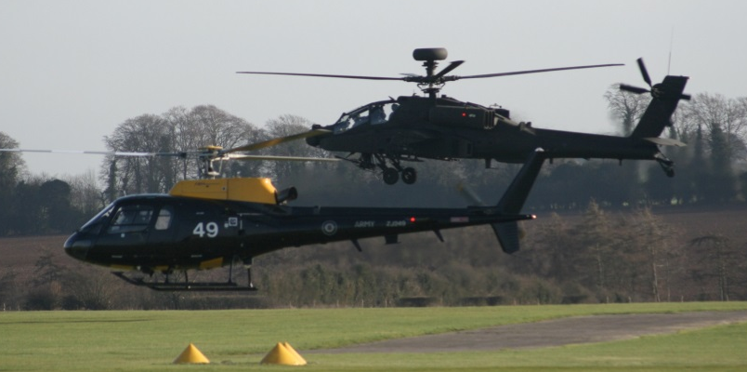
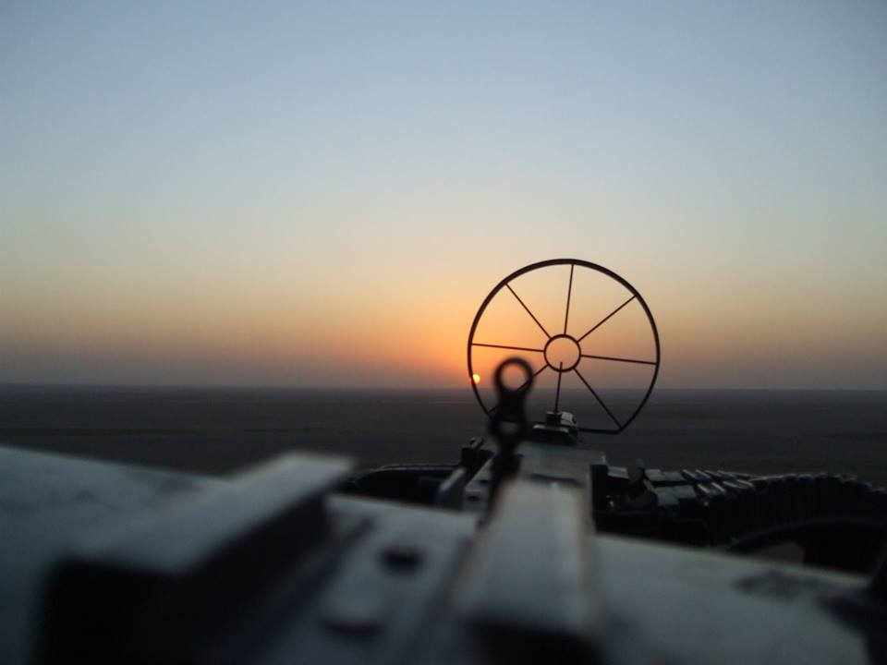
Flight expierence in UK
Maj Värk:
AS-350/Squirrel 129:50
Lynx mk 7 309:50
Lynx mk 9A 271:35
Total 711:15
Ltn Mau:
AS-350/Squirrel 117:10
Lynx mk 7 437:45
Lynx mk9A 15:10
Total 570:05
Notes:
14

Slide 15
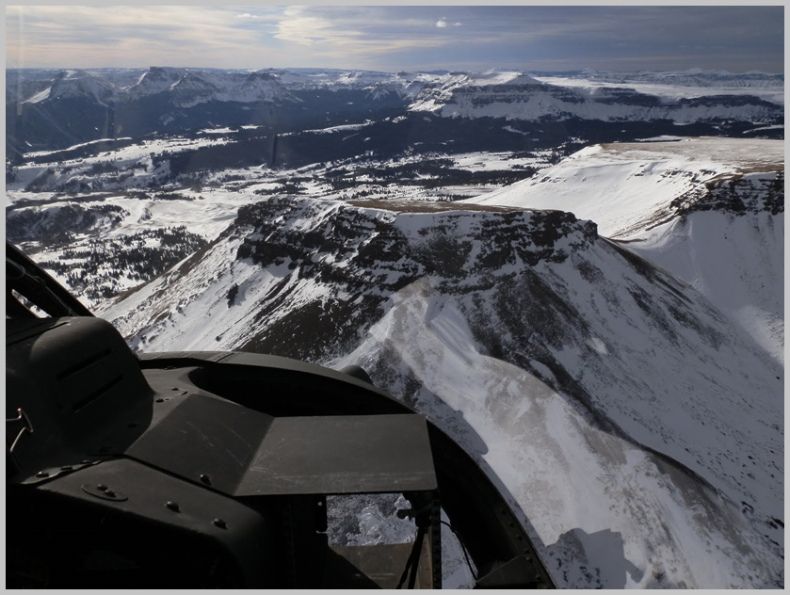
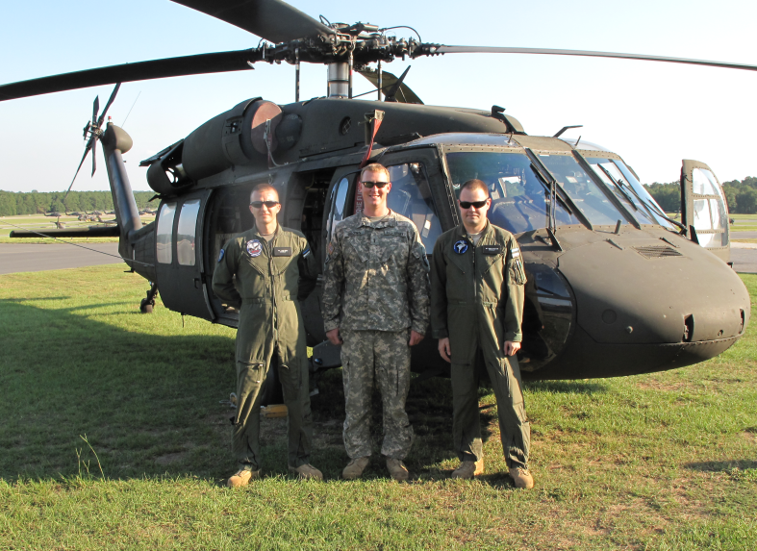
Training in U.S. Army
1 week familiarization training in MDARNG AASF
UH-60 Blackhawk AQC in Fort Rucker, AL
OH-58 Kiowa High-Altitude Power Management Mountain Qualification Course in HAATS, CO
Base at 6000 ft LZ at 12 000 to 14 000 FT

Slide 16
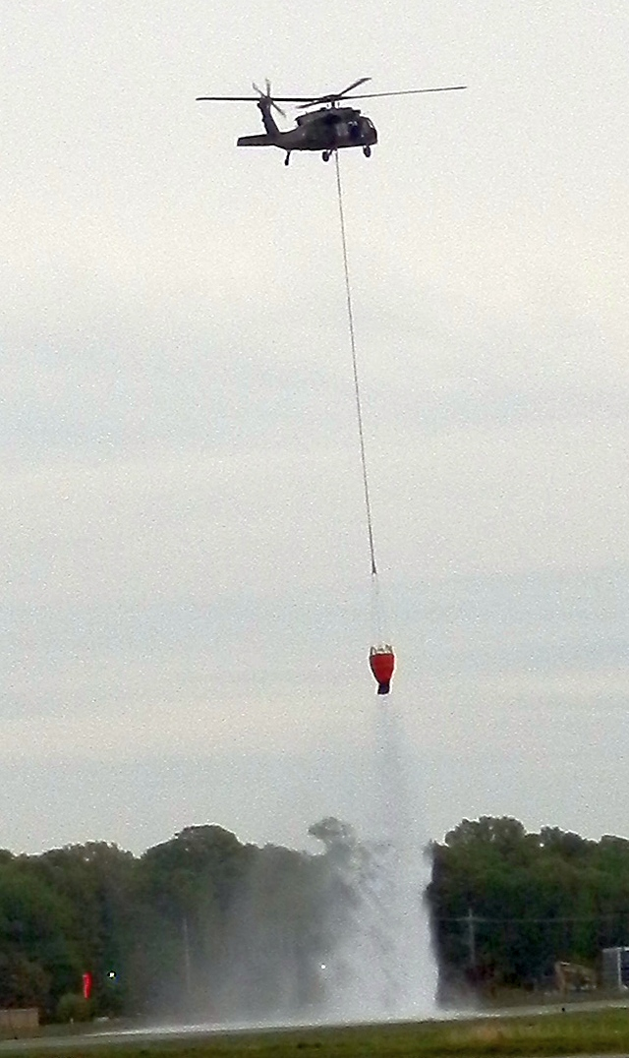
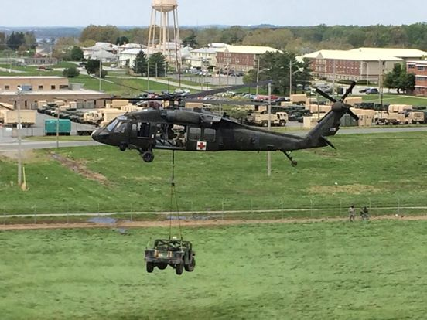
Training in U.S. Army
Unit level aircrew training
RL level 3, 2 and 1
Hoist, sling and water bucket
Pre Deployment training in Fort Benning, GA

Slide 17
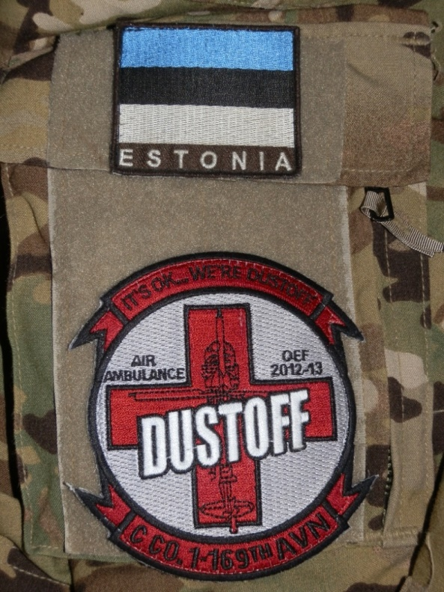
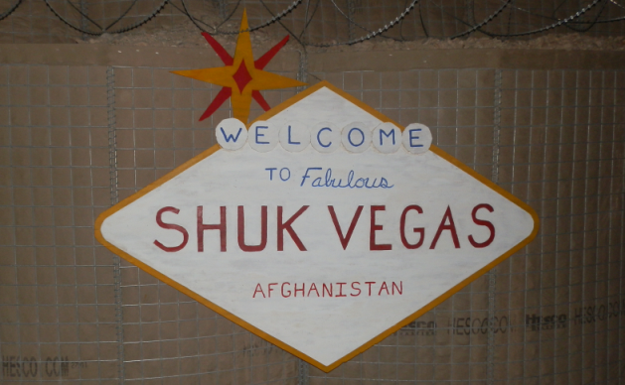
OEF 12 Afghanistan
U.S. Army Medevac cs „DUSTOFF“
„I will leave when I have your wounded“
25 CAB HQ in KAF
Phase maintenance
CoC-169th Base in Camp Dwyer
FOB Shukvani
FOB Payne
15 unarmed UH-60 Blackhawks
1st U.S. Army Medevac unit
Blood transfer during flight

Slide 18
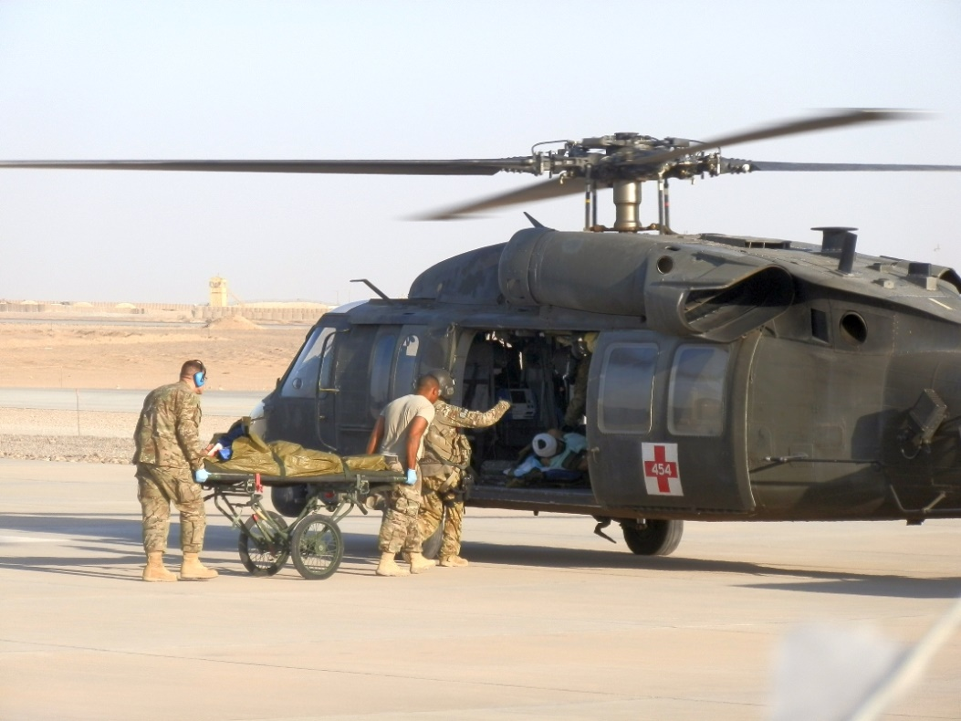
OEF12 Afghanistan
3 ½ months deployement, Helmand province, SW AFG
20 Medevac missions, 50 combat hours
Duties as UH-60 pilot(PI)
Medevac alert
Max 15 min
1st up 48h
2nd up 48h
24h crew rest
Ring routes
PAX, post and supplies

Slide 19
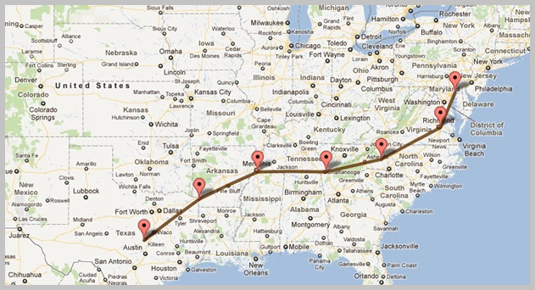
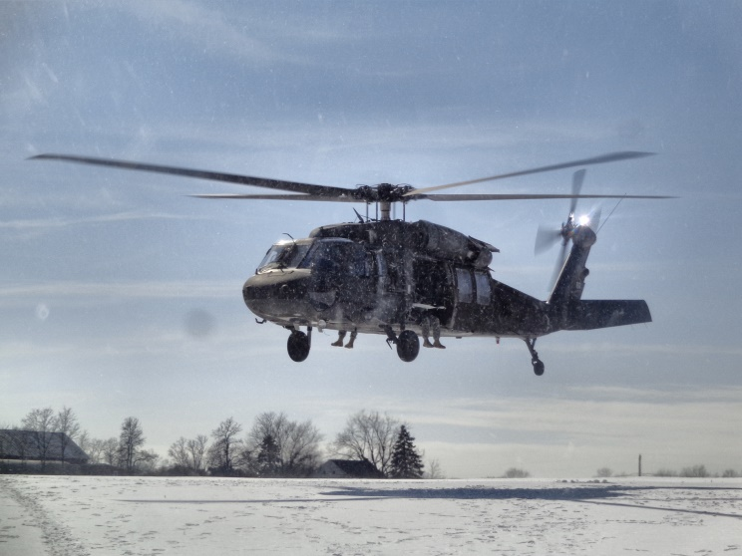
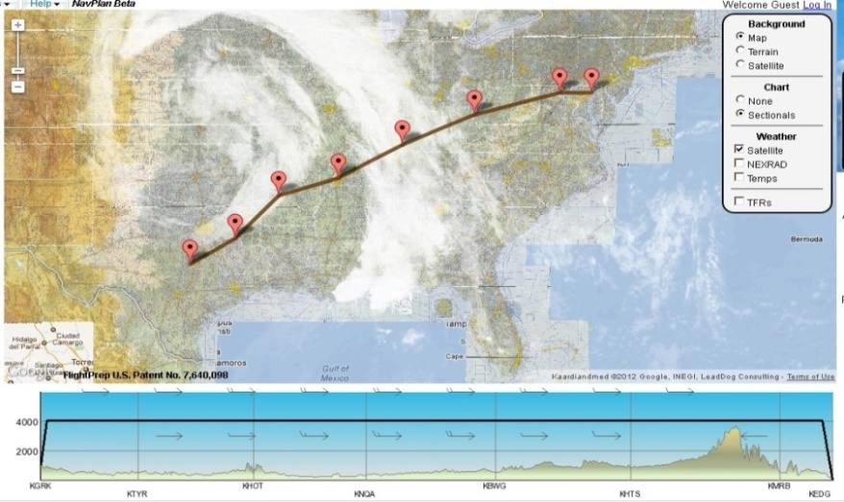
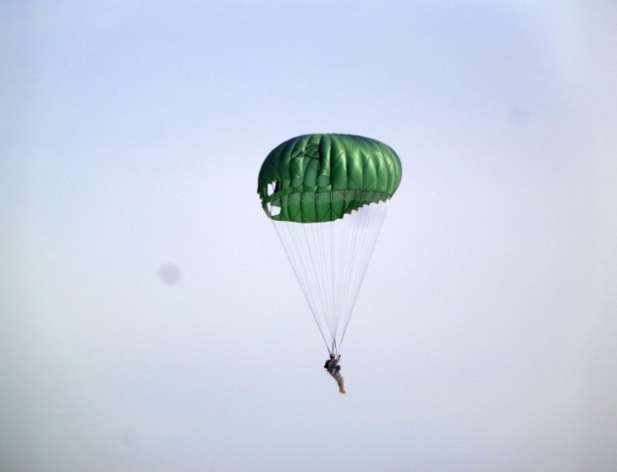
Service in MD ARNG
UH60 Blackhawk continuation training in MD ARNG AASF and assistant staff officer, 29th CAB S3 and MDARNG AASF

Slide 20
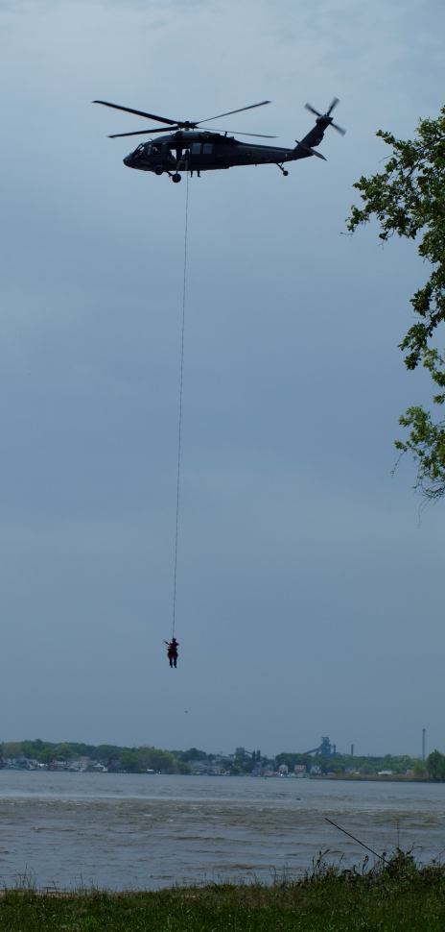
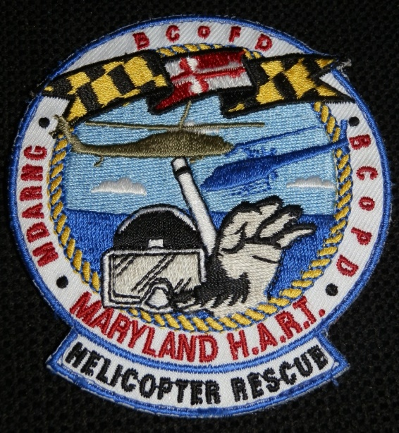
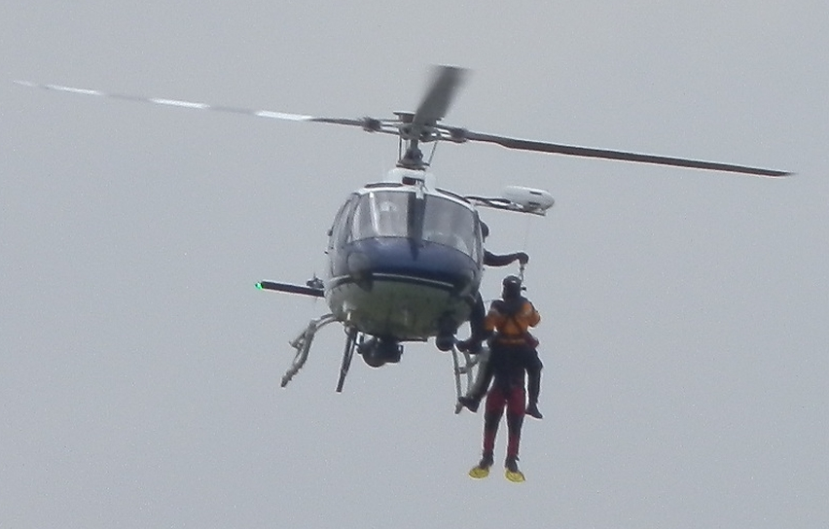
Service in MD ARNG
Annual Swift Water Resque traning exercice in cooperation with Baltimore County Police and Fire Department
Hoist and short haul training
As pilot and survivor
SE turbine helicopter

Slide 21
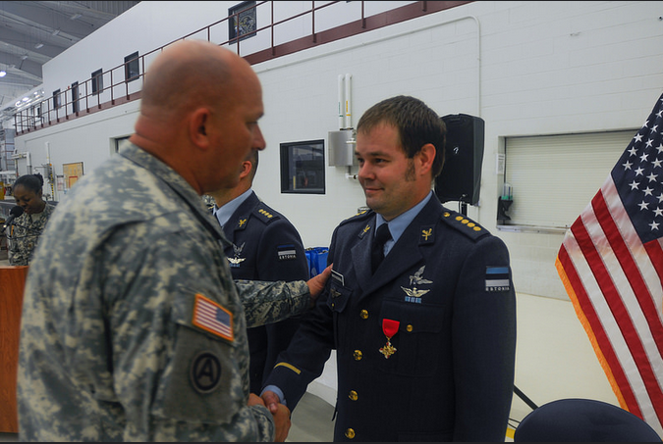
Flight experience in US
Approximately 500 flight hours flown total as PI&CP
We were presented with the Maryland National Guard Distinguished Service Cross (MDDSC). Highest MDNG state award

Slide 22
Summary and future cooperation
Exchange with the UK AAC and MD ARNG has given us a broad variety of experience and knowledge how to operate and support helicopters in operational environment.
Approximately 2200 flight hours flown (250 combat)
To take the full value of the experience and to be able to pass it on, thoughts should be given to future training and cooperation.

Slide 23
Questions
Mission complete!!

