Slide 1
CULTURE OF FLYING / Lendamise kultuur
Tiit Kepp
Notes:
Tere Hr... Kuidas teil läheb? Kuhu te reisite? Kes teiega koos reisivad? Kas pagasi registreerime lõpuni? Kas soovite istuda vahekäigupool või akna all?

Slide 2
Tallinn Airport GH Ltd.
Leading aircraft- and passenger service provider in Estonia
Founded in 2005
Operates at Tallinn, Tartu and Pärnu airports
235 employees by the end of year
Services yearly 2.06 mio passengers
Services about 1.3 thousand aviation enterprises from 28 countries
Over 130 agreements with airlines and flight ground support service providers

Slide 3
If you've booked an airline ticket for an upcoming trip, heading to the airport may be an anxiety-inducing experience. Whether you're an avid flyer or an infrequent one, there are a slew of fees to keep track of, plus security protocols that may seem overwhelming.
Fear not. This handy to-do list will help you get to the airport, through security, and to your gate with ease.
Before You Leave Your House…
„Small changes in the envoirment could have a big impact on people!“

Slide 4
Before you even start to pack, consult this list to make sure you're well prepared. Get additional expert packing tips
• Check in online or via mobile phone to avoid a long wait at the airport. You can usually check in online up to 24 hours before your flight..
• Find out if your carrier charges extra fees for baggage and/or an additional fee if you check your bags in person at the airport (Ryanair, airBaltic, Spirit, United, US Airways etc. currently have higher fees if you check bags in person versus online). Save yourself time and money and check your bags online at home before you go.
• Verify what the airline's weight limits are for baggage. To avoid extra fees, weigh your bags at home to make sure they're not overweight. If they are overweight, remove or redistribute some items, or plan to pay extra.

Slide 5
• Make sure you have all your travel documentation in one place (purse, carry-on, etc.) that's easy to access. Include a copy of emergency and customer service numbers with these documents.
• Make extra copies of important travel documents, ID/passports, key phone numbers, etc. It's advised to have a copy for each bag.
• If you're traveling with a carry-on bag, make sure there are no full-size toiletries inside. All liquids and gels must adhere by the 3-1-1 rule, and be stored in a clear plastic quart-sized bag.
• Ensure you're not traveling with any prohibited items. If you were planning on bringing such items with you, ship them instead—otherwise they'll be confiscated at the airport.

Slide 6
At Security
Take stock of the following steps before getting in the security line.
• Have your ID and boarding pass out and ready for the TSA official.
• Take off your shoes, belt, and any jewelry that may set off the metal detector. Make sure there is no loose change or other items in your pockets. Place all items in a bin on the conveyor belt.
• If you have a clear-plastic bag of liquids or gels in your carry-on bag, take it out and place it in a bin next to your shoes, belt, etc.
• Place your bags and coat on the conveyor belt.
• If you are traveling with a laptop, take it out of its carrier case and onto the screening belt. If your laptop is in a checkpoint-friendly butterfly-, trifold-, or sleeve-style case, it does not need to be removed from its outer bag.
• Wait until you are called to go through the metal detector. If asked, show the TSA official your ID and boarding pass. Acceptable forms of ID include passports, drivers' licenses, military IDs, and permanent resident cards, among a few others.
• Comply with any TSA official requests, such as an additional bag inspection, body scan, questioning, etc.
• Reclaim your items and head toward the gate.

Slide 7
At the Gate
You're almost done! Before you board the plane, check the following:
• Make sure your carry-on fits the aircraft's overhead dimensions. Usually there is a sample crate at your gate to determine if your bag will fit.
• Check to see if there is meal or snack service on board your flight. If not, you may want to purchase food and drink from a concessionaire in your terminal or at a food court.
• Wait for your clearance to board the plane, then make sure to get in line with your designated group (check your boarding pass to see what group you're in). If you have small children or special needs, you may be able to get advanced boarding privileges. See the gate agent if you have any questions.

Slide 8
Questions to be answered?

Slide 10
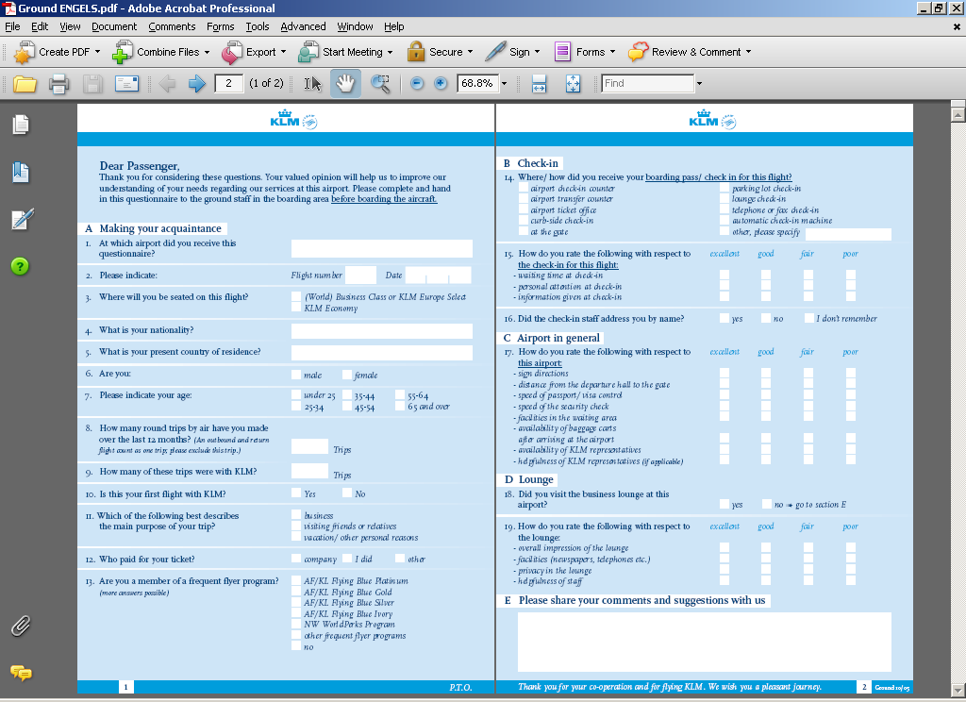
KLM/AF ground questionnaire

Slide 12
Maapealsed soovivad teile vähem stressi ja veel vähem komplekse ning palju arukat lendamist! GH wish you a complexity free and stressful free flying!

Slide 13
Tänan! Thank You!

