Slide 1
EASA alusmäärus
EASA Basic Regulation
Gerli Rebane, EASA
Margit Markus Moossen, Permanent Representation of Estonia to the EU
11.04.2019

Slide 2
Main objectives
Art 62 evaluation
Commission 2015 Aviation Strategy for Europe
Making better use of limited resources;
Flexible and performance based system;
Closing gaps and inconsistencies;
Better governance for EASA;
Notes:
EASA juhtimine- muude teemade kõrval (ametite horisontaalsete sätete ühtlustamine, grantide arvamine tulude hulka) ka paindlikum spetsialistide kasutamine sertifitseerimisel ja laiem EASA ekspertide kasutamine ka KOMi poolt.

Slide 3
Regulation 216/2008
Air-
worthiness
Environment
Operations
Licensing
Aerodromes
ATM/ANS

Slide 4
Regulation 2018/1139
Air-
worthiness
Environment
(Cyber)
Security
Operations
Ground Handling
Aerodromes
Licensing
SES Implemen-
tation
ATM/ANS

Slide 5
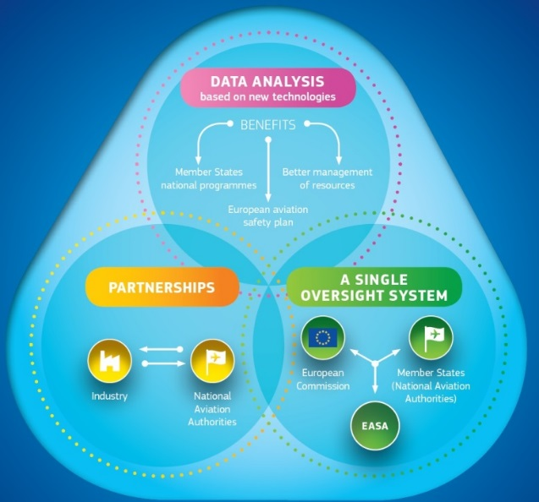
Making better use of limited resources
A pool of European aviation inspectors;
New framework for transferring responsibilities;
Oversight support mechanism
Qualified entities;
Repository and Big Data;
Framework for better working at international level;

Slide 6
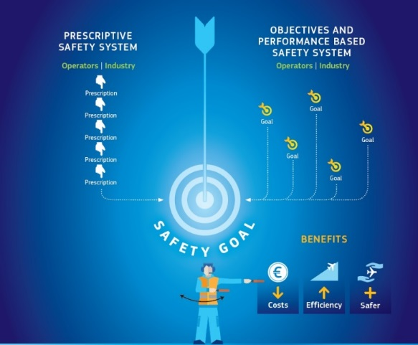
Flexible and performance based system
Risk based elements reinforced;
Promoting proportionate and performance based rules;
Additional flexibility for regulating General Aviation;
Safety plan for Europe and national safety plans;
Opt-in for aircraft manufacturers
Opt-in for state aircraft
Opt-out for micro-lights

Slide 7
Pool of European aviation inspectors
Voluntary mechanism for cooperative oversight;
Both MS and the EASA may request assistance from the experts included in the pool;
The Agency has coordinating role;
Both EASA and MS may designate experts;
- Use of experts from the pool;

Slide 8
Reallocation of responsibility (art 64 ja 134)
Voluntary reversible mechanism:
A transition plan to be established and transparency towards third parties ensured;
Member State- EASA
Member State- Member State
NB! Not affecting rights and obligations under a Chicago Convention, notification of ICAO necessary
Notes:
Määrust 1008/2008 muudetakse, et võimaldada AOC väljastamine

Slide 9
Organisations operating in more than one MS (art 65)
- Voluntary mechanism for regulated entities;
- Based on an organisation’s request;
Organisation may request only EASA
Possibility to object if adversely impact the effective functioning of the authority;
Two scenarios possible:
A group of organisations established in different MS and acting jointly;
An organisation established in one MS but with facilities or personnel also in other MS;

Slide 10
Oversight support mechanism(art 66)
Serious and persisting failure in complying with safety provisions
Establishment of a mandatory technical assistance programme
IMPORTANT: responsibility for the certification, oversight and enforcement tasks remain with the MS

Slide 11
Oversight support mechanism (art 66)
Member State can choose other measures to resolve the deficiencies;
To protect the credibility of the EU system

Slide 12
Opt-out of micro-lights (annex I)
Technical criteria:
Up to 2-seaters a/c, helicopters and sail-planes with certain weight;
The a/c is not yet certified by EASA;
Fall out of EASA system and no mutual recognition;
Operation in another MS only when that MS has opted-out ;
Commission and EASA has to be notified;
Reversiable mechanism;

Slide 13
Opt-in ‘state a/c’
Modular approach;
Comission ex-post control;
Reversiable mechanism;

