Slide 1
Regional aviation in the Baltics
Past, present and future
Dag Waldenström
20th Estonian Aviation Seminar “Aviation - Past, Present, Future”
Estonian Aviation Academy, Tartu, 12-13th November, 2015

Slide 2
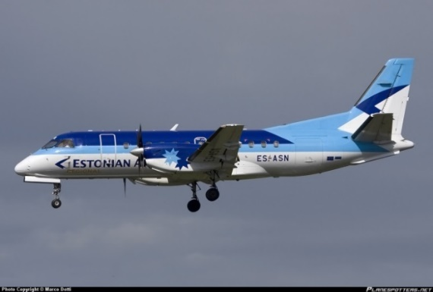
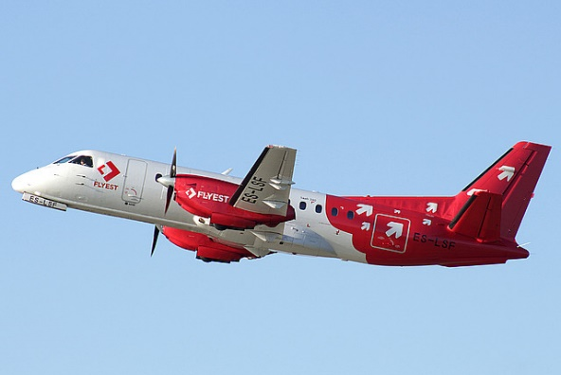
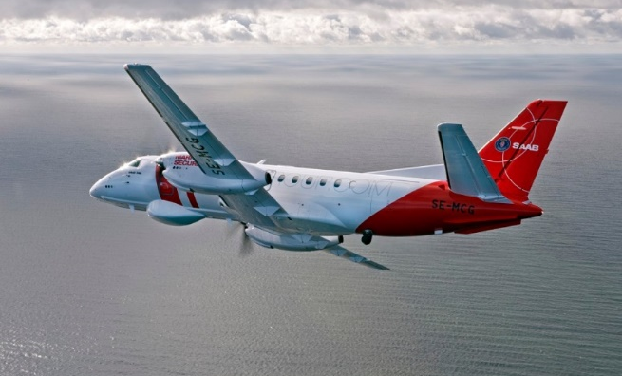
Regional aviation IN THE BALTICS
Past
Present
Future

Slide 3
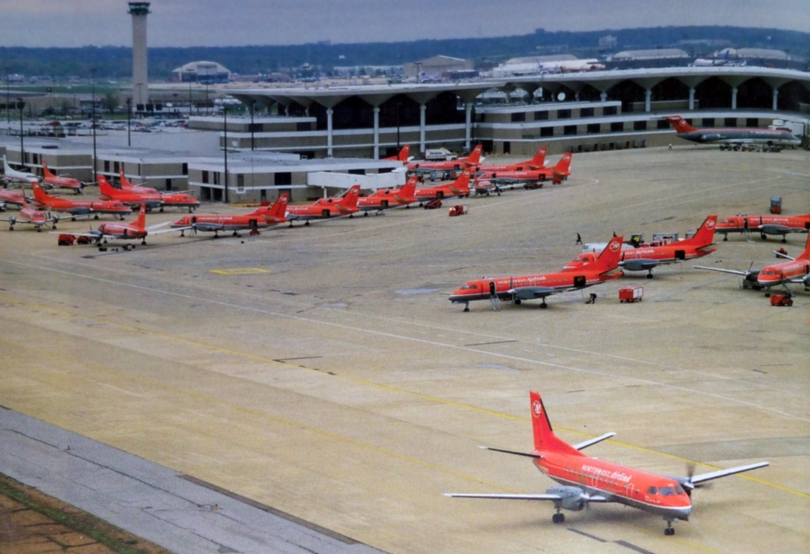
Regional aviation – THE NETWORK SOLUTION
Deregulation created the hub and spoke systems
Regional aircraft fed the hubs with passengers
Expensive system but with lot of choise
Low Cost Carriers flying point to point killed the smaller hubs
Move to larger regionals to reduce seat mile cost

Slide 4
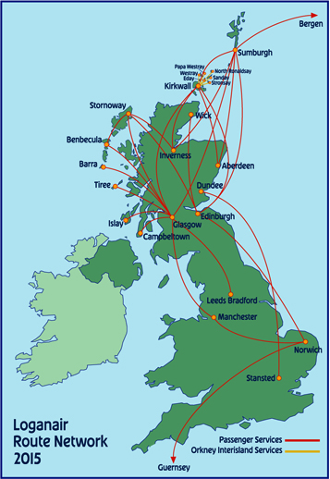
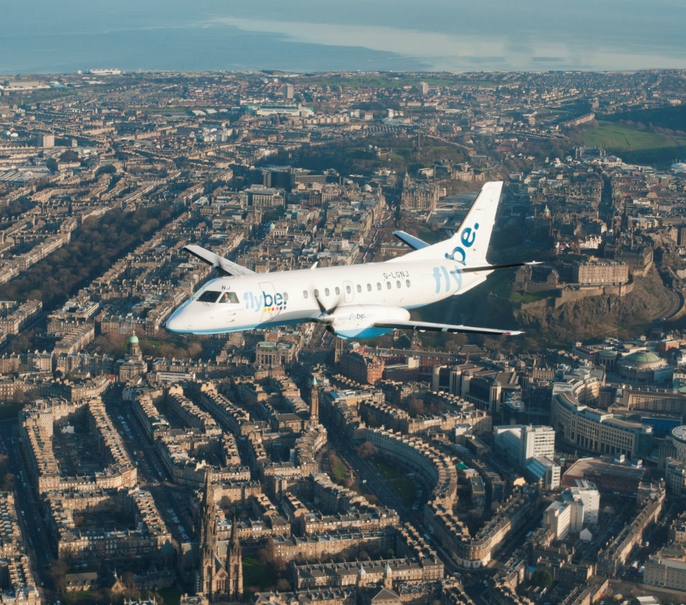
Regional aviation – CONNECTING THE REGION
Loganair in Scotland
REX in Australia
Connecting the regions

Slide 5
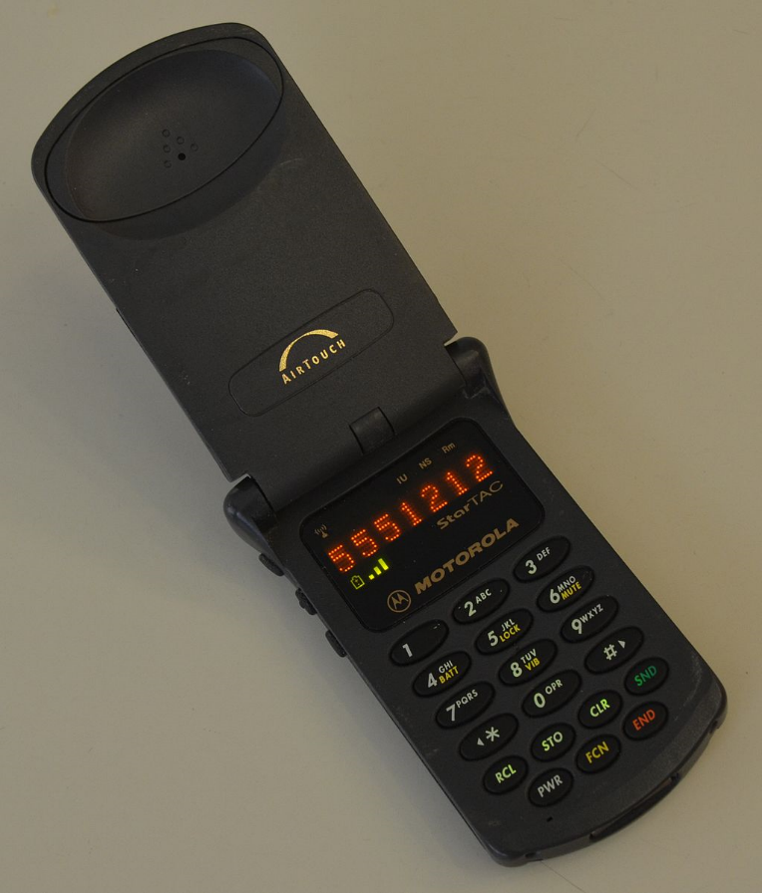
WHAT HAS HAPPENED SINCE THE 90IES?
This is what the McDonalds website looked like
This is how a laptop looked like
This is how the best selling mobile phone looked like
And this is how the best selling 30 seat regional aircraft looked !!!

Slide 6
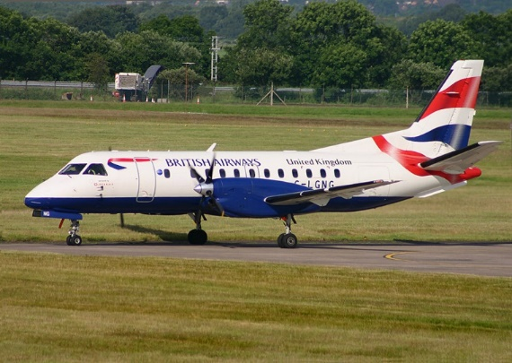
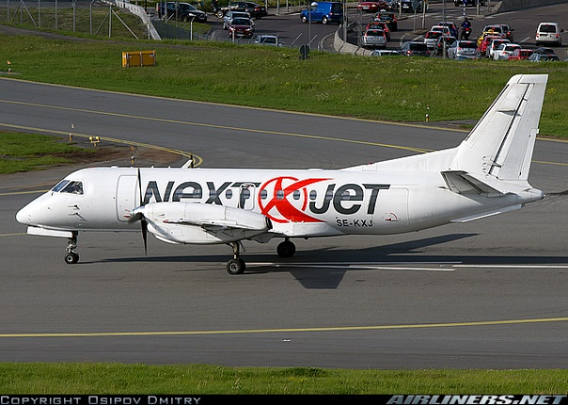
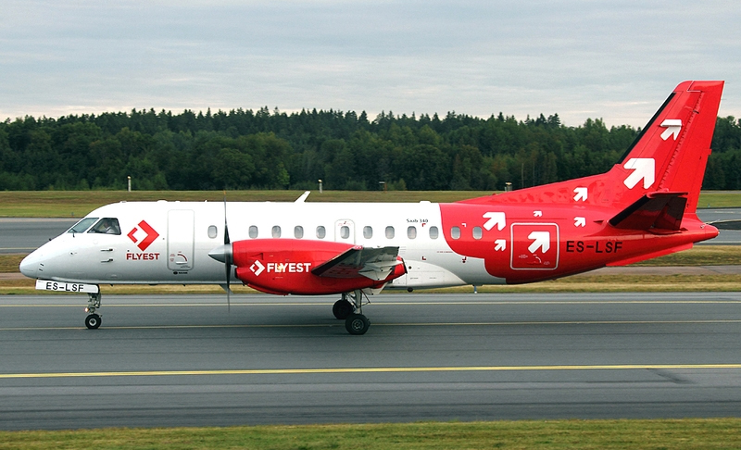
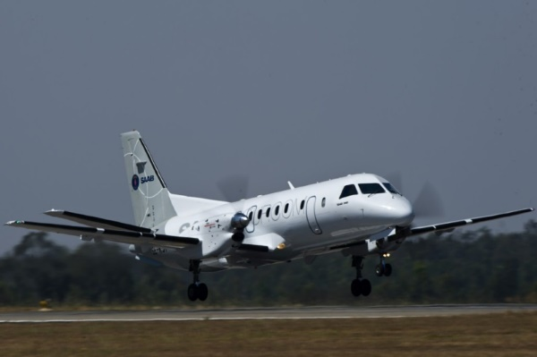
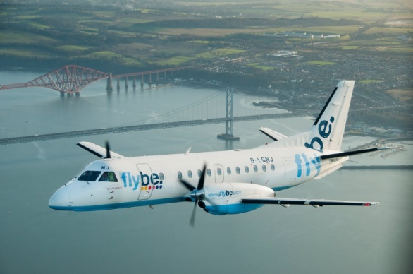
…AND the saab 340 IS STILL THE REGIONAL AVIATION TOP CHOICE in it’s segment

Slide 7
Regional aviation in the Baltics IN THE 90IES
New airlines started routes across the Baltics in the 90ies
This trend went on for some ten years, but the economics were not there
National airlines in Estonia, Latvia and Lithuania focused on routes from their respective capital

Slide 8
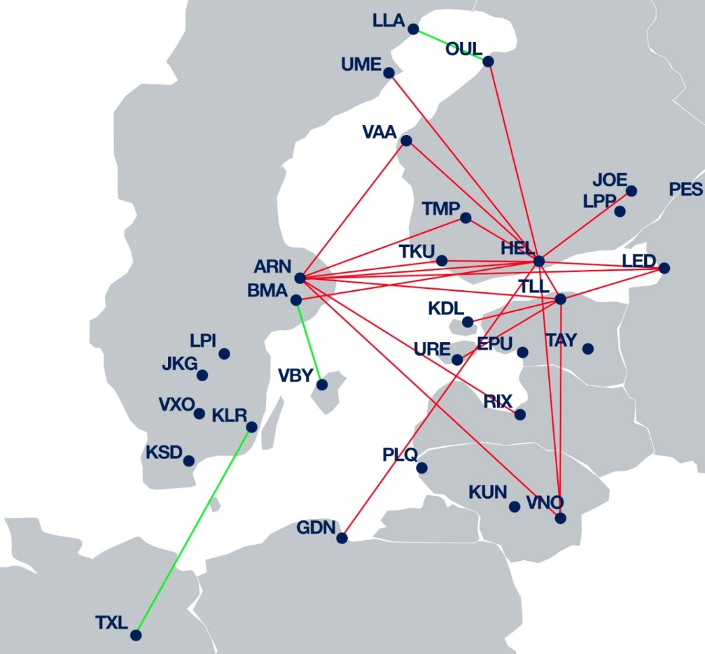
Regional aviation in the Baltics TODAY
Inter regional routes across the Baltics are scarce, if not linking capitals
Hubs in Riga, Helsinki and Stockholm dominate the traffic pattern
LCCs Low Cost Carriers fly several routes (not shown) and take a lot of traffic

Slide 9
Regional aviation in the Baltics IN THE FUTURE
Opportunities for direct regional routes as economies grow
Direct links facilitate local market access
Regional airports allow quicker access than big hub airports, saving time

Slide 10
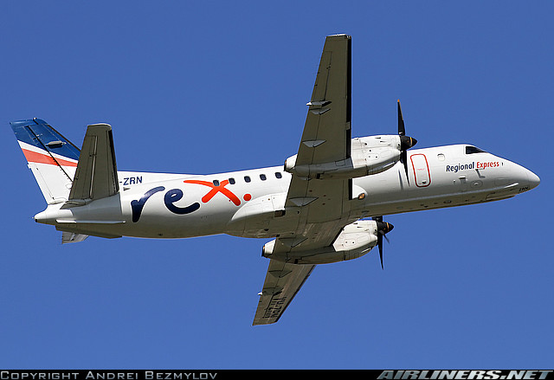
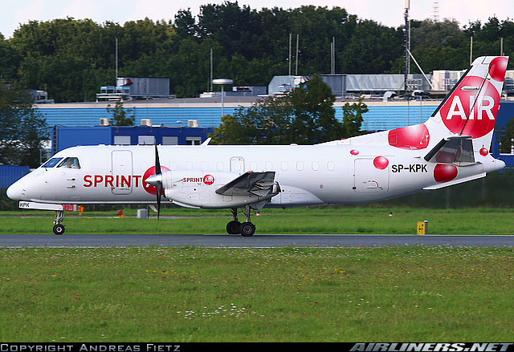
WHAT WILL WE FLY IN THE FUTURE?
No regional aircraft in the 20 to 40 seat size in production
Current fleet has with some exceptions a lot of life left
New produced aircraft would cost USD 12 to 14 million, and the market is not big enough for the manufacturers

Slide 11
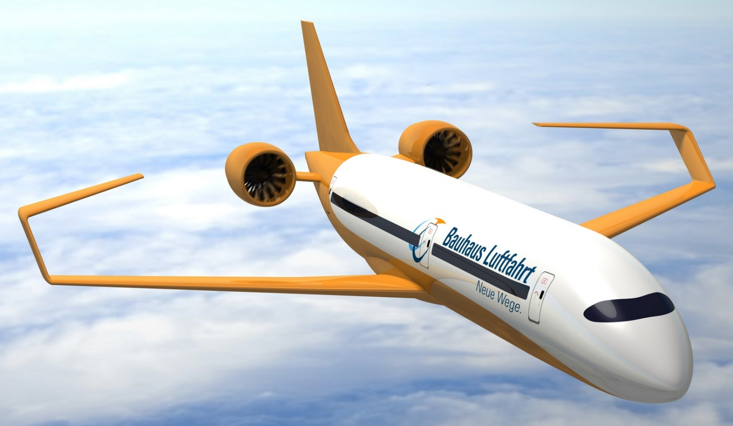
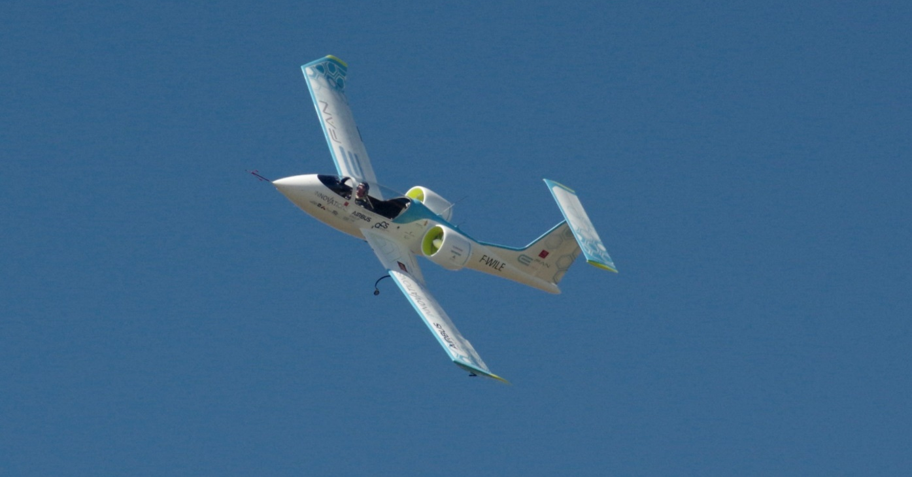
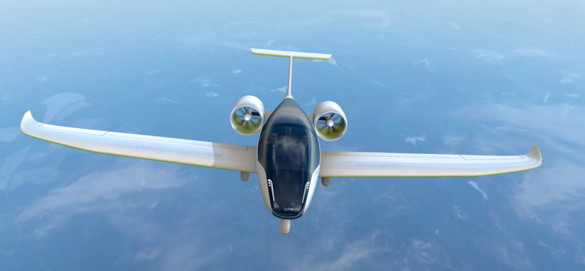
WILL Electric aircraft WILL be the next thing?
Two-seaters are already flying
Four-seaters will go into production 2019
Electric Regional Aircraft will be entering service around 2030 – 2035 according to Airbus
Huge technology leap in sight, who would be investing in new “CO₂” technology aircraft?
What will we fly until then?

Slide 12
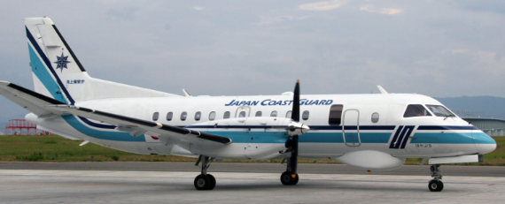
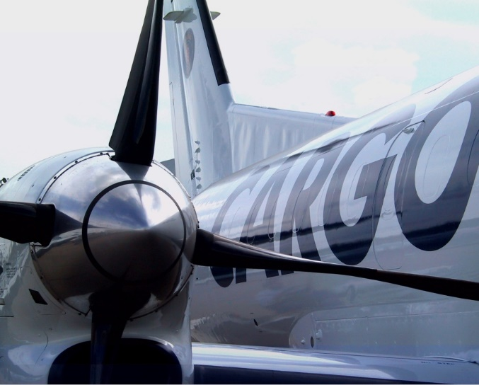
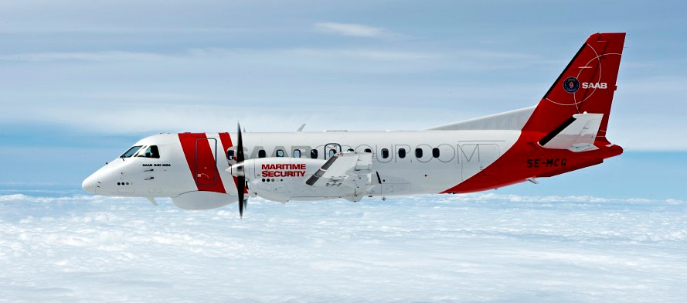
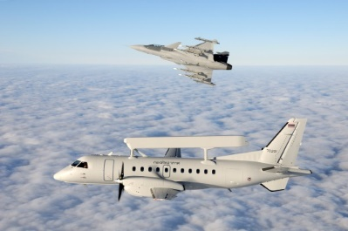
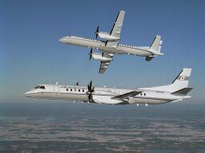
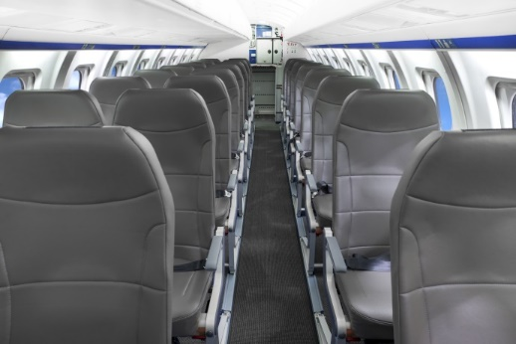
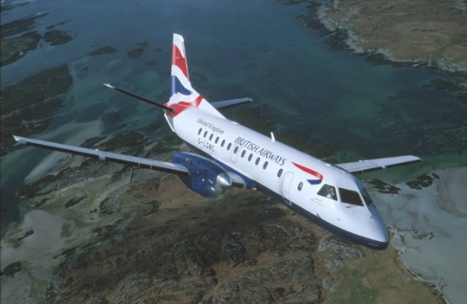
continous Saab REGIONAL AIRCRAFT developments

Slide 13
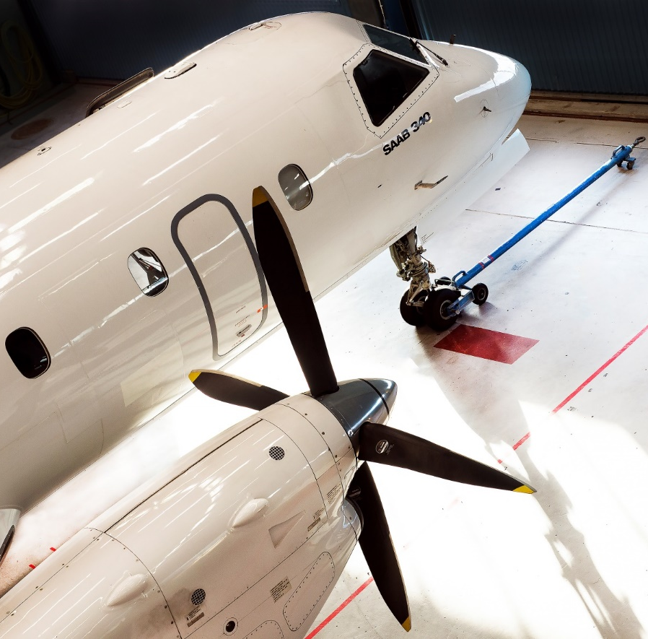
Why will the Saab 340 fly many years from now?
Capital cost
A new ATR 42-600 cost about 15 MUSD
A used Saab 340 costs not more than 3 MUSD
Difference in capital cost at 5% interest = 50.000 USD / Month
New designs are cost prohibitive
Any new aircraft program is likely to cost in the billions (USD)
The 30 to 50 seat turboprop market is a highly fragmented, replacement market = limited potential for large volume orders
The only way to start up a new programme is through government subsidizing and using an old design as base (T 328)
Changing fare structure
Regional operators have fewer opportunities to reduce crew salaries, training costs, handling fees etc. on a per seat basis
High yield regional routes are rare and hard to protect
Low cost operators have made it difficult to keep ticket prices at a profitable level with new (expensive) smaller aircraft.

Slide 14
