Slide 1
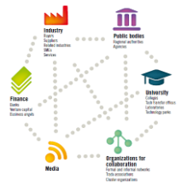
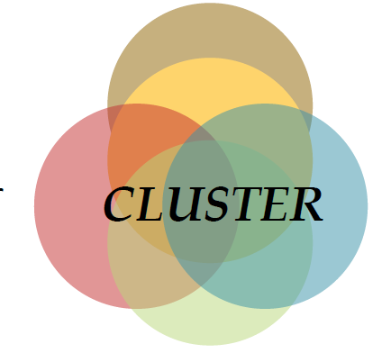
Cluster as the instrument to promote competitiveness in aviation
Urmas Varblane

Slide 2
Structure of the presentation
What are clusters? How do clusters arise?
Why do companies’ cluster ? What are the benefits of clusters?
Why are regions / countries interested in clusters ?
Which are the examples of clustering in aviation?
Why the clustering process of Estonian aviaton should be promoted?

Slide 3
Two broad trends in the world economy
A. The growing importance of GLOBALISATION.
businesses are more mobile – geographic distance
less important, many firms are active in several
continents.
B. The growing importance of REGIONALISATION
creation and manufacturing of products and
delivering of services is concentrating into specific
regions. Firms, active in these regions obtain
strong competitiveness advantage for a long period.
The growth of this - location driven – competitive
advantage is particulary often observed in knowledge
intensive industries.

Slide 6
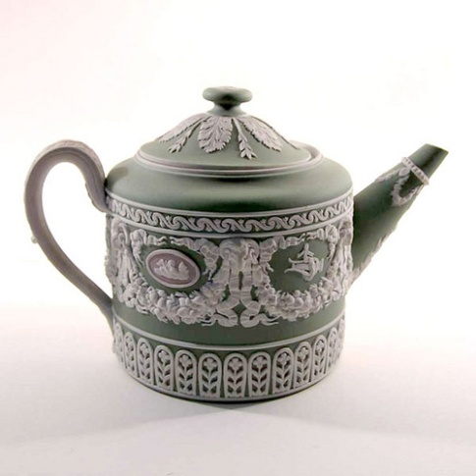
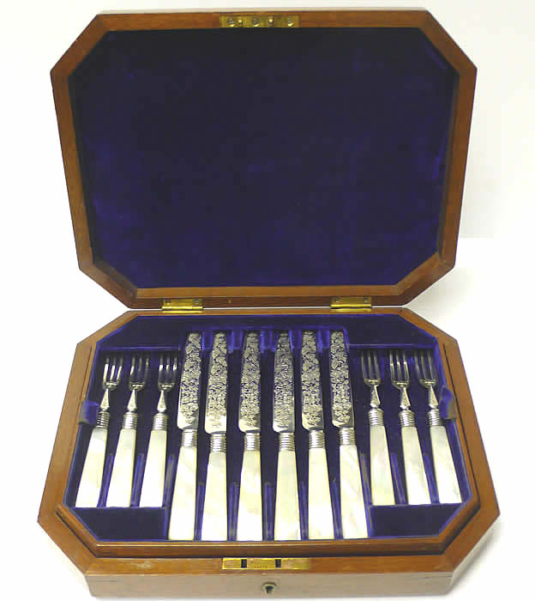
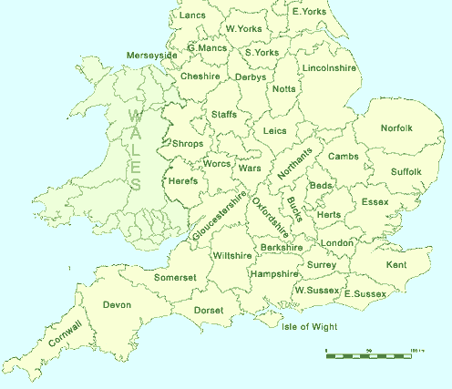
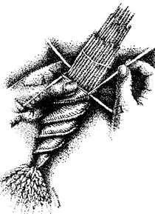
Staffordshire pottery
Sheffield cultery
Buckinghamshire chairs
Bedfordshire straw plaiting

Slide 8
What is told about clusters ?
Alfred Marshall - Industries tend to cluster in distinct geographic districts, with individual cities specializing in production of narrowly related set of goods
Joseph Schumpeter - Entrepreneur plays a disruptive role in creating products. Creative destruction, the successive replacement of one technology by newer technologies is the key to continuing economic development
Paul Romer -Increasing returns associated with knowledge, not the accumulation of capital and labor, are the key forces driving growth
Michael Porter -Clusters, or critical masses of unusual competitive success in particular business areas, are a striking feature of virtually every national, regional, state, and even metropolitan economy, especially in more advanced nations.

Slide 9
Clusters, definition and concept
Michael Porter’s definition of a cluster (On Competition, 1998):
A geographic concentration of interconnected companies, specialized suppliers, service providers, firms in related industries, and associated institutions (for example, universities, standard agencies and trade associations) in particular fields that compete but also cooperate
A :National ministries / agencies
B : Regional agencies / offices of national bodies
C : Regional agencies based on collective efforts of local communities
Industry
Public bodies
University Science parks, Research institutes
Christian Ketels, one of Porter’s students, adds the idea of interdependency (The Development of the cluster concept, 2003)
Clusters are groups of companies and institutions co-located in a specific geographic region and linked by interdependencies in providing a related group of products and/or services.
Financial actors
Organizations for collaboration
Media

Slide 10
Clusters are agglomerations of independent firms and institutions, which:
Cooperate and compete in the same time (coo-petition)
2) Concentrate geographically into one region (but in same areas they may have extensions all over the world)
3) Are specialised into certain field of activity, related with the similar technology or skills
4) Could be both, science based or traditional
5) Could be institutionalised (cluster could own formal management structure or some softer „cluster initiative“ type model or completely informal)

Slide 11
Clusters as innovation systems
OECD Cluster focus group
Innovation seldom takes place in isolation but is systemic. The notion of a cluster as a ‘reduced scale innovation system’
Clusters are networks of production of strongly interdependent firms linked to each other in a value-adding production chain.
Clusters mostly also encompass strategic alliances with universities, research institutes, knowledge-intensive business services, bridging institutions (brokers, consultants) and customers.

Slide 12
An alternative approach
Cluster as knowledge community
Node of knowledge generation and dissemination
Focus on agglomeration of skilled people rather than firms
Dominant designs, genres and movements
Competition and co-operation
Conventions and institutions
Shared assets

Slide 13
Main Shared Cluster Characteristics
Of firms to allow positive
spill-overs and
sharing resources
Proximity
Critical Mass
Cluster
Common Goal
Sufficient number of participants
Goal shared by participants
Interaction
Traded and untraded links

Slide 14
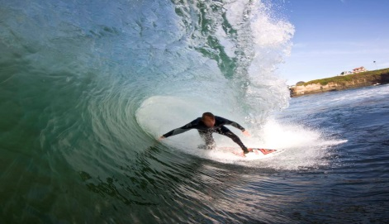
C
California – surfing cluster
Surf shops
Surf clothing
Competitions
Festivals
Foam &
fiberglass
Local surf heroes
Surfboard makers
Surf Clubs Surf Schools
Wax
Manu-facturing Association
Chemicals
Media
Lobby Groups
Skateboards
and Snowboards
Museums
Local university
Other local education
Source: HBS MOC student team

Slide 15
Cluster as the facilitator of competitiveness
Cluster affects the competitiveness in three directions (Porter 1998):
1) Growth of the productivity of firms;
2) Supporting innovativeness, which is factor of productivity growth;
3) Creation of new firms , which expands and strenghten the cluster.
Cluster affects the productvity by:
a) Better access of labour and other inputs of production;
b) Access to information and knowledge;
c) Mutual complementarity;
d) Better access to institutions and public goods;
e) Stronger motivation caused by the ability to compare results with other firms in cluster

Slide 16
Cluster benefits – growing productivity

Slide 17
Cluster benefits – faster innovation

Slide 18
Why are governments’ interested in clusters ? –what clustering brings to regions
Clustering processes are viewed as having the potential to :
Restore / enhance competitiveness
Reinforce the innovation capability
Increase attractiveness to investors
Transform a vicious cycle into a virtuous cycle
Low growth 🡺 little revenue generation🡺 poor quality infrastructure 🡺 capital outflows, brain drain 🡺 loss in competitiveness 🡺 low growth
Reinforcement of competitiveness 🡺 faster frowth 🡺 revenue generation 🡺 economic infrastructure development 🡺 FDI, HR development 🡺 improved competitiveness

Slide 19
Clusters and Regional Policy: Smart Specialization
The Challenge:
How to support structural change towards higher value-added activities?
The Old Answer:
Identify growing markets and try to enter them (bio, nano, eco, …)
Failure to succeed in intensely competitive markets without unique assets
The New (Smart Specialization) Answer:
Identify your assets, including your existing cluster base
Actively pursue opportunities in areas adjacent to current strengths and leading towards higher value added
Longer-term development of sustainable competitive advantages

Slide 20
Regional Cluster Policy
Clusters may (or may not) arise spontaneously
Can regional clusters be engineered?
Starting clusters ex nihilo is very difficult; cathedrals in the desert...
Example of a mainly market-induced cluster: Watchmaking cluster in the Swiss Jura (Maillat, 1995); the role of tradition in production
Nowadays, an increasing number of OECD and emerging countries’ governments actively pursue cluster-based policy as a means to foster regional development
All government efforts to develop & support clusters in a specific region
From studies to setting up platforms, to establishing brokering and networking schemes to providing subsidies for cooperation

Slide 21
Target Public Policy at Clusters
Business Attraction
Education and Workforce Training
Science and Technology Infrastructure (e.g., centers, university departments, technology transfer)
Clusters
Export Promotion
Market Information and Disclosure
Setting standards
Specialized Physical Infrastructure
Environmental Stewardship
Natural Resource Protection
Clusters provide a framework for organizing the implementation of public policy and public investments towards economic development
Notes:
More impact, because it creates spill-overs
More social benefits, because it reduces gap between public and private returns
Better decisions, because policy design can take cluster-specific factors into consideration through cluster dialogue
Not new money, but how to distribute it
Open to all clusters, not a few selected
Education – US WIRED program
Science – German R&D bonus
Business Attraction – Swedish ISA cluster focus
Infrastructure – many science parks with cluster focus, Russian cluster program

Slide 22
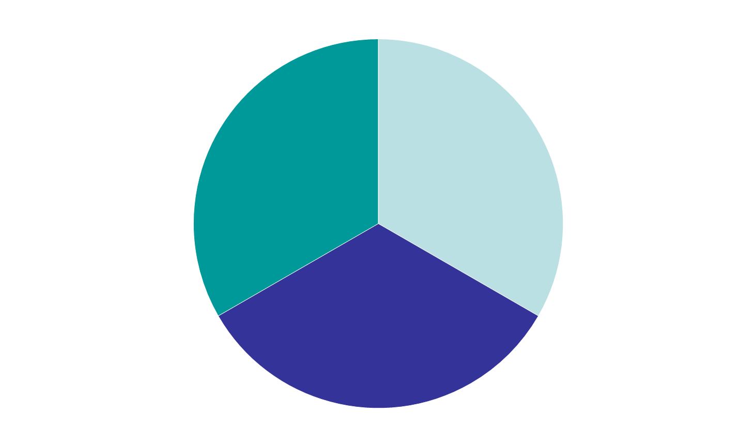
What are Cluster Initiatives?
Cluster initiatives are collaborative activities by a group of companies, public sector entities, and other related institutions with the objective to improve the competitiveness of a group of interlinked economic activities in a specific geographic region
Upgrading of company operations and strategies across a group of companies
Upgrading of cluster-specific business environment conditions
Strengthening of networks to enhance spill-overs and other economic benefits of clusters

Slide 23
Notes:
‹#›

Slide 24
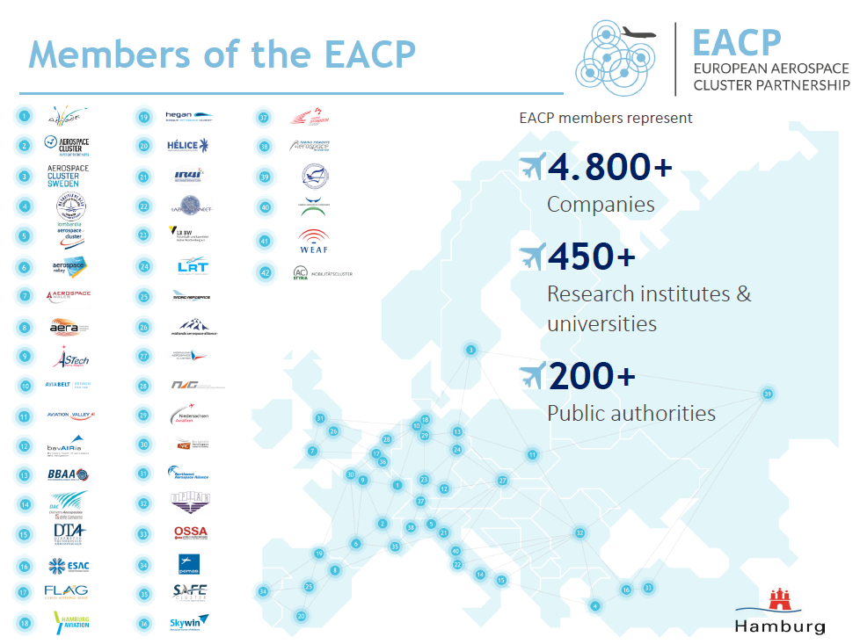
www.eacp-aero.eu
Notes:
‹#›

Slide 25
Benefits for Cluster member: EACP practice

Slide 26
GOALS:
to network the companies, organisations and institutions of Hamburg Aviation,
to promote the development of specialist personnel
to expand knowledge transfer
to improve the commercial and economic environment.
A FURTHER AIM :
to identify and fill gaps in the process chain
to produce innovations
to open up new areas of competency.

Slide 27
ANCHORS
Founding
members
The Hamburg Invest Corporation
Ministry of Economy, Transport and Innovation
was also a founding member

Slide 28
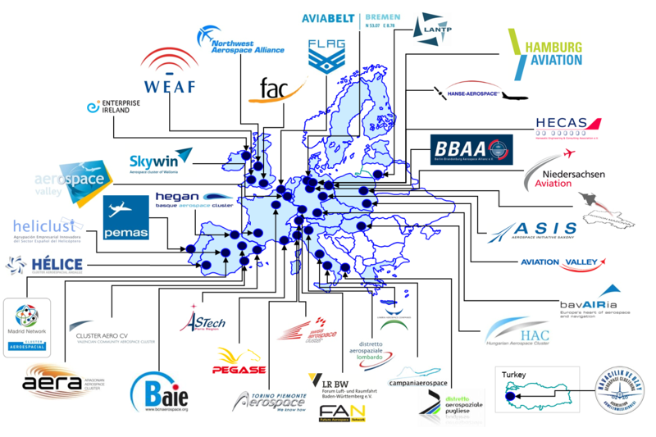
Estonia is the last member of the EU, which does not have either umbrella association or cluster in aviation
‹#›

Slide 29
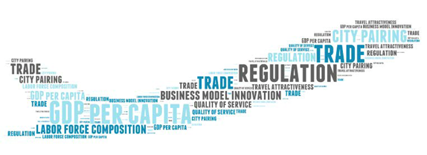
Why Aviation Cluster is needed in Estonia
Acknowledging importance of the sector (supposed 3% of GDP, but can contribute more) for policy-makers
Creating more high-paying jobs
Exploiting good geopolitical location
Intensifying cooperation with other sectors – tourism and transit sector, but also ICT!
Attracting foreign direct investments (Finnair, LH, Airbus have shown interest …?)
Buying ticket to play with big players – becoming a member of EACP

Slide 30
Potential members of the aviation cluster of Estonia
Aviation firms (e.g.Nordica)
Infrastructure providers (e.g. Tallinn Airport, Eesti Lennuamet, EASA etc.)
Customers (private- and business clients, incl. tourist sector and also state as customer)
Suppliers/service providers
- maintenance (e.g. Magnetic MRO)
- fuel (e.g.BP)
- leasing providers (e.g.Transpordi Varahaldus)
- handling firms (e.g. Tallinn Airport Ground Handling)
- catering firms (e.g. LSG …) jt

Slide 31
Potential members of the aviation cluster of Estonia
Education providers (Aviation Academy; diferent universities etc.)
State (as the owner of many firms, but also as the benefitting partner through the economic growth, creation of newe jobs, tax revenues etc.)
Enterprise Estonia – as the promoter of exports, foreign direct investments and tourism, as well as developer of space cluster in Estonia
Other transportation firms (e.g.. Tallink)
Tourism firms and their associations
Military aviation

Slide 32
Expected benefits for Estonian Aviation Cluster member
Management:
Protecting sector interests – having clear strategy
Improve labour law to match the 24/7 requirements
Tackle the shortage of industry specialists and seek solutions
Creating attractive opportunities for investments
Internationalization process with other clusters (42 clusters in EACP)
Networking:
Getting quicker access to clients, partners and knowledge – saves time and money
Joint participation at aerospace events – gives more credibility
Marketing:
Creating brand - Estonian Aviation or Aerospace Cluster!
Strong brand gives better presence (easier to find & connect)
Brand will be better accepted by public bodies
Raising visibility of the sector through:
Newsletters
Joint promotion materials (videos, brochures etc)

Slide 33
Some questions for the discussion
Which are the capabilities and resources for the creation of the aviation cluster? Who are the potential partners?
How to overcome potential problems coming from the smallness of Estonia?
Which are the common interests of cluster participants? Who is taking the lead in the clustering process?
Which areas of the aviation could benefit most from the clustering process?
How could be state involved and cooperate in cluster development process? What could be the role of the Enterprise Estonia cluster cooperation instrument ?

