Slide 1
Estonian RPAS Testing- and Demonstration Centre (TDC) in Tartu
Jaan Tamm
Estonian Aviation Academy
Ülenurme, November 14, 2014

Slide 2
Content
Activities started in spring 2014..
National Security Committee approval March 2014
EAVA / MoD contract May 2104
Feasibility study of RPAS TDC
Conclusions and recommendations of the Feasibility Study
Detailed developments
International dimension – SESAR JU activities
Further deliberations

Slide 3
Contract between EAVA and MOD
To cooperate in the RPAS domain for establishing the needed competence for developing the Estonian RPAS Testing and Demonstration Centre (TDC), and particularly:
Preparing the feasibility study
Investigating the funding opportunities
Consulting with the experts from EU bodies and particularly from SESAR JU
Making acquaintance with testing centres abroad
Consulting with other potential stakeholders in Estonia
Collecting know-how of the sector
Notes:
Konkreetsed arendustegevused:
Koostatakse teostatavusanalüüs
Kaardistatakse EL pakutavad rahastamisvõimalused
Konsulteeritakse EK ekspertidega
Tutvutakse EL olemasolevate võimalustega RPAS arendus-, testimis- ja demonstreerimisvõimaluste kohta
Konsulteeritakse Eesti teemassepuutuvate ametiasutuste, ülikoolide ning ettevõtetega
Muud tegevused põhieesmärgi saavutamiseks

Slide 4
The Feasibility Study of RPAS TDC
Describing the environment - mapping the present operational functionalities and screening them against evolving SESAR requirements – based on the graduation thesis of the ATS student of 2014 – COMPLETED with detailed analysis of ATM environment
Making the analysis of TDC technology – COMPLETED, part of input for funding request
Risk management, avoiding common failures
Opportunities for cyber-security solutions
Overview of RPAS international developments

Slide 5
ATM analysis
Basics from ATM Master Plan - what to expect
General description of TDC procedures
TSA, TRA and D operations
Configuration
Safety arrangements
Co-ordination procedures between TDC, ACC and Tartu TWR/APP
Separation
Operations in the controlled airspace
Operations in the uncontrolled airspace
Notes:
Recent problems with European VDL/2 !!

Slide 6
Technology
RPAS-specific technology
VHF
ADS-B
GPS, incl proposal for EGNOS RIMS to Tartu
Detect & avoid, C2 data-link (VDL/2 ??)
Laboratories and workshops od Academy
Participation (as observer?) in SESAR JU Definition Phase
Establishing co-operation with cyber-security stakeholders
Notes:
Recent problems with European VDL/2 !!

Slide 7
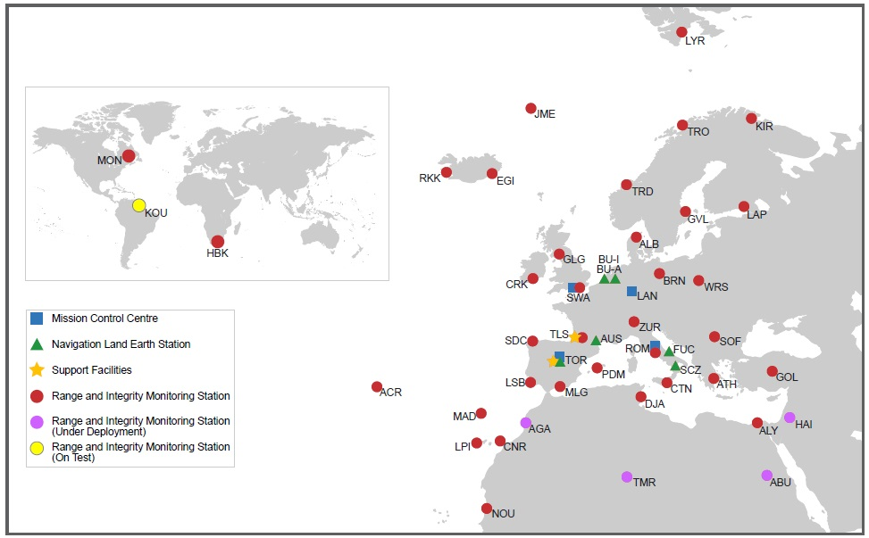
EGNOS RIMS to Tartu

Slide 8
Funding opportunities
Upgrading the Academy’s study infrastructure for project-based RPAS studies – request to the EU Structural Funds, qualified on May 27, 2014 – FAILED, intention to RE-APPLY
Arrangement with Ministry of Economic Affairs & Communications and Estonian ANS funding part of the ATM research – To draft and conclude the agreement
The upcoming SESAR JU demonstration and validation projects
Call to other stakeholders to contribute the TDC undertaking

Slide 9
General conclusions for developing the TDC
Giving priority for civil undertaking, involvement and motivation of stakeholders
The first goal - contributing to the RPAS integration into conventional aviation system
Setting balanced focus on developing the regulation, technology enablers and ATM procedures
EAVA special regard on educating the RPAS personnel, also developing technology
Organising the TDC as a spin-off at the Academy, aiming later at independent certified operator
To secure initial funding for the development phase..

Slide 10
International (European) dimension
Forth-coming SESAR RPAS Definition Phase aiming at integrating RPAS in the European aviation system and ATM
From 2016 and beyond (VLOS, IFR, VFR)
Phased integration into non-segregated ATM environments, including VLL operations
Produce R&D and validation programme
SESAR compliant - anticipating the 2015 update of the European ATM Master Plan
RPAS R&D to become part of SESAR 2020 development work
Funded under Horizon 2020

Slide 11
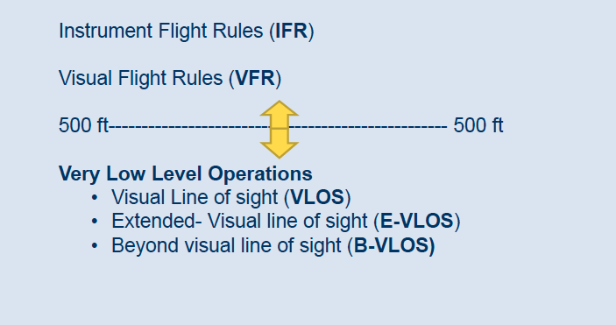
RPAS Scope – types of operations
Source: SESAR JU RPAS workshop on Sept 4, 2014

Slide 12
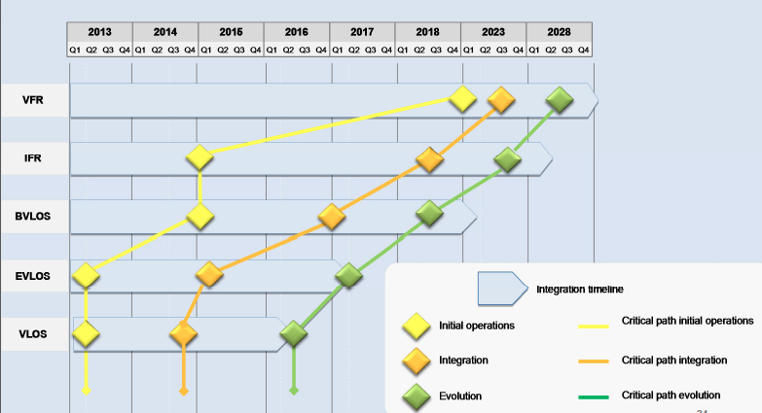
RPAS R&D roadmap timeline
Source: SESAR JU RPAS workshop on Sept 4, 2014

Slide 13
RPAS Definition Phase activities
Detect & Avoid (Saab)
C2 (Command & Control) data-link (Honeywell)
Airspace & airport access (CANSO)
Contingency (e.g loss of link ...) (ASD – AeroSpace and Defence Industries Association of Europe)
Human Factors (EUROCONTROL)
Security (SESAR JU)
Demos and best practices (SESAR JU / ECTL)

Slide 14
Opportunities for SJU co-operation
From the outcome of meeting the SESAR JU, Denis Koehl in Tartu on November 5th
The expected capacity of Tartu RPAS TDC could be of interest for SESAR for RPAS Very large scale demonstrations (VLD)
Estonian expertise and experience in the field of cyber technology can considered by SESAR

Slide 15
Vision for creating the Centre
Drafting the Operational Concept, synchronizing it with operations of Tartu Airport
Developing the master plan / action plan
Establishing the legal body – the operator of Centre
Communicating and marketing
Proposing the upgrades/adjustments for legislation
Making the Safety Case for the Centre establishment
Certifying the Centre with Estonian CAA and military authorities

Slide 16
Critical success factors
Broad involvement of all stakeholders – regulator, supervisor, ATM, Airport and RPAS operators
Co-operation with academic institutions, including Ministry of Education and Research
Funding and in kind contribution
Getting international, becoming partner in the broader RPAS research network
Delivering and demonstrating tangible results

Slide 17
Thank you for your attention! Tänan tähelepanu eest!

