Slide 1
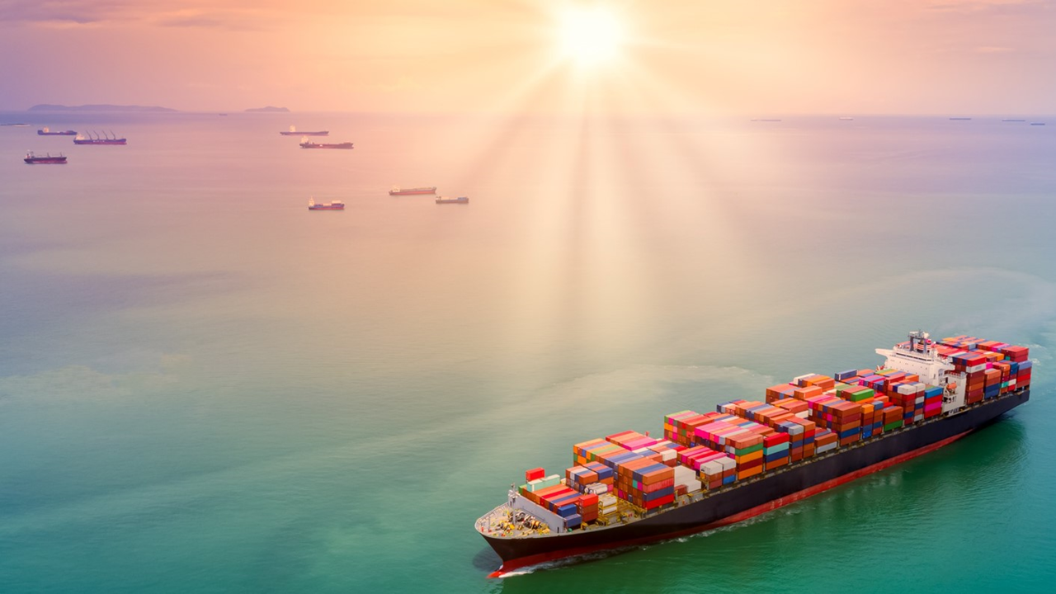
Latest Trends in Maritime Decarbonization
Paweł Grobelny, DNV
22nd International Maritime Converence, Tallinn

Slide 2
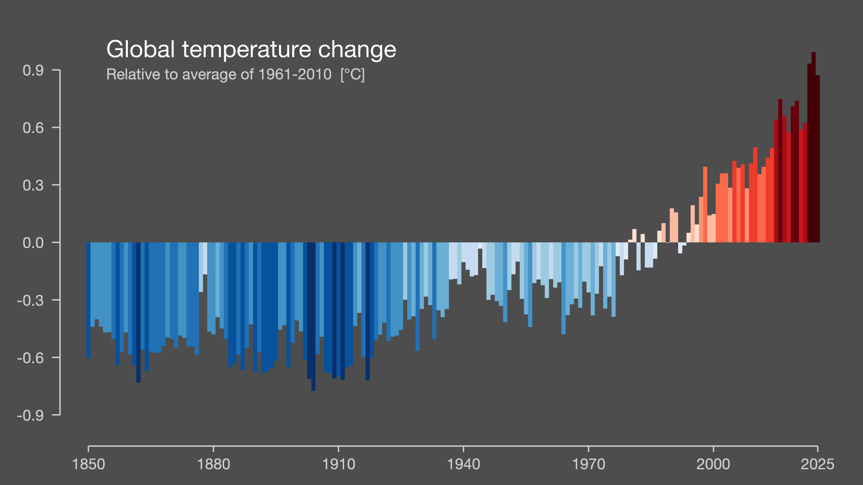

Prof. Ed Hawkins #ShowYourStripes
Notes:
Zoom out for a momrnt
Most important trend of all
Picture is fine, context
Global average temp
Story
triggered discussion.
But where does shipping fit into this picture?
Let's look at a few numbers.

Slide 3
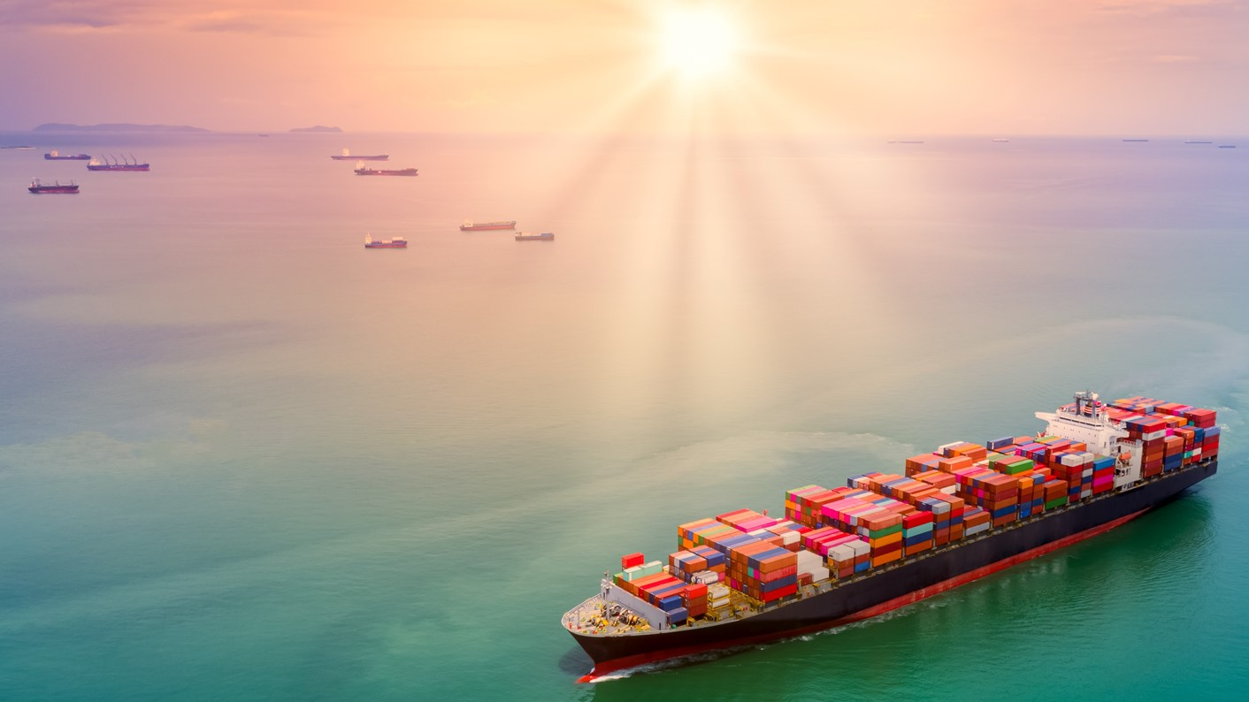
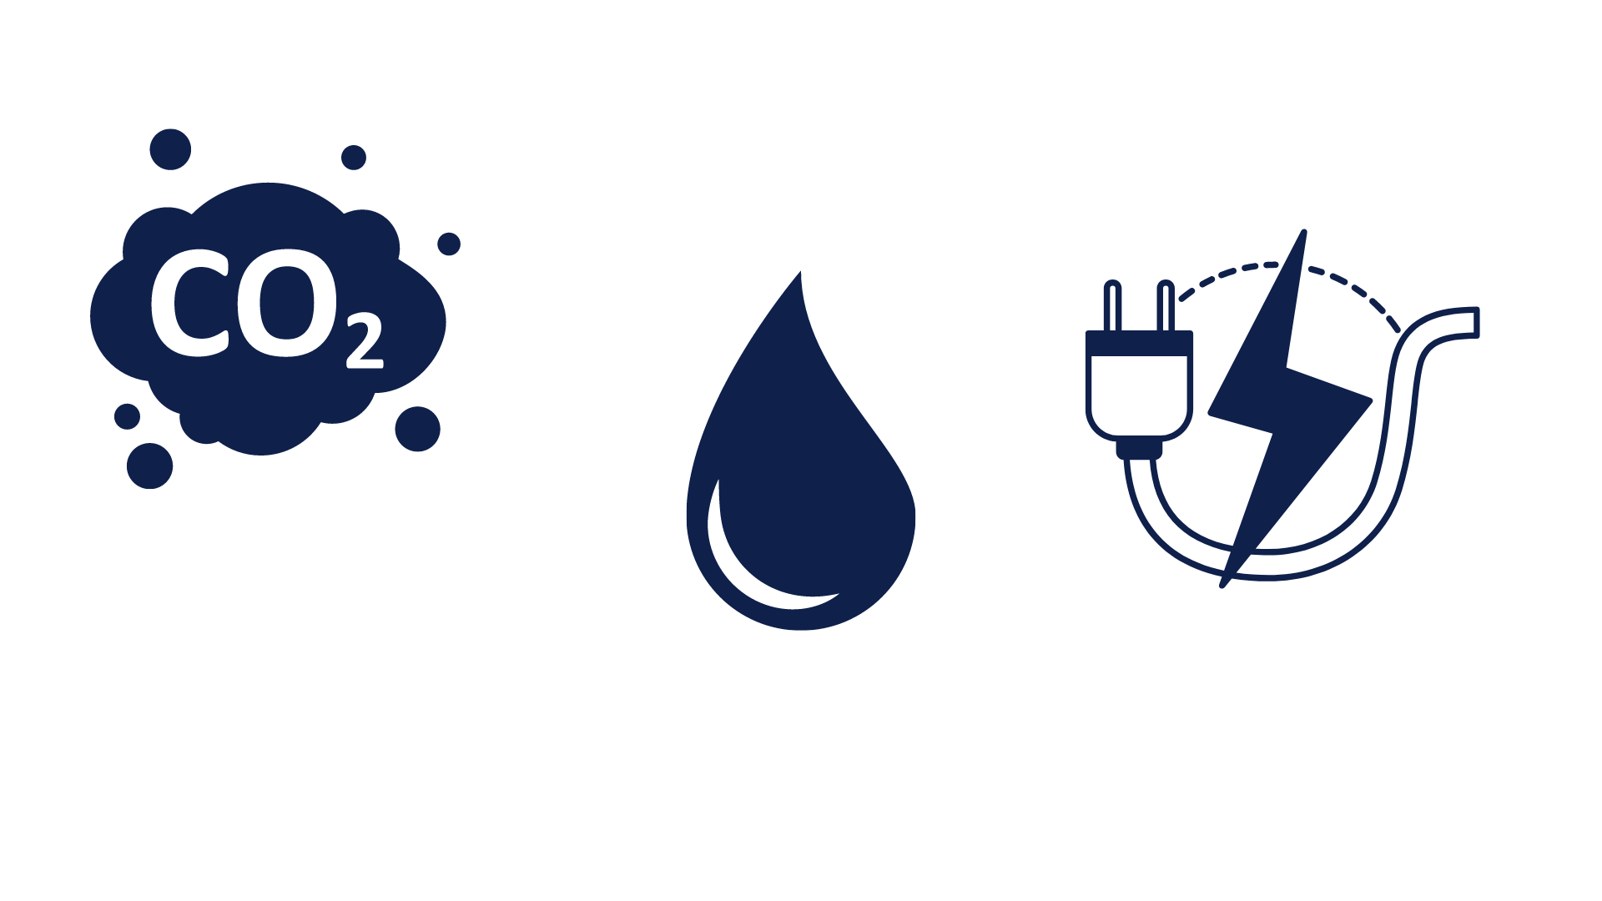
3%
7%
12%
2%
Notes:
responsible 3% of global final energy demand.
consume 7% of the world's oil production.
roughly 12% of transport-related greenhouse gas emissions.
around 2% of global CO₂ emissions.
Now, depending on your perspective, 2% may sound either very small or very large.
shipping can no longer remain outside the decarbonization discussion.
Decarb = only fuels

Slide 4
The decarbonization landscape is broader than low-GHG fuels.
DNV ©
Notes:
Energy efficiency, shore power, wind propulsion, carbon capture, difitalization and many other
Main message - wide portfolio, not a single silver bullet
Good afternoon

Slide 5
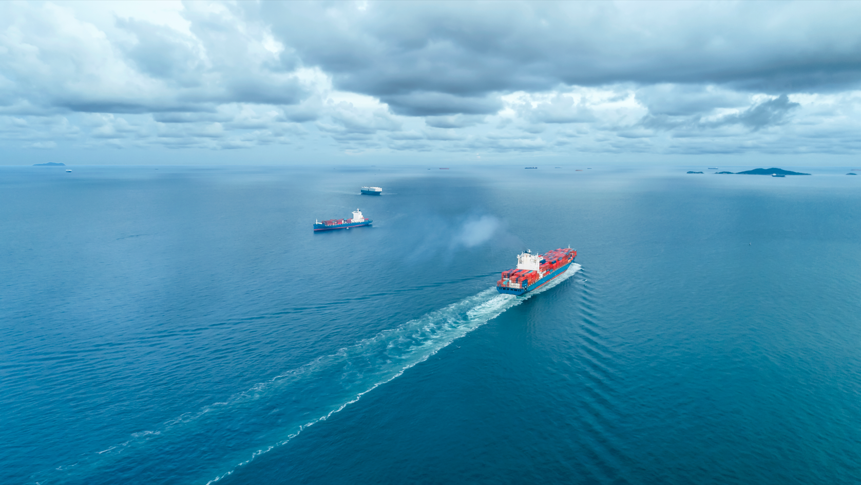
Key drivers of decarbonization
Notes:
Before moving to individual solutions, let’s try tu understand what is driving the change

Slide 6
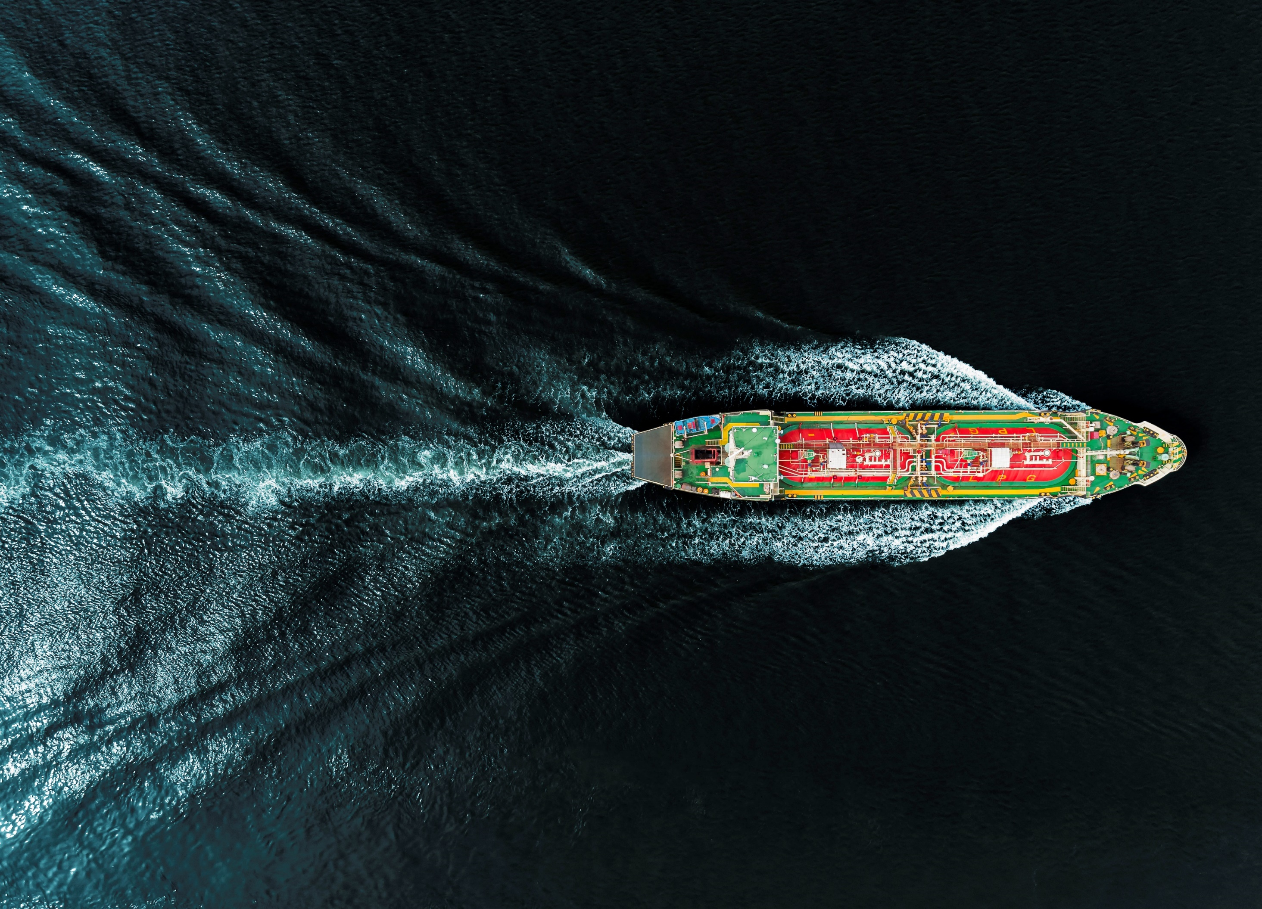


Main regulators
Notes:
Global and local regulations

Slide 7
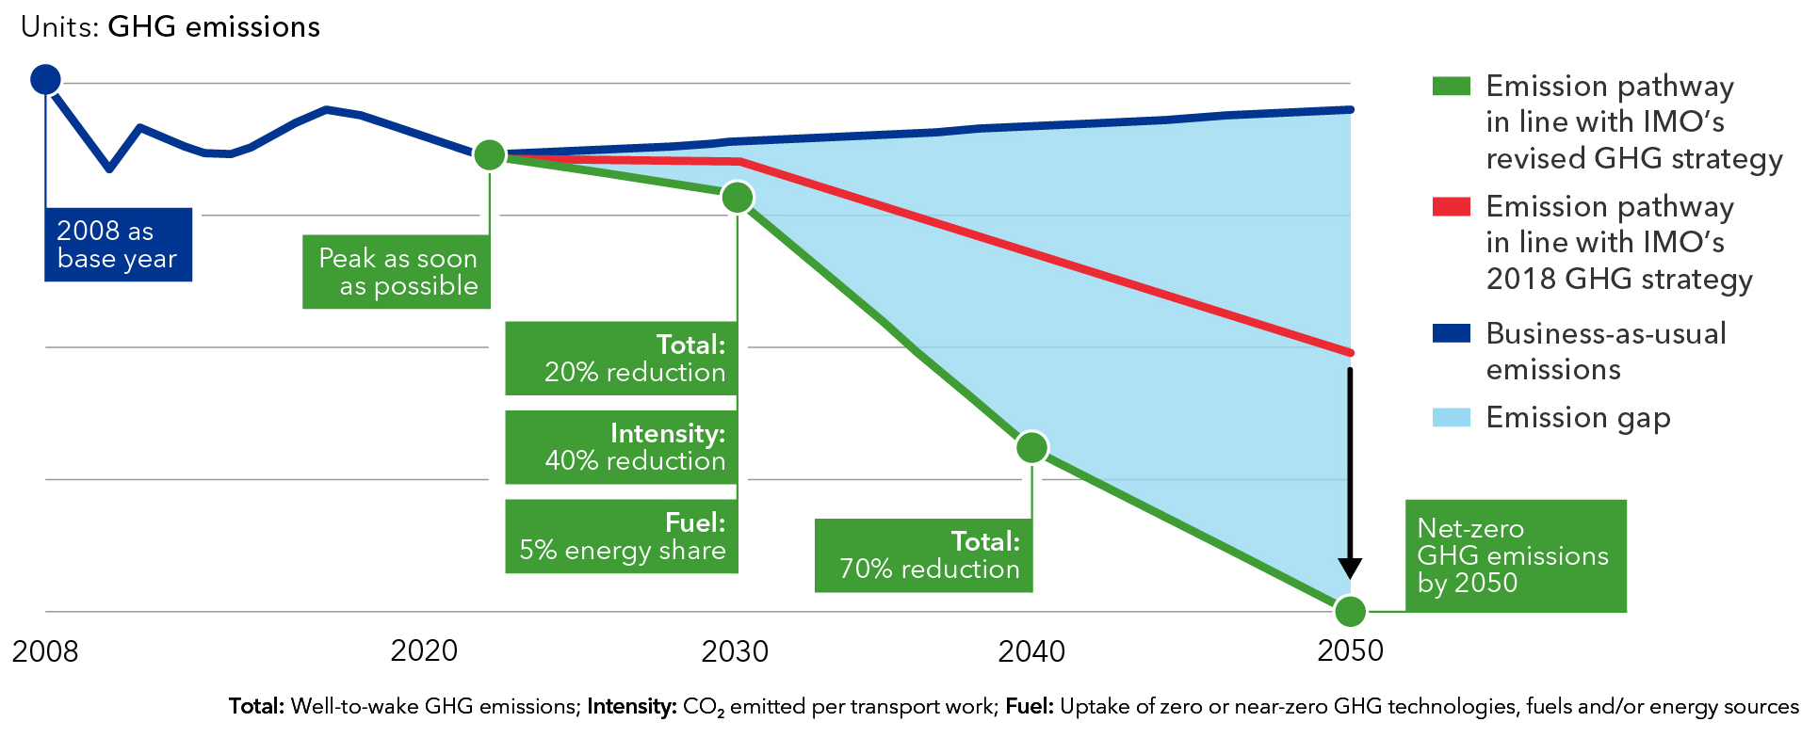
IMO decarbonization ambitions
Notes:
Imo set the goal – net zero by 2050.
All of the current newbuilds most probably will operate up to and beyond this date.
And that’s why it’s important to make a robust and future-proof decisions, and this may not be easy, because...

Slide 8

The exact shape and timeline of global GHG regulations remain uncertain
Net-Zero Framework
Notes:
... We still don’t know the exatc pathway
the final shape of the IMO Net-Zero Framework and its adoption timeline remain uncertain.

Slide 9
Multiple regulatory futures are possible, 4 different scenarios around NZF
DNV ©
Notes:
Several regulatory outcomes are possible,
We have drawn up four potential scenarios out of many possible outcomes, centered on IMO regulatory development.
1 and 2 – adopted either in current or revised form, taking effec from 2030, main driver for maritime decarb
3 and 4 – rejected and GHG reg remain delayed or gridlocked, potentially increasing importance of reg measures

Slide 10
Regional regulations are moving ahead while global alignment lags
DNV ©
Notes:
Those are moving ahead
Most notably, the EU ETS and FuelEU Maritime 15%
Similar regulations are emerging
Like UK and Türkiye, suggesting that regional pricing mechanisms may become more common

Slide 11




















Main „pressure makers”
Banks assessments
Cargo owners & Charters
Some of the Signatories
Some of the Signatories
Notes:
Regulations are not the only driver.
Banks, charterers, cargo owners and investors
are increasingly influencing fleet decisions and fuel strategies.

Slide 12
Fleet outlook
Notes:
Let's move from regulation to the fleet itself

Slide 13
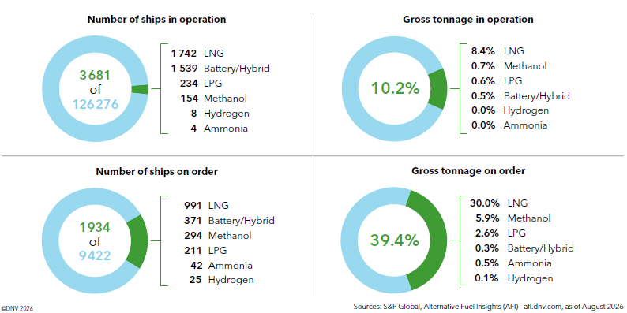
Fuel technology transition – minimal decrease in ordered alternative fuels capable tonnage year to year
DNV ©
Notes:
Decrease in alternative fuels capable tonnage orders
Compared to last year: 51,1%
regulatory uncertainty, as many owners delayed ordering decisions pending clarity on the IMO’s
the main driver is a shift in order book composition.
Alternative fuels have primarily been adopted container vessels, cruise ships, and car carriers,
the current order book is increasingly dominated by tankers and bulk carriers, which have lower uptake.

Slide 14
The world fleet can consume around 50 Mtoe of
non-oil fuels by 2030, dominated by LNG
In 2030, sailing fleet with today’s order book could potentially consume:
44 Mtoe LNG
6 Mtoe methanol
3 Mtoe LPG
0.2 Mtoe ammonia
0.04 Mtoe hydrogen
Source: Alternative Fuels Insight (AFI) – afi.dnv.com, as of August 2025
Notes:
Current fleet and orderbook
Could potentially consume 50 mtoe by 2030
Dominated by LNG,
Methanol is gaining momentum
Alternative-fuel capability does not guarantee use in practice.
Many LNG- and methanol-capable ships operate well below their capacity to operate on such fuels, for commercial reasons.

Slide 15
Alternative fuel capability remains uneven - ranging from 1% for bulk to 26% for car carriers
DNV ©
Notes:
regulation alone does not explain adoption.
Commercial drivers and customer expectations matter just as much.
26% of car carriers are alternative fuel-capable, only 1% of bulk carriers are.

Slide 16
Large bulkers, tankers, and containerships account for more than 50% of world fleet’s emissions
Share of emissions from bulkers, tankers, and containerships compared to total world fleet CO₂ emissions (TtW)
Annual emissions from large bulkers, tankers, and containerships (in total 17 025 vessels*)
Source: 2024 AIS data. *World fleet is all ships with an IMO number, which is mandatory for passenger ships of 100 GT and above and cargo ships of 300 GT and above
Notes:
Let’s for a moment focus on large bulkers, tankers, and containerships, as they are responsible for more than half of the world fleet’s emissions
While of course large ships have large emissions, we must never forget that they are much more efficient per transported cargo.
Therefore, decarbonizing the transport of a ton of cargo is less costly for large ships.

Slide 17
Alternative fuels and propulsion solutions
Notes:
The fleet is changing.
But are fuels keeping pace?

Slide 18
Low-GHG fuels are already being bunkered in almost 90 ports
Reported
low-GHG bunker operations by fuel-type
DNV ©
Notes:
The fuel transition has already started.
Low-GHG fuels are no longer theoretical.
Low-GHG fuel bunkering has now taken place in almost 90 ports globally.
low-GHG fuels account for only around 0.3% of shipping’s energy use, or about 1 Mtoe.
To understand why uptake remains so limited, we now turn to the marine market for low-GHG fuels, more specifically, supply.

Slide 19
Fuel production facing headwinds, multiple projects are delayed and cancelled
Notes:
Most recent report shows that 270 Mtoe is possible
Due to delays and cancellations the real supply will be much less
70-100 mtoe in 2030 may be more realistic – numbers from 2025
Bio-diesel & bio-methane dominates
It’s TOTAL supply for all industries

Slide 20
Regulatory uncertainty has huge implications on the future fuel demand - from 33 to 185 Mtoe in 2050
Scenario 1: Current NZF is adopted
Scenario 4: NZF rejected, IMO gridlock
25% lower fuel consumption
DNV ©
Notes:
Depending on future regulations, demand for low-GHG fuels could differ by more than a factor of five.
That is an astonishing difference.
Up to 22-25 mtoe by 2030
In Scenario 1, where the NZF is adopted, low-GHG fuel demand could reach 185 Million tonnes oil equivalent (Mtoe) in 2050 if sufficiently incentivized. Without the NZF, as in Scenario 4, demand is driven mainly by FuelEU Maritime and the EU ETS, limiting uptake to around 33 Mtoe by 2050.
The scenarios also differ significantly in total fleet energy use. By 2050, annual fuel consumption in Scenario 1 is 25% lower than in Scenario 4. This implies that global regulatory incentives could not only accelerate low-GHG fuel uptake, but also incentivize energy-efficiency measures.

Slide 21
Shipping will compete with other sectors for low-GHG fuels and their feedstocks
Direct competition
for low-GHG fuels
Competition for feedstocks
(example for biomass)
Notes:
Shipping is not alone in this transition.
The same low-GHG fuels in other sectors
Bio-SAF and marine bio-desiel = the same feedstock
Two levels of competition

Slide 22
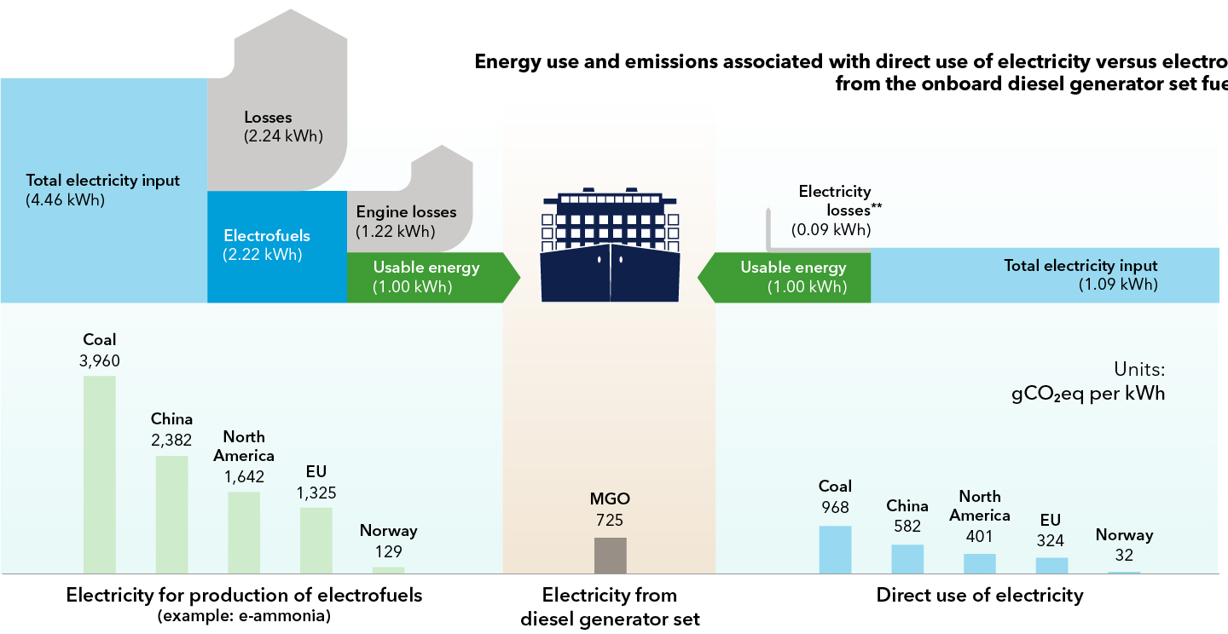
Green shore power can help reduce emissions from shipping by more than 7%
DNV ©
Notes:
well to wake emissions – 1kwh
Shore power = emission reductions even when the shore power is not fully green – due to high efficiency .
7% of energy consumption is in port
While further savings could come from short-sea shipping exploring electrification through plug-in hybrids.

Slide 23

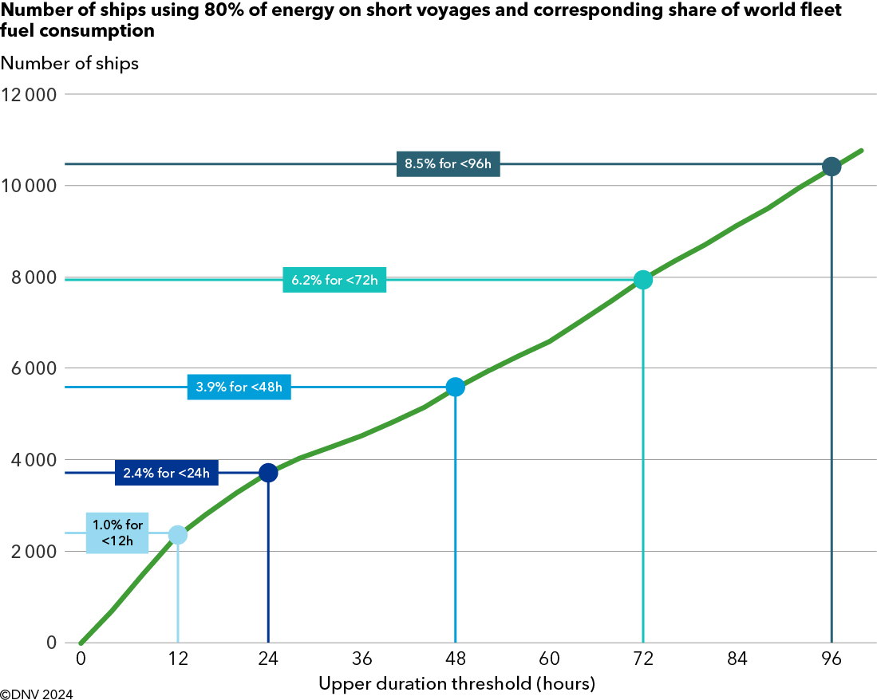
Potential for electrification and plug-in solutions
>400 GT
80% of energy is spent out of port on short voyages
Frequent battery charging
DNV ©
Notes:
AIS analysis – all ships >400GT
80% of energy out of port on short voyages
Frequent battery charging and
batteries to cover most of the energy needs.

Slide 24
Onboard adoption growing in cruise and container segments, but other vessels lagging behind
Around 4% of the global fleet is prepared for shore‑power.
Notes:
Currently, only about 4% of the global fleet is equipped or prepared to use shore power
Uptake highest in cruise ships, at around 29%, and containerships at about 20% - regulatory and commercial pressure
In contrast - dry bulk vessels at around 7% and tankers at just 1%,
However, there is positive momentum, as newbuilding shares are increasing, particularly for container vessels, suggesting that readiness will continue to improve over time.

Slide 25
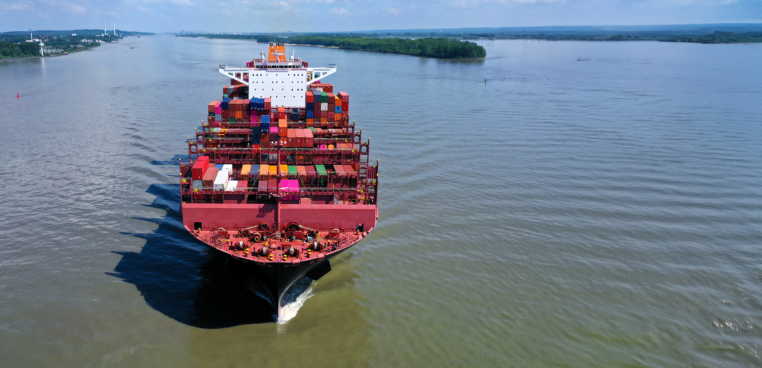
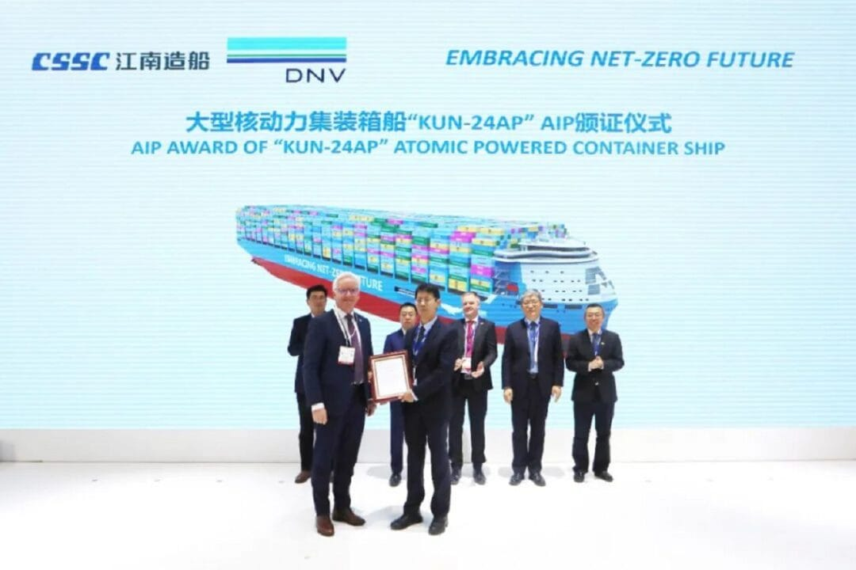
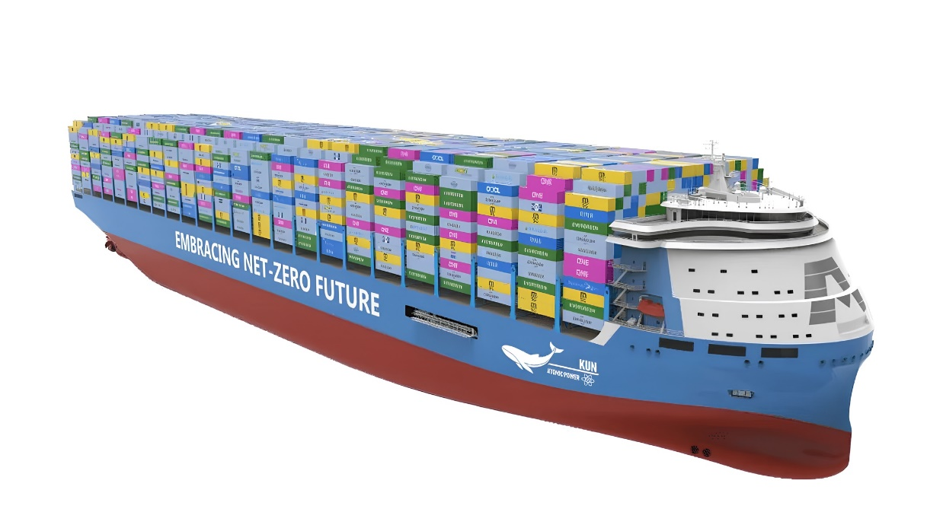
Nuclear propulsion entering commercial shipping
Container vessel 24000 TEU concept granted AiP by DNV
DNV ©
Notes:
Nuclear remains controversial.
Form purely technical and economic perspective it can no longer be dismissed.
Mature and recognized technology
160 ships, 200 reactors
This is just an example – many projects ongoing
Can compeete with other decarbonization solutions

Slide 26
Energy efficiency
Notes:
Let us now talk about what may be the most important decarbonization solution.

Slide 27
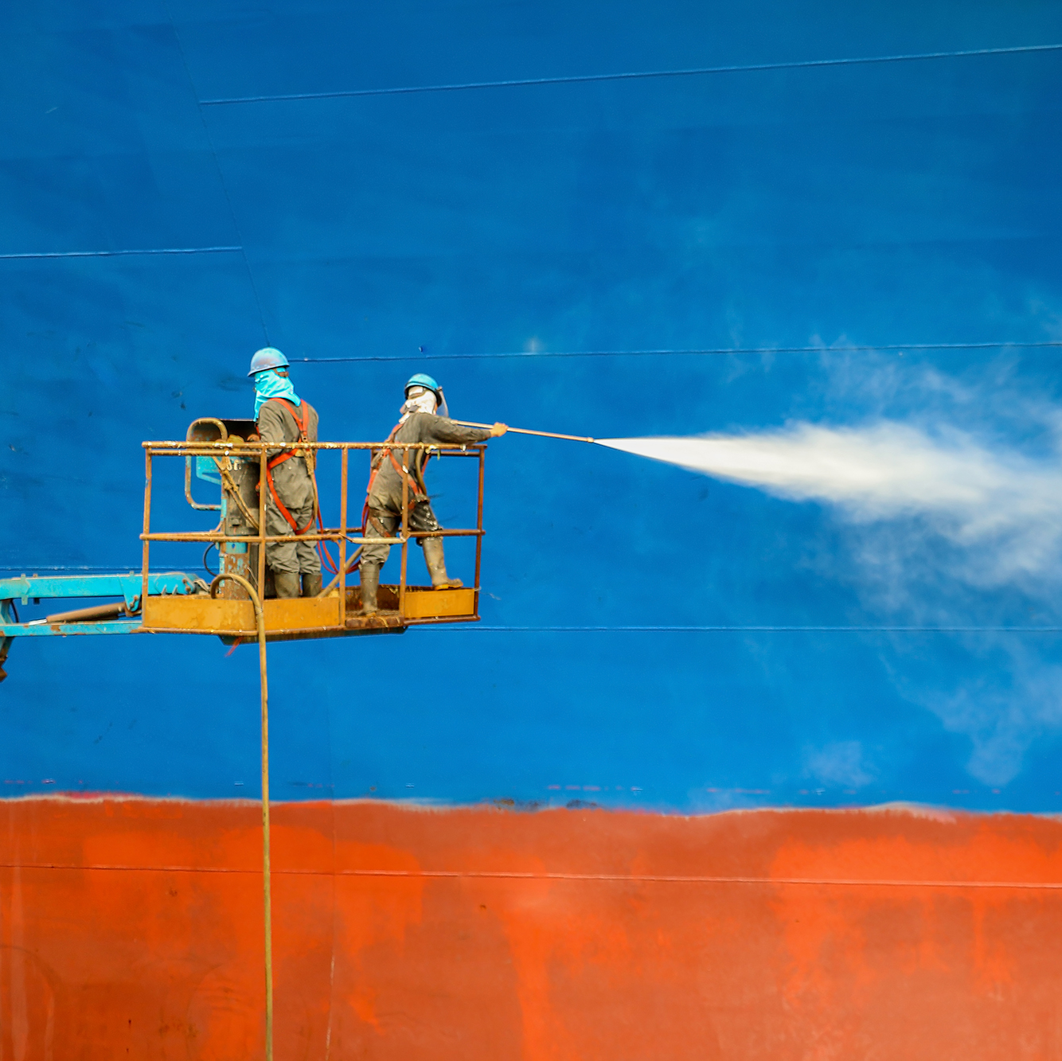
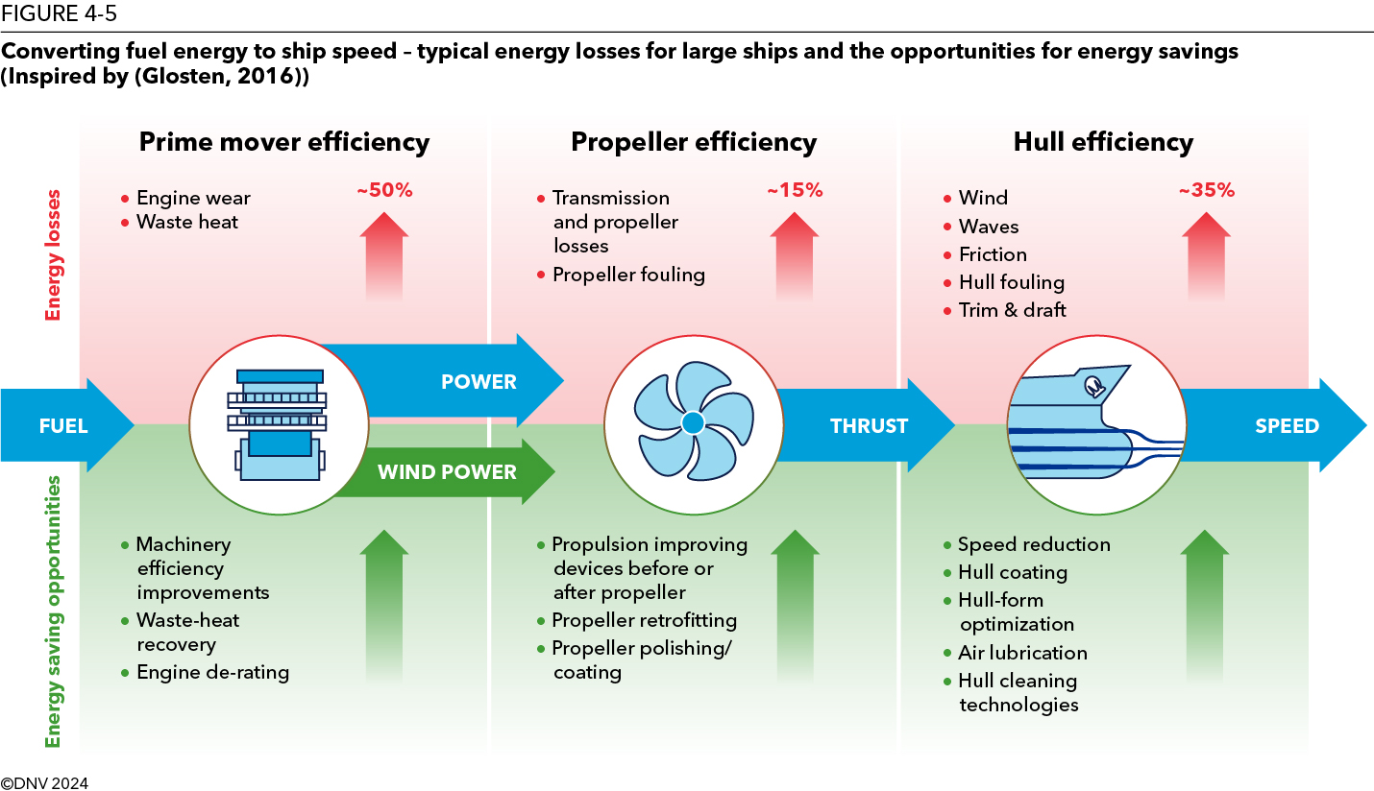
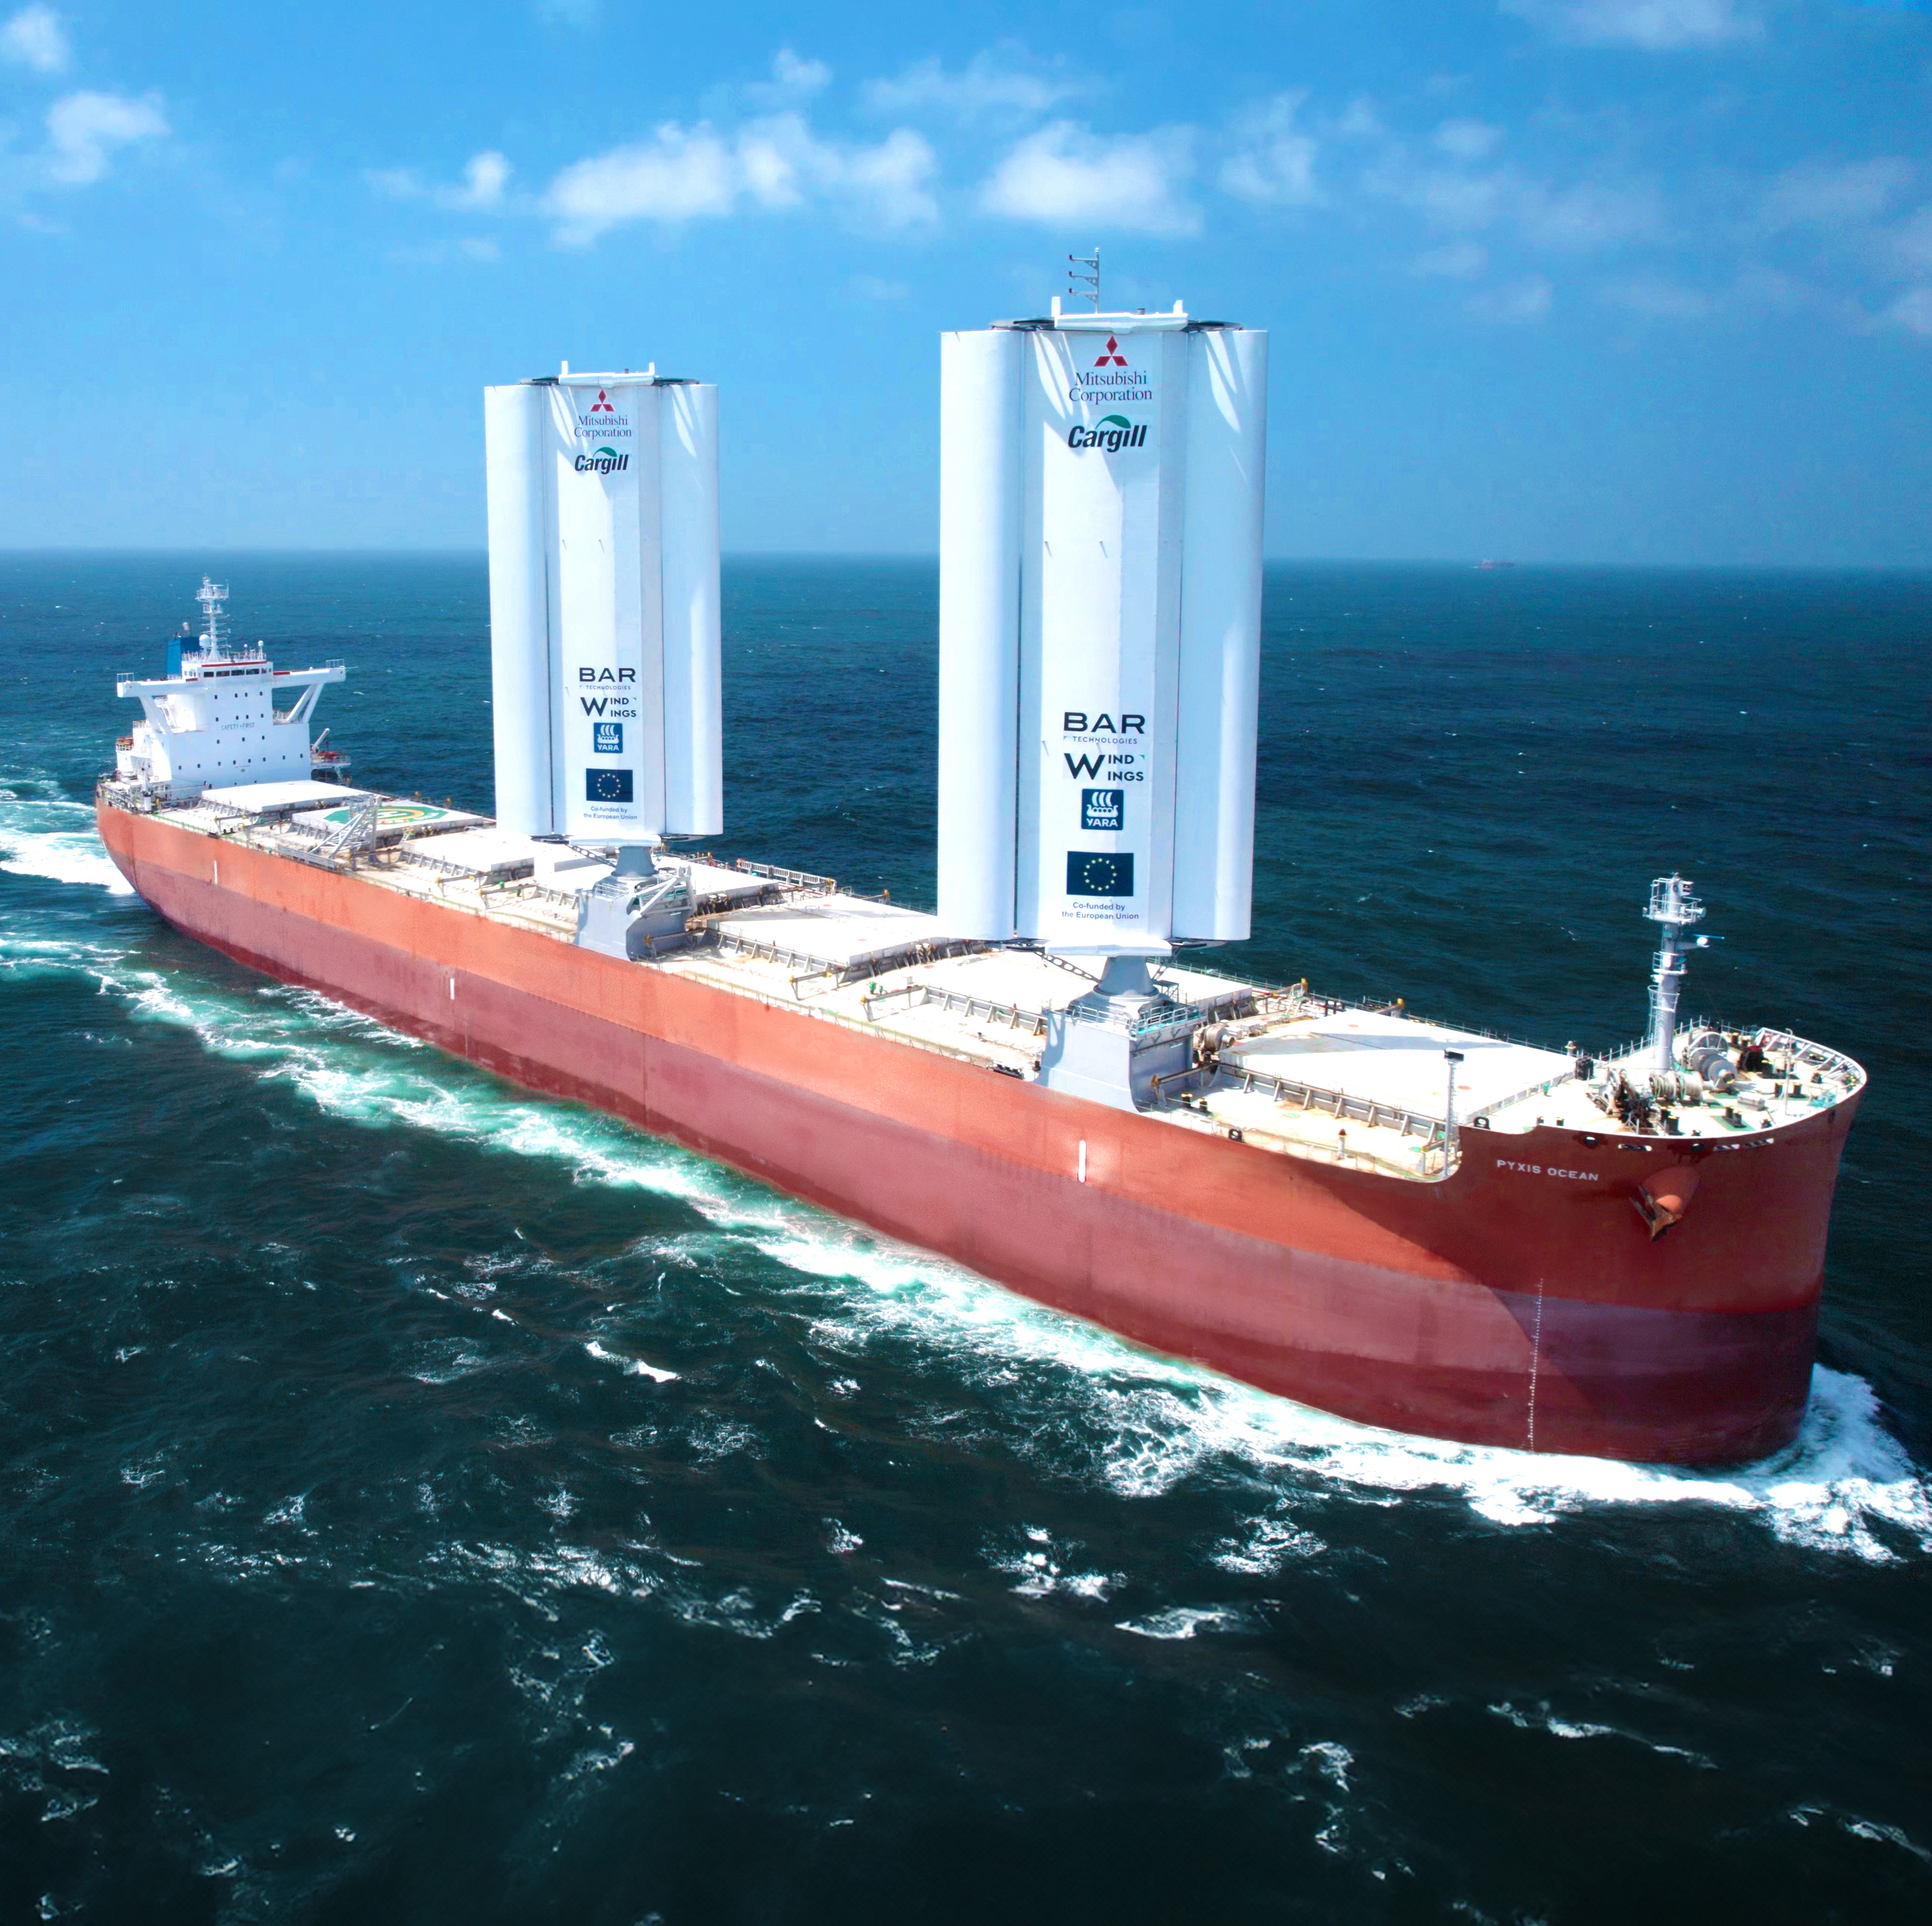
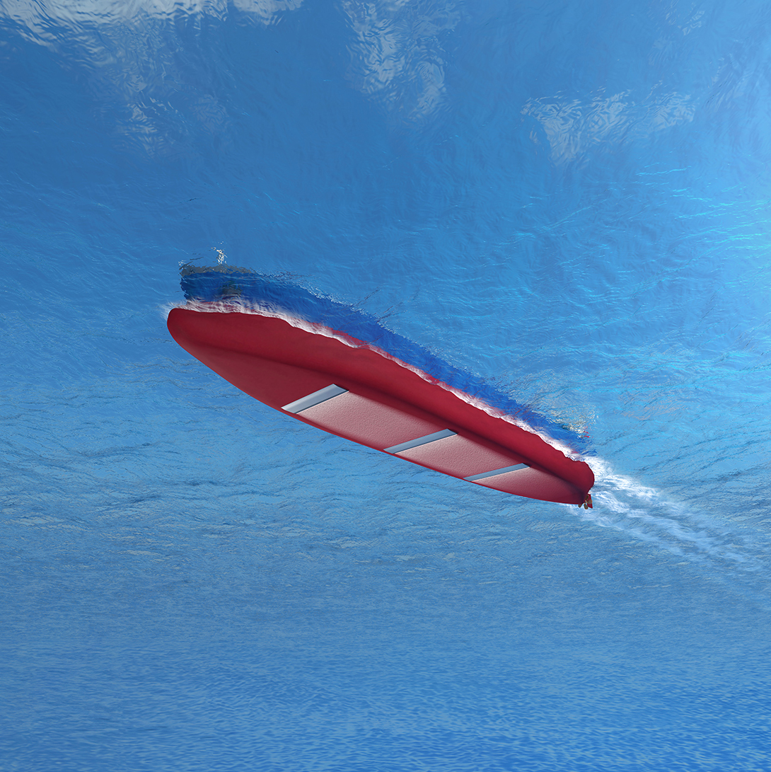
Two-thirds of fuel energy never becomes a propulsion
DNV ©
Notes:
We spend enormous effort discussing alternative fuels
The cheapest and most effective fuel is the fuel you don’t have to buy
Due to losses roughly two-thirds of fuel energy never becomes a propulsion
That’s why we need to attack the energy losses
By increasing enegry efficiency of the fleet

Slide 28
Energy efficiency is a toolbox of well-known solutions
Notes:
Energy efficiency is not one technology.
It is an entire toolbox.
Operational measures
Propulsion and hull improvements
Machinery measures
Energy consumers
Energy harvesting (e.g., sails and solar panels).
The industry has decades-long experience from energy efficiency, which improves the case for adoption.

Slide 29
Why is energy-efficiency important in the long-term?
  Reduced global fleet demand for carbon neutral fuels:
    Improved EE means lower fuel consumption and demand
Notes:
Energy efficiency can contribute significantly to reducing overall emissions in the global fleet
We estimate that energy efficiency = reductions of up to 16%.
This is a significant number, equivalent to decarbonizing 55,000 of the smallest or 2,500 of the largest ships in the global fleet.
Importantly, this can already be achieved with existing technologies

Slide 30
The WAPS fleet now comprises 90 vessels in operation and 91 on order
Notes:
WAPS is one of the few technologies capable of delivering double-digit fuel savings on suitable vessels and routes.
The performance of WAPS is highly route-, weather-, and season-dependent,
Even up to 20% of savings – DNV analysis
Wind propulsion has moved beyond pilot projects and is entering commercial deployment
90 vessels in operation and a similar number on order.
WIND REWARD FACTOR in Fuel EU Maritime
Highest uptake = bulkers, tankers and general cargo
Container and passenger = practical design constrains
Rotor sails currently dominate installations,.

Slide 31
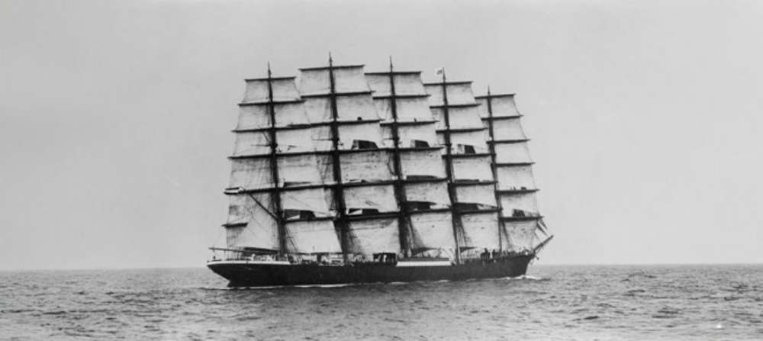
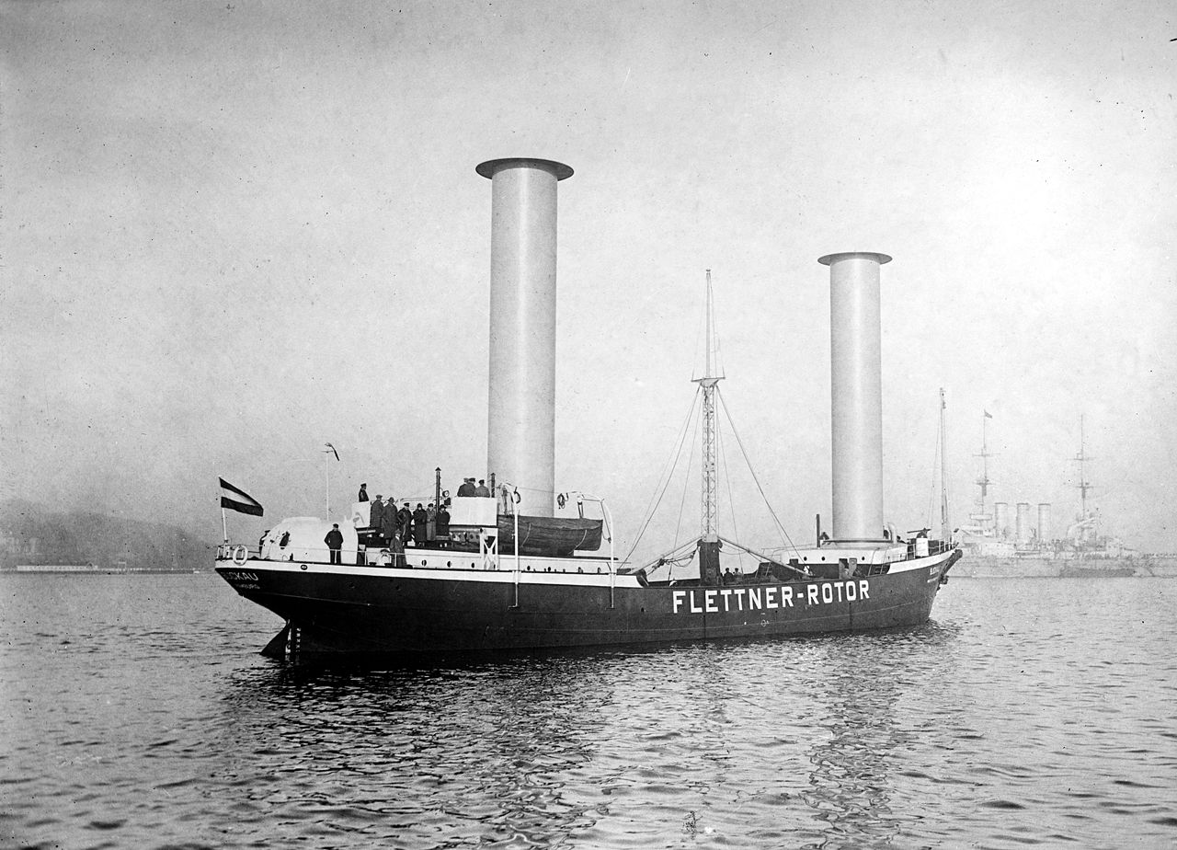
Wind-assisted propulsion systems have evolved significantly over the years.
18th century – golden age of sailing
1924 – Invention of the Flettner Rotor
Notes:
Ironically, one of humanity's oldest propulsion systems is becoming relevant again.

Slide 32
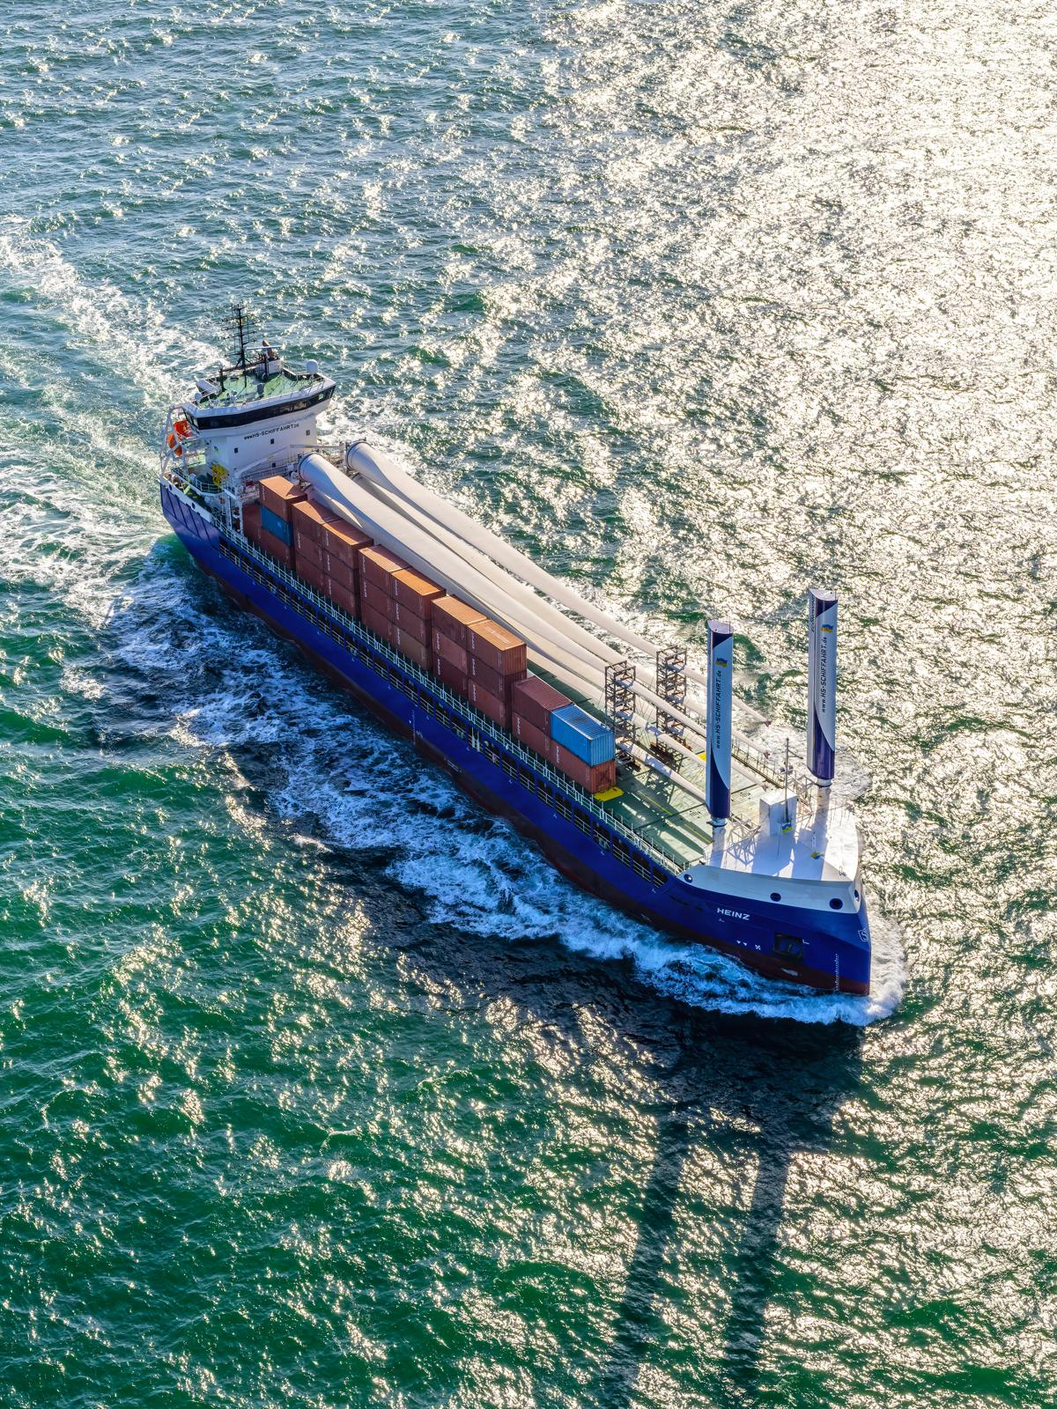
©HS Bereederungs GmbH & Co. KG
Modern WAPS with innovative technologies for smarter and more efficient operations
Rotor sail
Suction sail
Wing sail
Soft sail
Kite
Notes:
These are not traditional sails.
Modern WAPS combines aerodynamics, automation, digital control and FuelEU incentives.
utilize state-of-the-art intelligent control and automation systems to operate safely and without requiring additional crew.
Higher efficiency and lower emissions: reduced fuel consumption, lower GHG emissions, and improved operational efficiency.
Improvement opportunity: Newbuilds can achieve superior performance.
Wind reward factor: WAPS can help achieve compliance with FuelEU Maritime
DNV can help as 3rd party verifier of savings claims from EE

Slide 33
Fuel savings through retrofit – 16% for a 5000 TEU containership
DNV ©
Notes:
This is where decarbonization becomes a business case.
The payback period can be measured in years rather than decades.
3rd dryfocking
Upgraded propeller, propeller boss cap fin, new bow
No regulations included

Slide 34
CCS - Carbon capture and storage
Notes:
Another technology attracting significant attention is onboard carbon capture.

Slide 35
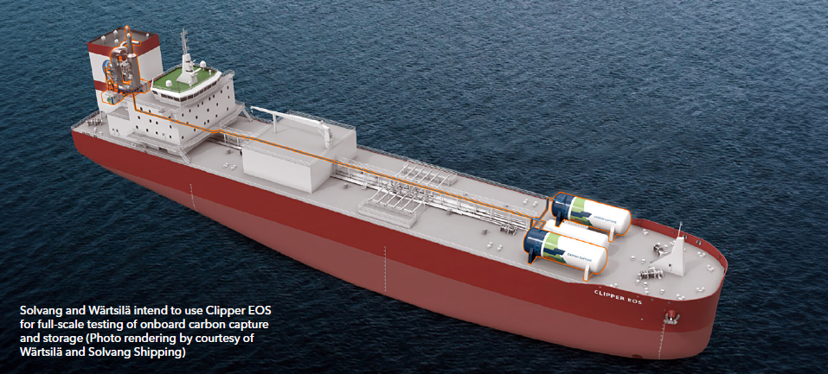
32 vessels are currently sailing with systems to capture CO₂ from the exhaust
32
3 ships have systems capable of storing liquefied CO₂ on board
29 ships store CO₂-rich amines for offloading to onshore processing
Notes:
The important message here is simple:
CCS is no longer theoretical.
It is already sailing.

Slide 36
Existing LNG installations give realistic estimates for CO₂ tank sizes and reduction potential for CCS
CO₂ tank volumes based on existing LNG tank installations
Notes:
The first question most people ask is:
Where do we store the CO₂?
Existing LNG installations onboard tnakers bulkers and containers
Assuming the same volume is used for CO2 we found realistic volumes for storing
we then use AIS analysis
to estimate the amount of CO2 the ship can capture on each voyage between ports with these tank sizes.

Slide 37
A significant share of large bulkers, tankers, and container ships can store most or all of captured CO₂
Assumptions:
CO₂ tank volumes based on existing LNG tank installations
100% capture rate
Notes:
IF, all ports have offloading capabilities for CO2,
more than 600 tankers have tank capacities to hold the CO2 produced on every voyage through the year, while the majority can capture most.
significant share of these large ships could potentially capture most of their CO2 through the year.
not all ports will have CO2 offloading capabilities

Slide 38
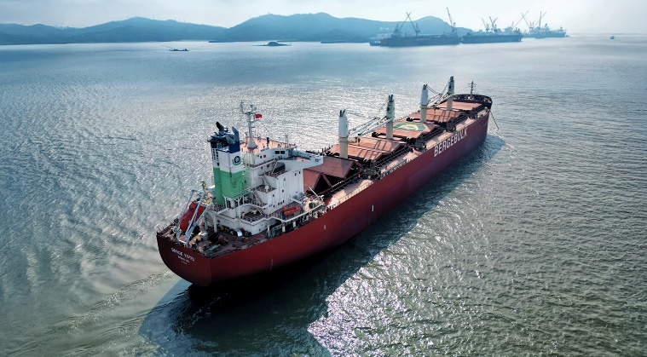
Onboard carbon capture can cut large bulker/tanker/container ship emissions by 19% with infrastructure in only 20 ports
Only 20 ports
19% of emmisions from target fleet
9% of global fleet emissions
25 Mtoe
Notes:
Let’s assume that all ships have OCC
By considering voyages starting and ending in 2024,
as few as 20 major ports with CO2 offloading
19% reduction – bulkers tankers etc,
reducing world fleet emissions by 9%.
25 mtoe low GHG fuels

Slide 39
Green shipping corridors
Notes:
Last but certainly not least,
let's talk about Green Shipping Corridors,
which may play a crucial role in turning decarbonization plans into reality.

Slide 40
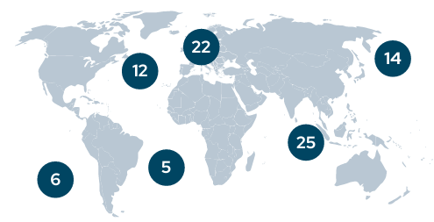
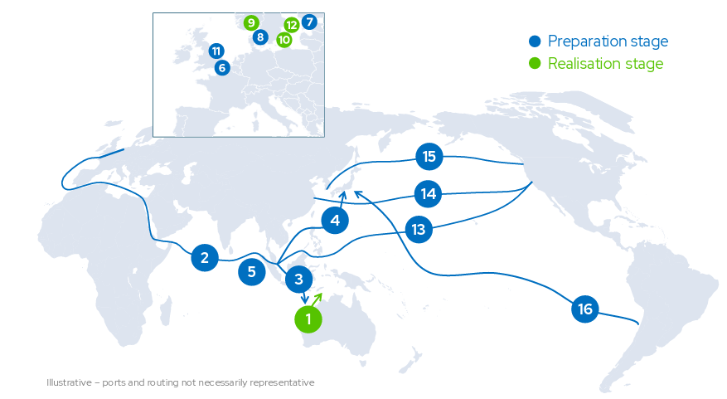
Green shipping corridor initiatives globally
Source: Global Maritme Forum Annual Report on Green Shipping Corridors, 2025
DNV ©
Notes:
Around the globe, Green Corridors are emerging as laboratories for maritime decarbonization.
According to global maritime forum
84 initiatives globally
There are now 12 initiatives in the Preparation stage and 4 in the Realisation stage

Slide 41
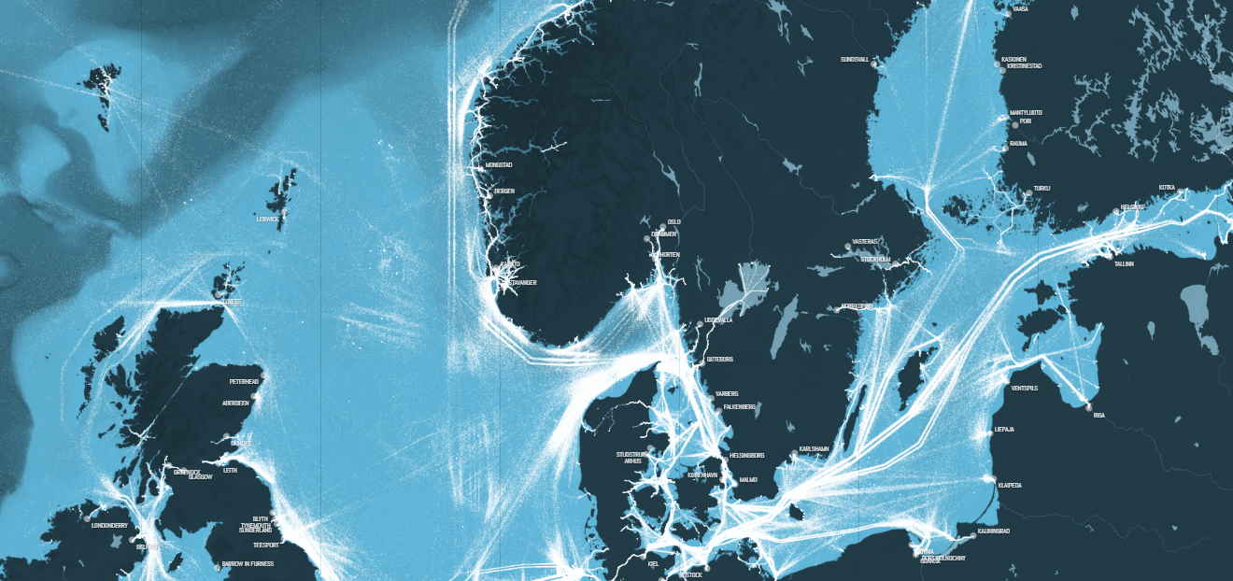
Baltic Sea - a perfect testbed for maritime decarbonization
► High traffic density
► Passenger and cargo operations
► Short and predictable routes
► Strong regulatory pressure
► Advanced port infrastructure
► Exceptional collaboration
shipmap.org
Notes:
The Baltic Sea combines something quite unique:
short routes,
high traffic density,
strong regulation,
advanced infrastructure,
and exceptional collaboration.
Very few regions offer all of this at the same time.

Slide 42
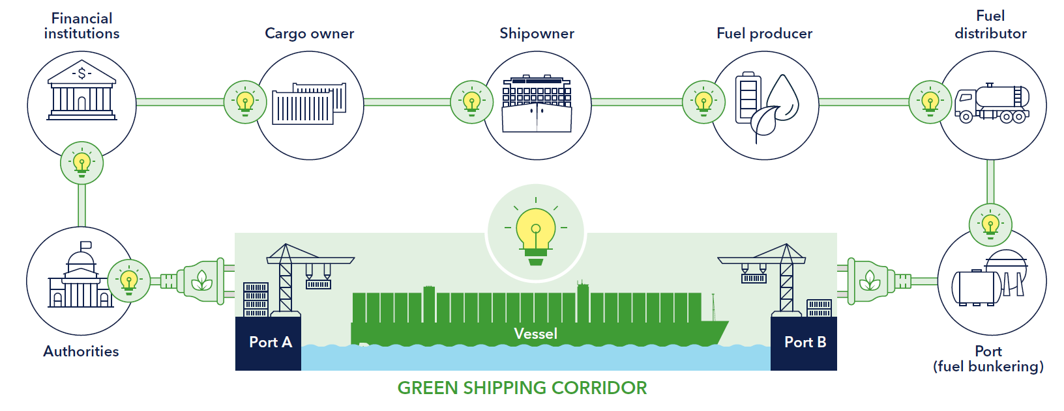
Why FIN-EST matters?
Source: DNV Maritime Forecast to 2050, 2023 edition
Notes:
The FIN-EST Green Corridor is more than just a shipping route
umbrella for multiple initiatives at sea and on land, including port operations
umbrella connecting ports, cities, governments, shipping companies and infrastructure providers.
it is not testing a ship. It is testing an ecosystem.
One of the most advanced green corridor initiatives in Europe
19 joint decarbonization projects already underway
Focus on alternative fuels, shore power, electrification and digitalization

Slide 43

FIN-EST = Maritime Decarbonization in One Place
🔋 Electric Ferries
⚡ Shore Power
🌱 Bio-LNG
♻ Renewable Diesel
💻 Digitalization
🛢️ Carbon Capture
☁️ Emissions benchmark
FIN-EST
Green Corridor
DNV ©
Notes:
If we look back at everything discussed today, we can find almost all of it somewhere within FIN-EST:
electrification,
shore power,
renewable fuels,
carbon capture,
digitalization.
First corridor-wide emmisions
This is why FIN-EST matters not only for Estonia and Finland, but potentially for the global maritime industry as well.
One of the most advanced green corridor initiatives in Europe
19 joint decarbonization projects already underway
Focus on alternative fuels, shore power, electrification and digitalization
First corridor-wide emissions baseline established
Potential blueprint for future Green Shipping Corridors worldwide
Viking Line conceptualizes the world’s largest electric passenger-car ferry
Neste and Eckero line adopts renewable diesel
Tallink begun a sucessfull transiotinto bio LNG
At the start of 2025, Finland’s Port of Helsinki achieved the target of making its own operations carbon neutral but continues efforts to reduce the total emissions generated in the port area.

Slide 44
Key takeaways

Slide 45
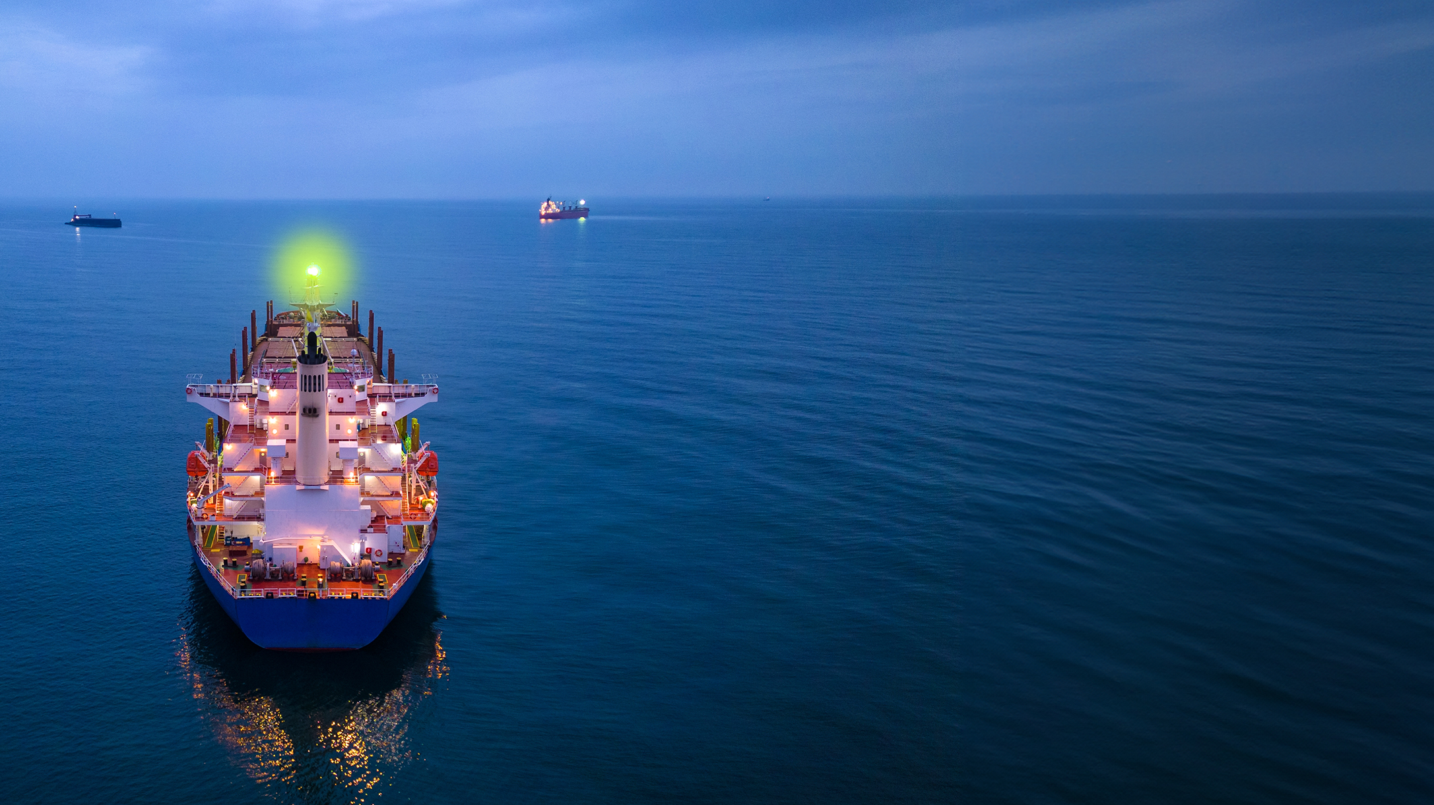
Key takeaways
Shipping's future energy mix will be diverse
Fuel availability may become a larger challenge than vessel technology
Energy efficiency will be essential regardless of which fuel wins
Robust strategies matter more than predicting the future correctly
DNV ©
Notes:
Maritime decarbonization is no longer a technology problem.
It is increasingly a question of regulations, fuel availability, and choosing robust strategies under uncertainty.

Slide 46
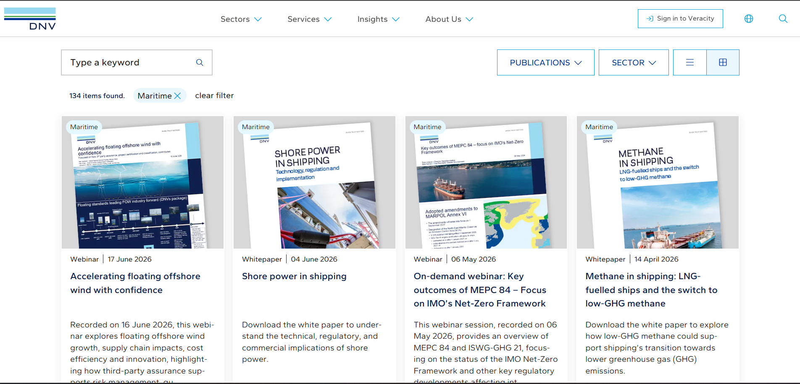
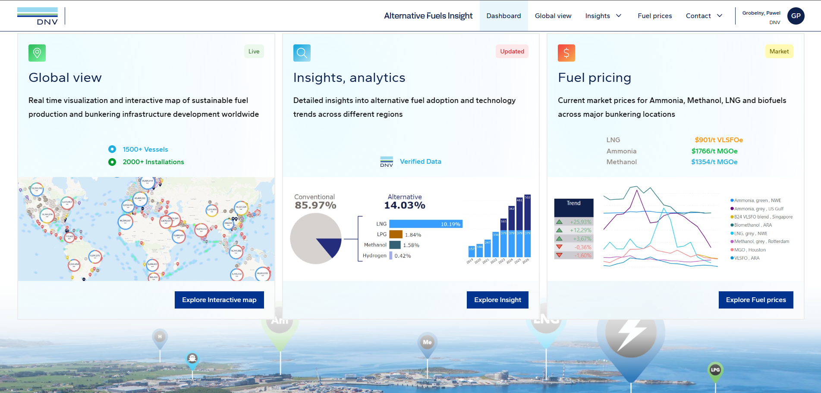
Thank you!
dnv.com/publications
afi.dnv.com
Notes:
Explore
Reports and publications
AFI
DNV can support – 3rd party and class

