Slide 1
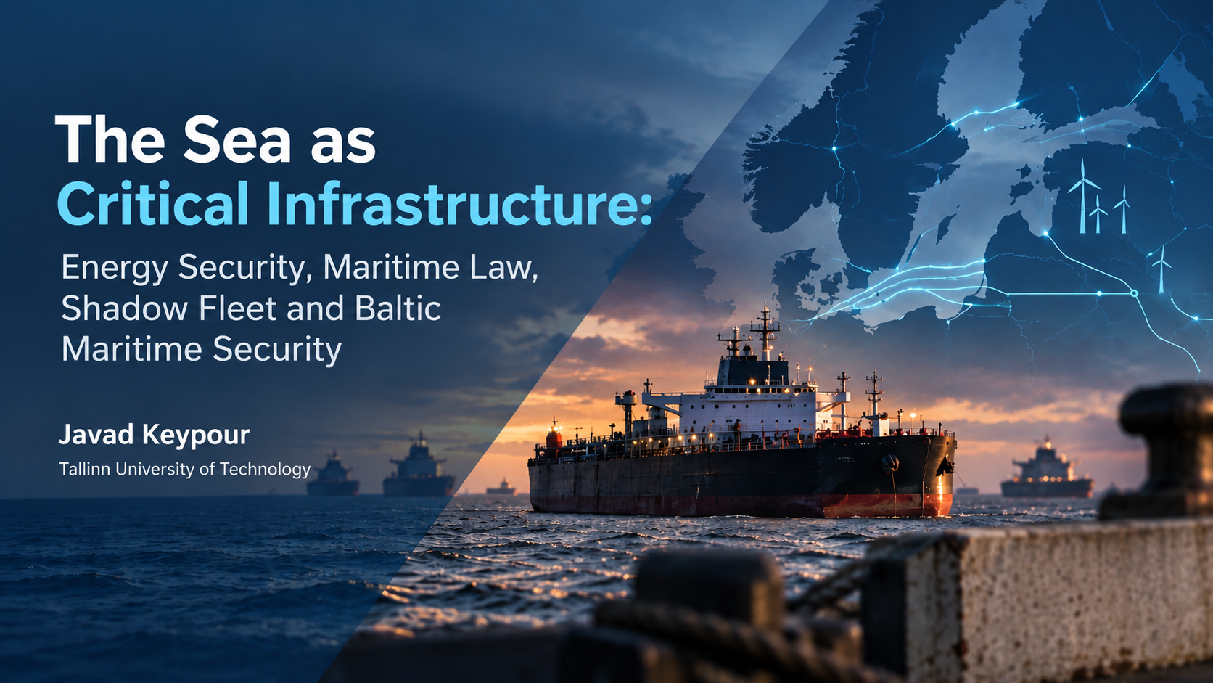

Slide 2
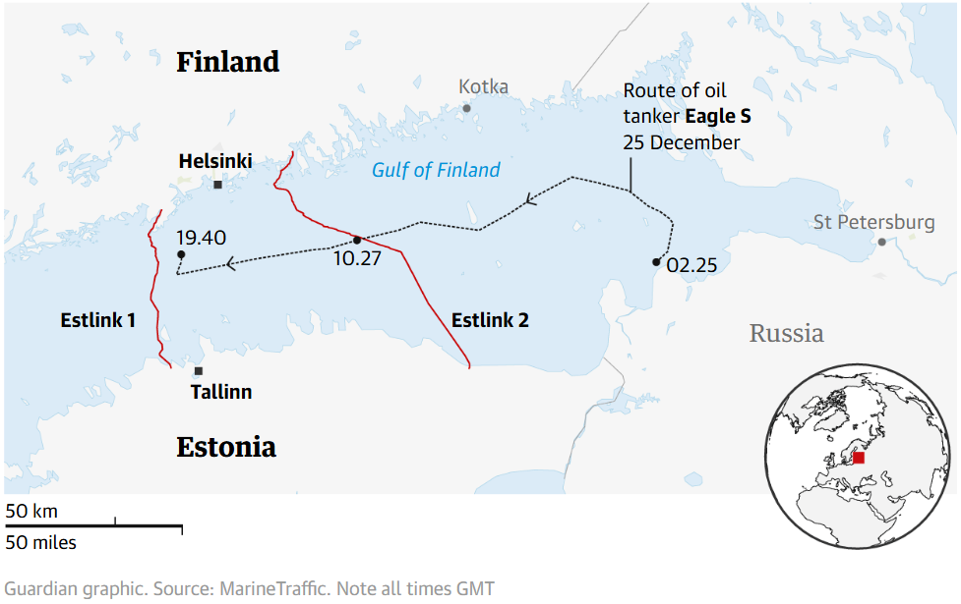


Opening Question:
What does an oil tanker carrying Russian petroleum have to do with electricity security in Estonia?

Slide 3
Opening Question:
What does an oil tanker carrying Russian petroleum have to do with electricity security in Estonia?

Slide 4
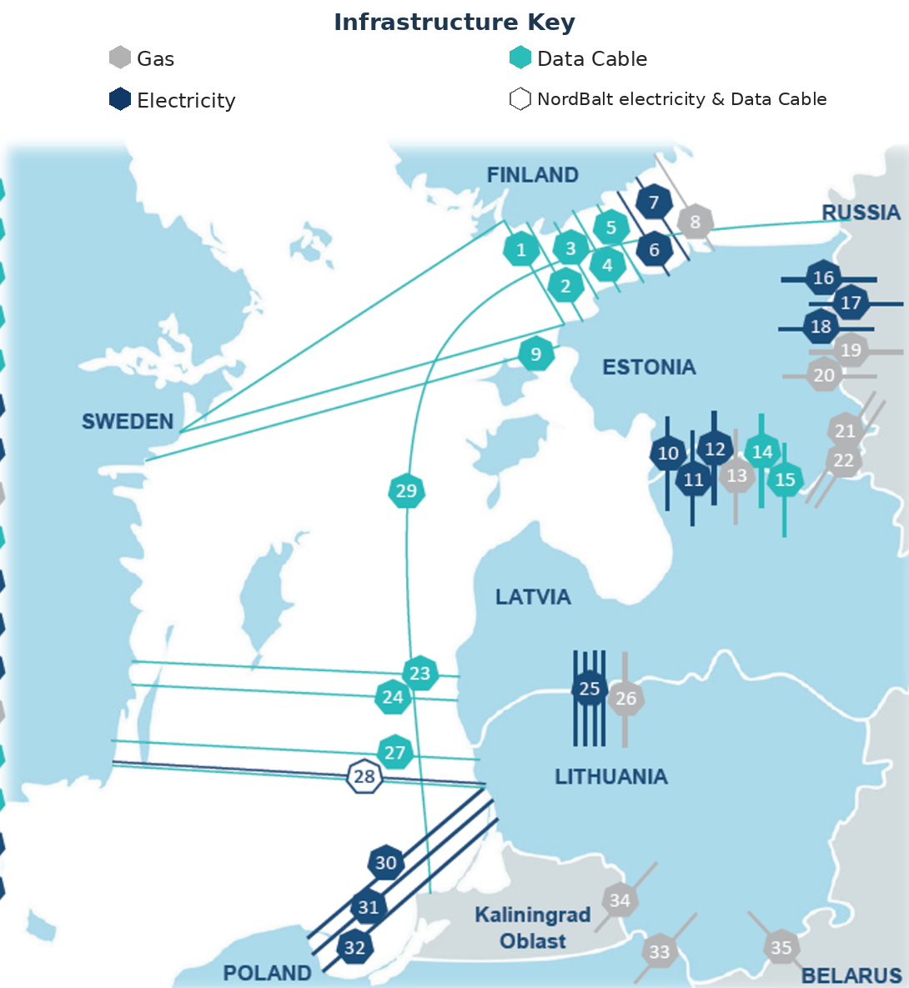

Greater Interconnection and Redundancy Make Baltic Energy Security More Maritime
Estonia has 21 cross-border energy & data connections, including 10 submarine links:
  5 data cables to Finland,
  2 electricity interconnectors (EstLink 1&2),
  The Balticconnector gas pipeline.
Electricity interconnectors play a critical role in meeting electricity demand across the Baltic States, where consumption exceeds domestic generation by approximately 40%.
Offshore wind capacities are rapid expanding:
  Poland: up to 11 GW by 2040
  Finland: up to 12 GW by 2040.
  Baltic States: 2.8 GW by 2030 (planned).
Source: doi.org/10.15158/nv7t-kg46

Slide 5

Shadow Fleet: From Sanctions Evasion to an Energy Security Problem
Russia has developed a parallel maritime system to sustain oil exports:
600–1,942 vessels estimated (depending on the definition of the shadow fleet).
89% of shadow-fleet tankers are estimated to be over 15 years old carried
69% of Russian seaborne crude exports (in April 2026).
None of these characteristics alone proves illegality or hostile intent.
Such combination is what creates an identification and risk-assessment challenge:
  50+ incidents have been reported involving vessels associated with the fleet
Aged Fleet
Repeated Flag Change
Opaque ownership
Shadow Fleet
Complex Corporate Arrangement
Less Reliable Insurance Policy
STS Practices

Slide 6
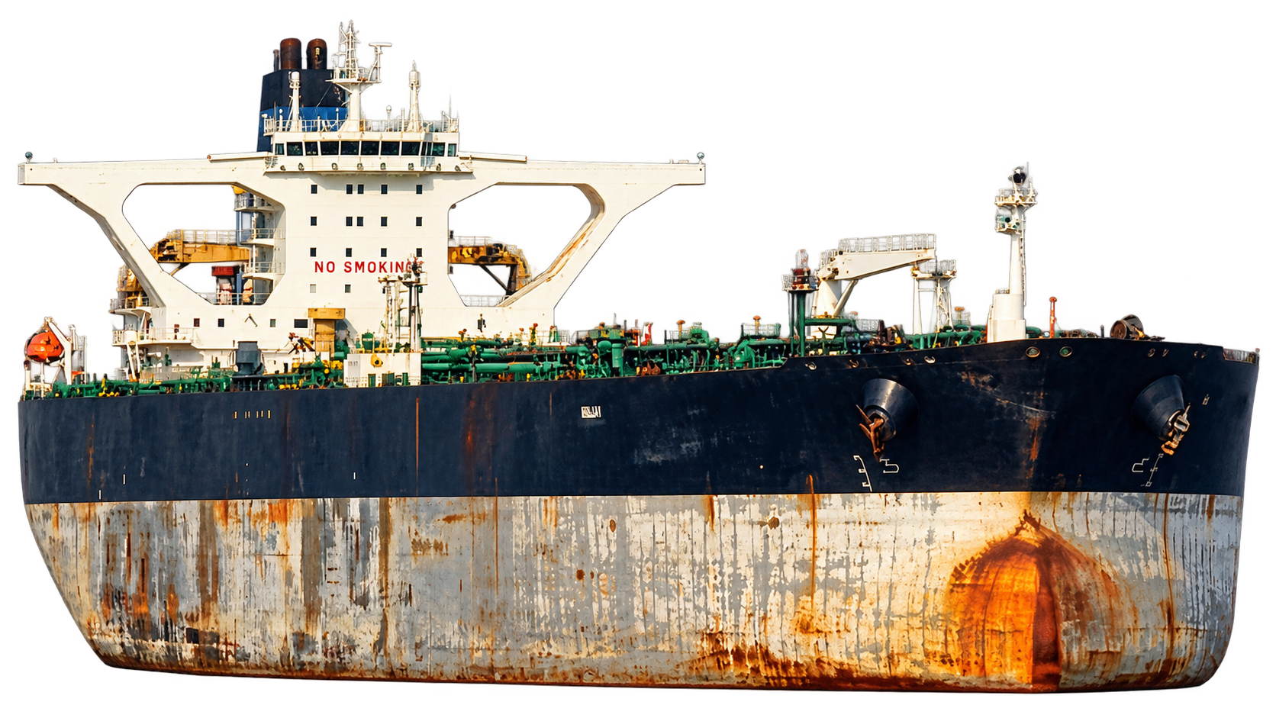
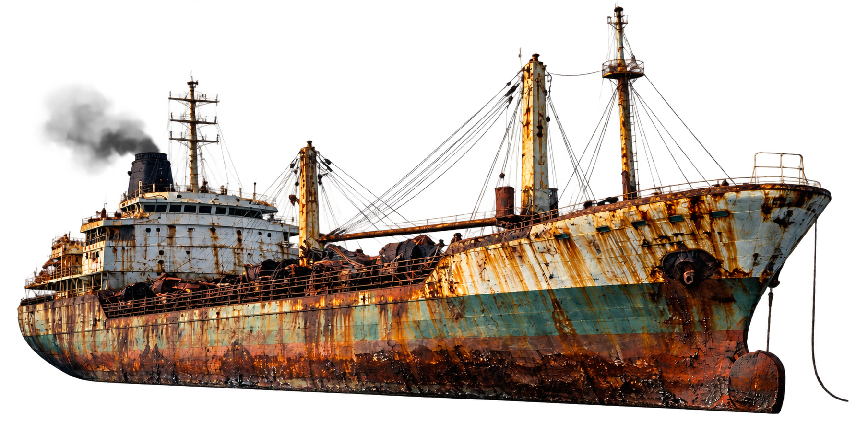

We May See the Ship without Knowing What the Ship Really Is.

Slide 7
We May See the Ship without Knowing What the Ship Really Is.
Identity
Entities
Behaviour
Context
Notes:
➢ Identity — is the vessel’s identity internally consistent?
➢ Behaviour — what does its operational pattern indicate?
➢ Entities — who owns, manages, charters and insures it?
➢ Context — how do these factors align with geography, trade and sanctions?

Slide 8
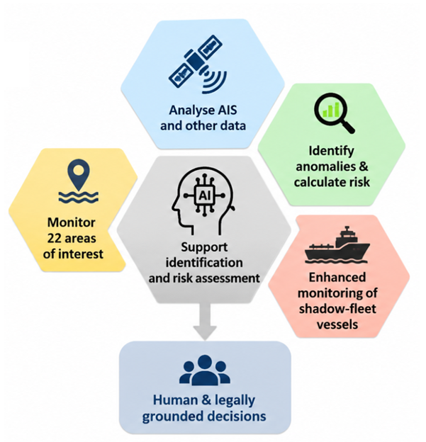
Can AI help? Yes: AI As Triage, Not As Judge
AI can help with identification and risk assessment:
  AIS & other maritime data
  Risk scoring & anomaly detection
  22 areas of interest
  Enhanced shadow-fleet monitoring.
An AI-generated risk score is not a jurisdictional basis of illegality:
  Risk alert ≠ right to board
  Suspicion ≠ proof of sabotage
  Detection ≠ legal authority
The role of AI should therefore be triage, not judgment:
  Anomaly identification
  Risk ranking
  Data preservation
  Human & legally grounded decisions

Slide 9
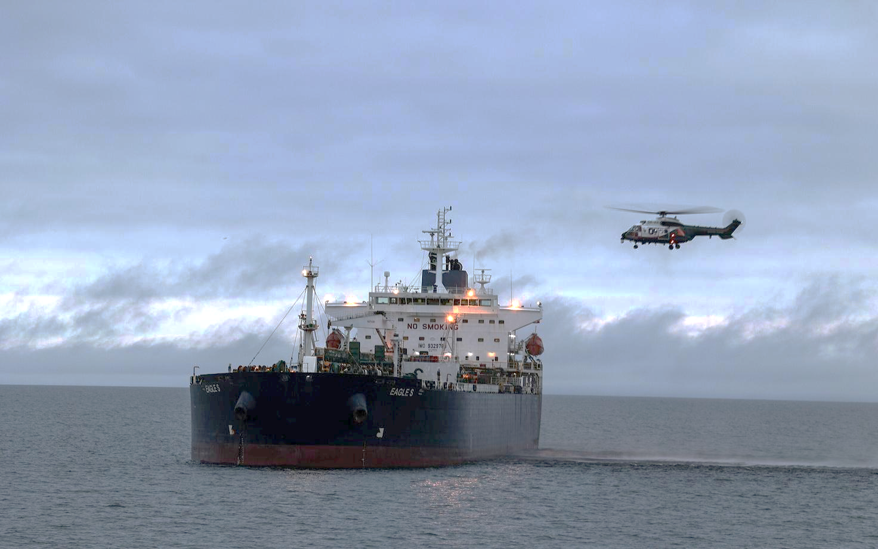
Seeing a Suspicious Ship Does Not Mean You Can Stop It Legally
Littoral state’s jurisdictional differs in territorial sea and EEZ.
The Eagle S case exposed the gap between awareness vs having jurisdiction for punishment.
  Do you have jurisdiction there?
UNCLOS criminalises certain cable damage but does NOT authorise boarding
  Article 113: intentional & culpably negligent damage
  EU wants to adhere to the Freedom of Navigation.
The oil tanker Eagle S. Source: SCANPIX/EPA/FINNISH BORDER GUARD

Slide 10
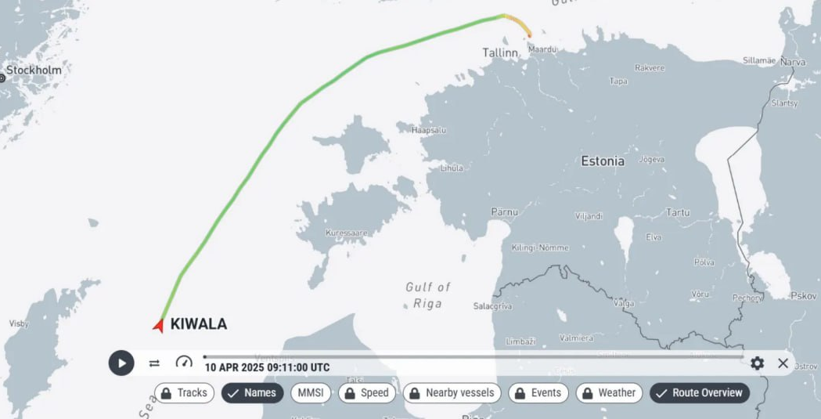
Seeing a Suspicious Ship Does Not Mean You Can Stop It Practically
The Kiwala case: when does information become actionable?
Kiwala showed how quickly identification can become an operational problem.
  40 deficiencies, 29 detention-level, 23 documentation.
  No valid flag-state certificate.
The Danish Straits are not legally unrestricted chokepoints.
  1857 Copenhagen Convention
  UNCLOS Art. 35(c)
  Geography ≠ unrestricted enforcement
The real question is when regional information becomes
actionable for the coastal state.
  Flag-switching / statelessness
  Maritime information-sharing
  Actionable information → operational response
https://eestinen.fi/2025/04/eesti-merevae-poolt-kinni-peetud-tanker-on-vahetanud-tihedalt-omanikku/
Notes:
https://acleddata.com/report/russias-shadow-fleet-presents-sustained-hybrid-war-threat-sea

Slide 11
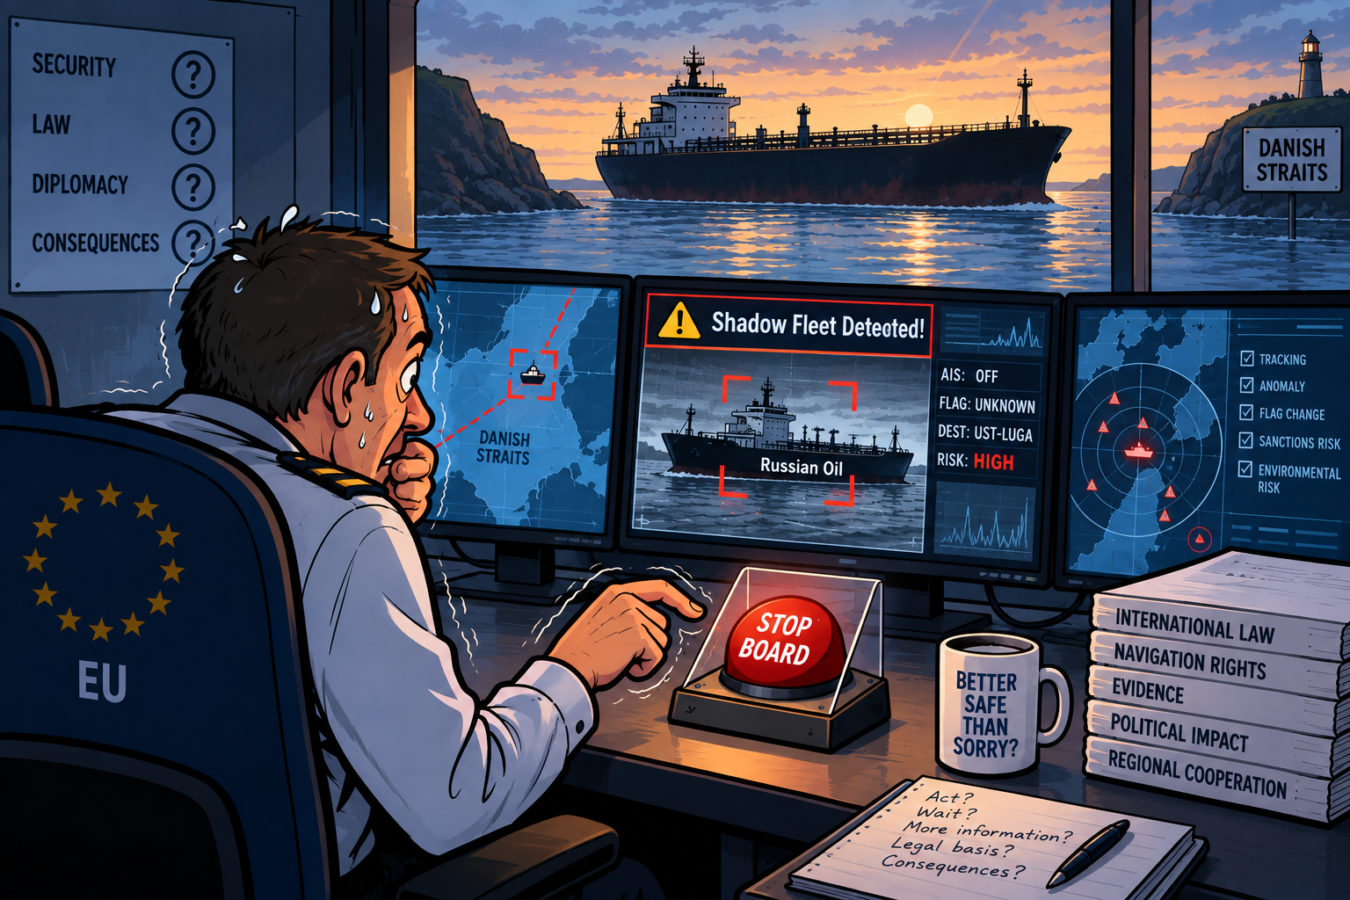
Is Europe Too Cautious About the Russian Shadow Fleet?
The EU member states have different national interests & levels of political willingness against it.
There are at least three additional factors:
  Maritime interdiction is legally restrained:
  Can we identify the ship?
  Can we lawfully interfere with the ship?
  Can we confiscate the cargo?
  Brace for escalation with Russia.
  Enforcement is resource intensive.
  Why are European states not stopping more vessels?
  How can we intervene earlier and more consistently to
  prevent sabotage while ensuring that interventions remains justified and legally defensible?

Slide 12
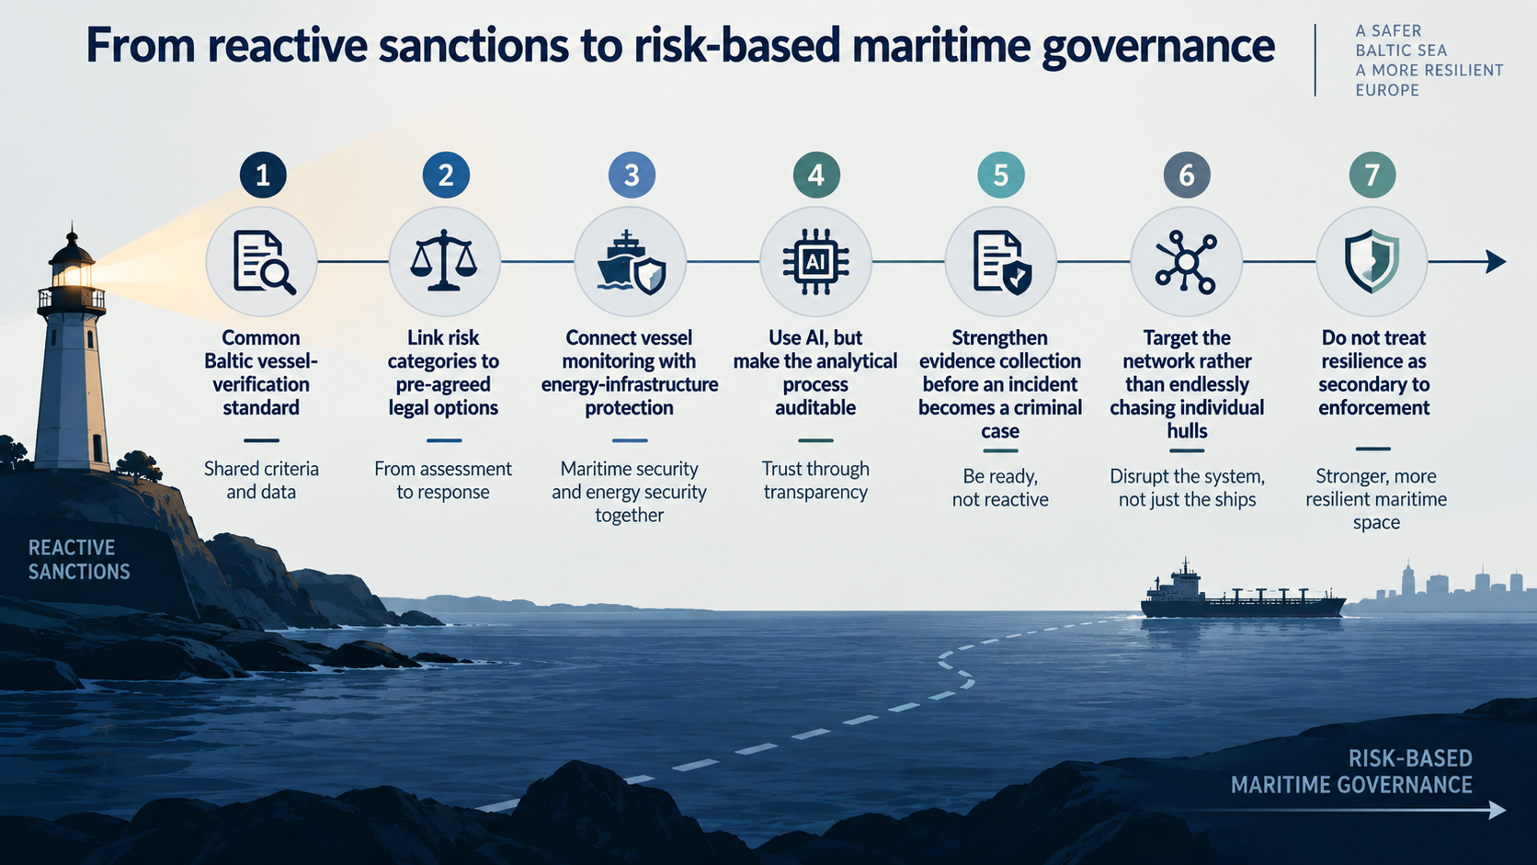

Slide 13

“Europe must protect an increasingly maritime energy system,
without abandoning the legal order on which maritime security depends,
From detection to identification,
From identification to legally defensible action,
From action to resilience
and rapid recovery.”

Slide 14
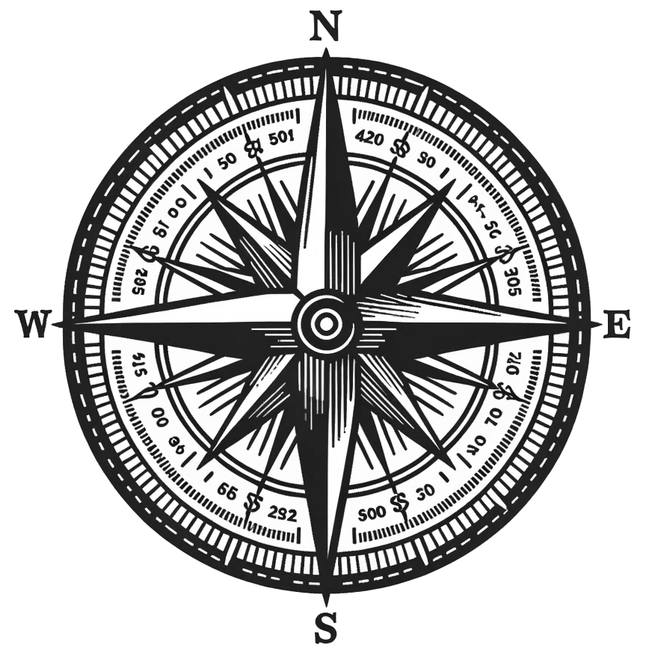



Thank You for
Your Attention!
Javad Keypour, PhD
School of Business and Governance
Department of Law
Tallinn University of Technology (TalTech)
Tallinn, Estonia
javad.keypour@taltech.ee
https://www.linkedin.com/in/javad-keypour/
@J_Keypour

