Slide 2
The invisible infrastructure: why data strategy is the key to competitive advantage in property management
Juuso Pelkonen
Notes:
• Before we begin, let me say this upfront: I’m not here to give you another speech about how “AI will replace 80% of all jobs in three years.” I’m pretty sure we’ve all heard enough of those.
• And whether you believe those predictions or not isn’t even relevant today.
• The next 30 minutes are about something much more practical: the things that stay relevant.
• What I’m going to talk about will matter next year, it will matter in three years, and it will still matter ten years from now — no matter how many new AI models are released between now and then.
• Because this isn’t a talk about hype. This is a talk about the foundations that determine who actually gets value out of AI — and who doesn’t.
• So with that, let’s get started.

Slide 3
If everyone can buy the same AI tools…
Where does real competitive advantage come from?
Notes:
• Let's start with a question — a simple one, but not an easy one.
• Today, AI tools are becoming widely accessible. The same models, the same agents, the same copilots — anyone can buy them… including your competitors.
• So the interesting question is: if everyone has access to the same technology, where does real competitive advantage come from?
• Hold onto that thought. We’ll come back to it.

Slide 4
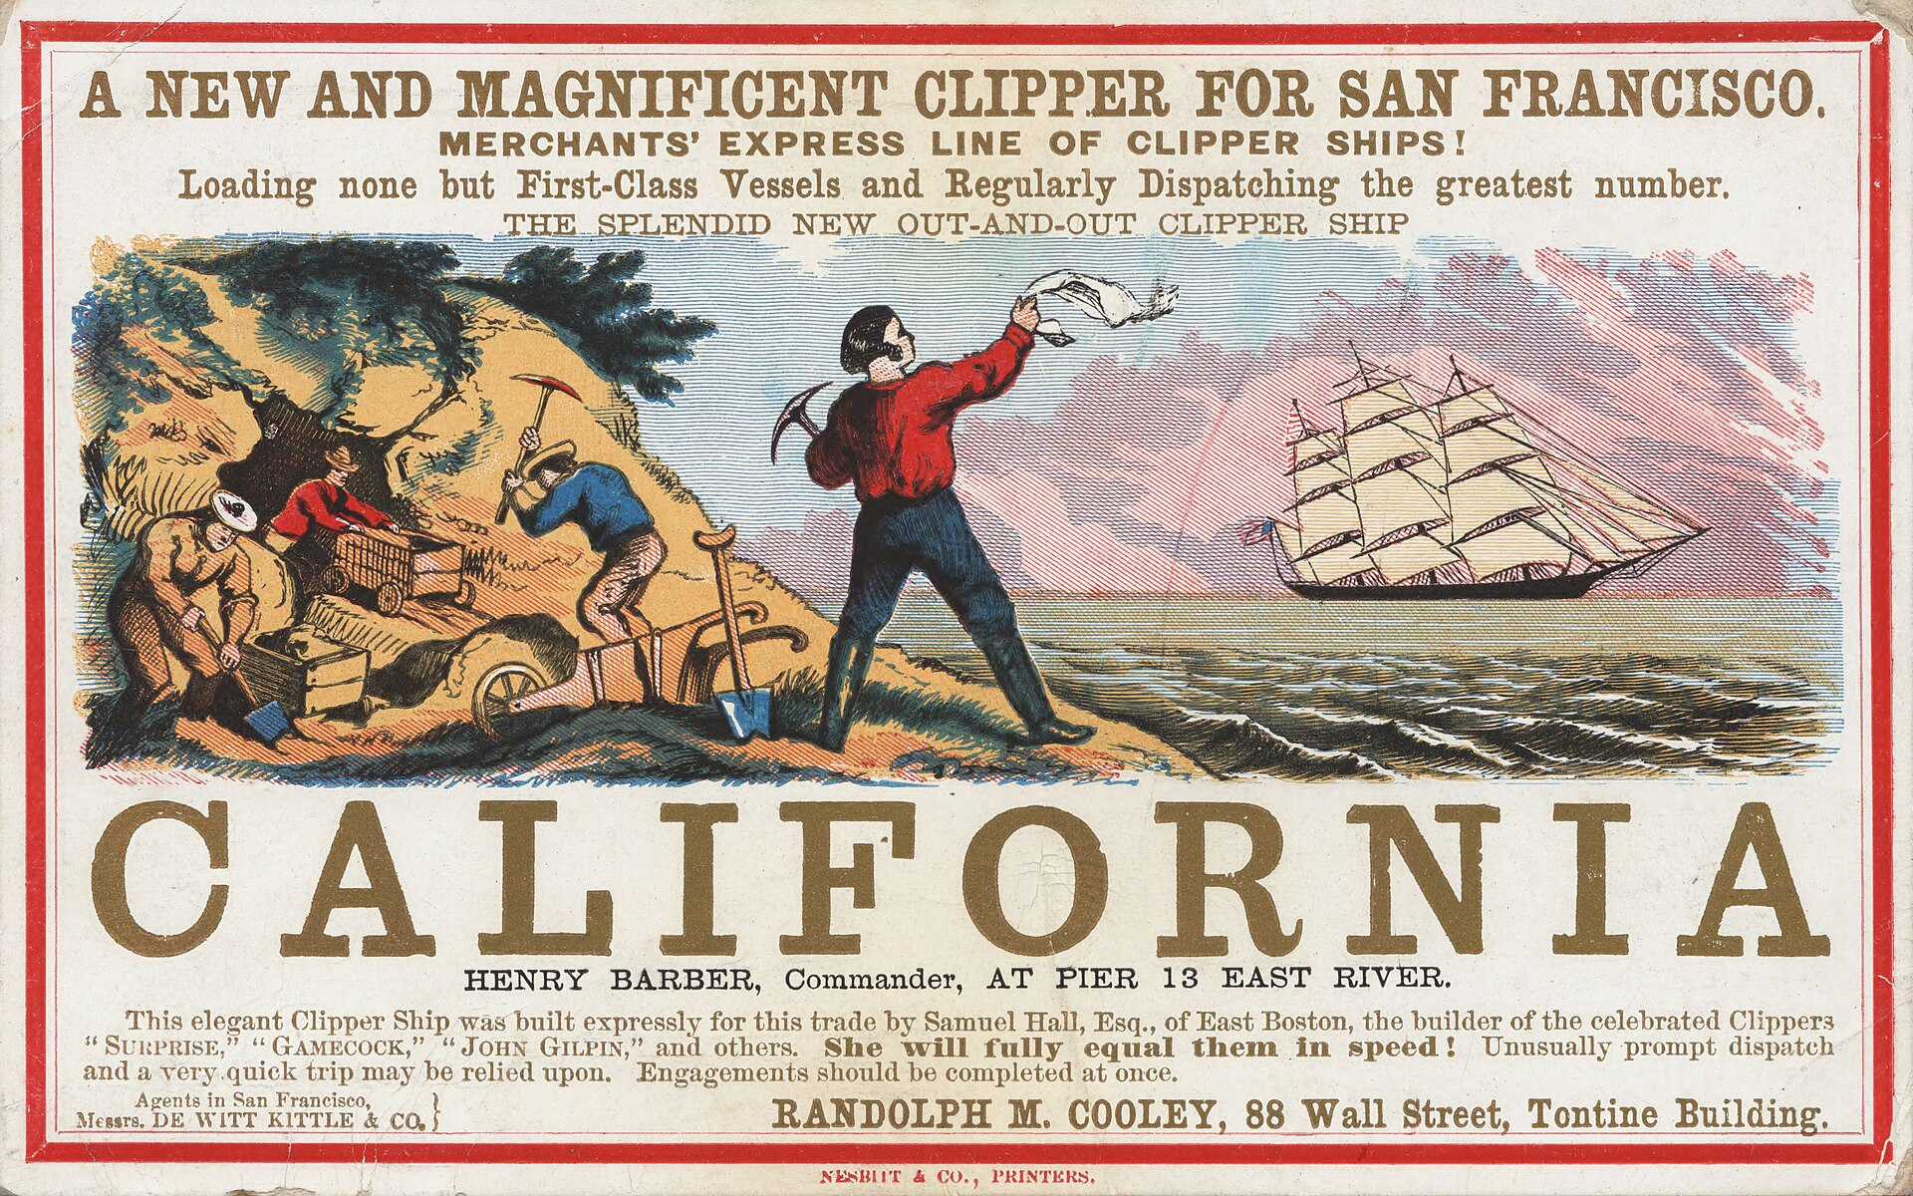
Notes:
• Let me tell you a story. Let me take you back to California, 1848. A remote sawmill. A man named James Marshall. He looks down into the water channel… and sees something glittering. Gold.
• At first, they try to keep it quiet. But news like that doesn’t stay small. It spreads — first as a rumor, then as a fever.
• By 1849, it becomes a global stampede. Around 300,000 people heading to California, all driven by the same simple equation: “Go there → dig → get rich.”
• Most of them arrive exhausted after weeks or months of travel. And their first stop isn’t digging — it’s shopping. (Pause.) Because you can’t mine with your bare hands.
• They buy shovels, pans, clothes, tents, pickaxes — anything that gives them a chance to survive and to search.
• And then reality hits. It isn’t simple. The easy nuggets are gone. Rivers are crowded. Weeks turn into months.
• And many of them end up going home with less than they arrived with.

Slide 5

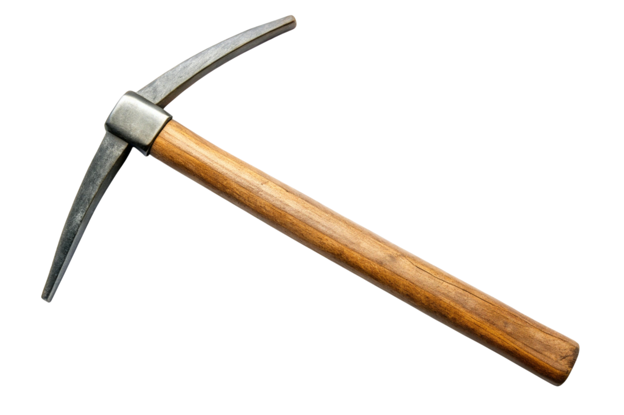

Notes:
• Here’s the twist of the Gold Rush story. Most people think the winners were the miners. In reality, many miners went home with nothing — and the more predictable money was often made selling what miners needed to keep going. Those selling the equipment made a fortune.
• One of the most iconic examples is Levi Strauss. He didn’t come to California to mine. He came to San Francisco to sell supplies — a dry‑goods business.
• Over time, he noticed a repeating problem: work pants kept tearing. A tailor, Jacob Davis, solved it with copper rivets at the stress points. Davis partnered with Strauss, and in 1873 they patented the riveted work pant — essentially the birth of the blue jean.
• And we’re seeing a similar dynamic today. There’s a gold‑rush energy in every industry — including property management: AI agents, copilots, AI models, “AI transformation packages”… pickaxes everywhere.
• Revenue tends to flow to the sellers of tools. But the bigger question — the one that matters for business leaders — is: where is the gold? Where is the durable, scalable value that lasts after the hype wave moves on? The history lesson isn’t that tools are bad — it’s that tools are easy to buy, but value is harder to produce.

Slide 6


What do most people see?
AI application or agent
Notes:
• Alright — let’s leave the gold rush metaphor behind for now. Let’s talk about AI as AI.
• This is what most discussions start with: the latest agent, the newest application, the shiny feature that promises to automate everything.
• And to be fair, these tools are impressive. We can all buy the newest ChatGPT license. We can all purchase tailored agents. The access barrier is basically gone.
• But here’s the problem: when we talk about AI, we often talk as if *this* is the whole story. As if buying the latest tool is enough to start automating company’s internal processes.
• If I want to automate a piece of bookkeeping, or a month-end step, is it enough to just buy an AI model and point it at the task?
• Of course not. But too often, that’s exactly how the conversation goes: “Just add AI.”
• And this is where things get interesting… because what you can see on this slide is only the very top of something much bigger.

Slide 7



The bigger picture
AI application or agent
Data platform
Software and systems
IT infrastructure
Notes:
• The AI app — the chatbot, the agent, the “magic” — is only the tip of the iceberg. It’s the visible, hype-friendly part.
• Real value comes from what sits under the surface — the foundation.
• First layer: the data platform. You need structured, clean, well-governed data before AI can do anything meaningful.
• Second layer: software and systems. They must generate consistent, reliable data — which means standardised, error‑proof processes.
• Third layer: IT infrastructure. Everything needs to run somewhere: systems, data platforms, integrations, and often the AI itself. Security, access, stability — all live here.
• If these layers aren’t solid, you get the same questions every time: “How do we know the AI output is correct?” And the bigger one: “Can we trust it at all?” • That trust — not the model — is what actually creates competitive advantage.

Slide 8

The invisible infrastructure
AI application or agent
Data platform
Software and systems
IT infrastructure
Cybersecurity
Notes:
• And there’s one thing that surrounds the whole iceberg — cybersecurity. Not as a separate topic. As the condition for doing any of this at scale.
• Because the moment AI touches real operations, it touches real risk: personal data, contracts, payments, tenant communications, owner reporting. If you can’t protect it, you can’t scale it.
• This is exactly why Newsec has been investing heavily in the bottom of the iceberg. Not to build pretty demos — but to build capability that’s reliable, auditable, and secure.
• In practice, that means security is designed in, not bolted on: access control, monitoring, data classification, secure integrations, and regular testing.
• And this is where the trust question returns: “Is the AI output correct?”
But more importantly: “Is this safe, controlled, and compliant?”
• Competitive advantage in the AI era will belong to the companies that can answer: “Yes — and we can prove it.”

Slide 9


The competitive advantage
Client
AI application or agent
Data platform
API
Software and systems
IT infrastructure
Cybersecurity
Notes:
• All the data management work we’ve talked about — the platform, the processes, the quality, the security — this isn’t internal plumbing anymore. It has become part of the actual service that clients benefit from.
• When a client buys financial management or property management services from Newsec, they’re not just buying hours or tasks. They’re buying the entire invisible infrastructure behind it.
• Their data is created inside Newsec systems, with Newsec processes, and with Newsec responsibility for correctness, consistency, and quality.
• And here’s where it becomes powerful: we can expose that high‑quality data directly to the client through APIs. Meaning they can feed it into their own tools, dashboards, analytics — even their own AI solutions.
• This turns our data platform into an extension of the client’s business. They get the reliability and structure we’ve built, without having to build it themselves.

Slide 10




Data management has become part of the core business
Client
AI application or agent
Data platform
API
Software and systems
IT infrastructure
Cybersecurity
Notes:
• Up to now, we’ve looked at our iceberg — the foundation that sits underneath our services. That’s what makes Newsec’s operations stable, scalable, and trustworthy.
• But here’s the key point: this isn’t just “our” iceberg. Every client also has their own version of it.
• For years, data was treated as something that supported operations. Today, it *is* the operation. Speed, accuracy, trust, compliance — all of it comes from the quality and structure of the data.
• Data management is not a back-office function anymore. It *is* core business execution.
• And this is exactly why Newsec has reorganized around this idea. We put a digital leader in charge of our largest business service area. It was a big bet from the company, but it reflects how the core business has changed.
• And honestly — I feel the pressure. Because the expectation is clear: digital capability is not a side function. It’s part of every service we deliver.
• And this is the moment where clients need to look at their own iceberg. If you’re in this industry and planning to build these foundations yourself — and you haven’t started — sorry to say, you’re already very behind. It takes lot of time and effort, and of course, lot of capital.
• This is why partnering with someone who has already built the bottom layers matters. We in Newsec have already done the heavy lifting. That’s why we can deliver speed, certainty, and trust from day one.
• AI sits on top of the iceberg. Advantage comes from the bottom. And every company, every client, needs A foundation to stand on.

Slide 11

Public awareness of ChatGPT-3.5. surges – November 2022
~20 versions discontinued
GPT-5.2. released – December 2025
GPT-5.3. released yesterday
Notes:
• Lastly, I want to say something about the speed of AI development and will use ChatGPT as an example.
• In November 2022, AI suddenly hit mainstream awareness. ChatGPT‑3.5 was the version everyone tried… and let’s be honest — it wasn’t great. Interesting, impressive at times, but very limited.
• Fast-forward to last December: ChatGPT 5.2. The leap from 3.5 to 5.2 is huge. Different level of reasoning, quality, context handling, reliability.
• And in between those two points? Around twenty now-intermediate versions came and went. Remember the o4-series models that felt like a massive step forward? Also already discontinued.
• And now, a new version was released just yesterday. This cycle is not slowing down — it’s accelerating.
• This is just one example of how fast AI evolves. What looks “best in class” today may be outdated in a few months. Which makes one thing very clear: If you’re building your strategy around the tool on top, you’re building on quicksand.

Slide 12
When everything constantly changes, what to invest in?
Notes:
• This is the next logical question, right? If AI evolves this fast, where does it make sense to invest in?
• As a decision‑maker, you’re expected to invest hundreds of thousands, at the very least, with a straight face… even though there’s a very real chance that in three months, a newer, better, cheaper model will appear.
• And this is the dilemma: How do you justify long‑term investments when the thing you’re investing in keeps changing?
• Because if you place your bets on the model itself, you’re guaranteed to rebuild, retrain, and reintegrate — over and over.
• So the real question is not: “Which AI tool should we buy?” The real question is: “What stays stable enough to build on?”

Slide 13
Notes:
• So let’s come back to the iceberg — because this is where the answer actually is. When everything on top keeps changing, you invest in the part that doesn’t.
• The foundation doesn’t expire. Data quality doesn’t go out of date. Standardised processes don’t break because a new model was released. Governance and infrastructure don’t get replaced every three months.
• This is the part that stays relevant for the next decade, even if the tip of the iceberg gets rebuilt every few weeks.
• So what should you invest in? Clean, structured, reliable data. Clear ownership and processes. A solid data platform. Secure, stable infrastructure.
• When that foundation is strong, that’s when AI becomes valuable — not as a demo, but as something you can actually trust in operations.
• And this is the part I’m genuinely proud of at Newsec: we’ve put the work in at the bottom of the iceberg. We keep improving it, strengthening it, investing in it.
• Which means that when we now build our own AI agents — for example, automating monthly accruals or other bookkeeping processes — we’re not gambling. We’re actually in a position to strike gold.

Slide 14
Everyone can buy a pickaxe –
but do you have what it takes to wield it?
Notes:
• This is the real question behind everything I’ve talked about today.
• Everyone can access AI tools. The models, the agents, the features — they’re becoming widely available and, increasingly, they’re becoming commodities.
• The differentiator is not the tool itself. It’s whether your organization is ready to use it in a safe, reliable, and scalable way.
• That readiness comes from the foundation: your data quality, your processes, your governance, your infrastructure, your security.
• In other words: the ability to “wield the tool” is built long before you actually pick it up.
• And that’s where real advantage comes from. Not from the tool — but from everything underneath it.
• Thank you.

