Slide 1
Digital Opportunity Scheme
Boosting digital skills on the job

Slide 2
Digitisation is transforming the economy

Slide 3
Digital skills in numbers
44% or 169 million Europeans do not have basic digital skills
Of these 77 million people have no digital skills at all

Slide 4
Digital Skills of the Labour force
37% or 93 million in the labour force
do not have basic digital skills
ICT jobs now 3.7% of total employment
Currently 300,000 vacancies for ICT specialists in the EU

Slide 5
Boosting digital skills for young people
Despite high levels of youth unemployment,
there are two million job vacancies in Europe
Skills mismatch
90% of jobs requires digital skills

Slide 6
Digital Opportunity scheme
Pilot project to provide cross-border traineeships for up to 6,000 students and recent graduates in 2018-2020

Slide 7
Digital Opportunity scheme
Main features
On-the-job training
Students and recent graduates from all faculties
Cross-border traineeships
Implemented through Erasmus +
Budget EUR 10M
Horizon 2020
Participants will receive
EUR 500 per month

Slide 8
Pilot project: Digital Opportunity Scheme to boost digital skills through Erasmus+ traineeships
Provide cross-border Erasmus+ traineeships for up to 6,000 students and recent graduates in 2018-2020 thanks to a 10 million budget from Horizon 2020
ICT specialist skills
Digital skills for business

Slide 9
Focus of Digital Opportunity traineeship
ICT specialist skills
Those necessary to programme, develop applications and manage networks
Digital skills for business
Skills to use ICT technologies for professional purposes, necessary to perform new tasks associated to the use of ICTs at work

Slide 10
Role for companies:
How to get involved:
Host students for a period from 2 to 12 months
Help train the workforce of tomorrow
Help you address important skills gaps and get valuable insights from young workers.
Businesses can publish their offers on the platforms Drop'pin@EURES or ErasmusIntern
Advertise the offers through direct contacts with university international relations or career offices.
Companies willing to host trainees should publish their offers on ErasmusIntern and Drop'pin, selecting the ‘Digital Opportunity’ category on both platforms.

Slide 11
Already available in the E+ 2018 call
Use of the existing Erasmus+ rules to boost traineeships in digital skills
What is a digital skills traineeship?
Geographical scope
Definition in the 2018 call Erasmus+ programme guide listing a number of activities (p. 32)
When one of the listed activities is practised during the traineeship it becomes a "traineeship for digital skills"
Traineeships implemented in Erasmus+ programme countries
Traineeship implemented in Horizon 2020 associated countries (including Switzerland)

Slide 12
Digital Opportunity scheme in practice
Students and recent graduates apply to their Universities for Erasmus+ contribution
Companies publish traineeship offers (through Universities, online platforms etc.)
Universities select future trainees on the basis of strict selection criteria
Trainees eligible to the Erasmus+ contribution look for traineeships
Learning Agreement is signed

Slide 13
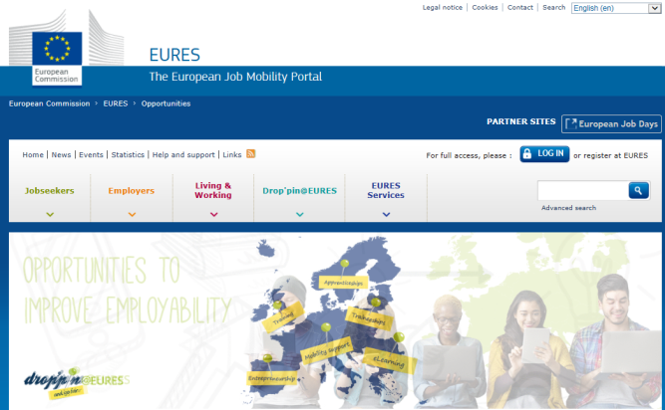
How to find the right profile?
Publish traineeship offers with the tag "digital opportunity"
Search for trainees
Check the applications
Drop'pin
University career offices
ErasmusIntern

Slide 14
Digital Opportunity traineeships scheme
Rules of Erasmus+ programme, the traineeship must be abroad.
Erasmus + foresee generally that the traineeship should have a duration of 2-12 months. The grant however covers generally 5-6 months.
Open for students and recent graduates (max 1 year after graduation) of all study levels: bachelors, masters, PhD.
Finance and accounting tolls are excluded from the scope of these traineeships.
For EU Member States and Horizon 2020 associated countries (Iceland, Norway, Albania, Bosnia and Herzegovina, the former Yugoslav Republic of Macedonia, Montenegro, Serbia, Turkey, Israel, Moldova, Switzerland, Faroe Islands, Ukraine, Tunisia, Georgia, Armenia).
Interested companies can publish their traineeship offers!
on ErasmusIntern and Drop’pin.
List of Q&As can be downloaded here, more information in this article.

