Slide 1
Riigi tugi perele enne lapse perest eraldamist. Euroopa riikide praktika
Katre Luhamaa
Kaasautorid: Amy McEwan-Strand; Barbara Ruiken; Marit Skivenes; Florian Wingens
Õigusteadlaste päevad 9. oktoobril 2020
Notes:
Paper is in review
Looking at the services and support that is provided to mothers and their newborn babies in vulnerable situation (CO proceedings)

Slide 2
Sissejuhatus
Riigi sekkumine perekonnaellu piirab pereliikmete õigust perekonnaelule.
Sotsiaaltoetused ja teenused võivad ennetada lapse perest eraldamist.
Analüüsisime, milliseid toetusi ja teenuseid pakuvad 8 Euroopa riiki peredele enne vastsündinute perest eraldamist.
Empiiriliseks materjaliks esimese astme vastsündinute perest eraldamise kohtuotsused.
Eestist 2015-2017 täielik valim – 17 kohtuotsust.
Photo: Colourbox
Notes:
If and how families in vulnerable situations are supported by the states.
Balance intervention – privacy. Core of CPS.
States have obligations - principle of least interference - Intervention/CO should be the last resort.
Before that: support services, social services, economic support, parenting course etc.
Mothers with newborns on the brink of CO (high-risk situations), should have more service provision here. In these cases concerns are noted during pregnancy, but services are dependent on mother’s cooperation.
8 countries: AUT, ENG, EST, FIN, IRL, GER, NOR, SPA
Best interests of the child principle + explicit/implicit that removal is the last resort.
This is a topic where little research has been made, exploratory focus.

Slide 3
Lastekaitse statistika
Riik | Laste populatsioon (0-17) (aasta) | Perest eraldatud lapsed per 1000
Israel | 2,768,700 (2015) | 3.9 ^
Italy | 10,008,033 (2017) | 2.6 #
Japan | 18,900,000 (2018) | 2.4 #
Latvia | 369,085 (2016) | 15.7 #
Lithuania | 503,015 (2017) | 17.4 (2017) #
Netherlands | 3,404,098 (2017) | 9.1 #
Northern Ireland | 436,403 (2017) | 6.9 #
Norway | 1,127,400 (2016) | 10.3 #
Poland | 6,920,800 (2017) | 10.6 #
Portugal | 1,781,663 (2015) | 4.9 #
Russia | 26,652,174 (2014) | 23 ^
Slovak Republic | 840,228 (0-14) (2016) | 10.4 ^
Spain | 8,119,000 (2015) | 4.3 #
Sweden | 2,239,615 (0-19) (2015) | 13.2 ^
Switzerland (3 cantons) | 1,500,000 (2017) 251,721 (2016) | 10.6 #
USA | 73,600,000 (2016) | 5.9 #
Riik | Laste populatsioon (0-17) (aasta) | Perest eraldatud lapsed per 1000
Australia | 5,440,000 (2017) | 8.8 #
Austria | 1,535,958 (2018) | 8.7 ^
Belgium | 2,301,495 (2018) | 9.6 ^
Canada | 7,006,303 (2015) | 8.9 #
Czech Republic | 1,671,000 (0-14) (2016) | 15.8 #
Denmark | 1,168,222 (2016) | 10.2 #
England | 11,785,311 (2016) | 6.2 #
Estonia | 258,835 (2016) | 10 #
Finland | 1,071,905 (2016) | 16.5 ^
France | 14,780,000 (2018) | 9.9 #
Germany | 13,470,300 (2016) | 10.8 #
Greece | 1,889,916 (2011) | 1.6 #
Ireland | 1,190,478 (2017) | 5.1 #
Child Protection Systems Across the World, Jill Duerr Berrick, Neil Gilbert & Marit Skivenes. In press. # = kindla kuupäeva seis; ^= aasta jooksul eraldatud lapsed

Slide 4
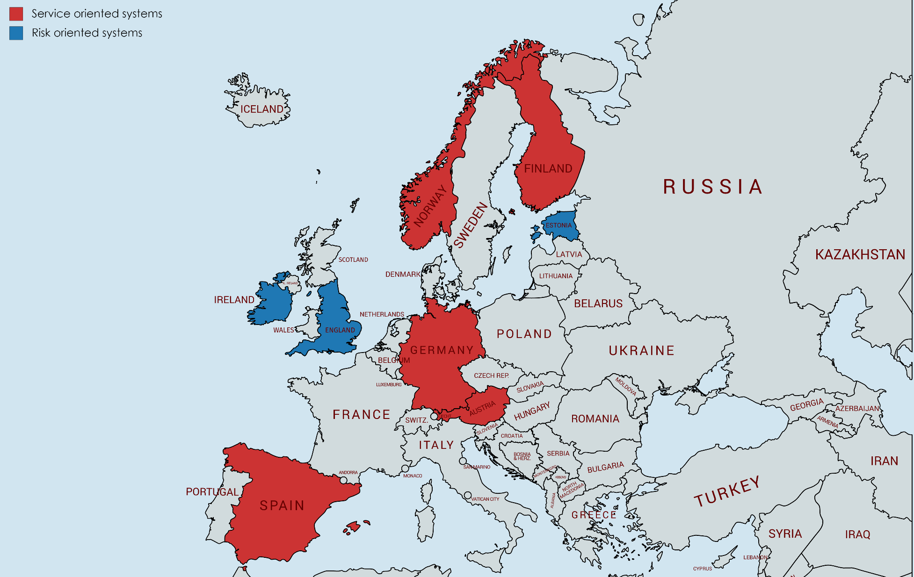
Uuringusse kaasatud riigid
Notes:
High income countries, but still large differences in GDP per capita > service provision.
Rel. high in other child welfare measures as well, such as SDG, KRI etc. But with some variations. These indexes show that in general, the countries are quite good at ensuring children’s wellbeing.
Blue = risk oriented CP systems, high threshold for intervention, when a child has been or is likely to be harmed.
Red = service oriented systems, promote wellbeing and approach the family early with assistive services.
How the welfare state of a country is organised will influence which services are provided and how.
Liberal: Means-tested benefits, min. welfare is provided, more through insurance/private market. EST, ENG, IRL. (risk oriented CPS)
Conservative: AUT, GER, SPA. State comes in where the family ends, family is more protected. Benefits depend on contribution. (service CPS)
Scandinavian: FIN, NOR. Power to the workers, universal benefits, defamilialisation, doesn’t wait until family resources are drained. (service CPS)

Slide 6
Õiguslik alus – Lapse õiguste konventsiooni artikkel 19
Osalisriigid rakendavad kõiki seadusandlikke, administratiivseid, sotsiaalseid ja haridusalaseid abinõusid, et kaitsta last…
Niisugused kaitseabinõud peaksid hõlmama tõhusaid vahendeid sotsiaalprogrammide ellurakendamiseks, mis tagaksid vajaliku toetuse lapsele ja nendele, kes tema eest hoolitsevad ….
Artikkel 3 (lapse parim huvi); artikkel 5 (vanemate õigused)
Artikkel 26 rõhutab lapse õigust sotsiaalsele turvalisusele.
Artikkel 27 kohustab riike toetama lapsevanemaid.
Notes:
2. Such protective measures should include … establishment of social programmes to provide necessary support for the child and for those who have the care of the child…

Slide 7
Euroopa õigusruum
EIK artikkel 8: õigus perekonnaelu kaitsele
Riigi sekkumine perekonnaellu peaks olema piiratud ning tuleb valida perekonnaelu kõige vähem piiravad meetmed (least intrusive measures)
Strand Lobben and others v. Norway [GC], 2019 para. 207
Täiendatud Euroopa Sotsiaalharta artikkel 16
Lepingupooled kohustuvad edendama perekonnaelu majanduslikku, õiguslikku ja sotsiaalset kaitset sotsiaal- ja peretoetuste, maksukorralduse, peredele eluaseme võimaldamise … ning teiste asjakohaste meetmetega.

Slide 8
Oluline on toetada nii vanemaid kui ka perekonda
Kui vanemaid saab toetada sotsiaaltoetuste või teenuste abil, peaksid need olema esmaseks valikuks (Strand Lobben v. Norway [GC] 2019, para 211).
Eriti oluline, kui vanemate raskused on seotud rahalise või majandusliku olukorraga ning kui vanemad ei ohusta lapsi (Saviny v. Ukraine 2008, paras. 57–58).
Puudub ammendav nimekiri kohustuslikest toetustest ja teenustest
Toetus on eriti oluline, kui on tegemist:
Haavatavas olukorras olevate inimestega (Zhou v. Italy, 2014, para. 58),
Sh puuetega või erivajadustega inimesed (B. v. Romania (no 2), 2013, para 86),
Riik peab erilise hoolsusega toetama inimesi, kes ei ole riigi sotsiaalhoolekandesüsteemiga piisavalt tuttavad (R.M.S. v. Spain, 2013, para 86).

Slide 9
Analüüsitud kategooriad
Teenused
Üldised teenused
Vanemate riskidele suunatud teenused
Vastsündinule pakutud teenused
Vanema-lapse teenused
Teenuste saamisega seotud teemad
Sobivaid teenuseid ei ole võimalik pakkuda
Vanemad soovivad täiendavaid teenuseid (ebaõnnestunult)
Vanemate koostöötahe
Negatiivne
positiivne
Kohtu seisukoht
Teenuste mõju analüüs
Teenused ei parandanud olukorda
Olukord ei paranenud piisavalt
Vanematele oleks pidanud pakkuma täiendavaid teenuseid

Slide 10
Andmestik ja meetod
N=216 esimese kohtuastme kohtuotsust või -määrust
Vastsündinud (kuni 30 päeva pere juures)
Ajaperiood 2012-2018
Analüüsisime:
Erinevatel ajahetkedel perele, vanematele ja lapsele pakutud teenuseid
Kriteeriume, mis olid teenuste pakkumisel või mittepakkumisel olulised: vanemate koostöö sotsiaaltöötajatega, vanemate soov saada täiendavaid teenuseid, sobivate teenuste puudumine
Teenuste temaatika olulisust kohtu analüüsis
Notes:
CO decisions from first instance court, from one or several years between 2012-2018
Newborns: removed within 30 days of birth/not moved home after birth/only stayed in facility with parents
Services before and after birth + cooperativeness of parents + how the court assessed their effectiveness

Slide 11
Pakutud teenused
 | Kokku (216) | Austria (24) | Ingl. (14) | Eesti (17) | Soome (25) | Saksamaa (27) | Iiri (17) | Norra (76) | Hisp. (16)
Teenused | 191 88 % | 19 79 % | 14 100 % | 13 76 % | 25 100 % | 17 63 % | 17 100 % | 75 99 % | 11 69 %
Üldised teenused | 124 57 % | 16 67 % | 3 21 % | 6 35 % | 9 36 % | 6 22 % | 8 47 % | 71 93 % | 5 31 %
Vanemate riskidele suunatud teenused | 113 52 % | 6 25 % | 10 71 % | 6 35 % | 16 64 % | 11 41 % | 16 94 % | 45 59 % | 3 19 %
Vastsündinule suunatud teenused | 75 35 % | 6 25 % | 5 36 % | 8 47 % | 14 56 % | 2 7 % | 10 59 % | 26 34 % | 4 25 %
Vanema-lapse teenused | 87 40 % | 6 25 % | 8 57 % | 4 24 % | 15 60 % | 3 11 % | 5 29 % | 43 57 % | 3 19 %
Notes:
Most countries are very high here, but some (Austria, Germany, Spain) are lower.
Some differences in the different services that are provided, general services are most often mentioned. NOR highest on general services.
Almost half mention services targeting the parent’s risks.
1/3 on newborn child services.
Over 1/3 on parent-child services
Differences across and within countries: ENG + IRL: more before or shortly after birth.
FIN: below average on general and above for the 3 other service aims.

Slide 12
Teenuste pakkumisel olulised kriteeriumid
 | Kokku (216) | Austria (24) | Ingl. (14) | Eesti (17) | Soome (25) | Saksamaa (27) | Iiri (17) | Norra (76) | Hisp. (16)
Olulised kriteeriumid | 198 88 % | 21 88 % | 13 93 % | 10 59 % | 24 96 % | 15 56 % | 15 88 % | 76 100 % | 15 94 %
Sobivaid teenuseid ei ole | 81 38 % | 5 21 % | 5 36 % | 2 12 % | 10 40 % | 4 15 % | 1 6 % | 54 71 % | 0 -
Vanemad soovivad lisateenuseid | 65 30 % | 1 4 % | 7 50 % | 1 6 % | 7 28 % | 1 4 % | 3 18 % | 44 58 % | 1 6 %
Vanemate koostöö | 180 83 % | 19 79 % | 13 93 % | 8 47 % | 23 92 % | 14 52 % | 15 88 % | 73 96 % | 15 94 %
- Vanemad ei tee koostööd | 121 56 % | 17 71 % | 10 71 % | 7 41 % | 18 72 % | 10 37 % | 12 71 % | 35 46 % | 12 75 %
- Vanemad teevad koostööd | 59 27 % | 2 8 % | 3 21 % | 1 6 % | 5 20 % | 4 15 % | 3 18 % | 38 50 % | 3 19 %
Notes:
35% no (further) services. Never mentioned in Spain, normal in NOR, FIN & ENG.
31% parent’s request. Over half of these also mentioned that there are no services available. 79% of cases where parent’s requested services the court assessed that services were not sufficient. Which means that social workers and the court find the requests unrealistic.
Country diff. are similar to the previous code.
Cooperation is important, very in NOR, FIN, ENG, IRL & SPA, more than half in AUT, GER, EST. Most parent’s do not cooperate.

Slide 13
III: Kohtu seisukoht
 | Kokku (216) | Austria (24) | Ingl. (14) | Eesti (17) | Soome (25) | Saksamaa (27) | Iiri (17) | Norra (76) | Hisp. (16)
Teenuste mõju analüüs | 157 73 % | 6 25 % | 7 50 % | 13 76 % | 24 96 % | 26 96 % | 10 59 % | 70 92 % | 1 6 %
- Teenused ei parandanud olukorda | 143 91 % | 6 25 % | 5 71 % | 11 65 % | 23 92 % | 22 81 % | 9 90 % | 66 87 % | 1 6 %
- On teenuseid, mida saaks veel pakkuda | 8 5 % | 0 - | 1 14 % | 1 6 % | 1 4 % | 1 4 % | 0 - | 4 5 % | 0 -
- Teenused parandasid olukorda piisavalt | 6 4 % | 0 - | 1 14 % | 1 6 % | 0 - | 3 11 % | 1 10 % | 0 - | 0 -
Täiendavate teenuste soovitus | 66 31 % | 2 8 % | 10 71 % | 4 24 % | 2 8 % | 2 7 % | 14 82 % | 32 42 % | 0 -
Notes:
% of the 3 alternatives is within the 69% that did assess the effectiveness of services. Very high: GER, NOR, FIN, EST, low for AUT, SPA, with ENG, IRL in the middle.
In almost all cases the court found that the services did not secure the situation enough for the newborn. These are the hardest cases and most end in a CO. Meaning that most cases where services were effective are not in the data material.
In a small portion the services helped enough or court said that more services were available that should be given/tried.

Slide 14
Kokkuvõtteks
Selge kohustus pakkuda teenuseid, kuid seda ei järgita alati.
Vanemate ja sotsiaaltöötajate koostöö on võtmetähtsusega.
Oluline on teenuste ajastamine ning küsimus, kui kaua tuleb teenuseid pakkuda
Riigi fookuses peaks olema sobivate teenuste arendamine ja pakkumine, koostööd hõlbustava õhkkonna loomine.
Keeruline tasakaalustamise ülesanne:
Kõige vähem sekkuv meede
Lapse parimad huvid
Photo: Colourbox
Notes:
Clear obligation to provide services that is not always fulfilled.
Cooperation is important also when there are no services provided. System is depended on cooperation and mutual understanding of the situation. Parents’ chaotic lifestyle makes following up services difficult and they can be scared and stigmatised by CPS involvement. Improvements to be made in how the system meets the parents.
Timing difficult – cooperation, pregnancy is fast, change takes time.
Difficult decision when to end a service and either try a different one or go for a CO.
Decisions are made by frontline workers. Policy makers should have on the agenda to develop & provide appropriate services, and how to facilitate cooperation. Another issue to consider is how to balance the least intrusive principle and the principle of the child’s best interests.

Slide 15
Tänan!
Katre.luhamaa@ut.ee
Tartu Ülikooli Euroopa õiguse ja rahvusvahelise õiguse lektor

