Slide 1
The Anglo-Scandinavian Cardiac
Outcomes Trial Lipid-Lowering Arm
(ASCOT-LLA):
11 Year Mortality Follow-up in the UK
Peter S. Sever*, Choon L. Chang, Ajay Gupta, Andrew Whitehouse and Neil R. Poulter
on behalf of the ASCOT Investigators
*Imperial College London, UK

Slide 2
Presenter Disclosure Information
ASCOT-LLA: 11 year mortality follow-up in the UK
P. S. Sever and N. R. Poulter have served as consultants or received travel expenses, or payment for speaking at meetings, or funding for research from one or more pharmaceutical companies that market blood-pressure lowering or lipid-lowering drugs, including Pfizer for ASCOT

Slide 3
ASCOT Study Design
19,342 hypertensive patients randomised to antihypertensive treatment
ASCOT-BPLA
Stopped at 5.5 yrs
Atenolol ± bendrofluazide
Amlodipine ± perindopril
10,305 patients eligible and randomised in lipid-lowering arm
TC ≤ 6.5 mmol/L (250 mg/dL)
ASCOT-LLA
Stopped at 3.3 yrs
Atorvastatin 10 mg
Placebo
Investigator lead trial of hypertensive subjects age 40-79 yrs , no history of CHD, but with 3 additional CV risk factors

Slide 4
ASCOT-LLA Primary End Point: Nonfatal MI and Fatal CHD
Atorvastatin 10 mg (Number of events: 100)
Placebo (Number of events: 154)
36% reduction
HR=0.64 (95% CI: 0.50, 0.83)
P=0.0005

Slide 5
ASCOT-LLA: Effects of Atorvastatin and Placebo on End Points
Primary End Points
Nonfatal MI (incl silent) + fatal CHD
Secondary End Points
Total CV events and procedures
Total coronary events
Nonfatal MI (excl silent) + fatal CHD
All-cause mortality
Cardiovascular mortality
Fatal and nonfatal stroke
Fatal and nonfatal heart failure
Tertiary End Points
Silent MI
Unstable angina
Chronic stable angina
Peripheral arterial disease
Development of diabetes mellitus
Development of renal impairment
Risk Ratio
HR (95% CI)
0.64 (0.50, 0.83)
0.79 (0.69, 0.90)
0.71 (0.59, 0.86)
0.62 (0.47, 0.81)
0.87 (0.71, 1.06)
0.90 (0.66, 1.23)
0.73 (0.56, 0.96)
1.13 (0.73, 1.78)
0.82 (0.40, 1.66)
0.87 (0.49, 1.57)
0.59 (0.38, 0.90)
1.02 (0.66, 1.57)
1.15 (0.91, 1.44)
1.29 (0.76, 2.19)
Atorvastatin better
Placebo better
0.5
1.0
1.5
Area of squares is proportional to the amount of statistical information

Slide 6
ASCOT-LLA-Extension
Early closure of ASCOT-LLA
Median follow-up 3.3 years
Atorvastatin versus placebo:
36% reduction in the primary endpoint
27% reduction in stroke
ASCOT-LLA-extension
Offering atorvastatin 10 mg daily to all patients in LLA
Continued for a further 2.2 years until the closure of ASCOT-BPLA
Statin usage
 | Atorvastatin (n=4978) |  | Placebo (n=4916)
 | Atorvastatin | Other statins | Atorvastatin | Other satins
End of ASCOT-LLA | 4113 (82.6) | 54 (1.1) | 415 (8.4) | 220 (4.5)
End of ASCOT-BPLA* | 3122 (62.7) | 200 (4.0) | 2752 (56.0) | 337 (6.9)
Values are n (%)
*Also the end of LLA-extension

Slide 7
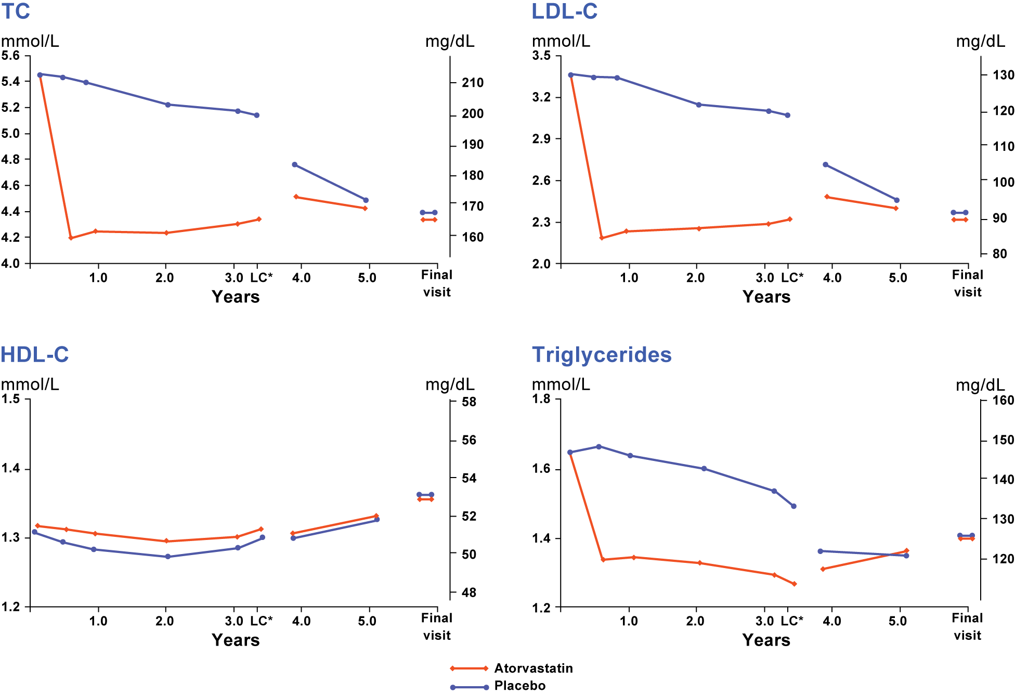
Lipids Levels During ASCOT-LLA and LLA-Extension
Atorvastatin
Placebo
*Lipid closeout visit (end of ASCOT-LLA)

Slide 8
ASCOT-LLA endpoints at the end of the trial (3.3 yrs) and at the end of BPLA (5.5 yrs)
3.3 yrs¹
Risk ratio
5.5 yrs²
Risk ratio
Primary endpoints
Non-fatal MI (incl silent) + fatal CHD
Secondary endpoints
Total CV events and procedures
Total coronary events
Non-fatal MI (excl silent) + fatal CHD
All-cause mortality
Cardiovascular mortality
Fatal and non-fatal stroke
Fatal and non-fatal heart failure
Tertiary endpoints
Silent MI
Unstable angina
Chronic stable angina
Peripheral arterial disease
Development of diabetes mellitus
Development of renal impairment
Atorvastatin better
Placebo better
Atorvastatin better
Placebo better
0.5
1.0
1.5
0.5
1.0
1.5
Area of each square is proportional to the amount of statistical information
1. Sever PS, et al. Lancet 2003;361:1149–58; 2. Sever PS, et al. Eur Heart J 2008;29:499–508

Slide 9
ASCOT-LLA: 11 Year Mortality Follow-up
Post-trial mortality data were collected every 2-3 months in the UK
For the current analysis:
The primary causes of death were defined as death from:
Any cause
Cardiovascular (CV) or non-CV disease
Cancer
Additional post-hoc outcomes included are death from:
Infection (infectious or parasitic diseases)
Respiratory illness (disease of the respiratory system including pneumonia, chronic obstructive pulmonary disease and acute respiratory diseases)
Infection/respiratory combined
The cut-off date was 31st December 2010 (inclusive)

Slide 10
Statistical Methods
Patients
All patients in the intention-to-treat population who were alive at the end of ASCOT-BPLA (also the end of LLA-extension)
Cox regression analysis
Two randomised treatment groups, i.e., atorvastatin and placebo, were compared for each mortality outcome
Analyses were unadjusted and adjusted for prespecified baseline risk factors including age, sex, systolic blood pressure, body mass index, total cholesterol, diabetes, current smokers, ethnicity, randomised blood pressure treatment and age at completion of education; hazard ratios (HR) were estimated
The assumption of proportionality was tested using Schoenfeld residuals
Tests for interactions were performed for:
Atorvastatin treatment and trial period (in- or post-trial)
Atorvastatin and randomised blood pressure treatment
Whether the atorvastatin effects differed between subgroups such as age, sex, ethnic or diabetes status
Statistical tests were 2-sided and a P value of <0.05 was considered to be of statistical significance

Slide 11
ASCOT-LLA 11 Year Mortality: Study Profile
ASCOT in the UK and Ireland
9098 patients randomised to antihypertensive treatment
4853 patients eligible and randomised in lipid-lowering arm
Excluded 248 patients from Ireland
4605 patients included in the current study
2317 patients Atorvastatin 10 mg
2288 patients Placebo
83 patients died
90 patients died
End of ASCOT-LLA 2234 alive
End of ASCOT-LLA 2198 alive
377 patients died
430 patients died
End of follow-up (31Dec2010) 1857 alive
End of follow-up (31Dec2010) 1768 alive

Slide 12
Effect of Atorvastatin on Mortality and Causes of Death ‒ 1
 | LLA |  |  |  |  |  |  | Total Follow-up
 | Placebo |  | Atorvastatin |  | HR (95% CI)† | P value |  | Placebo |  | Atorvastatin |  | HR (95% CI)† | P value
Cause of Death | N (%) | Rate* | N (%) | Rate*
 |  |  |  |  |  |  |  | N (%) | Rate* | N (%) | Rate*
All-cause | 90 (3.9) | 1.28 | 83 (3.6) | 1.18 | 0.92 (0.68, 1.24) | 0.60 |  | 520 (22.7) | 2.24 | 460 (19.9) | 1.94 | 0.86 (0.76, 0.98) | 0.02
CV | 36 (1.6) | 0.51 | 30 (1.3) | 0.43 | 0.83 (0.51, 1.35) | 0.45 |  | 167 (7.3) | 0.73 | 154 (6.6) | 0.65 | 0.89 (0.72, 1.11) | 0.32
Non-CV | 54 (2.4) | 0.77 | 53 (2.3) | 0.75 | 0.99 (0.67, 1.44) | 0.94 |  | 353 (15.4) | 1.52 | 306 (13.2) | 1.29 | 0.85 (0.73, 0.99) | 0.03
*Per 100 person-years
†Unadjusted hazard ratios (HR) (95% confidence interval [CI]) of atorvastatin effect on mortality and causes of death during ASCOT-LLA and total follow-up period

Slide 13
Effect of Atorvastatin on Mortality and Causes of Death ‒ 2
 | LLA |  |  |  |  |  |  | Total Follow-up
 | Placebo |  | Atorvastatin |  | HR (95% CI)† | P value |  | Placebo |  | Atorvastatin |  | HR (95% CI)† | P value
Cause of Death | N (%) | Rate* | N (%) | Rate*
 |  |  |  |  |  |  |  | N (%) | Rate* | N (%) | Rate*
Cancer | 37 (1.6) | 0.53 | 39 (1.7) | 0.55 | 1.05 (0.67, 1.65) | 0.82 |  | 212 (9.3) | 0.92 | 201 (8.7) | 0.85 | 0.92 (0.76, 1.12) | 0.43
Infection/ Respiratory | 6 (11.1) | 0.09 | 3 (5.7) | 0.04 | 0.51 (0.13, 2.04) | 0.34 |  | 56 (15.9) | 0.24 | 37 (12.1) | 0.16 | 0.64 (0.42, 0.97) | 0.04
Infection | 3 (5.6) | 0.04 | 1 (1.9) | 0.01 | 0.34 (0.04, 3.26) | 0.35 |  | 37 (10.5) | 0.16 | 23 (7.5) | 0.10 | 0.60 (0.36, 1.02) | 0.06
Respiratory | 3 (5.6) | 0.04 | 2 (3.8) | 0.03 | 0.68 (0.11, 4.07) | 0.67 |  | 19 (5.4) | 0.08 | 14 (4.6) | 0.06 | 0.72 (0.36, 1.44) | 0.35
*Per 100 person-years;
†Unadjusted hazard ratios (HR) (95% confidence interval [CI]) of atorvastatin effect on mortality and causes of death during ASCOT-LLA and total follow-up period

Slide 14
Adjusted Effect of Atorvastatin on Mortality and Causes of Death
 | LLA |  |  | Post-LLA* |  |  | Total Follow-up
Cause of death | HR (95% CI)† | P value |  | HR (95% CI)† | P value |  | HR (95% CI)† | P value
All-cause | 0.93 (0.69, 1.25) | 0.64 |  | 0.85 (0.74, 0.98) | 0.02 |  | 0.86 (0.76, 0.98) | 0.02
CV | 0.85 (0.52, 1.38) | 0.51 |  | 0.91 (0.72, 1.17) | 0.47 |  | 0.90 (0.72, 1.12) | 0.35
Non-CV | 0.99 (0.68, 1.44) | 0.94 |  | 0.82 (0.69, 0.97) | 0.02 |  | 0.84 (0.72, 0.98) | 0.03
Cancer | 1.05 (0.67, 1.64) | 0.84 |  | 0.89 (0.72, 1.10) | 0.28 |  | 0.92 (0.75, 1.11) | 0.37
Infection/Respiratory | 0.51 (0.13, 2.05) | 0.35 |  | 0.65 (0.42, 1.01) | 0.06 |  | 0.64 (0.42, 0.97) | 0.04
Infection | 0.33 (0.03, 3.16) | 0.33 |  | 0.61 (0.36, 1.05) | 0.07 |  | 0.59 (0.35, 0.99) | 0.046
Respiratory | 0.73 (0.12, 4.39) | 0.73 |  | 0.75 (0.36, 1.60) | 0.46 |  | 0.75 (0.37, 1.50) | 0.42
*Participants who died during LLA period were excluded
†Adjusted for age, sex, body mass index, systolic blood pressure, total cholesterol, diabetes, current smokers, ethnicity, randomised blood pressure treatment and completion educational age

Slide 15
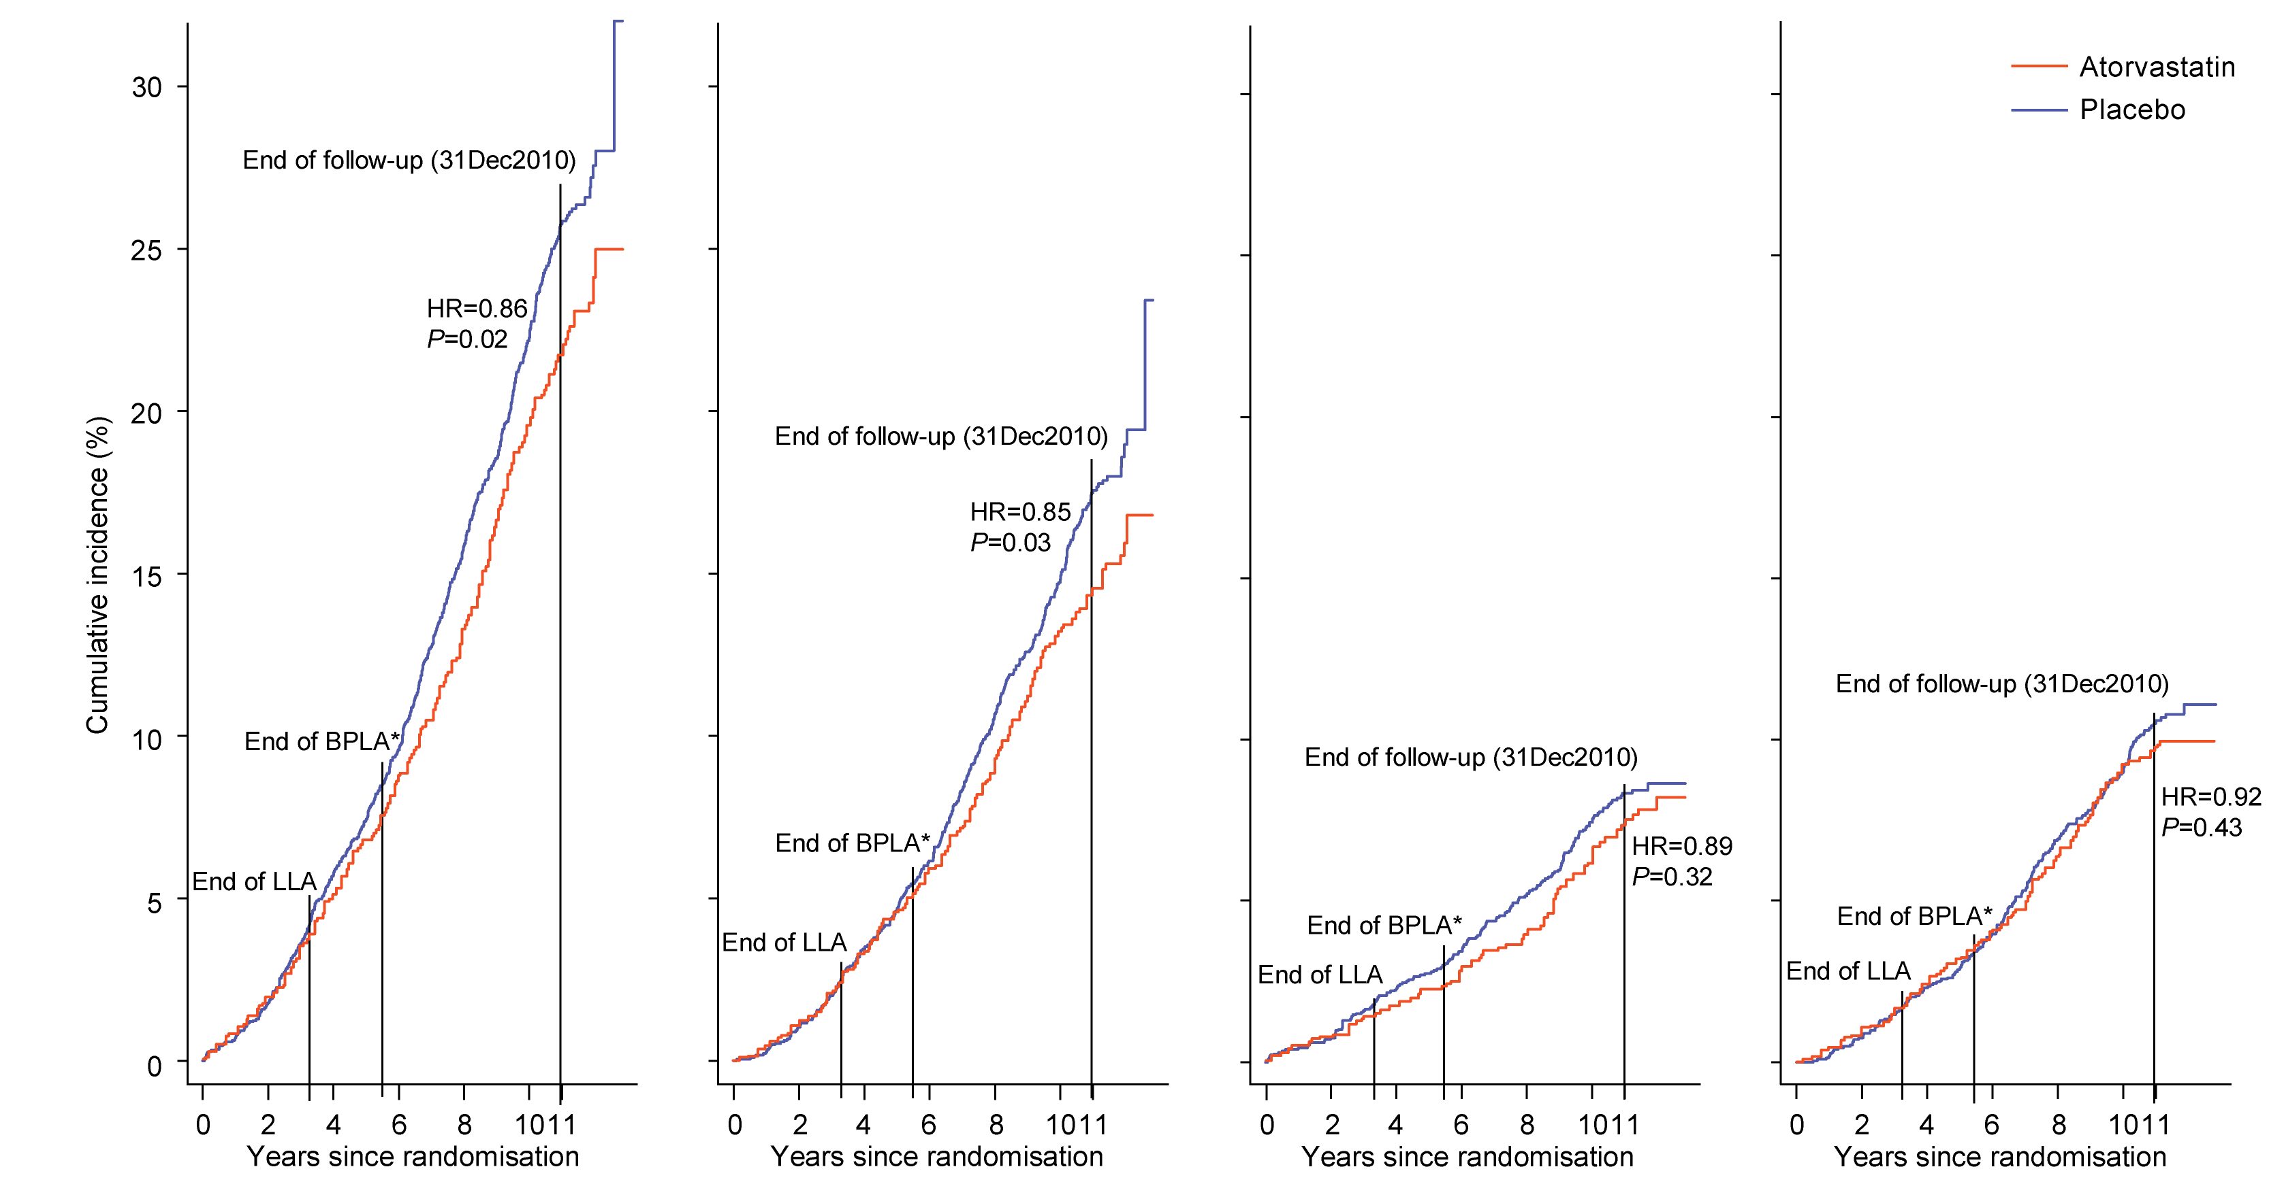
Cumulative Incidence by Cause of Death ‒ 1
All-cause mortality
Non-cardiovascular mortality
Cardiovascular mortality
Cancer mortality
Number at risk
Placebo
Atorvastatin
2288
2317
2191
2228
2052
2091
1208
1226
2288
2317
2191
2228
2052
2091
1208
1226
2288
2317
2191
2228
2052
2091
1208
1226
2288
2317
2191
2228
2052
2091
1208
1226

Slide 16
Cumulative Incidence by Cause of Death ‒ 1
All-cause mortality
Non-cardiovascular mortality
Cardiovascular mortality
Cancer mortality
P
A
P
A
P
A
P
P
A
A
Number at risk
Placebo
Atorvastatin
2288
2317
2191
2228
2052
2091
1208
1226
2288
2317
2191
2228
2052
2091
1208
1226
2288
2317
2191
2228
2052
2091
1208
1226
2288
2317
2191
2228
2052
2091
1208
1226

Slide 17
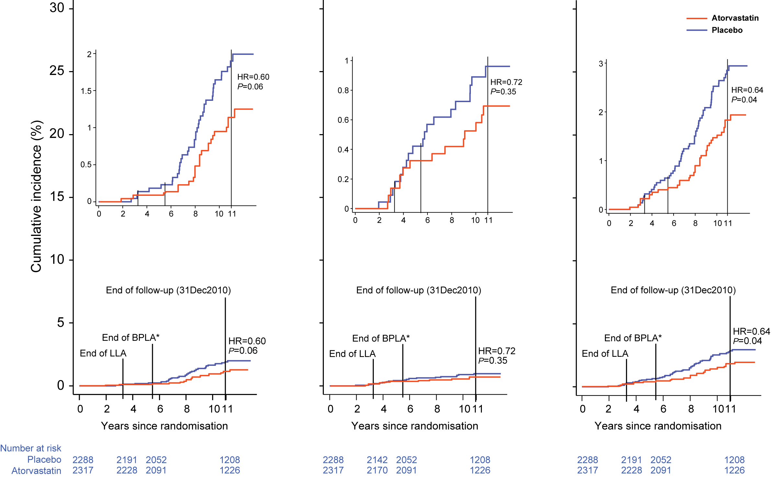
Cumulative Incidence by Cause of Death ‒ 2
Mortality due to infection
Mortality due to respiratory illness
Mortality due to infection and respiratory illness
Number at risk
Placebo
Atorvastatin
2288
2317
2191
2228
2052
2091
1208
1226
2288
2317
2191
2228
2052
2091
1208
1226
2288
2317
2191
2228
2052
2091
1208
1226

Slide 18
Summary
A median 11 years after the initial randomisation for ASCOT, and approximately 8 years after the closure of the LLA, all-cause mortality remained significantly lower in those originally assigned atorvastatin
Among the UK participants of ASCOT-LLA who were initially randomised to atorvastatin 10 mg therapy:
CV deaths were fewer, but the difference was not significant
Non-CV deaths were significantly fewer, attributed to a reduction in deaths caused by infection and respiratory illness

Slide 19
Statins on Infection
Experimental studies¹ show statins:
Modulate neutrophil function, reduce pro-inflammatory cytokine release, improve vascular function,
are anti-thrombotic and improve outcome from pneumonia and sepsis
Observational studies have shown prior statin use reduces mortality from sepsis and community acquired pneumonia¹
A review and meta-analysis² of randomised trials and cohort studies found that:
In 9 cohorts addressing the role of statins in treating infection, the pooled effect estimate ( mainly short term mortality) was 0.55 (95% CI: 0.36, 0.83) in favour of statin
In 7 cohort studies investigating the prevention of infection in patients with vascular disease, the pooled effect estimate ( mainly sepsis related event) was 0.57 (95% CI: 0.43, 0.75) in favour of statin use
A recent editorial³
Urged caution in their interpretation, on account of the fact that observational, retrospective and meta-analytical studies cannot eliminate the possibility of confounding bias
highlighted the need for formal prospective randomized controlled trials to be conducted
Chalmers JD, et al. Resp Med. 2010;104:1081-1091.
Tleyjeh IM, et al. Arch Intern Med. 2009;169:1658-1667.
Chopra V and Flanders SA. BMJ. 2011;342:d1907

Slide 20
Conclusions
Long-term benefits on all-cause mortality were observed among the UK participants of ASCOT-LLA who were originally assigned atorvastatin
No definitive explanation has been established for the hypothesised legacy effects of atorvastatin therapy on non-CV death reduction

