Slide 1
Youth standing up for sufficient climate action: Sweden's first systemic climate case
Climate complaints event in Tallinn
Estonian Environmental Law Center
15 May 2024
Ida Edling

Slide 2
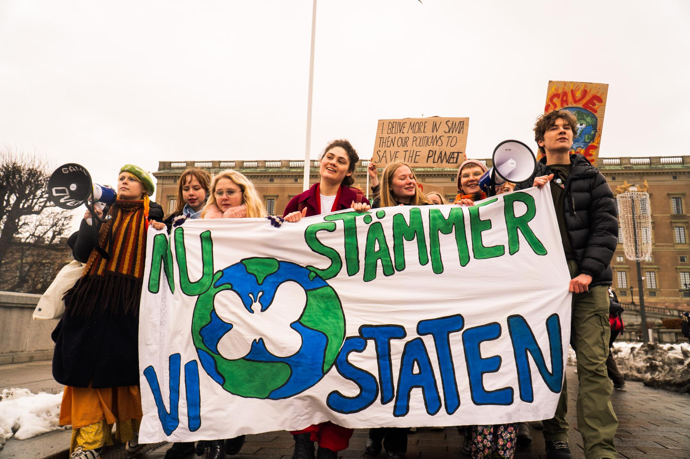
Aurora
Youth-led association suing the Swedish state for insufficient climate measures
Photos throughout the presentation: Albin Haglund

Slide 3
Where we come from: the midst of a climate emergency
“Any further delay in concerted anticipatory global action on adaptation and mitigation will miss a brief and rapidly closing window of opportunity to secure a liveable and sustainable future for all.”
IPCC, AR6, WG2, SPM, para D.5.3

Slide 4
What we’re attacking: the Swedish context
What is needed | What Sweden is doing
Reduce all emissions: IPEAW (EU-ETS and EU-ESR), LULUCF, consumption-based | Has a plan only for reducing IPEAW (and often only EU-ESR)
Conserve and enhance carbon sinks and reservoirs (forests, wetlands, oceans): uptake and storage of greenhouse gases from the atmosphere. | No targets on how many/large carbon sinks and reservoirs should be protected
Continuous emission reductions in line with carbon budget (cumulative emissions) insight, before 2030. Level of ambition in line with Sweden's 1.5 fair share. | No targets for continuous emission reductions. No calculation of Sweden's fair share. Current emissions targets far from scientific calculations of Sweden’s fair share.
Achieving sufficient climate impact reduction targets. | Failing to meet insufficient targets.

Slide 5
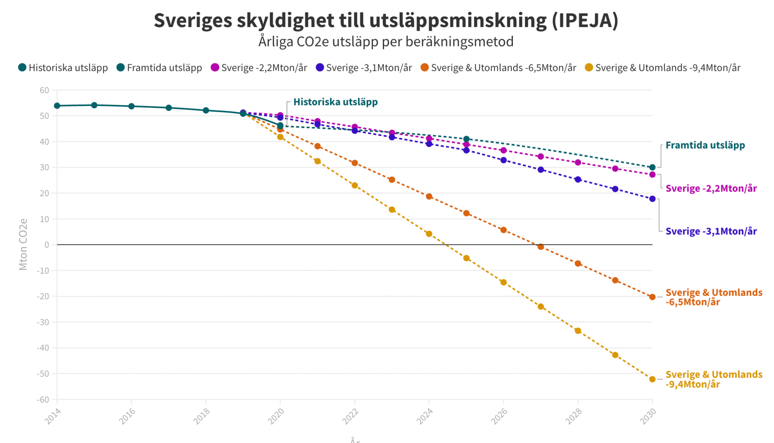
What we want: Fair share
The Swedish state must do its fair share of the global climate measures necessary to limit global warming to 1.5 degrees
How to calculate a fair share?
Factors
Responsibility
Capability
Equality
(Cost-effectiveness)
Principles under international environmental law, like
The precautionary principle
Common but differentiated responsibilities and respective capabilities (CBDR-RC)
Harm prevention
Demands drastic emissions reductions
References: https://drive.google.com/file/d/1FPmNw4vtd_XsjvxVLloAKZrDl8bfIruB/view https://climateactiontracker.org/methodology/cat-rating-methodology/fair-share/ https://www.tandfonline.com/doi/full/10.1080/14693062.2021.1970504

Slide 6
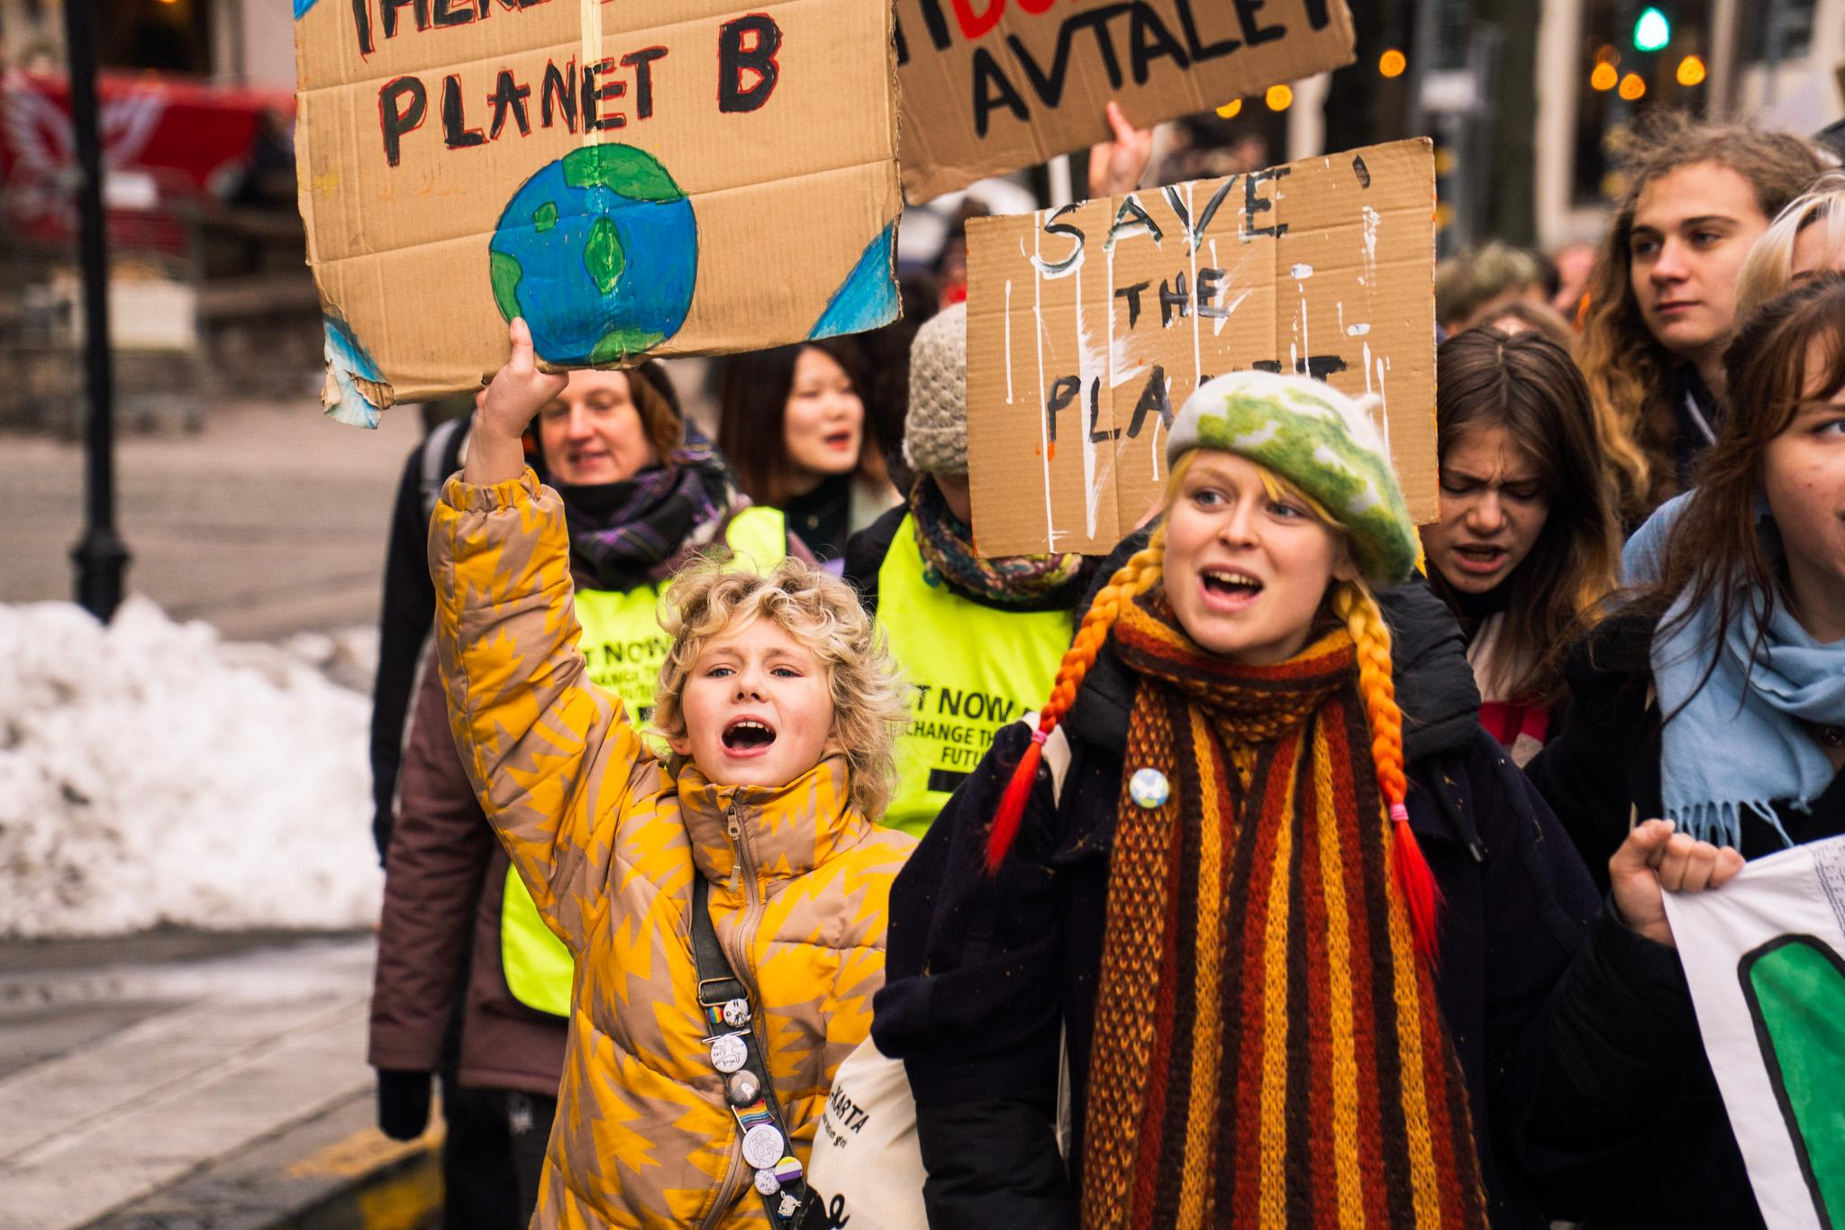
Background: Swedish procedural law and climate-related access to justice
No specific remedy
Swedish Climate Act contains no AtJ provisions
→ Human rights-based civil action against the State
Risks

Slide 7
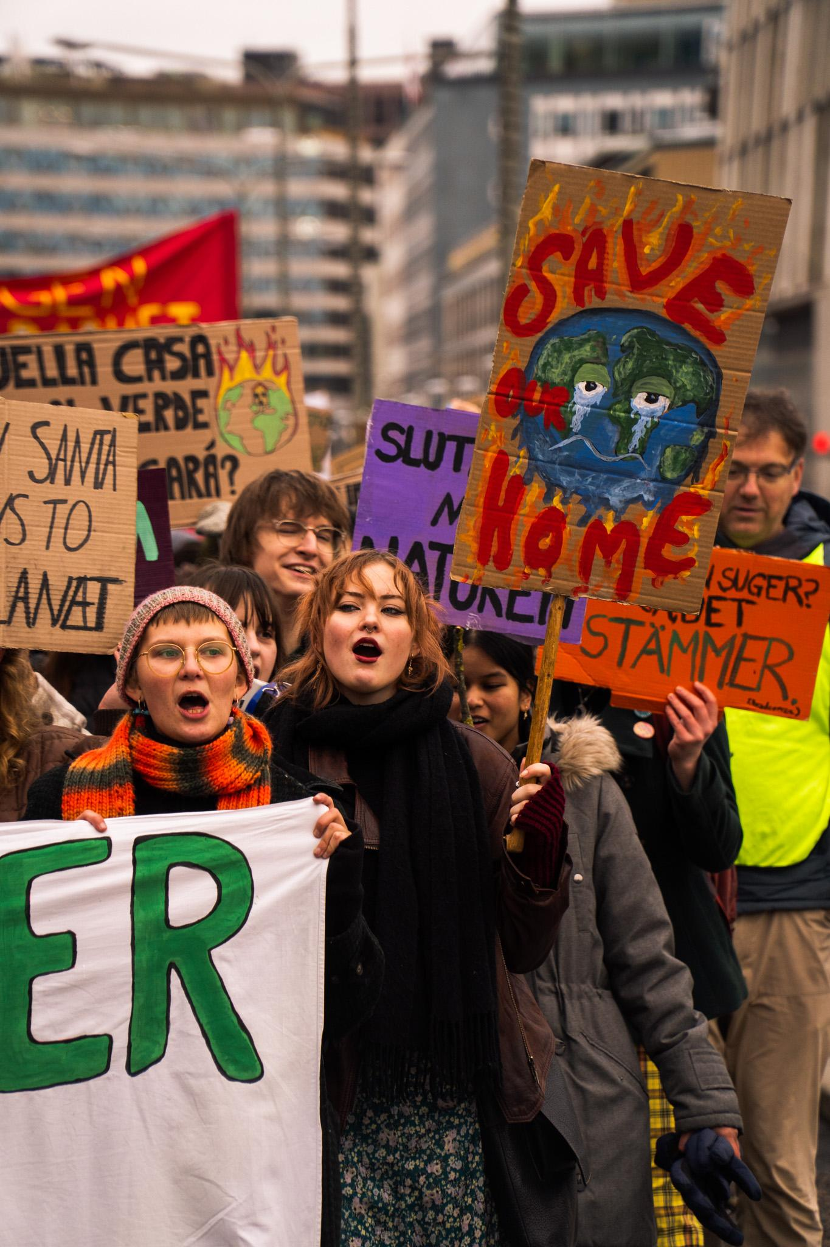
Standing: our chosen path
Class action (one main plaintiff)
Individual plaintiffs, but collective nature
Youth vulnerability

Slide 8
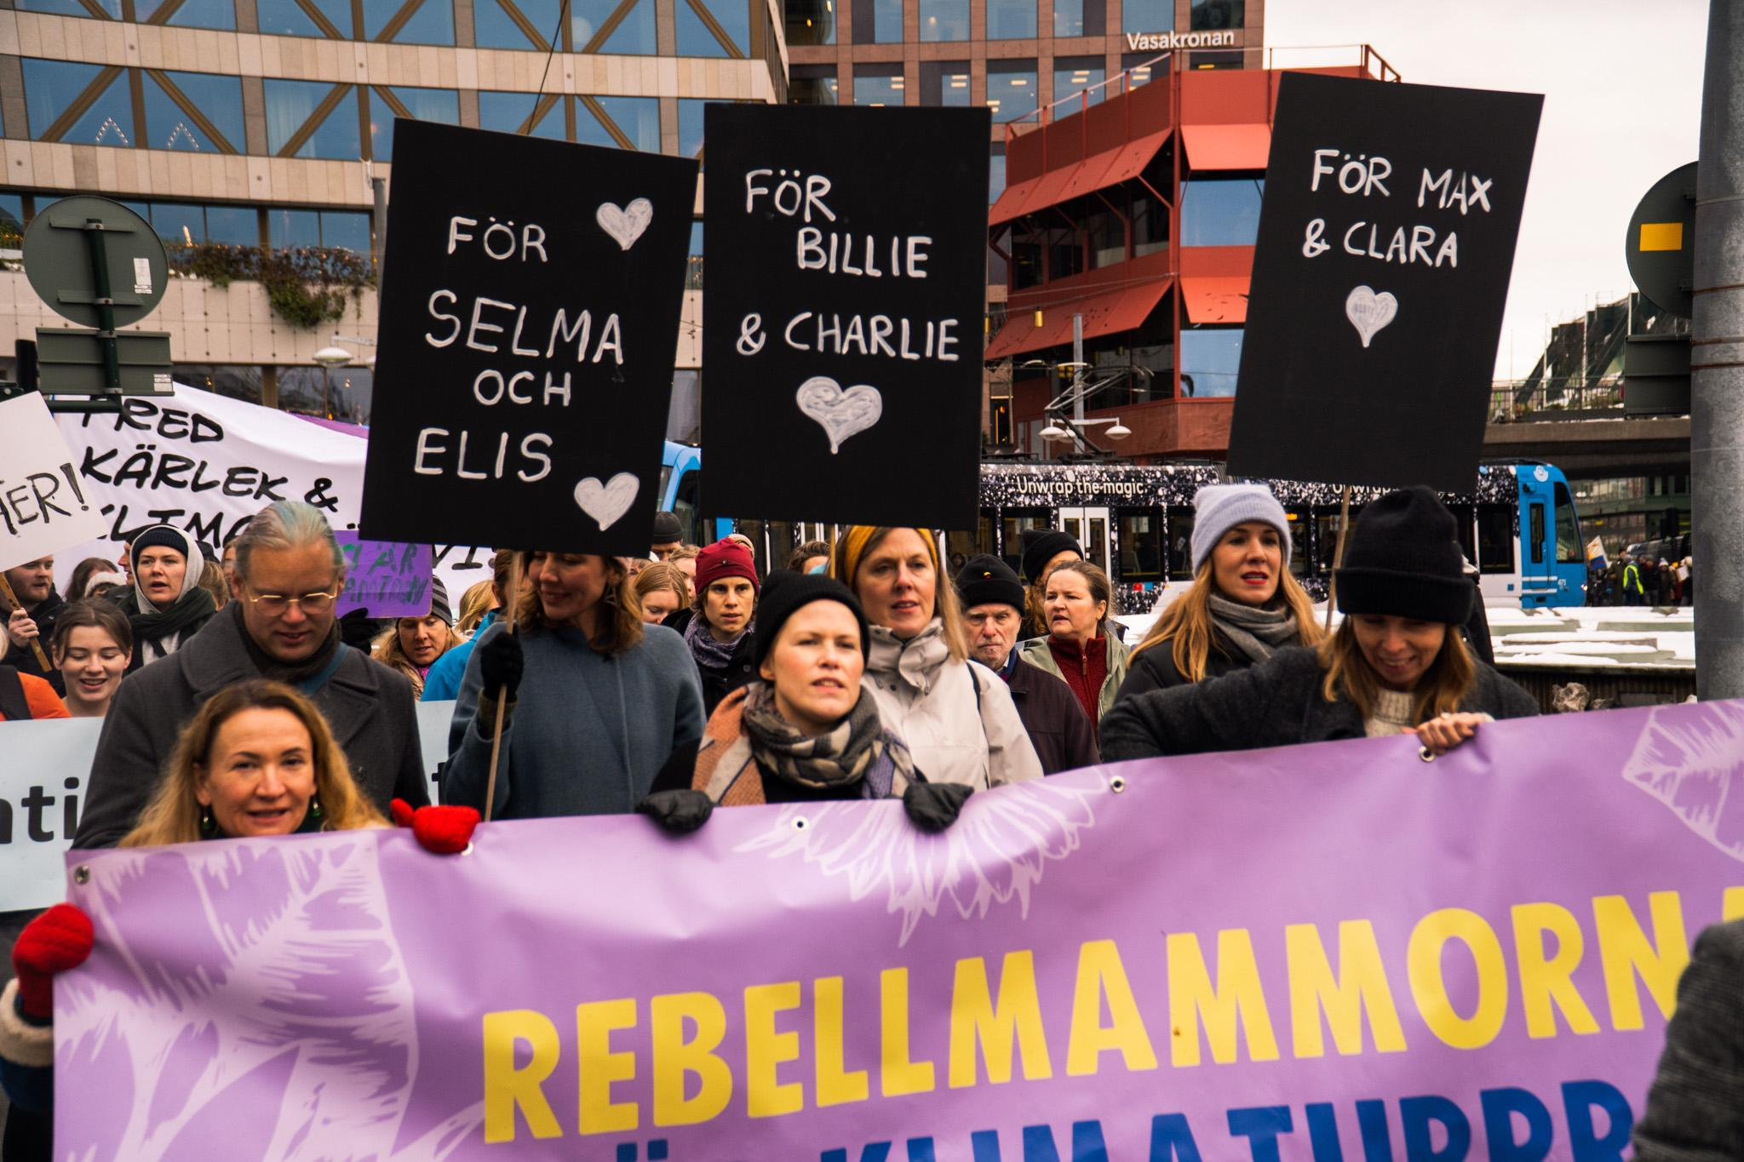
In light of the KlimaSeniorinnen ruling
Association standing (p. 502, e.g.)
“Especially high” threshold for individuals (p. 488)
Class action comparable?
Intergenerational burden-sharing (p. 410, 419, 420, 484, 489, 499)
(Case of Verein KlimaSeniorinnen Schweiz and others v. Switzerland, no. 53600/20)

Slide 9
Thank you! Questions?
auroramalet.se/en
ida.edling@auroramalet.se

