Slide 1
Kas inimene võib ka kehaga õppida ja mida? Kas ka ajuta …
Kristjan Port, TLU
14.05.2018
Rahvusvaheline Muuseumide Nõukogu

Slide 2
Intelligentsus rajaneb aju rakendamisele
Liikumisaparaadi juhtimisel koormatakse suuremat osa ajust kui filosofeerides, peast arvutades, kirjutades, maalides jne…
Kardame sarnaneda loomale, mistõttu kehalist geniaalsust häbeneme

Slide 3
Milleks inimesele +650 lihast?
Ajuta sport?
Miks kehalist geniaalsust ei taheta tunnistada tuleneb meie kristlikust hirmust sarnaneda loomaga
Mäletate kui suur šokk oli Darwini teooria (ja on tänaseni)
Mitte-kehaline intellektuaalsus hoiab meid eemal „loomaks olemisest“

Slide 4
Barkley 100

Slide 5
Triple DECA Iron

Slide 6
Sri Chinmoy Self-Transcendence 3,100 Mile Race

Slide 7
Trans Europe Foot Race

Slide 8
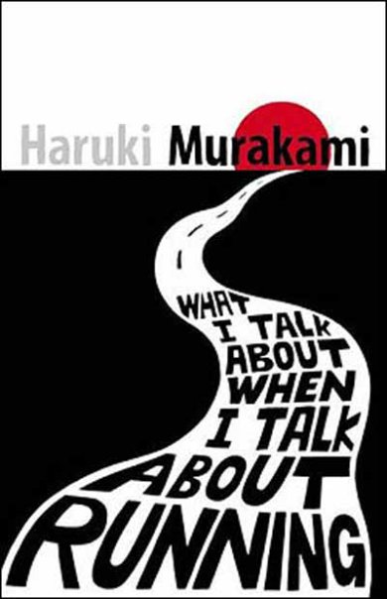
“An unhealthy soul requires a healthy body.”

Slide 9
“I didn't start running because somebody asked me to become a runner. Just like I didn't become a novelist because someone asked me to. One day, out of the blue, I wanted to write a novel. And one day, out of the blue, I started to run-simply because I wanted to. I've always done whatever I felt like doing in life. People may try to stop me, and convince me I'm wrong, but I won't change.”

Slide 10
90% triatleetidest omavad kolledži või kõrgemat haridust, tavapopulatsioonis on vastav näitaja 30%
Brett Maune (kvantelekrtroonika, Hughes Research Laboratories, võitis maailma raskeimaks peetava Barkley maratoni) koos 15 teadlasega arutasid suhet maratonidesse: osalejate seas on teadlased oluliselt rohkem esindatud kui populatsioonis keskmiselt … eriti astro/füüsika valdkonnast … paistab sobivat töö nõuetega … enamuse ajast arvutite ees, intellektuaalselt kestvalt tegevad kindla probleemi lahendamisega … sa ei pea olema kiireim, pead jaksama edasi rühkida … kõik see uuesti kirjutamine, pidev arvutamine, maailma dekodeerimine on vaimselt väga kurnav … joostes, rattaga sõites teeb keha tööd ja vaim rahuneb … ning …
vaikiv pea hakkab täituma mõtetega, probleemide lahendustega, seostega …
What gives with so many hard scientists being hardcore endurance runners? - Sarah Scoles, Wired, 21.09.2016
Notes:
47.3% percent of trail runners and 72.9 percent of Running USA members make more than $75,000 a year. The median household income of UltraRunning subscribers is $122,000; 55 percent of triathletes make more than $100,000. Almost 90 percent of triathletes have attended college or more, compared to 30 percent of the general population

Slide 11
Kehaline treening stimuleerib intellekti läbi mõtete voolavuse … olla samal ajal teadlik ümbrusest ja edendada mõtteid … olles paremini treenitud suudad hallata järjepidevamaid mõtteradasid … treeningu lõpus tunned nii kehalist kui vaimset heaolu … see on väga rikastav … jalutades, joostes või rattaga liikudes oled keskkonna suhtes tundlikum, võid soovides peatuda, olla vabam ja ärksam
- Jean-François Balaudé, filosoofia professor, Paris-Nanterre’ ülikooli president (Guillaume Lecaplain – Liberation, September 1, 2017)

Slide 12
Kargamine ja hüppamine kasulik aju arengule?
David E Koser et al. 'Mechanosensing is critical for axon growth in the developing brain.' Nature Neuroscience (2016)

Slide 13
Mis mõte on olla kui ei saa natukenegi lõbutseda?
#3 Lihased teevad meid õnnelikumaks
„Mäng on vabatahtlik katse ületada tarbetut takistust“ – Bernard Suits
Selleks on vaja: põhjustada teatud kindel olukord (n. ajada pall murus olevasse auku); tehes seda ainult vastavalt reeglitele, kusjuures reeglid keelavd kõige tõhusama viisi, eelistades vähema efektiivsusega viise (n. palli peab auku juhtima kepiga mitte käega); kusjuures reegleid tunnistatakse just seetõttu, et need teevad taolise tegevuse võimalikuks, st sa tahad tõesti mängida ja mitte petta.

Slide 14
#4 Lihaseid rakendatakse universaalselt elukvaliteedi parandamiseks iga kord kui selleks avaneb võimalus
Avastades jooksuratta, kasutasid vabas looduses elavad hiired võimalust selles jooksmiseks. Hiired, mutid, konnad ja isegi teod „käisid jooksmas“, kokku 200 000 looma 3 aasta jooksul. Paistab, et metsa elukad nautisid jooksmist, mis ei viinud neid kuhugi. Rattas jooksmises oli midgi eriliselt atraktiivset. Looduses, lagendikul niisama jooksmine oleks eluohtlik.
Isegi looduses tahavad hiired joosta „oravarattas“

Slide 15
#7 Lihased lükkavad majandust edasi
Kujuta ette riiki ilma spordita
Pelgalt „mängule“ kasutatud lihased loovad SKP’s kajastatud majandusest umbes 1.7% (rohkemgi sõltuvalt arvepidamisest)

Slide 16
Miriam S. Nokia, et al. Physical exercise increases adult hippocampal neurogenesis in male rats provided it is aerobic and sustained. The Journal of Physiology, 2016, DOI: 10.1113/JP271552

Slide 18
Jooksjate ajus võib olla rohkem ühendusi*
Ilma peenkoordinatsioonita monotoonne töö versus muusika instrumendi kasutus
Kas iseseisev mehhanism mille praktiline kasulikkus on laiem oskuste „treenimisest“?
Kognitiivse languse vastu, depressiooni ravis …
Ärkvelolekuga võrreldes joostes langeb neokorteksi energiakasutus ca 30%**
*Raichlen DA et al. Differences in Resting State Functional Connectivity between Young Adult Endurance Athletes and Healthy Controls. Front Hum Neurosci. 2016 Nov 29;10:610.
** Fischer SP et al. Stereotypic wheel running decreases cortical activity in mice. Nat Commun. 2016 Oct 17;7:13138
Notes:
Fewer studies have explored the neural effects of athletic activities that do not seem to rely on precise fine motor control (e.g., distance running). Here, we compared resting-state functional connectivity in a sample of adult male collegiate distance runners (n = 11; age = 21.3 ± 2.5) and a group of healthy age-matched non-athlete male controls (n = 11; age = 20.6 ± 1.1), to test the hypothesis that expertise in sustained aerobic motor behaviors affects resting state functional connectivity in young adults. Although generally considered an automated repetitive task, locomotion, especially at an elite level, likely engages multiple cognitive actions including planning, inhibition, monitoring, attentional switching and multi-tasking, and motor control. Here, we examined connectivity in three resting-state networks that link such executive functions with motor control: the default mode network (DMN), the frontoparietal network (FPN), and the motor network (MN). We found two key patterns of significant between-group differences in connectivity that are consistent with the hypothesized cognitive demands of elite endurance running. First, enhanced connectivity between the FPN and brain regions often associated with aspects of working memory and other executive functions (frontal cortex), suggest endurance running may stress executive cognitive functions in ways that increase connectivity in associated networks. Second, we found significant anti-correlations between the DMN and regions associated with motor control (paracentral area), somatosensory functions (post-central region), and visual association abilities (occipital cortex). DMN deactivation with task-positive regions has been shown to be generally beneficial for cognitive performance, suggesting anti-correlated regions observed here are engaged during running. For all between-group differences, there were significant associations between connectivity, self-reported physical activity, and estimates of maximum aerobic capacity, suggesting a dose-response relationship between engagement in endurance running and connectivity strength. Together these results suggest that differences in experience with endurance running are associated with differences in functional brain connectivity. High intensity aerobic activity that requires sustained, repetitive locomotor and navigational skills may stress cognitive domains in ways that lead to altered brain connectivity, which in turn has implications for understanding the beneficial role of exercise for brain and cognitive function over the lifespan.

Slide 19
Depressiooniga seostub aju kasvufaktorite (BDNF) madal tase ning aeroobse treeninguga kaasneb nii depressiooni vähendav kui BDNF taset tõstev efekt, potentsiaalselt pärssides süvenevat atroofiat*
*Erickson KI, Miller DL, Roecklein KA. The aging hippocampus: interactions between exercise, depression, and BDNF. Neuroscientist. 2012 Feb;18(1):82-97.

Slide 20
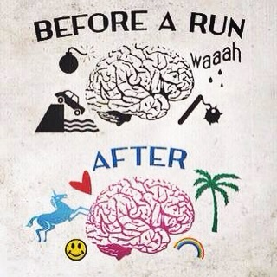
1 : 620 ameeriklasest läbis maratoni distantsi (2015)
1 : 5000 on ultrajooksja

Slide 21
The creative output increased by an average of 60 percent when the person was walking
Oppezzo, Marily,Schwartz, Daniel L. Give your ideas some legs: The positive effect of walking on creative thinking. Journal of Experimental Psychology: Learning, Memory, and Cognition, Vol 40(4), Jul 2014, 1142-1152

Slide 22
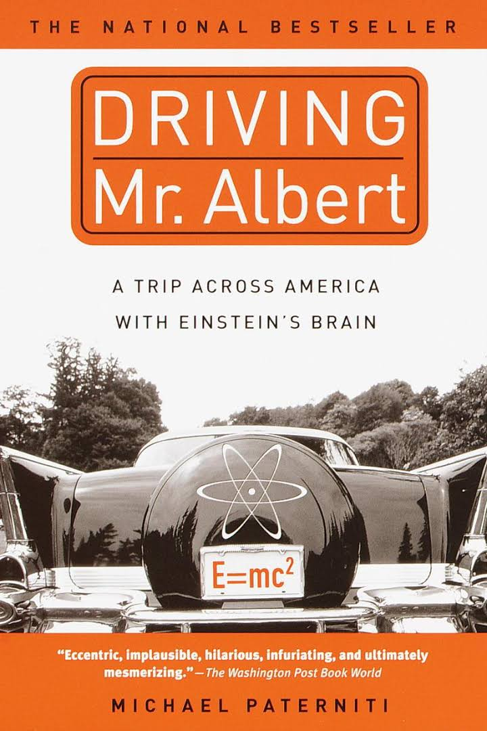
Enam-vähem* tavaline aju. Mõtlemine neurogeneesi ei käivita.
“I thought of that while riding my bicycle.”
― Albert Einstein
*doi:10.1038/nature.2012.11836
Notes:
Thomas Harvey, who performed the autopsy on Einstein in 1955 -- then simply removed the brain and took it home. And kept it for over forty years.

