Slide 1
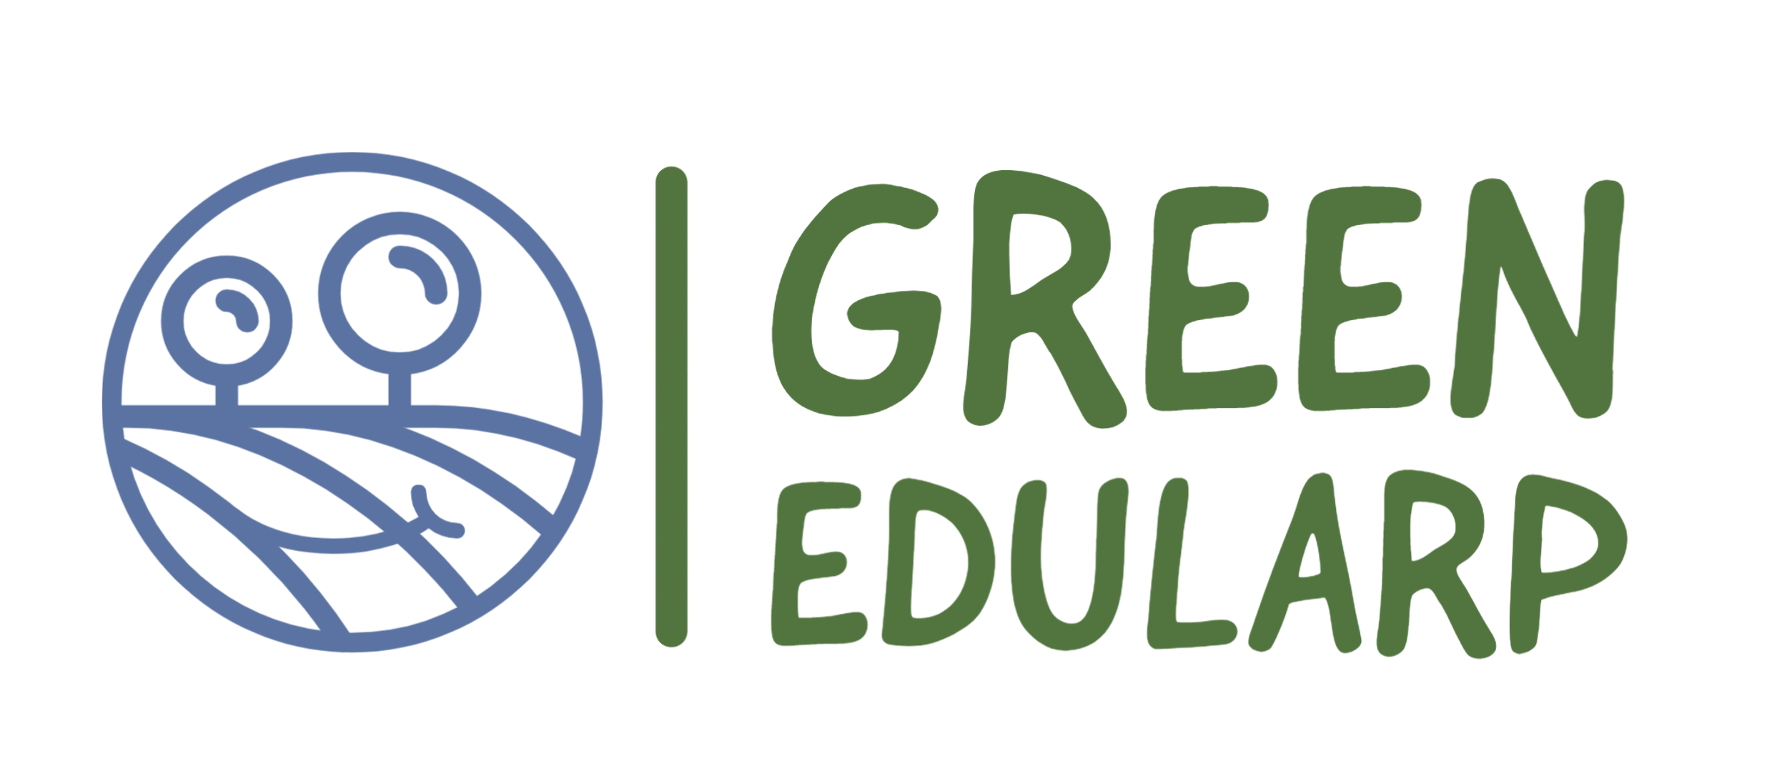
Using Environmental LARP in Education
Ederi Ojasoo
Peipsi Center for Transboundary Cooperation

Slide 2
Peipsi Center for Transboundary Cooperation
Our main focus:
- Environmental awareness and nature education
Cross-border and development cooperation
The scope of project activities continues to expand, with the major emphasis on creating projects that promote sustainable development, widespread cooperation and the pursuit of common goals to enhance the lives of the people living along the border area.

Slide 3
Today's school experience
Today's school experience in most of the world is quite different from that of their parents’ generation.
The learning process and the methods used are now more focused on learner’s personal and social development, learning skills, creativity and initiative.
Classes have become multicultural, students of different abilities and skill levels learn together.
The teacher's role at school is first and foremost to act as a mentor supporting the learner, helping them to orientate in an information-saturated world, construct new knowledge, relate it to the existing one, reflect on experiences and create a meaningful “big picture”.

Slide 4
Learning through play
In the learning process and the use of inclusive learning methods in schools, learning through play is also gaining popularity.
Well planned games for learning enables students to develop problem-solving and critical thinking skills, creativity, communication and teamwork skills.
The use of games in the learning process allows to give learners personalized tasks and concentrate their attention.

Slide 5
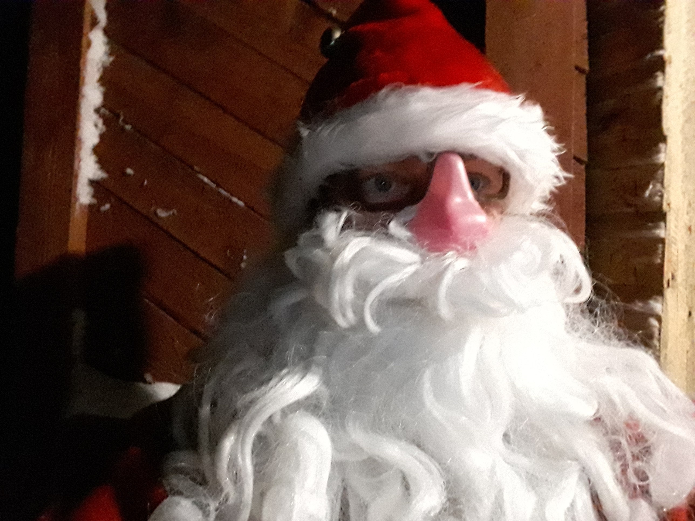
Educational live action role play (LARP)
In addition to educational computer games in the digital environment, it is also possible to use educational live action role play (LARP)in order to diversify learning experiences, explain different topics, play through situations and scenarios, and to simulate the consequences of one’s decisions.
Role-playing is any activity where the players pretend to be someone else.

Slide 6
Edularps
https://youtu.be/XPJQ2mNKL68

Slide 7
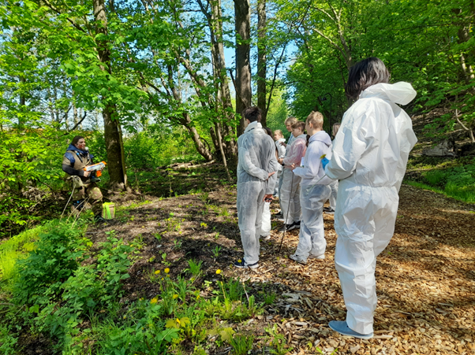
Project GreenEduLARP
Project GreenEduLARP aims at using the tool of EduLARP for Climate Change Education.
This way students but also teachers – as involved participants- will be connecting the topics related to Climate Change learned in classroom with real-life situations, therefore more easily relating them to their own life, making connections also on how green their life and attitude is.

Slide 8
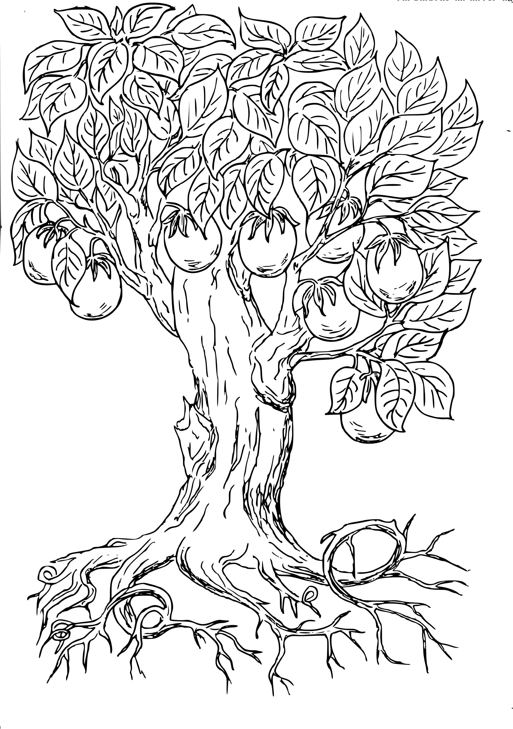
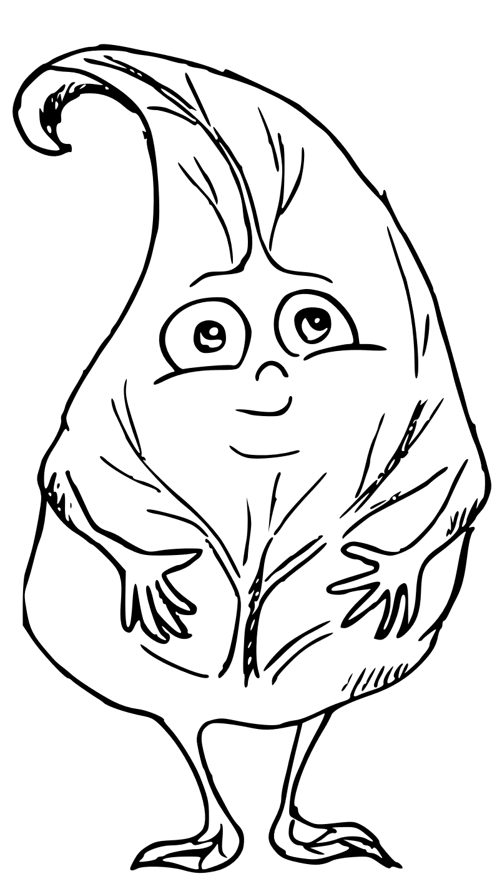
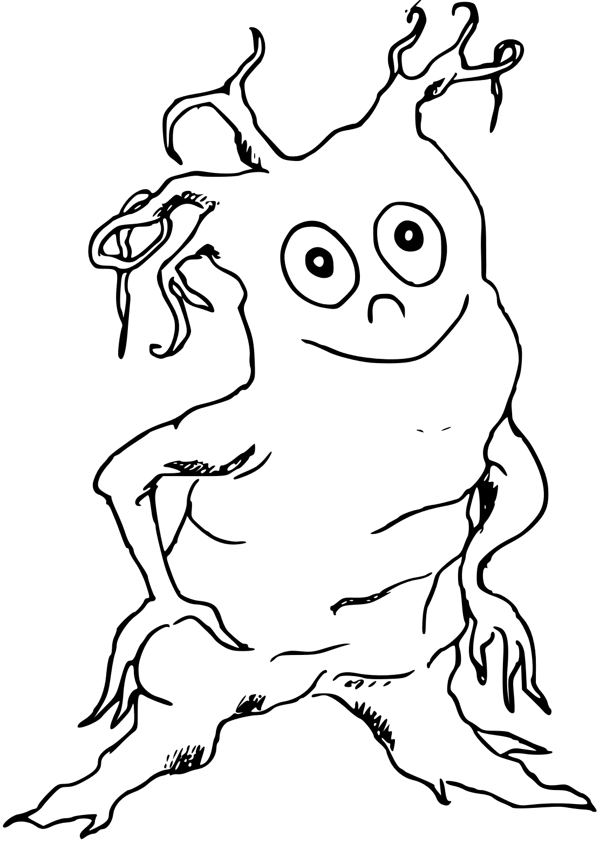
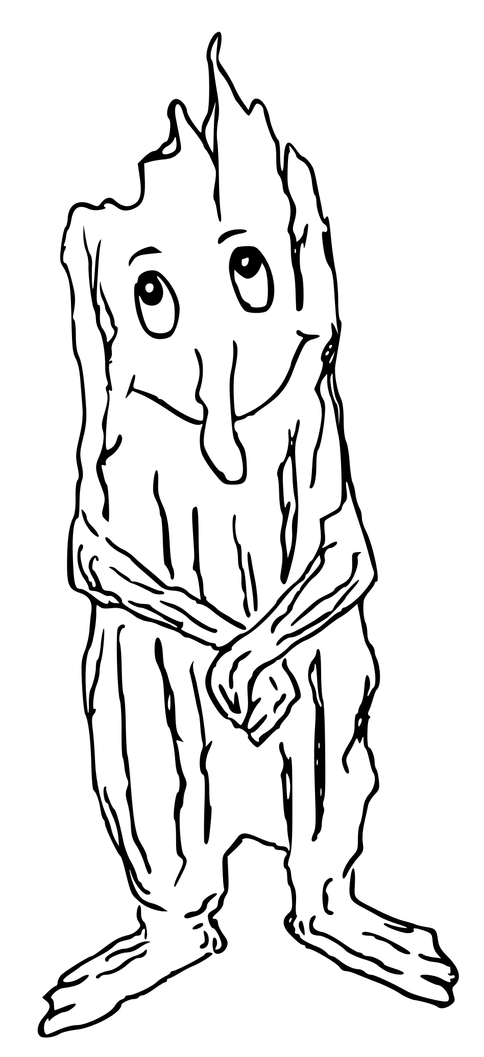
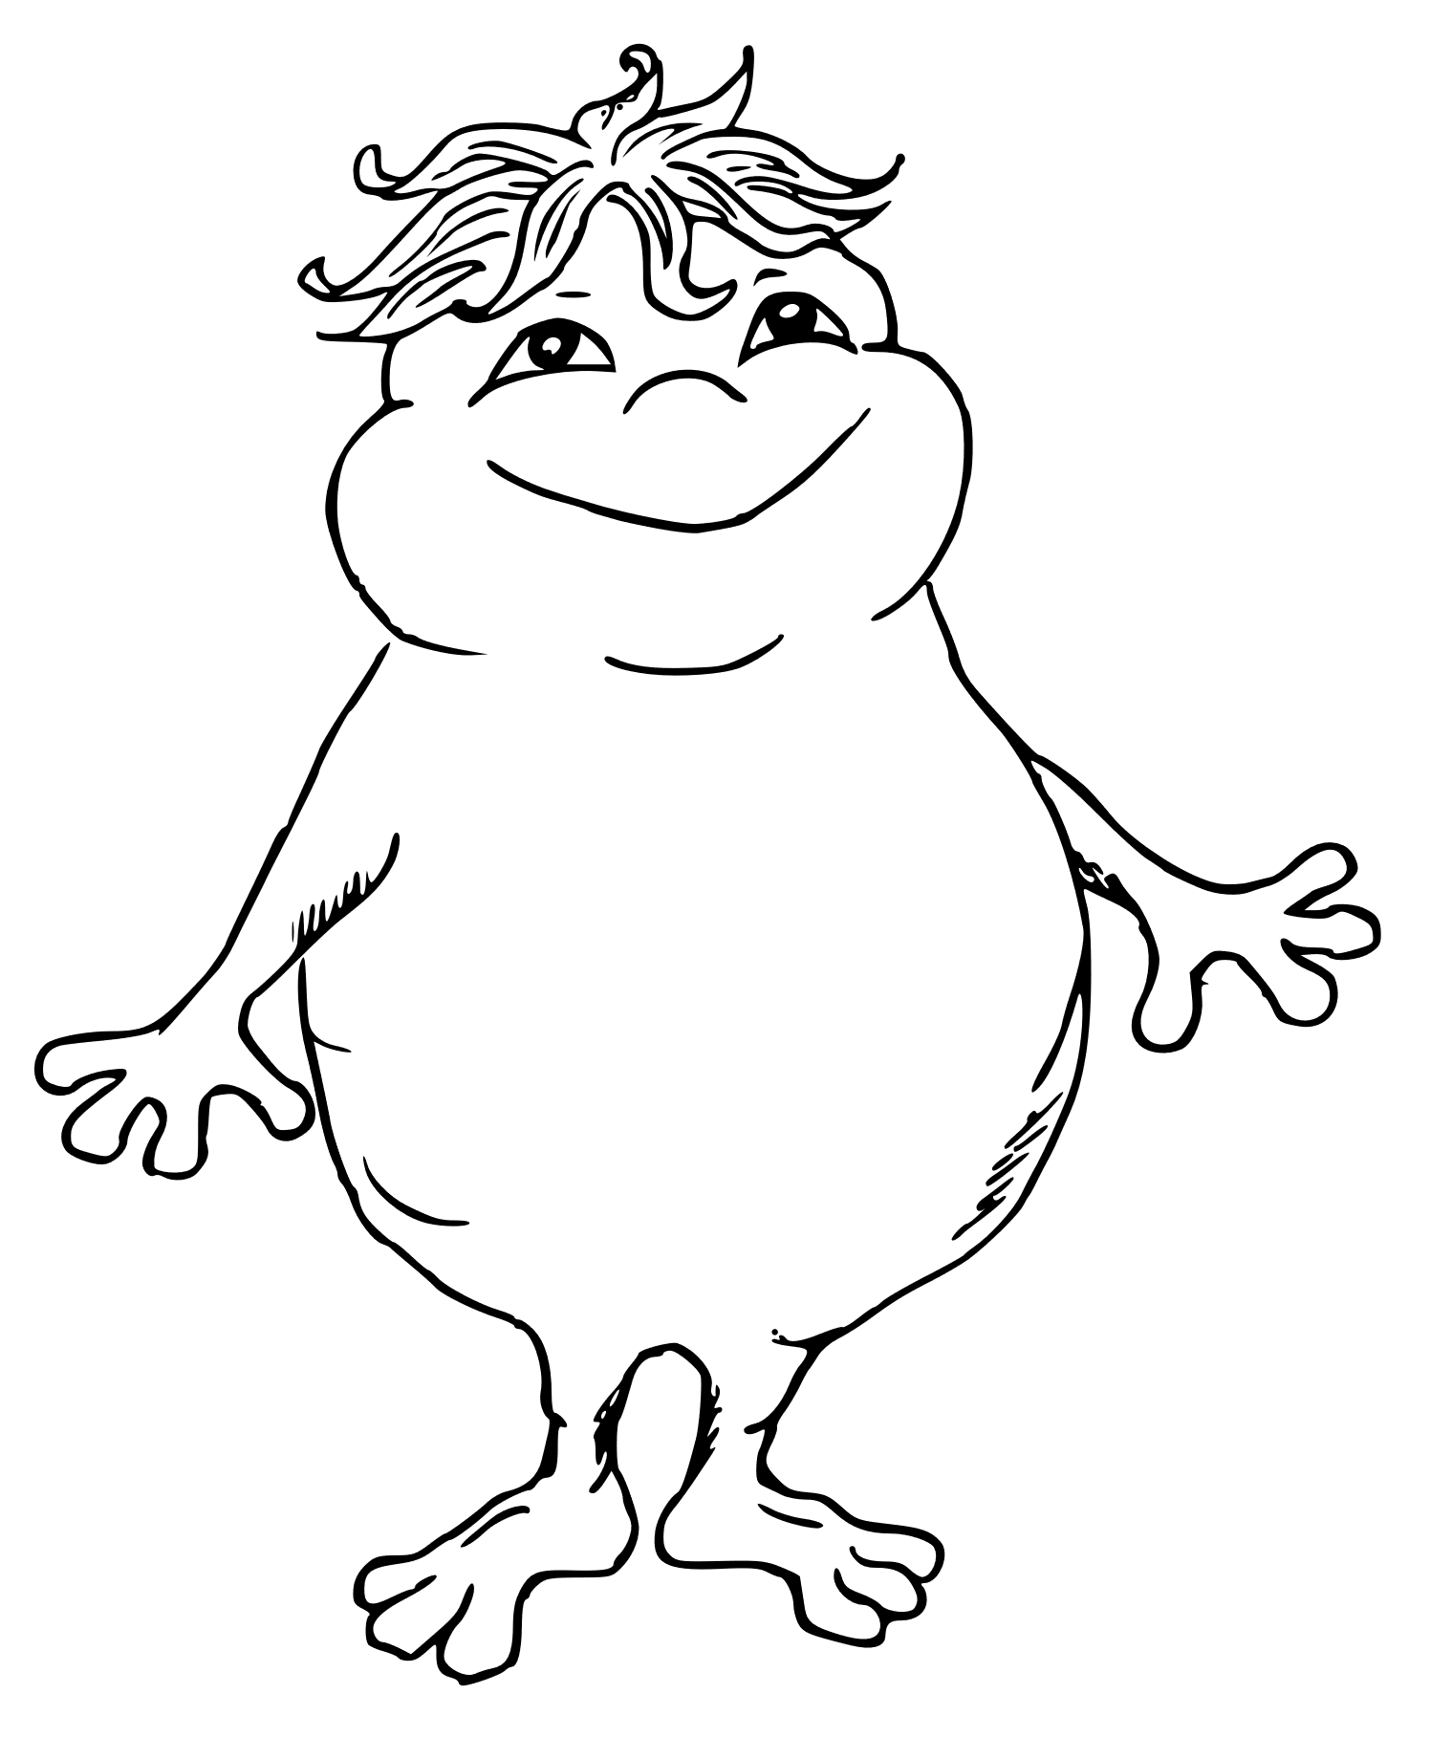
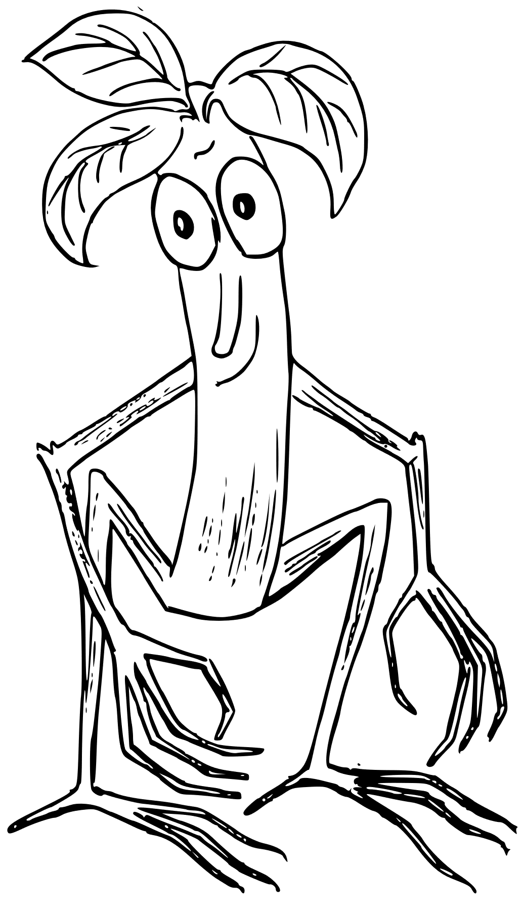
A Tree of Life
https://ctc.ee/activities-and-projects/implemented-projects/larp-for-climate

Slide 9
Project GreenEduLARP
The aims of the project are:
to empower teachers with new competencies in environmental education using LARP
to enhance students with confidence and agency skills through the LARPing methodology and teamwork.
to create accessible online materials about the method
to build a transnational strategy on how to adapt EduLARP methodology in school curricula.

Slide 10
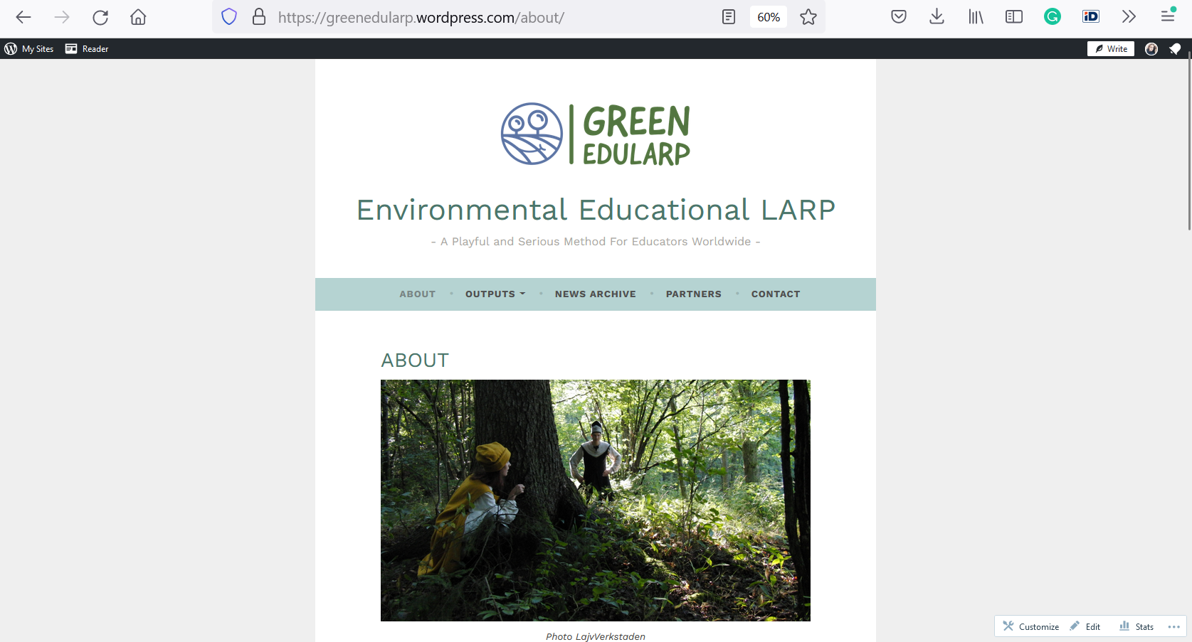
https://greenedularp.wordpress.com/about/

