Slide 1
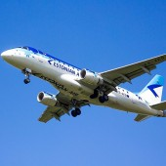
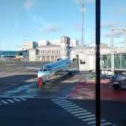
Sustainable aviation: how to implement the concept in Estonia?
Dr. Delia Dimitriu
Centre for Aviation, Transport,
and the Environment
Rovinari – 19 June2013

Slide 2
Sustainability.
Determining the complex environmental, economic and social impacts that are defining aviation’s future:
Environmental aspects
Economic aspects
Social aspects
A balance is needed between these three pillars…
Sustainable development is development that meets the needs of the present without compromising the ability of future generations to meet their own needs.
- From Our Common Future (the Brundtland Report)

Slide 3
Aviation, an Economic Engine
Air transport is a major contributor to global economic prosperityIf aviation were a country, it would rank 19th in terms of the size of economy.
Every day…
»» 8.6 million passengers
»» 99,700 flights
»» $17.5 billion worth of goods carried
(ATAG, 2014)

Slide 4
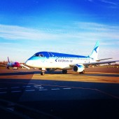
Aviation:Tourism
34 million Jobs in tourism supported by air transport
51% of international tourists travel by air.
$ 762 billion contribution to world GDP of air transport related tourism

Slide 5
Social Aspects
Aviation brings significant socially-related benefits, such as:
Freedom of mobility
Leisure
Health and welfare improvements through poverty reduction
Cultural enrichment and diversity
Connecting global society
Jobs/employment opportunities

Slide 6
Aviation’s Role in Global Aid and Social Development
In times of natural disaster or conflict, communities can quickly become displaced, isolated and left without proper access to food, water and shelter.
Commercial carriers fly personnel between major cities and ships deliver bulk food provisions to the nearest ports, etc.
In many cases, the presence of humanitarian staff depends on the availability of an air service to get them there and to get them out quickly when necessary.

Slide 7
Aviation: environmental responsibility
Worldwide, flights produced 705 million tonnes of CO2 in 2013.
2% of global CO2 emissions ( globally, humans produced over 36 billion tonnes of CO2).
70% Aviation emissions per passenger kilometre are over 70% less than in the 1960s
High ocupancy:
Aircraft 77%
Train 40%
Coach 60%
Car 30%

Slide 8

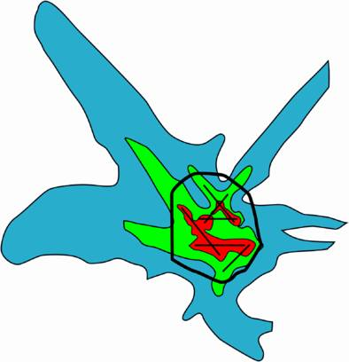


Multiple Environmental Challenges
Community Noise Impacts
Global climate
The potential impact of aviation on global climate
Air Quality
Limiting or reducing impact of aviation on local air quality
Water Quality
Reducing significant impacts on local water quality
Waste management
Reducing waste /solid or liquid

Slide 9
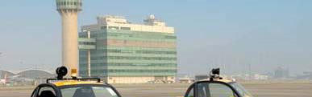






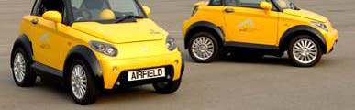

The Four Pillar Strategy
1) Invest in new technology
􀂃 Including sustainable aviation biofuels
2) Fly using more efficient operations
3) Build and use efficient infrastructure
4) Use effective economic measures

Slide 10
Global Industry Targets
2010
1.5% p/a fuel 50% Reduction Efficiency: Working towards Carbon Neutral Growth (CNG)
2020
CNG from 2010: Implementation of Global Sectoral Approach
2050
50% reduction in net CO2 emissions over 2005 levels
Goals are at the global level – not States or operators
Goals do not mean slowing down the growth of aviation

Slide 11
Three Imperatives
To ensure aviation license to grow:
1. Demonstrate that the sector can deliver on its targets
2. Make sustainable biofuels a success for aviation
3. Convince policymakers that a global approach is the only way forward

Slide 12
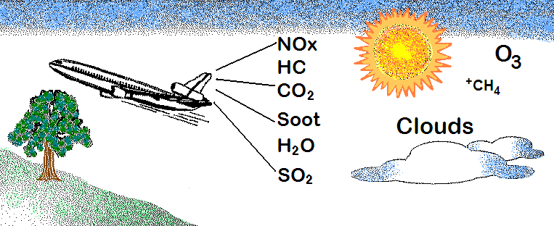
Aircraft Emissions in the Environment
Sun
Figure adapted from 1999 Atmospheric Effects of Aviation Project NASA /FAA /EPA Partnership poster

Slide 13


Sustainable Aviation — The Problem
Without significant action we will have major delays, large economic and environmental impact.

Slide 14
Sustainable Aviation — The Initiative
Goal: Develop technologies that will allow a tripling of capacity with a reduction in environmental impact.

Slide 15
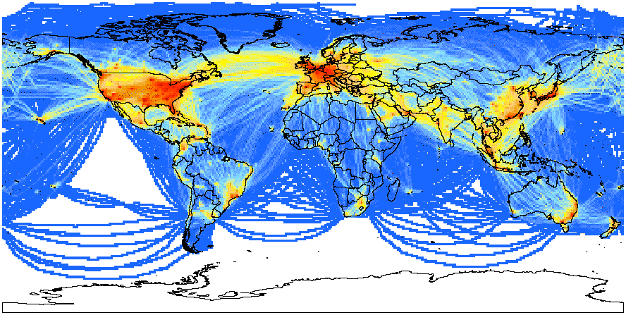
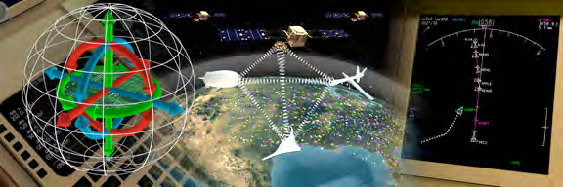
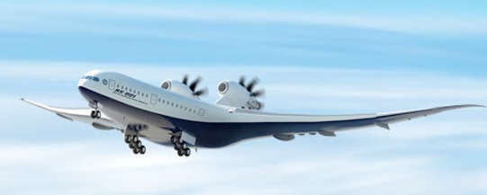
Research Thrusts
Active monitoring and managing air
transportation’s environmental
footprint
Safely increase the capacity of the
airspace system
Aerospace system design
for the environment

Slide 16
Aviation Sector Initiatives (1)
1. Research
- Understanding the issue
- Modelling and simulation
- Air Traffic Operations
Environmental management to reduce impact
2. Implementation
- projects on aviation growth, airport capacity, ATM/New operational procedures; alternative fuels, etc.

Slide 17
Aviation Sector Initiatives (2)
Work collaboratively - domestically
- Airlines and airports
- Terminal area re-design
- Tailored arrivals
- Corporate programme
International Cooperation
Work collaboratively - across the entire aviation sector- Asia & South Pacific
- Initiative to Reduce Emissions (ASPIRE): Green aviation routes will deliver environmental best practice to airlines across Asia Pacific and North America

Slide 18
Biofuel Opportunities
Biofuels: present and future challenges: the feedstock for them would be algae; camelina; mallee trees, jatropha and halophytes;
Already commercial, as well as military, planes did some tests:
  Air New Zealand (jatropha), Continental Airlines (jatropha & algae), Japan Airlines (jatropha, camelina, and algae), and KLM (camelina).
- Gol- 300 flights summer 2014, using farnesane (sugar cane based)
The importance of biofuels popularization in order to establish a market for production, distribution, and operation on a daily basis.
The need: production at an affordable price
‘available and affordable’

Slide 19
Collaboration on Infrastructure
The ATCs target by 2050 is 96 percent airspace efficiency, which means that planes will be taking only the most efficient routes.
Importantly is collaborative decision making of all stakeholders: air navigation services providers, governments, airports, and airlines

Slide 20
Collaboration on Operations
Flight operations (eg. APU fuel savings, pilot technique and flight management, engine out, taxi out):
- flight dispatch (e.g., cost index optimized and pilot & dispatcher additional fuel);
- engineering and maintenance (including APU maintenance, aerodynamic & airframe drag);
- regulatory measures (ground operations and performance based navigation).

Slide 21
Exploring the Interdependences
Interdependencies lead to CO2 reductions, environmental concern increase, and foster investment in alternative energy sources.
The noise and emissions are very crucial concerns for communities, therefore, airports should work on the relationship from the very beginning, as when a problem appears, that is too late.
Flight path designations due to noise preferential routes, track concentration, and continuous descent approach are important to work on, however, airports cannot forget recording and responding to complaints.
Airports need to have communities involved, and then the regulator is more likely to help.

Slide 22
Stakeholders
Governments
Regulators
Airports
Airlines
ANSP
Public/ airport residents
NGOs
Research community

Slide 23
Target_short-term: reducing noise & CO2
Noise & emissions improvements have historically gone hand-in-hand
Aviation cannot afford to lose ground on either:
- Conventional architecture can both improve fuel burn and reduce noise levels to be within airport boundary
- Open rotors, while promising, require more development to
resolve inherent noise issues

Slide 24
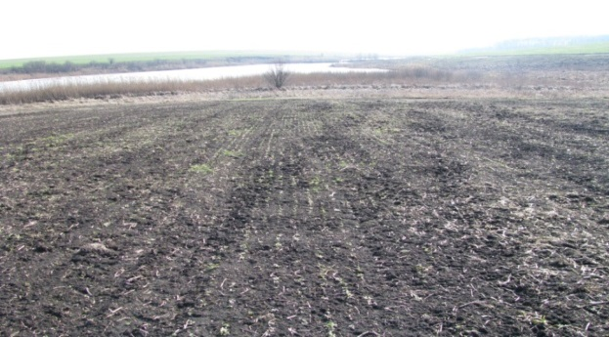
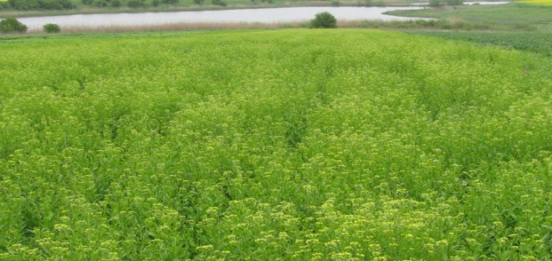
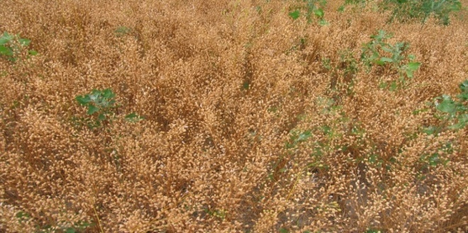

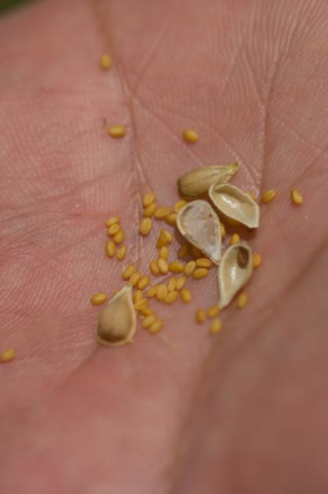
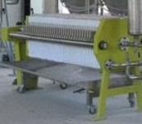
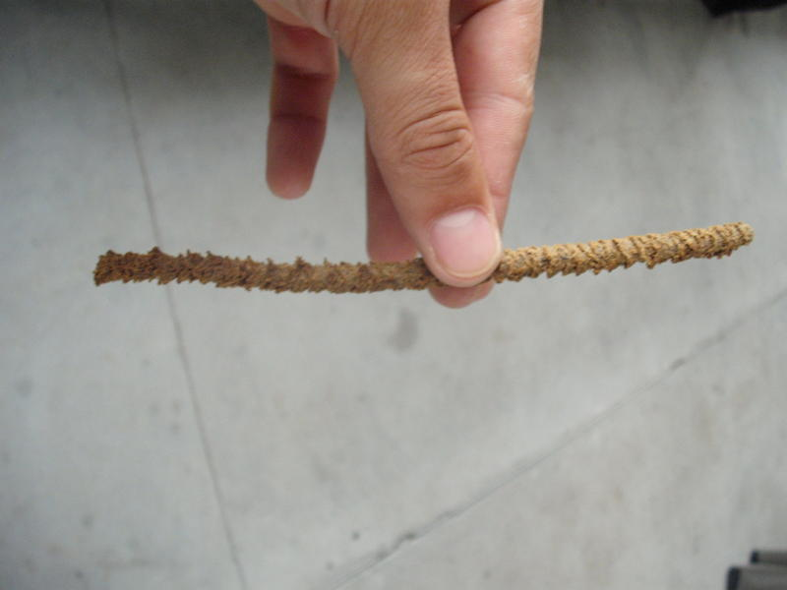
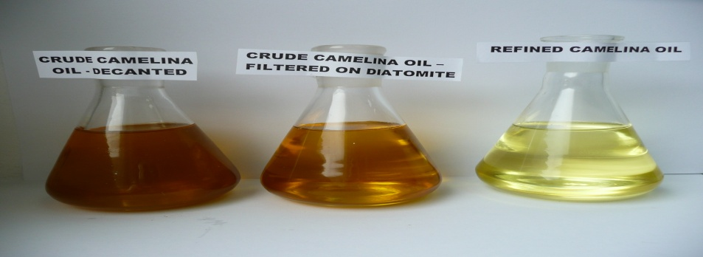
Alternative fuels … evolution, not
revolution
Carbon free implies alternative fuels … but there is no fix answer:
- Camelina value chain - a European feedstock-

Slide 25
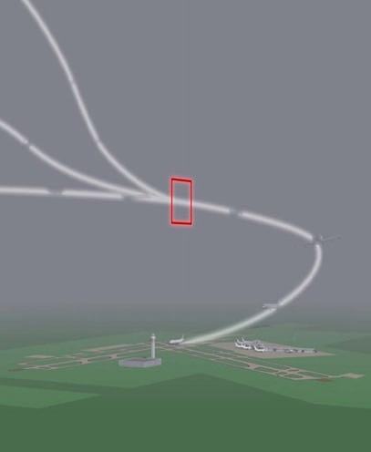
Operational Measures –
Global Standardization
- CDA’s
- Optimized Descents
- RNAV/RNP
- ADS-B in and out
- RVSM
- Steeper than Normal Approach
- Deeper Cutbacks
- Single-engine taxi
Important: growing within environmental capacity- sustainable development of aviation

Slide 26
How to implement the sustainability concept in Estonia; case study: Tallinn/Tartu Airport(s)
Objectives
To identify appropriate definition for sustainability at Tartu Airport, linked to its role in supporting regional development
To design necessary steps for implementation of a sustainability strategy in line with stakeholders expectation and priorities
To assess implications of the findings through a roundtable discussion with main stakeholders, including airline representatives
To identify initial sustainable indicators and potential targets
To describe a suite of possible projects and sources for funding as part of a sustainable development action plan
To assist in the development of an information package to support the airport dialogue with its various stakeholders.

Slide 27
Approach
Review of best practice in airport sustainability to inform the drafting of a be-spoke
Design a Sustainable Development Strategy for Tartu/ Tallinn Airport
Stakeholders dialogue, involving interviews to refine the Sustainable Development Strategy
Consultation with key stakeholders over an implementation action plan

Slide 28
Phase 1: Initial review
Task
Define what is meant by sustainability for Tartu/Tallinn Airport
Examine the existing EIA study, other internal sources, as well as national & local requirements regarding environmental compliance and existing references to sustainability
Review of lead-edge airports’ sustainability strategies: focus on noise management and action plan; air quality; water…waste
Clarify the role of the airport in the region, identify the social and economic benefits and the environmental and social costs associated with the Airport’s operation and expansion
Output - Report: compare current Tartu position and initiatives with accepted best practice across the sector in order to identify gaps in provision and how best to meet these challenges

Slide 29
Phase 2: Identify steps towards attainment of a sustainability strategy
Task 1
a. Clarify potential constraints to growth and explain how they might be addressed: i.e. identify if noise is an issue
b. Assess the priorities regarding development of Tartu/Tallinn Airport, expressed by its line management in existing statements and documents.
c. Understand the implications for future sustainability arising from predicted growth
Task 2
In the light of identified future priorities and emerging sustainable development objectives, derived from the gap analysis above, produce a draft sustainable development strategy for Tartu/Tallinn Airport.
Output - Draft Sustainable Development Strategy (SD)

Slide 30
Balanced approach to aircraft noise management
Noise reduction at source
Understanding and Management of
Noise Impacts
Reducing noise
impact of
air transport
Operational procedures
Environmental
Modelling

Slide 31
Phase 3. Stakeholder feed-back on draft strategy
Task 1
Identify the main stakeholders of Tartu/Tallinn Airport
Design an interactive stakeholder event (roundtable) to ensure input into the emergent Sustainable Development Strategy
Organise and deliver the stakeholder roundtable in cooperation with Tartu/Tallinn Airport and Tartu/Tallinn County Council (the owners?)
Task 2
Assess the roundtable findings and define roles and responsibilities in developing SD approaches
Develop a toolkit to communicate the Airport commitment to sustainability to its principle stakeholders – its employees, passengers, airlines, retailers, tenants, suppliers etc. and the communities in which it operates.
Output – Stakeholder Roundtable Event & Report with findings, roles and responsibilities

Slide 32
Phase 4. Identify possible projects and funding sources
Task 1 Action Plan
Develop initial sustainability indicators- identify possible improvement targets
Identify project designed to deliver improvements to core sustainable indicators; with links to the EIA (Environmental Impact Assessment) and any emergent EMS (environmental management system), as appropriate.
Liaise with local university to identify possible research partners for future projects.
Liaise with the Environmental Agency regarding the update of the existing noise strategy, noise maps and action plan (s)
Indicate possible funding sources.
Task2
Prepare 1 article to promote sustainability approach of Tartu/Tallinn Airport
Output – SD Action Plan and 1 article (content to be agreed by Airport(s) senior management)

Slide 33
Conclusion
Aviation is growing world-wide, and so is its environmental impact
Approach needs to be proactive…better than reactive;
Every aspect needs to be assessed and mitigated accordingly
Assess and manage accordingly:
  noise
  air quality
  emissions
  climate change
  water, waste
  energy, etc.

Slide 34
Conclusion (2)
If aviation is to continue to play a role in newly emerging visions for sustainability, it must demonstrate that it can deliver a positive balance across social, economic and environmental metrics… cultural & political approach to be considered
Furthermore, all practical opportunities to minimize adverse impacts should be seen to be achieved, otherwise aviation will not be perceived by society as achieving the required balance.

Slide 35
Conclusion (3)
New initiative for sustainable aviation provides:
• A strategic approach to develop business: managing environment responsible means cost reduction
A framework for integrating research in the sector
• A vital field of study for future students
• A focus on the most important problem in aviation
Questions?

Slide 36
Thank You
For Your Attention

