Slide 1
How to measure fire prevention activities: a practical workshop
Tarmo Puolokainen // University of Tartu
Uku Varblane // University of Tartu
Brussels 2018
Notes:
For fire prevention activities, the aim is to decrease the number of emergencies and fire casualties. In order to analyse, whether the undertaken fire prevention activities have the assumed effect in pursuing their aim, an impact assessment is needed. The EVAPREM 2017-2018 -project is developing a model for evaluating the results of prevention measures implemented by the rescue boards of European countries.

Slide 2
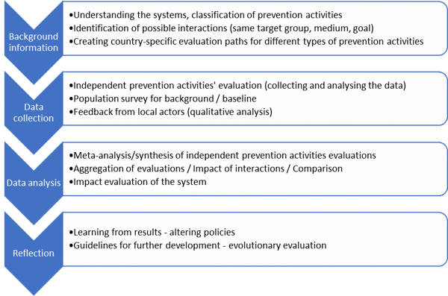
Steps of the analysis
Notes:
Tagasiside küsitluse vorm,

Slide 3
First step..
Background information
Understanding the systems, classifications and prevention activities
Identification of possible interactions (same target group, medium, goal)
Creating country-specific evaluation paths for different types of prevention activities
Notes:
Tagasiside küsitluse vorm,

Slide 4
Exercise 1: mapping the existing mix of fire prevention activities
Please list all fire prevention activities implemented in your region
Ca 10 min
Notes:
Tagasiside küsitluse vorm,

Slide 5
Personified activities
INDIVIDUAL – AT HOME
Individuals, households, professionals
Face-to-face
Feedback forms, calls
Standardized activities
CLOSED GROUP – WORKPLACE, SCHOOL
School children, work collectives
Face-to-face, exercise
Ex ante and ex post evaluation (tests, randomized groups)
Event-based activities
OPEN GROUP – PUBLIC ROOM
Exhibition/event visitors
Face-to-face, brochures, exhibits-boxes
“exit polls”, feedback forms
Large-scale media campaigns
General information provision
POPULATION GROUPS – MASS&SOCIAL MEDIA
Population, targeted group of population
TV- and radio advertisement, social media, newspapers
visibility evaluation, (social marketing campaign evaluation)
ENTIRE POPULATION – MASS&SOCIAL MEDIA
Population, targeted group of population
TV- and radio appearance, social media, newspaper articles
dependent on each activity
Exercise 2: classification of individual activities
Using the current framework, please classify the existing fire prevention activities under these categories
5-10 min
Notes:
Tagasiside küsitluse vorm,

Slide 6
Data collection
Data collection
Experiences of project partners
Notes:
Tagasiside küsitluse vorm,

Slide 7
What to do with this data?
Reflection
Experiences of project partners
Notes:
Tagasiside küsitluse vorm,

Slide 8
Discussion
Any questions? Comments? Ideas? Concerns?

Slide 9
Thank you for your attention!
Developing an evaluation model to assess prevention measures (EVAPREM)
Tarmo Puolokainen (tarmo.puolokainen@ut.ee)
Uku Varblane (uku.Varblane@ut.ee)
Brussels 2018

