Slide 1
SMART ACCESSORIES
Reno Meisalu
CEO

Slide 2
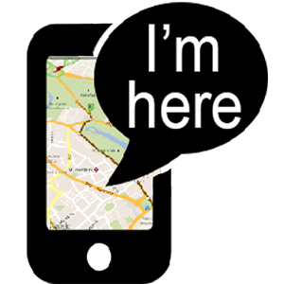
MILLIONS OF WALLETS ARE SOLD EACH YEAR, BUT STILL...
DISCONNECTED
IMPRACTICAL
UNINSPIRING
LOST AND LEFT HOME TOO OFTEN
UNSECURE

Slide 3
GRIFTERS WALLET
SLIM DESIGN
FITS 8 CREDIT CARDS
MAGNETIC MONEY CLIP
HIGHEST QUALITY LEATHER

Slide 4
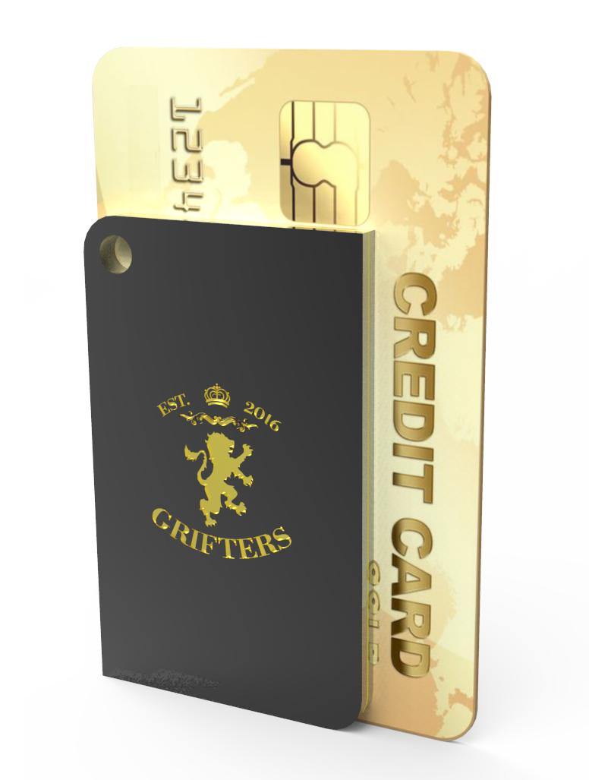
GRIFTERS TRACKER
BLUETOOTH SMART
TWO-WAY COMMUNICATION
CROWD GPS
RANGE UP TO 100FT OR 30M
90dB BUZZER

Slide 5
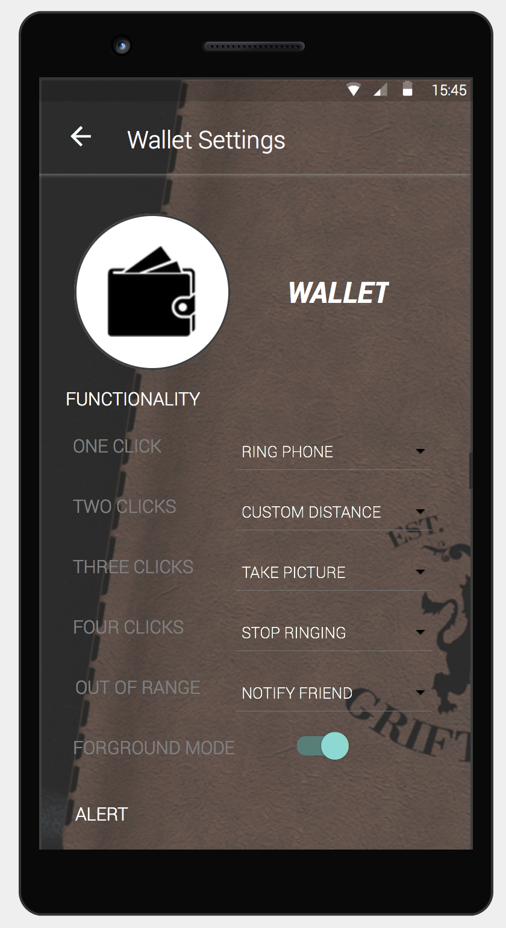
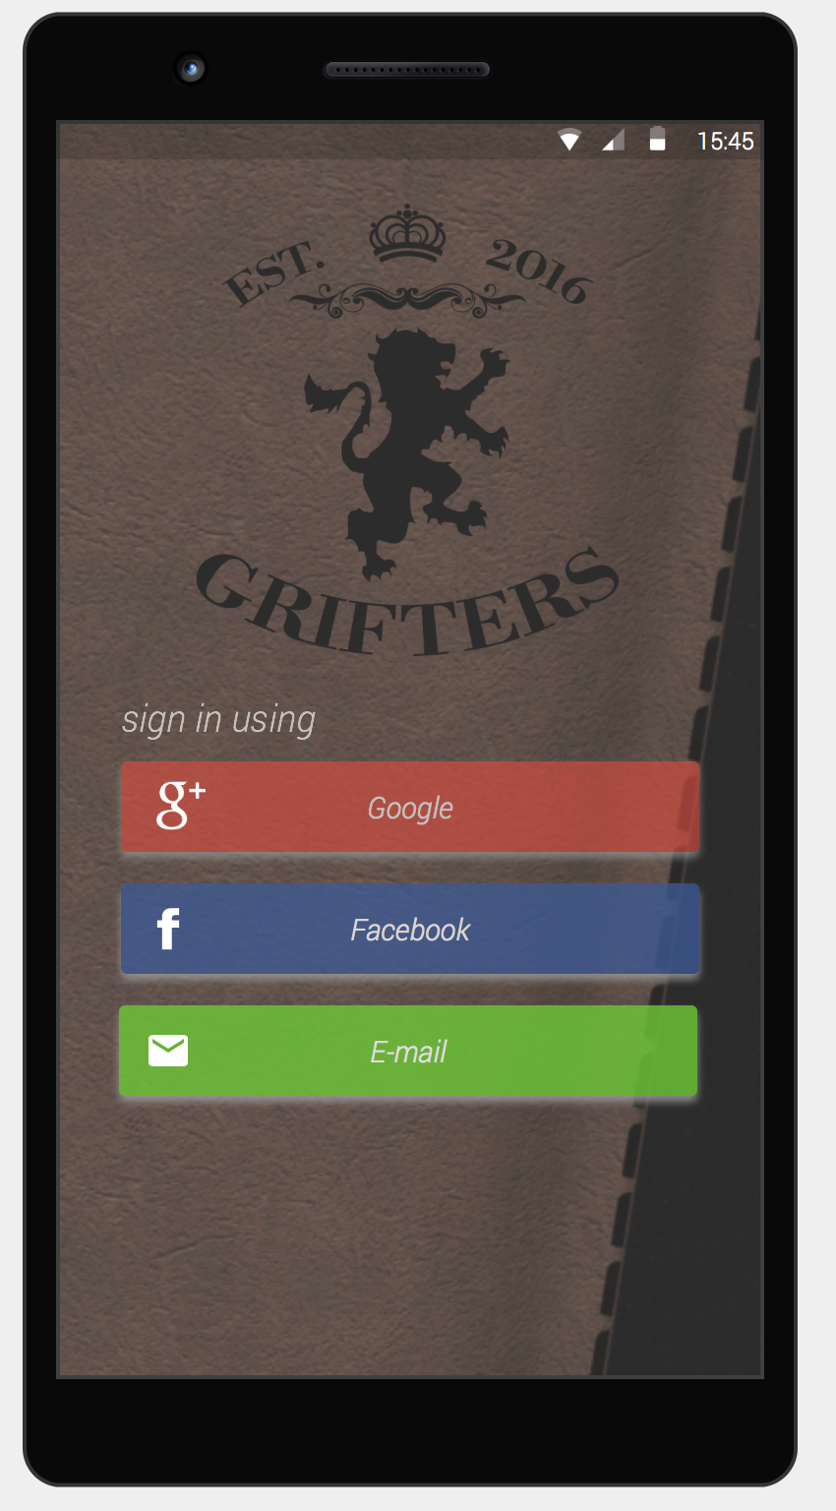
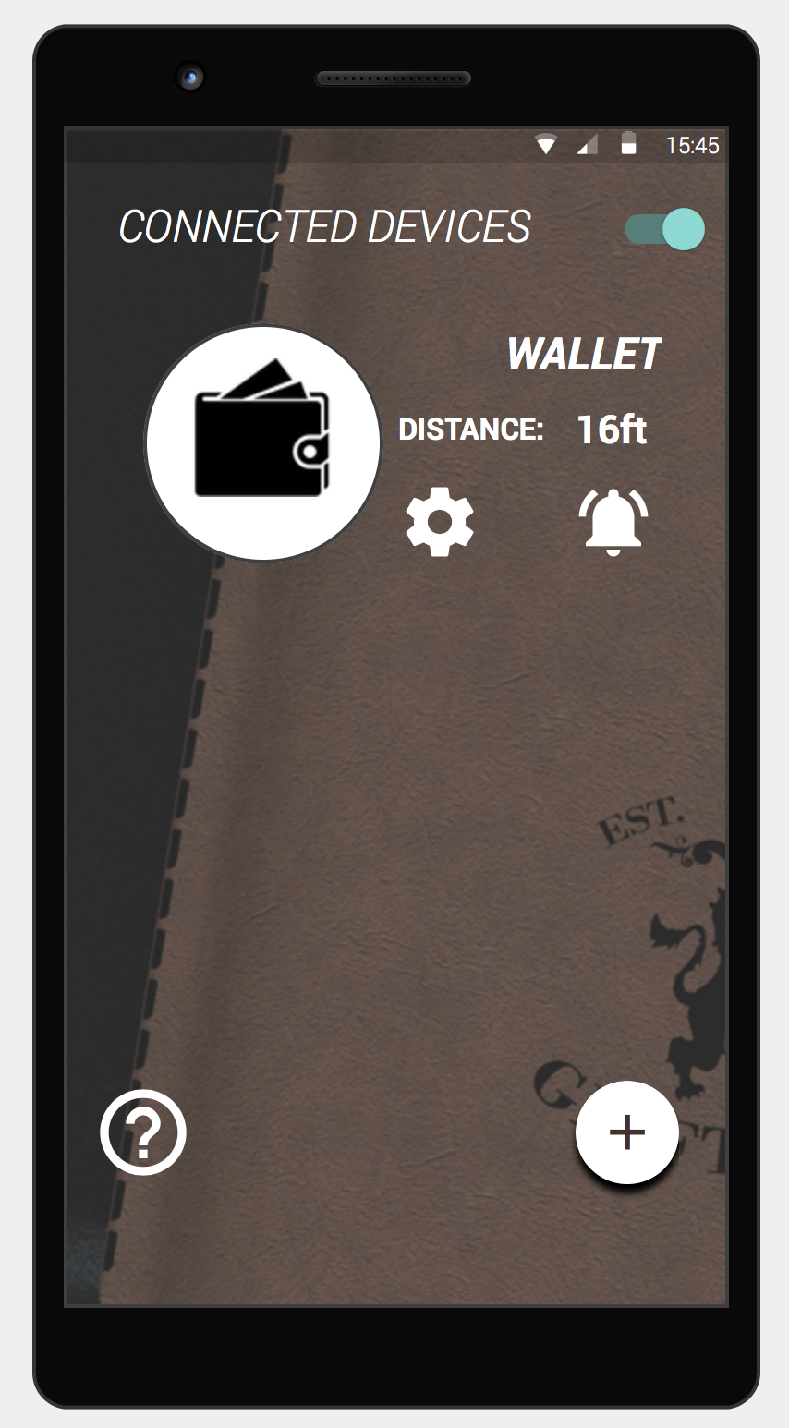
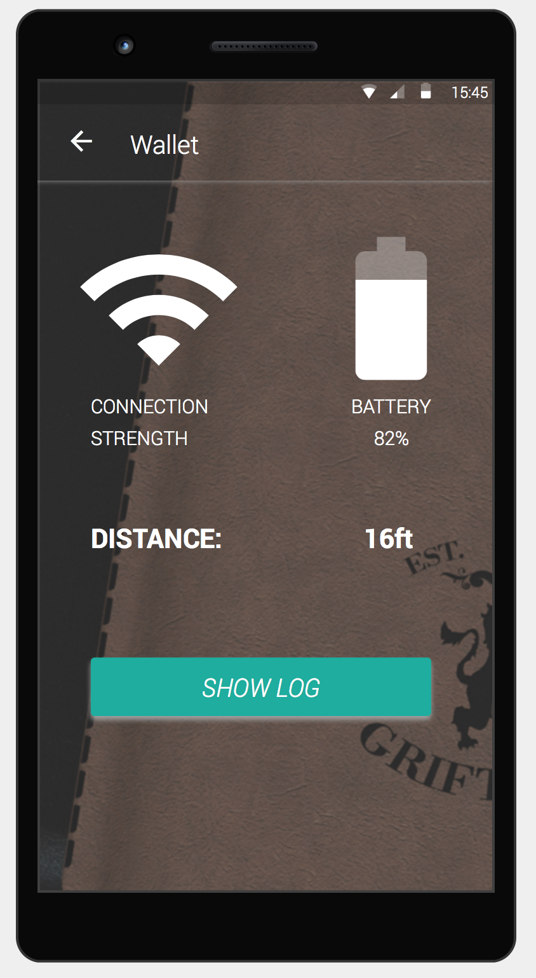
GRIFTERS APP
Android 4.3+ & iOS 7+

Slide 6
MARKET SIZE & COMPETITION
Tile 43M$ AND TrackR 12M$ (2015)
ESTIMATED BLE TRACKER MARKET SIZE IN 2020 371M UNITS
WE ARE OFFERING MORE VALUE AT A BETTER PRICE POINT.

Slide 7
TEAM & PARTNERS
RENO MEISALU
MARTIN MEISALU
MADIS VÄLJA
RAUNO PÜGI
CEO
CTO
MARKETING
SOFTWARE & SALES

Slide 8
MILESTONES
2016
BUSINESS PLAN
Jun-Sept
BUILDIT ACCELERATOR EAS INNOVATION VOUCHER GRANT
2016
Sept-Nov
2016
FIRST 200 WALLETS MANUFACTURED AND SOLD, STARTUP DAY
Nov-Dec

Slide 9
BLUETOOTH 5 LAUNCH
@CES
2017
January
CROWDFUNDING CAMPAIGN EST. LAUNCH DATE FOR GRIFTERS TRACKER
2017
March
FIRST TRACKER DELIVERY
CONTACTING RETAILERS, AMAZON LAUNCHPAD
2017
June-Aug

Slide 10
GRIFTERSWALLET.COM
TEAM@GRIFTERSWALLET.COM

