Slide 1
PATAREI as a building and a structure
Roode Liias
Professor, Tallinn University of Technology

Slide 2
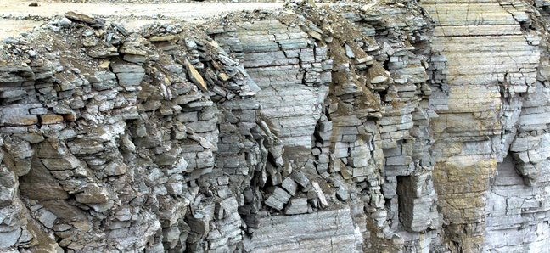
limestone
compressive strength starting with 200 kg/cm²
frost resistance 15
limestone of higher quality
compressive strength starting from 600 kg/cm²
frost resistance more than 25
limestone is considered as national stone

Slide 3
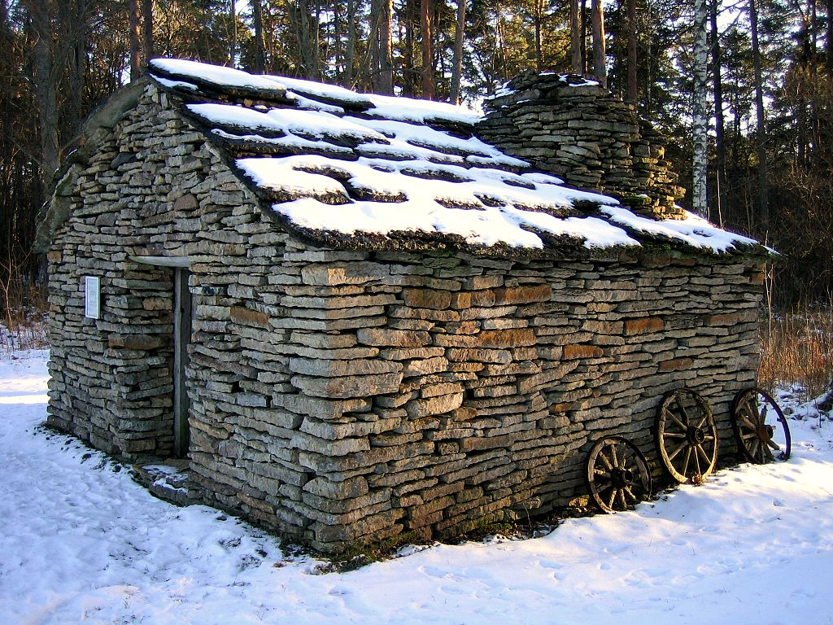
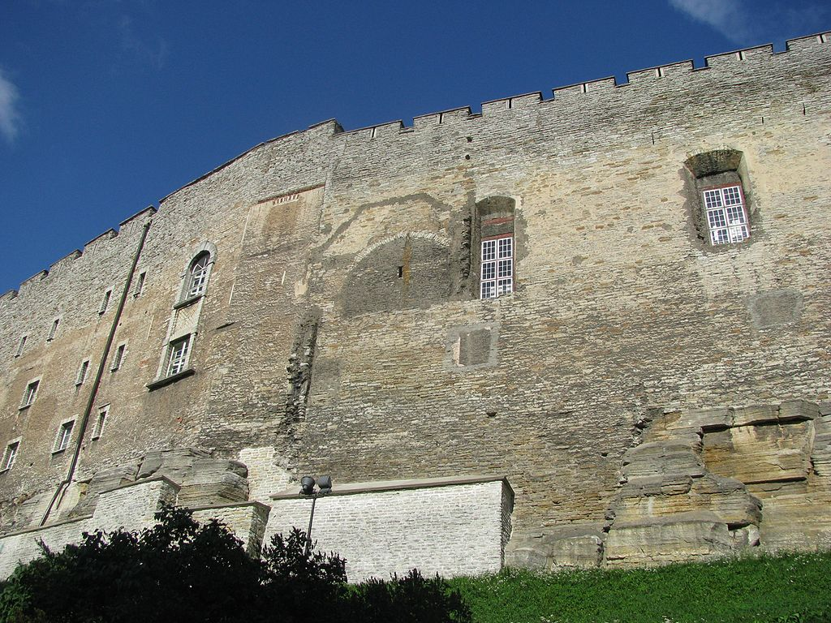
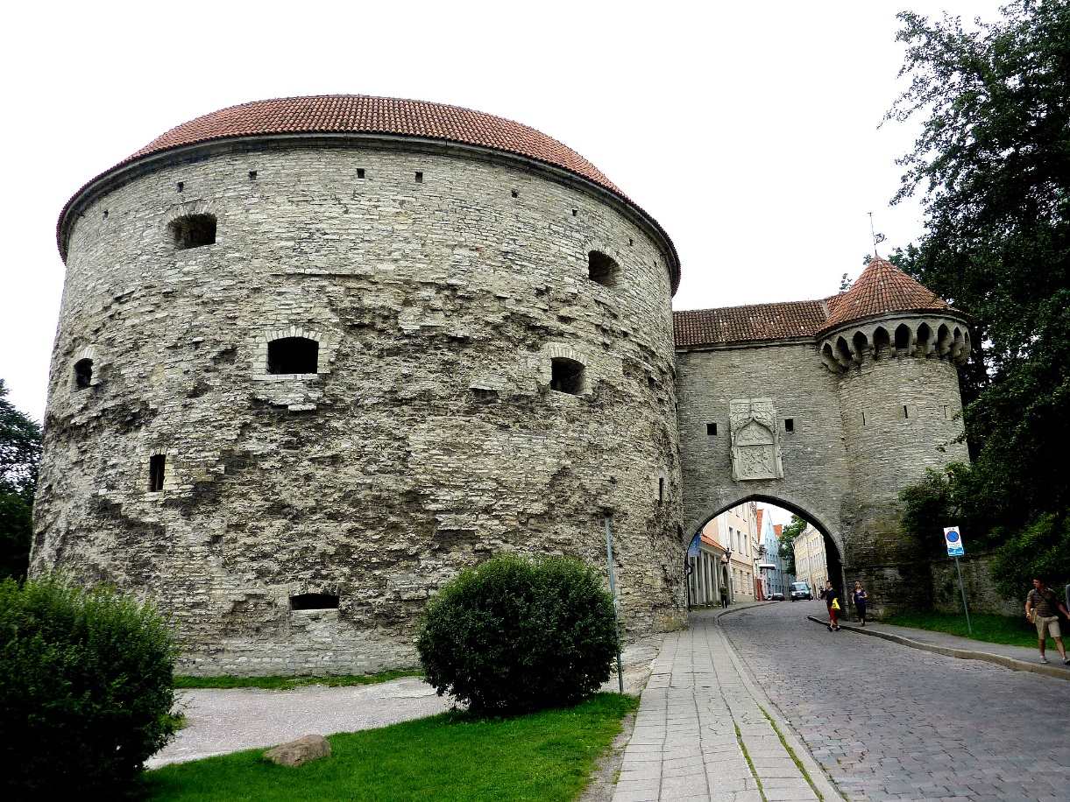

Slide 4
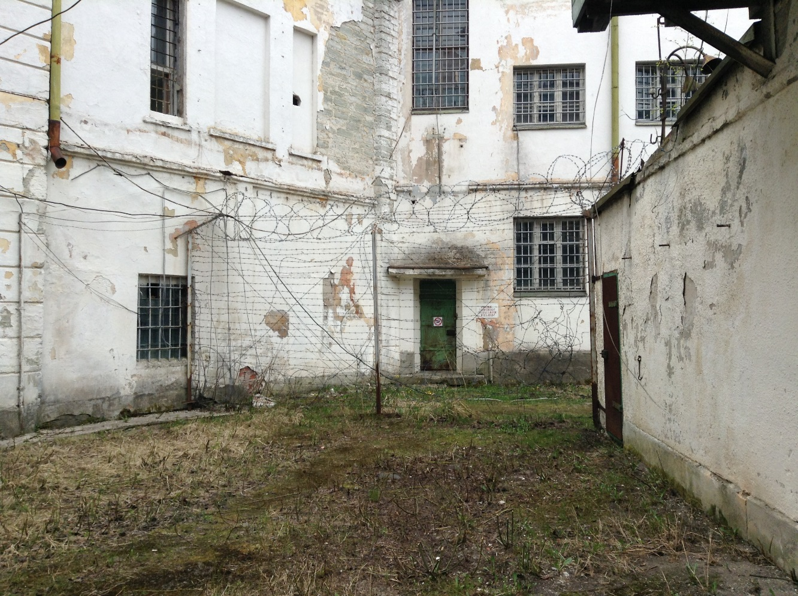
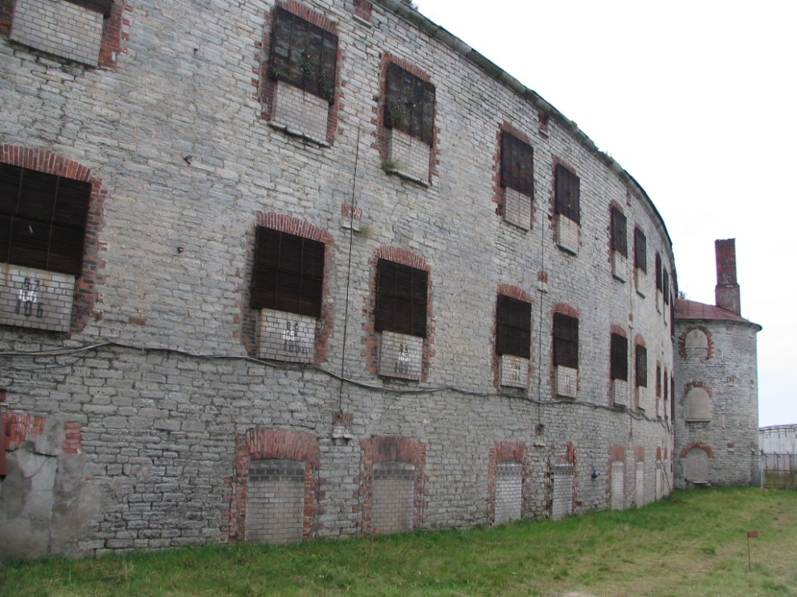
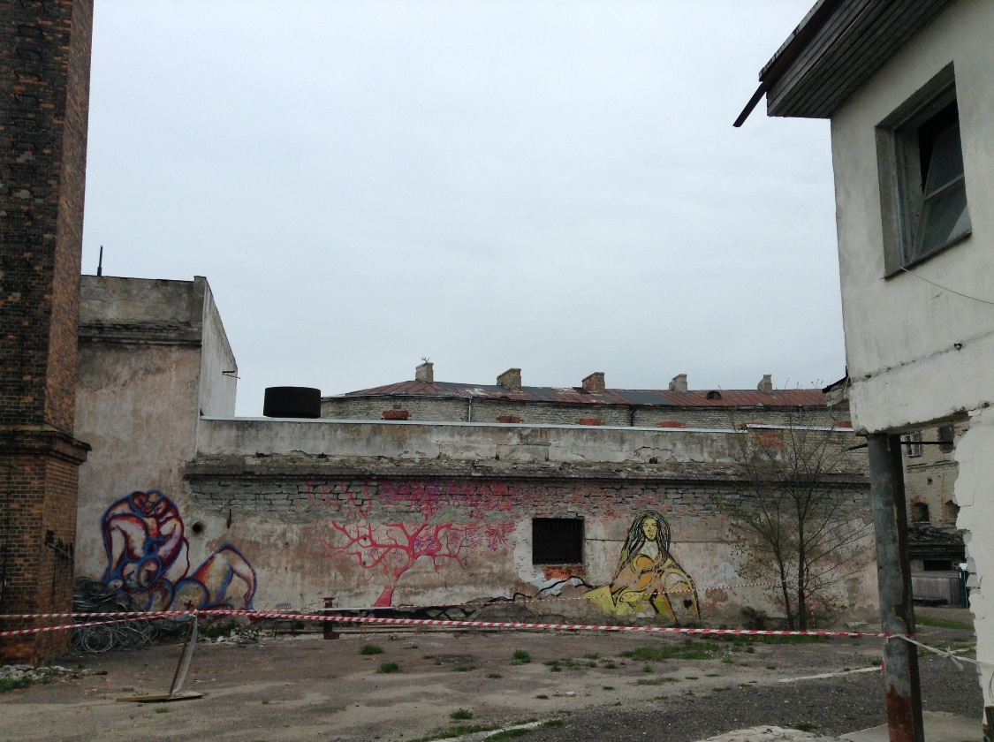
patarei as a fully deserted building today
no proper use, no proper user
normal wear and tear
years with no maintenance
several re-building cases
traces of vandalism
process of obsolesence

Slide 5
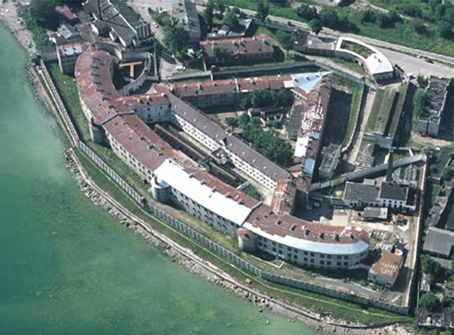
technical condition of Patarei
major survey has been done in 2005
in today’s presentation
general description of the situation
no exact locations for the defects are highlighted

Slide 6
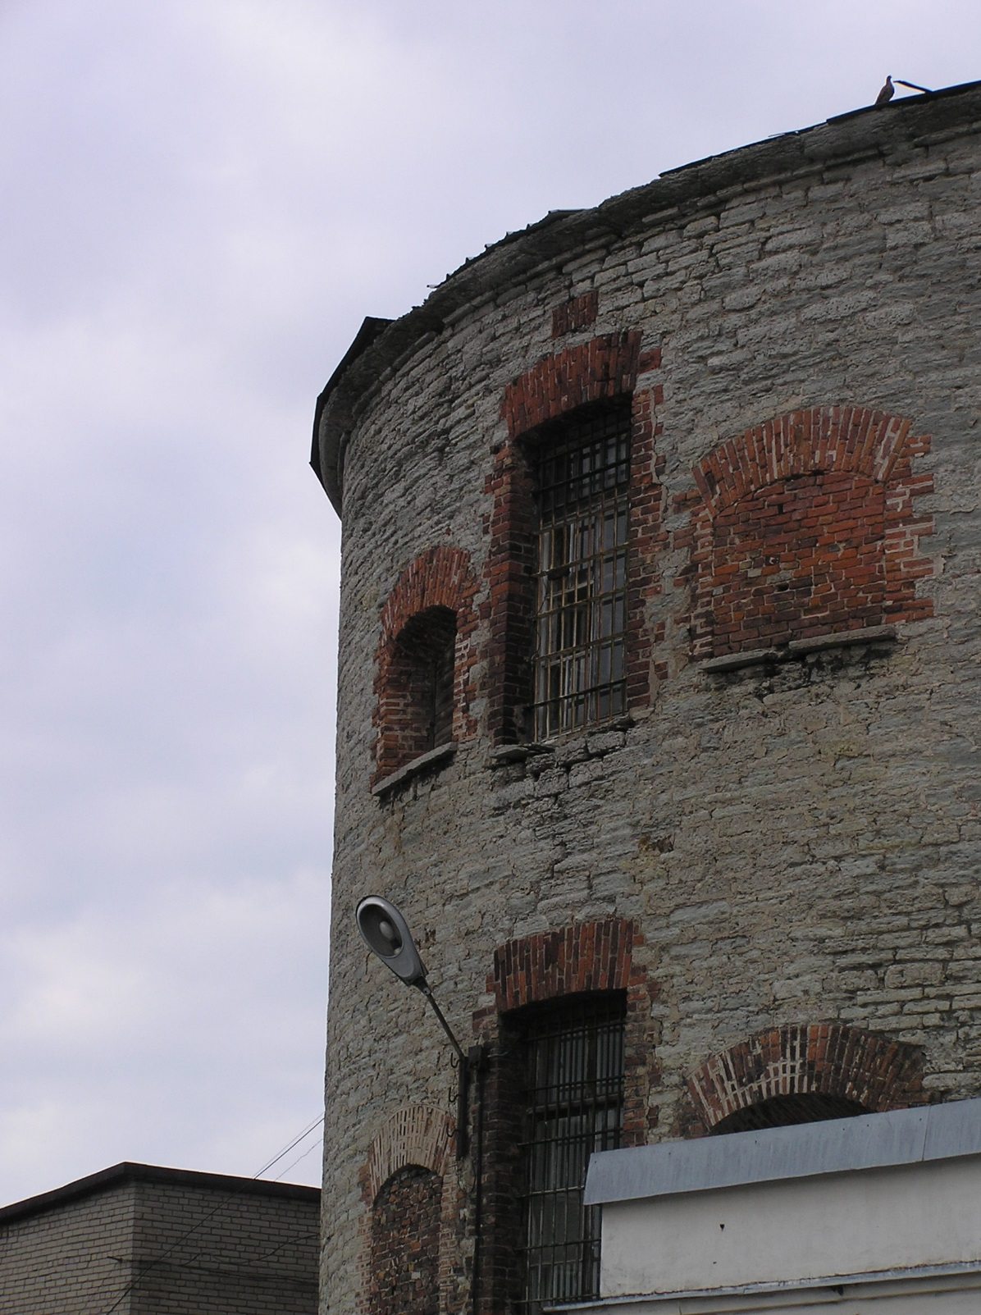
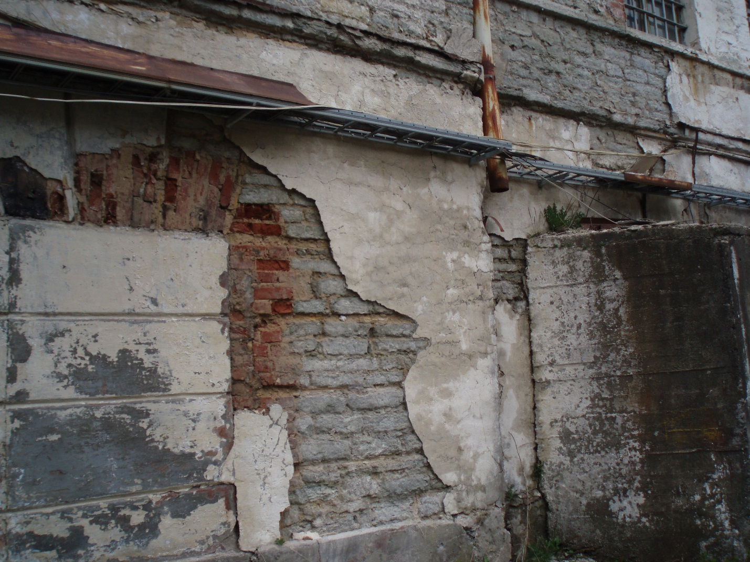
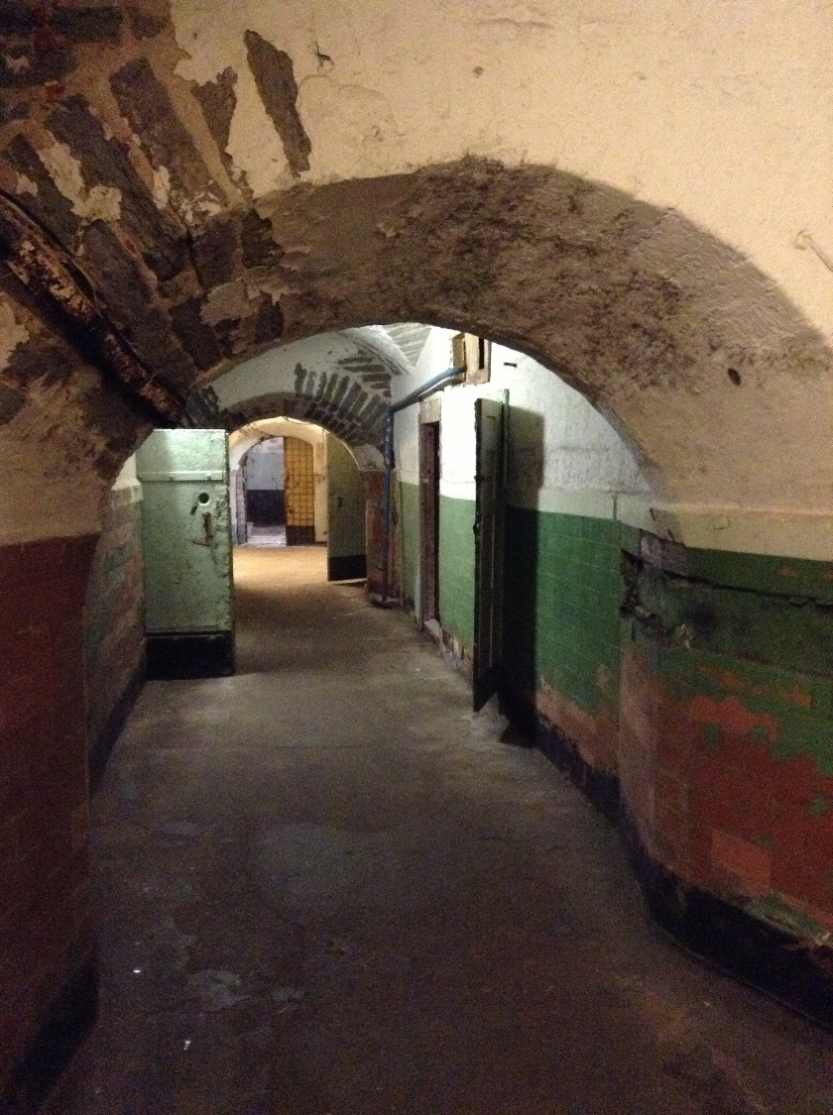
structural issues
limestone structures have preserved their major qualities
fully deteriorated roof

Slide 7
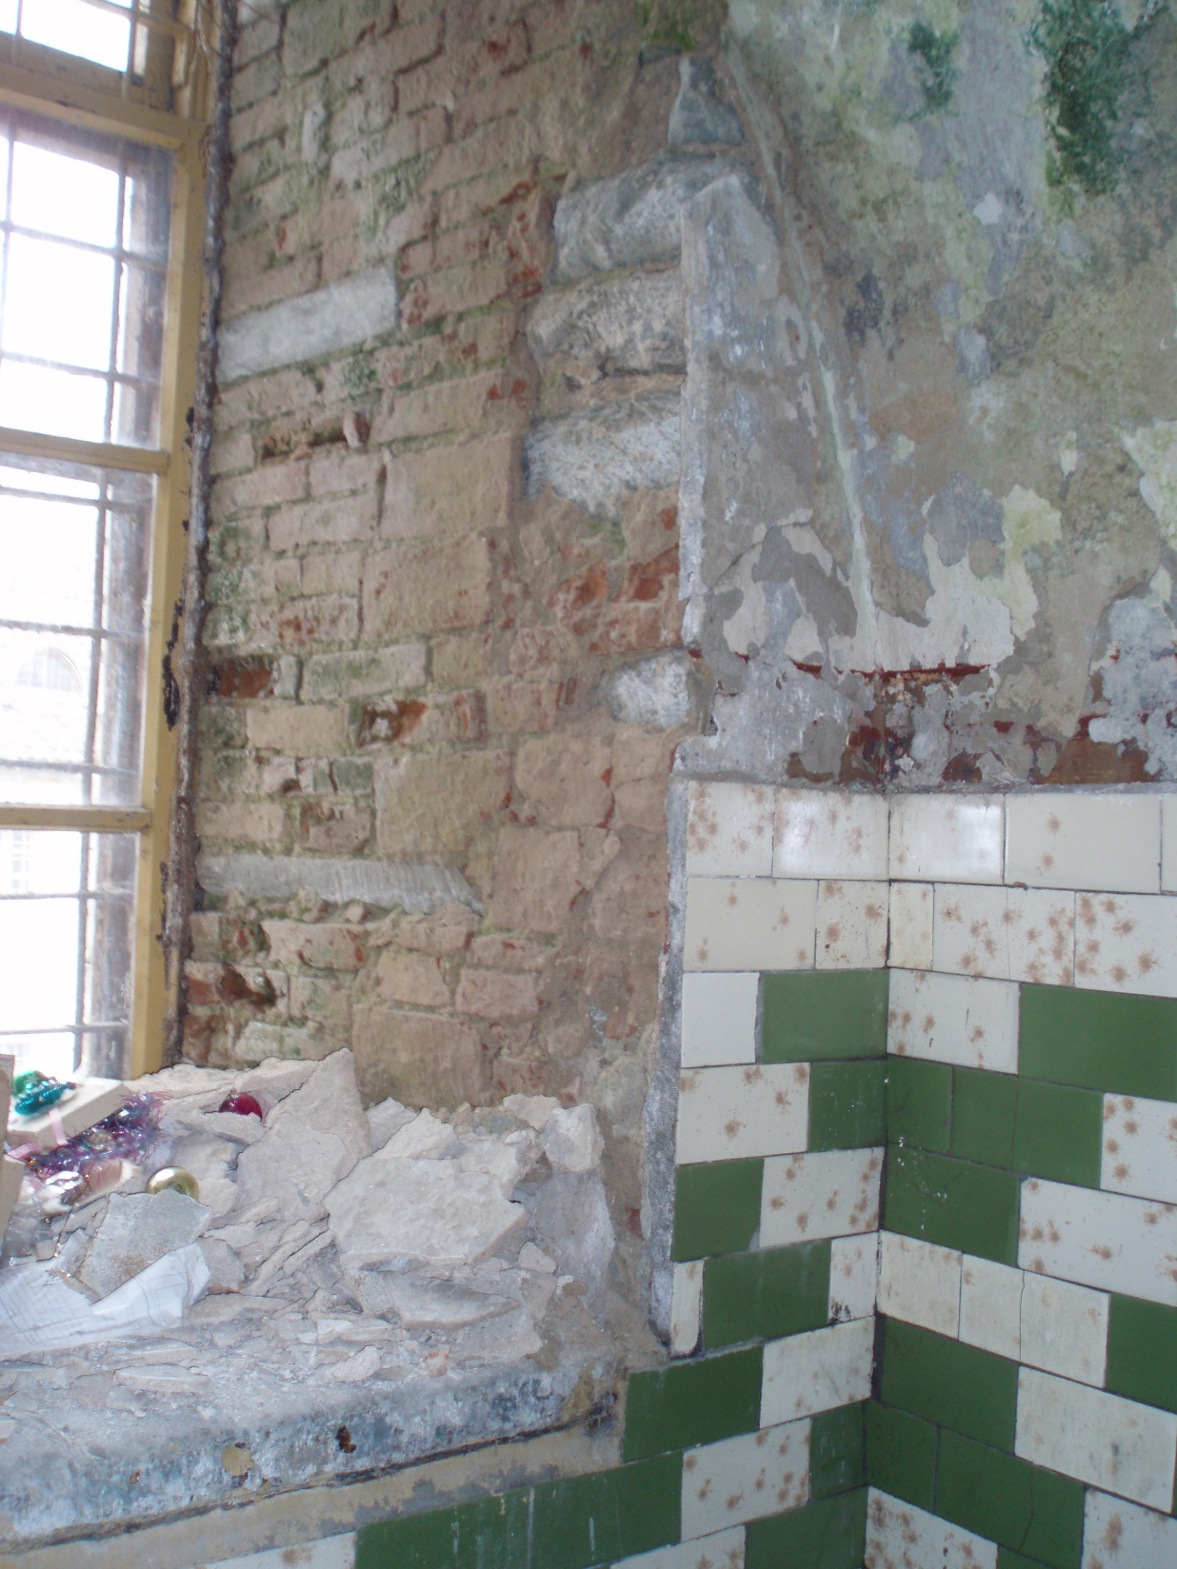
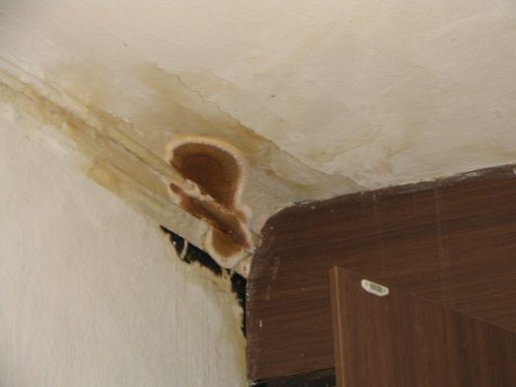
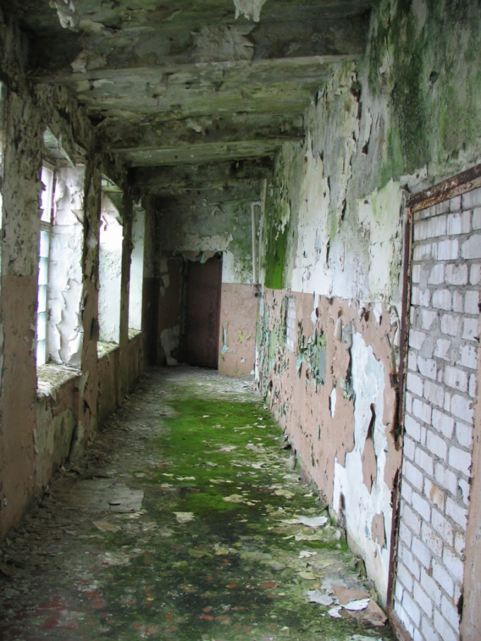
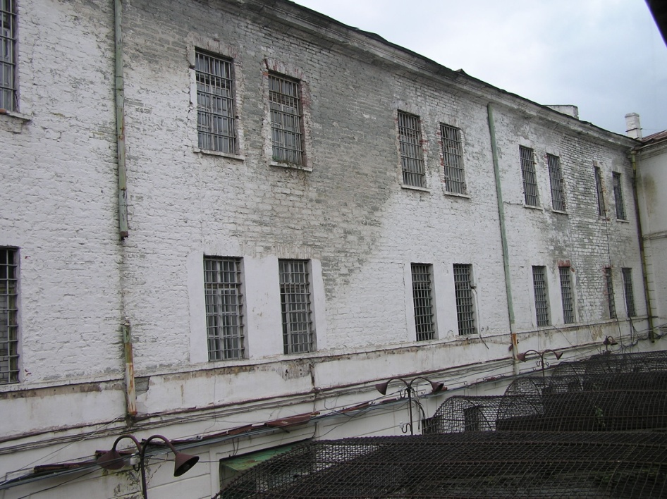
dampness and moisture
the greatest danger for any building
flow of moisture from the ground
influence of rain ja snow
high humidity degree in the rooms
Aspergillus
Penicillium
Stachybotrys
Cladosporium

Slide 8
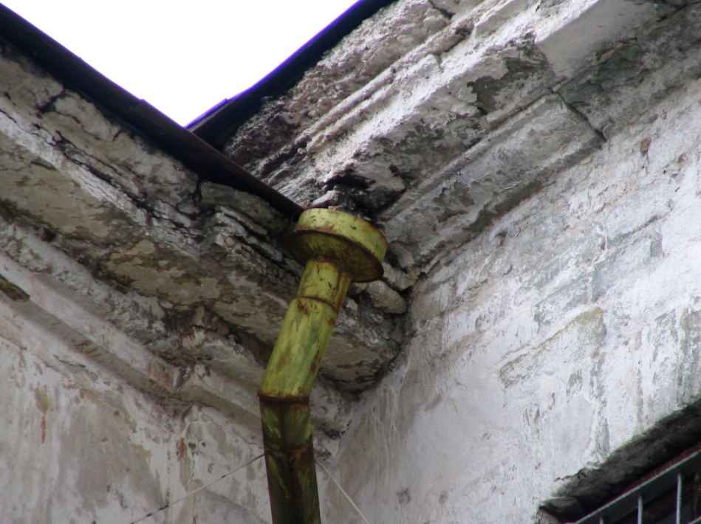
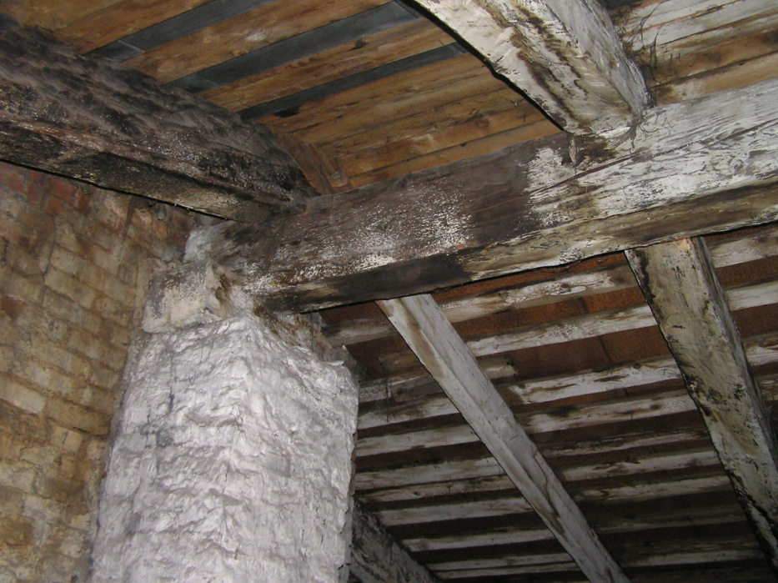
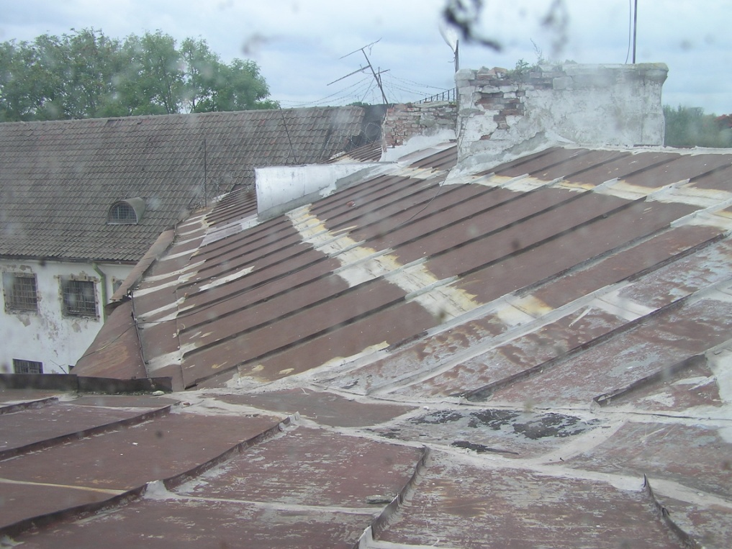
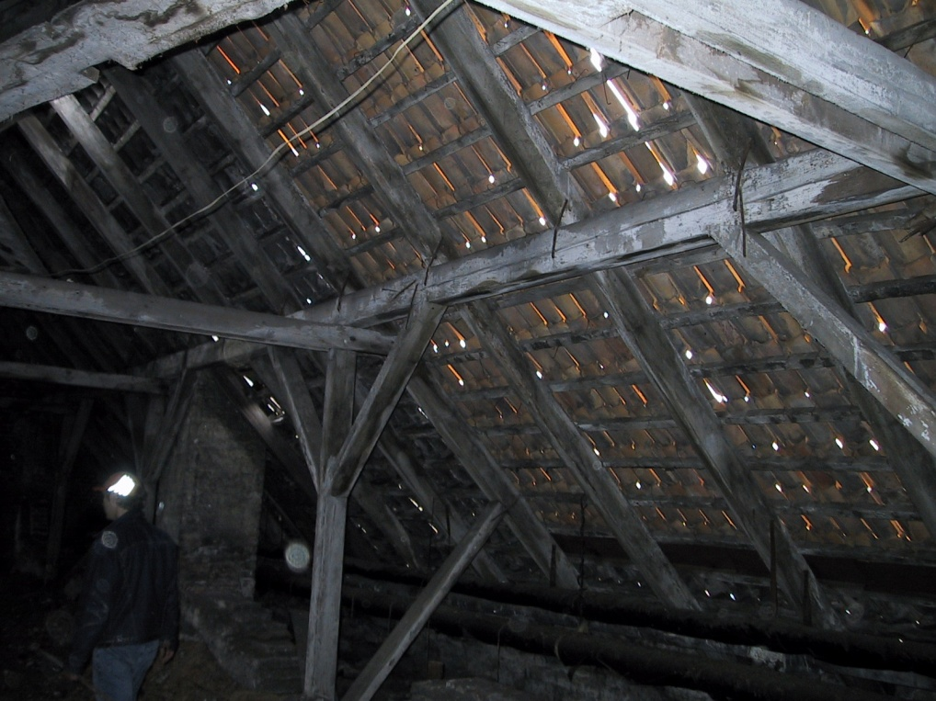
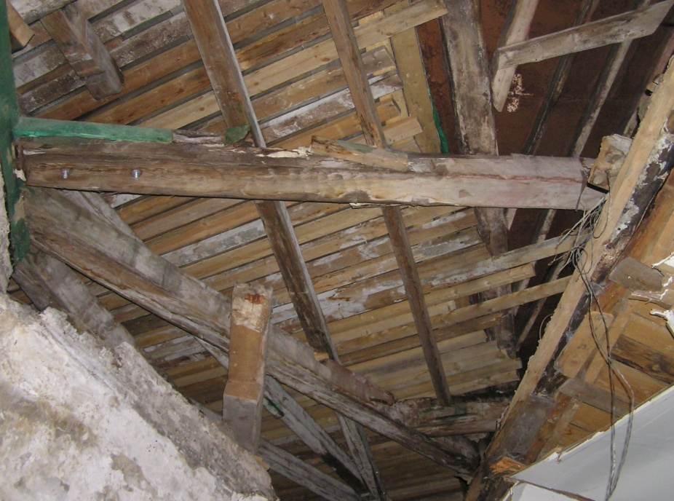
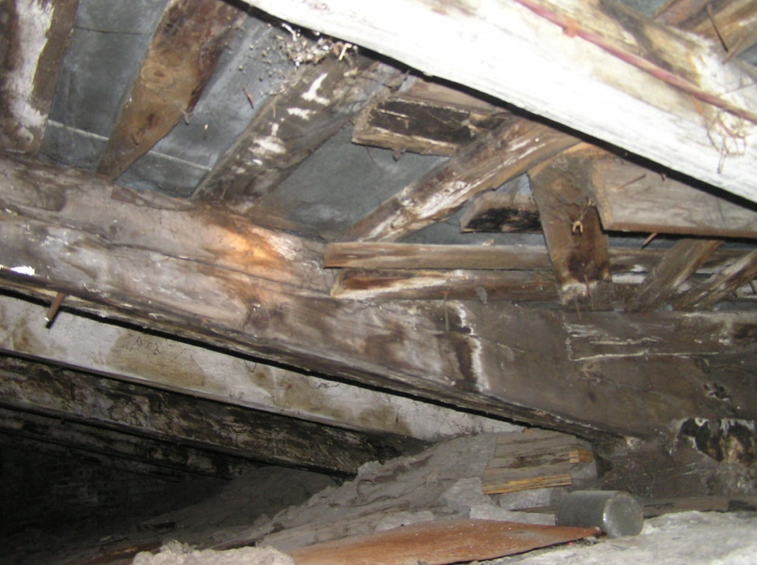
roofs
fully damaged
steel sheets have weared out
timber frame structures are fully rotten

Slide 9
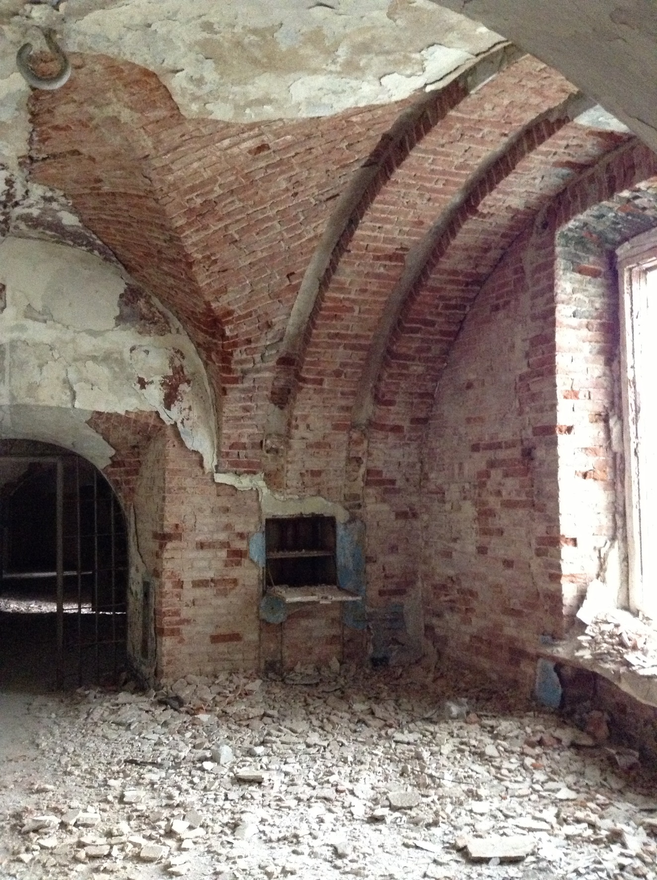
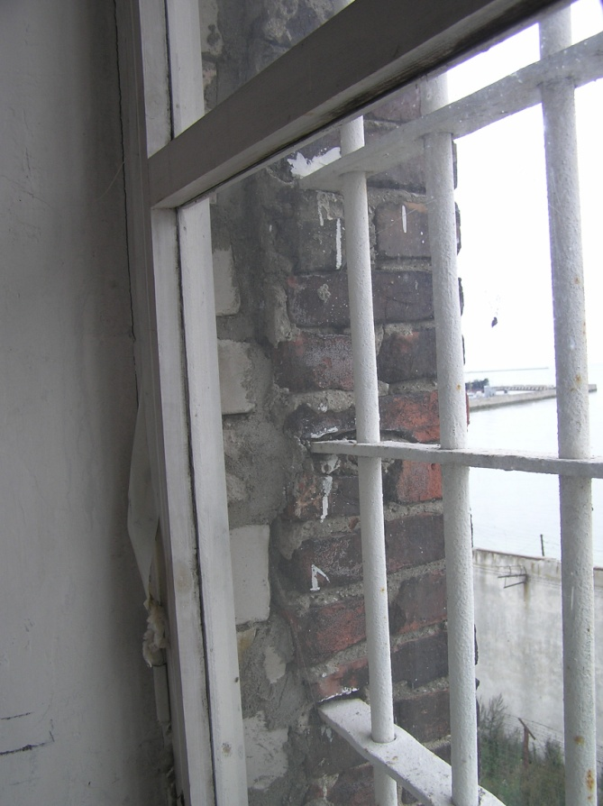
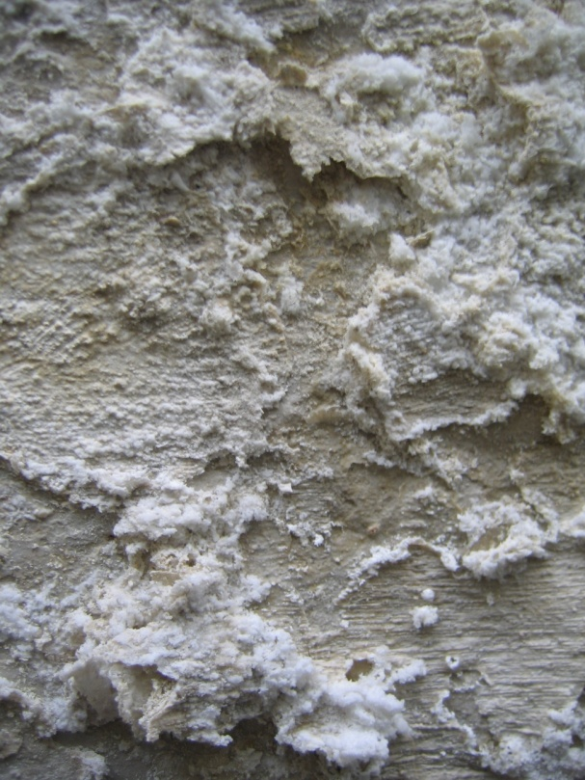
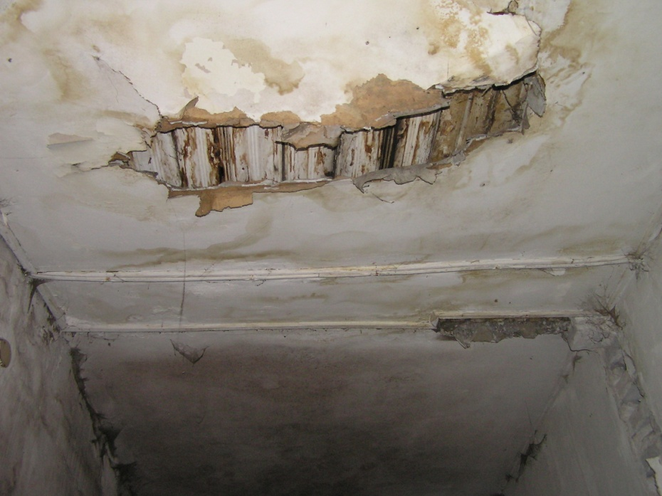
walls
carbonising process and salts have settled
thermal bridges around the windows
plaster in the rooms is mostly damaged
danger of diseases in some buildings and rooms

Slide 10
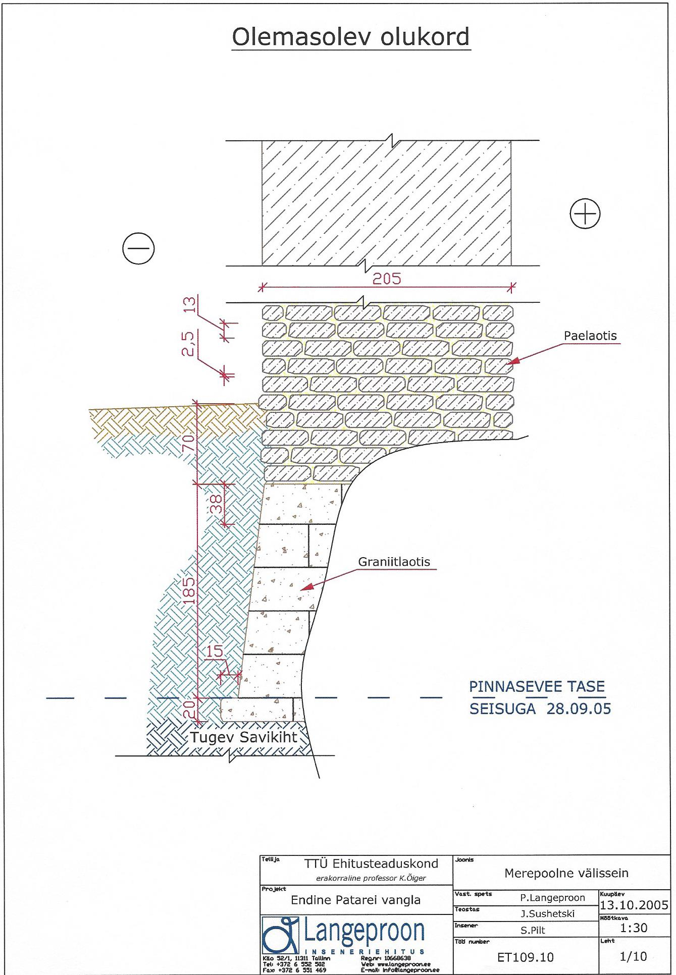
ground water and foundations
foundations are not damaged
there is no insulation to protect the structures from the flow of moisture
vertical insulation would not help much
limestone
granite
level of ground water
clay

Slide 11
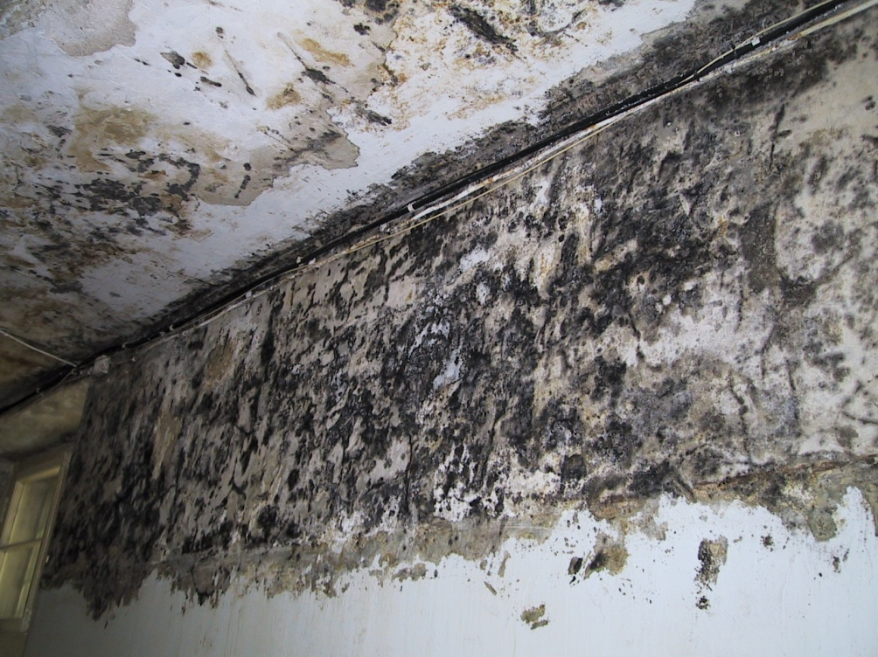
problems with ground floor-rooms
very high constant humidity level
no ventilation
all vertical wells for heating and ventilation are bricked up
massive mould nets

Slide 12
roode.liias@ttu.ee
thank you

