Slide 2
Johannes Bach Rasmussen
Copenhagen, Denmark.
www.coldwarsites.net

Slide 3
THE MAIN OBJECTIVE:
The main objective of the Initiative is
to strengthen mutual understanding
between the countries around the Baltic Sea
through an exchange of information
about their recent history,
mainly the Cold War Period.

Slide 4
THE MAIN IDEA:
The history should be told from historically
valuable sites at which events took place
as well as museums connected to the sites.
The opinion is that recent history can be told,
effectively, from the historically sites.

Slide 5
Relevant sites are for example:
military installations, KGB offices,
partisan bunkers, prison camps, cemeteries,
sculptures, architecture or simply squares
or buildings where memorable events took place.
The Baltic Initiative and Network is interested
in sites with story-telling potentials.

Slide 6
Main tasks of the Initiative:
To promote registration and protection of
historically valuable installations and sites
with a “history-telling” value.
To promote information about recent history
from these sites (and especially directed toward
visitors from foreign countries. The tourist aspect).
To start concrete, international activities and
co-operation projects which can improve
international understanding.

Slide 7
www.coldwarsites.net

Slide 8
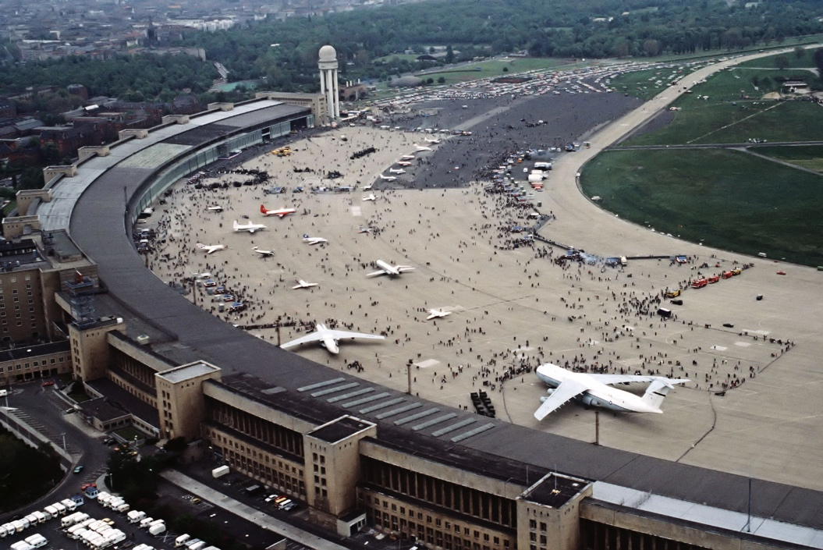
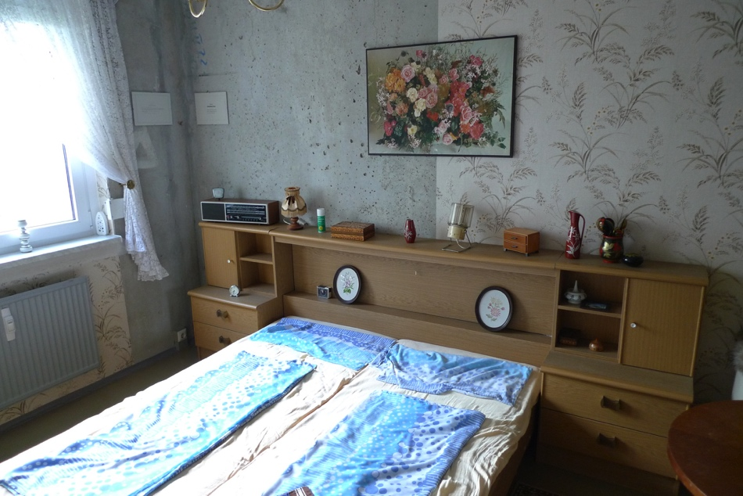
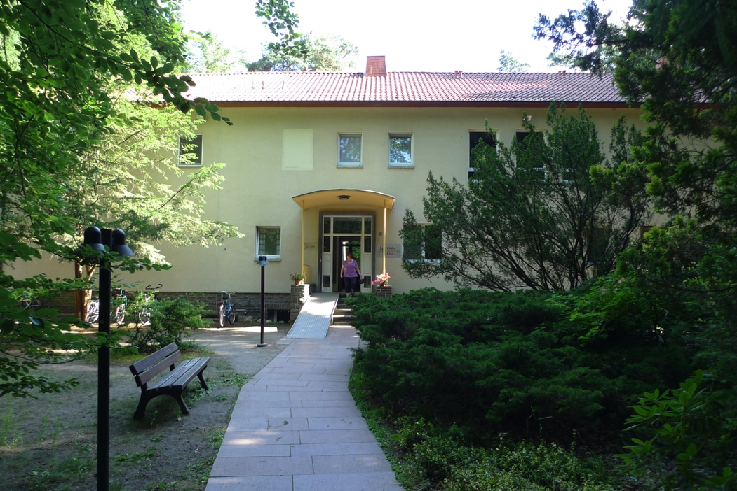
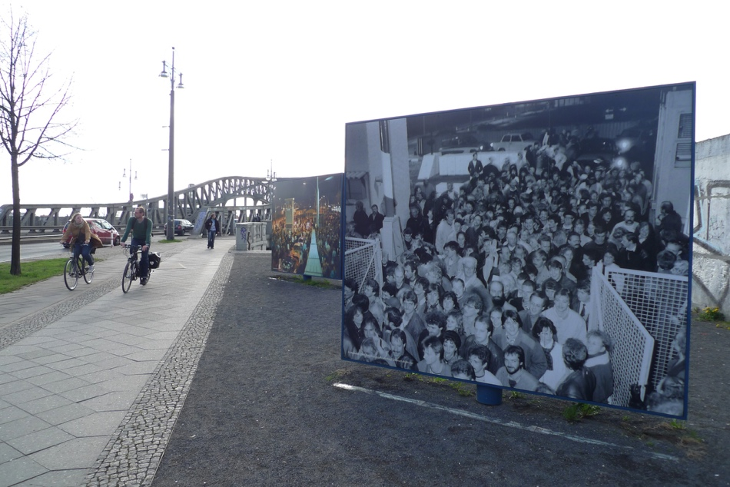

Slide 9
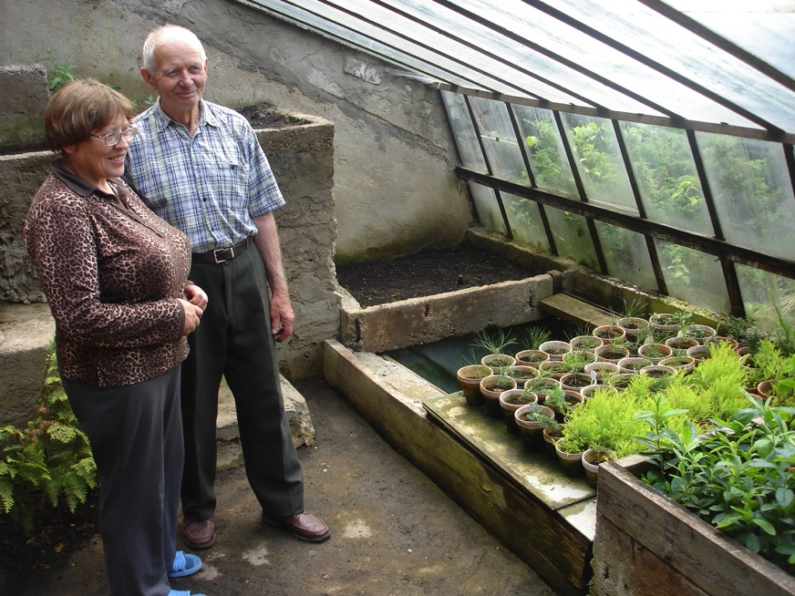
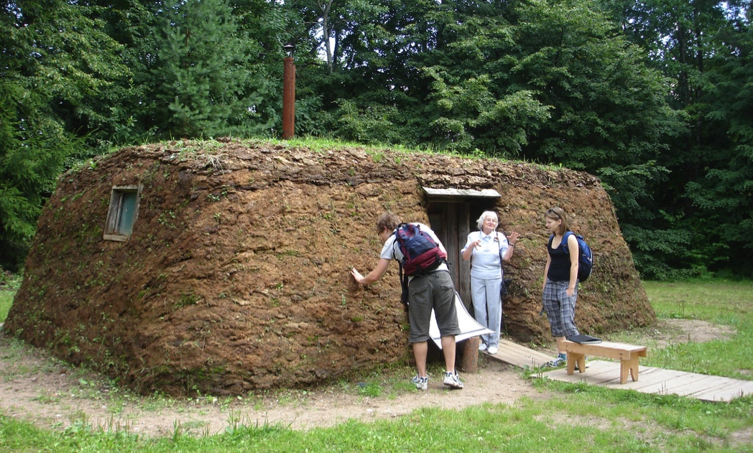
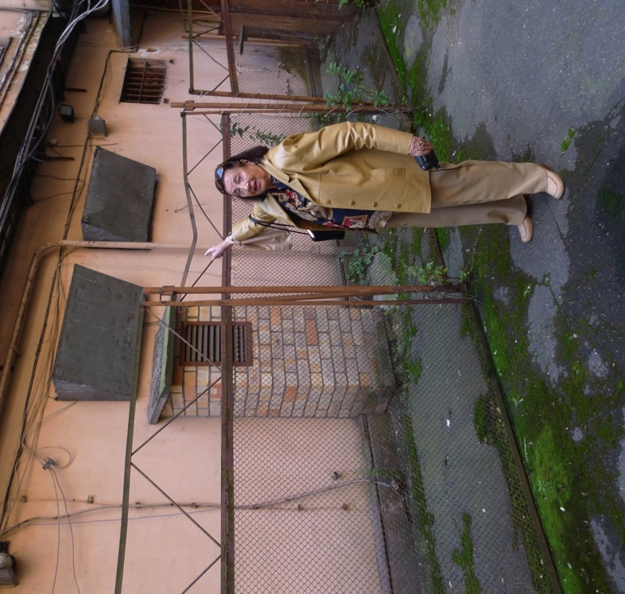
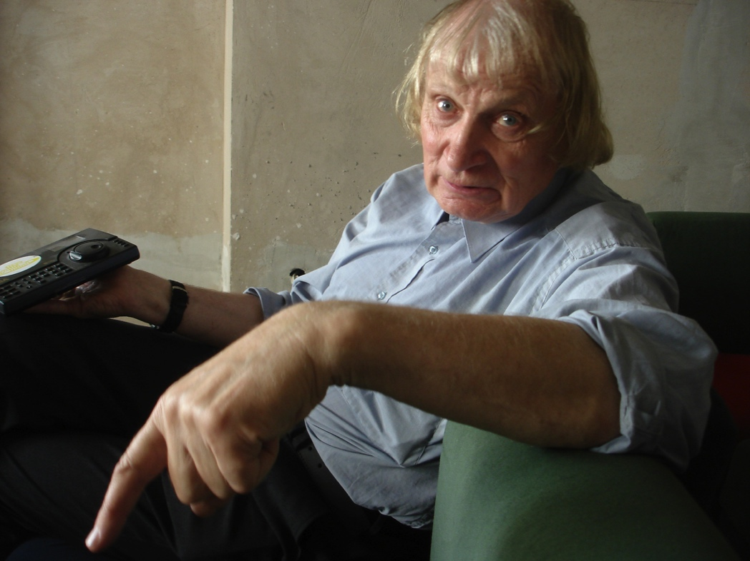

Slide 10
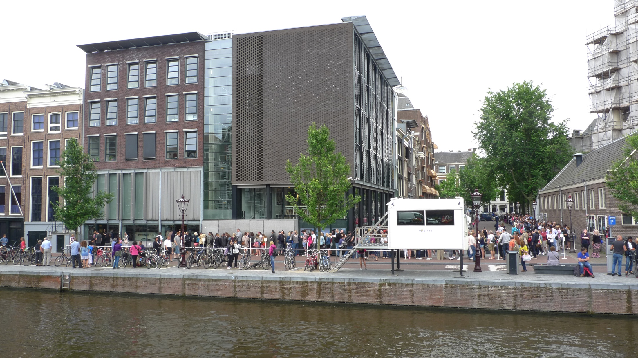

Slide 11
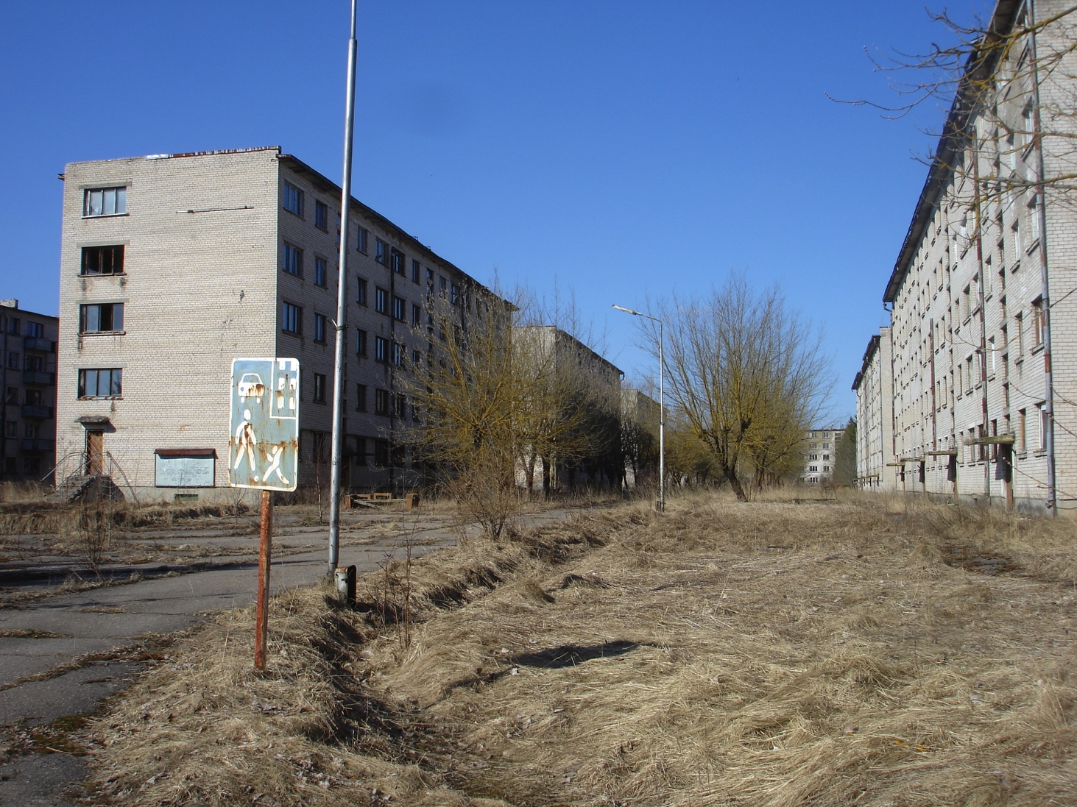
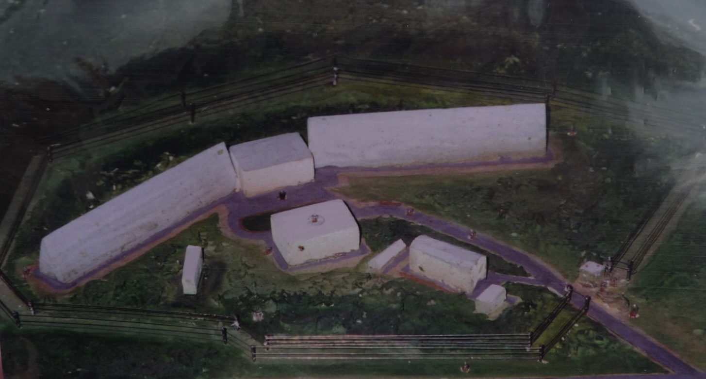

Slide 12
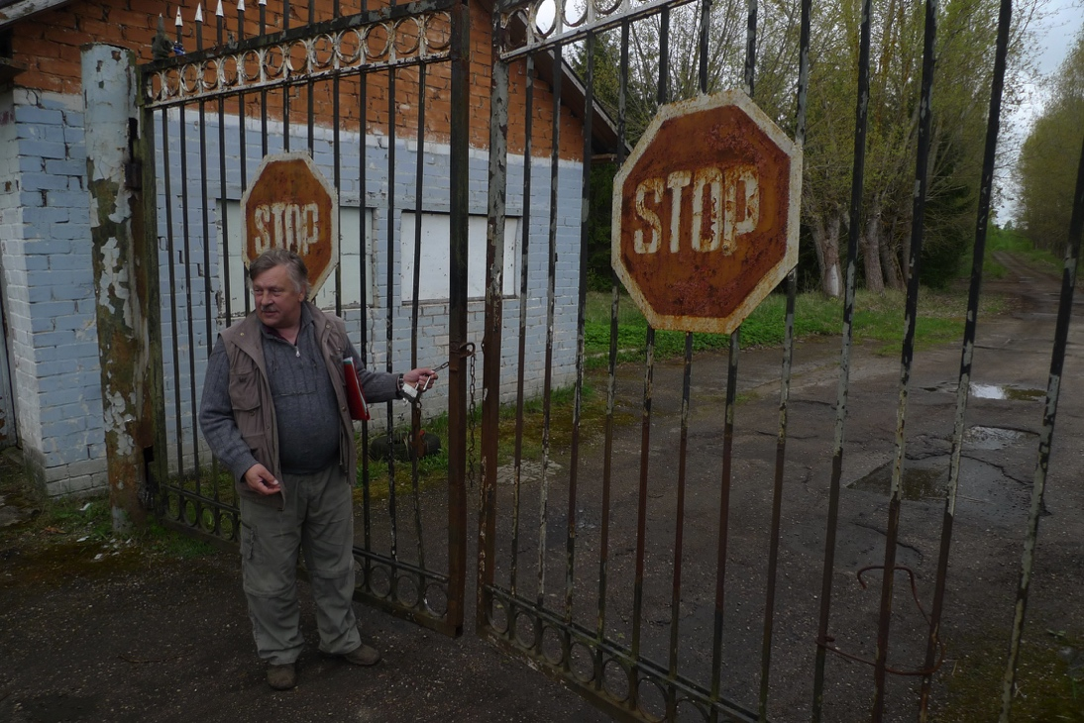
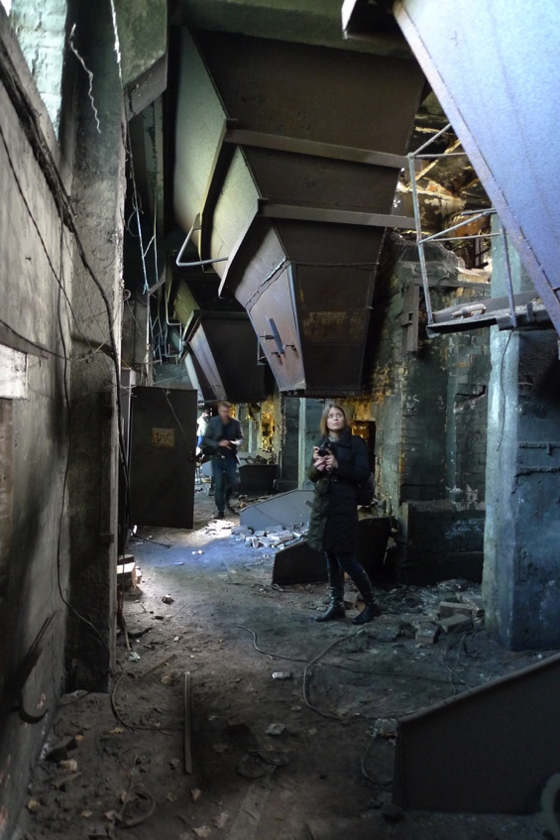
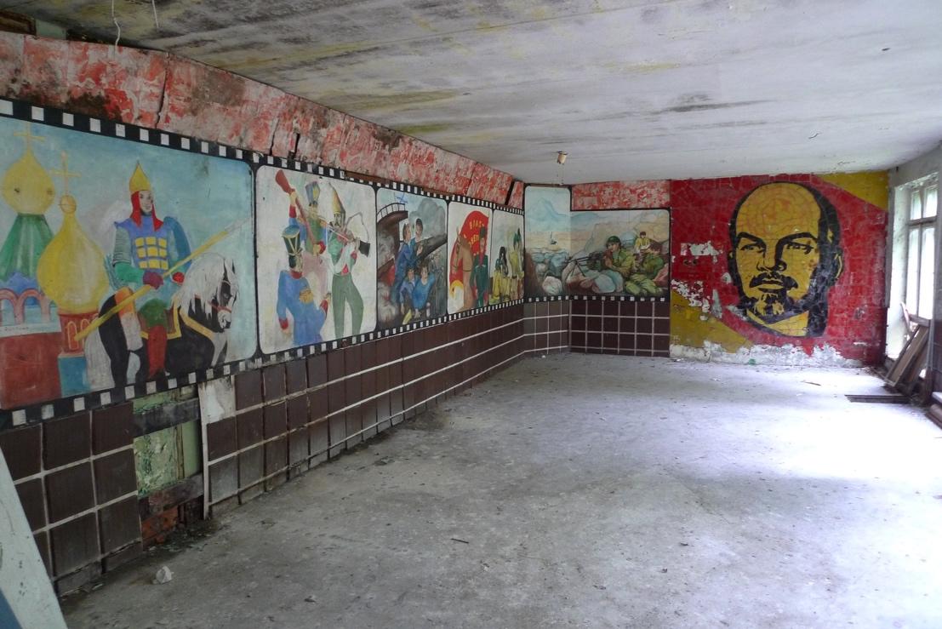
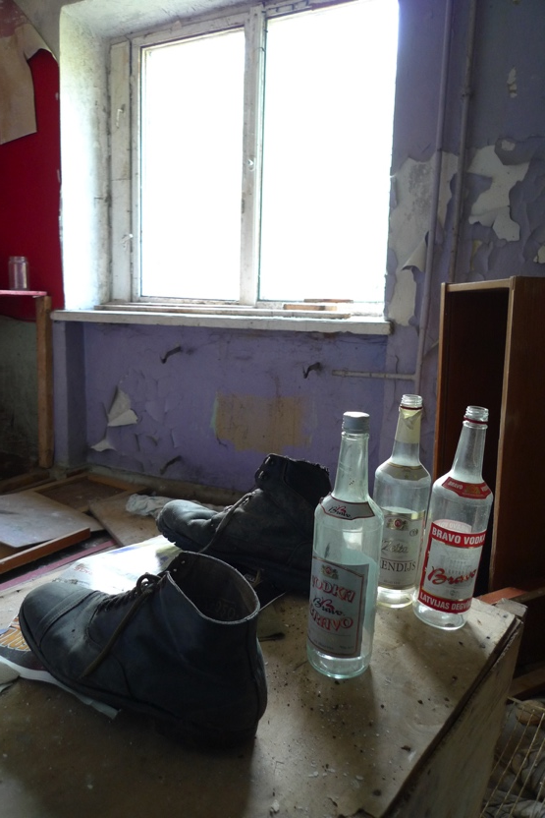

Slide 13
Proposal. Skrunda 2:
The overall objective is to protect, develop and secure public access to Skrunda 2, as a national cultural monument and tourist sight which can tell an important part of the Soviet occupation history of Latvia 1945-1990.

Slide 14
Skundra 2 is maintained as a city where the development of flora and fauna in principle is without restrictions, and without an ongoing restoration or conservation of the build-up areas. This means in principle that an overgrowing and building-related decline is allowed and desirable.
As the city appears today, it has a strong story-telling potential for tourism.

Slide 15
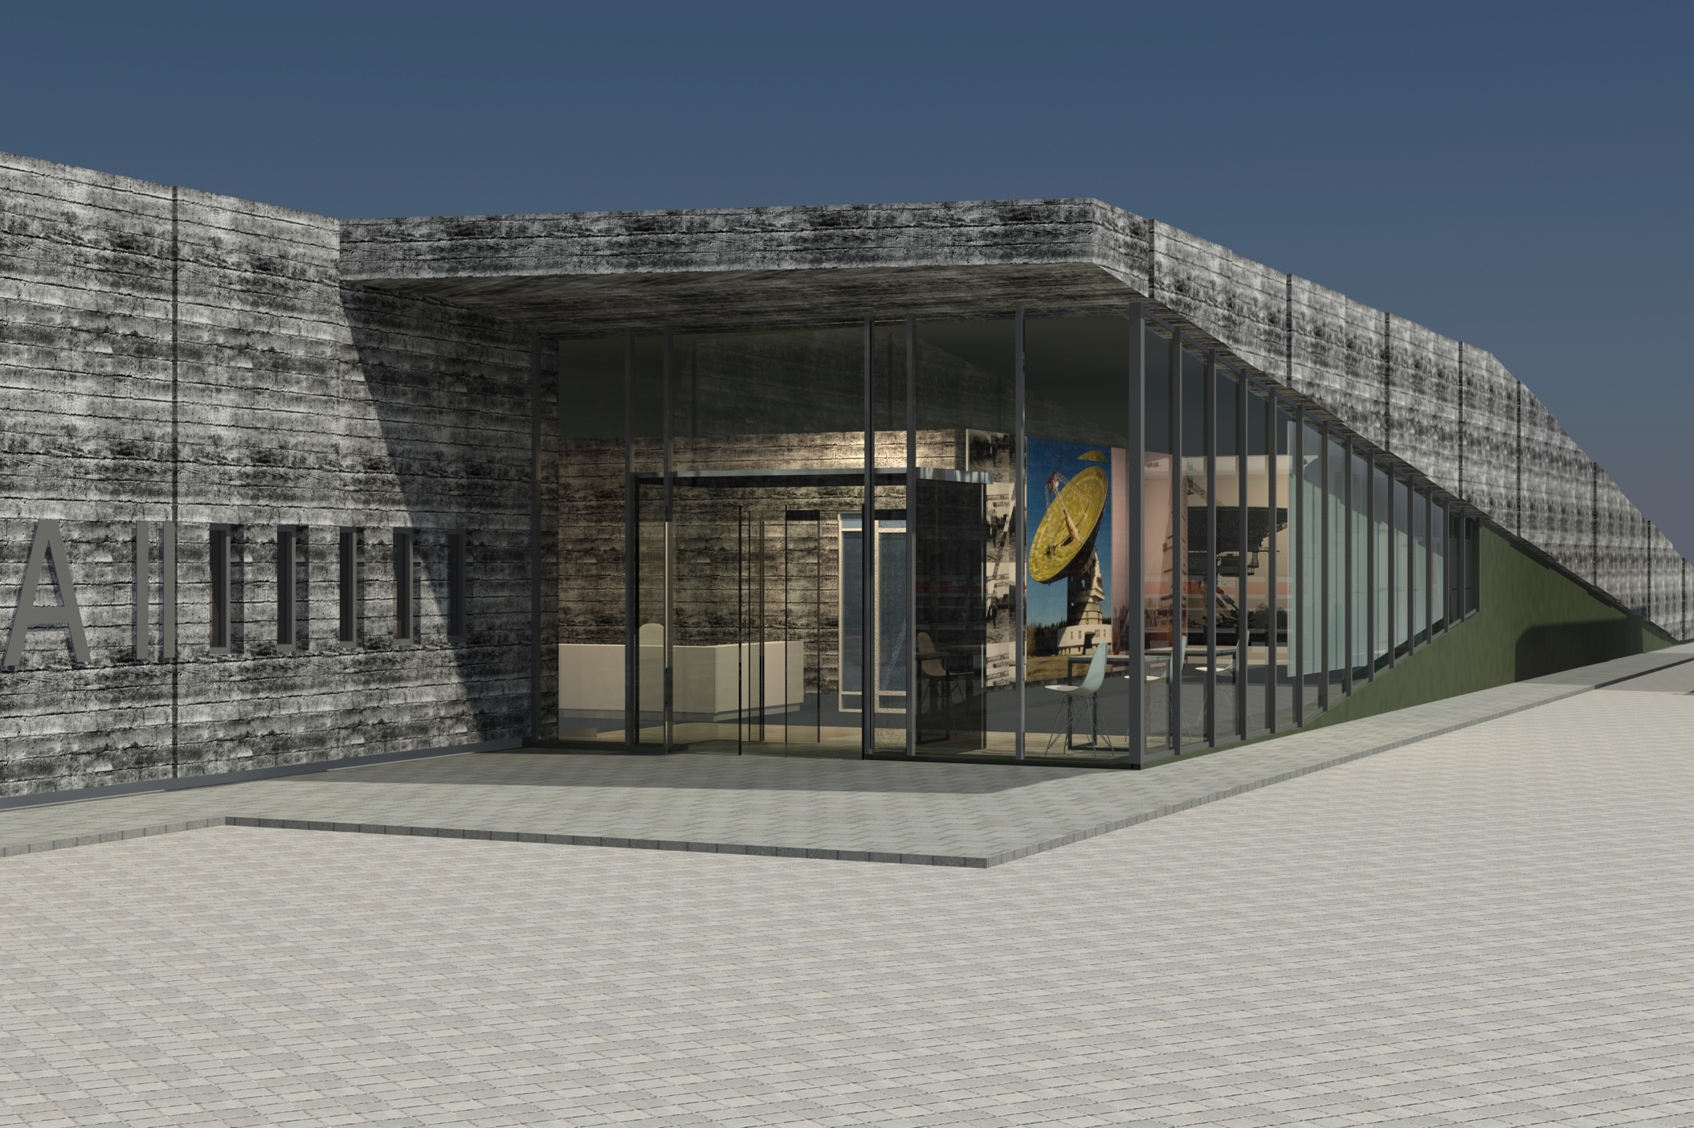

Slide 16
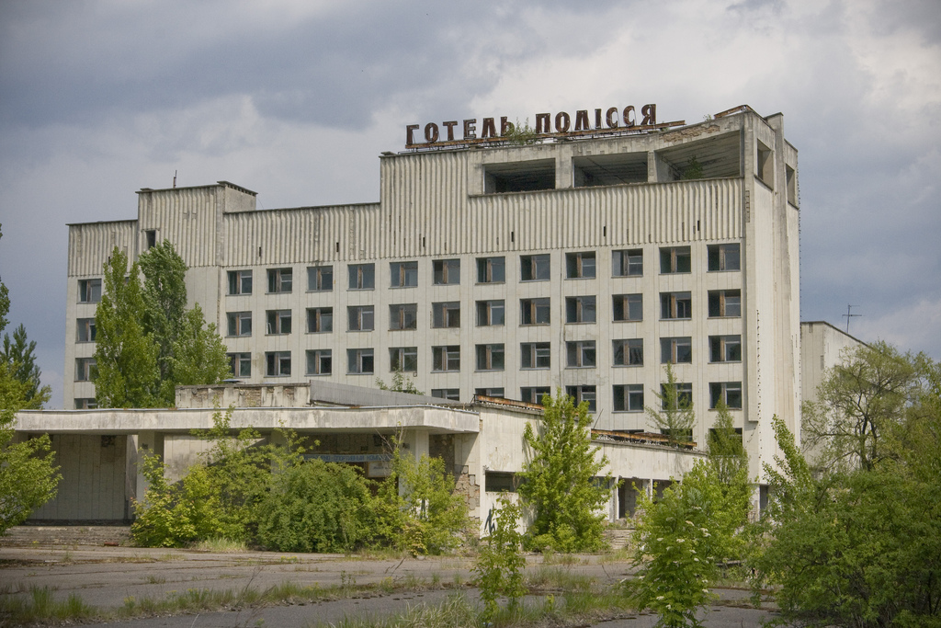

Slide 17
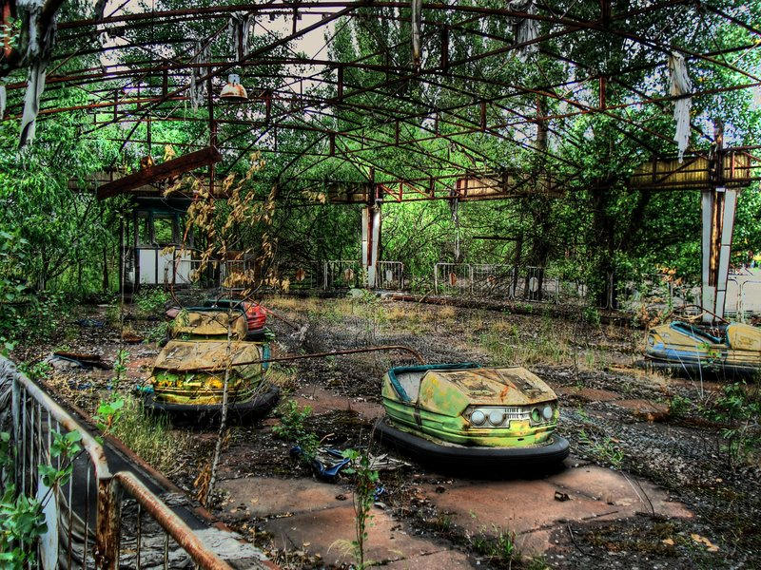

Slide 18
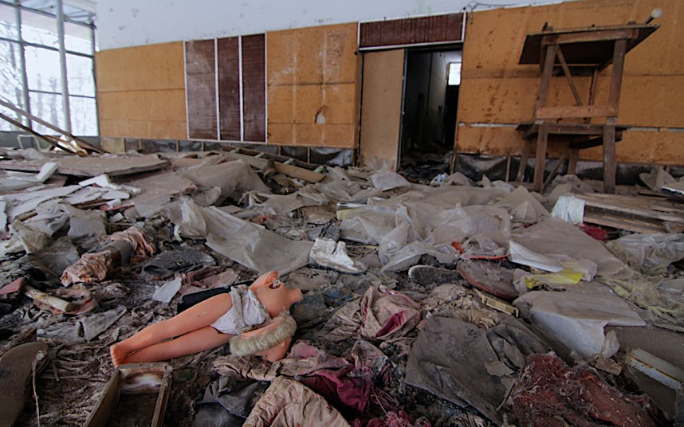

Slide 19
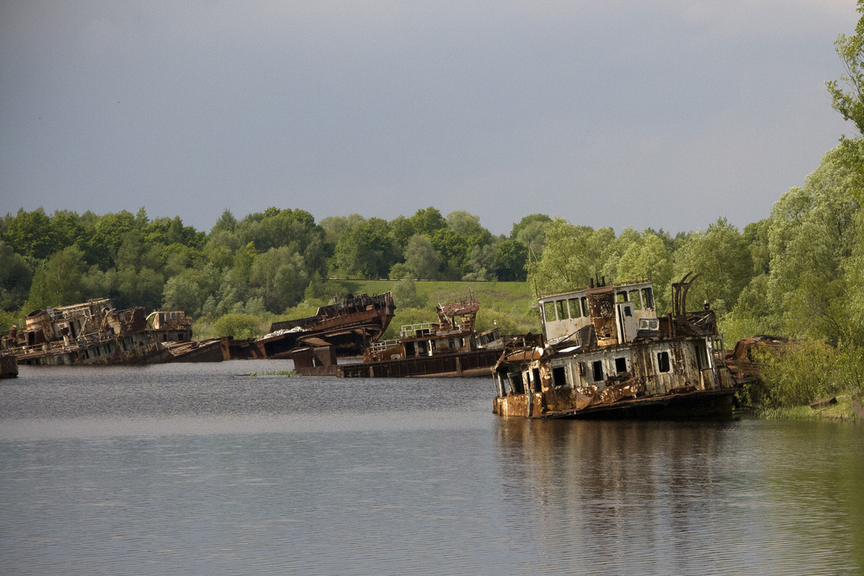

Slide 20
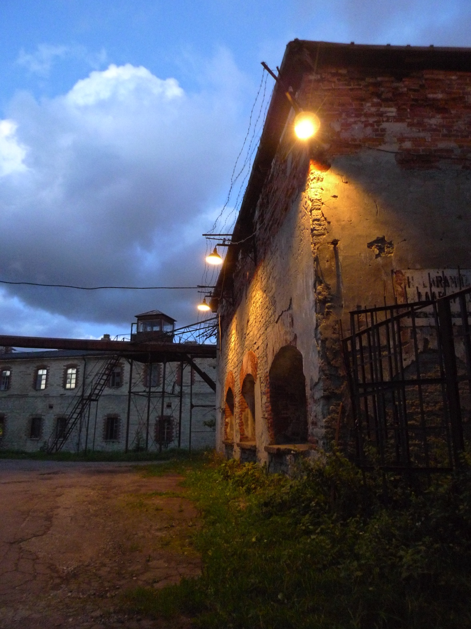
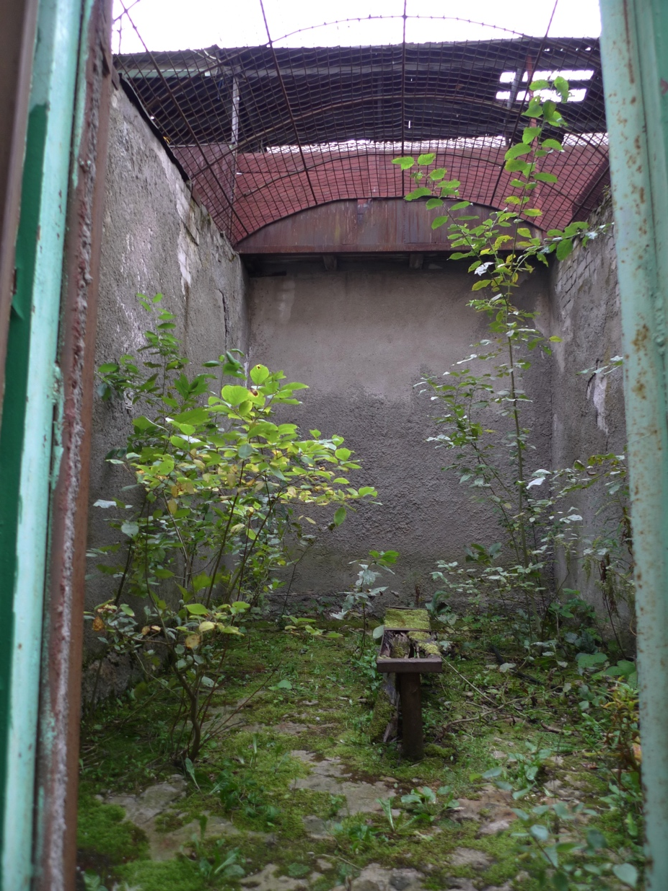

Slide 21
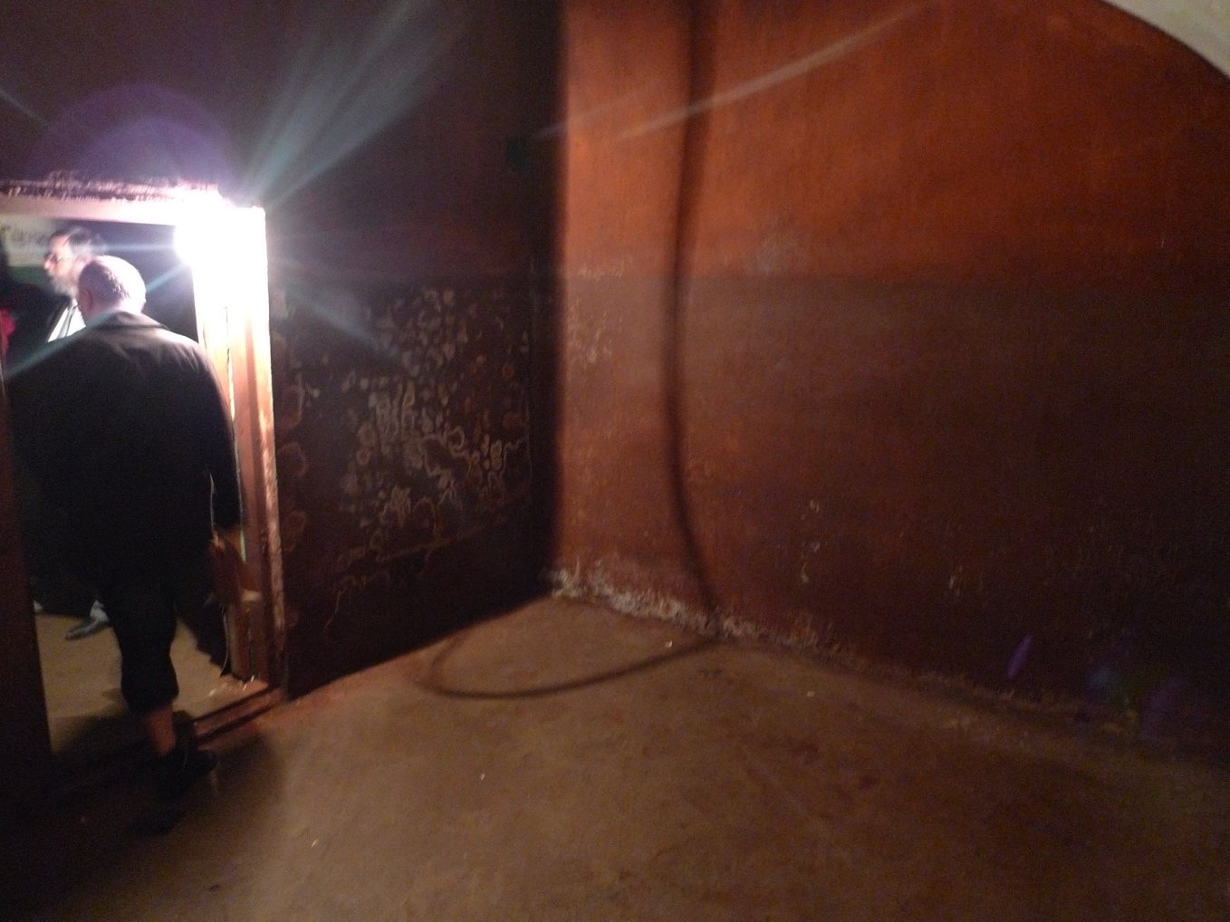
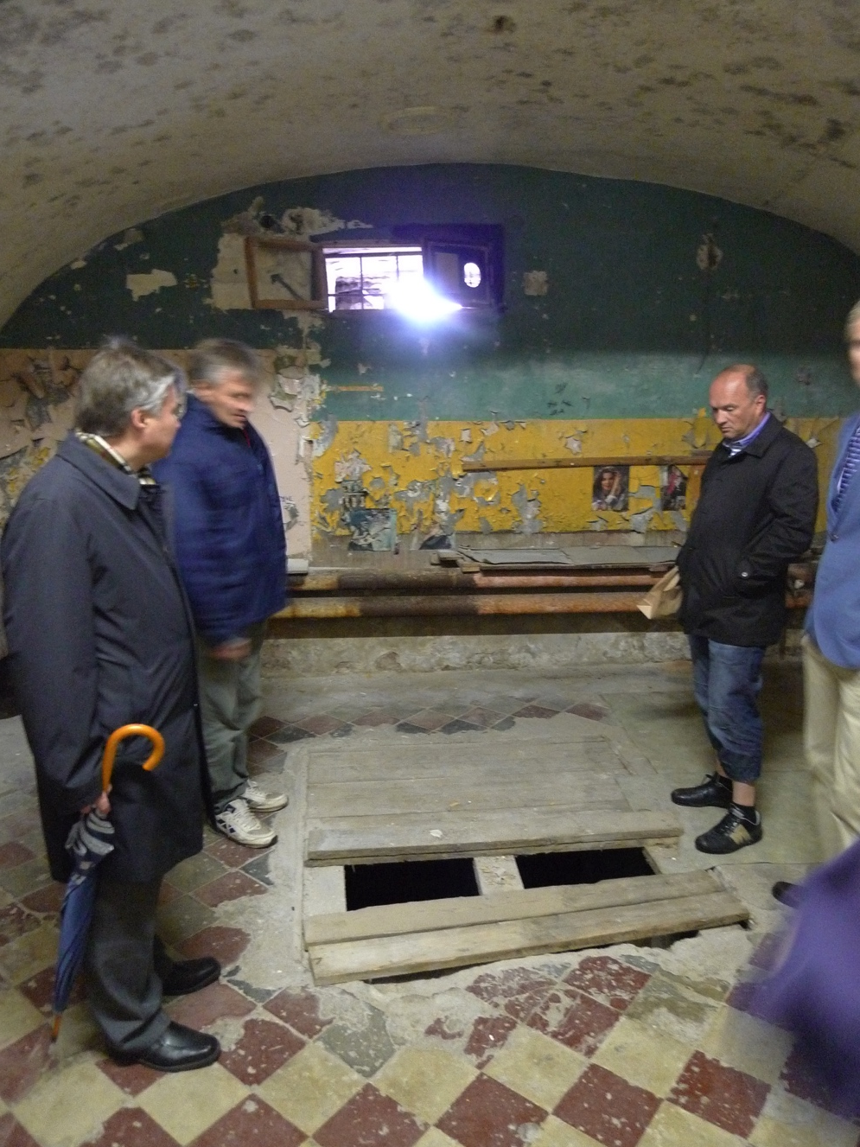

Slide 22
New visitor center (for staff, room/cinema for 75 people, restaurant/café, shop, toilets, room for temporary exhibitions).
Restoring of rooms in some part of the prison building for permanent exhibitions.
No restoring of other part of the prison building. Execution rooms etc.
No maintenance of the central open prisoner area. Overgrowing of some part is allowed.

Slide 23
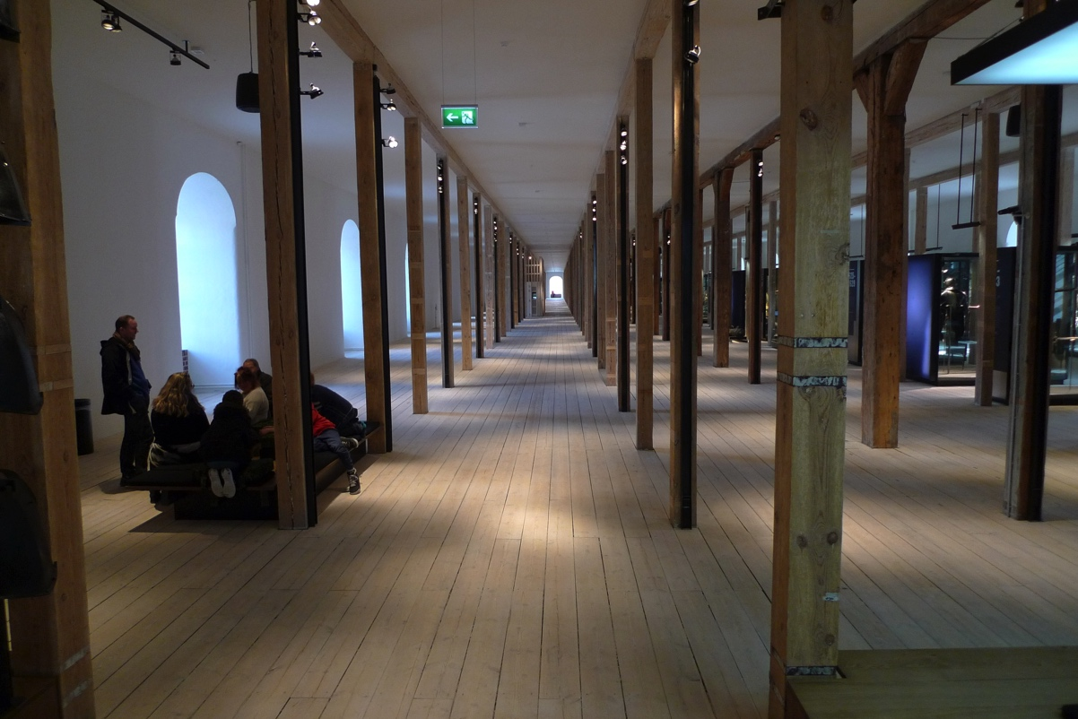
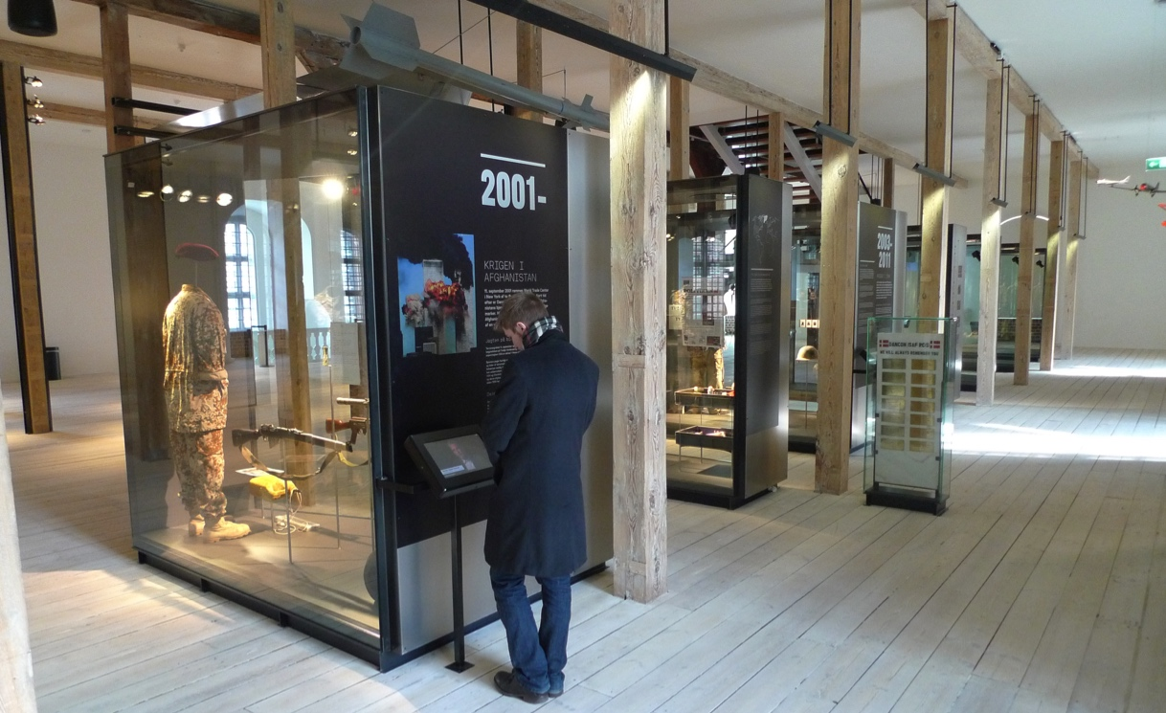

Slide 24
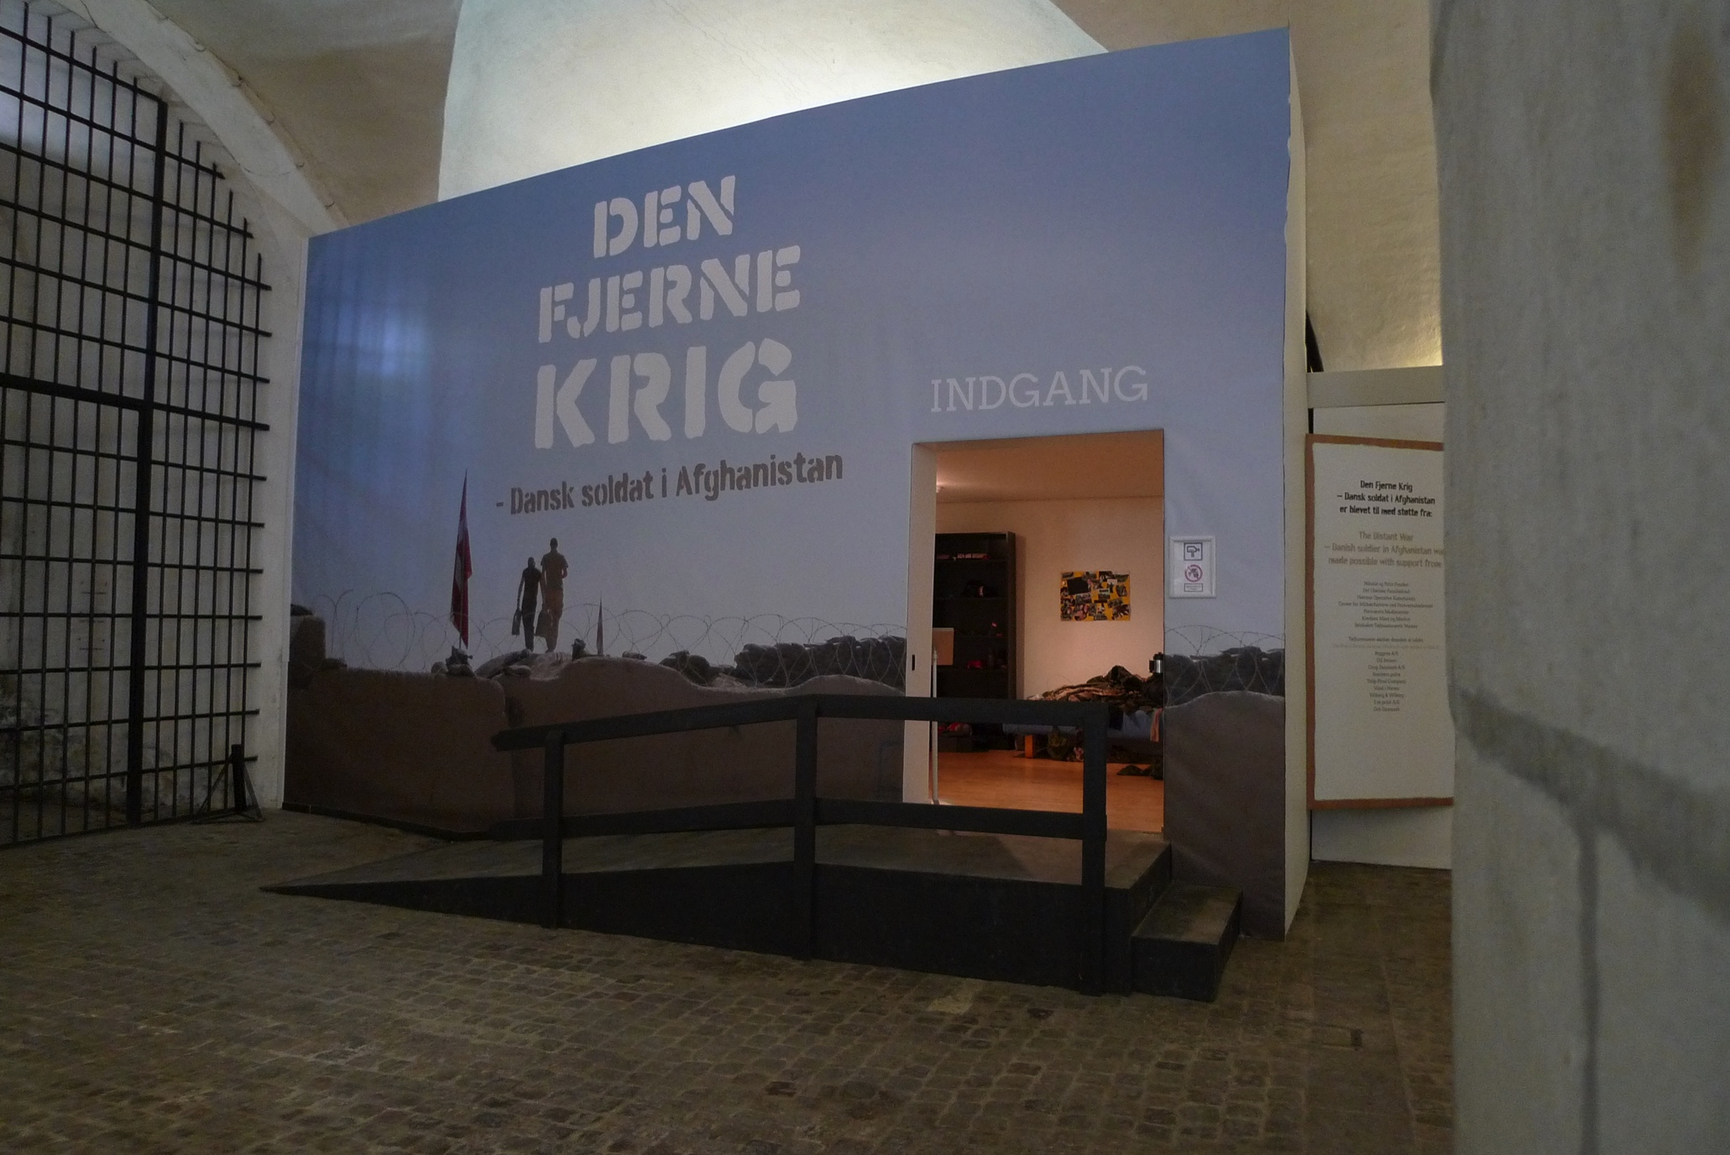

Slide 25
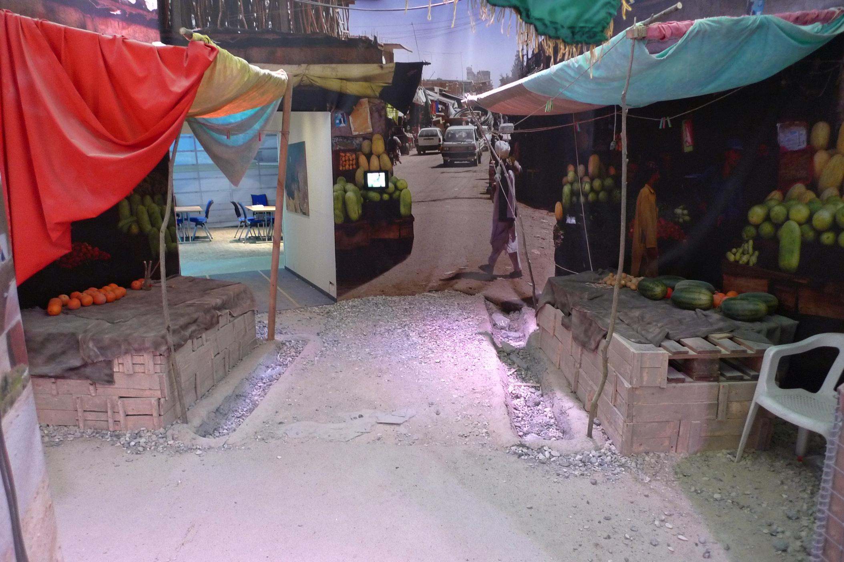

Slide 26
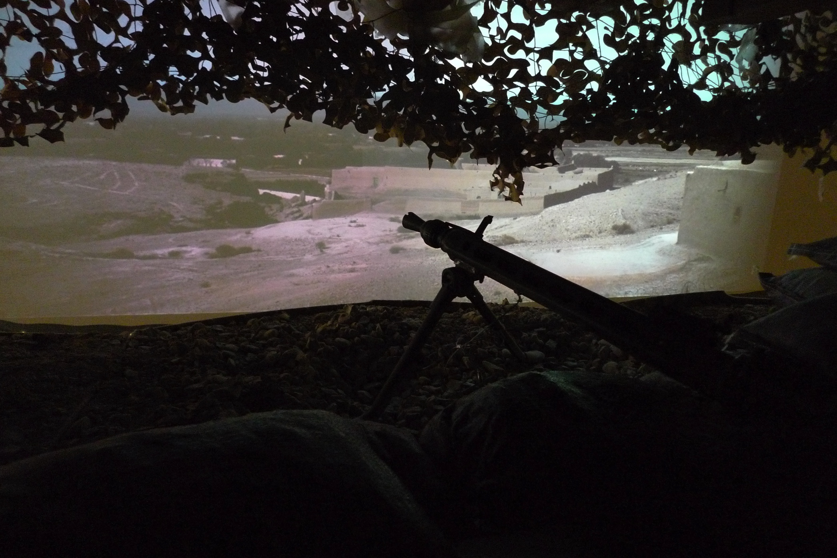

Slide 27
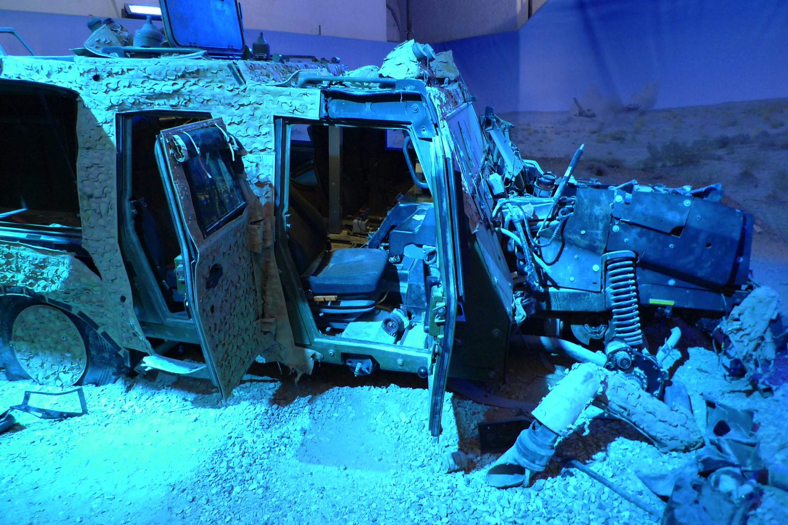

Slide 28
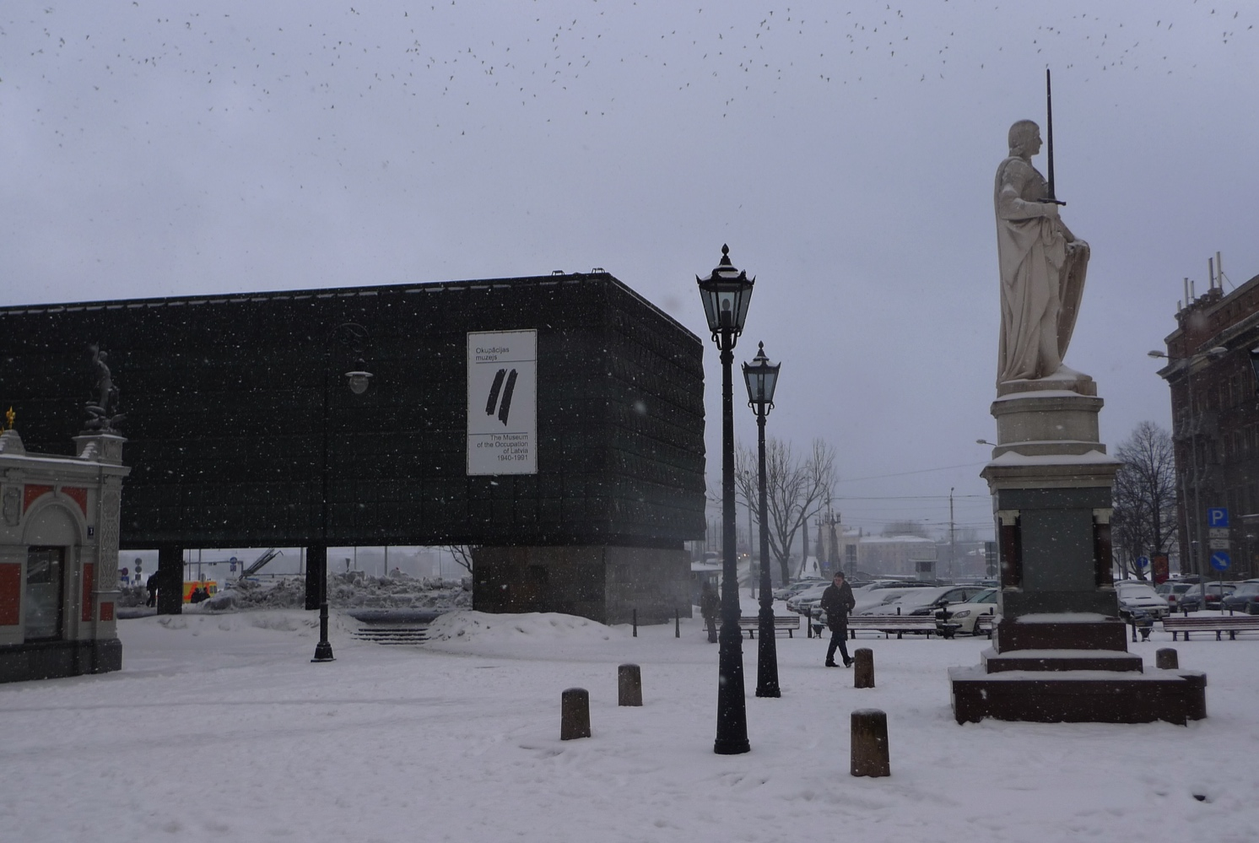

Slide 29
Not many people in Western Europe know the history of the communist dictatorship in the former communist countries.
The new museum: The International aspects are important. The former communist countries must tell their occupation history to other western countries.

