Slide 1



TREATMENT of HYPERTENSION in the 21st Century
Extracts from the Sir George Pickering Lecture
Peter Sever
International Centre for Circulatory Health
Imperial College London

Slide 2

Hypertension treatment
The ASCOT Legacy

Slide 3
ASCOT History
1988/9 European Blood Pressure Group- discussion on unmet needs in hypertension research
1991 British Hypertension Society Working Party formed; produced initial trial design but no funding
1993 Furberg and the CCB controversy
1993 NHLBI agree to fund ALLHAT
1995 Joint discussions between UK, Sweden and Pfizer.
1996 ASCOT announcement and Steering Committee established

Slide 4
ASCOT: Rationale
Insufficient outcome data on newer types of blood pressure lowering agents
No data on the evaluation of specific combination treatment regimens
Shortfall of CHD prevention using standard therapy
Need to evaluate multiple risk factors in the prevention of CHD
No data on the benefits of lipid lowering among hypertensives

Slide 5
ASCOT: Study design
19,257 hypertensive patients
ASCOT-BPLA stopped after 5.5 yrs
atenolol ± bendroflumethiazide
PROBE
design
amlodipine ± perindopril
10,305 patients
TC ≤ 6.5 mmol/L (250 mg/dL)
ASCOT-LLA stopped
after 3.3 yrs
atorvastatin 10 mg
Double-blind
placebo
Investigator-led, multinational randomised controlled trial
Sever et al J. Hypertension. 2001;19:1139

Slide 6
Lipid-lowering arm

Slide 7
ASCOT-LLA : Nonfatal MI and Fatal CHD
Atorvastatin 10 mg Number of events 100
Placebo Number of events 154
36% reduction
HR = 0.64 (0.50-0.83)
p=0.0005
Relative risk reductions independent of baseline cholesterol levels
Sever PS, Dahlöf B, Poulter N, Wedel H, et al, for the ASCOT Investigators. Lancet. 2003;361:1149-58
Notes:
The primary end point of nonfatal MI (including silent MI) and fatal CHD was significantly lower by 36% (hazard ratio 0.64, CI 0.5 – 0.83, p=0.005) in the atorvastatin group compared with the placebo group.

Slide 8
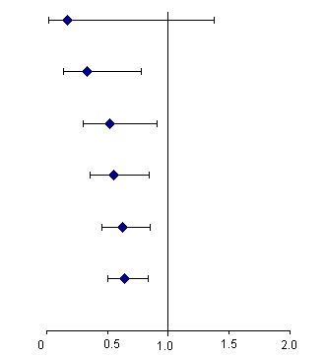
ASCOT-LLA CHD events :early benefits
*
Risk Reduction Event Rate
(%) Atorvastatin Placebo
83 2.4 14.2
67 5.5 16.6
48 7.5 14.3
45 6.6 12.0
38 5.9 9.5
36 6.0 9.4
Censoring Time
Hazard Ratios (95% CI)
30 days
90 days
180 days
1 Year
2 Years
End of Study
* Per 1000 patient years
Atorvastatin better
Placebo better

Slide 9
ASCOT-LLA
Summary of all end points
Primary End Points
  Nonfatal MI (incl silent) + fatal CHD
Secondary End Points
  Total CV events and procedures
  Total coronary events
  Nonfatal MI (excl silent) + fatal CHD
  All-cause mortality
  Cardiovascular mortality
  Fatal and nonfatal stroke
  Fatal and nonfatal heart failure
Tertiary End Points
  Silent MI
  Unstable angina
  Chronic stable angina
  Peripheral arterial disease
  Development of diabetes mellitus
  Development of renal impairment
Risk Ratio
Hazard Ratio
  0.64 (0.50-0.83)
  0.79 (0.69-0.90)
  0.71 (0.59-0.86)
  0.62 (0.47-0.81)
  0.87 (0.71-1.06)
  0.90 (0.66-1.23)
  0.73 (0.56-0.96)
  1.13 (0.73-1.78)
  0.82 (0.40-1.66)
  0.87 (0.49-1.57)
  0.59 (0.38-0.90)
  1.02 (0.66-1.57)
  1.15 (0.91-1.44)
  1.29 (0.76-2.19)
Atorvastatin better
Placebo better
0.5
1.0
1.5
Area of squares is proportional to the amount of statistical information
Sever PS, Dahlöf B, Poulter N, Wedel H, et al, for the ASCOT Investigators. Lancet. 2003;361:1149-58
Notes:
There was a significant reduction in the primary end point and also in four of the seven secondary end points, some of which were incorporated the primary end point.

Slide 10
Blood Pressure-lowering arm

Slide 11
ASCOT BPLA Summary of all end points
Unadjusted Hazard
ratio (95% CI)
0.90 (0.79-1.02)
0.87 (0.76-1.00)
0.87 (0.79-0.96)
0.84 (0.78-0.90)
0.89 (0.81-0.99)
0.76 (0.65-0.90)
0.77 (0.66-0.89)
0.84 (0.66-1.05)
1.27 (0.80-2.00)
0.68 (0.51-0.92)
0.98 (0.81-1.19)
0.65 (0.52-0.81)
1.07 (0.62-1.85)
0.70 (0.63-.078)
0.85 (0.75-0.97)
0.86 (0.77-0.96)
0.84 (0.76-0.92)
Primary
Non-fatal MI (incl silent) + fatal CHD
Secondary
Non-fatal MI (exc. Silent) +fatal CHD
Total coronary end point
Total CV event and procedures
All-cause mortality
Cardiovascular mortality
Fatal and non-fatal stroke
Fatal and non-fatal heart failure
Tertiary
Silent MI
Unstable angina
Chronic stable angina
Peripheral arterial disease
Life-threatening arrhythmias
New-onset diabetes mellitus
New-onset renal impairment
Post hoc
Primary end point + coronary revasc procs
CV death + MI + stroke
0.50
0.70
1.00
1.45
2.00
Amlodipine ± perindopril better
Atenolol ± thiazide better
The area of the blue square is proportional to the amount of statistical information

Slide 12
Synergy of atorvastatin and
amlodipine based treatment arm

Slide 13
ASCOT-LLA 2x2 analyses
Benefits of atorvastatin according to BP lowering strategy
Primary endpoint: Non-fatal MI and fatal CHD
Amlodipine-based treatment
Atenolol-based treatment
4.0
4.0
3.0
Atorvastatin
Placebo
3.0
Atorvastatin
Placebo
16%
53%
2.0
Cumulative incidence (%)
Cumulative incidence (%)
2.0
1.0
1.0
HR=0.47 (0.32 - 0.69) p<0.001
HR=0.84 (0.60 - 1.17) p=0.30
0.0
0.0
0.0
0.5
1.0
1.5
2.0
2.5
3.0
3.5
0.0
0.5
1.0
1.5
2.0
2.5
3.0
3.5
Years
Years
P for interaction = 0.017
Sever, Poulter, Dahlof, Wedel. Europ.Heart Journal. 2006;27:2982

Slide 14
LLA and BPLA
Combined benefits of lipid- and blood pressure- lowering

Slide 15
Estimated benefits of combined blood pressure and lipid lowering from meta-analyses of placebo controlled trials
 | Blood Pressure Lowering (15/10mmHg) | Lipid Lowering (1mmol/L) | Combined BP & Lipid Lowering
CHD | 30% | 25-35% | About 50%
Stroke | 45% | 15-20% | About 55%

Slide 16
Reduction in risk of non-fatal MI and fatal CHD using Framingham model for baseline estimates **
Framingham risk estimate from baseline data ( n=10,305) | Final risk in those assigned amlodipine/perindopril and atorvastatin | Relative risk reduction
22.8* | 4.8* | 79%
*per 1000 patient years
**Variables include SBP, smoking status, total and HDL-cholesterol, presence or absence of LVH,
age, gender, presence or absence of diabetes. No correction for on- treatment blood pressure
Sever et al. Int. J. Cardiol.2009. Feb 18, epub ahead of print

Slide 17
A molecular mechanism for synergy
Clunn GF, Sever,P, Hughes A. Int J Cardiol 2009 Jun 10 [Epub ahead of print]

Slide 18
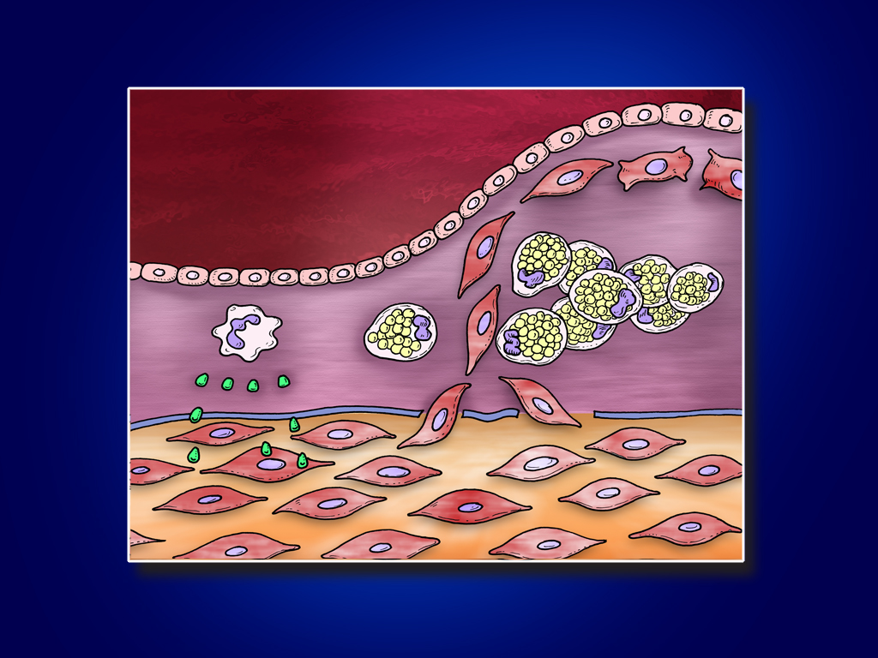
SMC dedifferentiation
to synthetic phenotype
Macrophage
Foam cells
Cytokine release
SMC
migration
and
proliferation
SMC = smooth muscle cell

Slide 19
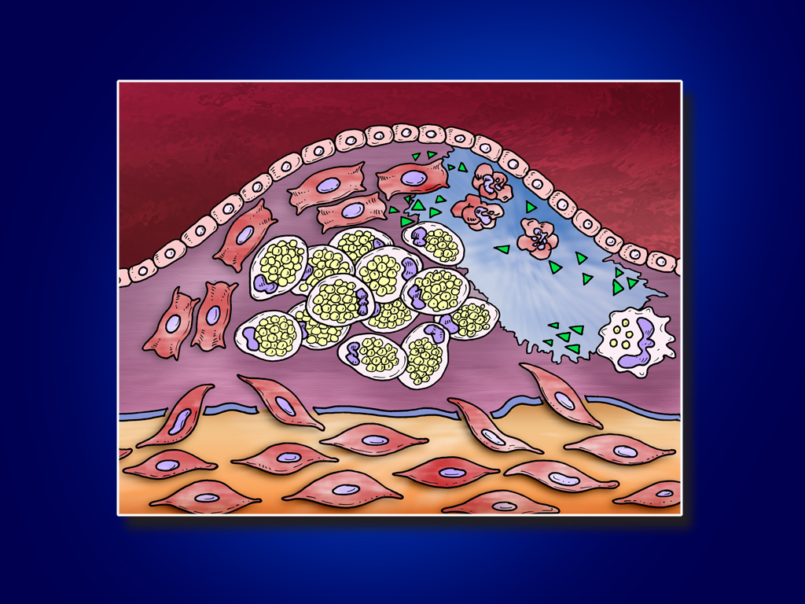
Apoptosis
MMPs
Destruction
of intercellular
matrix
Lipid-laden
macrophage
MMP = matrix metalloproteinase

Slide 20
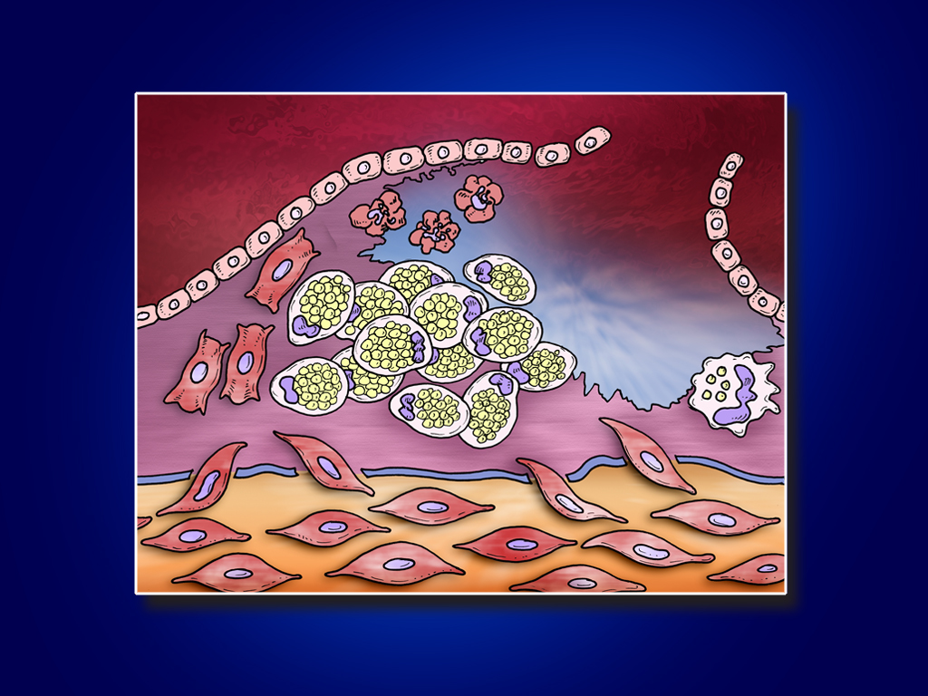
Plaque rupture

Slide 21
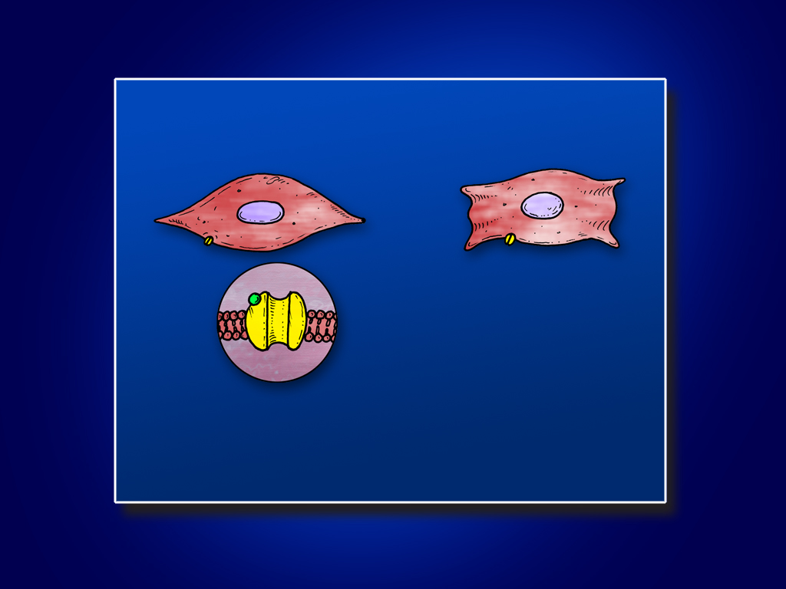
SMC DEDIFFERENTIATION
Contractile phenotype Synthetic phenotype
CCB
Ca²⁺
Loss of
functionality
of L-type VOC
• CCBs ineffective
Presence of statins leads to growth arrest and re-expression
of functioning
L-type VOCs
L-type VOC
• CCBs effective
CCB = calcium channel blocker
VOC = voltage-operated Ca²⁺ channel
Clunn GF, Sever P, Hughes A. Int J Cardiol 2009 Jun 10 [Epub ahead of print]

Slide 22
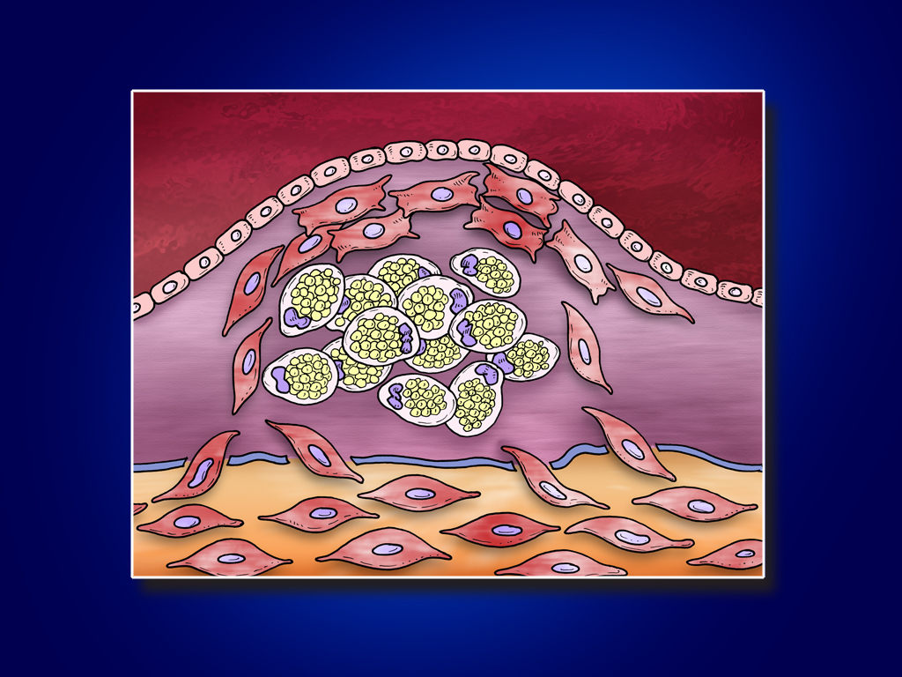
An additional mechanism?

Slide 23
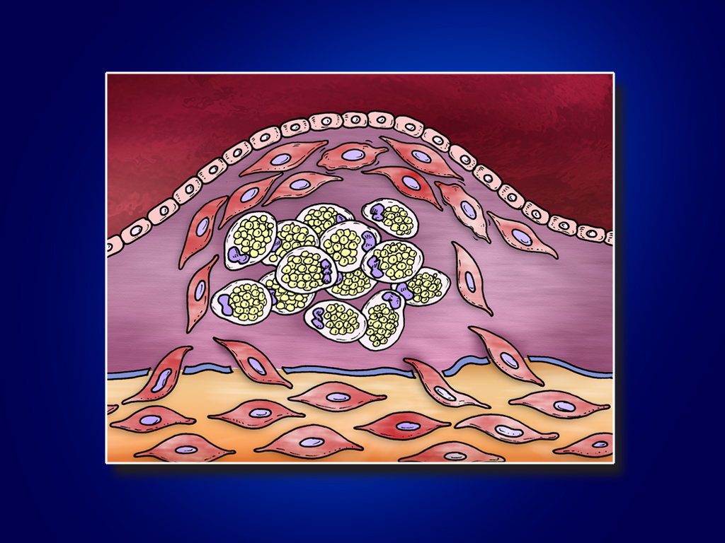
SMC: reversion to a more differentiated phenotype

Slide 24
Lipid-lowering arm
Atorvastatin and carotid artery pressure
Atorvastatin lowers carotid artery pressure but not brachial
artery pressure, with evidence of an enhanced
effect in those assigned amlodipine-based treatment

Slide 25
Effect of atorvastatin on carotid systolic pressure in those assigned amlodipine- or atenolol- based treatment in ASCOT
Aplanation tonometry performed on the right carotid artery .Carotid artery flow velocity measured by pulsed wave Doppler ultrasound, and wave intensity analysis also performed
Augmentation pressure and augmentation index were lower in those assigned atorvastatin
Manisty C, Mayet J, Tapp R, Sever P et al. Hypertension 2009:54; e-pub online Aug 31

Slide 26
Lipid-lowering arm
The relationship Between statin therapy and
the progression of renal damage

Slide 27
Background
Uncertainty whether the use of statin therapy is effective in retarding the progression of renal damage among high-risk patients in a primary prevention setting.
Would the use of statin therapy in combination with antihypertensive medication, be additive in reducing the age-related decline in renal function ?

Slide 28
Mean eGFR During Follow-up in the ASCOT-LLA, Stratified by Allocated Treatment
Aten-based & Placebo
Aten-based & Atorvastatin
74
Amlo-based & Placebo
Amlo-based & Atorvastatin
72
Mean eGFR (95% CI), mL/min/1.73 m²
70
68
Baseline
6 Month
Year 1
Year 2
Year 3
Aten-based & Placebo:
69.0
67.7
67.8
68.4
69.5
Aten-based & Atorvastatin:
68.9
67.9
68.0
68.8
70.0
Amlo-based & Placebo:
69.9
70.8
71.1
72.2
73.2
Amlo-based & Atorvastatin:
70.3
71.4
71.6
72.5
73.7
eGFR: estimated glomerular filtration rate; CI: confidence interval; Aten-based: Atenolol ± thiazide ; Amlo-based: Amlodipine ± Perindopril

Slide 29
Blood Pressure-lowering arm
Substudies

Slide 30
CAFÉ Study: Methods
SP
P₁
∆ P
Radial artery waveforms measured via noninvasive applanation tonometry
Augmentation index (AIx) defined as ratio of augmentation to central pulse pressure:
Alx = (∆ P/PP) × 100
Pressure
(mm Hg)
DP
Incisura
ED
Time (msec)
ED = ejection duration
CAFE Investigators. Circulation. 2006;113: epublished Feb 13, 2006.

Slide 31
CAFE: Lower central aortic BP with newer vs older antihypertensive regimen despite similar brachial BP
140
Brachial SBP
135
130
mm Hg
Central aortic SBP
125
120
115
0
0.5
1
1.5
2
2.5
3
3.5
4
4.5
5
5.5
6
AUC
Time (years)
Amlodipine ± perindopril
Atenolol ± bendroflumethiazide
CAFE Investigators. Circulation. 2006;113: epublished Feb 13, 2006.

Slide 32
ASCOT Study of LV diastolic function : Treatment effects at I year
 | Atenolol-Based Regimen (n = 411) | Amlodipine-Based Regimen (n = 413) | p Value
Transmitral Doppler
E wave, cm/s | 60.08 ± 14.87 | 63.41 ± 15.01 | 0.001
A wave, cm/s | 68.25 ± 14.63 | 75.08 ± 15.76 | <0.001
E/A ratio | 0.91 ± 0.29 | 0.86 ± 0.22 | 0.004
E-wave deceleration time, ms | 0.20 ± 0.05 | 0.18 ± 0.05 | <0.001
Tissue Doppler
Systolic velocity (S′), cm/s | 8.2 ± 1.75 | 9.5 ± 2.21 | <0.001
Early diastolic velocity (E′), cm/s | 7.91 ± 1.84 | 8.76 ± 2.04 | <0.001
Late diastolic velocity (A′), cm/s | 10.76 ± 2.15 | 12.34 ± 2.31 | <0.001
*Mean E/E′ ratio | 8.14 ± 2.38 | 7.76 ± 2.05 | 0.013
*BNP, pg/ml | 37 (20–56) | 19 (10–34) | <0.001
Early diastolic velocity (E`)( measure of diastolic relaxation) lower on atenolol, and left ventricular filling pressure (E/E`) and BNP higher on atenolol
* Both independent predictors of cardiac events
Tapp et al J Am Coll Cardiol. 2010 Apr 27;55(17):1875-81

Slide 33
Blood Pressure Variability

Slide 34
Blood Pressure variability
Background
Blood pressure variability is increased in cohorts at high risk of stroke and predicts stroke independent of mean blood pressure Rothwell 2005.

Slide 35
Blood pressure variability: methods
(based on over 1 million BP readings)
Of 19,257 patients, 18,530 had ≥ 2 follow-up visits (median = 10) from 6 months onwards until the end of the trial
3 blood pressure measurements were recorded at each visit, using standardised techniques, at 6 monthly intervals for a median follow up of 5.5 years

Slide 36
Within visit variability
164/96
159/92
150/92
173/90
169/89
174/96
164/90
168/94
158/94
156/88
148/86
159/86
170/92
166/88
174/88
Between visit or visit-visit variability

Slide 37
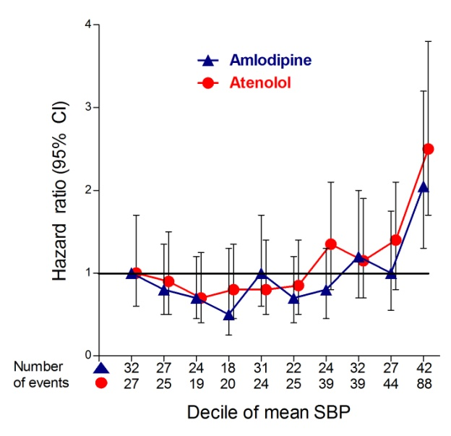
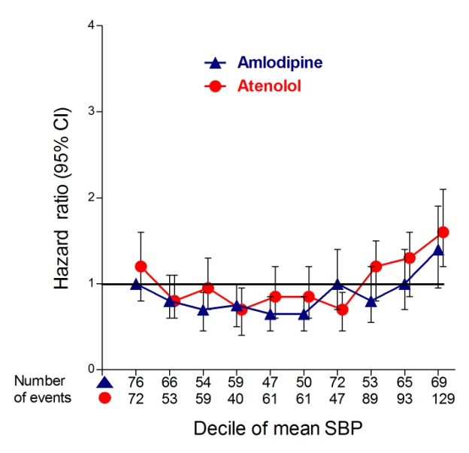
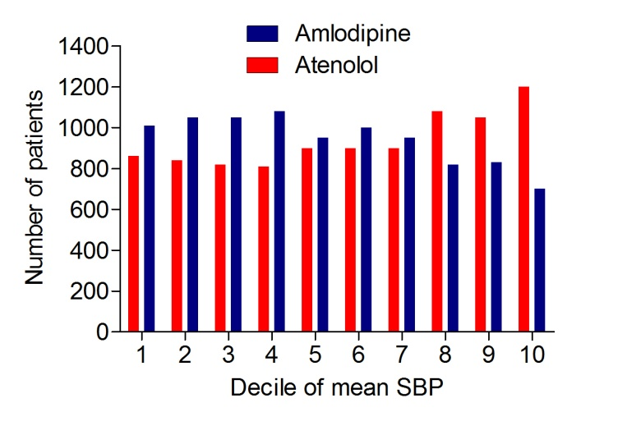
Visit-to-visit mean systolic blood pressure expressed in deciles, hazard ratios (95% CI) and number of stroke and coronary events in each decile
Mean SBP
Stroke risk
Coronary risk

Slide 38
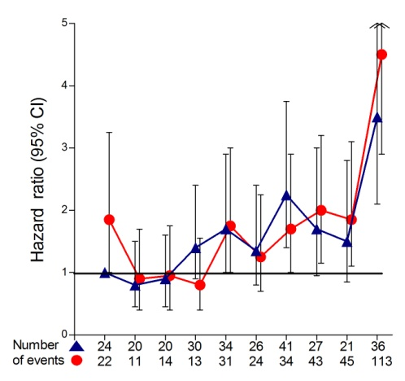
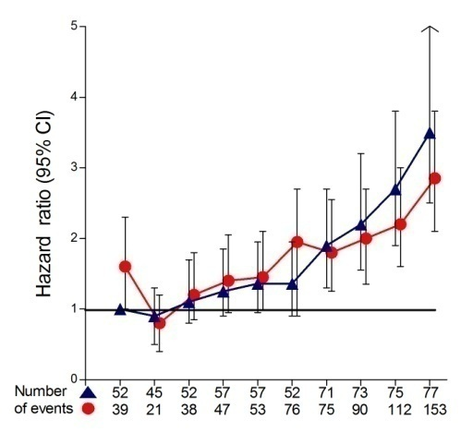
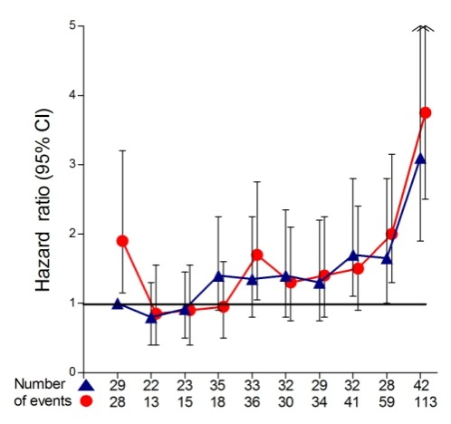
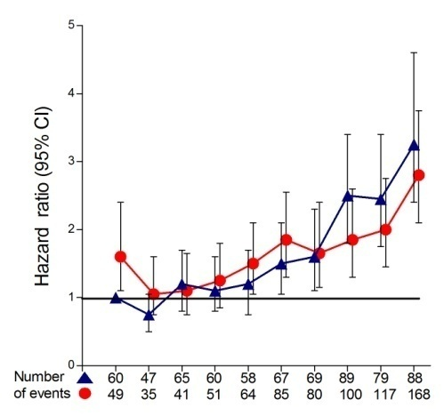
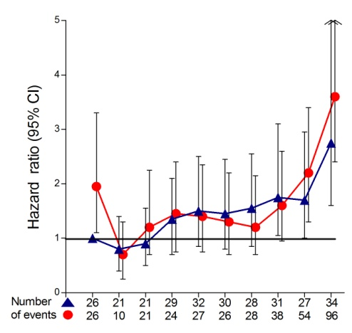
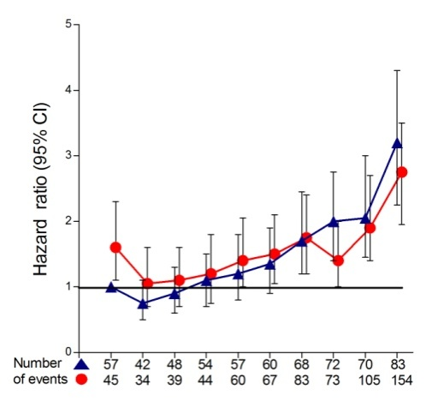
Stroke and coronary risk expressed by decile of measure of visit-to-visit SBP variability
Stroke Risk
Coronary Risk
Standard deviation of SBP
Amlodipine
Atenolol
Coefficient of variation of SBP
Variation independent of mean SBP
Decile of measure
Decile of measure

Slide 39
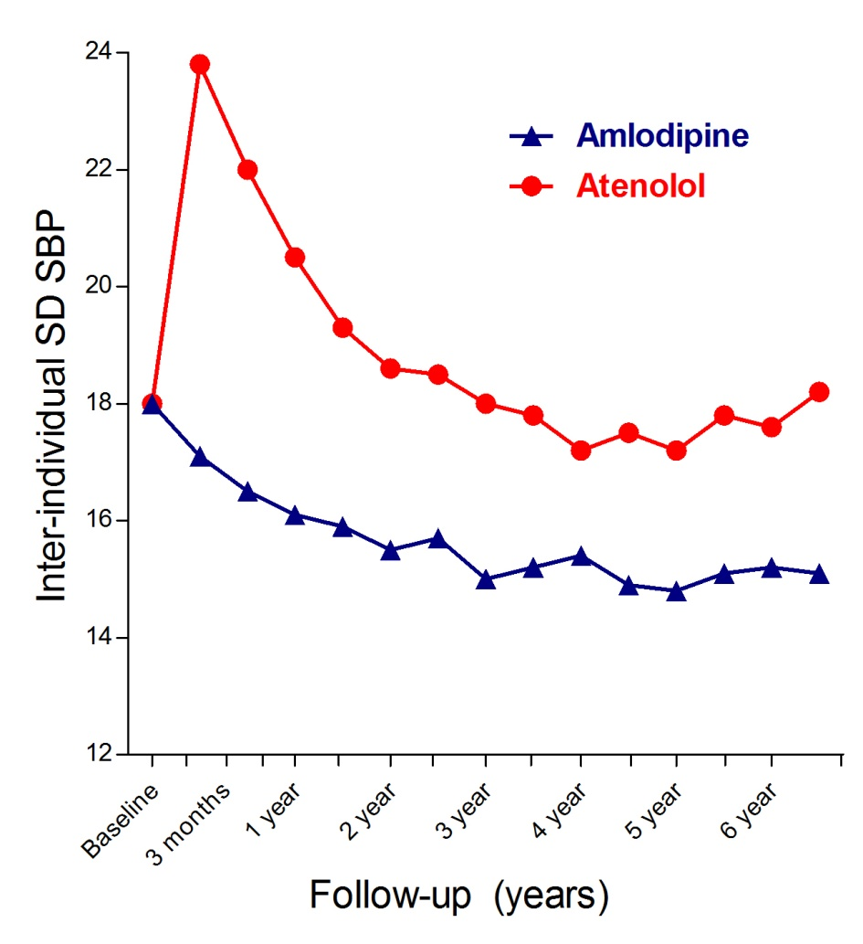
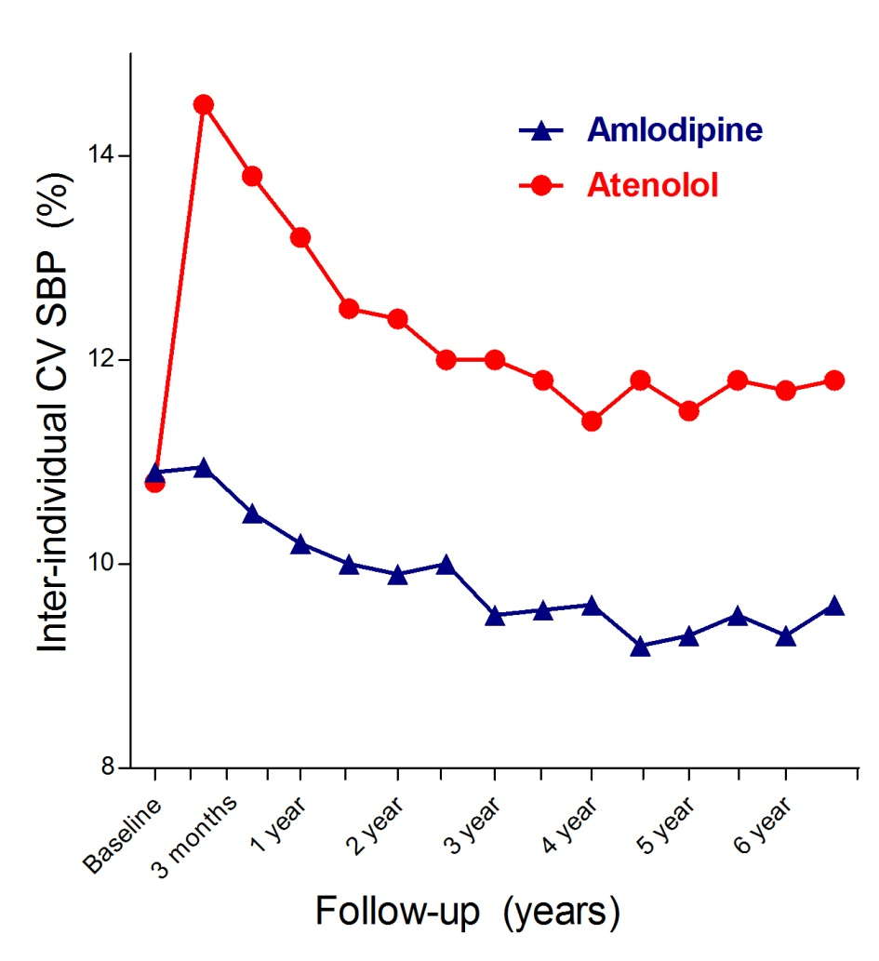
Group distribution (SD and CV) of measures of SBP at baseline and at each follow-up visit in the two treatment groups

Slide 40
Hazard ratios (95% CI) for the effect of treatment
(amlodipine versus atenolol) on risk of stroke
Parameters calculated using all BP measurements from 6 months onwards. Mean, SD, CV, and VIM are entered into the model as deciles
Stroke | Systolic blood pressure
Variables in model | HR (95% CI) | p value
Treatment (Rx) | 0.78 (0.67–0.90) | 0.001
Usual BP
Rx + mean | 0.84 (0.72–0.98) | 0.025
Visit-to-visit BP variability
Rx + mean + SD | 0.96 (0.82–1.12) | 0.59
Rx + mean + CV | 0.95 (0.82–1.11) | 0.55
Rx + mean + VIM | 0.96 (0.82–1.12) | 0.58
Within-visit and visit-to-visit BP variability
Rx + within-visit SD | 0.84 (0.72–0.98) | 0.024
Rx + mean + VIM + WVSD | 0.99 (0.85–1.16) | 0.89
SD, standard deviation; CV, coefficient of variation; VIM, variability independent of mean; WVSD, within-visit standard deviation

Slide 41
Hazard ratios (95% CI) for the effect of treatment
(amlodipine versus atenolol) on risk of coronary events
Parameters calculated using all BP measurements from 6 months onwards. Mean, SD, CV, and VIM are entered into the model as deciles
Coronary Events | Systolic blood pressure
Variables in model | HR (95% CI) | p value
Treatment (Rx) | 0.85 (0.77–0.94) | 0.002
Usual BP
Rx + mean | 0.88 (0.80–0.98) | 0.019
Visit-to-visit BP variability
Rx + mean + SD | 1.00 (0.90–1.11) | 0.98
Rx + mean + CV | 1.00 (0.90–1.11) | 0.99
Rx + mean + VIM | 1.00 (0.90–1.10) | 0.99
Within-visit and visit-to-visit BP variability
Rx + within-visit SD | 0.88 (0.79–0.97) | 0.013
Rx + mean + VIM + WVSD | 1.01 (0.91–1.12) | 0.88
SD, standard deviation; CV, coefficient of variation; VIM, variability independent of mean; WVSD, within-visit standard deviation

Slide 42
Conclusions
Blood pressure variability is a major predictor of stroke and coronary events
In individual trials average (mean) blood pressures poorly predict outcome
Increased blood pressure variability is associated with smoking, increasing age, diabetes, presence of vascular disease
There are major differences in the effects of different drug regimens on blood pressure variability

Slide 43
Biomarkers and cardiovascular risk prediction

Slide 44
Biomarkers
Inflammation
CRP,IL6,LpPLA2,neopterin
Lipids
ApoA,ApoB1,Lp(a)
Metabolic
proinsulin,insulin,adiponectin,
fructosamine
Thrombosis
aPAF, aPC
Current hot biomarkers
NT-proBNP, cystatin C
Others
cortisol, urate, renin, aldo, CFH,GDF 15
Vascular
ADMA, t-PA, ICAM-1

Slide 45
ASCOT Biomarker Programme: Although both these biomarkers independently predict risk of future cardiovascular events in the ASCOT Trial of 19342 hypertensive subjects, Nt-proBNP is the only one which has predictive ability beyond classical risk factors (Net reclassification improvement 11.8%)
Baseline Nt-BNP and Risk of CV Events
Per 1 SD increase log Nt-BNP 451 1265 1.30 <0.0001
Tertile 1 :<57 128 441 1 (ref) <0.0006
Tertile 2 :58-141 141 438 1.17 0.30
Tertile 3: >141 182 338 1.70 0.0007
Baseline CRP and Risk of CV Events
Per 1 SD increase log CRP 452 1269 1.19 0.006
Tertile 1 CRP: <1.74mg/L 131 448 1 (ref) 0.05
Tertile 2 CRP: 1.74-4.09mg/L 153 417 1.25 0.14
Tertile 3 CRP: >4.09mg/L 168 404 1.35 0.05
1
1.5
2
Odds ratio and 95% CI (log scale)
0.5
1.0
1.5
2.0
Odds ratio 95% CI
Sever et al Europ Heart J 2011 epub July 28
Multivariable adjustment. Adjusted for current smoking status, diabetes mellitus, randomized BP treatment (atenolol/amlodipine), randomized atorvastatin/placebo/not in LLA, left ventricular hypertrophy, baseline SBP, total cholesterol and HDL-C BMI, log_{e}-glucose, family history of CHD, creatinine and educational attainment

Slide 46
Lipid-lowering arm
The LLA Extension

Slide 47
Changes in total cholesterol over time
60% + of patients in
both arms now on statins
mmol/L
mg/Dl
End of LLA
Atorvastatin
Placebo
End of
BPLA
Sever PS, et al. Eur Heart J 2008;29:499–508

Slide 48
ASCOT-LLA endpoints
3.3 yrs¹
Risk ratio
5.5 yrs²
Risk ratio
Primary endpoints
Non-fatal MI (incl silent) + fatal CHD
Secondary endpoints
Total CV events and procedures
Total coronary events
Non-fatal MI (excl silent) + fatal CHD
All-cause mortality
Cardiovascular mortality
Fatal and non-fatal stroke
Fatal and non-fatal heart failure
Tertiary endpoints
Silent MI
Unstable angina
Chronic stable angina
Peripheral arterial disease
Development of diabetes mellitus
Development of renal impairment
Atorvastatin better
Placebo better
Atorvastatin better
Placebo better
0.5
1.0
1.5
0.5
1.0
1.5
Area of each square is proportional to the amount of statistical information
1. Sever PS, et al. Lancet 2003;361:1149–58; 2. Sever PS, et al. Eur Heart J 2008;29:499–508

Slide 49
ASCOT-ON and ASCOT-10
Mortality and morbidity follow up of
UK ASCOT patients

Slide 50
ASCOT-10 Objectives
• To establish the effect of study interventions on long term mortality and morbidity outcomes for coronary, stroke and other vascular diseases in patients from the ASCOT study, five years after completion of the study.
To ascertain the number of cases of new onset diabetes amongst the study population.
To ascertain, in patients who developed new onset diabetes during the main ASCOT study, whether this is associated with greater vascular morbidity and mortality.
To ascertain whether blood pressure variability during the main ASCOT trial follow up is a predictor of subsequent cardiovascular morbidity and mortality
Primary endpoint CV death + non-fatal MI + non-fatal stroke

Slide 51
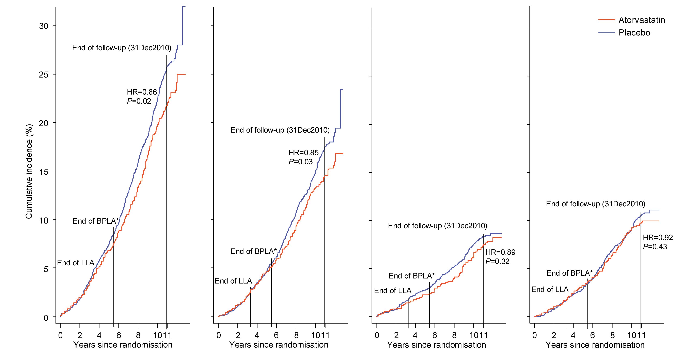
Cumulative Incidence by Cause of Death ‒ 1
All-cause mortality
Non-cardiovascular mortality
Cardiovascular mortality
Cancer mortality
Number at risk
Placebo
Atorvastatin
2288
2317
2191
2228
2052
2091
1208
1226
2288
2317
2191
2228
2052
2091
1208
1226
2288
2317
2191
2228
2052
2091
1208
1226
2288
2317
2191
2228
2052
2091
1208
1226

Slide 52
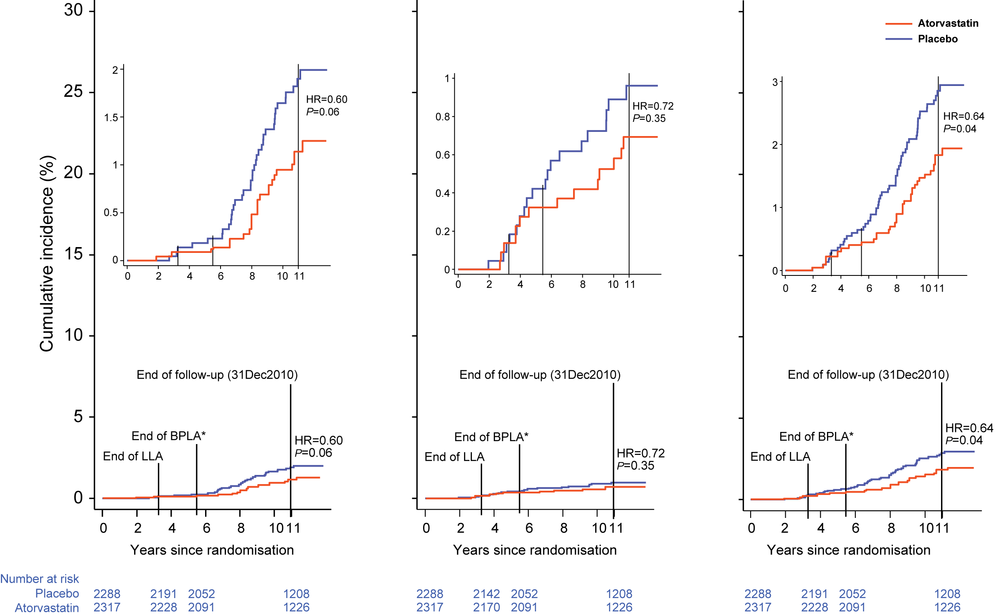
Cumulative Incidence by Cause of Death ‒ 2
Mortality due to infection
Mortality due to respiratory illness
Mortality due to infection and respiratory illness
Number at risk
Placebo
Atorvastatin
2288
2317
2191
2228
2052
2091
1208
1226
2288
2317
2191
2228
2052
2091
1208
1226
2288
2317
2191
2228
2052
2091
1208
1226

Slide 53
Hypertension treatment in the 21st century
ASCOT Legacy

Slide 54
Guidelines influenced by ASCOT-LLA
BHS IV and JBS 2
Taskforce of ESH and ESC 2007 and 2009.
Advocate lipid-lowering in primary prevention based on absolute risk assessment
ATP III Update 2004

Slide 55
Influence on Blood Pressure Guidelines
The demise of the beta-blocker
ASCOT BPLA
Less protection against stroke
Higher central aortic blood pressures
( Increase in BP variability )
Less effect on LV dysfunction
More new-onset diabetes
Pre-eminence of CCB over thiazide in treatment
strategies
Importance of CCB/ACEI combination

