Slide 1
The c4c project: a comprehensive overview
Mark Turner, Carlo Giaquinto, Katharine Cheng, Heidrun Hildebrand

Slide 2
Vision
Better medicines for babies, children and young people through a pan-European clinical trial network
6 year horizon

Slide 3
MISSION
c4c will use a coordinated approach to deliver high quality “regulatory grade” clinical trials in:
Multiple countries
Multiple sites
All paediatric age groups
by supporting:
Trial implementation using resources shared between studies
Trial design through a combination of information about natural history, feasibility, appropriate innovation, and expert opinion
Education and awareness within and beyond the network

Slide 4
MISSION
c4c will use a coordinated approach to deliver high quality “regulatory grade” clinical trials in:
Multiple countries
Multiple sites
All paediatric age groups
by supporting:
Trial implementation using resources shared between studies
Trial design through a combination of information about natural history, feasibility, appropriate innovation, and expert opinion
Education and awareness within and beyond the network

Slide 5
MISSION
c4c will use a coordinated approach to deliver high quality “regulatory grade” clinical trials in:
Multiple countries
Multiple sites
All paediatric age groups
by supporting:
Trial implementation using resources shared between studies
Trial design through a combination of information about natural history, feasibility, appropriate innovation, and expert opinion
Education and awareness within and beyond the network
Relevance to Estonia / Lithuania / Latvia:
Facilitation – infrastructure
Enrichment – width

Slide 6
Planning, set-up & conduct of a Paediatric Development Program A multifaceted challenge…
Right indication and population
Insufficient trial infrastructure
Use/acceptance of innovative study designs
Divergent view of Ethic Committees
Diverse standard of care across Europe
Contradictory local regulations
Small patient populations – competing developments
Dose, route of administration, application device
Impact on daily lives of patients and families
Defining the medical need
Acceptance of Paediatric research in society
Preparing and agreeing a Paediatric Development Plan

Slide 7
Challenges when conducting paediatric trials
Most new paediatric trials require a new network of sites to be built
Assessment of site capability, patient availability, and feasibility of trials is often inaccurate
Many sites are inexperienced, poorly trained, and under-resourced
Most sites negotiate their own CDAs, contracts, budget templates, and IRBs/EC approvals to prepare for studies
Lack of experience in designing & conducting Paediatric studies by (industry) sponsor
Poor study design
Poor feasibility
Poor site engagement
Inefficiency
Poor/delayed study delivery

Slide 8
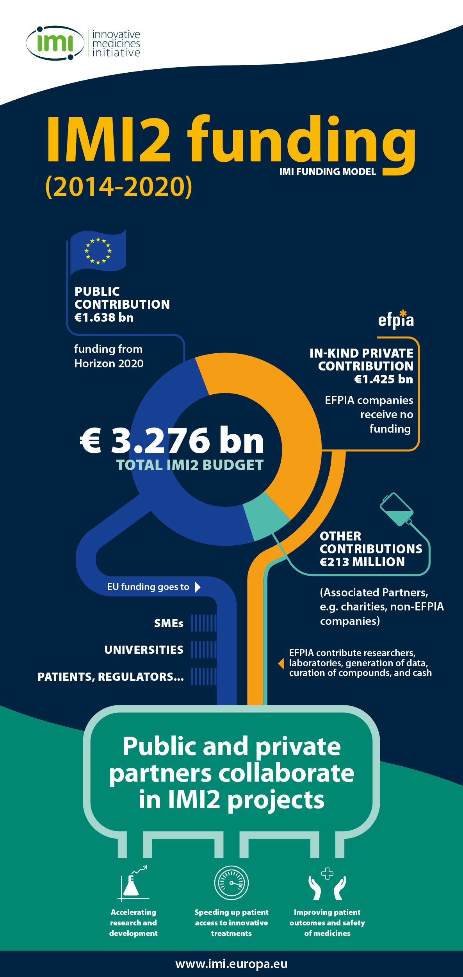
A pan-EU Paediatric Clinical Trial Network A project under the EU Innovative Medicines Initiative (IMI)
Ensure efficacy, safety & quality of health products
Reduce time to clinical proof of concept
Improve the current drug development process
Develop new therapies for diseases with high unmet need & limited market incentives
Allow engagement in a cross-sector, multi-disciplinary consortium at the forefront of cutting-edge research

Slide 9
Project Concept
Use resources and funding of the IMI project to setup the network and its processes
National
International
Demonstrate the value of the network approach with selected
Studies
Sites
Generalise from the demonstration projects to the broader network

Slide 10
Project Concept
Use resources and funding of the IMI project to setup the network and its processes
National
International
Demonstrate the value of the network approach with selected
Studies
Sites
Generalise from the demonstration projects to the broader network
Avoiding duplication

Slide 11
Project Concept
Use resources and funding of the IMI project to setup the network and its processes
National
International
Demonstrate the value of the network approach with selected
Studies
Sites
Generalise from the demonstration projects to the broader network
From
Specific
Selected
To
Generalised
Sustainable
2019
2024

Slide 12
Sustainability
“Generalise from the demonstration projects to the broader network”
This involves:
Persuading funders to invest in sites, national networks and international networks (including expert advisory groups)
Demonstrating financial, economic and social value of the network
Capturing value that sites and networks create
Proof-of-viability: inclusion or exclusion in the demonstration projects does not affect involvement in the definitive network

Slide 13
Key Objectives
More efficient trial implementation through the set-up of national hubs and qualified sites
Input in clinical trial design and implementation from pilot expert advisory groups and other fora
Educational programme for health professionals and awareness raising campaigns for the general public
Identification of Data standards and performance metrics
Business cases for sustainability beyond IMI funding

Slide 14
Key features
International network with lean central coordination
A single point of contact (One-stop-shop)
Efficient implementation of trials
Consistent procedures across sites
Strategic and operational feasibility assessment
Involvement of experts to develop innovative trial designs and methodology
Multi-KEY stakeholder collaboration

Slide 15
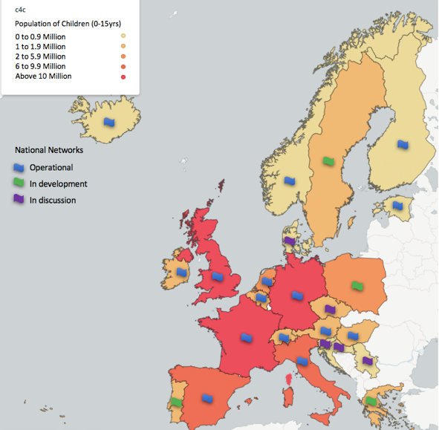
The c4c consortium members
10 EFPIA companies
18 pediatric national networks
2 large patient advocacy groups
8 EU Multinational sub-specialty Networks
200 large children’s hospitals

Slide 16
Private-public partnership between Academia and Pharma

Slide 17
Infrastructure Office
Evaluation/ Assessment- the single point of contact will trigger the evaluation/ assessment process for the provision of services by the c4c network
Communication with Existing Specialty/National Networks
Specialty networks
Operations
Site Feasibility
Site identification
Study/site setup
Ongoing support
Sites
National Hubs
Single Contact Point
Advice
Contributors
Sponsor
Advisory Group Secretariat
Central advisory process- All queries, at whatever stage, i.e. pre-PIP; FPI, during the study, or after the study for analysis and interpretation of data will undergo Advice.
Expert Advice
Strategic feasibility
Scientific/ clinical
Operational/do-ability assessment
Groups setup for specific tasks
Clinical
Children, Young People and Families
Methodological
Industry

Slide 18
Work Packages
Work package 1: Project management and oversight of IMI project
Work package 2: Organisation and governance of the pan-European paediatric clinical trials network
Work package 3: Business plan development, expansion of the network and sustainability of the network funding sources post-IMI2 support
WP5: Data coordinating centre and data quality standards
WP7: Planning and execution of clinical trials

Slide 19
WP4: Scientific advice, feasibility and innovation - Saskia De Wildt
 |  | Lead Beneficiary | Lead EFPIA (expected) | Additional party
WP4 | Scientific advice, feasibility and innovation | RUN-MC, SIOPE | JANSSEN, BAYER, GSK, SANOFI | Servier, UCB, Lilly, Novartis
4.1 | Implement expert panels (Feasibility Groups). | RUN-MC
4.2 | Set-up and maintain groups of scientific experts to trigger innovation. | RUN-MC
4.3 | Implement standing disease or condition-focused network Clinical Expert Groups. Clinical Expert Groups | SIOPE
4.4 | Set-up process to allow patients/parent representatives to give input | FSJD
4.5 | Creation of the charter, definitions of operations, and selection of members of the different scientific bodies | RUN-MC

Slide 20
WP6: Network research personnel education and training - Paolo Rossi
To create an integrated educational program developed jointly
by Academy and Pharmaceutical Companies
to address paediatric medicine development and paediatric clinical trials
How:
developing a web-based Virtual Learning Environment (VLE). The platform will be the IMI2/C4C on-line Paediatric Medicines Academy
creating and adopt an ad hoc Paediatric eTraining GCP course
define and developing a training curriculum of Paediatric Clinical Trialist/Paediatric Pharmacologist (MS)
organizing on site training stages for Clinical Trial Unit Staff
implementing specific on site short courses dedicated to Ethic Committees and administrative hospital Personnel
training investigators about patient and family involvement
developing educational materials appropriate to children in different ages and their families, validated by the Young Persons’ Advisory Group (YPAG)
Organizing an information campaign addressed to the general public on the importance of new drug development for children

Slide 21
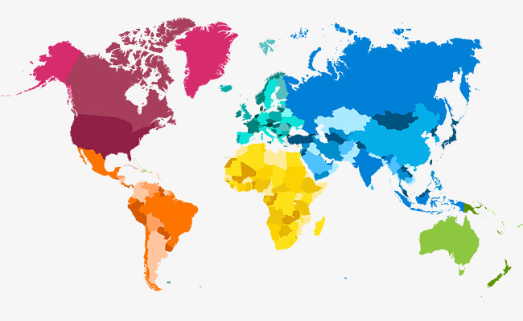
Global Paediatric clinical trial networks
The c4c network will collaborate with other existing networks
US
Canada
Europe
DCRI-GPN
(Global Pediatric Network – Duke)
i-ACT
Kids
CAN
c4c
PENTA-ID
/PRINTO/CF/SIOPE/ECRIN…
Japan
Japanese Pediatric Network for Drug Development
Australia
Pediatric Trials Network of Australia (PTNA)

Slide 22
Benefits for sponsors in placing a study with c4c
High quality input in study design and preparation through rigorous strategic and operational feasibility assessment
Efficient implementation by adopting consistent approaches, aligned quality standards and coordination of sites at national and international level
A single point of contact for all sponsors, sites and investigators
Collaboration with EU pediatric specialty networks

Slide 23
Benefits to the paediatric community
Harmonized, streamlined procedures across the trial lifecycle
Opportunities to build economies of scale at site and national level
Reducing barriers to entry and so making paediatric research more attractive and competitive
Access to a wide range of study sponsors through a transparent, evidence-based, network-wide vetting procedure
Input from relevant specialty networks and methodologists on study design, implementation and assessment

Slide 24
Expected long term impact of c4c
Access to new experimental therapies for children in well-designed clinical trials
Better training for research personnel and improved trial readiness at all participating sites
Improved efficiency in executing trials (faster, cheaper)
Improved data quality for labelling of next generation medicines for children
Enhanced role of clinicians and patient/parent advocacy groups in planning and designing studies
Broadening the access of academic medical centers and clinical faculty across Europe to new experimental therapies

Slide 25
How c4c will be put to the test
Proof-of-viability trials
Industry sponsored
Non-industry-sponsored
selecting and comparing metrics about studies’ start-up and conduct

Slide 26
Scope of c4c (at end of year 6)
Type of study | Industry/non-industry
Intervention | Drug, biologics, devices
Geography | Europe
Phase of study | Ph 1- 4; registry studies, non-interventional
Endpoints | PK/PD, efficacy, safety
Responsibilities | The c4c network will provide some central services for trials, for example, trial feasibility, pharmacovigilance activities and commissioning of trial supplies. Other operations to be supplied by the sponsor

