Slide 1
Concepts of Paediatric Investigation Plans (PIP)
Irja Lutsar
University of Tartu
Bucharest, 08.June 2017

Slide 2
Outline
Paediatric Regulation
Paediatric Investigational Plan
Waivers and deferrals
Performance of Paediatric Regulation

Slide 3
EU Paediatric Regulation
Entry into force January 2007
Improve the health of children
Increase high quality, ethical research into medicines for children
Increase availability of authorised medicines for children
Increase information on medicines
Achieve the above
Without unnecessary studies in children
Without delaying authorisation for adults

Slide 4
Paediatric Committee (PDCO)
established in 26 July 2007
CHMP members (5)
Patient/family and health-
care professionals (6)
Experts from National Competent Authorities (23) + EEA
+ alternates

Slide 5
Paediatric Investigational plan (PIP)
The aim of a PIP is to support the medicine’s authorisation in children
Should be developed for all new medicinal products
Responsibility of the applicant (e.g. pharmaceutical company)
Experts are often involved
Is discussed and agreed by the PDCO
Is binding to the applicant
Can be modified in agreement with PDCO

Slide 6
PIP decision tree: end of phase 1
Is there an unmet medical need?
No
Yes
Full waiver
Pathomechanism is different from adults
Pathomechanims is similar to adults
Mechnism is unknown
Toxicity is uncertain
Full paediatric development
Partial paediatric development
Deferral
PK studies
Efficacy and safety
PK studies
PD based extrapolation

Slide 7
Components of PIP: background
An overview of the available data for the medicine, including:
Brief description of the disease(s)
Justification of paediatric needs
Chemical information on the current formulation
Non-clinical and clinical study data in adults

Slide 8
Proposed strategy: preclinical
A description of any additional non-clinical studies
- use of juvenile animals
Plans for a paediatric formulation (if required)
measures to adapt the medicine’s formulation to make its use more acceptable in children,
use of a liquid formulation rather than large tablets
novel formulations

Slide 9
Description of clinical studies (1)
PK studies –
SD or MD
Number of subjects
Dosing regimen
Stuggerred approach
Sampling schedule
PK analysis – conventional PK or popPK
How will be dosing derived
PD parameters

Slide 10
Description of clinical studies (2)
Efficay and safety studies
Study design
Single arm
Randomised trial
Single center or multicenter, location
Study population and numbers
Conduction of the study and Outcome measures
Statistical analysis
Follow-up measures (need for LT FU)

Slide 11
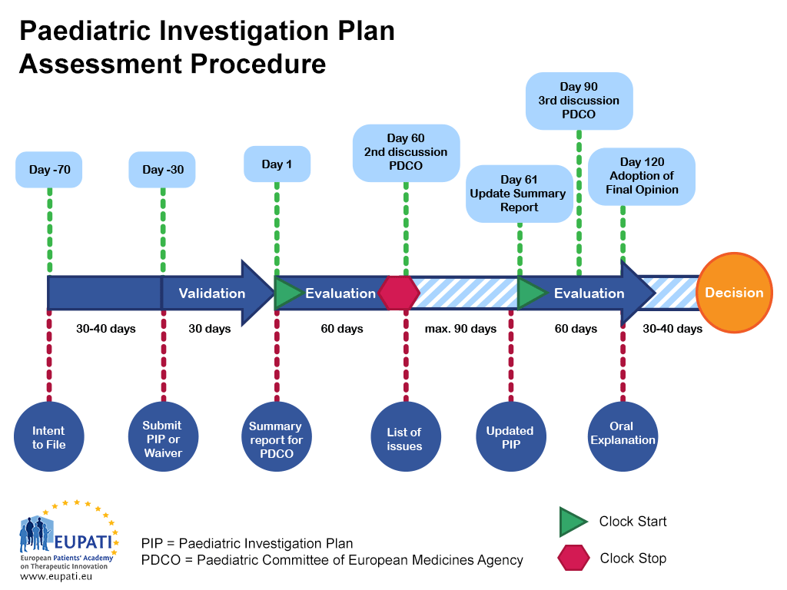

Slide 12
Outcome of PIP
Agreed PIP – positive opinion
Not-agreed PIP – negative opinion
Withdrawn PIP

Slide 13
Conditions for deferrals and waivers
Deferrals
In early stages of development when behaviour of drug in adults is unsure
Preclinical safety concerns – data should be generated in adults first
Waiver
Disease does not occur in children
There is no unmet medical need
Waiver is given to some paediatric subsets

Slide 14
Waivers
Class waiver – according to a list issued by the PDCO of conditions that only occur in adults
Full waiver – for all paediatric subset(s) and indication(s)
Partial waiver – for one or more paediatric subset(s) and indication(s)

Slide 15
Protecting children in research
Children are a vulnerable population, legally incompetent to consent to clinical trials
PIPs include:
Data & Safety Monitoring Board as standard requirement
Minimising pain, distress and fear
Control of Sampling (e.g. advocating sparse sampling where possible)
Modelling and simulation to avoid unnecessary exposure
Innovative (non conventional) methodology for design and analysis to limit the number of children included

Slide 16
Overview of PIPs with decision
https://ec.europa.eu/health/sites/health/files/files/paediatrics/2016_pc_report_2017/ema_10_year_report_for_consultation.pdf

Slide 17
Number of PIPs per therapeutic area 2007-2015
https://ec.europa.eu/health/sites/health/files/files/paediatrics/2016_pc_report_2017/ema_10_year_report_for_consultation.pdf

Slide 19
Future directions
Speed up drug development
Innovative study design
Training for paediatricians
Reconsider need for staggered approach
Modelling and extrapolation
PIP is not end of paediatric drug development
Strategic trials should be conducted by academic consortia
Best treatment, optimal duration

Slide 20
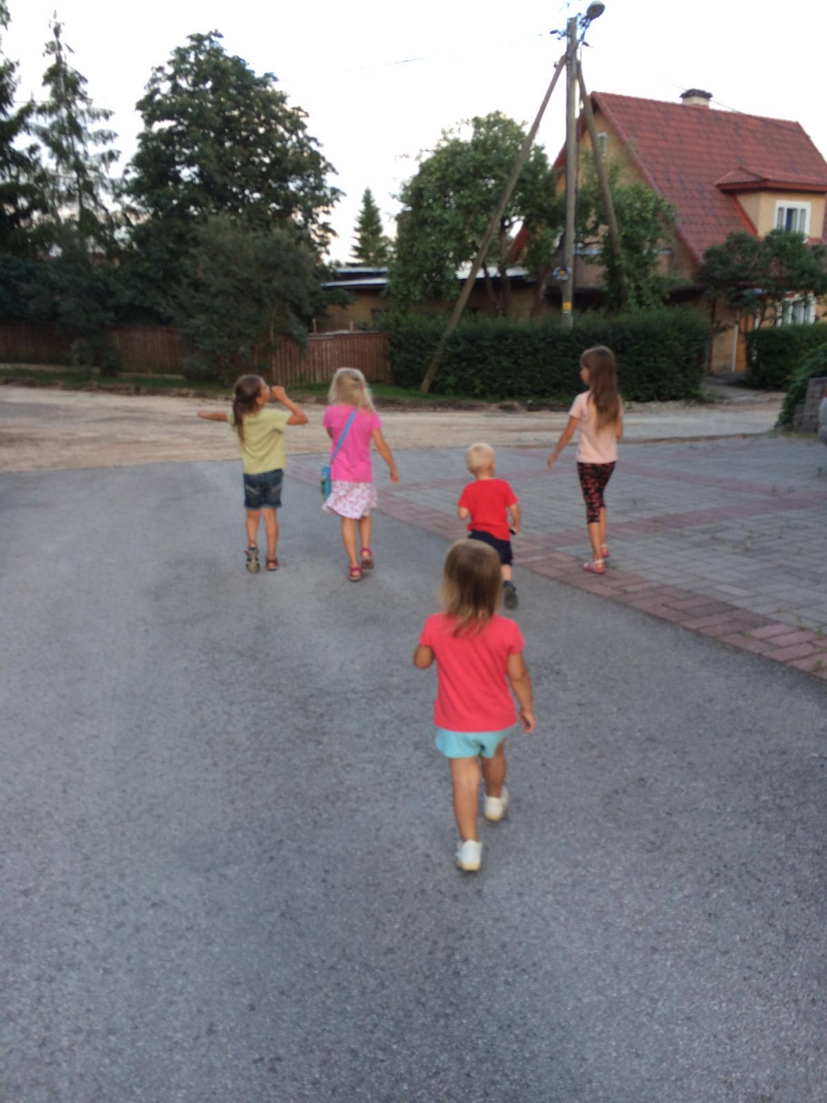
The smallest ones are always left behind

