Slide 1
Back to the Future

Slide 2
This is a story about dedicated people in Estonia
with the same aim and willing to work very hard
to make a new future for Estonian aviation

Slide 4
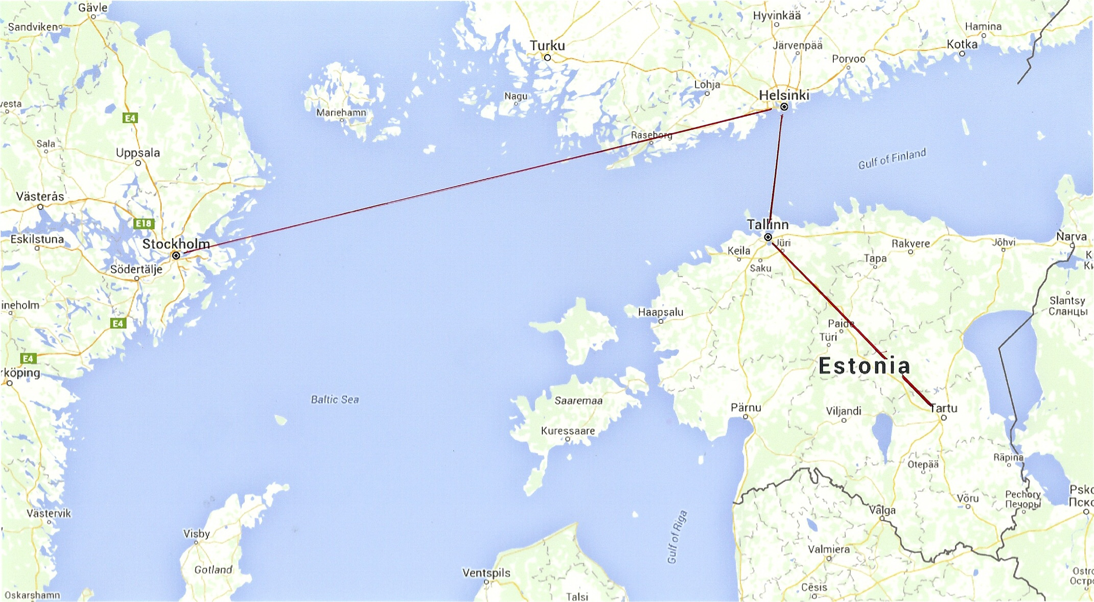

Slide 5
Bromma Flygskola - Scandinavian Aviation Academy
1963
Bromma Flygskola is established offering private pilot education.
1967
First Commercial Pilot education in cooperation with Scandinavian Airline System (SAS) and Linjeflyg.
1980
Introduction and evaluation of a new training syllabus for the integrated pilot training program, in accordance with ICAO Annex 1 requirements.
1984
The first aviation school in Sweden authorized by the Swedish CAA, to perform the modern integrated, Ab-initio, pilot training.
1987
Transition training of military pilots towards civilian certificates on commission by SAS, Linjeflyg and Swedair. More than 100 pilots trained during a 3-year programme.

Slide 6
1988
Commercial Pilot training on commission by Linjeflyg.
1991
New Ab-Initio, Commercial Pilot training single engine and instrument, in accordance with new ICAO requirements.
___________________________________________________________________
1992
Commercial Pilot training in Estonia on commission for the Estonian CAA. Training of
Estonian flight instructors in modern western techniques and ICAO requirements.
Lease of airplanes and technical support to Tartu Aviation College in Estonia.
1993
Renewed contract regarding 3 400 hours flight training in Estonia.
1994
Commercial Pilot training at secondary school level on commission by the Västerås City School board. Hangar 5 receives JAR-145 approval.

Slide 7
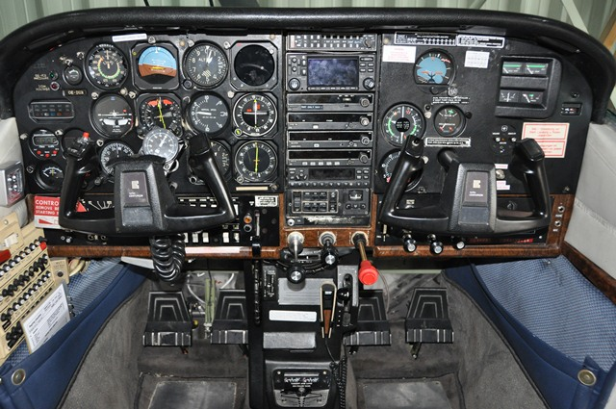

Slide 8
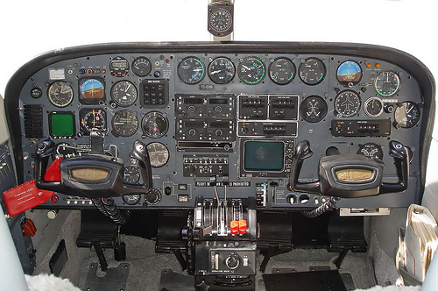

Slide 9
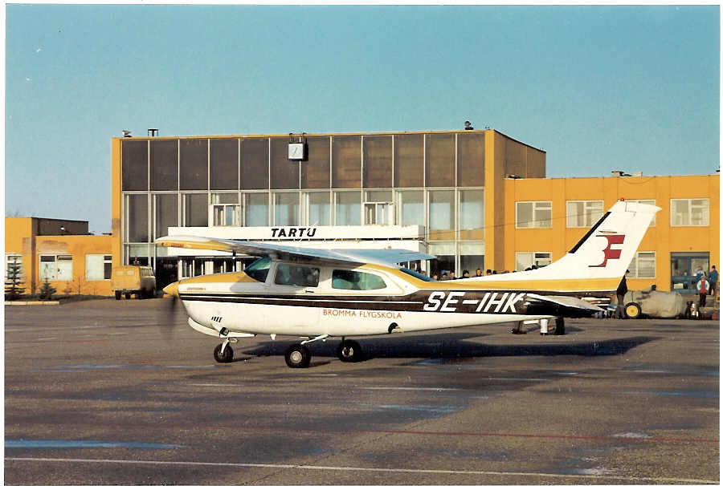

Slide 10
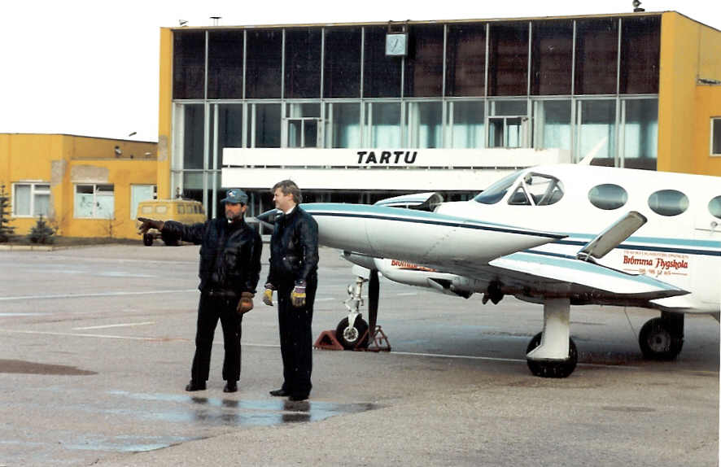

Slide 11
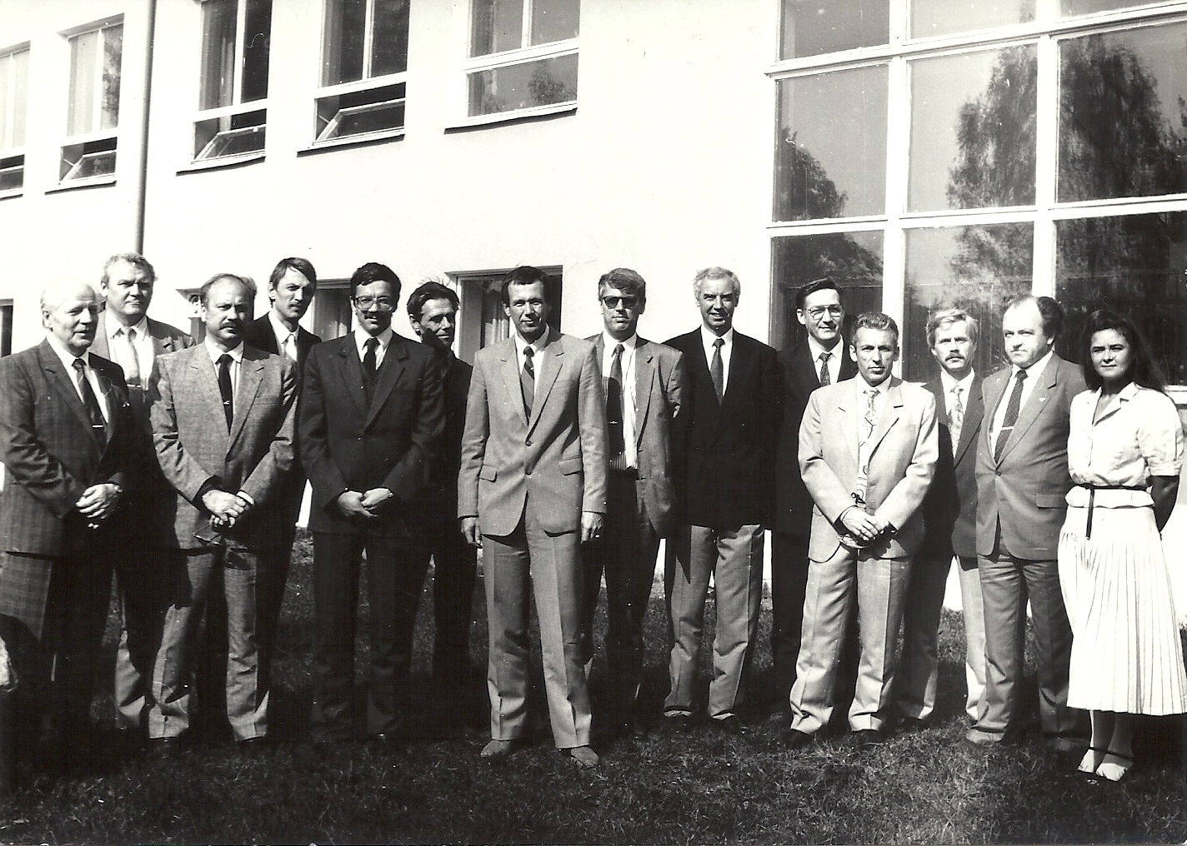

Slide 12
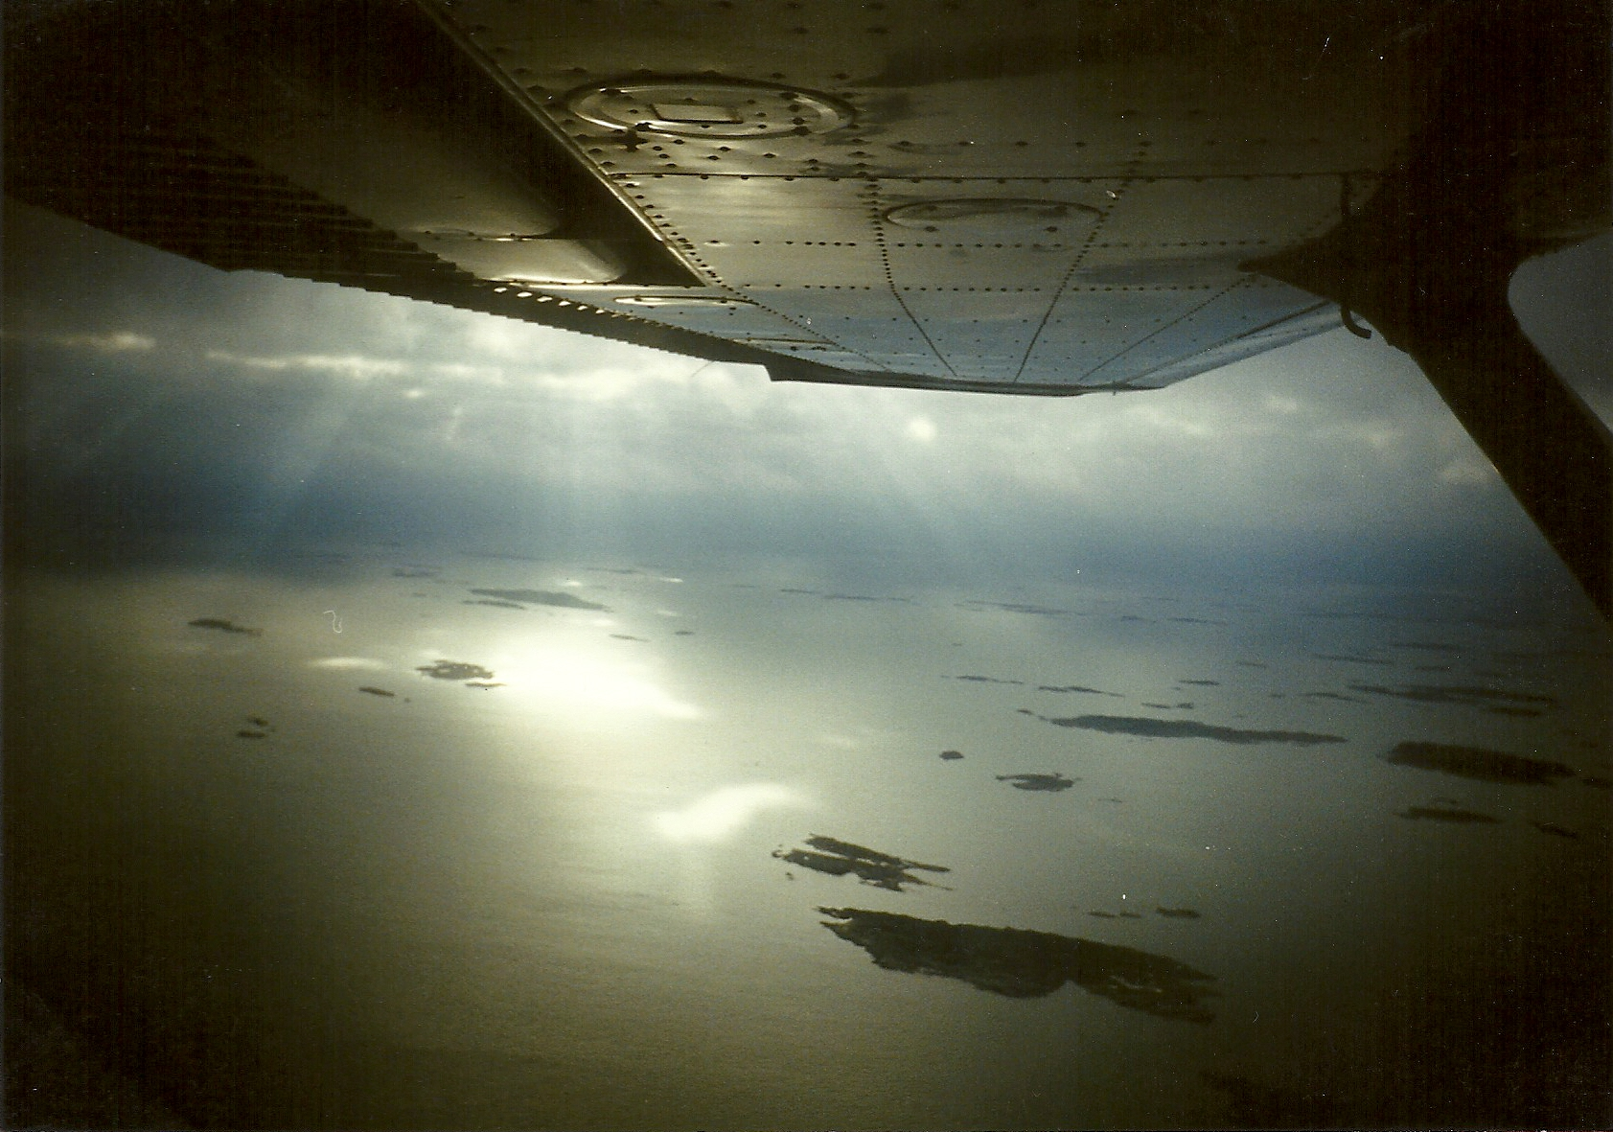

Slide 13
February 7, 1992
The first officially recorded meetinq on establishing an aero college was held. Mati Sörmus, the Vice Director of Estonian Civil Aviation, chaired the meeting. Otto Taur recorded the minutes.The participants were Rein Porro, Teo Kruuner, Illar Vaks, Raivo Kask and August Kaasik.

Slide 15
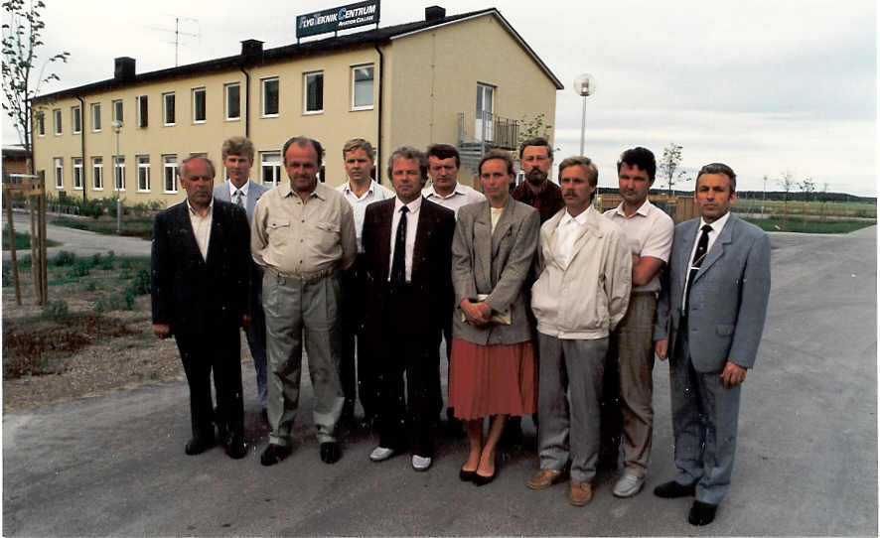

Slide 16
Johannes Tilk – mechanic
Jüri Hirve pilot-instructor
Endel Käärt – pilot-instructor and Director of Ergon
Einar Redi – pilot-instructor
Jaan Kilusk –pilot-instructor
Jaan Ütsi – pilot-instructor
Kai Virves – interpreter
Jüri Päri – mechanic
Tõnu Malkki – pilot-instructor
Anatoli Roost – pilot-instructor
Rein Porro – pilot-instructor, Head of Licensing Department of Estonian CAA

Slide 17
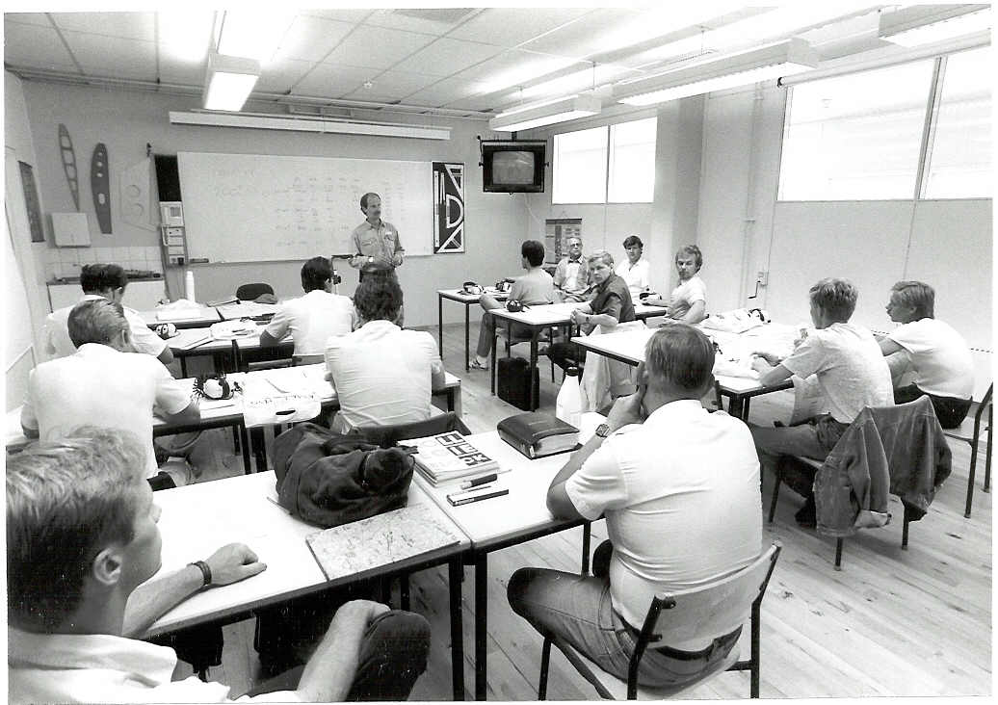

Slide 18
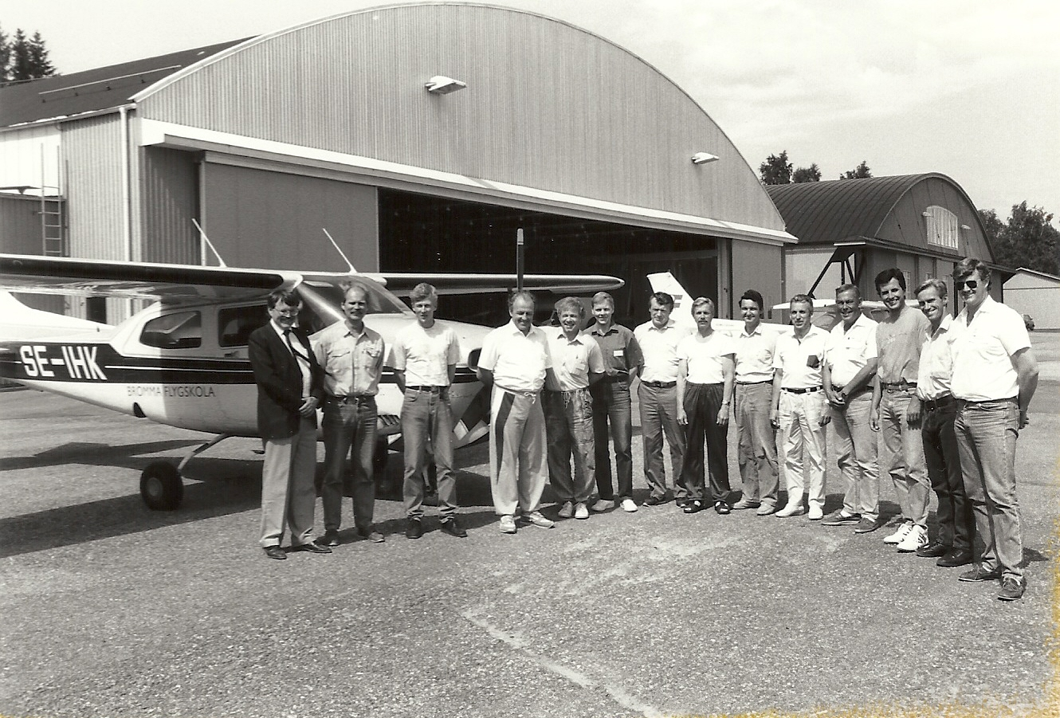

Slide 19
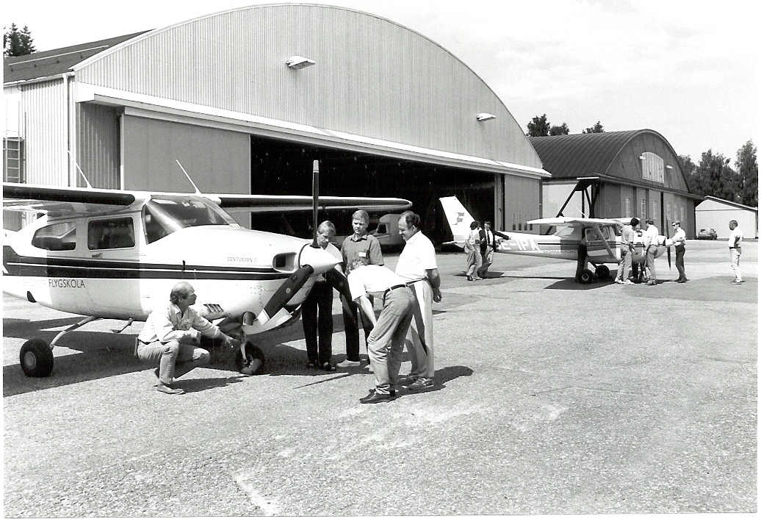

Slide 20
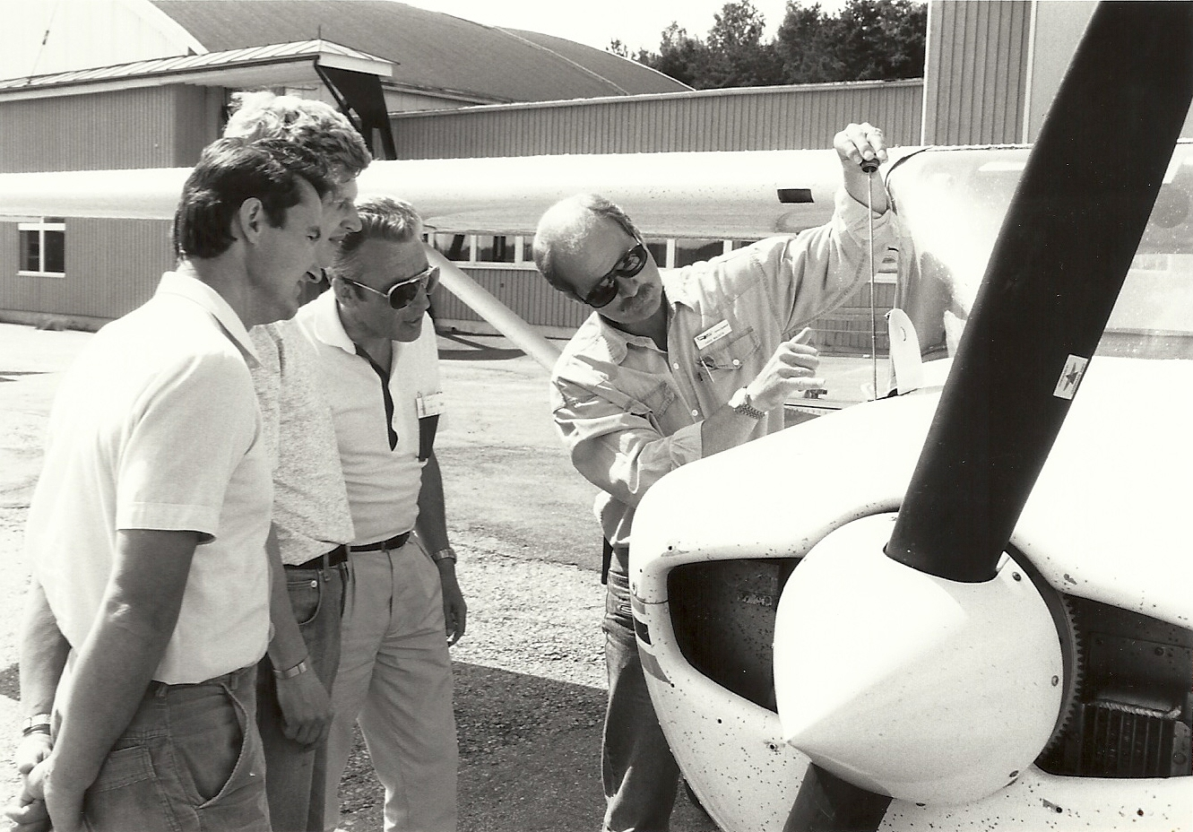

Slide 21
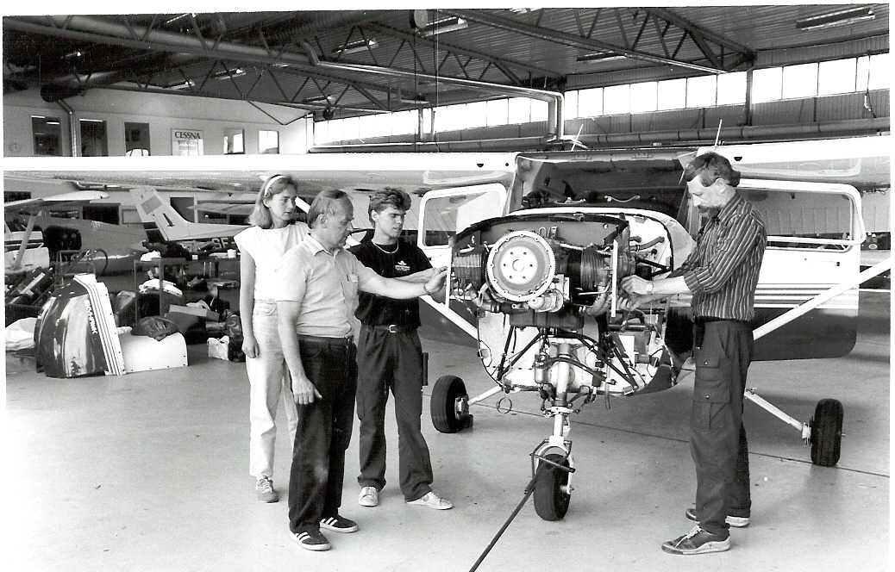

Slide 22
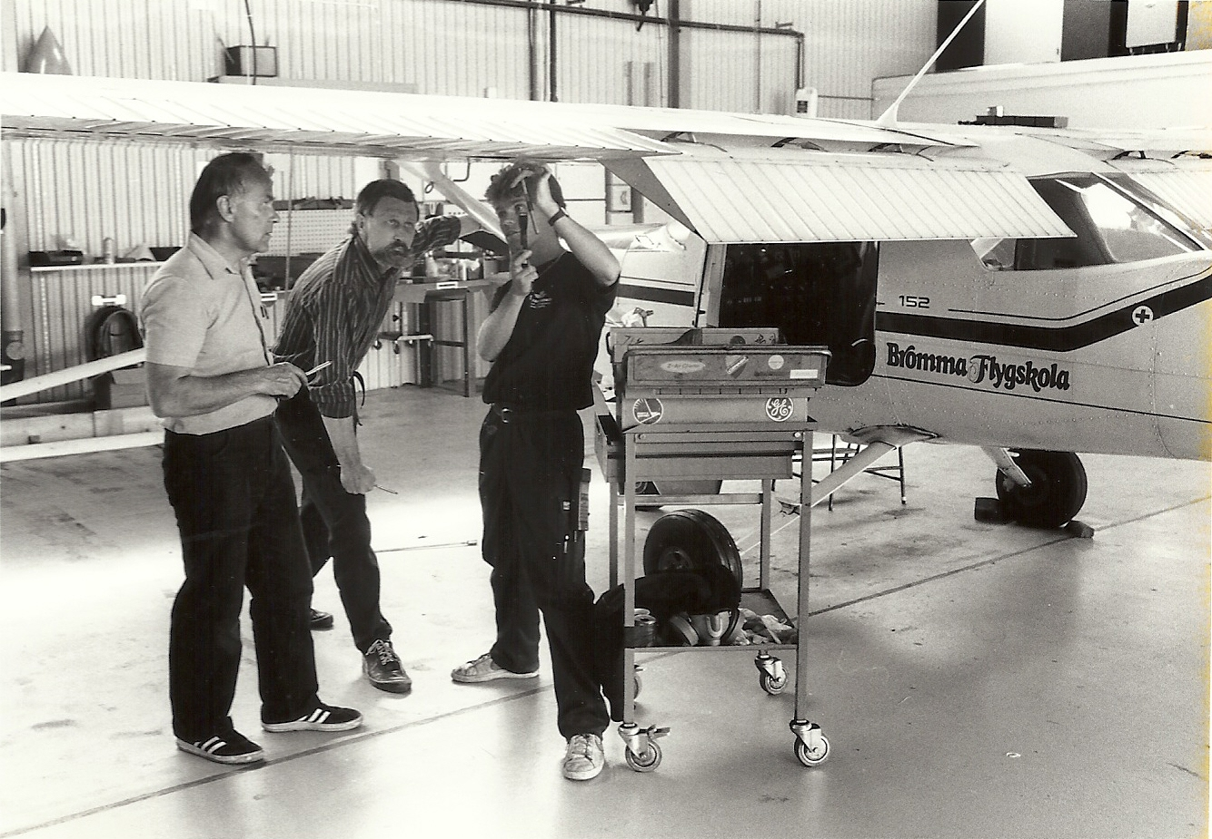

Slide 24
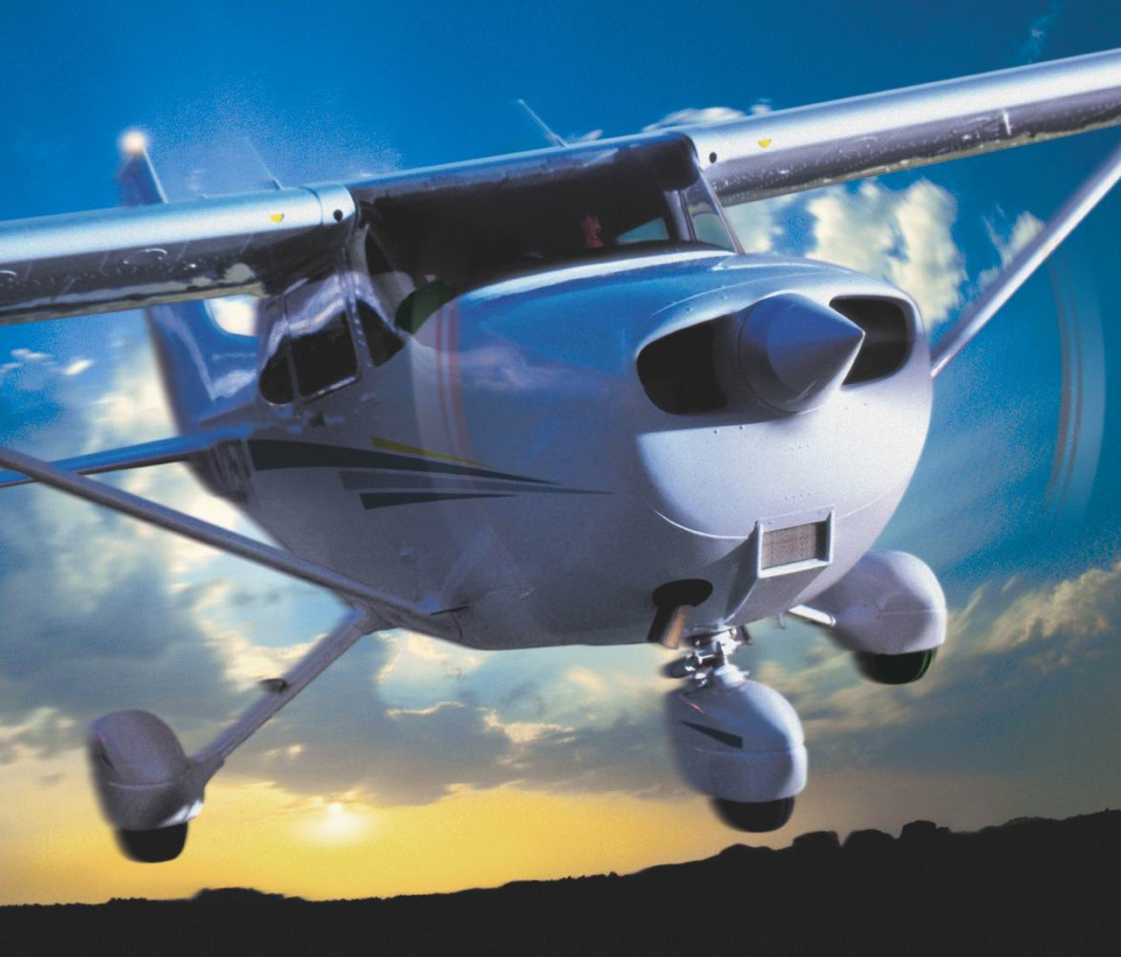

Slide 25
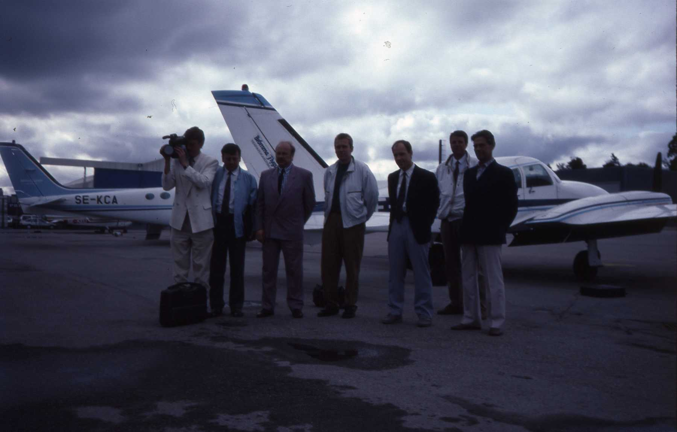

Slide 26
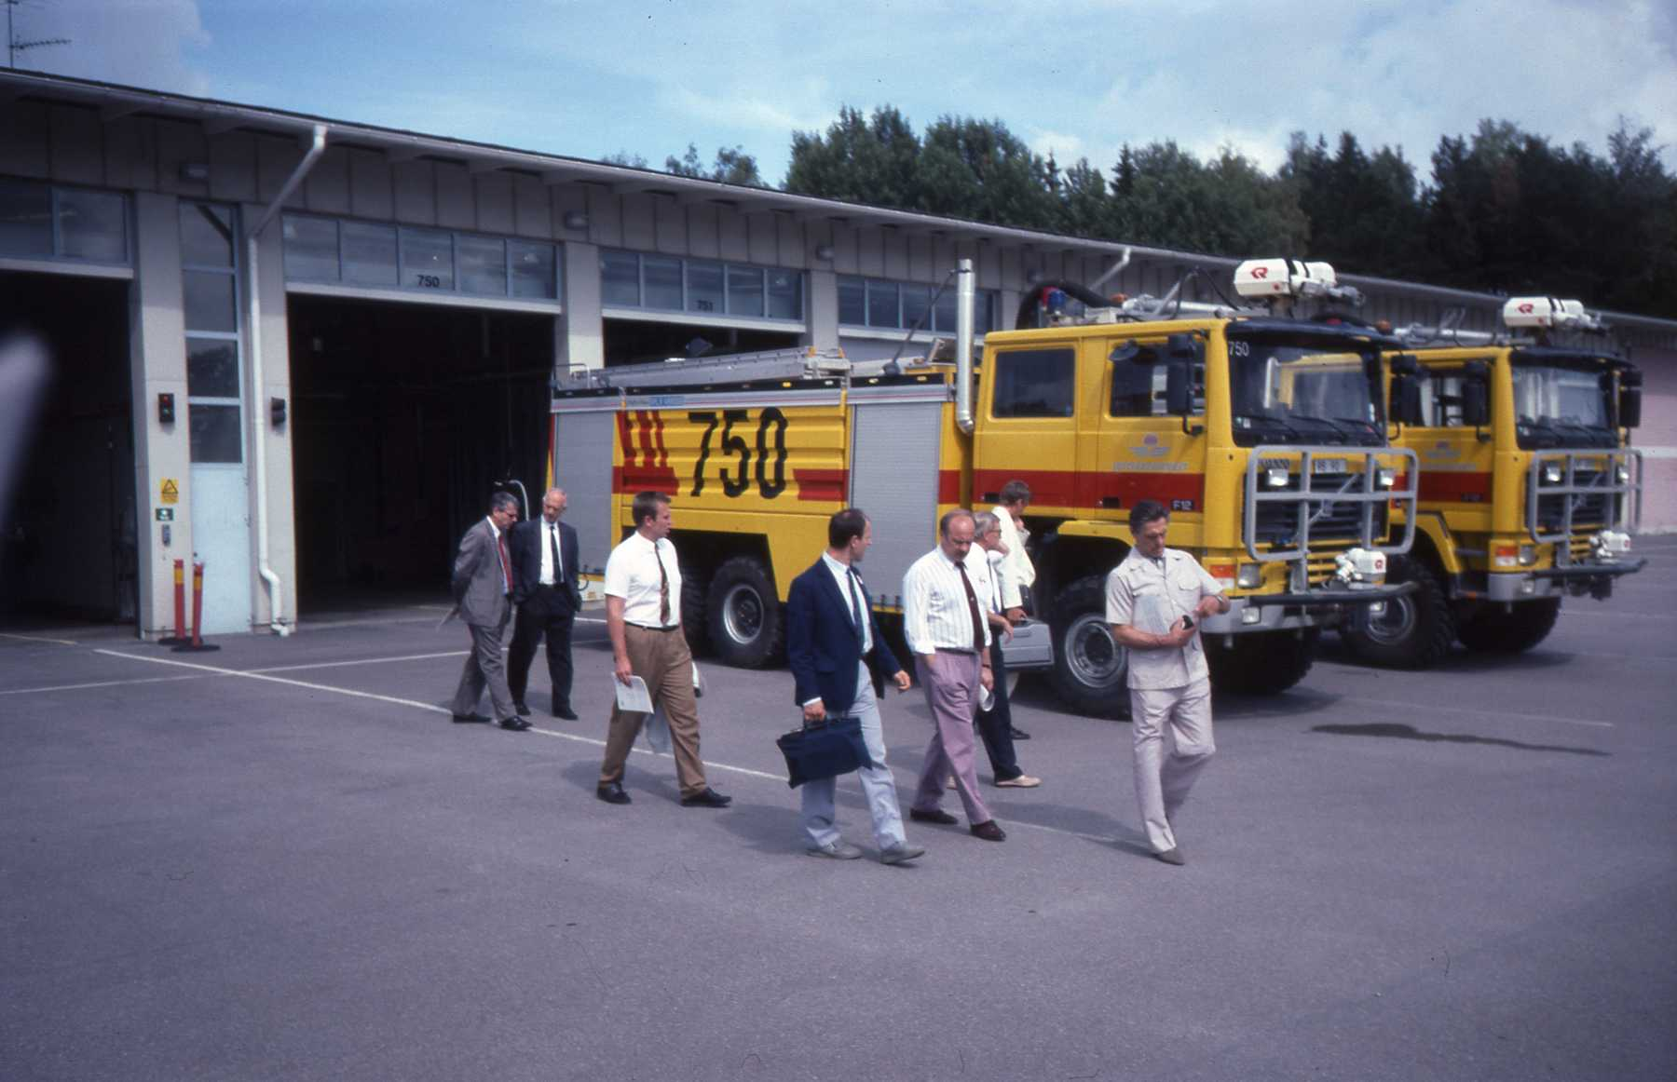

Slide 27
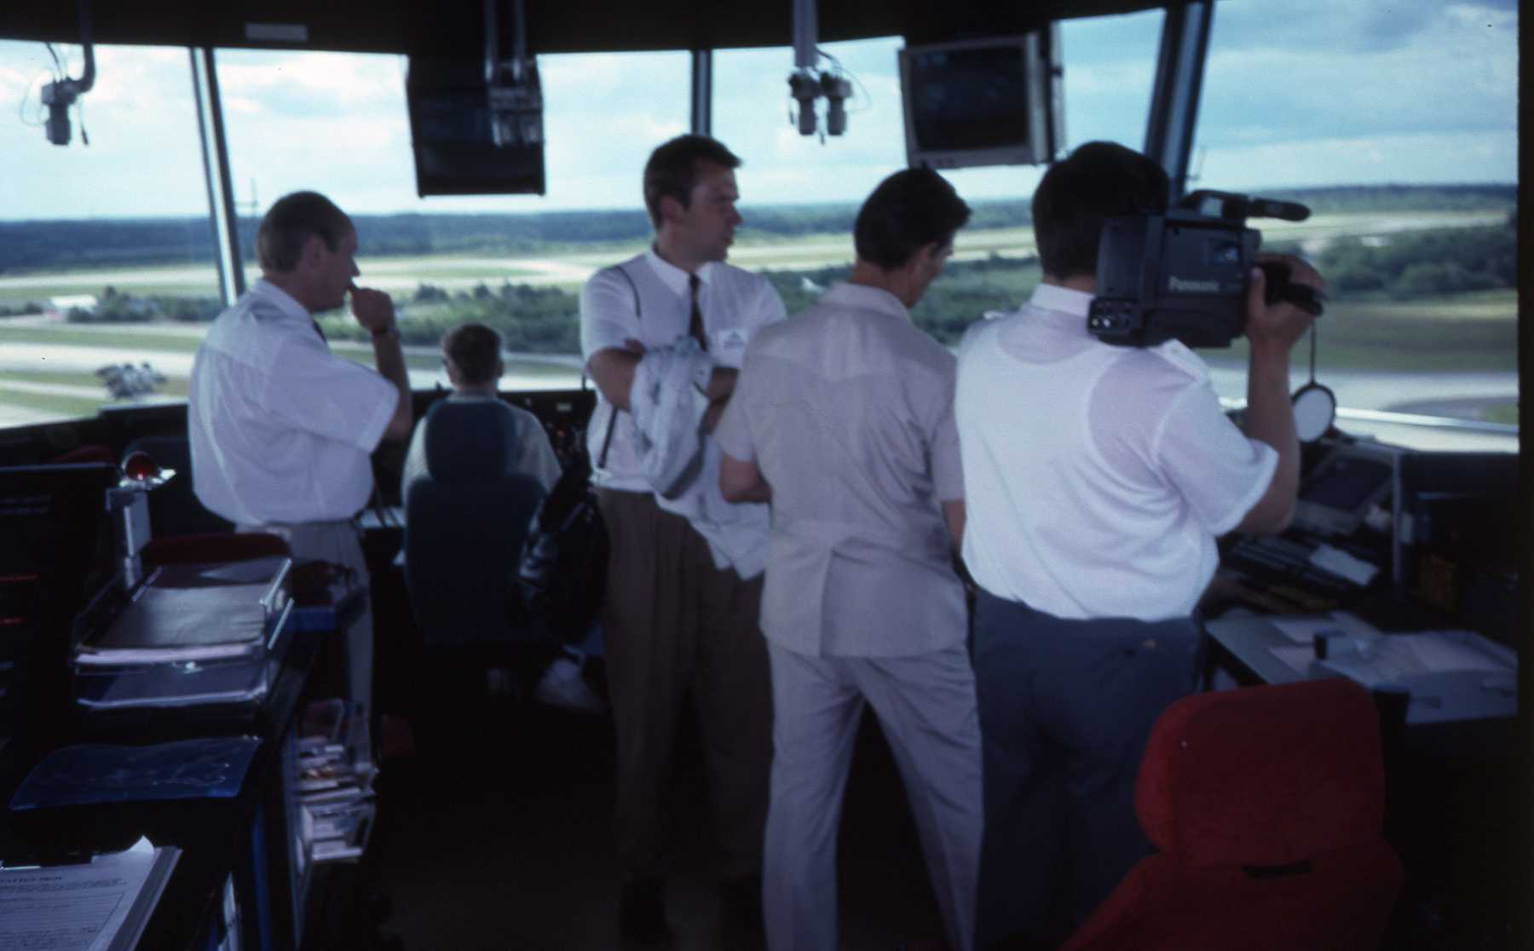

Slide 28
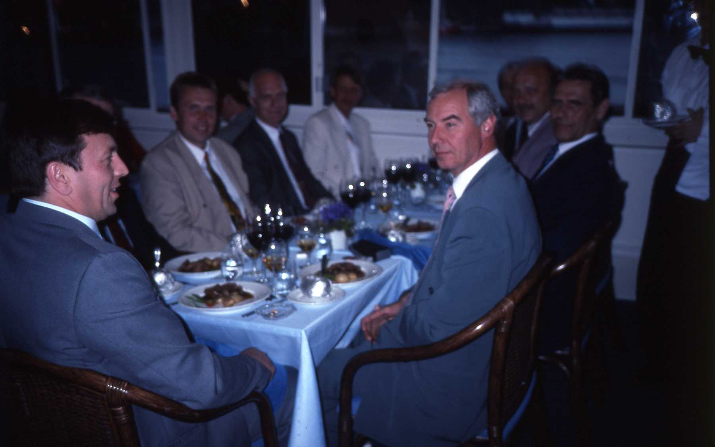

Slide 29
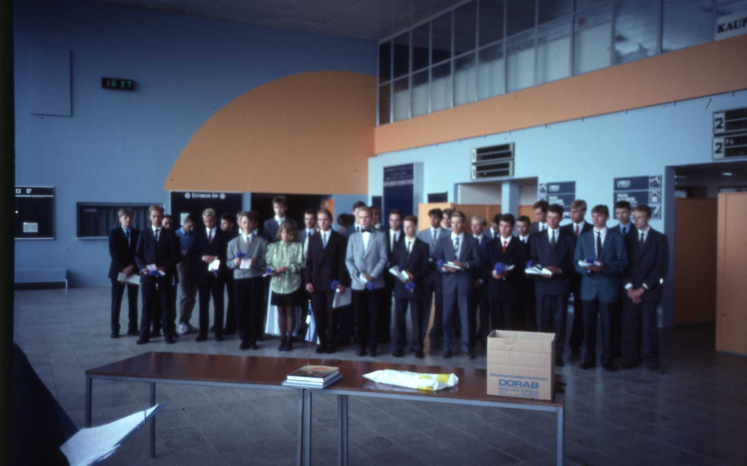

Slide 30
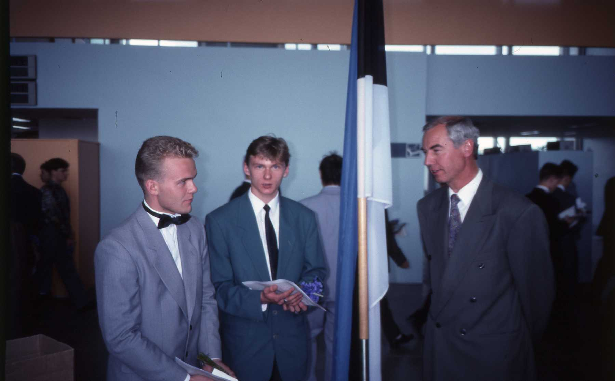

Slide 31
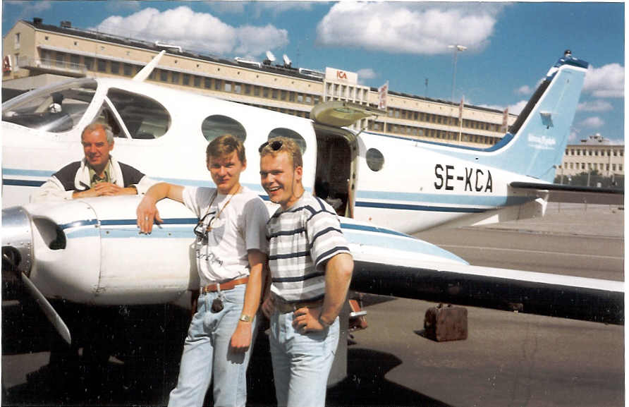

Slide 32
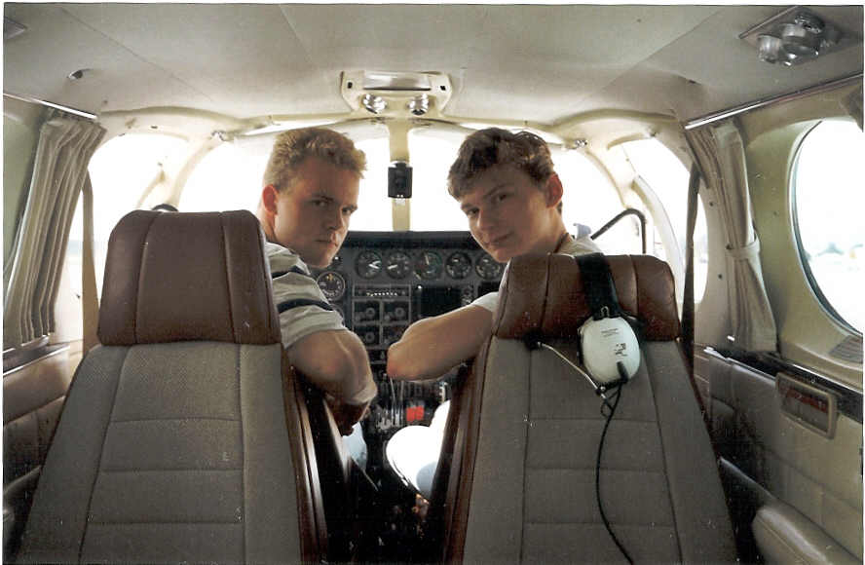

Slide 33
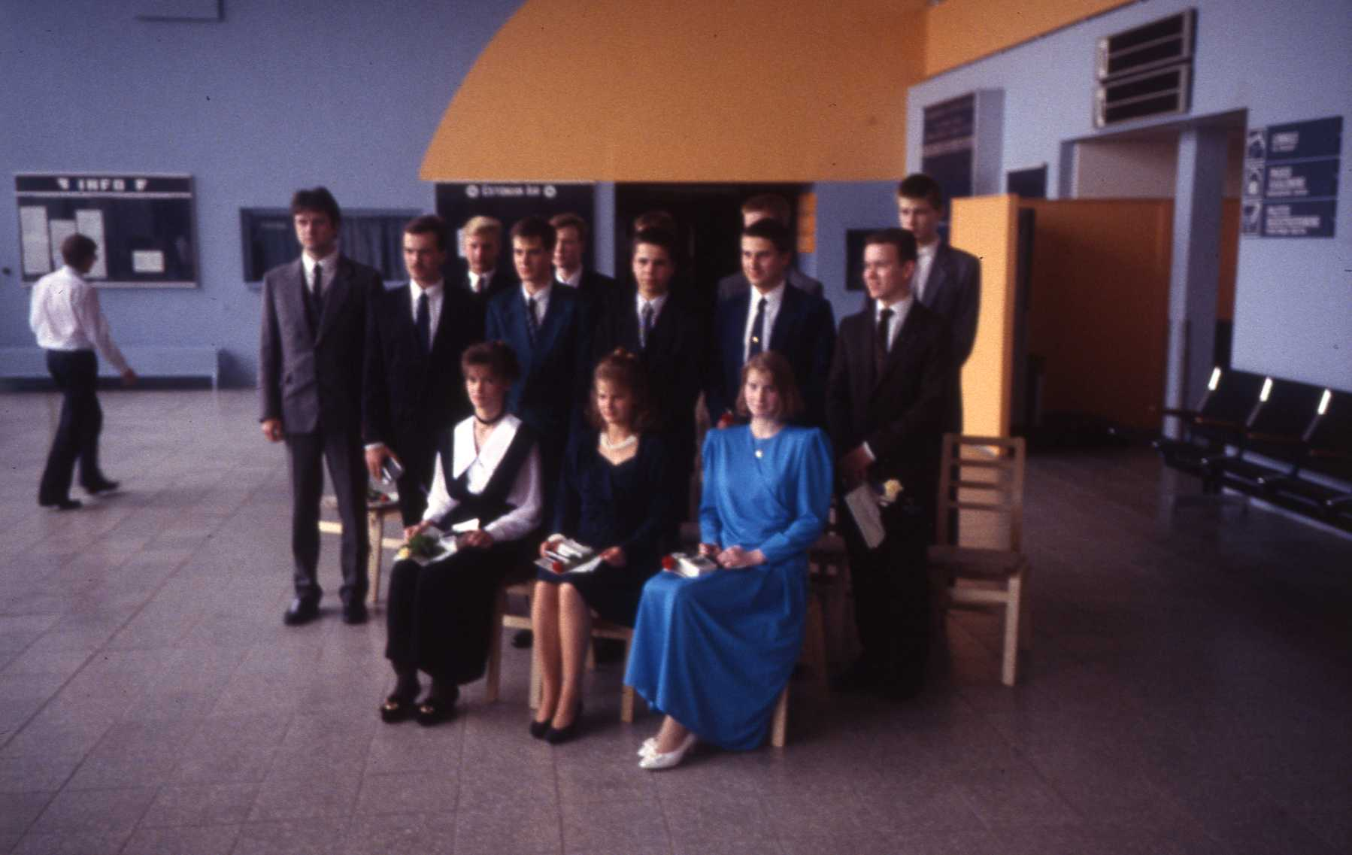

Slide 34
1992
Commercial Pilot training in Estonia on commission for the Estonian CAA. Training of
Estonian flight instructors in modern western techniques and ICAO requirements.
Lease of airplanes and technical support to Tartu Aviation College in Estonia.
1993
Renewed contract regarding 3 400 hours flight training in Estonia.
1994
Commercial Pilot training at secondary school level on commission by the Västerås City School board. Hangar 5 receives JAR-145 approval.

Slide 35
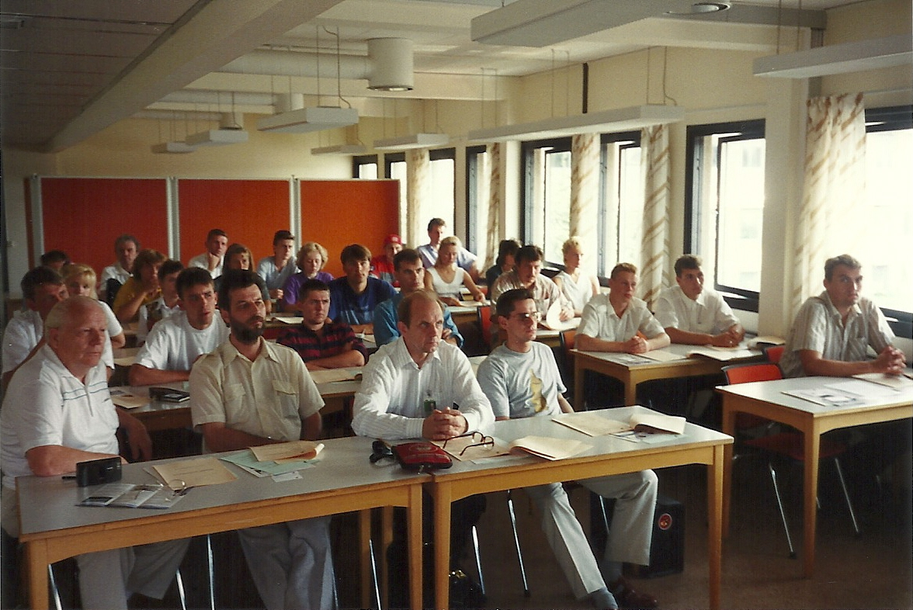

Slide 36
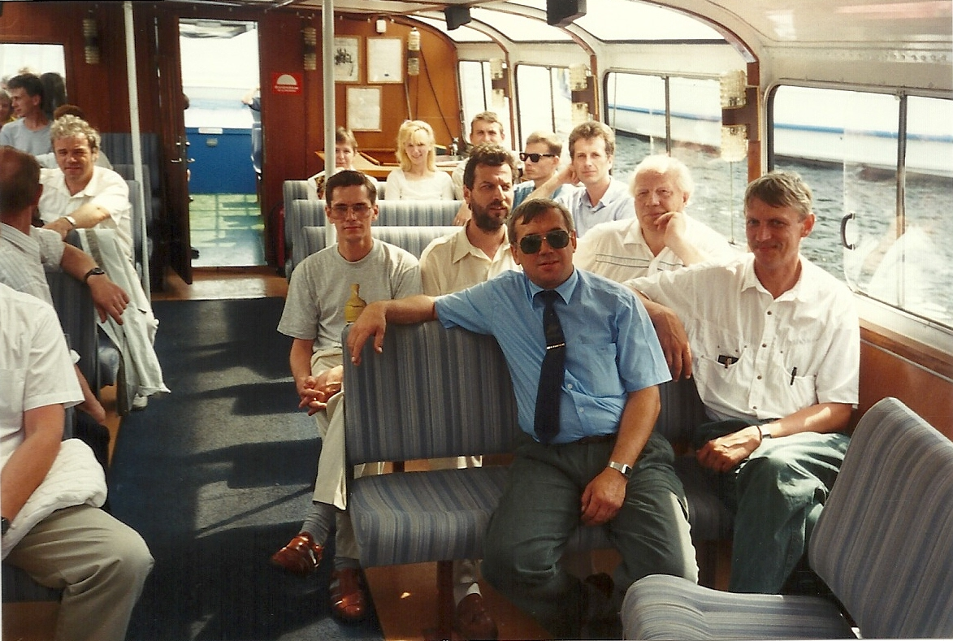

Slide 37
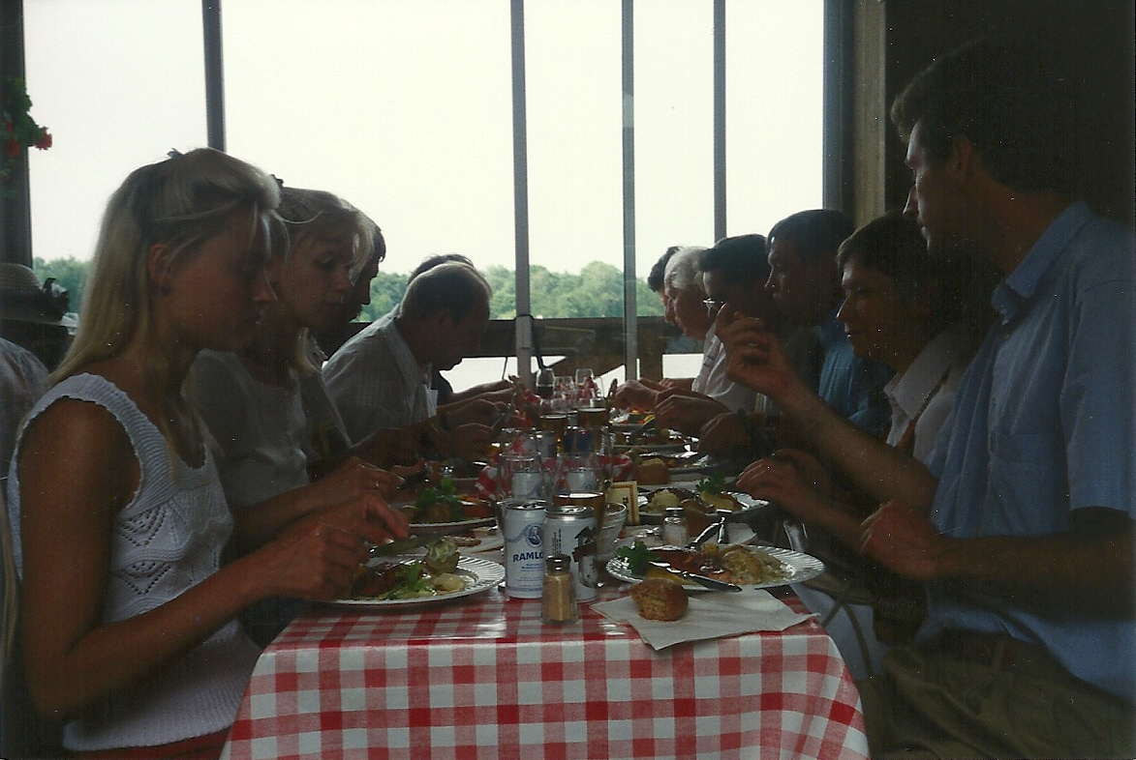

Slide 38
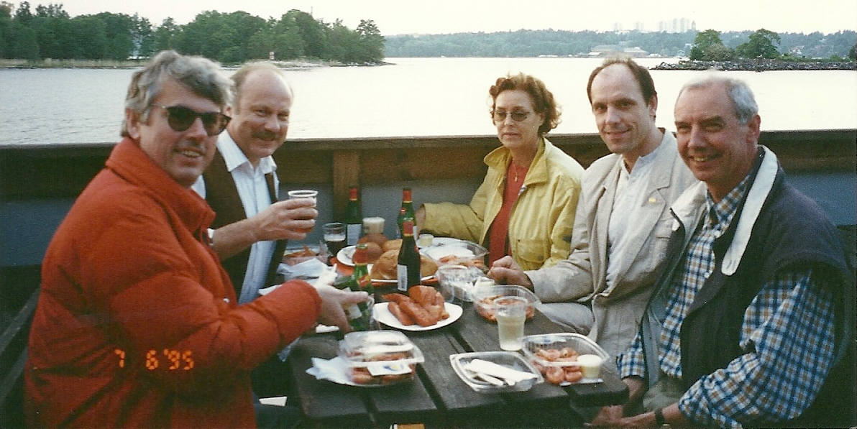

Slide 39
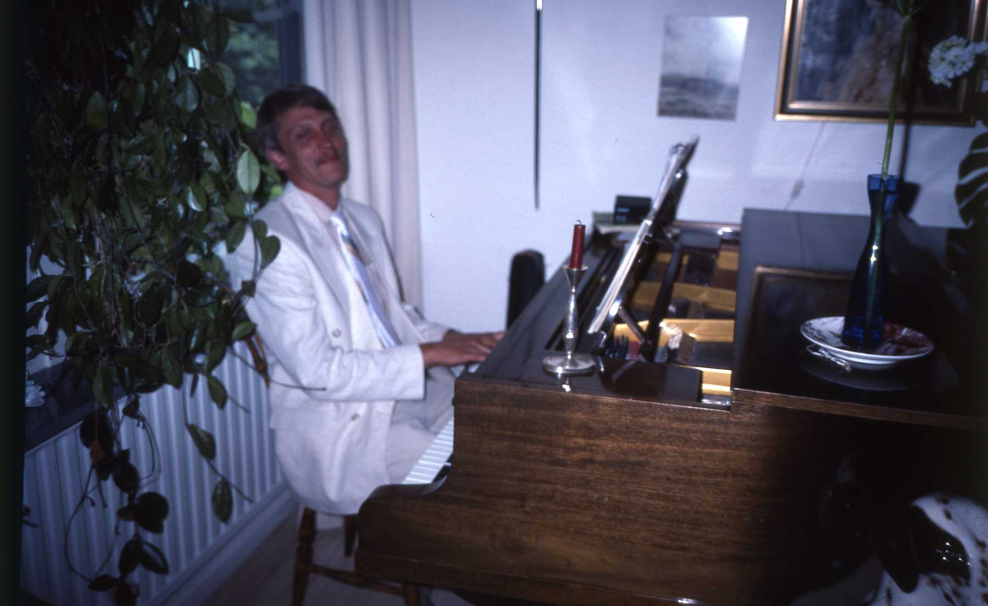

Slide 40
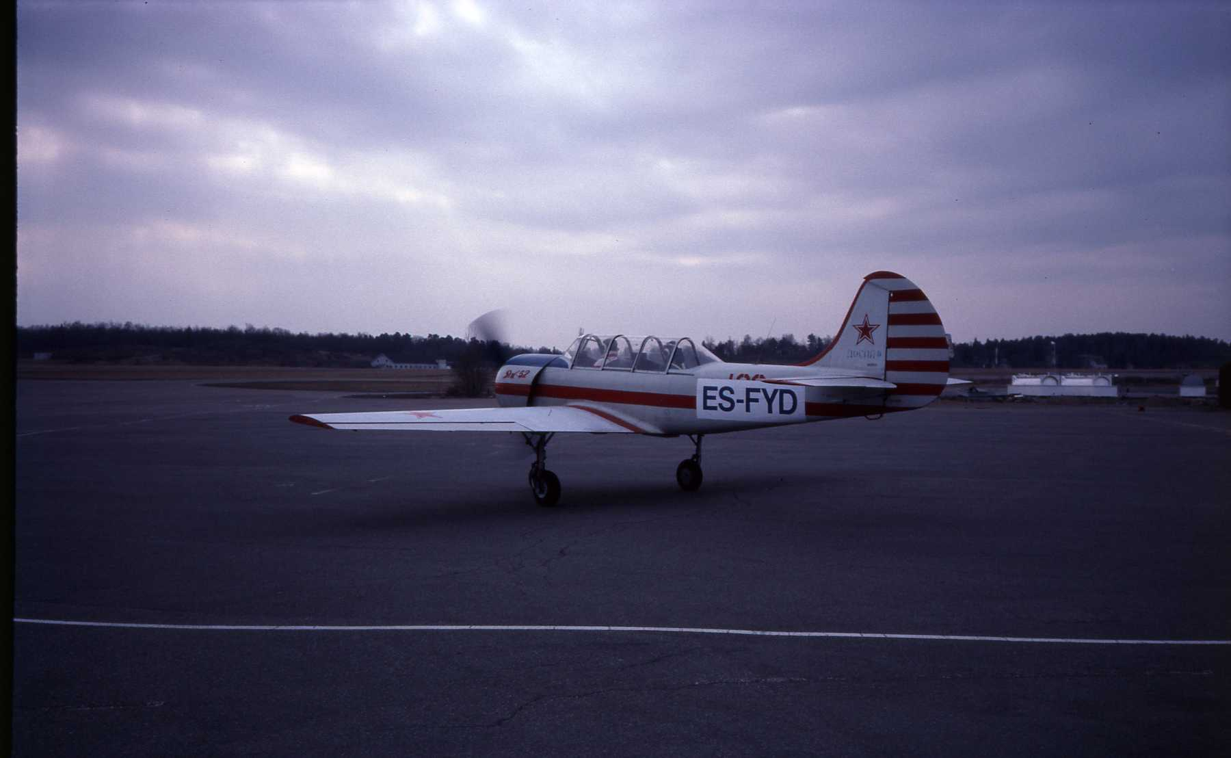

Slide 41
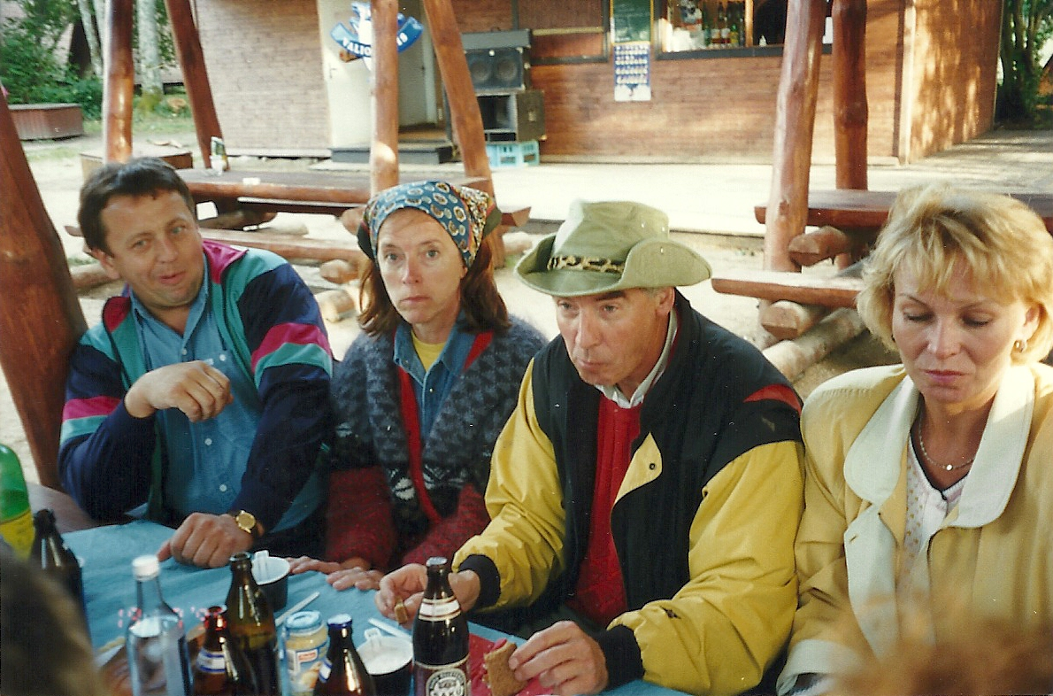

Slide 42
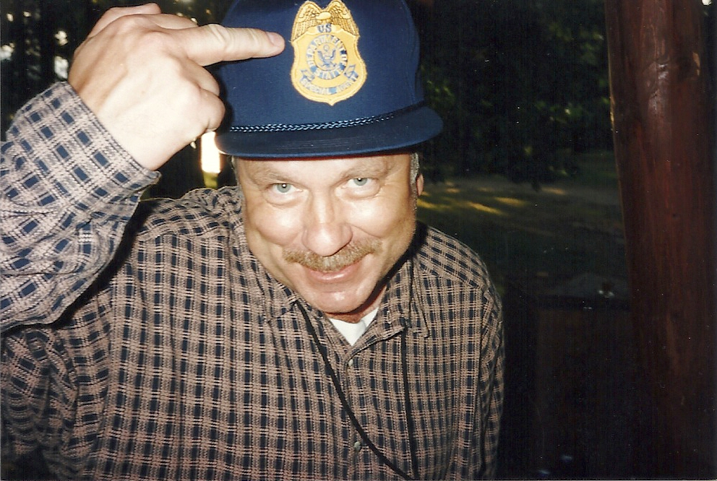

Slide 43
