Slide 1

“Aviation Industry Perspectives in Lithuania
20-th Estonian Aviation Seminar
Prof. Dr. Habil. Jonas Stankūnas
Dr. Darius Rudinskas

Slide 2
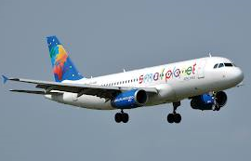
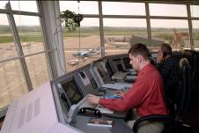
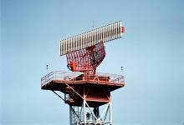
Overview of Lithuanian civil aviation
Tartu 2015-11-12 “Aviation Industry Perspectives in Lithuania

Slide 3


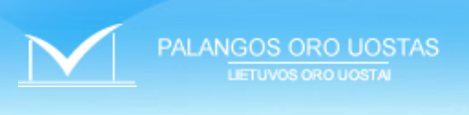

Civil Aviation (1)
International Airports
(Established 2014 July )
ŠIAULIŲ ORO UOSTAS
Tartu 2015-11-12 “Aviation Industry Perspectives in Lithuania

Slide 4
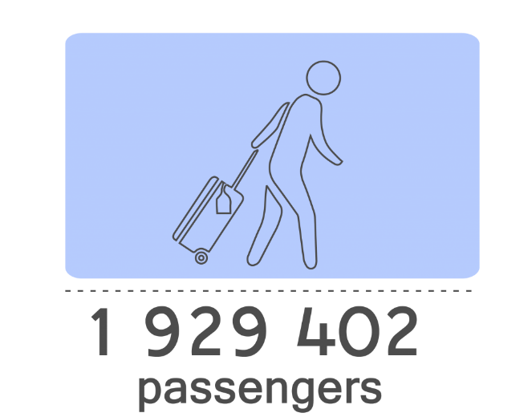
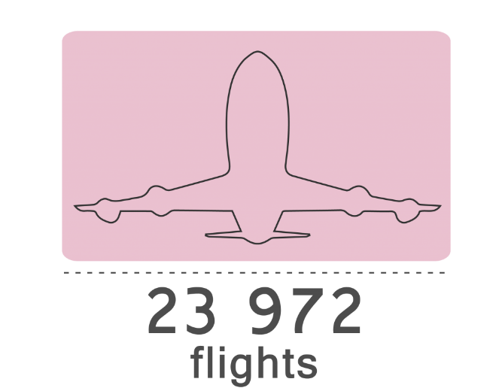

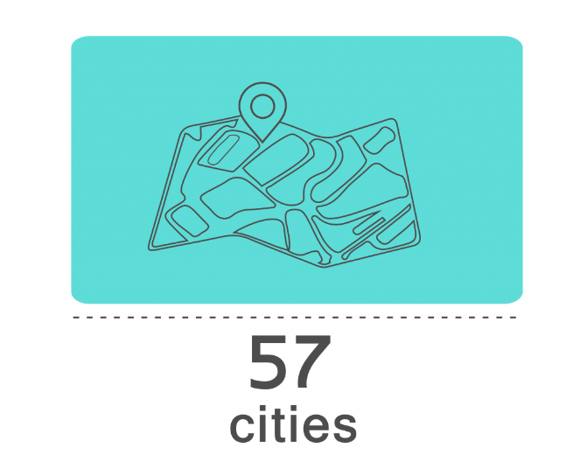
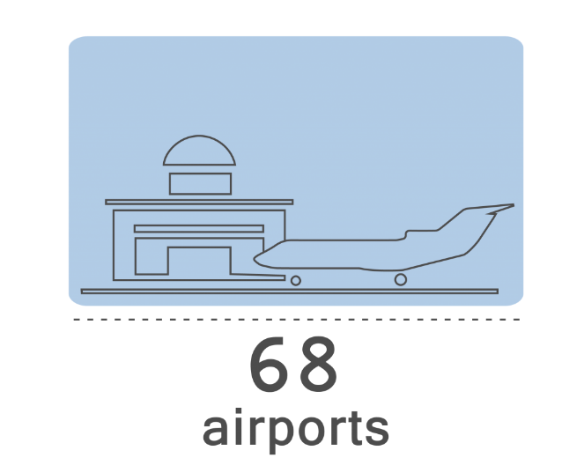

Lithuanian Airports Statistics
First half-year 2015
Source: http://www.ltou.lt/en/
Tartu 2015-11-12 “Aviation Industry Perspectives in Lithuania

Slide 5
Passengers in Lithuanian airports (mln.)
Tartu 2015-11-12 “Aviation Industry Perspectives in Lithuania

Slide 6



Civil Aviation (2)
Air navigation Service Providers
Lithuanian Armed Forces
Tartu 2015-11-12 “Aviation Industry Perspectives in Lithuania

Slide 7
Flights in Lithuanian airspace (in thousands)
Tartu 2015-11-12 “Aviation Industry Perspectives in Lithuania

Slide 8








Civil Aviation
Civil aviation carriers
Klaipėdos avialinijos
Tartu 2015-11-12 “Aviation Industry Perspectives in Lithuania

Slide 9
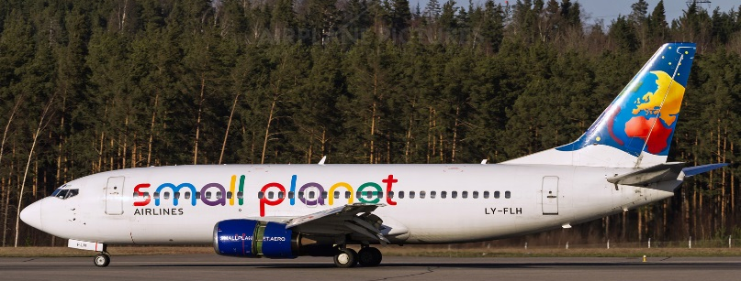
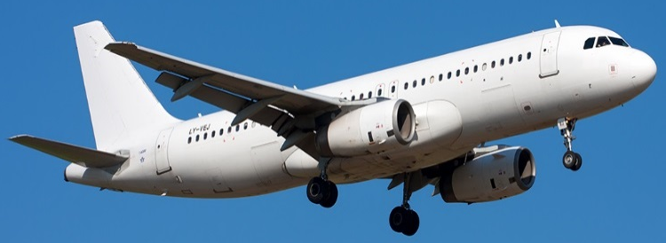
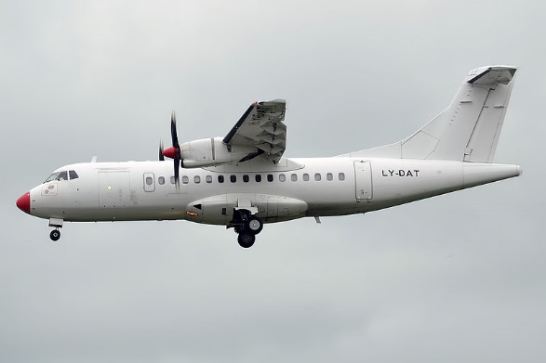
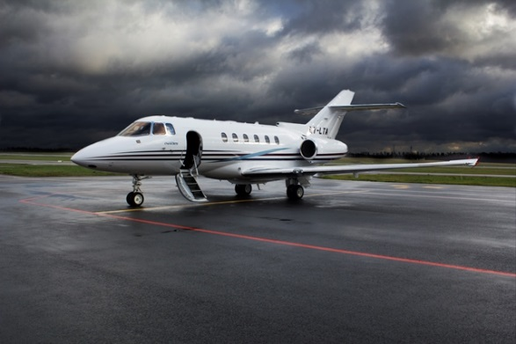
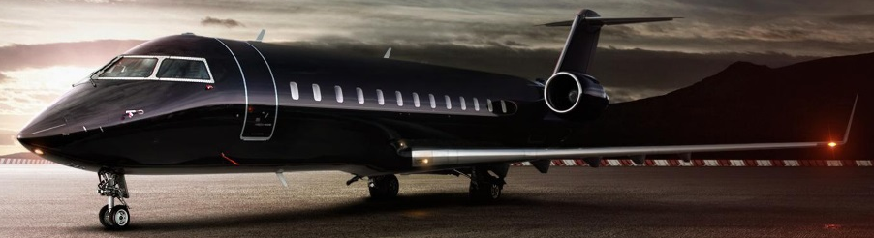
Lithuania‘s aircraft fleet
Boeing 737
Airbus A319, A320
ATR 42 – 4
Hawker – 6
Bombardier - 2
Tartu 2015-11-12 “Aviation Industry Perspectives in Lithuania

Slide 10
State supervision 2015
10 certified aviation enterprices (commercial)
4 international airports
31 aerodromes (4 international, 4 state, 2 regional, 14 aeroclubs, 7 private)
778 civil aircraft
1 approved aviation manufacturing company
1 approved design company
20 approved maintenance organisations
3 air navigation service providers
28 accredited training institutions
1300 valid civil aviation specialist licences
1 aviation medical center
7 aviation medical doctors
20 aeroclubs
Tartu 2015-11-12 “Aviation Industry Perspectives in Lithuania

Slide 11

In memoriam
Strategic
OLT Express
Aerosvit
Bingo
Airways
Livingston
Hamburg Airways
Orbest
Wind
jet
Belle Air
Air One
Cyprus Airways
hello
Tartu 2015-11-12 “Aviation Industry Perspectives in Lithuania
Notes:
- Savininkai - darbuotojai
- Management buy-out‘as

Slide 12



In memoriam
1991 – 2009
2009 – 2010
2013 – 2015
Tartu 2015-11-12 “Aviation Industry Perspectives in Lithuania

Slide 13
Silent aviation revolution in Lithuania
Profits, mil. LTL
Employees
1270
1790
911
703
246,41
567
226,13
233,35
2001
2005
2009
2014
2001
2005
2009
2014
2001 data: Lietuvos Avialinijos
2005 data: Lietuvos Avialinijos
2009 data: Avia Solutions Group
2014 data: Avia Solutions Group, Avion Express, Small Planet Airlines
Tartu 2015-11-12 “Aviation Industry Perspectives in Lithuania
Notes:
- Savininkai - darbuotojai
- Management buy-out‘as

Slide 14
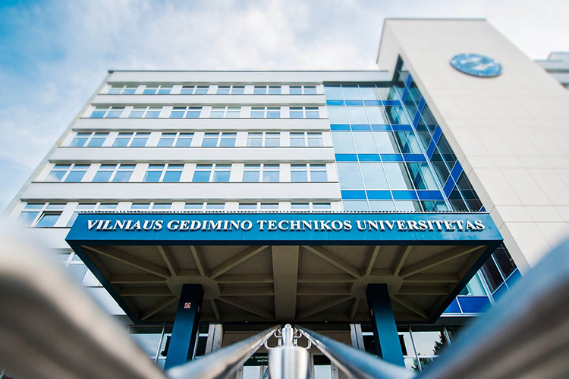











University Profile
  930 academic staff members;
  100 study programmes based on three-cycle structure:
  undergraduate, graduate and post-graduate studies;
  14 research institutes,
  33 research laboratories,
  2 research centers
Tartu 2015-11-12 “Aviation Industry Perspectives in Lithuania
Notes:
centres;
940 academic staff members;

Slide 15
Structure of Antanas Gustaitis’ Aviation Institute
ANTANAS GUSTAITIS'AVIATION INSTITUTE OF VGTU
Department of Aviation Mechanics
Department of Avionics
Air Traffic Control Training Unit
Department of Aviation Technologies
Flight Training Unit
Aircraft Maintenance Service (under regulations of organisation 145)
Aviation Specialists' Qualification Improvement Centre
Tartu 2015-11-12 “Aviation Industry Perspectives in Lithuania

Slide 16
Studies model at
VGTU AGAI
Doctoral studies
(4 years)
Doctoral studies
(4 years)
III level
II level
Master degree studies (2 years)
Integrated studies
(5 years)
I level
Bachelor studies (4 years)
U n i v e r s i t e t a s
K o l e g i j a
Tartu 2015-11-12 “Aviation Industry Perspectives in Lithuania

Slide 17
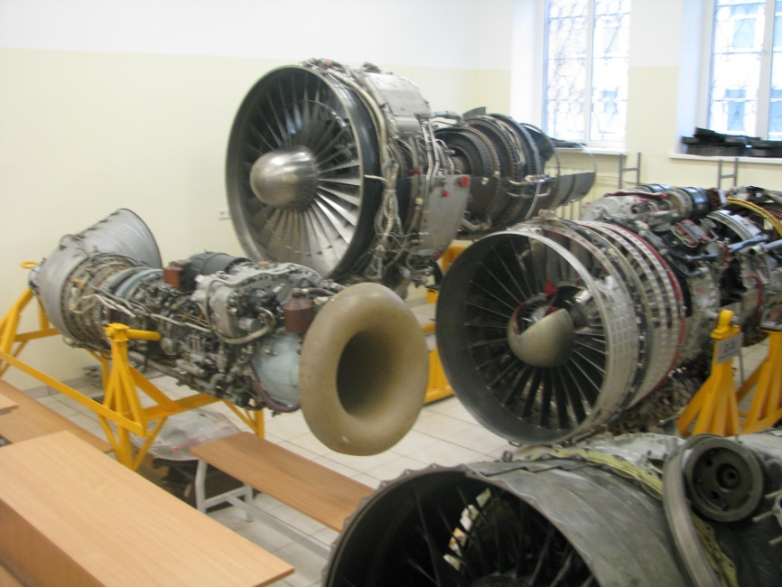
Department of Aviation Mechanics
Bachelor Degree Programmes:
Aviation Mechanics Engineering
Master Degree Programmes:
Aviation Mechanics Engineering
Doctoral Degree Programme:
Mechanics
Main Fields of Research:
Aircraft structure analysis
Investigation and improvement of aerodynamic calculation
methods for light aircraft
Drones‘ technology and modelling
Tartu 2015-11-12 “Aviation Industry Perspectives in Lithuania

Slide 18
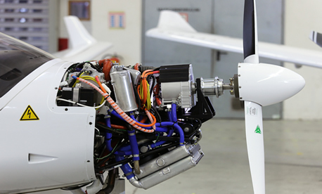
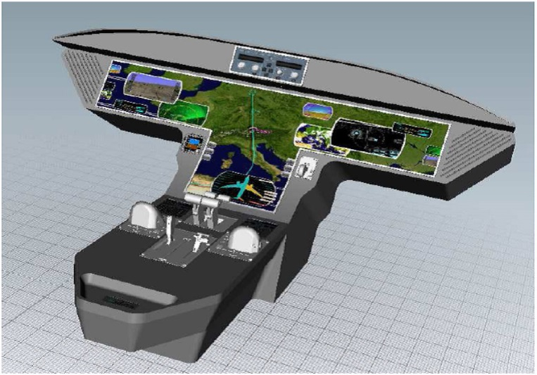
Department of Avionics
Bachelor Degree Programmes:
Avionics
Master Degree Programmes:
Electronics Engineering (Avionics)
Doctoral Degree Programmes:
Transport engineering
Main Fields of Research:
• UAV controls and navigation systems
• Methods of non-destructive testing and quality control of aircraft structures and elements
• Research on global navigation systems and technologies and their applications
Tartu 2015-11-12 “Aviation Industry Perspectives in Lithuania

Slide 19
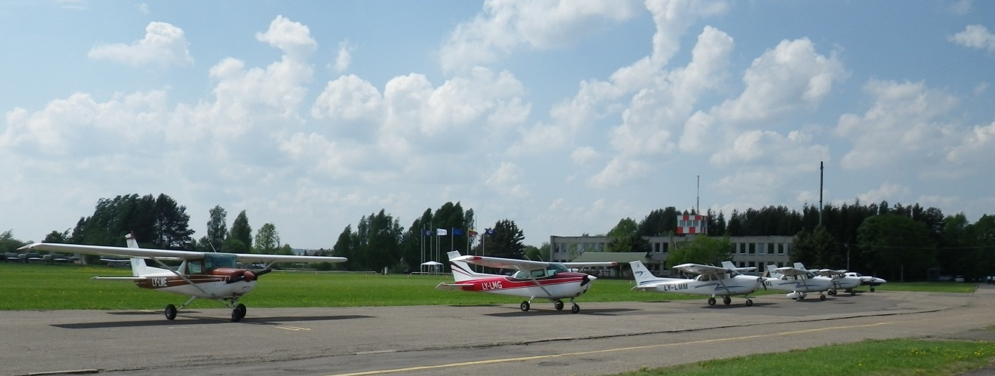
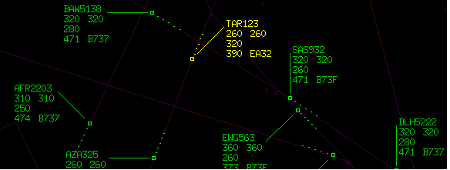
Department of Aviation Technologies
Integrated (University) Study Programmes
Aircraft Piloting
Air Traffic Control
Master Degree Programme:
Aviation Management
Main Fields of Research:
Drone technologies
Flight control technologies
Tartu 2015-11-12 “Aviation Industry Perspectives in Lithuania

Slide 20
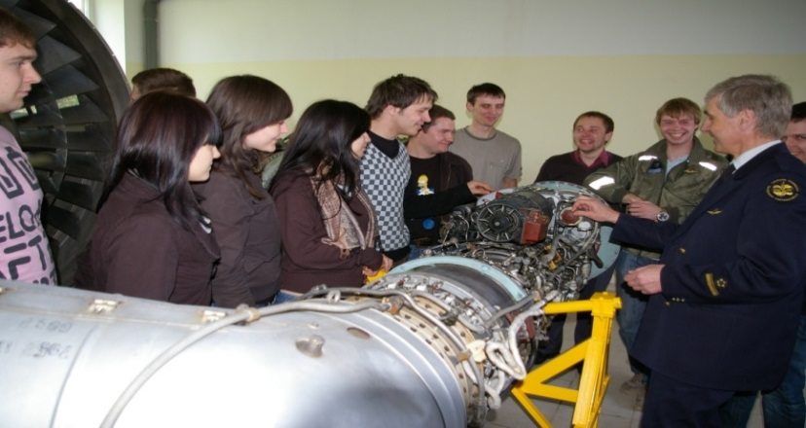
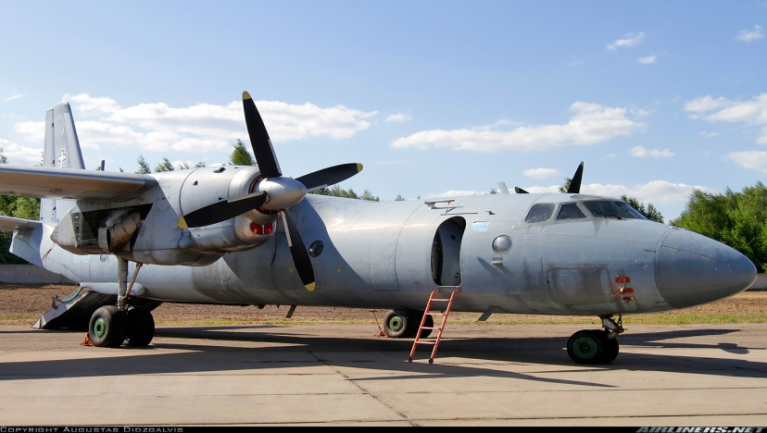
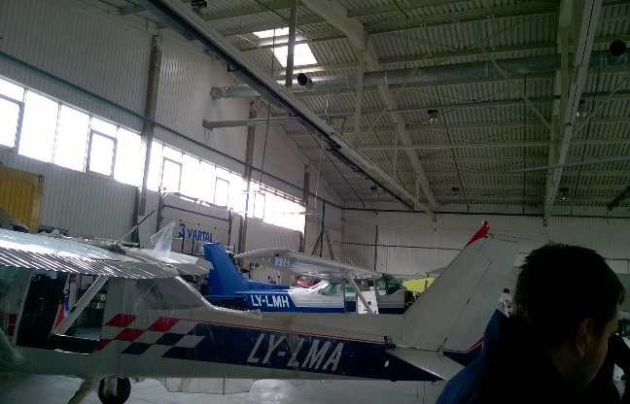
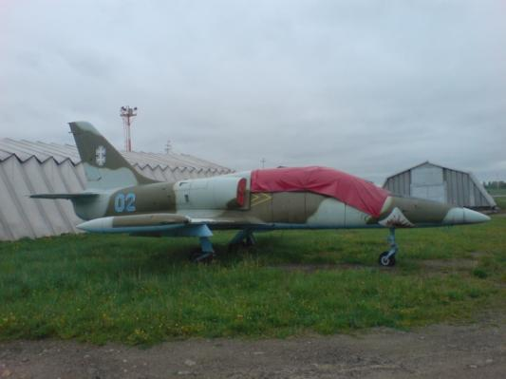
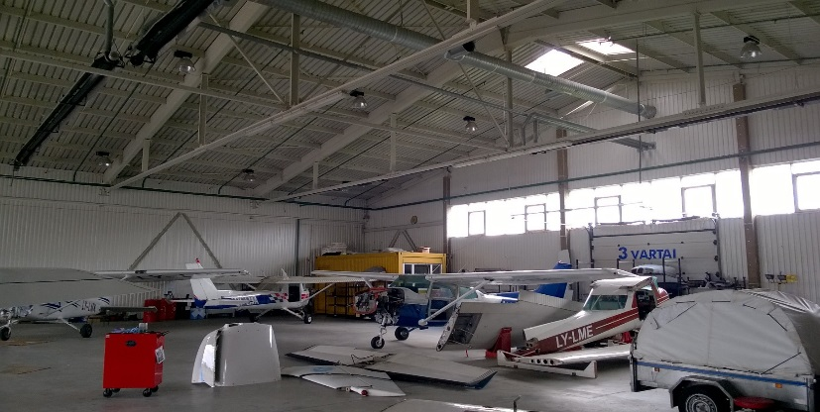
Other relevant organizations
Aircraft Maintenance Service
• Aircraft Maintenance
Aircraft Maintenance Practical Training
Aviation Engineering Practical Training Unit
Basic training courses
Recognized type training courses
Knowledge examination and practical assessment in accordance with the regulations of Part-147 and Part-66 syllabuses.
Tartu 2015-11-12 “Aviation Industry Perspectives in Lithuania

Slide 21
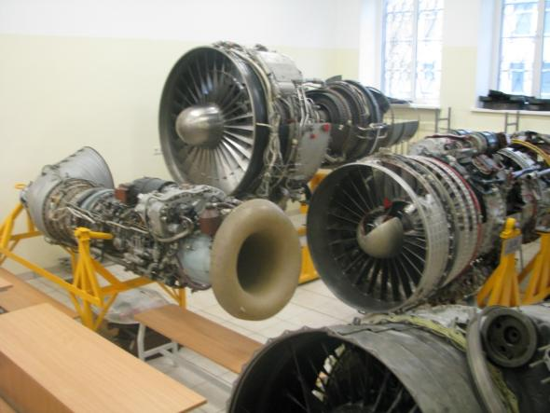
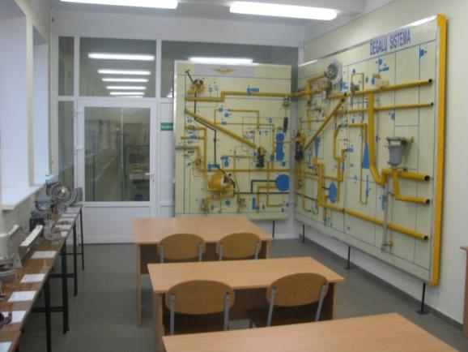

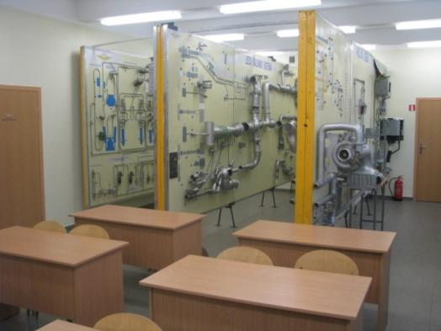
Laboratory of Aviation Mechanics
Tartu 2015-11-12 “Aviation Industry Perspective in Lithuania

Slide 22
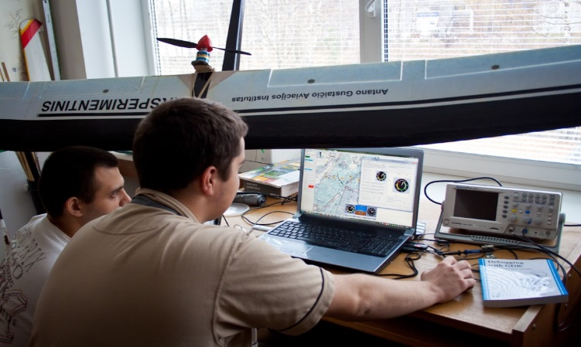
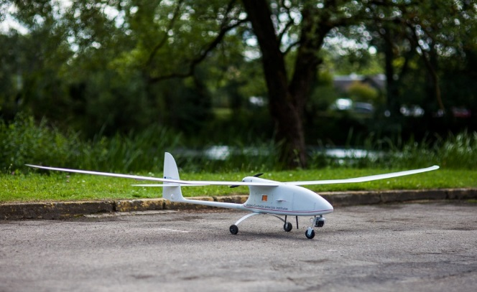
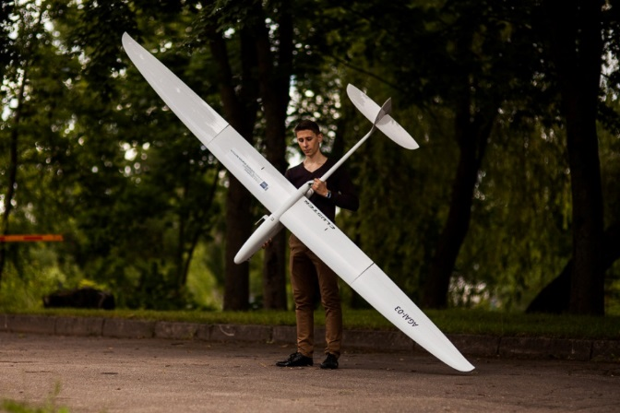
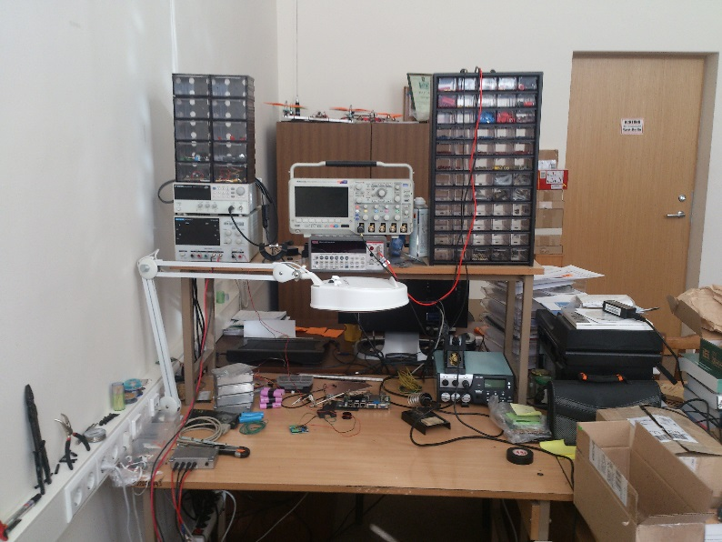

Avionics Laboratory
Tartu 2015-11-12 “Aviation Industry Perspectives in Lithuania

Slide 23
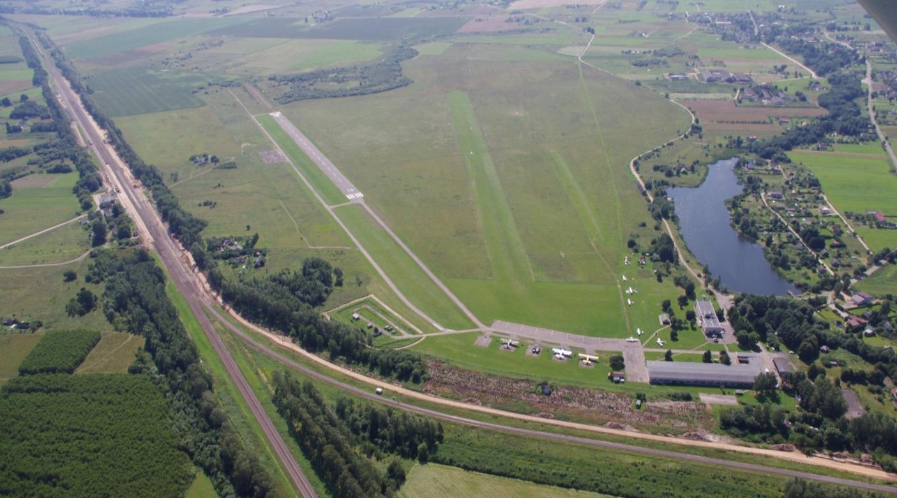
Kyviškės airfield
Tartu 2015-11-12 “Aviation Industry Perspectives in Lithuania

Slide 24
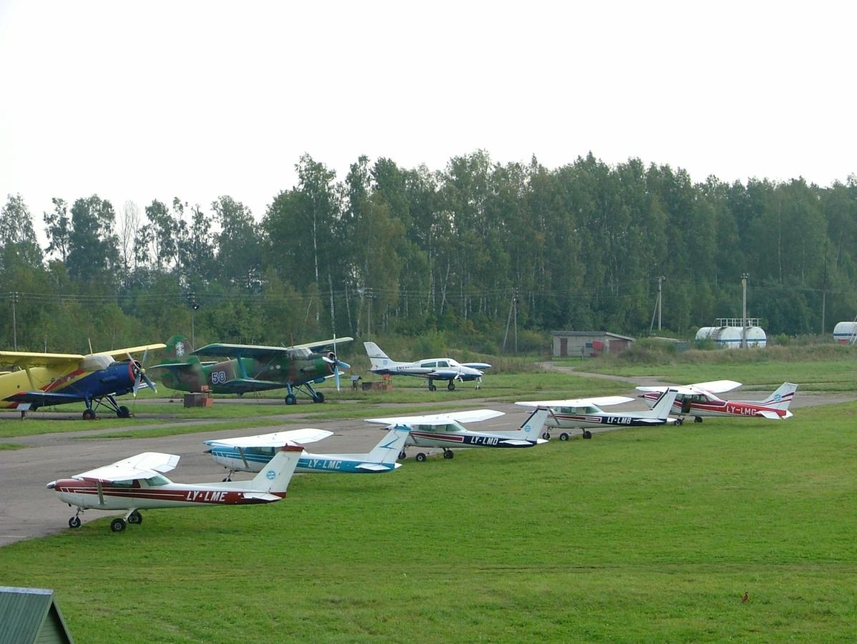
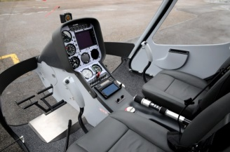
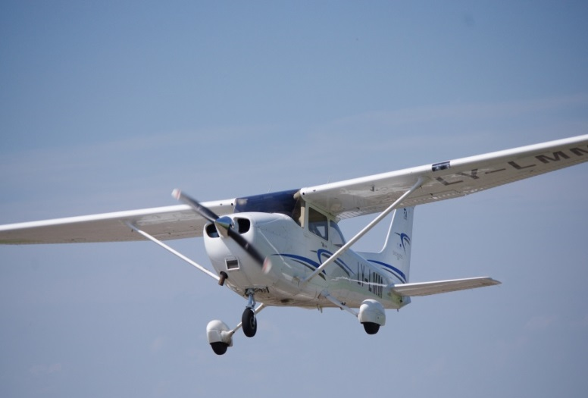
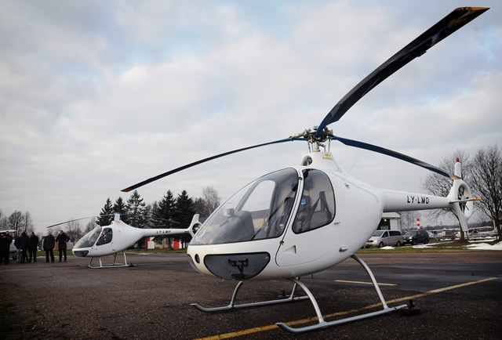
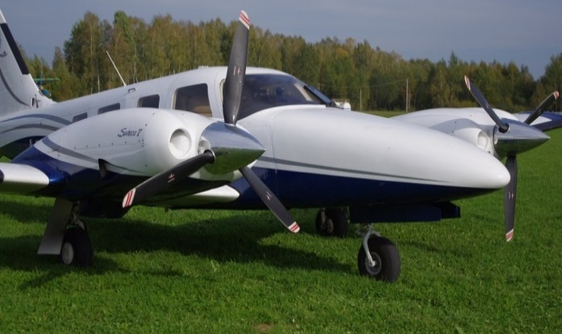
Flight Training Base
Tartu 2015-11-12 “Aviation Industry Perspectives in Lithuania

Slide 25
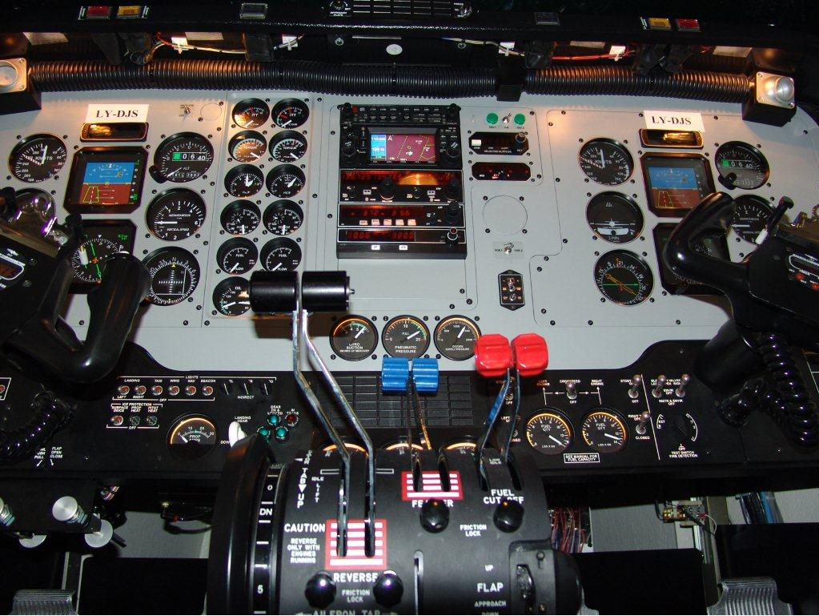
Flight Simulator FNTP II MCC
Tartu 2015-11-12 “Aviation Industry Perspectives in Lithuania

Slide 26
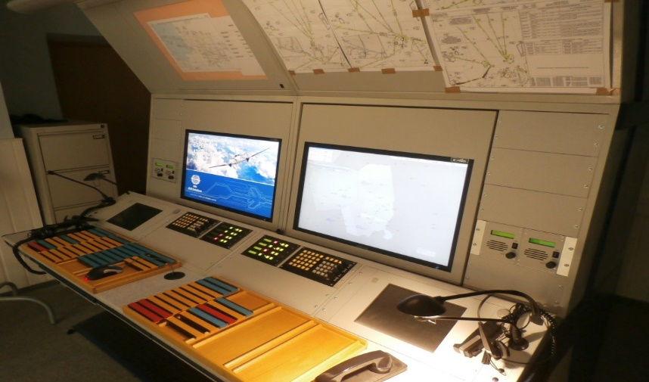
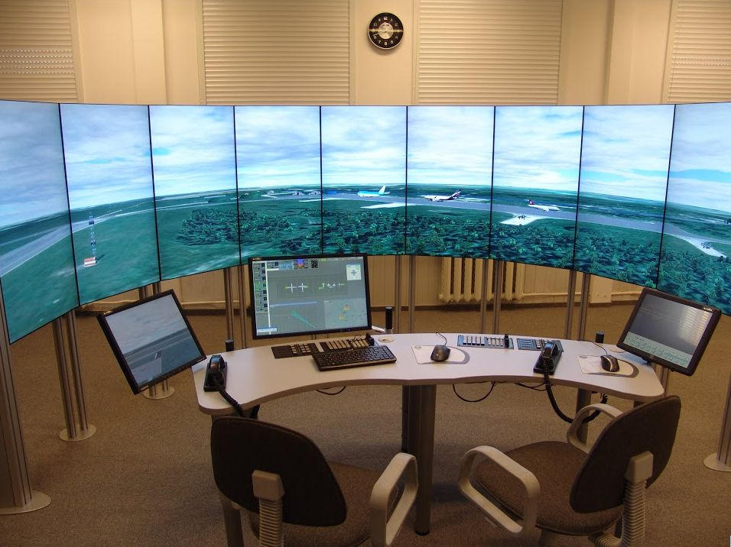
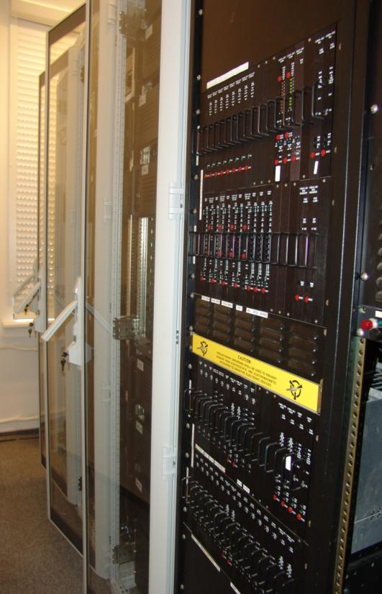
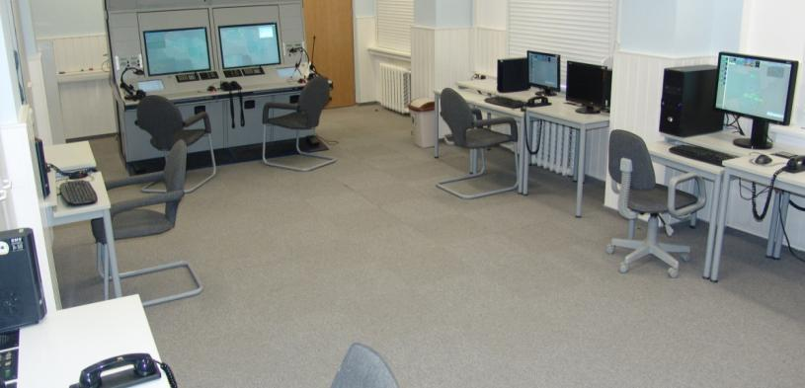
ATC Simulators
Tartu 2015-11-12 “Aviation Industry Perspectives in Lithuania

Slide 27
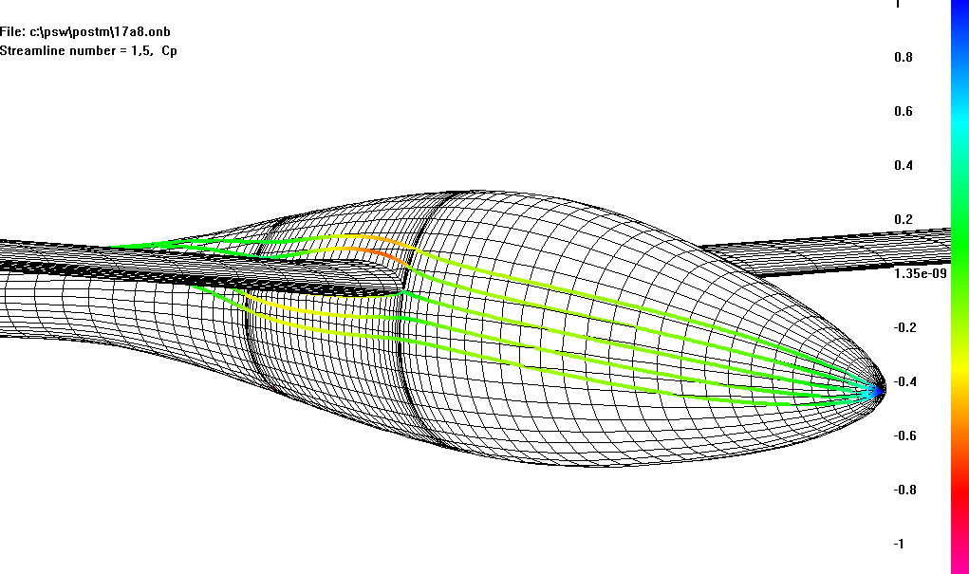
Aerodynamic design of high performance UAV
  UAV airfoils characteristics (Eppler-program, XFOIL, RFOIL, MSES)
  UAV stability and control (VLA, VLAERO)
  UAV wing and plane 3-D configuration (PSW, KK-Aero)
  Computational Fluid Dynamics (CFD) analysis (Fluent)
Tartu 2015-11-12 “Aviation Industry Perspectives in Lithuania

Slide 28
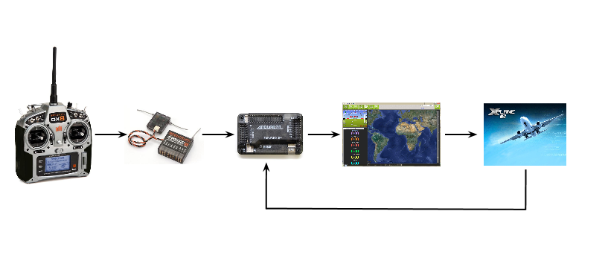
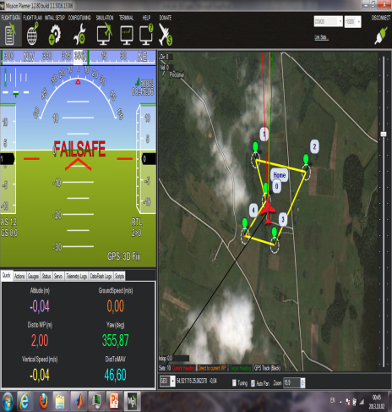
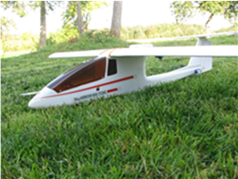



UAV control process analysis
Hardware in the loop
Design of UAV guidance and control algorithm and analysis;
Design of UAV integrated system health management methods;
UAV HIL testing;
$$x_{P}^{+}= P_{P}\left\{P_{1}^{−1}x_{1}^{+}+P_{2}^{−1}x_{2}^{+}+ ⋯+P_{N}^{−1}x_{N}^{+}\right\}$$
$$P_{P}^{−1}= P_{1}^{−1}+P_{2}^{−1}+ ⋯+ P_{N}^{−1}$$
$$S_{i}= {\left(x_{i}^{+}− x_{P}^{+}\right)}^{T}{\left(P_{i}+ P_{P}\right)}^{−1}(x_{i}^{+}−x_{P}^{+})$$
Flight tests;
Post flight analysis.
Tartu 2015-11-12 “Aviation Industry Perspectives in Lithuania

Slide 29
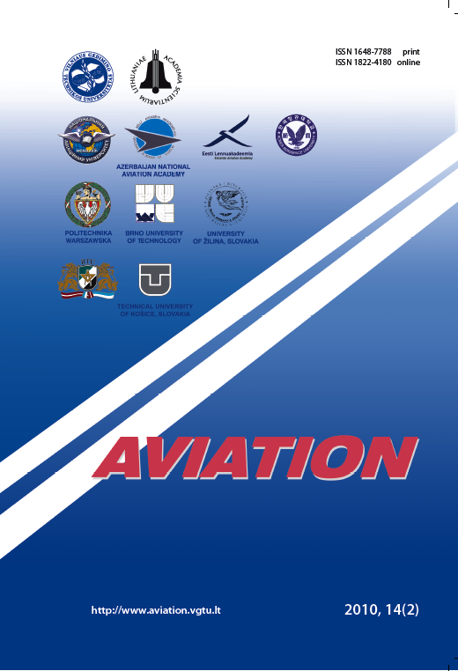
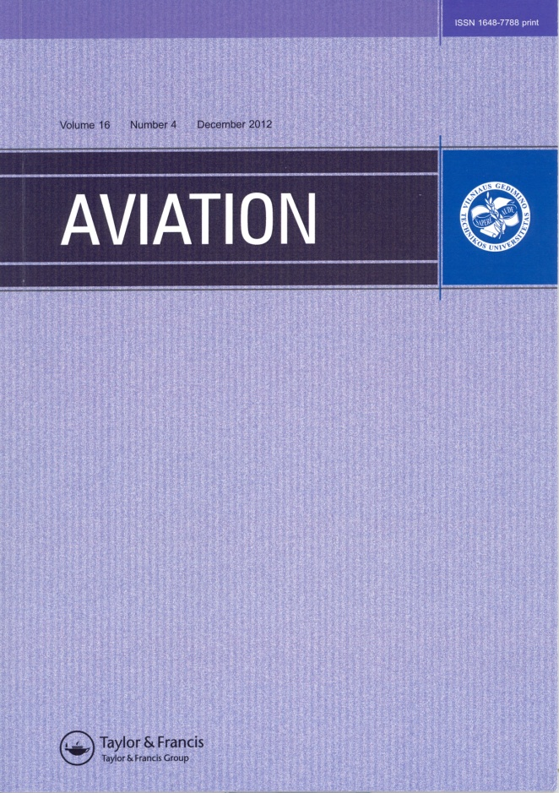
Scientific Journals
Tartu 2015-11-12 “Aviation Industry Perspectives in Lithuania

Slide 30
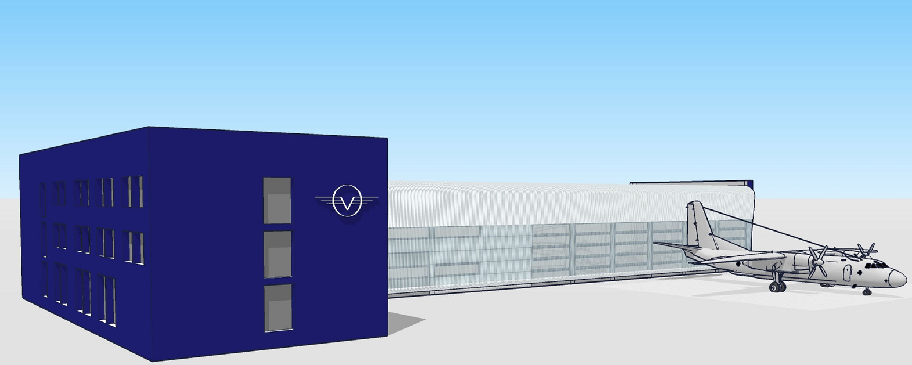
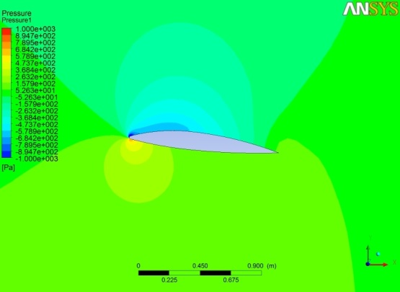





Simulator and Laboratory Facility
"Development of Aviation Specialists' Training Base: construction of Simulator and Laboratory Facility„;
Total project cost – 2,44 mln. Eur;
Project duration : 01/2013 06/2015.
2742 m² for simulators and laboratories.
Laboratorys for:
  FNTP II MCC;
  ATC;
  Avionics;
  Aviation mechanics engineering.
Tartu 2015-11-12 “Aviation Industry Perspective in Lithuania

Slide 31

Kyviškės airfield reconstruction project
Tartu 2015-11-12 “Aviation Industry Perspectives in Lithuania

Slide 32








Licenses
Tartu 2015-11-12 “Aviation Industry Perspectives in Lithuania

Slide 33
Audits
2006 - the first JAA audit;
2010-03-02 – EASA audit for FTO;
2014-09-14 – EASA audit for ATC;
2015-11-25 – EASA audit for FSTD.
Tartu 2015-11-12 “Aviation Industry Perspectives in Lithuania

Slide 34
Scientific Journals
Tartu 2015-11-12 “Aviation Industry Perspectives in Lithuania

Slide 35

Questions ?
Rodūnios kelias 30, Vilnius
http://agai.vgtu.lt

